Slide 1


Optical Device Design Based on Automatic Differentiation Programming
汇报人：高博 何家阳

Slide 2
Contents
Background
Related Work
System Design
Evaluation
Conclusion and Future Work
1

Slide 3
Backgroud
Advancements in modern optical systems and devices have significantly propelled developments across various fields
Telecommunications, biosensing, energy-saving
Traditional design paradigm of optical devices faces challenges.
Demand for smaller, more efficient, and more powerful optical components
Computational resources and efficiency
2

Slide 4
Backgroud
Inverse Design
Deep Learning
Automatic Differentiation (AD)
Compute the gradients of the objective function with respect to all the design parameters
3

Slide 5
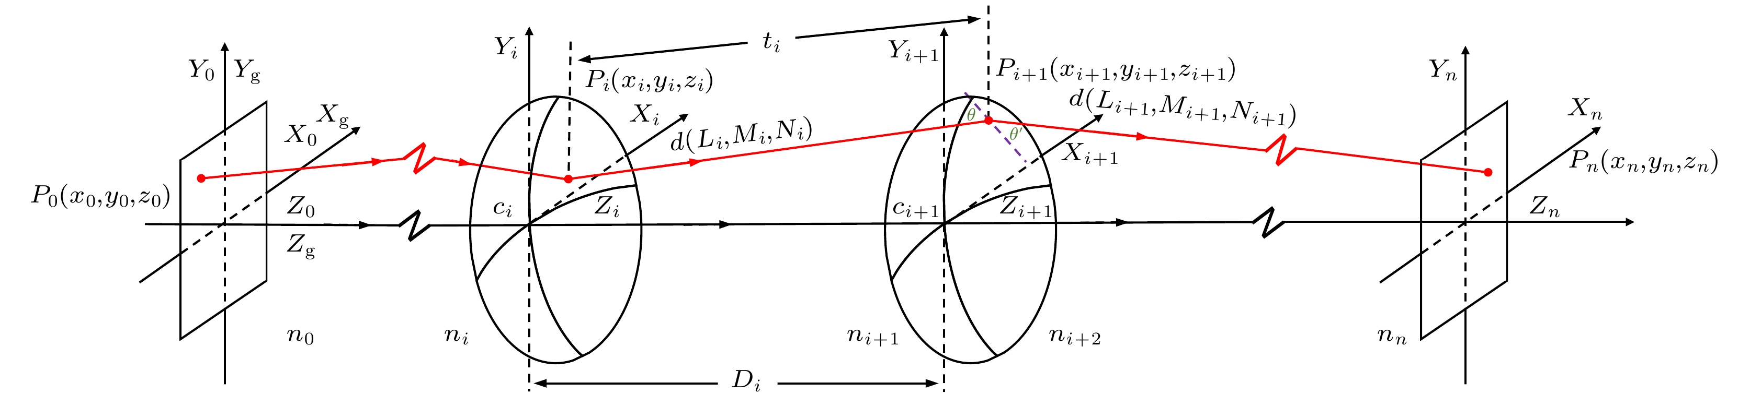
Related Work
Ray-tracing
Based on geometric optics
Excellent performance in lens components and illumination systems
Difficulties in capturing wave phenomena
[1] Wu Chang-Mao, Tang Xiong-Xin, Xia Yuan-Yuan, Yang Han-Xiang, and Xu Fan-Jiang. High precision ray tracing method for space camera in optical design. ACTA PHYSICA SINICA, 72(8), 2023.
4

Slide 6
Related Work
Full-wave simulation techniques
Numerically solving Maxwell’s equations
Accurate simulation of nanophotonic devices
Unable to provide guidance on how to modify the device
Manual adjustment, heavily dependent on the experience of the engineer
[2] K.S. Yee and J.S. Chen. The finite-difference time-domain (fdtd) and the finite-volume time-domain (fvtd) methods in solving maxwell’s equations. IEEE Transactions on Antennas and Propagation, 45(3):354–363, 1997.
5

Slide 7
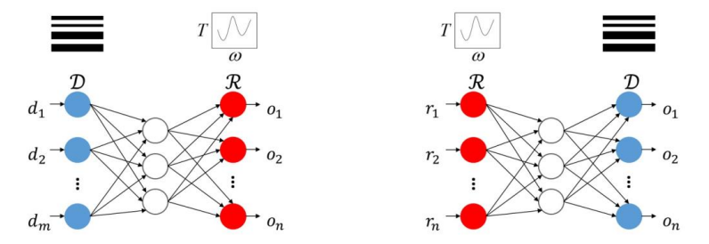
Related Work
Neural network
End-to-end machine learning approach
High accuracy
Poor interpretability
[3] Dianjing Liu, Yixuan Tan, Erfan Khoram, and Zongfu Yu. Training deep neural networks for the inverse design of nanophotonic structures. ACS Photonics, 5(4):1365–1369, Apr 2018.
6

Slide 8
System Design
We target at a novel paradigm for optical device design
High accuracy
Automatic design
Maintain interpretability
Low computational resource requirements
7

Slide 9
System Design
Optical device Design based on automatic Differentiation Programming
Julia
Spatial discretization
Forward simulation
Back propagation
8

Slide 10
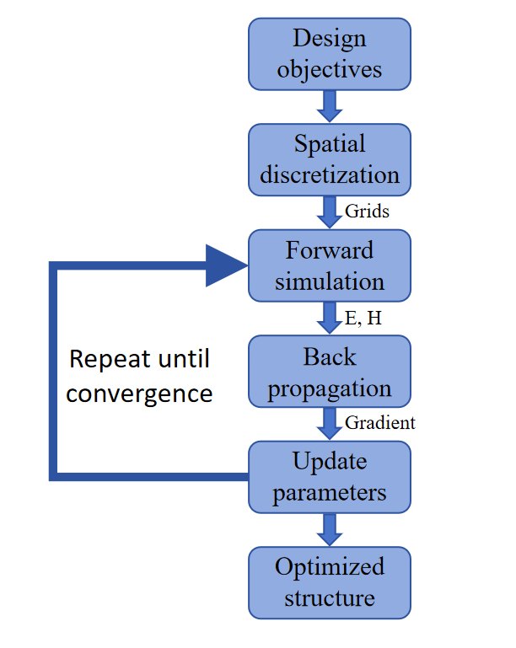
System Design
System Workflow
Spatial discretization
Forward simulation
Back propagation
9

Slide 11

Evaluation
Based on inverse design simulation with Julia
Evaluation of optical conponents
Demultiplexer
Symmetric crossing
1x2 splitter
MMI 1x2 splitter
Design objectives, key parameters, optimization performance, efficiency.
10

Slide 12
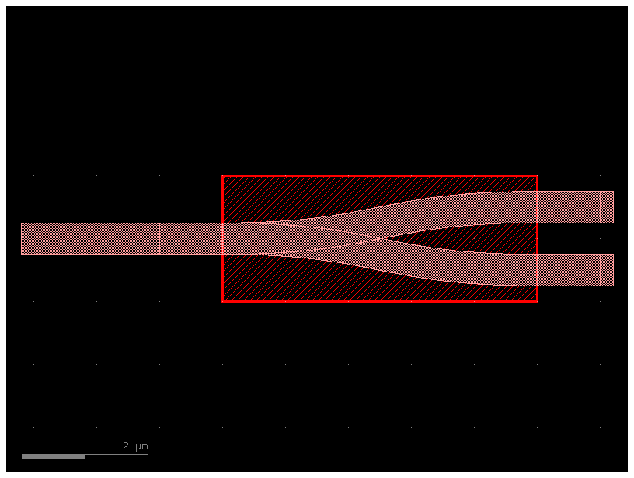
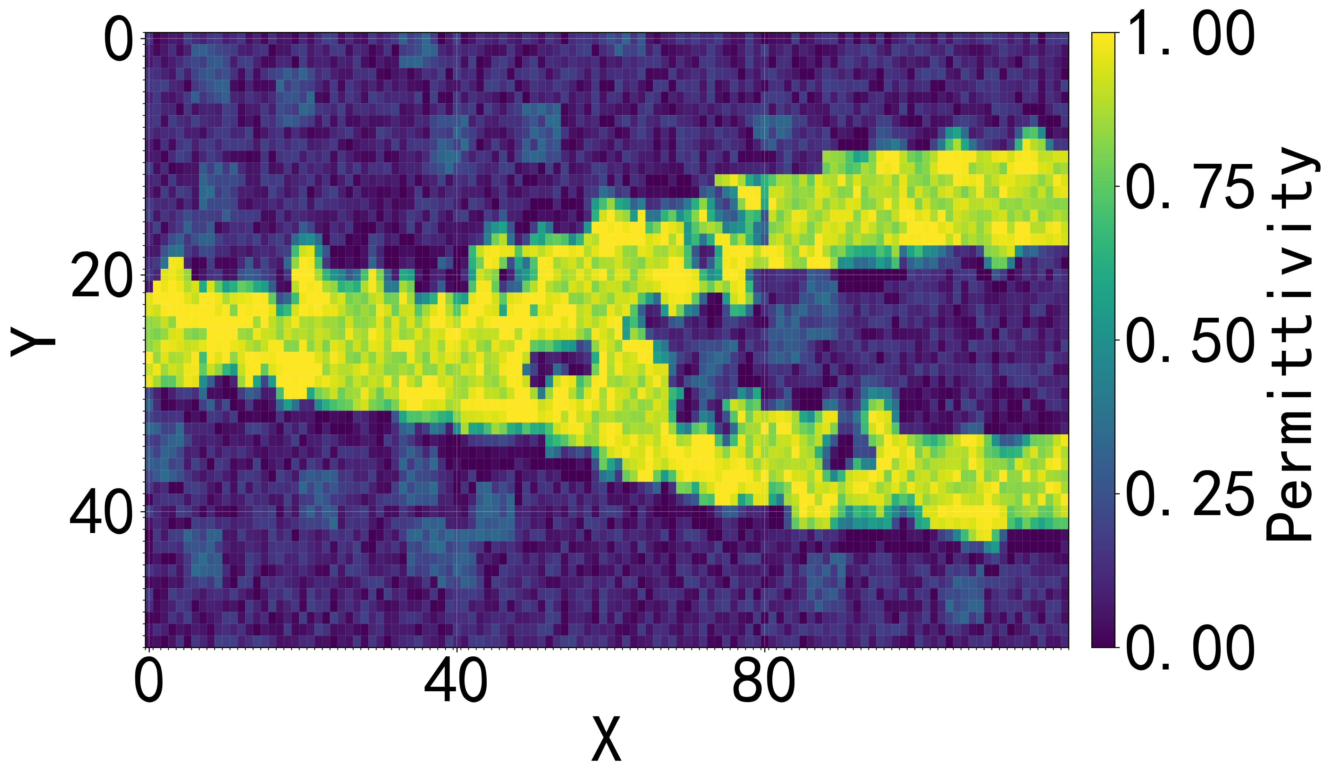
1)Demultiplexer
The demultiplexer separates distinct optical signals in wavelength division multiplexing systems based on their different wavelengths.
Frame Design Simulated permittivity
11

Slide 13
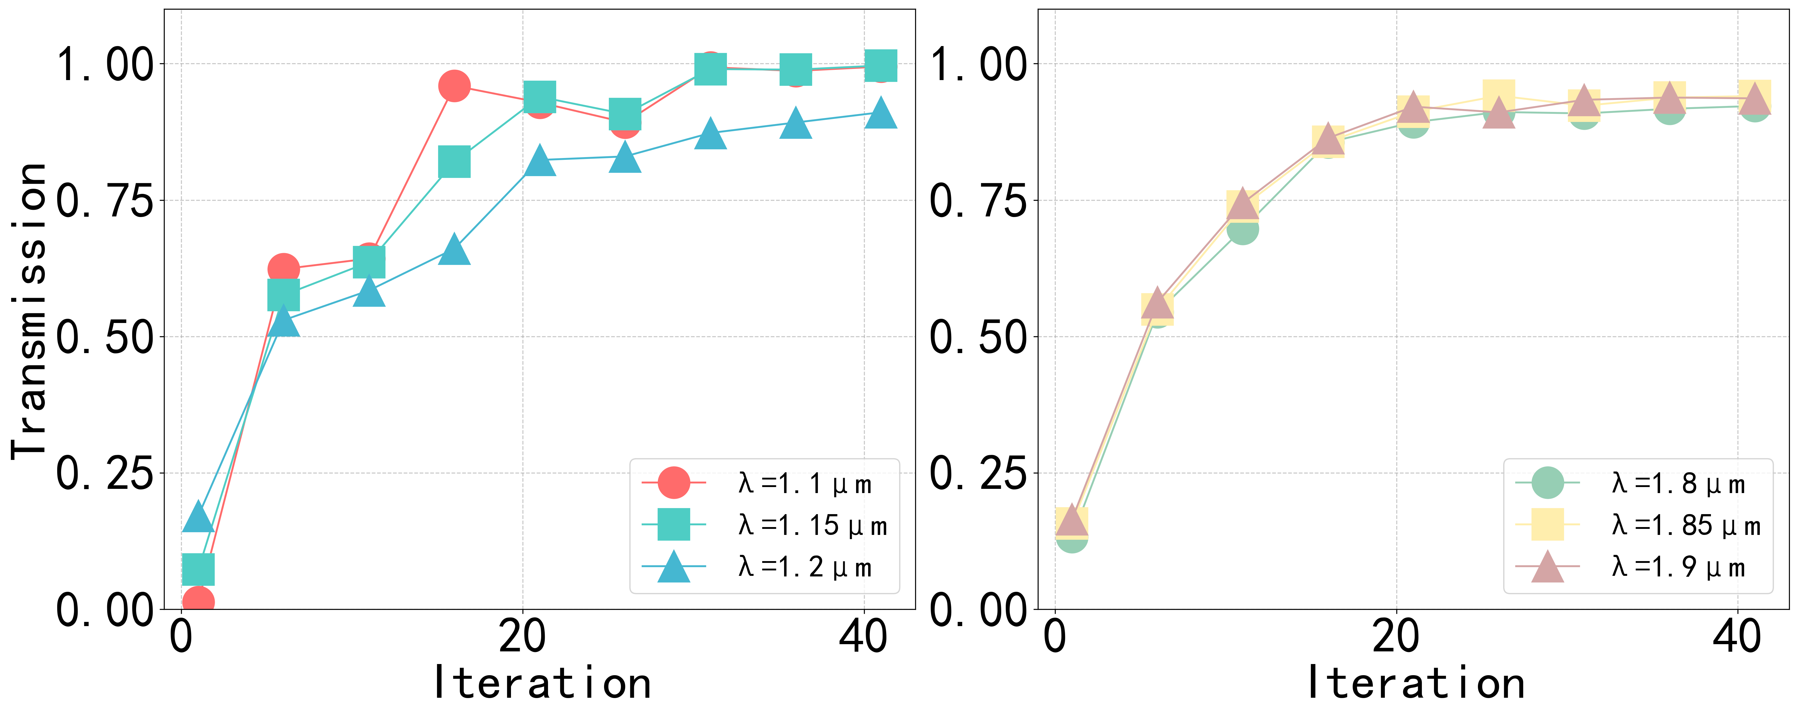
1)Demultiplexer
Target: 1.1-1.2 μm (Port 2) & 1.8-1.9 μm (Port 3)。
Parameters:
1.Size: 5.0 μm x 2.0 μm
2.Waveguide width: 0.5 μm
3.Internal core of 0.22 μm silicon, outer layer of SiO2 cladding(包层)
4.Minimum Feature: 0.2 μm
O2 port
O3 port
Optimizing target setting
T(o2,o1)=1 , T(o3,o1) = 1
Optimizing Results:
T(o2,o1) ~0.99, T(o3,o1) ~0.94
41 iterations, ~123 min
Optimization Results
12

Slide 14
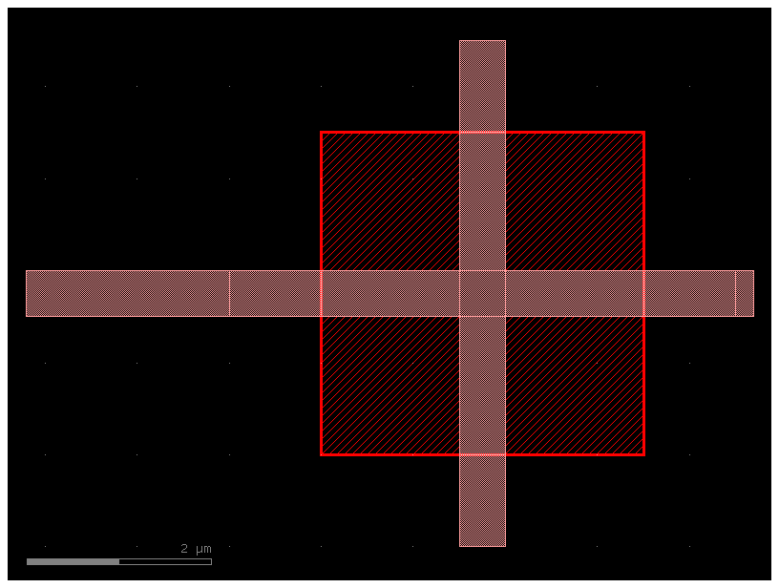
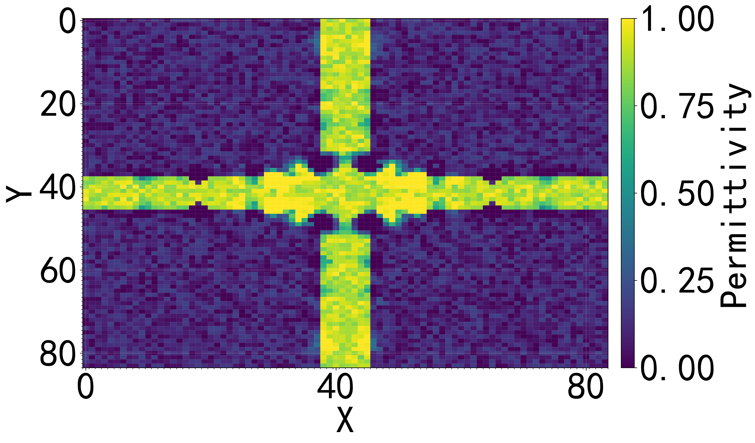
2)Symmetric Crossing
Enables efficient, low-crosstalk, and low-loss Transmission in photonic integrated circuits.
Frame Design Simulated permittivity

Slide 15
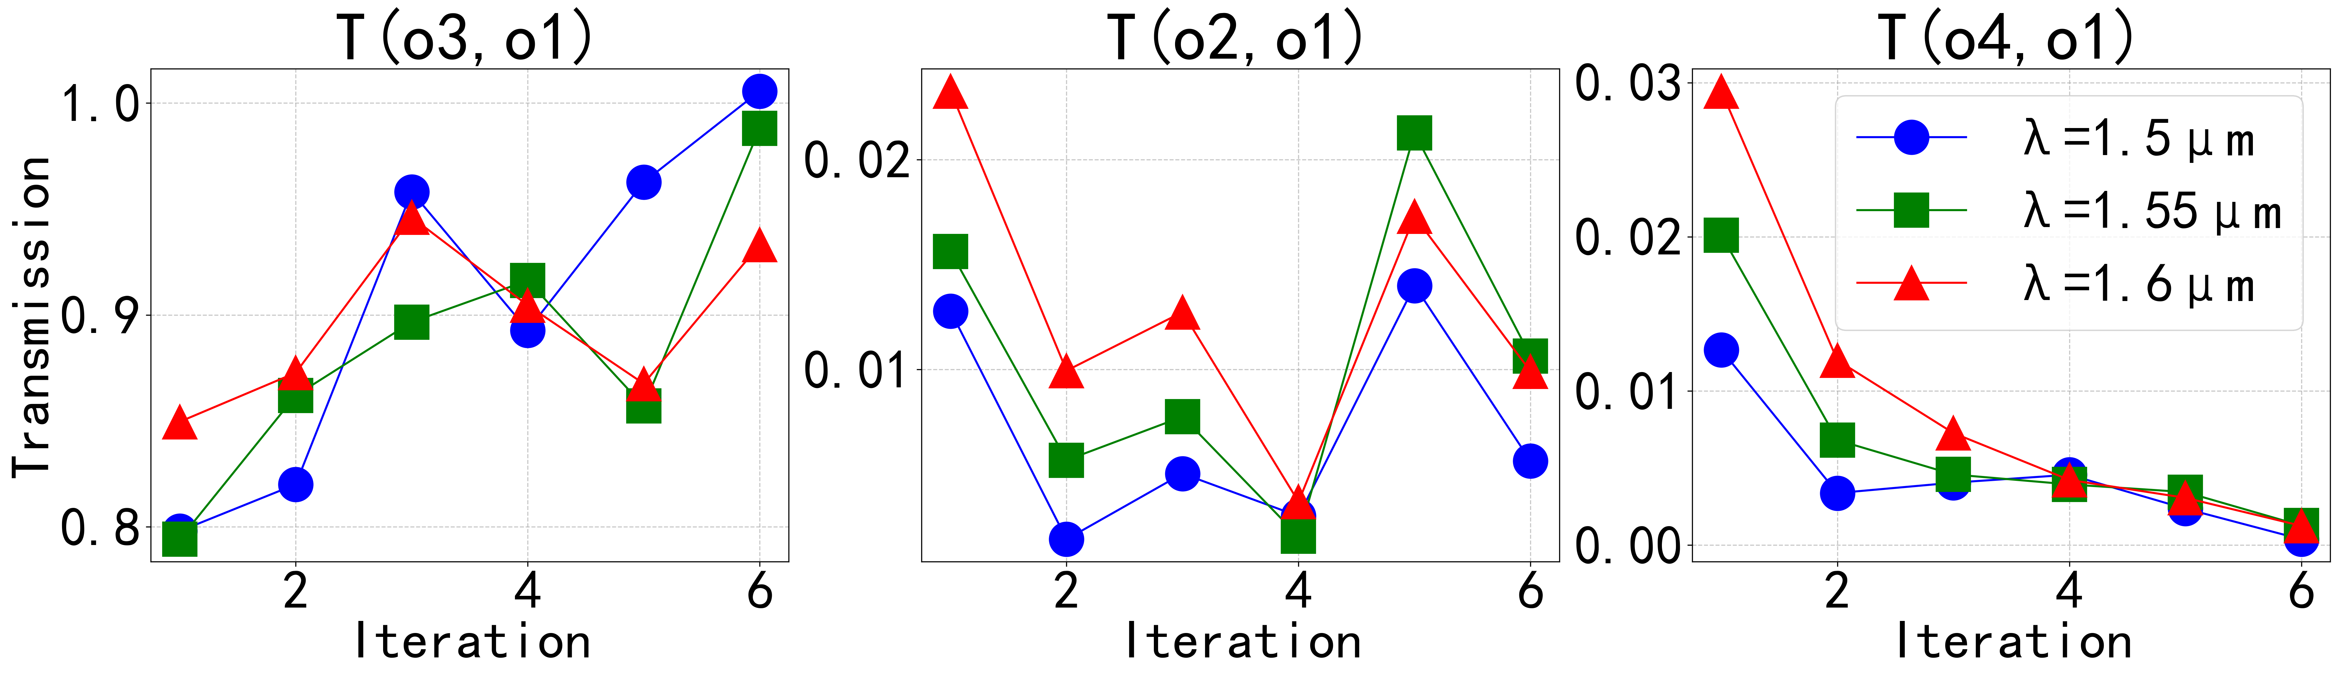
2)Crossing
Parameters:
1.Size: 3.5 μm x 3.5 μm
2.Waveguide width: 0.5 μm
3.Internal core of 0.22 μm silicon, outer layer of SiO2 cladding(
4.Minimum Feature: 0.2 μm
Optimizing target setting:
T(o3,o1)=1 , T(o2,o1) = T(o4,o1) = 0
Optimizing Results:
Crosstalk is less than 0.01141 .
6 iterations,~68 min

Slide 16
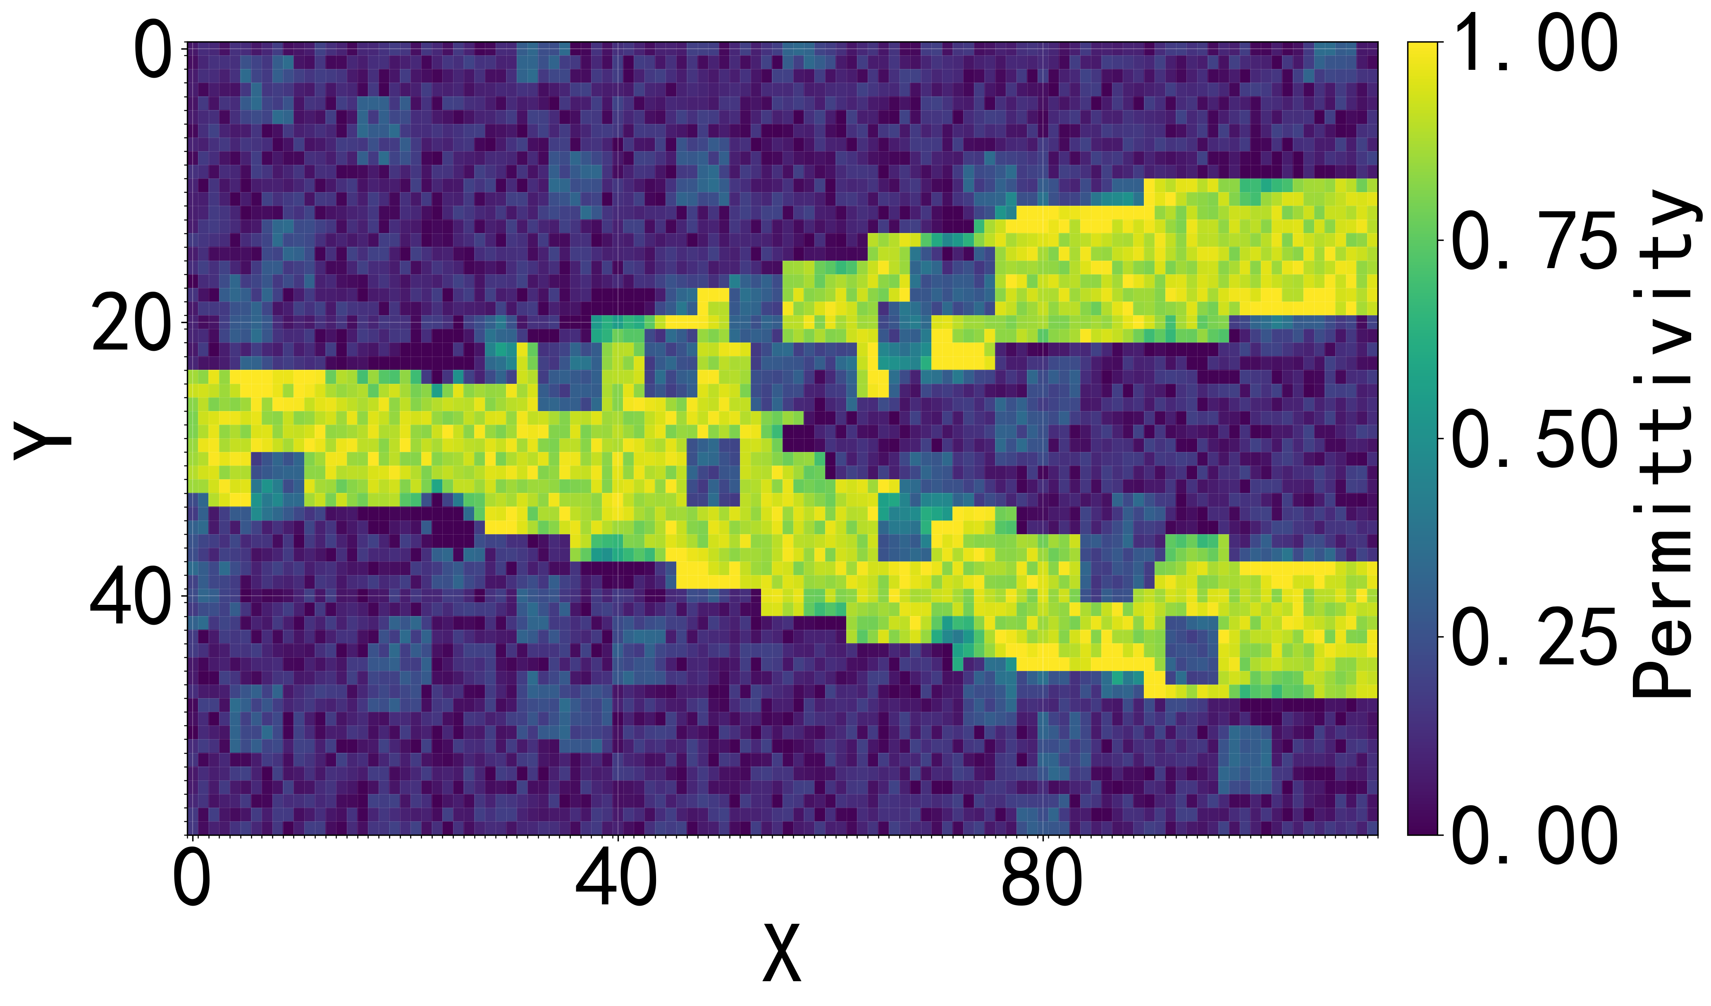
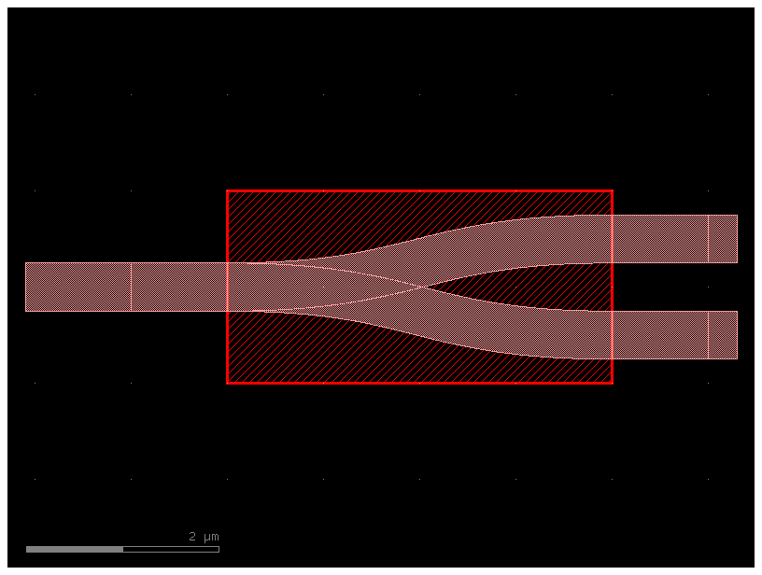
3)1x2 Splitter
The splitter divides an incoming optical signal into two or more output signals.
Frame Design Simulated permittivity
15

Slide 17
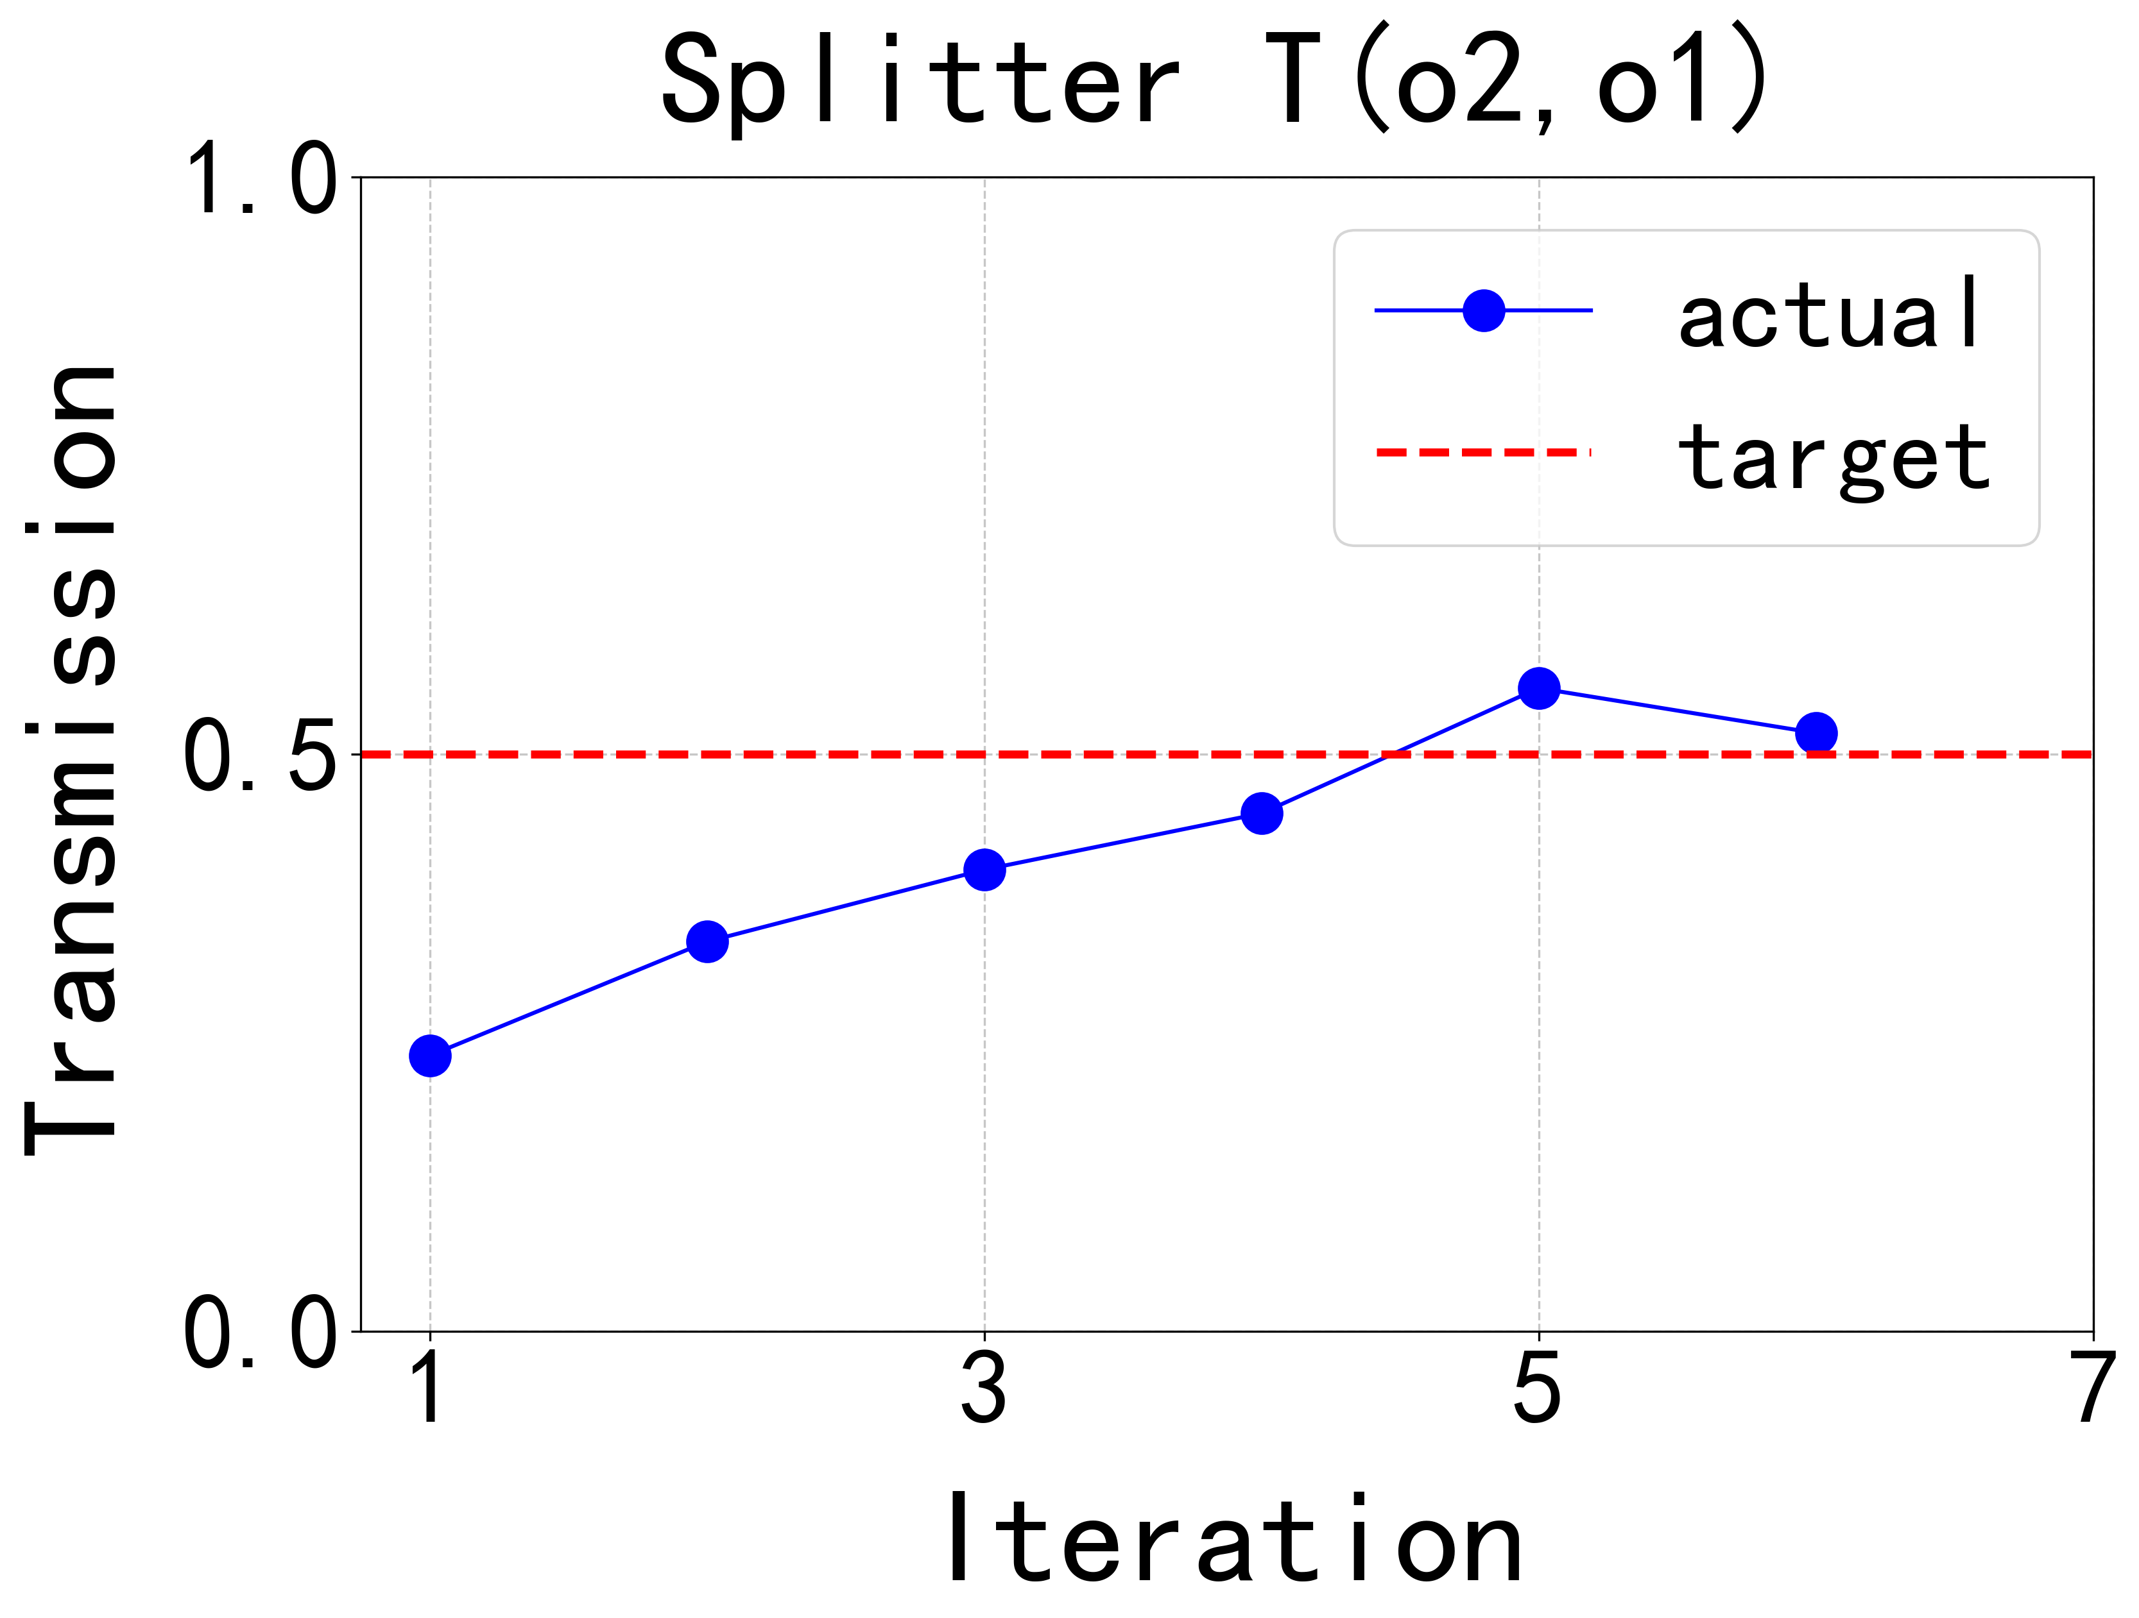
3)1x2 Splitter
Parameters:
1.Size: 4.0 μm x 2.0 μm
2.Waveguide width: 0.5 μm
3.Internal core of 0.22 μm silicon, outer layer of SiO2 cladding
4.Minimum Feature: 0.15 μm
5.using a 1.55 μm wavelength beam
Optimizing target setting:
(Including y-symmetry)
T(o2,o1) = T(o3,o1) =0.5
Optimizing Results:
T(o2, o1) = 0.518
6 iterations,~24 min
Optimization Results
16

Slide 18
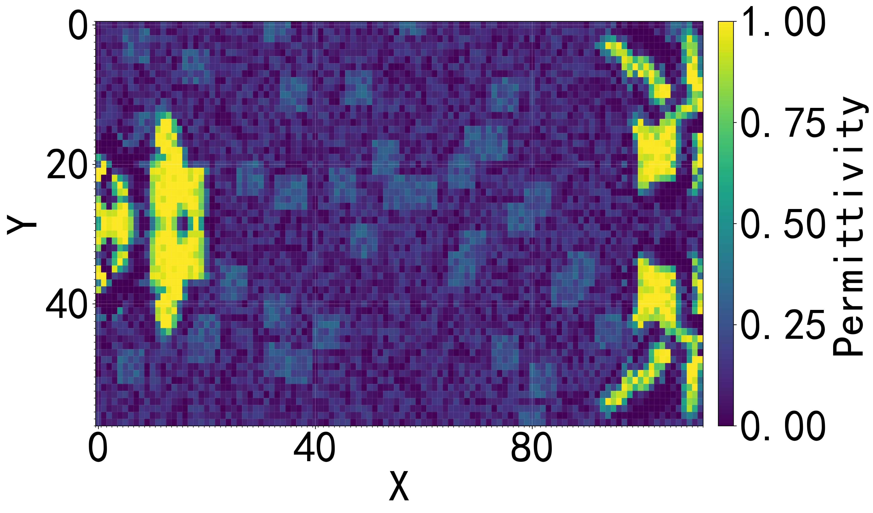
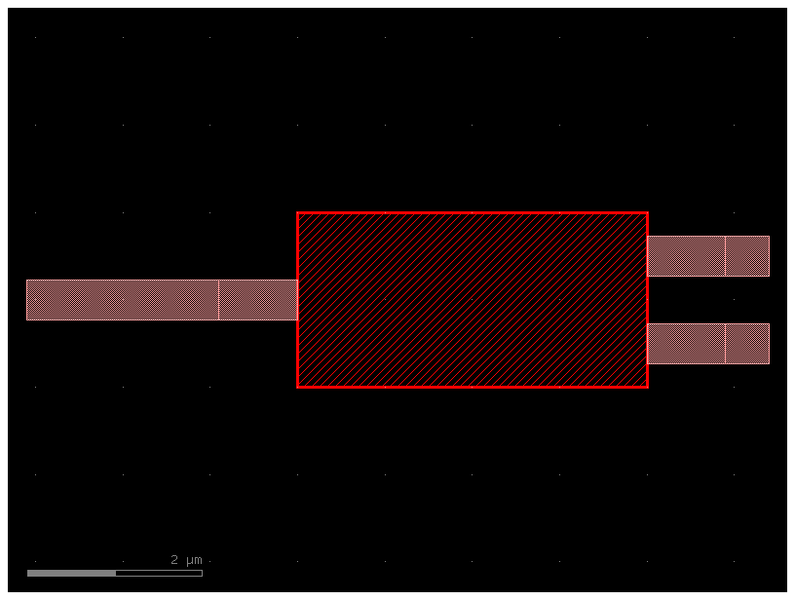
4)MMI 1x2 Splitter
A multi-mode interference (MMI) splitter divides an incoming optical signal into multiple output signals by utilizing the interference effects of different modes within a multi-mode waveguide.
Frame Design Simulated permittivity

Slide 19
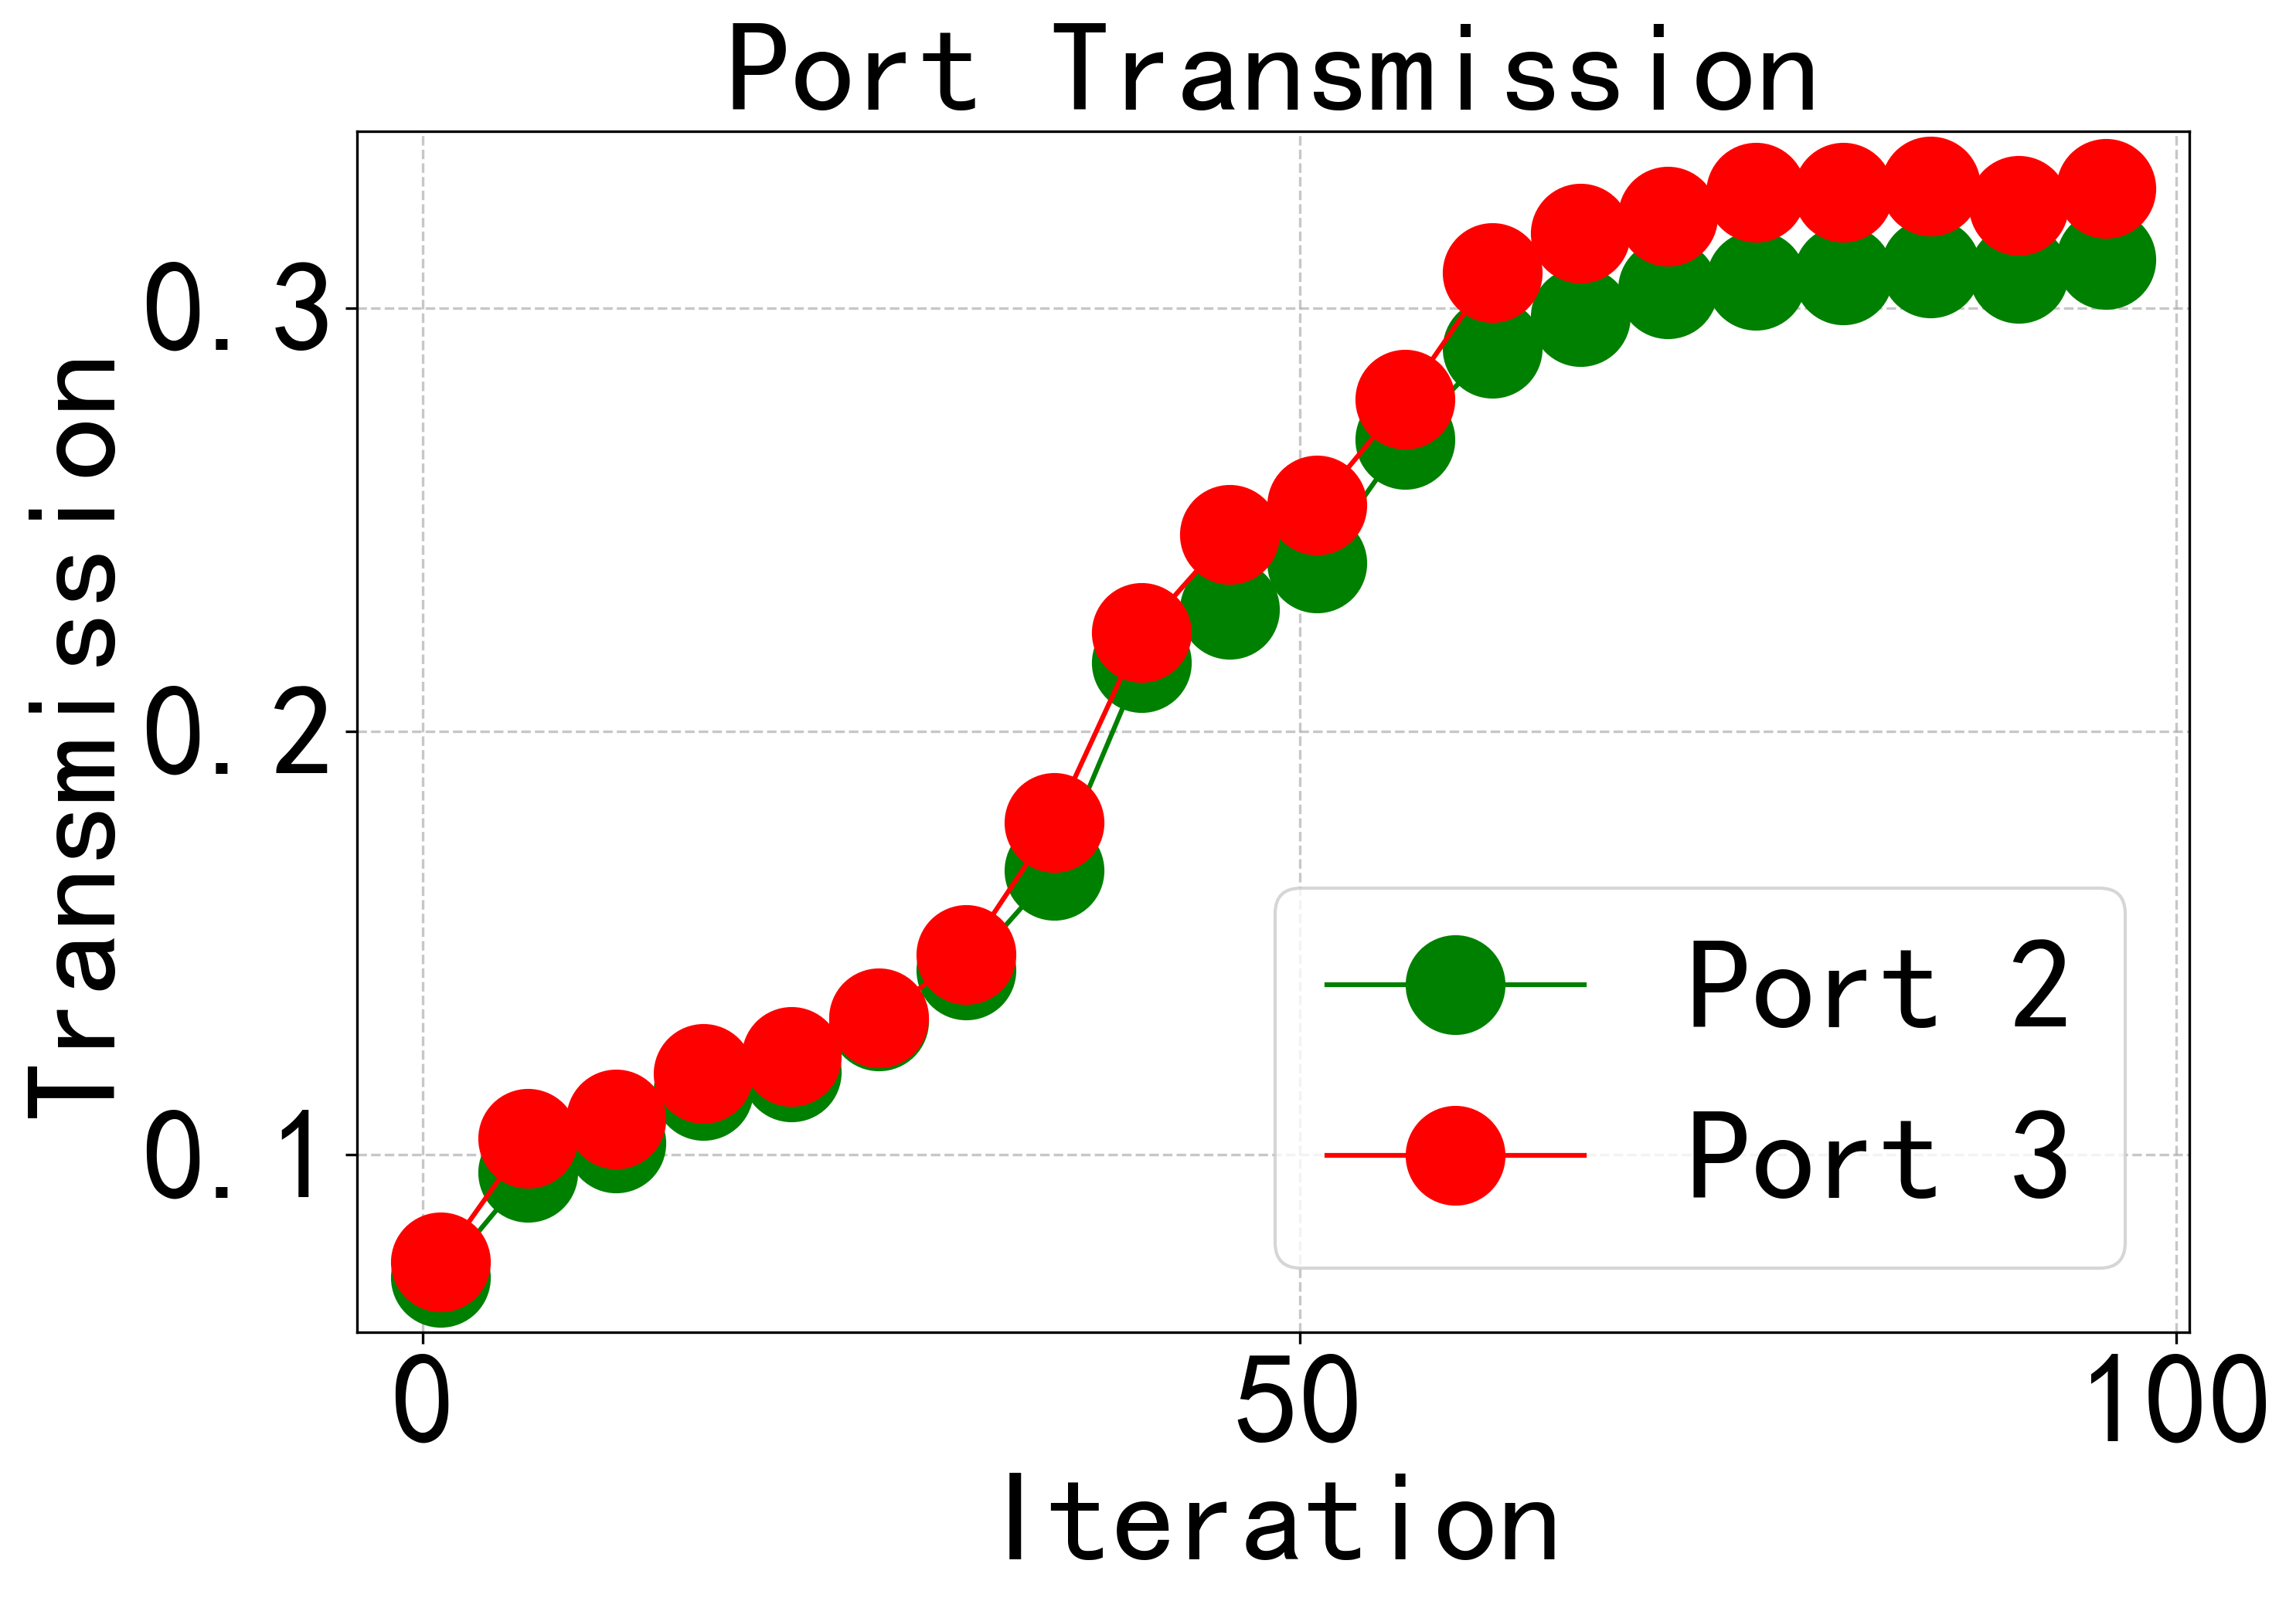
4)MMI 1x2 Splitter
Parameters:
1.Size: 4.0 μm x 2.0 μm
2.Waveguide width: 0.45 μm
3.Internal core of 0.22 μm silicon, outer layer of SiO2 cladding
4.Minimum Feature: 0.15 μm
5.using a 1.55 μm wavelength beam
Optimizing target setting:
(Including y-symmetry)
T(o2,o1) = T(o3,o1) =0.5
Optimizing Results:
T(o2, o1) = 0.311
T(o3, o1) = 0.328(optimization is required)
96 iterations,~143 min
Optimization Results

Slide 20
Conclusion and Future Work
Julia AD + adjoint optimization = efficient inverse design of integrated optical components.
Julia's native AD significantly accelerates gradient computation, enabling faster design.
Traditional optical design software such as Lumerical FDTD runs slowly on CPUs due to complex gradient calculations.
All designed devices are high-performance, except for MMI.
19

Slide 21
Conclusion and Future Work
GPU Acceleration
Optimize the parameters of design components
Design of more complex components
20

Slide 22
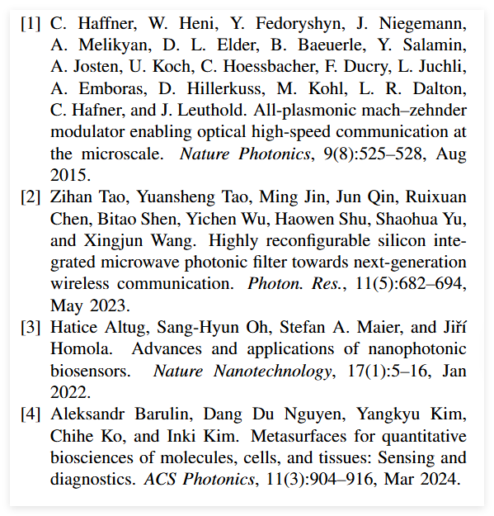
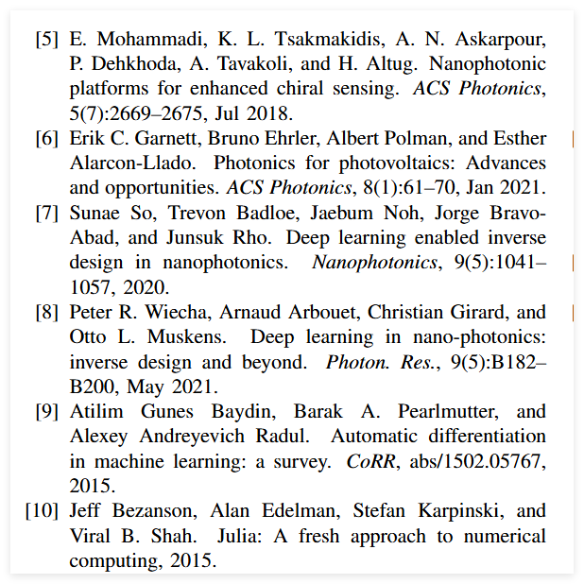
Reference

Slide 23
谢谢！

