Slide 1
Introduction to Algorithms
慈濟大學
醫學資訊學系

Slide 2
HomeWork- Greedy Algorithms
Given a connected and undirected graph G using the adjacency matrix representation. Write a program to find a minimum-spanning tree of G by using
(a) Kruskal’s Algorithm
(b) Prim’s Algorithm
(Need to output your selected edges and total weight; 30%*2)
Analyze and compare the time complexities of your algorithms (40%)

Slide 3
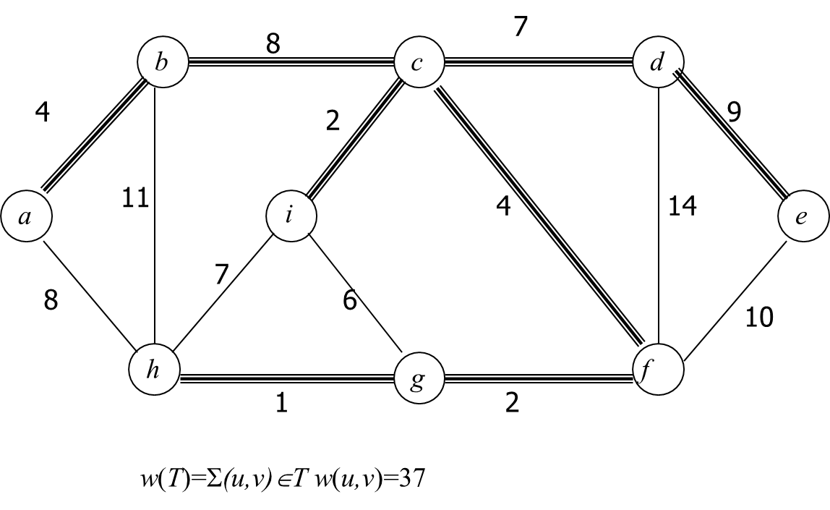
Example

