Slide 1
Data Structure
CHAPTER 6
GRAPHS

Slide 2
HomeWorks-6-2
Given a graph G using the adjacency matrix representation. Write a program which has the following functions.
(1) transfer into an adjacency lists representation of G (25%)
(2) output depth first search; (35%)
(3) output breadth first search (35%)

Slide 3
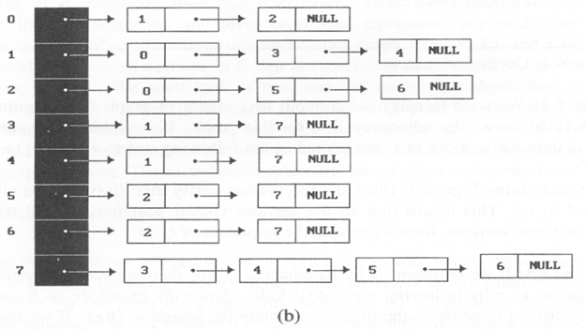
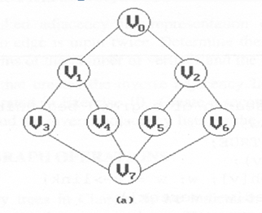
Example
depth first search: v₀, v₁, v₃, v₇, v₄, v₅, v₂, v₆
breadth first search: v₀, v₁, v₂, v₃, v₄, v₅, v₆, v₇

