Slide 1
Data Structure
CHAPTER 6
GRAPHS

Slide 2
HomeWorks-6-3
Given a connected and undirected graph G using the adjacency matrix representation. Write a program to find a minimum-spanning tree of G by using
(a) Kruskal’s Algorithm
(b) Prim’s Algorithm
(Need to output your selected edges and total weight;答對一題50%;二題95%)

Slide 3
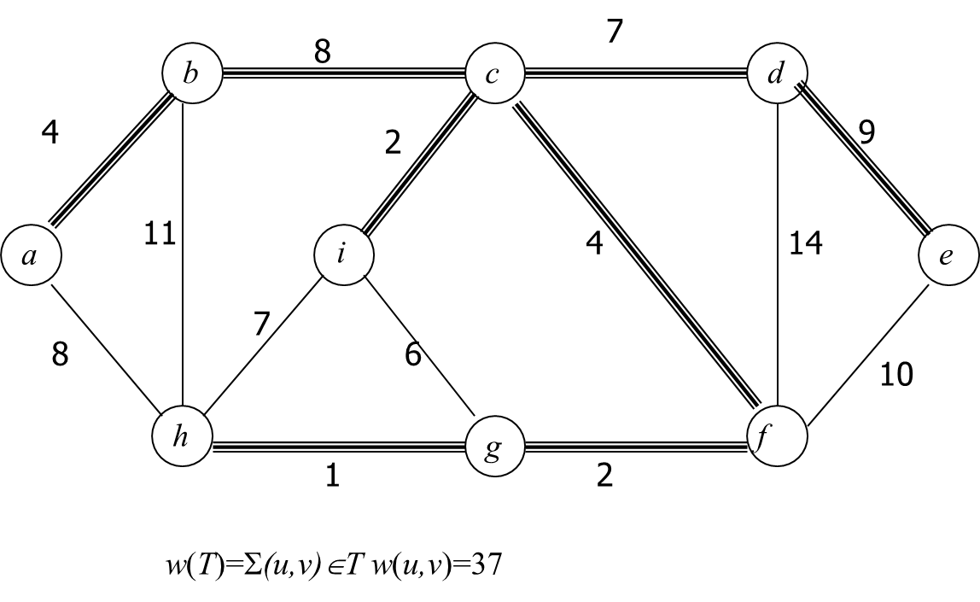
Example

