Slide 1
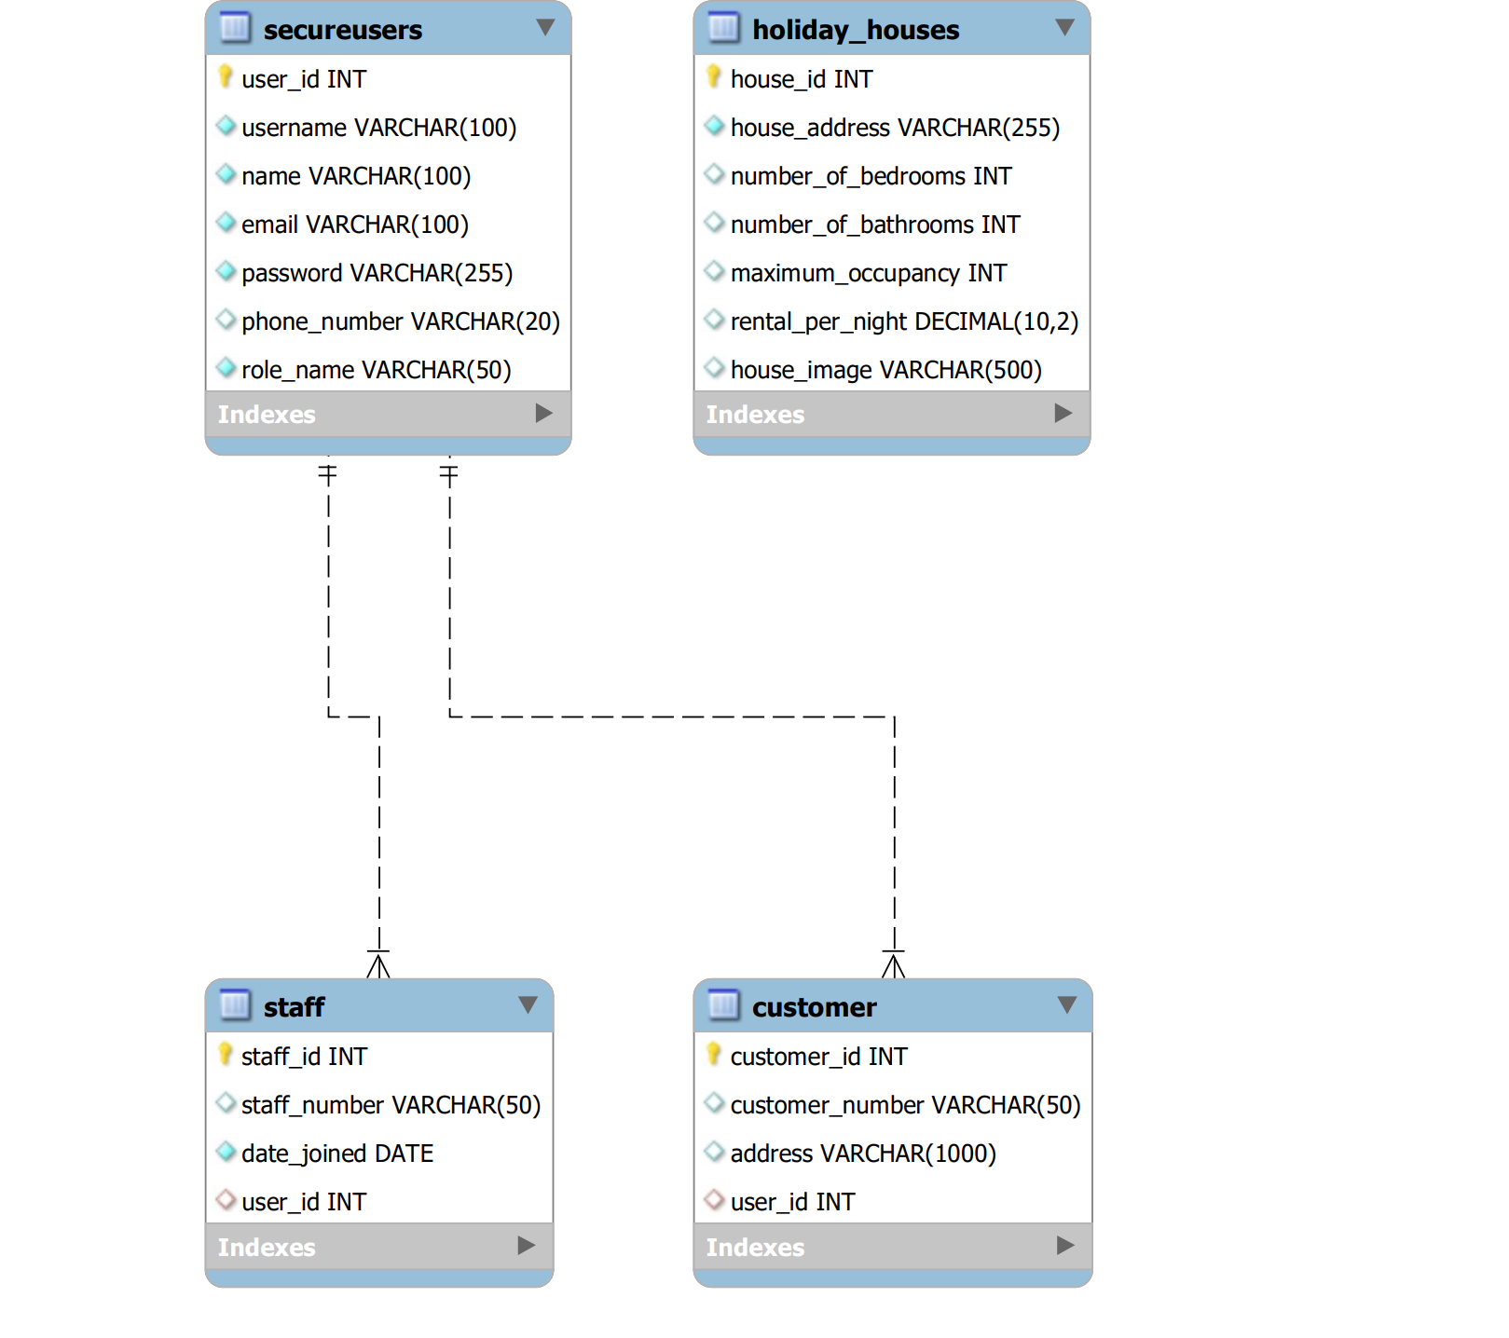

Slide 2
Routes
Function
Redirect users to role-specific home pages or to login if not logged in.
HTML Template
/
main()
Home.html
Staffhome.html
Login.html
/login/
login()
Authenticates users and directs them to role-based home pages
Database connection
houses_sys.sql
/logout
logout()
Cleans session data to log out the user and redirects to the login page.
Login.html
/register
register( )
connect.py
register.html
/home
home()
Customer registrations
/staffhome
Staffhome( )
Displays the home page (view house information)
home.html
/add_house
add_house
( )
Displays the staff home page (view, edit and delete house information)
staffhome.html
Staffhome-add.html
staffhome-edit.html
/edit_house
edit_house()
Web application
/delete_house
delete_house()
Main.py
/profile
Profile()
Displays the personal profile, update profile and update password
profile.html
updateprofile.html
Updateprofile-password.html
/updateprofile
Updateprofile()
/updateprofile-password
updateprofile-password()
/viewcustomer
Viewcustomer()
If logged in as the staff (do not include admin), it shows the customer information
viewcustomer.html

Slide 3
Routes
Function
Redirect users to role-specific home pages or to login if not logged in.
HTML Template
/
main()
Home.html
Staffhome.html
Login.html
/login/
login()
Authenticates users and directs them to role-based home pages
Database connection
houses_sys.sql
/logout
logout()
Cleans session data to log out the user and redirects to the login page.
Login.html
/register
register( )
connect.py
register.html
/home
home()
Customer registrations
/staffhome
Staffhome( )
Displays the home page (view house information)
home.html
/add_house
Staffhome( )
Displays the staff home page (view, edit and delete house information)
staffhome.html
/edit_house
Web application
/delete_house
Main.py
/profile
/updateprofile
/updateprofile-password
/viewcustomer

