Slide 1
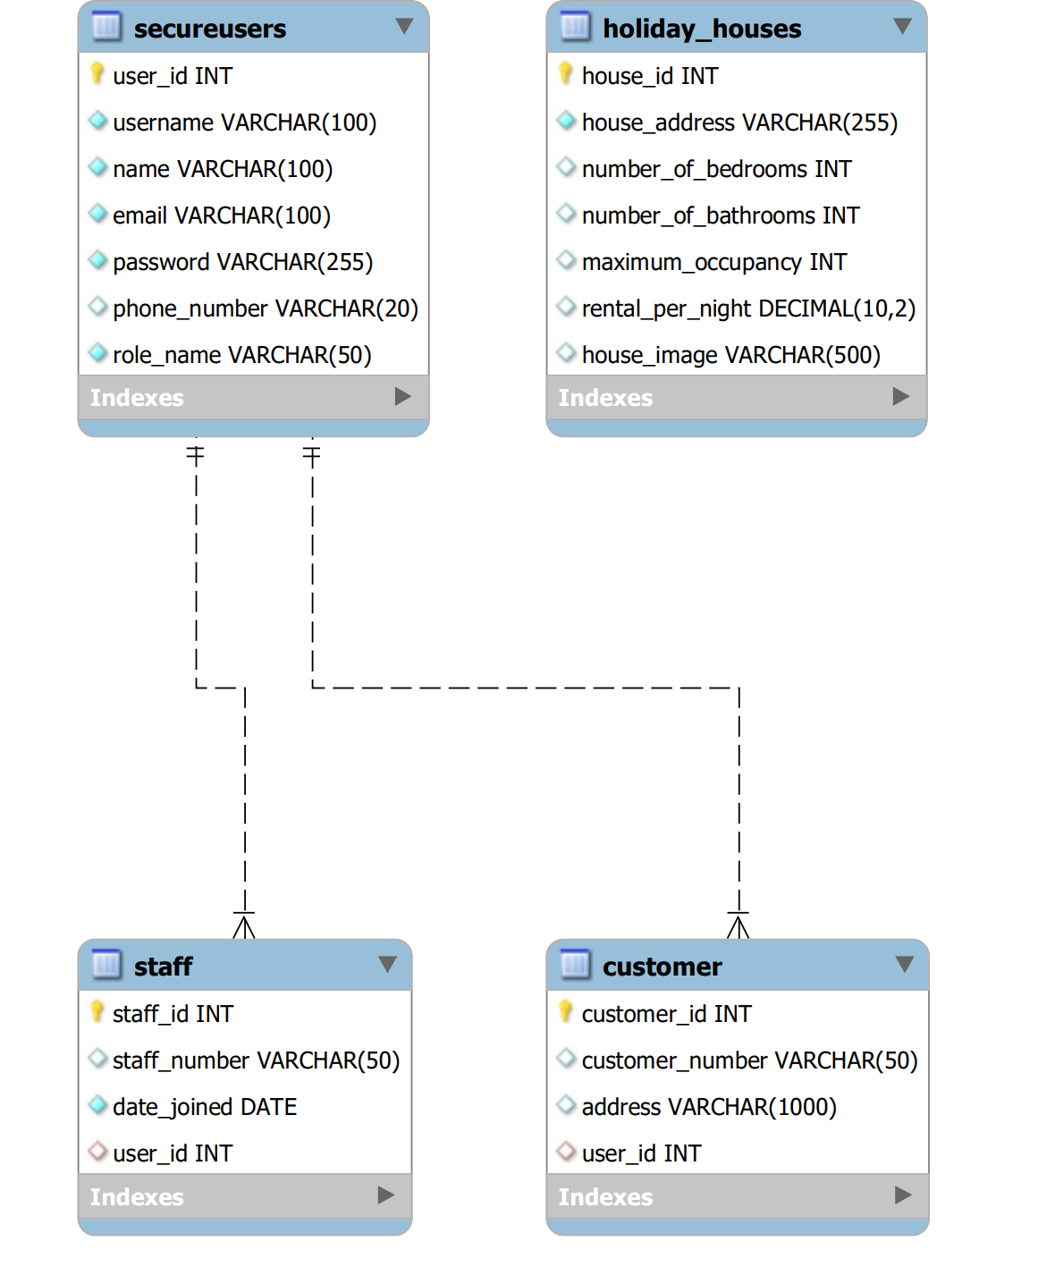
Database connection
houses_sys.sql
connect.py
Web application
Main.py

Slide 2
Routes
Function
Redirect users to role-specific home pages or to login if not logged in.
HTML Template
/
main()
Home.html
Staffhome.html
Login.html
/login/
login()
Authenticates users and directs them to role-based home pages
Database connection
houses_sys.sql
/logout
logout()
Cleans session data to log out the user and redirects to the login page.
Login.html
/register
register( )
connect.py
register.html
/home
home()
Customer registrations
/staffhome
Staffhome( )
Displays the home page (view house information)
home.html
/add_house
add_house
( )
Displays the staff home page (view, edit and delete house information)
staffhome.html
Staffhome-add.html
staffhome-edit.html
/edit_house
edit_house()
Web application
/delete_house
delete_house()
Main.py
/profile
Profile()
Displays the personal profile, update profile and update password
profile.html
updateprofile.html
Updateprofile-password.html
/updateprofile
Updateprofile()
/updateprofile-password
updateprofile-password()
/viewcustomer
Viewcustomer()
If logged in as the staff (do not include admin), it shows the customer information
viewcustomer.html

Slide 3
Routes
Function
If logged in as the staff-admin, the manage customer page shows the customer information and button for edit and delete
HTML Template
/editcustomer
editcustomer()
editcustomer.html
Database connection
/edit_customer_page/<int:customer_id>
edit_customer_page(customer_id)
houses_sys.sql
Add, edit and delete customer function when log in as admin
(admin will not create password for customer, they need to logged in by default password 123456 and update their own password)
edit_customer_page.html
edit_customer_add.html
editcustomer.html
/edit_customer_add
edit_customer_add()
connect.py
/delete_customer/<int:customer_id>
delete_customer(customer_id):
Add, edit and delete staff function when log in as admin(admin will not create password for customer, they need to logged in by default password 56789 and update their own password)
/editstaff
editstaff()
edit_staff_page.html
edit_ staff _add.html
editstaff.html
Web application
/edit_staff_page/<int:staff_id>
edit_staff_page(staff_id)
Main.py
/edit_staff_add
edit_staff_add()
/delete_staff/<int:staff_id>
delete_staff(staff_id)

