Slide 1

Note: The data and information in this document is reflective of a hypothetical situation and client. This document is to be used for KPMG Virtual Internship purposes only.
Sprocket Central Pty Ltd
Data analytics approach
[Data Analytics] - [Intern]

Slide 2
Note: The data and information in this document is reflective of a hypothetical situation and client. This document is to be used for KPMG Virtual Internship purposes only.
Agenda
Introduction
Data Exploration
Model Development
Interpretation

Slide 3
Note: The data and information in this document is reflective of a hypothetical situation and client. This document is to be used for KPMG Virtual Internship purposes only.
Introduction
Data Insights Of Identifying High Value Customers
-- by creating customer segmentations and analyzing their attributes
Data Exploration
Understanding the data set by looking into the distributions and plotting customers and transactions information
Model Development
Combine marketing analysis with machine learning algorithm to identify best customer groups
Result Interpretation
Analyze high quality customers groups’ attributes
Preparing data for the model by fixing data type/format

Slide 4
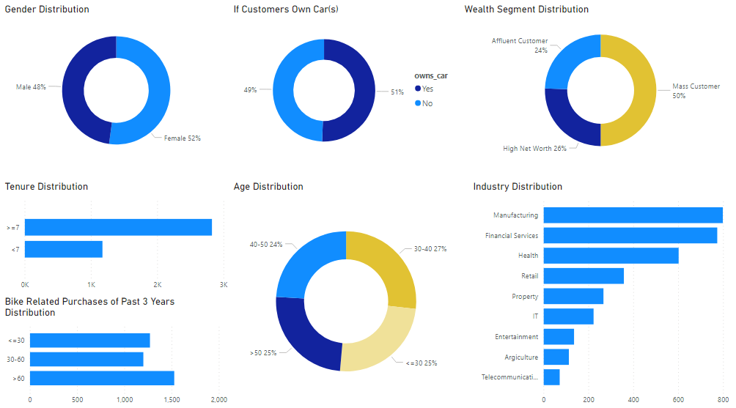
Note: The data and information in this document is reflective of a hypothetical situation and client. This document is to be used for KPMG Virtual Internship purposes only.
Data Exploration
Understanding the Data Set
-- exploring and plotting both customers and products information
Customers – demographic information
Gender – female slightly more than male
Tenure – most people have tenure of more than 7
Bike Related Purchases of Past 3 Years – most people have purchases more than 60
Car ownership – 50% people have car(s)
Age – about half are above 40 years old
Wealth Segment – half of the people are mass customers
Industry – most from manufacturing, financial services and health

Slide 5
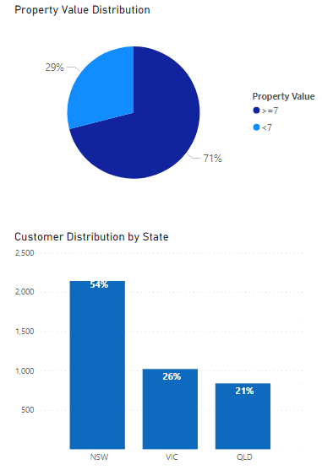
Note: The data and information in this document is reflective of a hypothetical situation and client. This document is to be used for KPMG Virtual Internship purposes only.
Data Exploration
Understanding the Data Set
-- exploring and plotting both customers and products information
Customers – geographic information
Property Value – More than 70% of the customers have property value of more than 7
State – More than half of the customers live in NSW

Slide 6
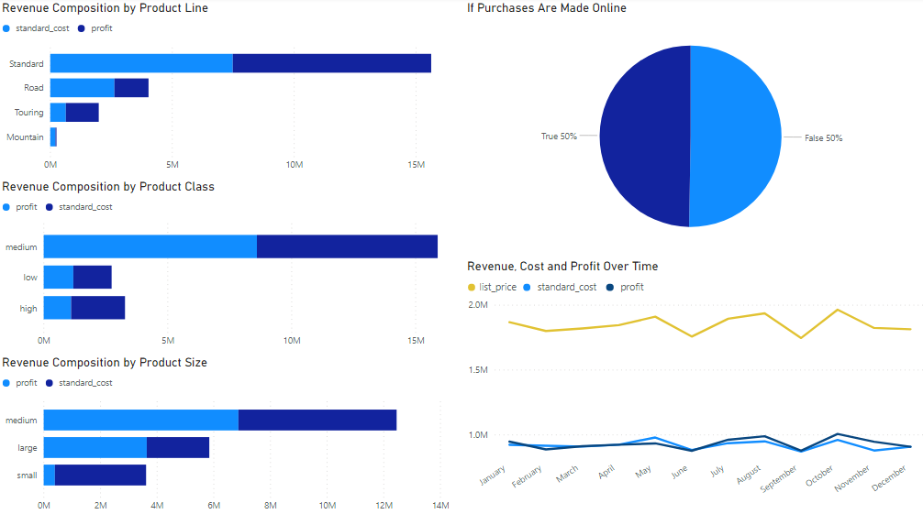
Note: The data and information in this document is reflective of a hypothetical situation and client. This document is to be used for KPMG Virtual Internship purposes only.
Data Exploration
Understanding the Data Set
-- exploring and plotting both customers and products information
Products
Most popular/profitable product line – standard
Most popular/profitable product class – medium
Most popular/profitable product size – medium
No significant difference between online and offline order amount
No significant seasonality

Slide 7
Note: The data and information in this document is reflective of a hypothetical situation and client. This document is to be used for KPMG Virtual Internship purposes only.
Model Development
Customer Segmentation
-- 4 customer clusters (Platinum, Gold, Silver, Bronze) created based on existing customers information
Process Breakdown
Feature Engineering & Data Transformation
Adjust/align data categories, data input format for all columns (e.g. change F to Female in gender column)
Prepare Transactions Table for modeling:
a) Add profit column
b) Drop 197 rows that have missing information (product standard cost and thus profit)
c) Drop another 178 rows that stored information about cancelled orders
d) 19,625 transactions from 3,493 customers will be analyzed, 98% of the raw data

Slide 8
Note: The data and information in this document is reflective of a hypothetical situation and client. This document is to be used for KPMG Virtual Internship purposes only.
Model Development
Customer Segmentation
-- 4 customer clusters (Platinum, Gold, Silver, Bronze) created based on existing customers information
Modeling
Calculate RFM (Recency, Frequency, Monetary) value based on transactions information for each customer
RFM is marketing analysis tool often used to identify best customers based on their spending history
Recency – days between each customer’s last order date and 2017-12-31
Frequency – number of orders during the year 2017 for each customer
Monetary – total amount of profit generated from each customer of the year 2017
Divide customers into 4 clusters using K means method based on RFM value
K means is a machine learning algorithm to group similar data points together
Algorithm also showed there should be 4 similar groups
4 customer clusters were named Platinum, Gold, Silver, Bronze according to each group’s characteristics

Slide 9
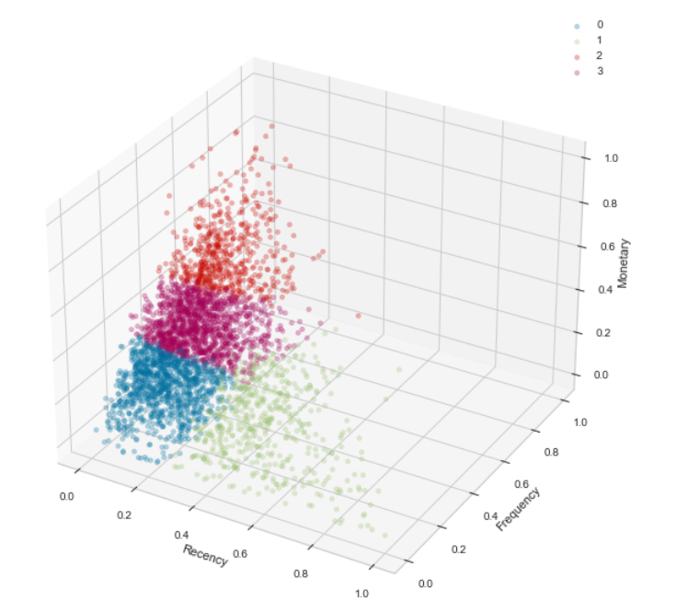
Note: The data and information in this document is reflective of a hypothetical situation and client. This document is to be used for KPMG Virtual Internship purposes only.
Model Development
Customer Segmentation
-- 4 customer clusters (Platinum, Gold, Silver, Bronze) created based on existing customers information
Modeling Results
4 Customer Clusters:
14% of the customers are categorized as platinum, 38% are gold, 30% are silver, 18% are bronze
3D Plot Cluster | Cluster Name | Recency | Frequency | Monetary
Red Cluster | Platinum | Low | Highest | Highest
Purple Cluster | Gold | Low | High | High
Blue Cluster | Silver | Low | Low | Low
Green Cluster | Bronze | Highest | Low | Lowest

Slide 10
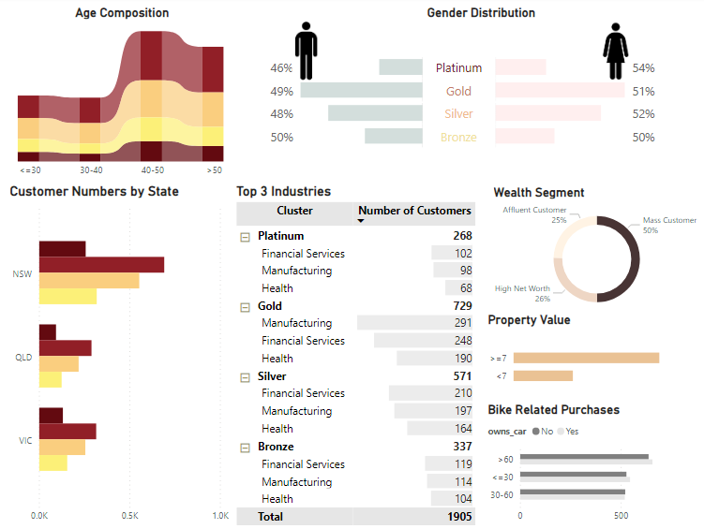
Note: The data and information in this document is reflective of a hypothetical situation and client. This document is to be used for KPMG Virtual Internship purposes only.
Interpretation
Customer Demographic Information Differs in Each Cluster
-- we suggest to focus on new customers with similar characteristics of platinum (and/or gold) customers
Platinum/Gold customers characteristics:
Age – over 40 years old (most between 40 and 50)
Gender – female slightly more than male
State – mostly from NSW
Industry – mostly from manufacturing, financial services and health
Wealth Segment – mostly from mass customers
Property Value – mostly with a value more than 7
Bike Related Purchases in Past 3 Years – mostly have more than 60 purchases
Platinum
Gold
Silver
Bronze

Slide 11
Note: The data and information in this document is reflective of a hypothetical situation and client. This document is to be used for KPMG Virtual Internship purposes only.
Appendix

Slide 12
Note: The data and information in this document is reflective of a hypothetical situation and client. This document is to be used for KPMG Virtual Internship purposes only.
Appendix
Modelling Code:
KPMG_VI/KPMG_VI_Customer_Segmentation.ipynb at main · lueurrrr/KPMG_VI (github.com)

