Slide 1
Task I want to solve:
I want to be able to control the temperature on the web page with frequency under scene changes and record the data in the cloud.
System components:
Arduino IDE, EC2 instance, temperature sensor, Wifi, Mongodb
Component Interaction:
Arduino IDE code for collecting information and wifi connection to the phone.
EC2 instance hosted in the cloud is used to receive and process data from the Arduino device.
The cell phone is used to establish a Wifi connection with the Arduino.

Slide 2
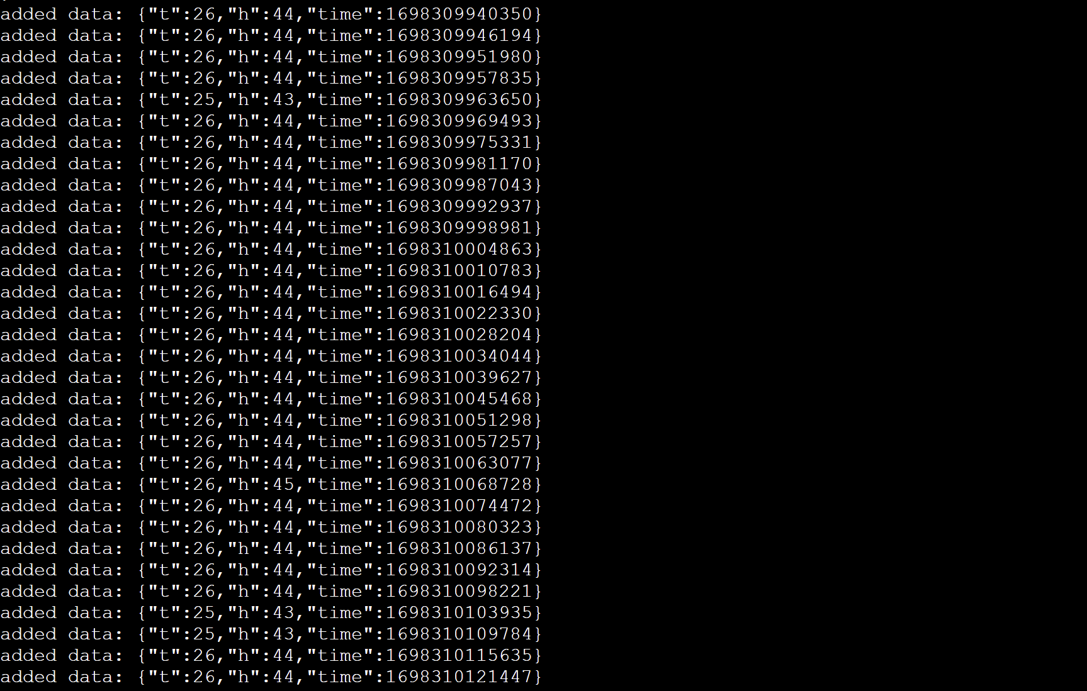
Challenges ：1. Instability of wifi
2. I've never learned C and may have trouble editing it
Timeline: 2 Weeks.

