Slide 1
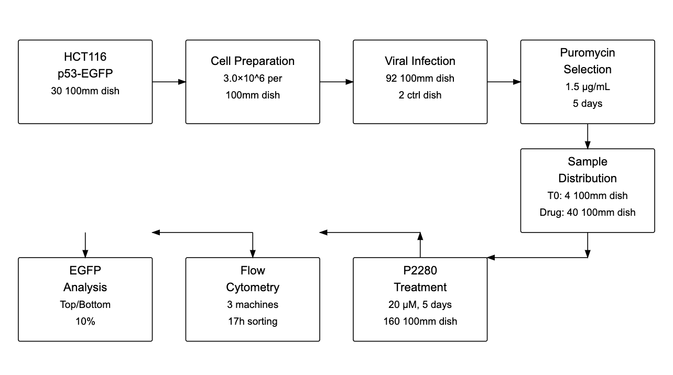

Slide 2
HCT116
p53-EGFP
30×100mm dish
Cell Preparation
3.0×10⁶ per
100mm dish
Viral Infection
90×100mm dish
+2 ctrl dish
Puromycin
Selection
1.5μg/ml
5 days
EGFP
Analysis
Top/Bottom
10%
Flow
Cytometry
DAPI Dyeing
P2280
Treatment
20μM, 120h
160×100mm dish
Sample
Distribution
T0:4×100mm dish
Drug:40×100mm dish

