Slide 1


















































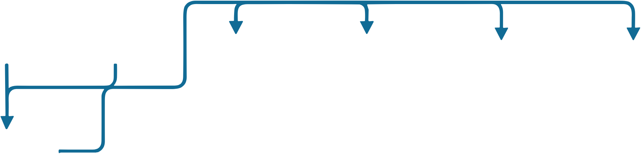















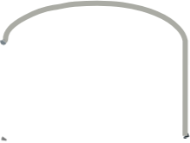





























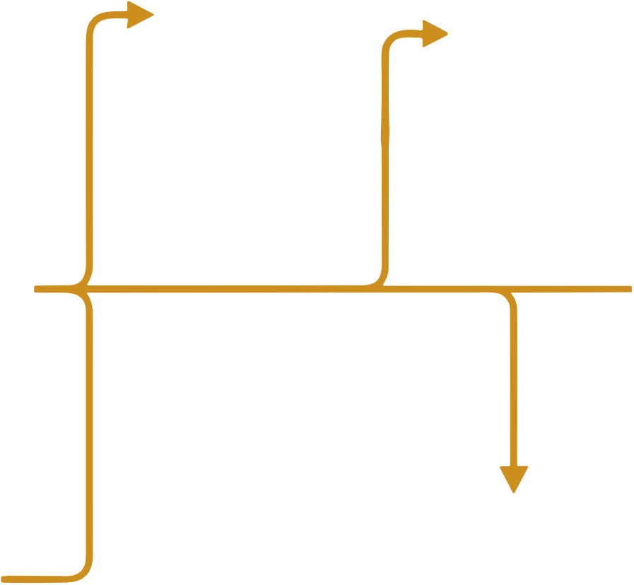














































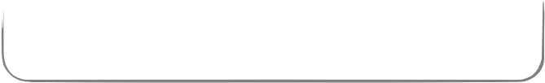




























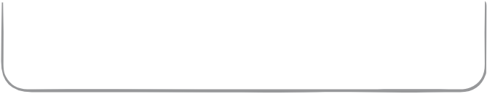
DISPATCH CHALLENGE
CONTROL FRAMEWORK
PAPER OUTPUTS
State
DRL
Physics-aware
Executable
observation
policy
safety projection
dispatch
raw action → feasible action
Coupled electricity-heat-
Yearly cost and
cooling decisions
STUDIED CCHP PLANT
reliability evaluation
Heat↓
↓Cool
Grid
Renewables
Physical feasibility of
Same-information
thermally driven cooling
BES
TES
ABS Chiller
ECH Chiller
DRL comparison
(Battery Energy
(Thermal Energy
(Absorption)
(Electric
Storage)
Storage)
Compression)
GT
(Gas Turbine)
Long-horizon annual
HRSG
Multi-seed
operating cost
(Heat Recovery
robustness analysis
Steam Generator)
Electric Load
田
田
Reliability constraints
Boiler
Heating Load
Cooling Load
Oracle benchmark as
for electric, heat, and
cooling supply
Executable absorption cooling depends on available driving heat and thermal state.
planner-side reference

