Slide 1














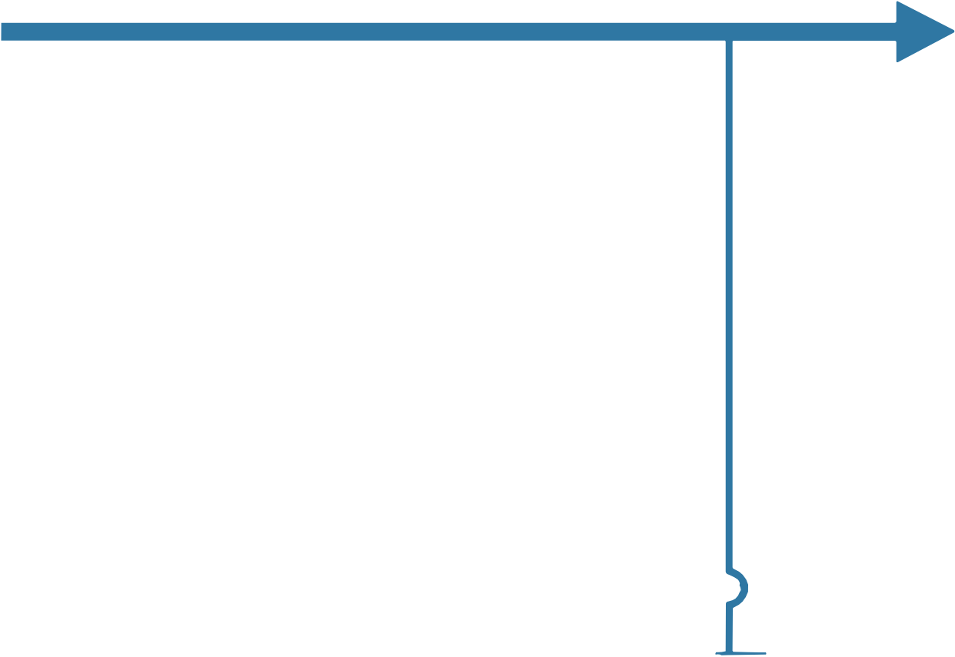

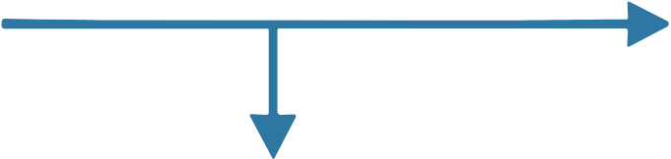
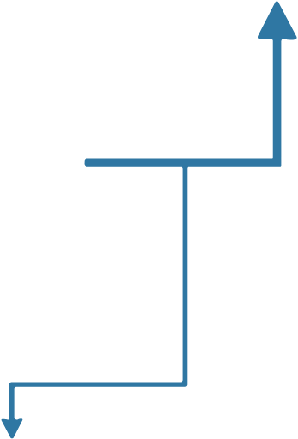





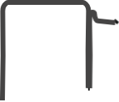





















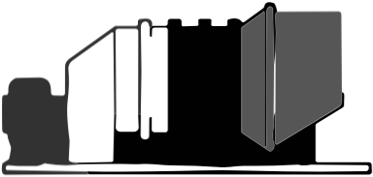









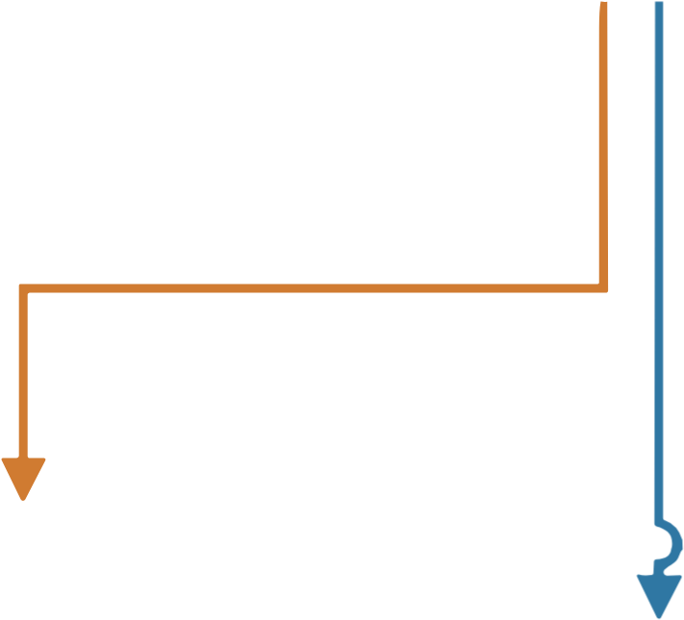











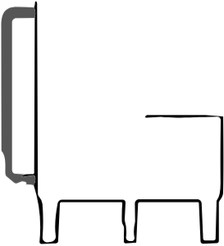

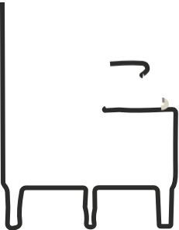






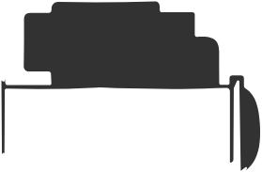





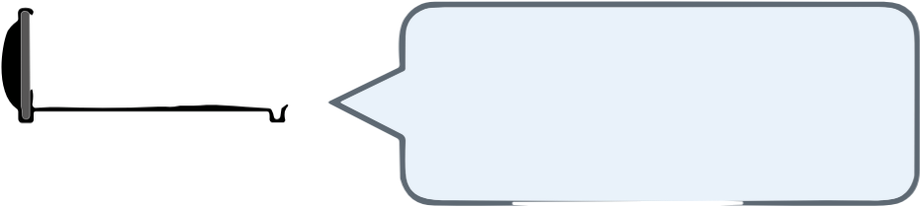

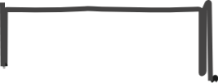




ELECTRICAL PATHWAY
Electrical flexibility and
Charge
grid-shaping support
Battery Energy
Discharge
Storage (BES)
Grid
Electric Bus
Electric Load
Renewables
Gas Turbine (GT)
THERMAL PATHWAY
Thermal Bus
Boiler
HRSG
Discharge
Short-term heat
Heating Load
Charge
buffering and shifting
Thermal Energy
Storage (TES)
COOLING PATHWAY
Thermally driven cooling,
feasible only with
Cooling Load
sufficient driving heat
Electrically driven
Absorption Chiller
Electric Chiller
cooling fallback
(ABS)
(ECH)

