Slide 1












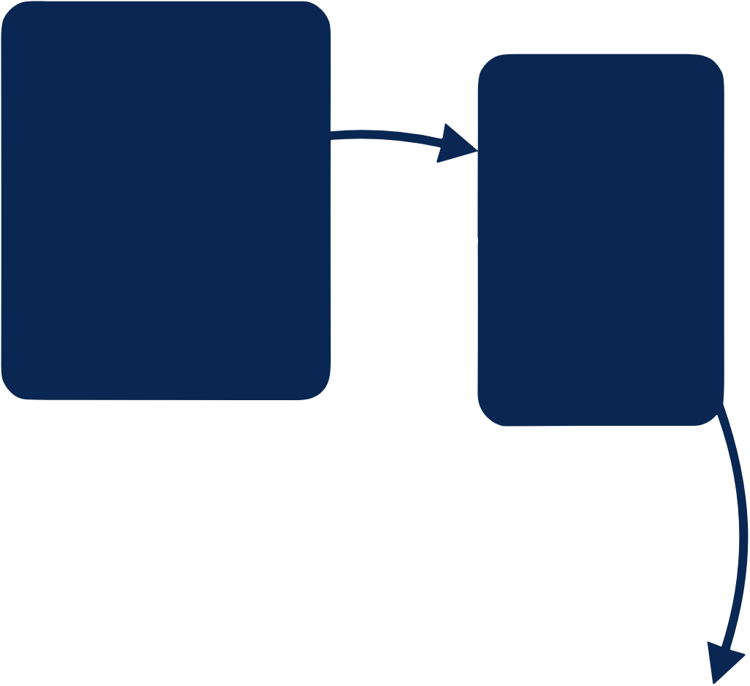









































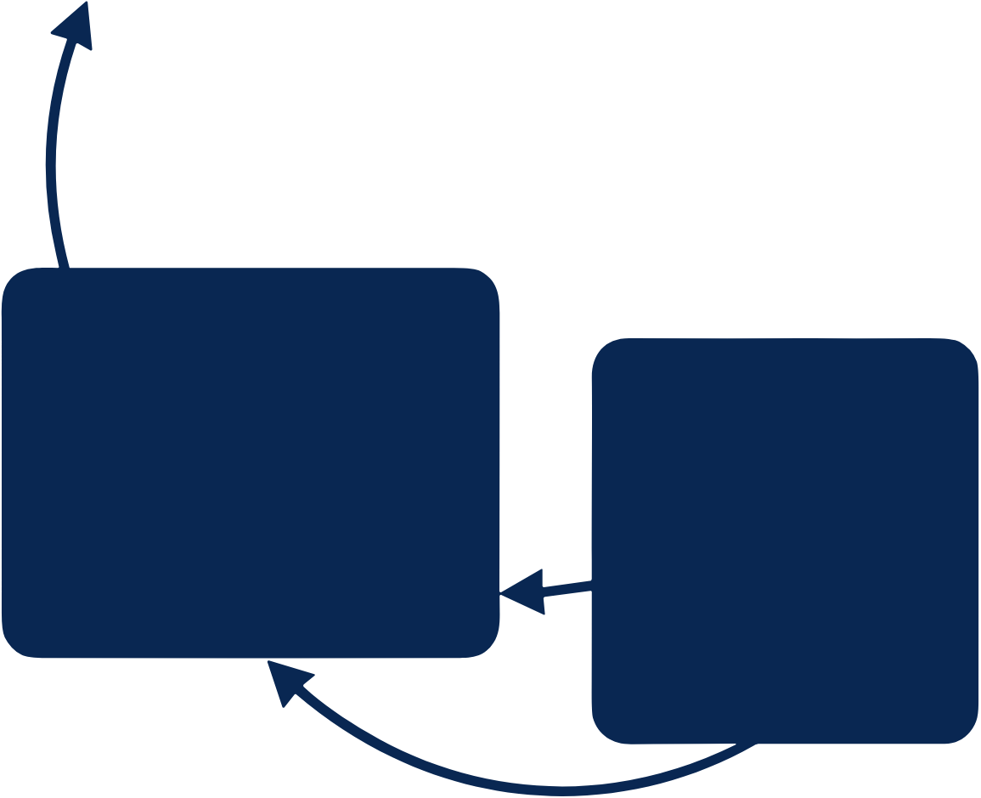

























































SAC-based Network-Constrained Battery Scheduling Workflow
Observation
SAC Agent
Battery
Execution
Full
Transition
Time features
Actor
Rint only
(t, t + 1, ·· · )
Network
Replay
Buffer
Loss only
PV forecast/
SOC limits
PV realization
Simple
(P_{pv}, P_{pv})
Power limits
Load (P_{Load})
(P_{min}/P_{max})
Pandapower AC Power
battery
Calculate safety modifier
Flow Settlement
Electricity
power
price
set-point
Bus voltages (V_{bus})
Critic Networks
(a_{t})
Feeder loading (I_{feeder})
State of
Charge (SOC)
Network
Import/export to grid
(P_{grid})
limits
Policy Update
Clip/reshape
Net-demand
Loop
infeasible actions
(P_{net})
under constraints
Reward & Next State
Operating cost
reward (r_{t})
Network penalties
next state (S_{t+1})
SOC-shaping

