Slide 1











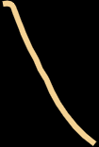





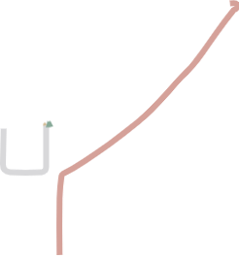



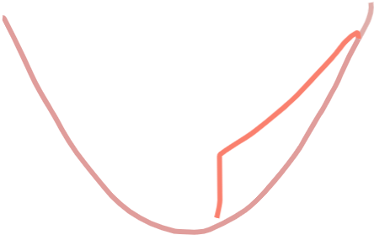










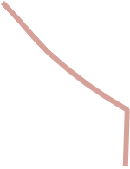
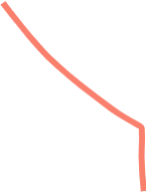




























W
Full Thevenin
—W
Battery model fidelity ↑
Loss-aware
storage
fidelity value is mixed-fidelity is a
Thevenin
matters
non-monotonic narrow stabilizer
CIGRE LV
IEEE 33 feeder
Simple

