Slide 1


























































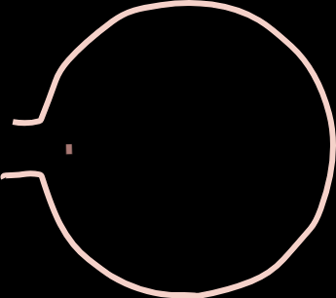











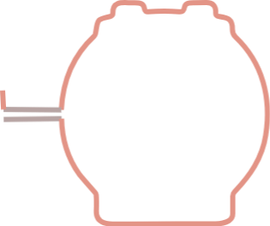































































































CIGRE European Low-Voltage
Modified IEEE33 Feeder
Benchmark Network
PV
Load
BESS
PV
PCC
PCC
Load
BESS
PV
PV
PV
PV
Load

