Slide 1
CSCI561 spring 2016 Week 12 Discussion
Prof Tejada stejada@usc.edu

Slide 2
Semantics
If correct, the network represents the full joint distribution: P(x₁, … ,x_{n}) = π_{i=1} P(x_{i} | parents(X_{i}))
n

Slide 3
n
P(x₁, … ,x_{n}) = π_{i=1} P(x_{i} | parents(X_{i}))
E.g., the probability of a complete false alarm (no burglary or earthquake) with two calls is:
P(j, m, a, ¬b, ¬e)
= P(j | a) P(m | a) P(a | ¬b, ¬e) P(¬b) P(¬e)
= .9 x .7 x .001 x .999 x .998 ≈ .000063

Slide 4
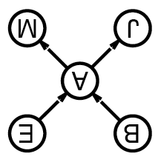
Enumeration in Bayesian Networks
Compute probabilities from Bayesian network as if from FJPT, but without explicitly constructing the table
Otherwise would lose benefit of decomposing full table into network
Consider simple query on burglary network
P(b | j,m)
= P(b,j,m)/P(j,m)
= αP(b,j,m)
= αΣ_{e}Σ_{a}P(b,e,a,j,m)
= αΣ_{e}Σ_{a}P(b) P(e) P(a | b,e) P(j | a) P(m | a)
= αP(b)Σ_{e} P(e) Σ_{a} P(a | b,e) P(j | a) P(m | a)
Compute by proceeding through terms in a depth-first fashion, multiplying and adding CPT entries as we go

Slide 5
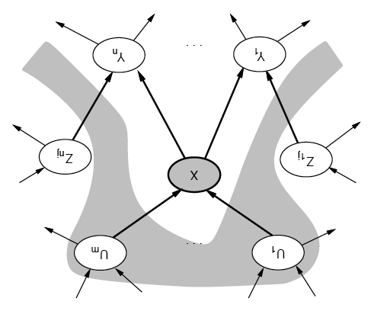
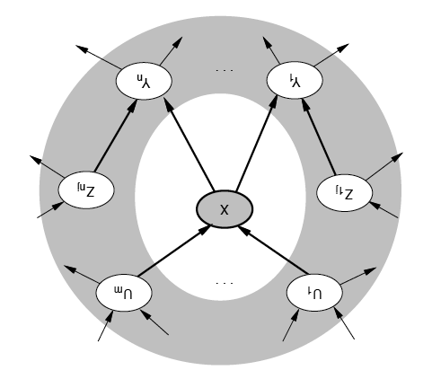
Conditional Independence of Nodes
A node is conditionally independent of its nondescendents given its parents
A node is conditionally independent of all others given its Markov blanket
Parents, children and children’s parents

Slide 6
Probability formulas
Conditional probability: P(a | b) = P(a ∧ b) / P(b)
Product rule: P(a ∧ b) = P(a | b) P(b) = P(b | a) P(a)
⇒ Bayes' rule: P(a | b) = P(b | a) P(a) / P(b)

Slide 7
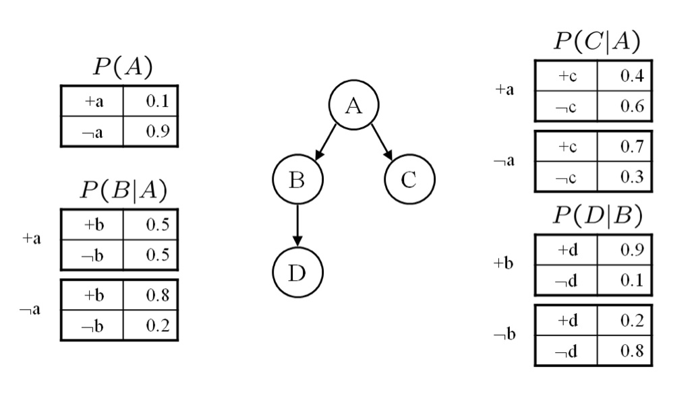
Bayesian Networks
Given this network calculate the following probabilities. Give both the formula and calculations with values. These questions are designed so that they can be answered with a minimum of computation. If you find yourself doing a copious amount of computation for each part, step back and consider whether there is simpler way to deduce the answer.
1. P(a,¬b,c,¬d)
P (a)P (¬b|a)P (c|a)P (¬d|¬b)
= 0.1 × 0.5 × 0.4 × 0.8 = 0.016

Slide 8
Bayesian Networks
2. P(b)
P(b) = ∑_{A={a,¬a}} P(A)P(b|A)
= 0.1 × 0.5 + 0.9 × 0.8 = 0.77
3. P(a|b)
P (a|b) = P (a,b)/ P (b) = P (a)P (b|a) / P (b)
= 0.1×0.5 / .77 = 0.064935

Slide 9
Bayesian Networks
4. P(d|a)
P (d|a) = ∑_{B={b,¬b}} P (d|B)p(B|a)
= 0.9 × 0.5 + 0.2 × 0.5 = 0. 55
5. P(d|a,c)
From the conditional independence properties of the graph, D ⊥ C|{A}. Hence, P(d|a,c) = p(d|a)
= 0.55

Slide 10
16.15 Making Simple Decisions
Consider a student who has the choice to buy or not buy a textbook for a course. We’ll model this as a decision problem with one Boolean decision node, B, indicating whether the agent chooses to buy the book, and two Boolean chance nodes, M, indicating whether the student has mastered the material in the book, and P , indicating whether the student passes the course. Of course, there is also a utility node, U. A certain student, Sam, has an additive utility function: 0 for not buying the book and -$100 for buying it; and $2000 for passing the course and 0 for not passing. Sam’s conditional probability estimates are as follows:
P(p|b,m) = 0.9
P(m|b) = 0.9
P (p|b, ¬m) = 0.5
P (m|¬b) = 0.7
P(p|¬b, m) = 0.8
P (p|¬b, ¬m) = 0.3
You might think that P would be independent of B given M, But this course has an open- book final—so having the book helps.

Slide 11
Draw the decision network for this problem.

Slide 12
Compute the expected utility of buying the book and of not buying it.

Slide 13
Compute the expected utility of buying the book and of not buying it.
0.35 x 0
BUY!

Slide 14
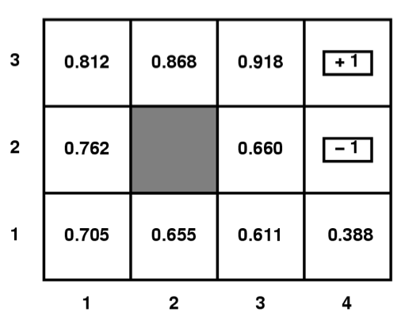
MDP
50
500
Given a Gridworld domain, where terminal states
(1,3), (4,3), and (4,2) have rewards 50, 500, and -50
respectively, the set of possible actions are
{N,E,S,W, or X for terminal states}, the agent moves
Deterministically, all V and Q values for non terminal
states have been initialized to 0,
answer the questions below.
Circle the letter that corresponds to the best answer for the question.
What are the optimal values, V∗ of each state in the above grid if γ = 0.5, c(a)=0, R(s)=0 for non terminal states? (Remember V_{t+1}(s) = R(s) + Max_{aεA} {c(a)+γΣ_{s’εS} P(s’|a,s) V_{t}(s’)} )
V_{(1,1)}=15.75, V_{(1,2)}=25, V_{(2,1)}=31.25, V_{(2,3)}=125, V_{(3,1)}=62.5, V_{(3,2)}=125, V_{(3,3)}=250, V_{(4,1)}=25
V_{(1,1)}=12.5, V_{(1,2)}=25, V_{(2,1)}=31.25, V_{(2,3)}=125, V_{(3,1)}=62.5, V_{(3,2)}=125, V_{(3,3)}=250, V_{(4,1)}=31.25
V_{(1,1)}=15.625, V_{(1,2)}=25, V_{(2,1)}=31.25, V_{(2,3)}=125, V_{(3,1)}=62.5, V_{(3,2)}=125, V_{(3,3)}=250, V_{(4,1)}=31.25
V_{(1,1)}=12.5, V_{(1,2)}=25, V_{(2,1)}=25, V_{(2,3)}=25, V_{(3,1)}=50, V_{(3,2)}=100, V_{(3,3)}=250, V_{(4,1)}=25
None of the above
-50
C

Slide 15
mdp
What are the Q values of state (3,2) in the above grid if γ = 0.5, c(a)=0, R(s)=-2 for non terminal states?
(Remember Q_{t+1}(a,s) = R(s) + c(a)+γΣ_{s’εS} P(s’|a,s)max_{a’εA} Q_{t}(a’s’) )
Q_{((3,2),N)}=122, Q_{((3,2),E)}=-27, Q_{((3,2),S)}=59
Q_{((3,2),N)}=122, Q_{((3,2),E)}=-27, Q_{((3,2),S)}=27.5
Q_{((3,2),N)}=125, Q_{((3,2),E)}=-25, Q_{((3,2),S)}=62.5
Q_{((3,2),N)}=120, Q_{((3,2),E)}=-27, Q_{((3,2),S)}=31.5
None of the above
500
50
500
50
-50
-50

Slide 16
mdp
What are the Q values of state (3,2) in the above grid if γ = 0.5, c(a)=0, R(s)=-2 for non terminal states?
(Remember Q_{t+1}(a,s) = R(s) + c(a)+γΣ_{s’εS} P(s’|a,s)max_{a’εA} Q_{t}(a’s’) )
Q_{((3,2),N)}=122, Q_{((3,2),E)}=-27, Q_{((3,2),S)}=59
Q_{((3,2),N)}=122, Q_{((3,2),E)}=-27, Q_{((3,2),S)}=27.5
Q_{((3,2),N)}=125, Q_{((3,2),E)}=-25, Q_{((3,2),S)}=62.5
Q_{((3,2),N)}=120, Q_{((3,2),E)}=-27, Q_{((3,2),S)}=31.5
None of the above
50
E248
500
-50

Slide 17
mdp
What are the Q values of state (3,2) in the above grid if γ = 0.5, c(a)=0, R(s)=-2 for non terminal states?
(Remember Q_{t+1}(a,s) = R(s) + c(a)+γΣ_{s’εS} P(s’|a,s)max_{a’εA} Q_{t}(a’s’) )
Q_{((3,2),N)}=122, Q_{((3,2),E)}=-27, Q_{((3,2),S)}=59
Q_{((3,2),N)}=122, Q_{((3,2),E)}=-27, Q_{((3,2),S)}=27.5
Q_{((3,2),N)}=125, Q_{((3,2),E)}=-25, Q_{((3,2),S)}=62.5
Q_{((3,2),N)}=120, Q_{((3,2),E)}=-27, Q_{((3,2),S)}=31.5
None of the above
50
E248
500
N122
-50

Slide 18
mdp
What are the Q values of state (3,2) in the above grid if γ = 0.5, c(a)=0, R(s)=-2 for non terminal states?
(Remember Q_{t+1}(a,s) = R(s) + c(a)+γΣ_{s’εS} P(s’|a,s)max_{a’εA} Q_{t}(a’s’) )
Q_{((3,2),N)}=122, Q_{((3,2),E)}=-27, Q_{((3,2),S)}=59
Q_{((3,2),N)}=122, Q_{((3,2),E)}=-27, Q_{((3,2),S)}=27.5
Q_{((3,2),N)}=125, Q_{((3,2),E)}=-25, Q_{((3,2),S)}=62.5
Q_{((3,2),N)}=120, Q_{((3,2),E)}=-27, Q_{((3,2),S)}=31.5
None of the above
B
50
E248
500
N122
-50
S27.5
N59

Slide 19
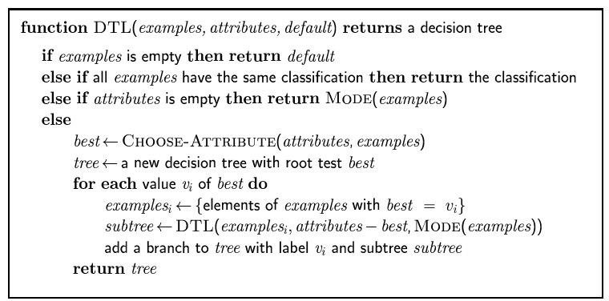
Exercise 18.6
Consider the following data set comprised of
three binary input attributes (A1, A2, and A3)
and one binary output:
Use the algorithm in Figure 18.5 (page 702) to learn a decision tree for these data.
Show the computations made to determine the attribute to split at each node.

Slide 20
Exercise 18.6
Need to compute Remainder(Ai) for each attribute Ai, and select the attribute the provides the minimal remaining information
p = 2; n = 3;
Computations for first split: remainders for A1:
A1 splits 5 cases into 4 and 1:
p₁ = 2; n₁ = 2; p₂ = 0; n₂ = 1;
A1: (4/5)(−2/4 log(2/4) − 2/4 log(2/4)) + (1/5)(−0 − 1/1 log(1/1)) = 0.800

Slide 21
Exercise 18.6
Need to compute Remainder(Ai) for each attribute Ai, and select the attribute the provides the minimal remaining information
Computations for first split: remainders for A1, A2, and A3 are
A1: (4/5)(−2/4 log(2/4) − 2/4 log(2/4)) + (1/5)(−0 − 1/1 log(1/1)) = 0.800
A2: (3/5)(−2/3 log(2/3) − 1/3 log(1/3)) + (2/5)(−0 − 2/2 log(2/2)) ≈ 0.551
A3: (2/5)(−1/2 log(1/2) − 1/2 log(1/2)) + (3/5)(−1/3 log(1/3) − 2/3 log(2/3)) ≈ 0.951

Slide 22
Exercise 18.6
After splitting on A2, we compute
the remaining information for the
other two attributes on the three remaining examples (x3, x4, x5) that have A2 = 1.
A1: (2/3)(−2/2 log(2/2) − 0) + (1/3)(−0 − 1/1 log(1/1)) = 0
A3: (1/3)(−1/1 log(1/1) − 0) + (2/3)(−1/2 log(1/2) − 1/2 log(1/2)) ≈ 0.667.
So, we select attribute A1 to split on, which correctly classifies all remaining examples.

Slide 23
Want more?
Exercises 16.5, 17.1, 17.9, 17.10, 18.5, 18.7

