Slide 1
Compiling Linux with LLVM
Presented by: Mark Charlebois
Presentation Date: 03/26/2012

Slide 2
Disclaimer
Nothing in these materials is an offer to sell any of the components or devices referenced herein. Certain components for use in the U.S. are available only through licensed suppliers. Some components are not available for use in the U.S.

Slide 3
Agenda
Why would I want to use Clang to compile Linux?
Status updates:
cross compiling for ARM with Clang
building Linux kernel with Clang
running Linux compiled with Clang
To do list

Slide 4

Why Would I Want to Use Clang to Compile Linux?

Slide 5
Better Diagnostics
$ gcc-4.2 -fsyntax-only t.c
t.c:7: error: invalid operands to binary + (have 'int' and 'struct A')
$ clang -fsyntax-only t.c
t.c:7:39: error: invalid operands to binary expression ('int' and 'struct A')
return y + func(y ? ((SomeA.X + 40) + SomeA) / 42 + SomeA.X : SomeA.X);
~~~~~~~~~~~~~~ ^ ~~~~~
See http://clang.llvm.org/diagnostics.html for more examples
GCC extensions: all extensions are explicitly recognized as such and marked with extension diagnostics, which can be mapped to warnings, errors, or just ignored.
Google builds their products also with Clang just for the better debug output

Slide 6
Fix-it Hints
"Fix-it" hints provide advice for fixing small, localized problems in source code.
$ clang t.c
t.c:5:28: warning: use of GNU old-style field designator extension struct point origin = { x: 0.0, y: 0.0 };
~~ ^
.x =
t.c:5:36: warning: use of GNU old-style field designator extension struct point origin = { x: 0.0, y: 0.0 };
~~ ^
.y =

Slide 7
Macro Expansion
$ gcc-4.2 -fsyntax-only t.c
t.c: In function 'test':
t.c:80: error: invalid operands to binary < (have 'struct mystruct' and 'float')
$ clang -fsyntax-only t.c
t.c:80:3: error: invalid operands to binary expression ('typeof(P)' (aka 'struct mystruct') and 'typeof(F)' (aka 'float'))
X = MYMAX(P, F);
^~~~~~~~~~~
t.c:76:94: note: instantiated from:
#define MYMAX(A,B) __extension__ ({ __typeof__(A) __a = (A); __typeof__(B) __b = (B); __a < __b ? __b : __a; })
~~~ ^ ~~~

Slide 8
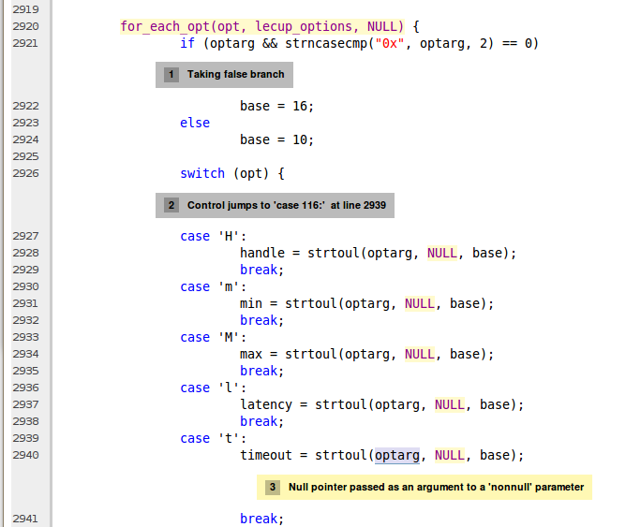
Static Analyzer
http://littlechina.org/~vcgomes/bluez-static-analysis/2012-02-10-1/report-n7KJtW.html#EndPath
Notes:
Bluetooth
(http://www.spinics.net/lists/linux-bluetooth/msg21271.html)

Slide 9




Clang/LLVM use in Open Source OSes
Minix moved to Clang as default compiler
http://wiki.minix3.org/en/MinixReleases
FreeBSD is working on ClangBSD
Using LLVM and KLEE for automatic test generation
http://wiki.freebsd.org/BuildingFreeBSDWithClang
LLVM is the basis of the Renderscript compiler in Android
Supported on ARM, MIPS and x86
LLVM a hard dependancy for Gallium3D
llvm-pipe driver
Clover – OpenCL state tracker
May be used for GLSL shader optimizer

Slide 10


Clang and Debian
Building Debian with Clang:
“…most of the issues are either difference in C standard supported, difference of interpretation or corner cases.”
“My personal opinion is that clang is now stable and good enough to rebuild most of the packages in the Debian archive, even if many of them will need minor tweaks to compile properly.”
“In the next few years, coupled with better static analysis tools, clang might replace gcc/g++ as the C/C++ compiler used by default in Linux and BSD distributions.”
“The clang developers are progressing very fast: 14.5% of the packages were failing with version 2.9 against 8.8% with version 3.0.”
Sylvestre Ledru: http://sylvestre.ledru.info/blog/sylvestre/2012/02/29/rebuild_of_the_debian_archive_with_clang

Slide 11
Status of Cross Compiling for ARM with Clang

Slide 12
Clang Parameters for Building ARM Linux User Space
Getting much simpler now:
export COMPILER_PATH=/opt/arm-2011.03
CC=clang -ccc-host-triple arm-none-linux-gnueabi \
-ccc-gcc-name arm-none-linux-gnueabi-gcc \
--sysroot=${COMPILER_PATH}/arm-none-linux-gnueabi/libc \
-march=armv7-a -mfpu=neon
The default for arm-none-linux-gnueabi is armv4t
Using triple armv7-none-linux-gnueabi will not find the codesourcery compiler and default to the native assembler: /usr/bin/as

Slide 13
Universal Driver - http://clang.llvm.org/UniversalDriver.html
User speciﬁes just a “conﬁguration”:
clang --config=arm-cortex-a9-baremetal foo.c
clang --config=cortex-m4-my-toaster morning-food.c
Under the hood this entry point (the universal driver) would have access to all the information that the driver, compiler, and other tools need to build applications for that target.
Status?

Slide 14
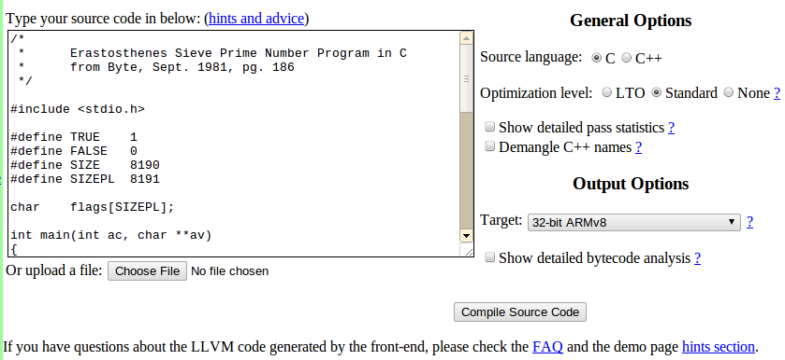
ELLCC - http://ellcc.org/
The primary emphasis of the ELLCC project is to create an easy to use multi-target cross compilation environment for embedded systems [based on Clang and LLVM].
Multi-target support: ARM, i386, Microblaze, Mips, Nios2^{[2]}, PowerPC, PowerPC64, Sparc^{[1]} and X86_64

Slide 15
Challenges Using Clang to Build Linux Kernel

Slide 16
Challenges Using Clang for Cross Compilation
Cross compilation with Clang
Not a supported configuration
Dependence on GNU cross toolchain for assembly and linking
Configuring GNU toolchain dependencies
Finding the right triplet
Lots of warnings
-Wunused-value (slows compilation)
Clang/LLVM Bugs
Clang C99 vs GCC GNU89
Kernel expects some undocumented GCC behavior

Slide 17
Unsupported GCC Behavior Expected by Linux Kernel
scripts/Kbuild.include are gcc specific
cc-option tests fail for gcc, pass erroneously for clang
Clang warning is for unused, not unsupported
No way to check supported options in clang
http://clang.llvm.org/docs/DriverInternals.html#int_unused_warnings
cc-option = $(call try-run,\
$(CC) $(KBUILD_CPPFLAGS) $(KBUILD_CFLAGS) $(1) -c -xc /dev/null -o "$$TMP",$(1),$(2))
GCC returns false for unsupported flag and issues warning:
cc1: error: unrecognized command line option "-fno-delete-pointer-checks"
Clang returns true for unused flag and issues warning:
clang: warning: argument unused during compilation: '-fno-delete-pointer-checks'

Slide 18
Unsupported GCC Flags
-fconserve-stack
Attempt to minimize stack usage. The compiler will attempt to use less stack space, even if that makes the program slower. This option implies setting the large-stack-frame parameter to 100 and the large-stack-frame-growth parameter to 400.
-fdelete-null-pointer-checks
Assume that programs cannot safely dereference null pointers, and that no code or data element resides there. This enables simple constant folding optimizations at all optimization levels. In addition, other optimization passes in GCC use this flag to control global dataflow analyses that eliminate useless checks for null pointers; these assume that if a pointer is checked after it has already been dereferenced, it cannot be null.
-fno-inline-functions-called-once
Suppresses inlining of subprograms local to the unit and called once from within it, which is enabled if -O1 is used.
http://gcc.gnu.org/onlinedocs/gnat_ugn_unw/Switches-for-gcc.html

Slide 19
Unsupported GCC C Language Extensions
Variable length arrays in structs (VLAIS)
A declaration like:
void f (int i) {
struct foo_t {
char a[i];
} foo;
}
cannot be compiled in Clang, though declarations like:
void f (int i) {
char foo[i];
}
are perfectly acceptable.
Used in the iptables code, the kernel hashing (HMAC) routines, and some drivers

Slide 20
Unsupported GCC C Language Extensions
Explicit register variables not supported
register unsigned long current_sp asm ("sp");
Nested functions
Only used in a thinkpad driver

Slide 21
Incompatibilities with GCC
Warnings for unused return values
Thousands of instances in kernel
Segment references
More __refdata, __initdata, __exitdata attributes required
Investigate differences in linking and segments
Inline syntax handling
GNU89

Slide 22
ARM Specific Clang/LLVM Bugs or Missing Features
-mabi-linux not properly supported on ARM
Causes incorrect structure member offsets
64 bit type parameter passing
Must use register pairs
QuIC patch submitted upstream
ARM paired register GNU inline assembly syntax
QuIC patch being developed for upstream submission
Clang IA not enabled for ARM (incomplete)

Slide 23
ARM Specific Clang Configuration Issues
Using triple arm-none-eabi, or triple arm-none-linux-gnueabi generates
undefined reference to __aeabi_*
Using triple “arm” or “armv7” works for kernel, but causes:
arch/arm/kernel/unwind.c:
warning: Your compiler does not have EABI support.
warning: ARM unwind is known to compile only with EABI compilers.
warning: Change compiler or disable ARM_UNWIND option.
__kernel_size_t vs size_t and posix functions
Clang IA not yet enabled for ARM by default

Slide 24
Status of Building Linux Kernel With Clang

Slide 25
Wiki and git Repository at llvm.linuxfoundation.org
Links to known LLVM bugs, organized by architecture, place to aggregate information about building Linux with Clang
Automated Build Framework
Documented in Wiki
Git repository
Current support for:
ARM Cortex A9 (Versatile Express)
Qualcomm MSM
Easy to add new arch/platforms
Anyone welcome to participate, would especially like to see x86 and MIPS support

Slide 26
Automated Build Framework
Automated build to simplify fetching and building Clang, QEmu, and initrd
Automates fetching, patching and building the Linux kernel
Git repository of build scripts and patches
http://git.linuxfoundation.org/llvm-setup.git
Proper build dependencies for Clang, kernel, qemu and initrd
Patches organized as:
General
Arch specific
SoC family or board specific
Tracks which patches apply
Python tools for managing and maintaining patches
All build targets can be listed
Make list-targets

Slide 27
Common/Arch Independent Status
No clang patches used
Linux Kernel patches for
Explicit register variables
VLAIS
Segment linkage differences
Use of COMPILER_PATH simplifies configuration of GNU compiler tools
Rich diagnostic output enables auto-generation of patches

Slide 28
Status of Building the ARM Linux Kernel With Clang
Some common kernel patches required:
Workarounds:
__refdata issue
return_address and extern inline in ftrace.h
VLAIS
Warning fixes:
Unused return value
ARM Versatile Express
compiles (3.3 kernel)
boots and runs toybox userspace
Qualcomm MSM
compiles with 64bit type ASM in atomic.h stubbed out
Fix has been submitted upstream
More __refdata fixes

Slide 29
Specific ARM Issues
Unsupported flags
-mlittle-endian
Everything assumes little-endian byte order
-mno-thumb-interwork
-mshort-load-bytes
Broken flags
-mabi=aapcs-linux
Creates struct member offset issues
Replace
register unsigned long current_sp asm ("sp");
asm ("mov %0, r13" : "=r" (current_sp));

Slide 30
Unsupported ARM Flags
-mno-thumb-interwork
Generate code that supports calling between the ARM and Thumb instruction sets. Without this option, on pre-v5 architectures, the two instruction sets cannot be reliably used inside one program. The default is -mno-thumb-interwork, since slightly larger code is generated when -mthumb-interwork is specified. In AAPCS configurations this option is meaningless.
-mlittle-endian
Generate code for a processor running in little-endian mode. This is the default for all standard configurations
-mshort-load-bytes
deprecated alias for -malignment-traps.
-malignment-traps
This option is ignored when compiling for ARM architecture 4 or later, since these processors have instructions to directly access half-word objects in memory.
http://gcc.gnu.org/onlinedocs/gcc/ARM-Options.html

Slide 31
TODO
Check status of other issues reported by Bryce Lebach
-mregparm
-fcall-saved-reg
-pg and mcount
-fno-optimize-sibling-calls
Status of Clang IA (Integrated Assembler)
Assembling Linux kernel
Previous issue with boot code
IA for ARM
Segment linkage differences
Inline differences
Try building LTP with LLVM and create virtual SD card FS
Set up test suite for known LLVM bugs

Slide 32
Call for Participation
Others are welcome to participate at the LLVM work at Linux Foundation
Wishlist:
Integrating the patches from PAX team’s tree for x86/x86_64
X86 QEMU test target
MIPS support and QEMU test target
LTP integration
Unit tests for known LLVM Linux Bugs

Slide 33
Thank You

