Slide 1
Turning Control Flow Graphs into Callgraphs Transformation of partitioned codes for execution in heterogeneous architectures
PABLO BARRIO
TOBIAS KENTER
CARLOS CARRERAS
CHRISTIAN PLESSL
ROBERTO SIERRA

Slide 2
Outline
Heterogeneous High Performance Computing
Compilation toolchain
Code refactoring for execution in heterogeneous platforms
Notes:
We called it “code generation” before, but it may be confusing since code generation is assumed to be the translation between LLVM IR and native code.

Slide 3
Outline
Heterogeneous High Performance Computing
Compilation toolchain
Code refactoring for execution in heterogeneous platforms

Slide 4
High Performance Computing & Embedded Systems
 | Embedded | HPC
Type of processors | Heterogeneous | Homogeneous
Size | Small | Massive
Memory | Shared | Distributed
but getting closer every day…
Notes:
Power constraints have only recently broken into HPC -> start copying embedded systems (power efficient).
To achieve petascale or exascale systems, we need a massive amount of processing elements.
Shared memory is hard to implement in these scenarios -> DISTRIBUTED MEMORY!!

Slide 5
Objectives
A code partitioner for heterogeneous architectures.
Easy to add models for new devices and architectures.
Partitioning based on software and hardware characteristics.
Communications generated for distributed memory systems.
Automatic parallelization, both functional and data parallel.
Notes:
Overall, we want to port a sequential program into a heterogeneous massively parallel architecture, with the minimum effort from the application developer.

Slide 6
The solution under research
C, C++, Fortran…
Profiling
FRONT END
Estimation
LLVM IR
optimization passes
Partitioning
&
Mapping
LLVM IR
Code
refactoring
BACK END
asm, VHDL…
Notes:
We use LLVM because:
Our code is easy to integrate with the compiler flow to make a complete toolchain.
Frontends are available for C/C++ and Fortran, de facto standards in HPC.
Several backends are also available, very important for a tool aimed at heterogeneous systems.
Many useful passes are already there (and others coming, such as vectorization).
We can control which passes execute and which don’t.
Previous works follow similar approaches:
HARTES extends GCC to execute applications in a heterogeneous system composed of a CPU, a DSP and an FPGA. However, the architecture is fixed and targeted at embedded systems, not HPC.
PEPPHER is more HPC-like, but relies on the application developer specifying all the kernels to be executed at the accelerators. We try to run away from master-accelerator paradigms in favor of a more peer-to-peer solution.

Slide 7
Outline
Heterogeneous High Performance Computing
Compilation toolchain
Code refactoring for execution in heterogeneous platforms

Slide 8
LLVM-based compilation toolchain
Module 1
Data in
.
.
.
Front ends
opt & link
Linked
module
Profiling?
lli
yes
Module N
Profile
info
no
Exe1
Back end 1
Module 1
.
.
.
.
.
.
.
.
.
Code refactoring
Partitioning & mapping
Estimation
RSD file
ExeM
Back end M
Module M

Slide 9
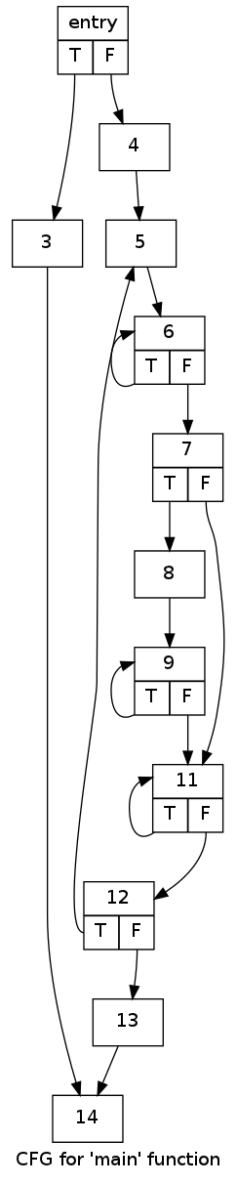
Partitioning & Mapping
[PartitioningPass] PARTITIONING OVERVIEW:
Initial exec time was 1.81e-07 s,
new is 1.06e-07
-- Speedup = 1.71e+00
[PartitionWriterPass] Generating partitioned code
PartitionWriterPass::runOnModule() -- Original functions:
odd with BBs:
entry --> CPU
main with BBs:
entry --> CPU
3 --> CPU
4 --> CPU
beforeHeader --> CPU
5 --> CPU
6 --> CPU
7 --> CPU
8 --> CPU_SIMD
9 --> CPU_SIMD
11 --> CPU_SIMD
12 --> CPU_SIMD
13 --> CPU
14 --> CPU
afterHeader --> CPU
...
Notes:
Usual approach is: 1. partition based on the SW characteristics, 2. map based on HW characteristics.
My approach is to do it altogether.

Slide 10
Outline
Heterogeneous High Performance Computing
Compilation toolchain
Code refactoring for execution in heterogeneous platforms
Notes:
We called it “code generation” before, but it may be confusing since code generation is assumed to be the translation between LLVM IR and native code.

Slide 11
Function-based control flow
BB_A:
...
jmp BB_B
BB_A:
...
call B()
ret
callA:
...
call A()
ret
A()
callA:
...
call A()
ret
BB_B:
...
jne callA, callC
BB_B:
...
jne A, C
B()
callC:
...
call C()
ret
BB_C:
...
BB_C:
...
C()
Notes:
Explain why we use function calls -> because Remote Method Invocation techs. have been widely used to pass control between processing devs. in a distributed system.

Slide 12
Refactoring methodology
duplicate constants
distribute globals
for every original function f
initiatorList ← find initiators(f)
create new functions(f, initiatorList)
fix branches(initiatorList)
fix phi nodes(initiatorList)
Notes:
Current state:
- Globals are kept in the module assigned to the master device, and shared memory is assumed.

Slide 13
Refactoring methodology
duplicate constants
distribute globals
for every original function f
initiatorList ← find initiators(f)
create new functions(f, initiatorList)
fix branches(initiatorList)
fix phi nodes(initiatorList)
Notes:
What an initiator is:
- We want to break a function into pieces.
- An initiator is a BB from the originalo function that will be the entry block of a newly created function.
- The simplest case of initiator takes place when a BB and one of its predecessors are mapped to different devices. A function call is required to pass control between both devices.

Slide 14
Initiator list ← find initiators(f)
Partitioning result
Initiators
Resulting functions
entry
T F
entry
T F
entry
T F
if.end
T F
if.end
T F
if.end
T F
for.cond.preheader
if.then
for.cond.preheader
if.then
for.cond.preheader
if.then
for.cond18.loopexit
for.cond18.loopexit
for.cond18.loopexit
for.body
T F
for.body
T F
for.body
T F
for.body20
T F
for.body20
T F
for.body20
T F
for.end26
for.end26
for.end26
return
return
return

Slide 15
Refactoring methodology
duplicate constants
distribute globals
for every original function f
initiatorList ← find initiators(f)
create new functions(f, initiatorList)
fix branches(initiatorList)
fix phi nodes(initiatorList)
Notes:
Current state:
- Globals are kept in the module assigned to the master device, and shared memory is assumed.

Slide 16
create new functions (f, initiatorList)
MODULE 1
MODULE 2
i32 f(i8* %num)
declare i32 @puts(i8*)
BB_A:
%3 = add i32 %2, 6
jmp BB_B
DEV 1
BB_B:
%4 = mul i32 %3, %3
jne BB_A, BB_C
DEV 2
Declare used functions in the destination module
BB_C:
ret call i32 @puts(%num)
Notes:
BB_B is an initiator.

Slide 17
Splitting functions
MODULE 1
MODULE 2
i32 f(i8* %num)
declare i32 @puts(i8*)
BB_A:
%3 = add i32 %2, 6
jmp BB_B
DEV 1
i32 f2(i8* %arg1, i32 %arg2)
BB_B:
%4 = mul i32 %3, %3
jne BB_A, BB_C
Create new function prototype
DEV 2
BB_C:
ret call i32 @puts(%num)

Slide 18
create new functions (f, initiatorList)
MODULE 1
MODULE 2
i32 f(i8* %num)
declare i32 @puts(i8*)
BB_A:
%3 = add i32 %2, 6
jmp BB_B
i32 f2(i8* %arg1, i32 %arg2)
BB_B:
%4 = mul i32 %3, %3
jne BB_A, BB_C
Move Basic Blocks
BB_C:
ret call i32 @puts(%num)

Slide 19
create new functions (f, initiatorList)
MODULE 1
MODULE 2
i32 f(i8* %num)
declare i32 @puts(i8*)
BB_A:
%3 = add i32 %2, 6
jmp BB_B
i32 f2(i8* %arg1, i32 %arg2)
BB_B:
%4 = mul i32 %arg2, %arg2
jne BB_A, BB_C
Fix argument uses
BB_C:
ret call i32 @puts(%arg1)

Slide 20
Refactoring methodology
duplicate constants
distribute globals
for every original function f
initiatorList ← find initiators(f)
create new functions(f, initiatorList)
fix branches(initiatorList)
fix phi nodes(initiatorList)
Notes:
Current state:
- Globals are kept in the module assigned to the master device, and shared memory is assumed.

Slide 21
fix branches (initiatorList)
MODULE 1
MODULE 2
i32 f(i8* %num)
declare i32 @puts(i8*)
BB_A:
%3 = add i32 %2, 6
%r = call i32 f2(%num, %3)
ret %r
i32 f2(i8* %arg1, i32 %arg2)
BB_B:
%4 = mul i32 %arg2, %arg2
jne fcaller, BB_C
Replace old branches by function calls
BB_C:
ret call i32 @puts(%arg1)
fcaller:
%r = call i32 f(%num, %3)
ret %r
Notes:
This step is the one that switches from a CFG-based control flow into a callgraph-based one.

Slide 22
Refactoring methodology
duplicate constants
distribute globals
for every original function f
initiatorList ← find initiators(f)
create new functions(f, initiatorList)
fix branches(initiatorList)
fix phi nodes(initiatorList)
Notes:
Current state:
- Globals are kept in the module assigned to the master device, and shared memory is assumed.

Slide 23
Loops generate recursive calls
BB_A:
...
jmp BB_B
BB_A:
...
call B()
ret
A()
callA:
...
call A()
ret
BB_B:
...
jne A, C
BB_B:
...
jne callA, callC
B()
callC:
...
call C()
ret
BB_C:
...
BB_C:
...
C()
stack limit
.
.
.
STACK A
vars
ret
vars
ret
vars
ret
vars
ret
vars
ret
vars
.
.
.
STACK B
ret
vars
ret
vars
ret
vars
ret
vars
ret
vars
ret
Notes:
Every time a function is called, new entries are added to the stack for the local variables of the previous function and the return address of the current function.

Slide 24
Fixing loop recursion: a loop pass
preheader:
%cmpRes = alloca i1
store i1 true, i1* %cmpRes
br label %header
header:
%3 = add i32 %2, 6
br label %latch
header:
%cond = load i1* %cmpRes
br i1 %cond, label %postheader, label %”exit”
latch:
%4 = mul i32 %3, %3
%cond = icmp ne %4, 0
br i1 %cond, label %header, label %exit
postheader:
%3 = add i32 %2, 6
jmp label %latch
exit:
ret call i32 @puts(%num)
latch:
%4 = mul i32 %3, %3
%cond = icmp ne %4, 0
store i1 %cond, i1* cmpRes
br label %header
exit:
ret call i32 @puts(%num)
Notes:
Fixing recursion requires two steps. Take a leap of faith and believe me when I denormalize the loop.
First one is to rearrange the loop to ensure that the header and the exiting block are the same BB. It’s done prior to the main code refactoring.
Key is that there is only one BB (the header) that controls the loop: exit and start.

Slide 25
Fixing loop recursion: final code refactoring
preheader:
%cmpRes = alloca i1
store i1 true, i1* %cmpRes
br label %header
f()
preheader:
%cmpRes = alloca i1
store i1 true, i1* %cmpRes
br label %header
header:
%cond = load i1* %cmpRes
br i1 %cond, label %postheader, label %”exit”
header:
%cond = load i1* %cmpRes
br i1 %cond, label %postheader, label %”cal”
postheader:
%3 = add i32 %2, 6
jmp label %latch
postheader:
%3 = add i32 %2, 6
call latch()
br label %header
cal:
call exit()
DEV 1
latch:
%4 = mul i32 %3, %3
%cond = icmp ne %4, 0
store i1 %cond, i1* cmpRes
br label %header
DEV 2
latch()
latch:
%4 = mul i32 %3, %3
%cond = icmp ne %4, 0
store i1 %cond, i1* cmpRes
ret
exit:
ret call i32 @puts(%num)
exit()
exit:
ret call i32 @puts(%num)
Notes:
Second step to fix the recursion is to refactor: this is done as usual, with the exception of the original latch/exiting block. This block now returns instead of calling the header function again → recursion removed!!!

Slide 26
Output from the tool
Time profiling hello.ir
[HPCmap] Parsing module hello.ir...
[ReadArchPass] Parsing architecture ../architectures/CPU_SIMD.arch...
[EstimationPass] Estimating from profiling information...
[PartitioningPass] PARTITIONING OVERVIEW:
[PartitioningPass] Initial exec time was 1.81e-07 s, new is 1.06e-07 -- Speedup = 1.71e+00
[LoopRecursionBreakPass] Analyzing loop 5 <-> 12
[PartitionWriterPass] Generating partitioned code
PartitionWriterPass::runOnModule() -- Original module's functions:
odd with BBs:
entry --> CPU
main with BBs:
entry --> CPU
3 --> CPU
...
PartitionWriterPass::find_initiators() -- Inspecting function main()
Trivial initiators:
5
8
Entry block initiator: entry
Nontrivial initiators:
14
...
PartitionWriterPass::create_new_Fs() -- Splitting up function main
Function main1_CPU inserted in module CPU.part
Moving BB 14 from function main to function main1_CPU
...
PartitionWriterPass::branches_to_fcalls() -- Fixing branches:
to BB entry, moved to function main
to BB 14, moved to function main1_CPU
PartitionWriterPass::fix_initiator_phis() -- Initiators:
main2_CPU::5
2 phis updated
[PartitionWriterPass] Module CPU.part generated
[PartitionWriterPass] Module CPU_SIMD.part generated
Partitioned hello.ir

Slide 27
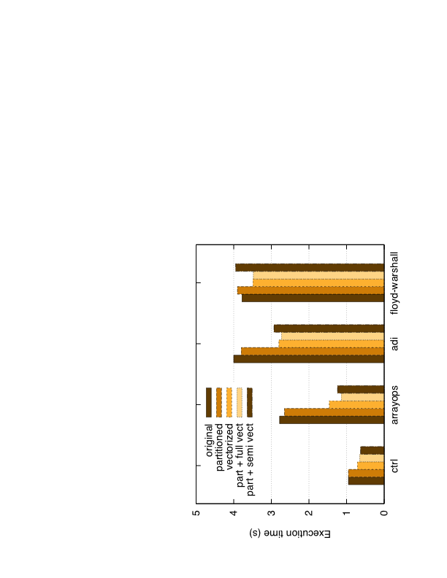
Preliminary results
Notes:
EXPLAIN THE EXPERIMENT
COMMENT BENCHMARKS (loops, vector...)
Performance results are better for the partitioned code than the original:
- Not really executing in different devices.
- Overhead of extra function calls is negligible.
- After detailed inspection of generated assembler: code refactoring enables further optimization of a few loops, possibly related to the fact that many Phis disappear (turned into function parameters).
- Comparing the result of both versions of the partitioned code -> the estimator is not perfect and sends some code that can be vectorized to a device without vectorization support.

Slide 28
Conclusions
Compilation toolchain for heterogeneous architectures
Code refactoring based on splitting functions into smaller ones.
Removed recursion generated by loops being transformed into functions.
The function call approach does not introduce a significant overhead so far.

Slide 29
Work in progress…
IN THE REFACTORING PASS
Execute in a real architecture (one executable per device)
Distributed memory
Automatic communications
IN THE COMPLETE TOOLCHAIN
Identification of parallelism
Data partitioning
Improve estimation, partitioning heuristics, profiling…

Slide 30
Notes:
Thank you all for coming and specially the organizers to let me present my work here.
Now I’ll be glad to answer your questions.

