Slide 1
Custom Hardware State-Machines and Datapaths – Using LLVM to Generate FPGA Accelerators
Alan Baker
Altera Corporation

Slide 2
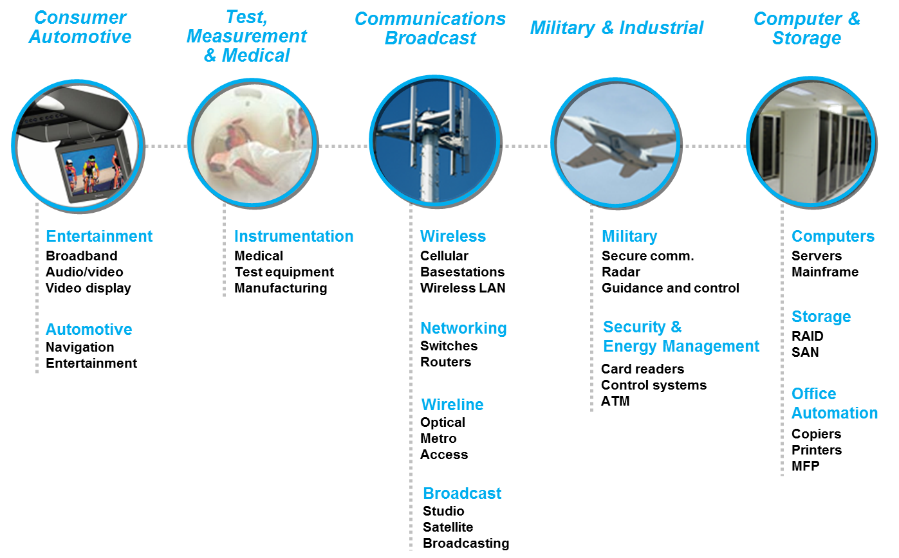
FPGAs are Awesome
Fully Configurable Architecture
Low-Power
Customizable I/O

Slide 3
FPGA Design Hurdles
Traditional FPGA design entry done in hardware description languages (HDL)
e.g. Verilog or VHDL
HDL describe the register transfer level (RTL)
Programmer is responsible for describing all the hardware and its behaviour in every clock cycle
The hardware to describe a relatively small program can take months to implement
Testing is difficult
Far fewer hardware designers than software designers

Slide 4
Simpler Design Entry
Use a higher level of abstraction
Easier to describe an algorithm in C than Verilog
Increases productivity
Simpler to test and verify
Increases the size of the developer pool
Sounds promising, but how can we map a higher level language to an FPGA?

Slide 5
Our Vision
Leverage the software community’s resources
LLVM is a great compiler framework
Mature
Robust
Well architected
Easy to modify and extend
Same IR for different input languages
We modify LLVM to generate Verilog
Implemented a custom backend target

Slide 6


OpenCL
Our higher level language
Hardware agnostic compute language
Invented by Apple
2008 Specification Donated to Khronos Group and Khronos Compute Working Group was formed
What does OpenCL give us?
Industry standard programming model
Aimed at heterogeneous compute acceleration
Functional portability across platforms

Slide 7












OpenCL Conformance
You must pass conformance to claim OpenCL support
Over 8000 tests
Only one FPGA vendor has passed conformance

Slide 8
The BIG Idea behind OpenCL
OpenCL execution model …
Define N-dimensional computation domain
Execute a kernel at each point in computation domain
Traditional loops
Data Parallel OpenCL
void trad_mul(int n,
const float *a, const float *b,
float *c) {
int i;
for (i=0; i<n; i++)
c[i] = a[i] * b[i];
}
kernel void dp_mul(global const float *a,
global const float *b,
global float *c) {
int id = get_global_id(0);
c[id] = a[id] * b[id]; } // execute over “n” work-items
Notes:
8

Slide 9
FPGAs vs CPUs
FPGAs are dramatically different than CPUs
Massive fine-grained parallelism
Complete configurability
Huge internal bandwidth
No callstack
No dynamic memory allocation
Very different instruction costs
No fixed number of program registers
No fixed memory system

Slide 10
Targeting an Architecture
In a CPU, the program is mapped to a fixed architecture
In an FPGA, there is NO fixed architecture
The program defines the architecture
Instead of the architecture constraining the program, the program is constrained by the available resources

Slide 11
Datapath Architecture
FPGA datapath ~ Unrolled CPU hardware

Slide 12
A simple 3-address CPU
LdAddr
LdData
StAddr
PC
Fetch
Load
Store
StData
Instruction
Op
Op
Registers
Aaddr
A
ALU
Val
A
C
Baddr
Caddr
B
CWriteEnable
CData
Op

Slide 13
Load immediate value into register
LdAddr
LdData
StAddr
PC
Fetch
Load
Store
StData
Instruction
Op
Op
Registers
Aaddr
A
ALU
Val
A
C
Baddr
Caddr
B
CWriteEnable
CData
Op

Slide 14
Load memory value into register
LdAddr
LdData
StAddr
PC
Fetch
Load
Store
StData
Instruction
Op
Op
Registers
Aaddr
A
ALU
Val
A
C
Baddr
Caddr
B
CWriteEnable
CData
Op

Slide 15
Store register value into memory
LdAddr
LdData
StAddr
PC
Fetch
Load
Store
StData
Instruction
Op
Op
Registers
Aaddr
A
ALU
Val
A
C
Baddr
Caddr
B
CWriteEnable
CData
Op

Slide 16
Add two registers, store result in register
LdAddr
LdData
StAddr
PC
Fetch
Load
Store
StData
Instruction
Op
Op
Registers
Aaddr
A
ALU
Val
A
C
Baddr
Caddr
B
CWriteEnable
CData
Op

Slide 17
Multiply two registers, store result in register
LdAddr
LdData
StAddr
PC
Fetch
Load
Store
StData
Instruction
Op
Op
Registers
Aaddr
A
ALU
Val
A
C
Baddr
Caddr
B
CWriteEnable
CData
Op

Slide 18
A simple program
Mem[100] += 42 * Mem[101]
CPU instructions:
R0 ← Load Mem[100]
R1 ← Load Mem[101]
R2 ← Load #42
R2 ← Mul R1, R2
R0 ← Add R2, R0
Store R0 → Mem[100]

Slide 19
CPU activity, step by step
R0 ← Load Mem[100]
A
Time
R1 ← Load Mem[101]
A
R2 ← Load #42
A
R2 ← Mul R1, R2
A
R0 ← Add R2, R0
A
Store R0 → Mem[100]
A

Slide 20
Unroll the CPU hardware…
R0 ← Load Mem[100]
Space
A
R1 ← Load Mem[101]
A
R2 ← Load #42
A
R2 ← Mul R1, R2
A
R0 ← Add R2, R0
A
Store R0 → Mem[100]
A

Slide 21
… and specialize by position
R0 ← Load Mem[100]
A
Instructions are fixed. Remove “Fetch”
R1 ← Load Mem[101]
A
R2 ← Load #42
A
R2 ← Mul R1, R2
A
R0 ← Add R2, R0
A
Store R0 → Mem[100]
A

Slide 22
… and specialize
R0 ← Load Mem[100]
A
Instructions are fixed. Remove “Fetch”
Remove unused ALU ops
R1 ← Load Mem[101]
A
R2 ← Load #42
A
R2 ← Mul R1, R2
A
R0 ← Add R2, R0
A
Store R0 → Mem[100]
A

Slide 23
… and specialize
R0 ← Load Mem[100]
A
Instructions are fixed. Remove “Fetch”
Remove unused ALU ops
Remove unused Load / Store
R1 ← Load Mem[101]
A
R2 ← Load #42
A
R2 ← Mul R1, R2
A
R0 ← Add R2, R0
A
Store R0 → Mem[100]
A

Slide 24
… and specialize
R0 ← Load Mem[100]
Instructions are fixed. Remove “Fetch”
Remove unused ALU ops
Remove unused Load / Store
Wire up registers properly! And propagate state.
R1 ← Load Mem[101]
R2 ← Load #42
R2 ← Mul R1, R2
R0 ← Add R2, R0
Store R0 → Mem[100]

Slide 25
… and specialize
Fundamental Datapath
R0 ← Load Mem[100]
Instructions are fixed. Remove “Fetch”
Remove unused ALU ops
Remove unused Load / Store
Wire up registers properly! And propagate state.
Remove dead data.
R1 ← Load Mem[101]
Instead of a register file, live data is carried through register stages like a pipelined CPU instruction
Live ranges define the amount of data carried at each register stage
R2 ← Load #42
R2 ← Mul R1, R2
R0 ← Add R2, R0
Store R0 → Mem[100]

Slide 26
Optimize the Datapath
R0 ← Load Mem[100]
Instructions are fixed. Remove “Fetch”
Remove unused ALU ops
Remove unused Load / Store
Wire up registers properly! And propagate state.
Remove dead data.
Reschedule!
R1 ← Load Mem[101]
R2 ← Load #42
R2 ← Mul R1, R2
R0 ← Add R2, R0
Store R0 → Mem[100]

Slide 27
FPGA datapath = Your algorithm, in silicon
Load
Load
42
Store

Slide 28
Data parallel kernel
__kernel void
sum(__global const float *a,
__global const float *b,
__global float *answer)
{
int xid = get_global_id(0);
answer[xid] = a[xid] + b[xid];
}
float *a =
0
1
2
3
4
5
6
7
float *b =
7
6
5
4
3
2
1
0
__kernel void sum( … );
float *answer =
7
7
7
7
7
7
7
7

Slide 29
Example Datapath for Vector Add
8 work items for vector add example
0
1
2
3
4
5
6
7
Load
Load
Work item IDs
+
On each cycle the portions of the datapath are processing different threads
While thread 2 is being loaded, thread 1 is being added, and thread 0 is being stored
Store

Slide 30
Example Datapath for Vector Add
8 work items for vector add example
1
2
3
4
5
6
7
0
Load
Load
Work item IDs
+
On each cycle the portions of the datapath are processing different threads
While thread 2 is being loaded, thread 1 is being added, and thread 0 is being stored
Store

Slide 31
Example Datapath for Vector Add
8 work items for vector add example
2
3
4
5
6
7
1
Load
Load
0
Work item IDs
+
On each cycle the portions of the datapath are processing different threads
While thread 2 is being loaded, thread 1 is being added, and thread 0 is being stored
Store

Slide 32
Example Datapath for Vector Add
8 work items for vector add example
3
4
5
6
7
Load
2
Load
1
Work item IDs
+
On each cycle the portions of the datapath are processing different threads
While thread 2 is being loaded, thread 1 is being added, and thread 0 is being stored
0
Store

Slide 33
Example Datapath for Vector Add
8 work items for vector add example
4
5
6
7
Load
3
Load
2
Work item IDs
+
On each cycle the portions of the datapath are processing different threads
While thread 2 is being loaded, thread 1 is being added, and thread 0 is being stored
1
Store
0
Silicon used efficiently at steady-state

Slide 34
High Level Datapath Generation
Compiler Flow

Slide 35
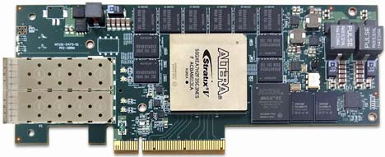

Compiler Flow
Source Code
FPGA Programming File
Altera Offline Compiler
kernel void
sum(global float *a,
global float *b,
global float *c)
{
int gid = get_global_id(0);
c[gid] = a[gid] + b[gid];
}
AOC
Verilog Design File
LLC
Clang
LLC
Clang
OPT
OPT
LLVM IR is used to describe a custom architecture specific to the program
Frontend
Parses OpenCL extensions and intrinsics to produce LLVM IR
Middle end
Clang –O3 optimizations followed by numerous custom passes to target the FPGA architecture
Backend
Creates and schedules an elastic pipelined datapath and produces Verilog HDL

Slide 36
Dealing with Resource Constraints
Branch Conversion

Slide 37
Branch Conversion Example
Branch
A: True
B: False
C

Slide 38
Branch Conversion Example
Determine control flow to conditionally executed basic blocks
Branch
A: True
B: False
C

Slide 39
Branch Conversion Example
Determine control flow to conditionally executed basic blocks
Predicate instructions
A is predicated if the branch was false and vice-versa
Branch
A: True
B: False
C

Slide 40
Branch Conversion Example
Determine control flow to conditionally executed basic blocks
Predicate instructions
A is predicated if the branch was false and vice-versa
Combine A and B
Branch is now unconditional
PHIs in C become select instructions
Branch
A/B
C

Slide 41
Branch Conversion Example
Determine control flow to conditionally executed basic blocks
Predicate instructions
A is predicated if the branch was false and vice-versa
Combine A and B
Branch is now unconditional
PHIs in C become select instructions
Simplify the CFG
Merges remaining blocks
All
Logic

Slide 42
Branch Conversion
Squeezes the majority of the CFG into one basic block
Saves significant amounts of area
Increased instruction count in the basic block does not adversely affect performance

Slide 43
Improving Performance of Individual Threads
Loop Pipelining

Slide 44
OpenCL Task
__kernel void
accumulate(__global float *a,
__global float *b,
int n)
{
for (int i=1; i<n; ++i)
b[i] = b[i-1] + a[i];
}
Kernel operates on a single thread
Data for each iteration depends on the previous iteration
Loop carried dependency bottlenecks performance

Slide 45
Loop Carried Dependencies
Loop-carried dependency: one iteration of the loop depends upon the results of another iteration of the loop
The value of state in iteration 1 depends on the value from iteration 0
Similarly, iteration 2 depends on the value from iteration 1, etc
kernel void state_machine(ulong n)
{
t_state_vector state = initial_state();
for (ulong i=0; i<n; i++) {
state = next_state( state );
unit y = process( state );
// more work…
}
}

Slide 46
Loop Carried Dependencies
To achieve acceleration, we can pipeline each iteration of a loop containing loop carried dependencies
Analyze any dependencies between iterations
Schedule these operations
Launch the next iteration as soon as possible
kernel void state_machine(ulong n)
{
t_state_vector state = initial_state();
for (ulong i=0; i<n; i++) {
state = next_state( state );
unit y = process( state );
// more work…
}
}
At this point, we can launch the next iteration

Slide 47
Loop Pipelining Example
No Loop Pipelining
With Loop Pipelining
i0
i0
i1
i2
i1
i3
Looks almost like ND-range thread execution!
Clock Cycles
Clock Cycles
i4
i2
Finishes Faster because Iterations
Are Overlapped
No Overlap of Iterations

Slide 48
Pipelined Threads vs. Loop Pipelining
So what’s the difference?
Loop Pipelining enables Pipeline Parallelism AND the communication of state information between iterations.
t0
i0
Loop dependencies may not be resolved in 1 clock cycle
t1
Pipelined threads launch 1 thread per clock cycle in pipelined fashion
i1
t2
i2
t3
i3
t4
i4
Pipelined Threads
Loop Pipelining

Slide 49
Accumulator Datapath
__kernel void
accumulate(__global float *a,
__global float *b,
int n)
{
for (int i=1; i<n; ++i)
b[i] = b[i-1] + a[i];
}
Load
+
Store
A new iteration can be launched each cycle
Each iteration still takes multiple cycles to complete, but subsequent iterations are not bottlenecked

Slide 50
Accumulator Datapath
__kernel void
accumulate(__global float *a,
__global float *b,
int n)
{
for (int i=1; i<n; ++i)
b[i] = b[i-1] + a[i];
}
i=0
Load
+
Store
A new iteration can be launched each cycle
Each iteration still takes multiple cycles to complete, but subsequent iterations are bottlenecked

Slide 51
Accumulator Datapath
__kernel void
accumulate(__global float *a,
__global float *b,
int n)
{
for (int i=1; i<n; ++i)
b[i] = b[i-1] + a[i];
}
i=1
Load
i=0
+
Store
A new iteration can be launched each cycle
Each iteration still takes multiple cycles to complete, but subsequent iterations are bottlenecked

Slide 52
Accumulator Datapath
__kernel void
accumulate(__global float *a,
__global float *b,
int n)
{
for (int i=1; i<n; ++i)
b[i] = b[i-1] + a[i];
}
i=2
Load
i=1
+
i=0
Store
A new iteration can be launched each cycle
Each iteration still takes multiple cycles to complete, but subsequent iterations are bottlenecked

Slide 53
Dependence Analysis
Has profound effect on Loop Pipelining
Can lead to difference in performance of more than 100x
Significant effort spent to improve dependence analysis
Especially loop-carried dependence analysis
Added complex range analysis to help
Uses knowledge of our specialized hardware and programming model
Never good enough!

Slide 54
LLVM Issues/Wishlist

Slide 55
LLVM Issues
Intrinsics don’t support structs
We extended CallInst for our intrinsics
Module pass managers running every analysis on every function when only requesting a single function
On-the-fly pass manager not inheriting analyses
Ran into several scaling problems with LLVM passes
Often due to significant loop unrolling and inlining
Loop representation
Well formed loops are extremely important to us
Some optimizations introduce extra loops
while(1) with no return is useful to us

Slide 56
LLVM Wishlist
Conditional preservation of analyses
Windows debug support
Improved dependence analysis

Slide 58
References
Altera OpenCL Example Designs
http://www.altera.com/support/examples/opencl/opencl.html
Altera OpenCL Best Practices Guide
http://www.altera.com/literature/hb/opencl-sdk/aocl_optimization_guide.pdf
Stratix V Overview
http://www.altera.com/devices/fpga/stratix-fpgas/stratix-v/stxv-index.jsp
Cyclone V Overview
http://www.altera.com/devices/fpga/cyclone-v-fpgas/cyv-index.jsp
Stratix V ALM
www.altera.com/literature/hb/stratix-v/stx5_51002.pdf

