Slide 1
LLILC: LLVM as a code generator for the CoreCLR
With a particular emphasis on GC
Andy Ayers
Microsoft

Slide 2
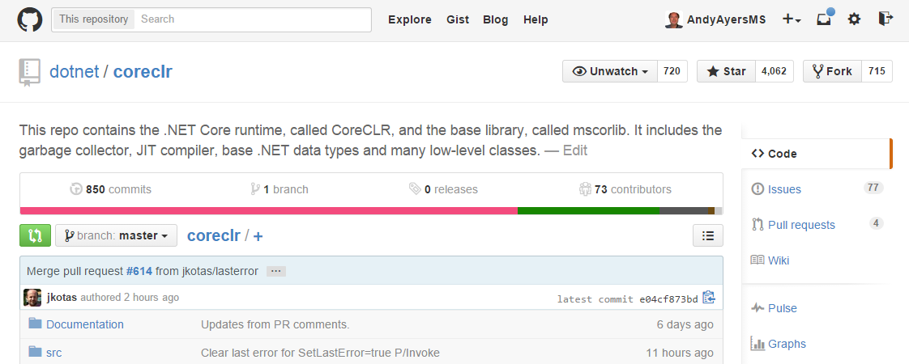
The CoreCLR
https://github.com/dotnet/coreclr
Open-source, cross platform capable version of the CLR
Supports the “Portable API” surface for .Net frameworks

Slide 3
Codegen in the CoreCLR
All methods jit compiled by default (no interpreter)
Single-tier “RyuJit” comes with CoreCLR
Pluggable Jit architecture allows for experimentation (aka “alt jit”)
Install-time codegen possible via NGEN/Crossgen
There’s an interface between the JIT and the VM, but
Jit must know intimate details of many runtime features
In particular, GC and EH
This talk will focus largely on the implications of the GC

Slide 4
LLVM
Suspect you all know what this is...
Capable, cross-platform compiler and tools framework
Supports various Jitting approaches, eg MCJIT

Slide 5
Introducing LLILC
LLVM IL Compiler: An open-source, cross-platform capable code generator for the CoreCLR based on LLVM
https://github.com/dotnet/llilc
Aka “lilac”
Initial focus is on building an alternate JIT

Slide 6
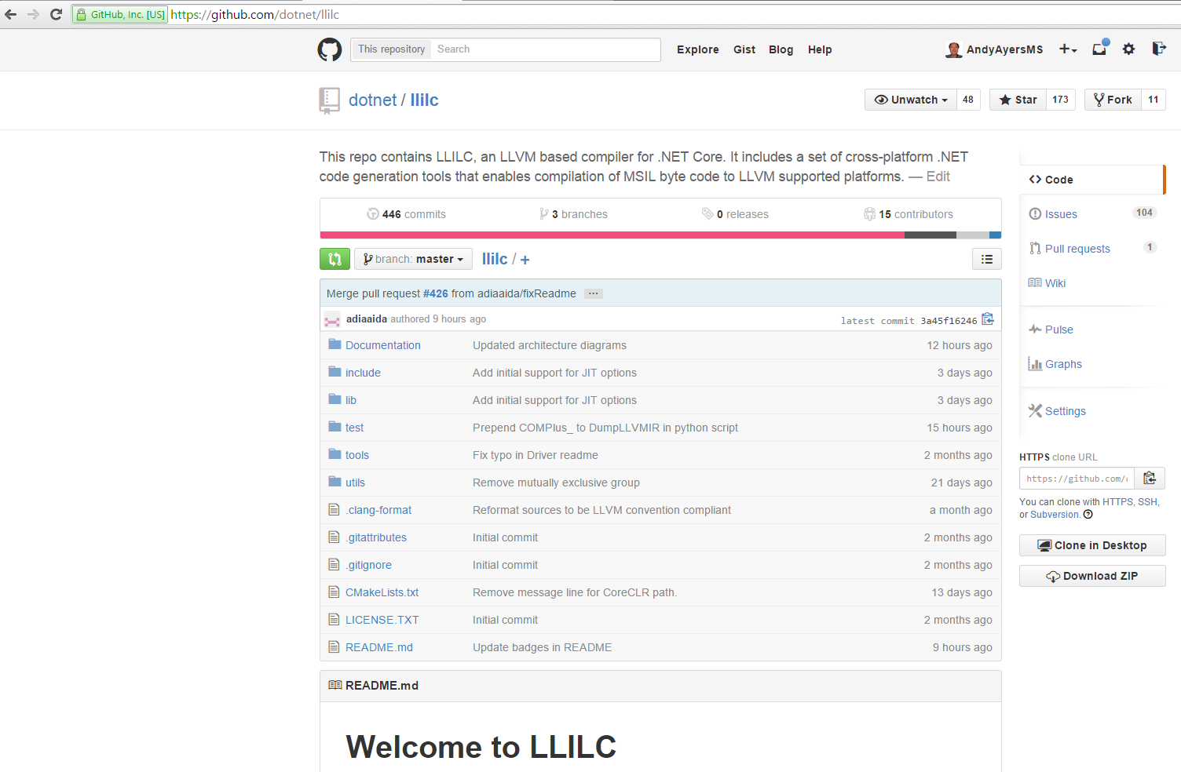

Slide 7
LLILC Implementation
Currently using MCJIT
For Windows, we added some basic COFF support to RTDlyLd
CoreCLR handles all external symbol resolution for the JIT
At some point we’ll have to introduce a new runtime target since we don’t have a CRT to fall back on
JIT is multithreaded, all threads are independent of one another
Using sys::ThreadLocal<T> to have per-thread LLVM context, etc
Modelling CLR types as llvm types, hitting various complications
Unions, unsigned types, padding,

Slide 8
Sample MSIL -> LLVM IR Translation
static bool IsNullOrEmpty(String value) { return (value == null || value.Length == 0); }
define i8 @String.IsNullOrEmpty(%System.String addrspace(1)* %param0) {
entry:
%arg0 = alloca %System.String addrspace(1)*
store %System.String addrspace(1)* %param0, %System.String addrspace(1)** %arg0
%0 = load %System.String addrspace(1)*, %System.String addrspace(1)** %arg0
%1 = icmp eq %System.String addrspace(1)* %0, null
br i1 %1, label %10, label %2
; <label>:2 ; preds = %entry
%3 = load %System.String addrspace(1)*, %System.String addrspace(1)** %arg0
%NullCheck = icmp eq %System.String addrspace(1)* %3, null
br i1 %NullCheck, label %ThrowNullRef, label %4
; <label>:4 ; preds = %2
%5 = getelementptr inbounds %System.String, %System.String addrspace(1)* %3, i32 0, i32 1
%6 = load i32, i32 addrspace(1)* %5
%7 = icmp eq i32 %6, 0
%8 = sext i1 %7 to i32
%9 = trunc i32 %8 to i8
ret i8 %9
; <label>:10 ; preds = %entry
ret i8 1
ThrowNullRef: ; preds = %2
call void inttoptr (i64 NORMALIZED_ADDRESS to void ()*)() #0
unreachable
}

Slide 9
CoreCLR GC
CoreCLR's GC
generational
fully relocating
precise
stop-the-world
supports weak, pinning and interior pointers (no “exterior” pointers)
code may be required to be fully interruptible or may be partially interruptible
CoreCLR GC also supports a conservative mode which greatly simplifies the obligations of a code generator.

Slide 10
Requirements for Code Generation
Generational
JIT must insert write barriers for most stores of GC references
Fully relocating
JIT must anticipate that GC references may change at GC safepoints
Precise
JIT must precisely report the set of stack locations and registers that contain GC references at each GC safepoint
JIT must not have GC references in callee save registers across native (aka pinvoke) calls that are GC safepoints
JIT must sometimes keep on-stack GC references live even if there are no explicit uses in the code
JIT may have “untracked” references (live at every safepoint) that are reported just once per method
Object, Interior, and pinned references
JIT must describe which type of GC reference exists in each reported location
JIT must ensure that each reported location contains a valid reference
No “exterior” references
JIT must ensure that at each safepoint, each reported reference falls within the object being referenced
Stop-the-world
JIT must ensure that a GC safepoint is reached by each thread with sufficient frequency

Slide 11
LLVM Support for GC
GCRoot
Essentially allow for “untracked” reporting.
Some stack slots are considered to hold GC references and those values are reported live at each safepoint.
Statepoints
Allows for “tracked” reporting. Set of GC references to report is customized at each safepoint via SSA variables.
This gives us most of what we’ll need, and we’re going to build upon it
Currently using addrspace(1) to tag GC references
Statepoint insertion: liveness determines what references are live to each call

Slide 12
Statepoint example
.method public hidebysig static int32 Main() cil managed { IL_0000: ldsfld class Program.Num Program.Test::A IL_0005: ldc.i4.2 IL_0006: callvirt instance int32 Program.Num::Add(int32) IL_000b: ret }
define i32 @Program.Test.Main() gc "CoreCLR" { entry: br label %0 ; <label>:0 ; preds = %entry call void inttoptr InitClass(Program.Test, 2) %1 = load %Program.Num addrspace(1)*, ... %NullCheck = icmp eq %Program.Num addrspace(1)* %1, null br i1 %NullCheck, label %ThrowNullRef, label %2 ; <label>:2 ; preds = %0 %3 = call i32 Add(Program.Num addrspace(1)* %1, i32 2) ret i32 %3
ThrowNullRef: ; preds = %0 call void ThrowNullRef()
unreachable
}
Statepoint insertion computes live set of GC refs at each call. Rewrites the call to a statepoint intrinsic that calls the original method and takes the GC refs as extra args.
Return value and updated GC refs produced as result.

Slide 13
Statepoint Example (con’t)
; <label>:2 ; preds = %.split %safepoint_token2 = call i32 (i32 (%Program.Num addrspace(1)*, i32)*, i32, i32, ...)* @llvm.experimental.gc.statepoint.p0f_i32p1Program.Numi32f (i32 (%Program.Num addrspace(1)*, i32)* Add, i32 2, i32 0, %Program.Num addrspace(1)* %1, i32 2, i32 0, %Program.Num addrspace(1)* %1) %3 = call i32 @llvm.experimental.gc.result.i32(i32 %safepoint_token2) ret i32 %3
The first %1 is the call argument this pointer; the second is the GC reference live into the call.
Then a rewriting pass makes the potential GC update of %1 explicit. Any downstream uses of %1 will now use %3 instead.
; <label>:2 ; preds = %.split %safepoint_token2 = call i32 (i32 (%Program.Num addrspace(1)*, i32)*, i32, i32, ...)* @llvm.experimental.gc.statepoint.p0f_i32p1Program.Numi32f (i32 (%Program.Num addrspace(1)*, i32)* Add, i32 2, i32 0, %Program.Num addrspace(1)* %1, i32 2, i32 0, %Program.Num addrspace(1)* %1) %3 = call coldcc %Program.Num addrspace(1)* @llvm.experimental.gc.relocate.p1Program.Num(i32 %safepoint_token2, i32 6, i32 6) %4 = call i32 @llvm.experimental.gc.result.i32(i32 %safepoint_token2) ret i32 %4

Slide 14
Correctness Challenges (Overview)
GC references from unenregisterable value types
Reporting GC reference kinds (interior, pinned, this)
Ensuring there are no exterior references
Ensuring the live reference set stays accurate
Honoring semantics of pinning
Fully interruptible reporting
Keeping certain special locals live and reported to GC
Interaction of GC and EH (funclets, etc)
Ensure all callee saves are spilled at Pinvoke points
Ensure all spilled callee saves are restored
Ensure all reported slots contain valid references
Ensure GC safepoints are hit frequently enough (GC polls in loops)

Slide 15
Callee-Save Spills and Restores
If a callee save is spilled to the stack across a safepoint, the callee save must be restored from the stack. Consider...
spill RBX
br i1 %p, label %1, label %2
;<label>:1
...modify RBX
br label %3
;<label>:2
call[safepoint] f()
br label %3
;<label>:3
restore RBX
ret
spill RBX
br i1 %p, label %1, label %2
;<label>:1
...modify RBX
restore RBX
ret
;<label>:2
call[safepoint] f() // GC might modify spilled RBX
restore RBX // this restore is not redundant
ret
Tail Duplicate

Slide 16
Pinning
Pinning (‘fixed’ in C#) is used to temporarily stop an object from being relocated by GC, typically so the object can be operated on by non-GC aware code. The result of a pin is a native pointer.
Point pt = new Point();
fixed (int* p = &pt.x) {
// pt will not be relocated while control is in this scope
}
Pinned pointers must be reported live and pinned for at least the duration of the pin. If a pinned pointer is copied, at least one of the references must be reported as pinned at each safepoint in the pinned range.

Slide 17
Pinning, con’t
Problem: uses of the pinned objects aren't data-dependent on them
pinnedLocal.mp = ...
otherLocal.up = convert pinnedLocal.mp
... uses of otherLocal.up ...
pinnedLocal.mp = null
The constraint is something like: given any use that is transitively data-dependent on otherLocal (with maybe a special case to break out if otherLocal gets converted back to a reported pointer), if that use gets moved passed a store to pinnedLocal then it can't further get moved past a safepoint

Slide 18
Performance Challenges (Overview)
Use untracked reporting to help manage time/space overhead of GC reporting
Enregistration of GC references across calls
But not pinvoke calls
Stack-pack (color) conflicting GC reference locals together so they can be efficiently zeroed when necessary
Stack-pack non-conflicting GC references together
Defer/shrink-wrap GC reference initialization/nulling
Defer/shrink-wrap callee save spills
Ensure nulling writes aren’t optimized away as dead stores
Model side-effecting calls that can’t cause GCs
Don’t report null pointers as live
Optimize write barriers
Minimize impact of safepoint insertion on optimization

Slide 19
Safepoint Placement
Want to place safepoints early to lock in semantics and minimize the likelihood that some optimization breaks GC reporting
Want to place safepoints late to give maximum ability to optimize
Want to place safepoints in-between when optimizations need to take safepoints into account.
For now we’re placing them early, once we are confident GC is correctly reported, we’ll start looking at alternatives.

Slide 20
Optimizing Write Barriers
Remove unnecessary write barriers - for instance, no barriers are necessary on newly created objects that haven't crossed a safepoint. Note this will entail code-motion restrictions; a store with an elided barrier cannot cross a safepoint.
Write barrier calls may be inlined or tailored to mesh with the allocator's needs. The actual barrier typically has fairly low register cross section, so customizing its register usage during register allocation is appealing. If the barrier is inlined, special care must be taken to prevent subsequent code motion.
Merge barriers - the underlying GC may track suspect regions of older generations at page or larger granularity, so stores to contiguous or locally dense regions may be handled with a single write barrier. This can be especially useful in copy loops. No safepoint can appear between the actual writes and the ultimate reporting barrier.
Storing null to a location may not require a write barrier.
Defer lowering of stores requiring write barriers into helper calls so that upstream optimizations can deal with them more or less as normal stores.

Slide 21
Observations on LLVM
In general it’s been great to work with
No codegen bugs found so far. All bugs are our own doing.
Insertion point management has probably been the biggest pain
Things we’ve missed from other compilers
Ability to model semantically meaningful machine exceptions
Memory SSA
Explicit alias dependence in the IR
Explicitly tracked pointer kinds (managed, interior, etc)
Easy ability to defer lowering of runtime abstractions
Write barriers, virtual calls, type tests, etc

Slide 22
Current Status
LLILC is open for business, and we welcome collaborators
https://github.com/dotnet/llilc
Able to handle around 95% of all methods in simple tests. CoreCLR allows LLILC to bail out and let the real jit handle the method so we can do incremental bring-up.
GC in conservative mode during bring-up, working on implementing precise reporting. Should have it in place relatively soon.
EH not handled yet
LLILC also building and working for Linux x64

Slide 23
Possible Future Topics
How we’re handling EH
CLR semantics are that MSIL opcodes can cause exceptions. Many of these naturally map to machine instructions, eg ldlen.
Right now we insert explicit checks & calls to throw helpers (see NullRef example earlier).
What needs to be done to get truly performant managed code
GC is an important part of the perf story, but not the only part
Check optimization (null, bounds, checked math, etc) is vital, especially with “precise” EH reporting per .Net standard
Lots of “managed idioms” to handle
High-level type-based optimizations (CoreCLR is type safe)
Lots of cleverness around generics
What a true ahead-of-time (AOT) system might look like

Slide 24
Questions...?

