Slide 1
Causes of Performance Swings Due to Code Placement in IA
Zia Ansari
zia.ansari@intel.com
Intel Corporation
11/03/16

Slide 2
Agenda
The purpose of this presentation
Intel Architecture FE 101
Let’s look at some example
So can we do anything about all this?
Conclusion / Future work

Slide 3
Purpose of This Presentation
Performance swings not immediately apparent at a high level
Are my changes “good”?
Performance doesn’t match expectations
Performance neutral changes caused swings
Help when performance results lie to you
Evaluation through micro-benchmarking
Wrong decisions are made
Notes:
Introduction to some of the lower level architectural reasons for performance swings not immediately apparent at a high level in the software.
Important for various reasons, one of which is as a means to determine if you changes are good

Slide 4
Purpose of This Presentation
Important to having a better understanding of the architecture
Make better optimization decisions
Save time on analysis
May not be able to resolve all the issues, but useful to at least understand
Notes:
Better understanding of architecture
exposure to some examples that cause these performance swings
Give new perspective to looking at performance outside of just looking at instructions.

Slide 5
IA Front End 101
Older Gen Intel Architectures VS. Newer Gen Intel Architectures

Slide 6
Core / NHM / Atom
16Bytes
Instructions
Decoder
uops
……..
execute
16Bytes
Instructions
uops
16Bytes
Instructions
LSD

Slide 7
IVB / SNB / HSW / SKL*
16Bytes
Instructions*
uops
uops
Decoder
DSB
……..
execute
16Bytes
Instructions*
uops
16Bytes
Instructions*
LSD

Slide 8
Let’s Look At Some Examples
Core / NHM / Atom decoder alignment
DSB Throughput Alignment
DSB Thrashing Alignment
BPU Alignment

Slide 9
Aligning for 16B Fetch Lines
40049e: mov 0x600be0(%rax),%ecx
4004a4: mov 0x600a40(%rax),%edx
4004aa: add %ecx,%edx
4004ac: lea (%rdx,%rcx,1),%esi
4004af: sub $0xa,%ecx
4004b2: mov %edx,0x6008a0(%rax)
4004b8: mov %ecx,0x600be0(%rax)
4004be: mov %esi,0x600a40(%rax)
4004c4: sub %ecx,%esi
4004c6: add $0x4,%rax
4004ca: lea (%rsi,%rdx,1),%edx
4004cd: add %edx,%edi
4004cf: cmp $0x100,%rax
4004d5: jne 40049e
400497: mov 0x600be0(%rax),%ecx
40049d: mov 0x600a40(%rax),%edx
4004a3: add %ecx,%edx
4004a5: lea (%rdx,%rcx,1),%esi
4004a8: sub $0xa,%ecx
4004ab: mov %edx,0x6008a0(%rax)
4004b1: mov %ecx,0x600be0(%rax)
4004b7: mov %esi,0x600a40(%rax)
4004bd: sub %ecx,%esi
4004bf: add $0x4,%rax
4004c3: lea (%rsi,%rdx,1),%edx
4004c6: add %edx,%edi
4004c8: cmp $0x100,%rax
4004ce: jne 400497 <main+0x17>
for (ii=0;ii<64;ii++) {
a[ii] = b[ii] + c[ii];
b[ii] = c[ii] + a[ii];
c[ii] = c[ii] - 10;
total += a[ii] + b[ii] - c[ii];
}
400490
4004a0
4004b0
4004c0
4004d0
 |  |  |  |  |  |  |  |  |  |  |  |  |  | X | X
X | X | X | X | X | X | X | X | X | X | X | X | X | X | X | X
X | X | X | X | X | X | X | X | X | X | X | X | X | X | X | X
X | X | X | X | X | X | X | X | X | X | X | X | X | X | X | X
X | X | X | X | X | X | X
20% Speedup (NHM)
Notes:
Pull back vs push forward

Slide 10
… but wait
for (ii=0;ii<64;ii++) {
for (ii=0;ii<65;ii++) {
a[ii] = b[ii] + c[ii];
b[ii] = c[ii] + a[ii];
c[ii] = c[ii] - 10;
total += a[ii] + b[ii] - c[ii];
}
Aligned case 9% slower
Misaligned case on par with aligned case
Why?
LSD firing, delivering uops from cache
Speeds up FE, but costs mispredict
As iterations go up, penalty lessens, and alignment doesn’t matter anymore.

Slide 11
Why not just always align?
Costs code size
Can cost performance if executed
With branches, becomes a gamble
4 16B chunks -> 5 16B chunks
~80% Slowdown on Core/NHM
400900 |  |  |  |  |  |  |  |  |  |  | CMP | CMP | CMP | JNE | JNE
400910
400920
400930
400940 | ADD | ADD | ADD | ADD | MOV | MOV | MOV | CMP | CMP | CMP | JNE | JNE
400950
400960
400970 | ADD | ADD | ADD | ADD | ADD | ADD | ADD | ADD | ADD | ADD | ADD | ADD | ADD | ADD | ADD | CMP
400980 | CMP | CMP | CMP | CMP | CMP | CMP | JL | JL
400900 | CMP | CMP | CMP | JNE | JNE
400910
400920
400930 |  |  |  |  |  |  | ADD | ADD | ADD | ADD | MOV | MOV | MOV | CMP | CMP | CMP
400940 | JNE | JNE
400950
400960 |  |  |  |  |  |  | ADD | ADD | ADD | ADD | ADD | ADD | ADD | ADD | ADD | ADD
400970 | ADD | ADD | ADD | ADD | ADD | CMP | CMP | CMP | CMP | CMP | CMP | CMP | JL | JL
400980
Notes:
Maybe include GCC example
Hard to see what’s happening when the second block shows up.. Separate or remove first after second shows up.

Slide 12
Breaking the Instruction Bottleneck
- Fetching 16B of instructions at a time can be limiting
movups 0x80(%r15,%rax,8),%xmm0 : 9 Bytes!
Decoder restrictions, power, etc...
LSD helps by replaying uops, but is very limited
Has a small window of instructions, within a loop only
Assumes “endless loop” (no prediction)
Ideally, we’d like to cache arbitrary uops for replay
Decoded Stream Buffer (DSB)

Slide 13

Decoded Stream Buffer (DSB)
DSB is a cache for uops that have been decoded.
Extends the FE window to 32B to increase throughput.
Saves power and lowers mispredict costs.
32 sets
6 uops / way
8 ways / set
1
2
3
4
..
..
31
32
1
1 | 2 | 3 | 4 | 5 | 6
2
Uops in way must be in 32B aligned window
Only 3 ways per 32B windows
Only 2 JCC per way
JMP will always end a way
Entry to DSB only through branch
Expensive to exit/enter frequently
LSD requires all uops to be in DSB
8
Notes:
What if instructions split? Add it?

Slide 14
Aligning for 32B DSB Lines
for (i = 0; i < n; i++) {
for (ii = 0; ii < m; ii++) {
if (ii == 0) {
x++;
}
if (ii > 0) {
x+=2;
}
}
}
4004b6: test %esi,%esi
4004b8: jle 4004ca
4004ba: xor %eax,%eax
4004bc: test %eax,%eax
4004be: je 4004da
4004c0: add $0x2,%edx
4004c3: add $0x1,%eax
4004c6: cmp %esi,%eax
4004c8: jne 4004bc
4004ca: add $0x1,%ecx
4004cd: cmp %edi,%ecx
4004cf: jne 4004b6
4004c6: test %esi,%esi
4004c8: jle 4004da
4004ca: xor %eax,%eax
4004cc: test %eax,%eax
4004ce: je 4004ea
4004d0: add $0x2,%edx
4004d3: add $0x1,%eax
4004d6: cmp %esi,%eax
4004d8: jne 4004cc
4004da: add $0x1,%ecx
4004dd: cmp %edi,%ecx
4004df: jne 4004c6
4004a0
4004b0
4004c0
4004d0
 |  |  |  |  |  | X | X | X | X | X | X | X | X | X | X
X | X | X | X | X | X | X | X | X | X | X | X | X | X | X | X
X
4004b0
4004c0
4004d0
4004e0
 |  |  |  |  |  | X | X | X | X | X | X | X | X | X | X
X | X | X | X | X | X | X | X | X | X | X | X | X | X | X | X
X
30%
Speedup
SNB/IVB/HSW
Notes:
Arrows confusing… remove head on first arrow? Anything to clear it up.

Slide 15
DSB Thrashing
……
80483f9: inc %eax
80483fa: mov (%edx,%ecx,4),%esi
80483fd: inc %ecx
80483fe: cmp $0x4,%esi
8048401: ja 80483fa
8048403: jmp *0x804854c(,%esi,4)
804840a: dec %eax
804840b: jmp 80483fa
804840d: add %eax,%eax
804840f: jmp 80483fa
8048411: mov %eax,%esi
8048413: sar $0x10,%eax
8048416: shl $0x10,%esi
8048419: or %esi,%eax
804841b: jmp 80483fa
……
804840f: inc %eax
8048410: mov (%edx,%ecx,4),%esi
8048413: inc %ecx
8048414: cmp $0x4,%esi
8048417: ja 80483fa
8048419: jmp *0x804854c(,%esi,4)
8048420: dec %eax
8048421: jmp 80483fa
8048423: add %eax,%eax
8048425: jmp 80483fa
8048427: mov %eax,%esi
8048429: sar $0x10,%eax
804842c: shl $0x10,%esi
804842f: or %esi,%eax
8048431: jmp 80483fa
int foo(int *DATA, int n)
{
int i = 0;
int result = 0;
while (1) {
switch (DATA[i++]) {
case 0: return result;
case 1: result++; break;
case 2: result--; break;
case 3: result <<=1; break;
case 4: result = (result << 16) |
(result >> 16); break;
}
}
}
PR5615
Uops in way must be in 32B aligned window
JMP will always end a way
Only 3 ways per 32B windows
Only 2 JCC per way
Entry to DSB only through branch
LSD requires all uops to be in DSB
Expensive to exit/enter frequently
DSB2MITE_SWITCHES.COUNT
312M vs 37M
LSD.CYCLES_ACTIVE
32K vs 1B
30% Speedup SNB/IVB/HSW

Slide 16
Teaser . . .
8048452: inc %eax
8048453: mov (%edx,%ecx,4),%esi
8048456: inc %ecx
8048457: cmp $0x4,%esi
804845a: ja 8048453
804845c: jmp *0x804851c(,%esi,4)
8048463: dec %eax
8048464: jmp 8048453
8048466: add %eax,%eax
8048468: jmp 8048453
804846a: mov %eax,%esi
804846c: sar $0x10,%eax
804846f: shl $0x10,%esi
8048472: or %esi,%eax
8048474: jmp 8048453
Exact same code
Different alignment
> 5x slower

Slide 17
Aligning for Branch Prediction
int foo(int i, int m, int p, int q, int *p1, int *p2)
{
if (i+*p1 == p || i == q || i-*p2 > m) {
y++;
x++;
if (i == q) {
x += y;
}
}
return 0;
}
400500: mov (%r8),%eax
400503: add %edi,%eax
400505: cmp %edx,%eax
400507: jne 40054b
40050d: mov 0x200b25(%rip),%eax
400513: inc %eax
400515: mov %eax,0x200b1d(%rip)
40051b: mov 0x200b13(%rip),%edx
400521: inc %edx
400523: mov %edx,0x200b0b(%rip)
400529: cmp %ecx,%edi
40052b: jne 400560
400531: add %edx,%eax
400533: mov %eax,0x200afb(%rip)
400539: jmpq 400560
BR_MISP_RETIRED.ALL_BRANCHES
300M vs 150M
40054b: cmp %ecx,%edi
40054d: je 40050d
400553: mov %edi,%eax
400555: sub (%r9),%eax
400558: cmp %esi,%eax
40055a: jg 40050d
400560: xor %eax, %eax
40054b: nop
40054c: cmp %ecx,%edi
40054e: je 40050d
400554: mov %edi,%eax
400556: sub (%r9),%eax
400559: cmp %esi,%eax
40055b: jg 40050d
400561: xor %eax, %eax
30%
Speedup
SNB/IVB/HSW

Slide 18
Identifying Potential Issues
Understand the architecture / Read the optimization manual
If your perf swings “don’t make sense”
Compare before / after hardware counters
Branch mispredicts
Delivery : Fetch? LSD? DSB? Switch counts?
Come up with potential theories, and try adding nops
If all else fails, ask Intel

Slide 19
Current / Future Work
Do we really need alignment on all loops and branch targets? Why 16B?
Architectures becoming less alignment sensitive
Spec2k -O2 is 2.72% smaller w/o alignment with flat performance
Maybe make them more limited (no branchy loops)
Better heuristics to catch some subtle cases
Space branches in same 32B window to same target
Space jmp/jcc to not thrash DSB
etc.
Omer Paparo Bivas at Intel is currently working on experimenting with this and a late “nop” pass

Slide 20
Questions?

Slide 21
Backup

Slide 22
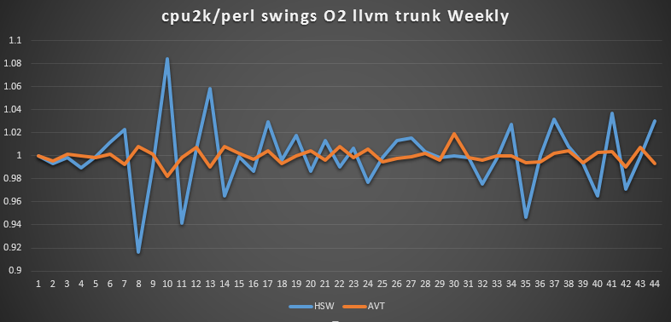
“Oh, it’s just Perl”

Slide 23
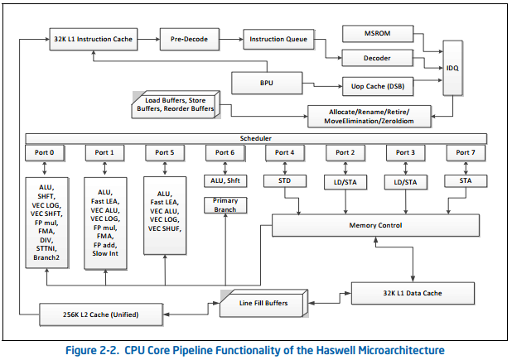
IVB / SNB / HSW / SKL
Fetch / decode / feed to DSB / read out of DSB -> execute / read out of DSB (hopefully) -> execute …

Slide 24
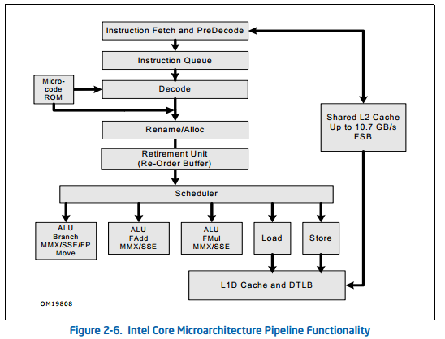
Core / NHM / Atom
Fetch 16B aligned window of instructions -> decode -> execute -> fetch -> decode -> execute ..

