Slide 1

Polly-ACC: Transparent Compilation to Heterogeneous Hardware
Tobias Grosser, Torsten Hoefler
Johannes Doerfert
University of Saarbruecken
Michael Kruse, Albert Cohen, Sven Verdoolaege
Polly Labs
Yabin Hu
China University of Geoscience
… many others
Swiss Universities / PASC
ARM, Qualcomm, Xilinx
LLVM Workshop @CGO’17 February 4, 2017 | Austin - TX

Slide 2


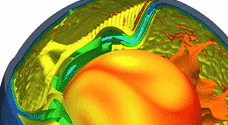
Sequential Software
Parallel Hardware
Multi-Core CPU
Fortran
C/C++
row = 0;
output_image_ptr = output_image;
output_image_ptr += (NN * dead_rows);
for (r = 0; r < NN - KK + 1; r++) {
output_image_offset = output_image_ptr;
output_image_offset += dead_cols;
col = 0;
for (c = 0; c < NN - KK + 1; c++) {
input_image_ptr = input_image;
input_image_ptr += (NN * row);
kernel_ptr = kernel;
S0: *output_image_offset = 0;
for (i = 0; i < KK; i++) {
input_image_offset = input_image_ptr;
input_image_offset += col;
kernel_offset = kernel_ptr;
for (j = 0; j < KK; j++) {
S1: temp1 = *input_image_offset++;
S1: temp2 = *kernel_offset++;
S1: *output_image_offset += temp1 * temp2;
}
kernel_ptr += KK;
input_image_ptr += NN;
}
S2: *output_image_offset = ((*output_image_offset)/ normal_factor);
output_image_offset++ ;
col++;
}
output_image_ptr += NN;
row++;
}
}
CPU
CPU
CPU
CPU
CPU
CPU
CPU
CPU
Development
GPU
GPU
GPU
GPU
GPU
GPU
GPU
GPU
GPU
GPU
GPU
GPU
GPU
GPU
Maintenance
GPU
GPU
GPU
GPU
GPU
GPU
GPU
GPU
GPU
GPU
GPU
GPU
GPU
GPU
Accelerator
Performance Tuning

Slide 3
Design Goals
Automatic
Automatic Accelerator Mapping
-
How close can we get?
Automatic Accelerator Mapping
-
How close can we get?
Non-Goal:
Algorithmic Changes
“Regression Free”
High Performance

Slide 4
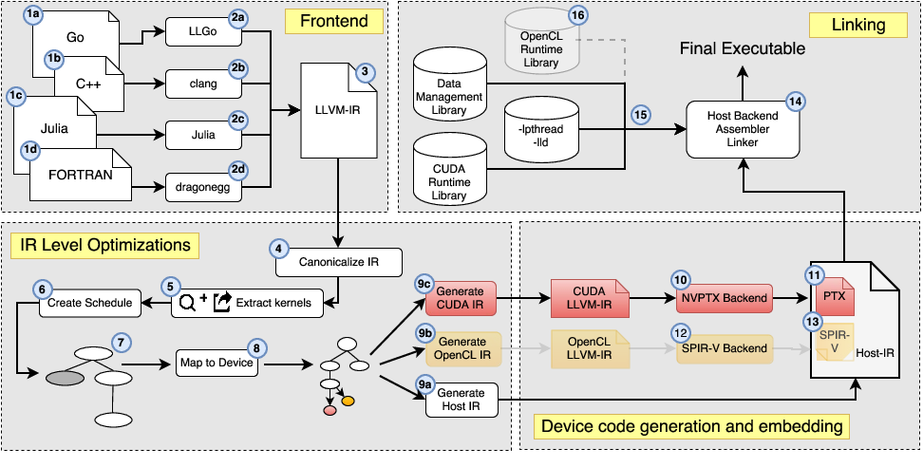
Polly-ACC: Architecture
GSoC ‘11
Justin Holewinski
(OSU/ today NVIDIA)
GSoC ‘16
Matthias Reisinger
(TU Wienna)
GSoC ‘10
Hongbin Zheng
(Xilinx)
GSoC ’12/14
Yabin Hu
Polly-ACC: Transparent Compilation to Heterogeneous Hardware
Tobias Grosser, Torsten Hoefler at International Conference of Supercomputing (ICS), June 2016, Istanbul

Slide 5
How to get Polly-ACC
cd <llvm-src>
cd tools; git clone llvm.org/polly.git
cd <llvm-build>; make
clang –O3 –mllvm –polly
–mllvm –polly-target=gpu
-lGPURuntime –ldl
-o cpu-gpu-hybrid-prog
file.c
./cpu-gpu-hybrid-prog

Slide 6
Polyhedral Loop Modeling
Iteration Space
i
5
4
3
2
1
0
0
1
2
3
4
5
j

Slide 7


Mapping Computation to Device [-mllvm -polly-target=gpu]
Automatic
Device Blocks & Threads
0
1
0
1
2
3
0
1
2
3
Iteration Space
0
0
1
i
0
0
1
1
2
j
0
$$BID= \{\left(i,j\right)→\left(\left\lfloor \frac{i}{4}\right\rfloor \% 2,\left\lfloor \frac{j}{3}\right\rfloor \% 2\right)\}$$
1
1
$$TID= \{\left(i,j\right)→\left(i \% 4, j \% 3\right)\}$$
2

Slide 8
Memory Hierarchy of a Heterogeneous System
Polyhedral Parallel Code Generation for CUDA
Verdoolaege, Sven et. al, ACM Transactions on Architecture and Code Optimization, 2013

Slide 9
Host-device Date Transfers
Automatic
Polyhedral Parallel Code Generation for CUDA
Verdoolaege, Sven et. al, ACM Transactions on Architecture and Code Optimization, 2013

Slide 10
Host-device Date Transfers [-lGPURuntime -lld]
Automatic
Polyhedral Parallel Code Generation for CUDA
Verdoolaege, Sven et. al, ACM Transactions on Architecture and Code Optimization, 2013

Slide 11
Mapping to Fast Memory [-mllvm -polly-acc-use-shared]
High-Performance
Polyhedral Parallel Code Generation for CUDA
Verdoolaege, Sven et. al, ACM Transactions on Architecture and Code Optimization, 2013

Slide 12
Mapping to Fast Memory [-mllvm -polly-acc-use-private]
High-Performance
Polyhedral Parallel Code Generation for CUDA
Verdoolaege, Sven et. al, ACM Transactions on Architecture and Code Optimization, 2013

Slide 13
Accessed Data (for a 2x2 thread block) [-delinearize]
for (i = 1; i <= 6; i++)
for (j = 1; j <= 4; j++)
… = A[i+1][j] + A[i-1][j] + A[i][j] + A[i][j-1] + A[i][j+1];
Optimistic Delinearization of Parametrically Sized Arrays
Tobias Grosser, J. Ramanujam, Louis-Noel Pouchet, P. Sadayappan, Sebastian Pop
at Internnational Conference on Supercomputing (ICS), 2015

Slide 14
Accessed Data (for a 2x2 thread block) [-delinearize]
for (i = 1; i <= 6; i++)
for (j = 1; j <= 4; j++)
… = A[i+1][j] + A[i-1][j] + A[i][j] + A[i][j-1] + A[i][j+1];
Optimistic Delinearization of Parametrically Sized Arrays
Tobias Grosser, J. Ramanujam, Louis-Noel Pouchet, P. Sadayappan, Sebastian Pop
at Internnational Conference on Supercomputing (ICS), 2015

Slide 15
Accessed Data (for a 2x2 thread block) [-delinearize]
for (i = 1; i <= 6; i++)
for (j = 1; j <= 4; j++)
… = A[i+1][j] + A[i-1][j] + A[i][j] + A[i][j-1] + A[i][j+1];
Optimistic Delinearization of Parametrically Sized Arrays
Tobias Grosser, J. Ramanujam, Louis-Noel Pouchet, P. Sadayappan, Sebastian Pop
at Internnational Conference on Supercomputing (ICS), 2015

Slide 16
Accessed Data (for a 2x2 thread block) [-delinearize]
for (i = 1; i <= 6; i++)
for (j = 1; j <= 4; j++)
… = A[i+1][j] + A[i-1][j] + A[i][j] + A[i][j-1] + A[i][j+1];
Data needed on device
12 elements
Minimal data, but complex transfer
Optimistic Delinearization of Parametrically Sized Arrays
Tobias Grosser, J. Ramanujam, Louis-Noel Pouchet, P. Sadayappan, Sebastian Pop
at Internnational Conference on Supercomputing (ICS), 2015

Slide 17
Accessed Data (for a 2x2 thread block) [-delinearize]
for (i = 1; i <= 6; i++)
for (j = 1; j <= 4; j++)
… = A[i+1][j] + A[i-1][j] + A[i][j] + A[i][j-1] + A[i][j+1];
One-dimensional hull
20 elements
Simple transfer, but redundant data
Optimistic Delinearization of Parametrically Sized Arrays
Tobias Grosser, J. Ramanujam, Louis-Noel Pouchet, P. Sadayappan, Sebastian Pop
at Internnational Conference on Supercomputing (ICS), 2015

Slide 18
Accessed Data (for a 2x2 thread block)
Accessed Data (for a 2x2 thread block) [-delinearize]
for (i = 1; i <= 6; i++)
for (j = 1; j <= 4; j++)
… = A[i+1][j] + A[i-1][j] + A[i][j] + A[i][j-1] + A[i][j+1];
Modeling multi-dimensional access
behavior is important
“Optimistic Loop Optimization” at CGO’17
with Johannes Doerfert and Sebastian Hack
Two-dimensional hull
16 elements
Simple transfer, less redundant data
Optimistic Delinearization of Parametrically Sized Arrays
Tobias Grosser, J. Ramanujam, Louis-Noel Pouchet, P. Sadayappan, Sebastian Pop
at Internnational Conference on Supercomputing (ICS), 2015

Slide 19
Access Coalescing
High-Performance
a
DRAM
a
b
b
c
c
d
d
e
e
f
f
g
g
h
h
i
i

Slide 20
Access Coalescing (no permute)
High-Performance
a
DRAM
a
b
b
c
c
d
d
e
e
f
f
g
g
h
h
i
i
a
Shared Memory
a
b
b
c
c
d
d
e
e
f
f
g
g
h
h
i
i

Slide 21
Access Coalescing (permuted)
High-Performance
a
DRAM
a
b
b
c
c
d
d
e
e
f
f
g
g
h
h
i
i
a
Shared Memory
a
d
d
g
g
b
b
e
e
h
h
c
c
f
f
i
i

Slide 22
Profitability Heuristic [-mllvm -polly-process-unprofitable=false]
Regression-Free
Modeling
Execution
GPU
All
Loop
Nests
static
dynamic
Insufficient Compute
Unsuitable
Trivial

Slide 23
Kernels to Programs – Data Transfers
High-Performance
void heat(int n, float A[n], float hot, float cold) {
float B[n] = {0};
initialize(n, A, cold);
setCenter(n, A, hot, n/4);
for (int t = 0; t < T; t++) {
average(n, A, B);
average(n, B, A);
printf("Iteration %d done", t);
}
}

Slide 24








Data Transfer – Per Kernel
High-Performance
Host Memory
Device Memory
$$D→H$$
initialize()
setCenter()
$$D→H$$
average()
$H→D$
$D→H$
time
average()
$H→D$
$D→H$
average()
$H→D$
$D→H$

Slide 25


Data Transfer – Inter Kernel Caching [POLLY_CACHE_ALLOCATIONS=1]
High-Performance
Host Memory
Host Memory
Device Memory
initialize()
setCenter()
average()
time
average()
$D→H$
$H→D$
average()

Slide 26
Evaluation
Evaluation
Workstation: 10 core SandyBridge NVIDIA Titan Black (Kepler)

Slide 27
LLVM Nightly Test Suite
# Compute Regions / Kernels

Slide 28
Polybench 3.2 Computional Kernels
Baseline: icc –O3 (sequential), 10 core CPU + NVIDIA Titan Black (workstation)

Slide 29
Lattice Boltzmann (SPEC 2006)

Slide 30
Cactus ADM (SPEC 2006) - Performance

Slide 31
Cactus ADM (SPEC 2006) - Data Transfer

Slide 32
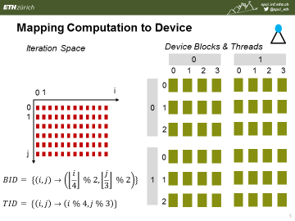
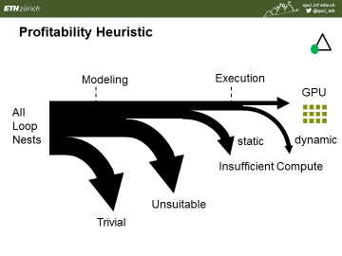
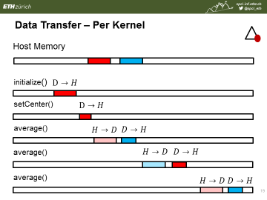
Polly-ACC
http://spcl.inf.ethz.ch/Polly-ACC
Automatic
“Regression Free”
High Performance

