Slide 1
1
2
3
Location of the prize
1
2
3
1
2
3
1
2
3
Choice of the contestant
2
3
3
2
3
1
3
1
2
1
1
2
Door that host opens
(1,1,2)
(1,1,3)
(1,2,3)
(1,3,2)
(2,1,3)
(2,2,1)
(2,2,3)
(2,3,1)
(3,1,2)
(3,2,1)
(3,3,1)
(3,3,2)

Slide 2
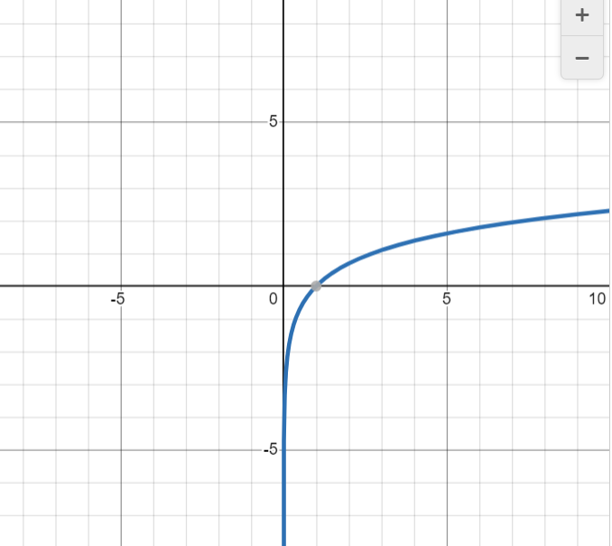
n
n+1

Slide 3
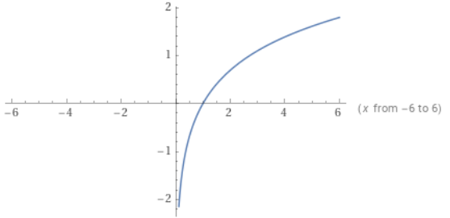
a
a+1

Slide 4
