Slide 1
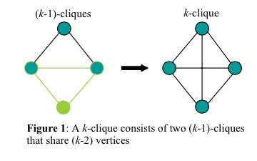
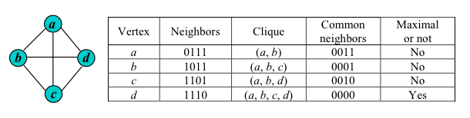
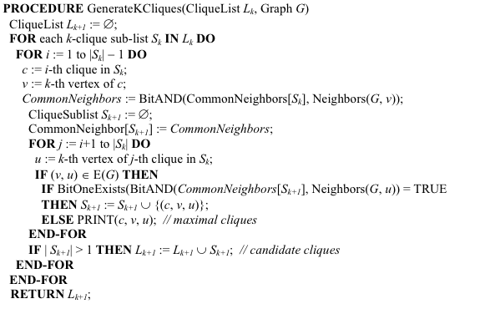
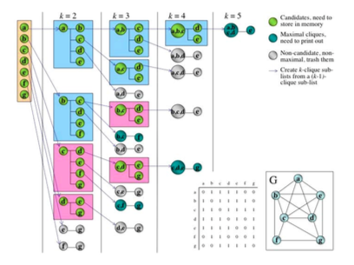
(a)
(b)
(c)
(d)

Slide 2
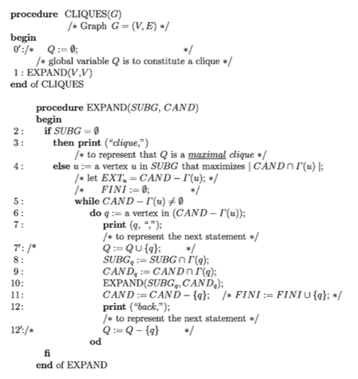
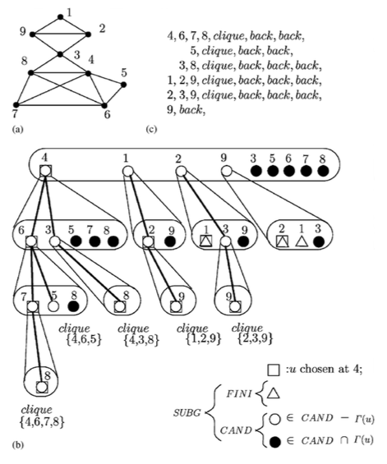
(a)
(b)

Slide 3
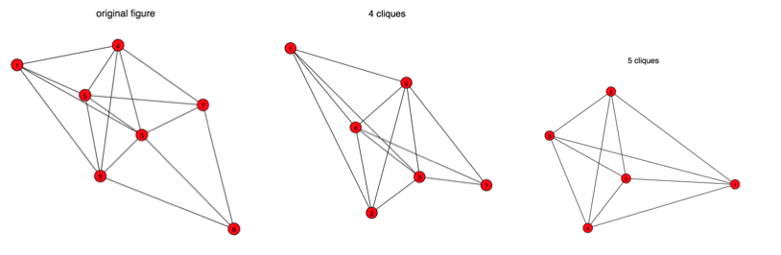
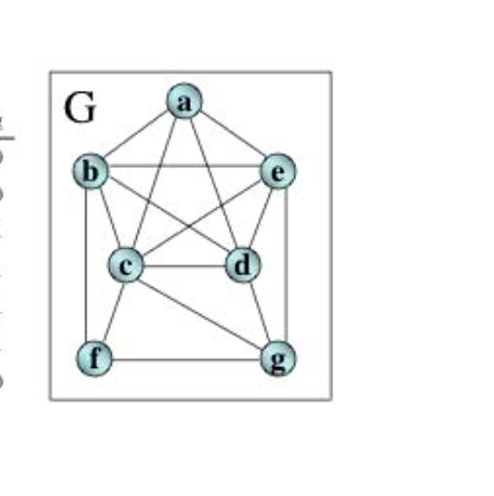
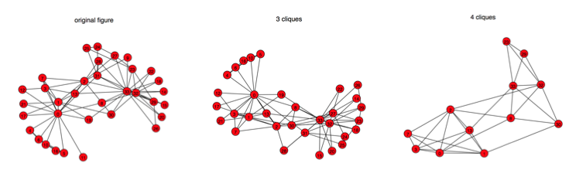
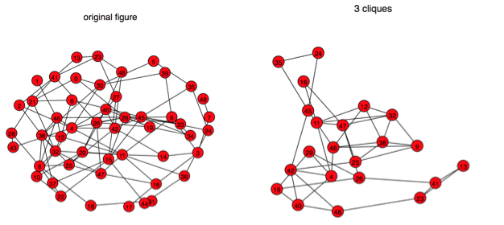
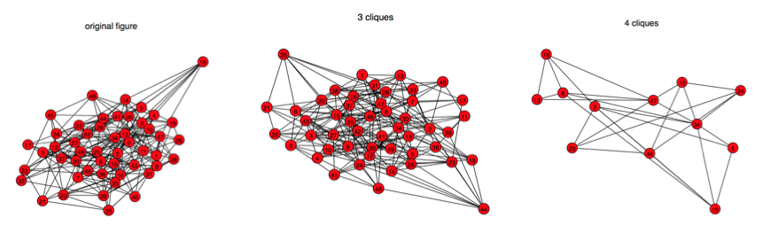
(a)
(b)
(c)
(d)

Slide 4
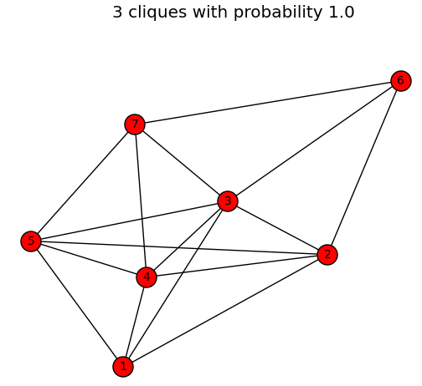
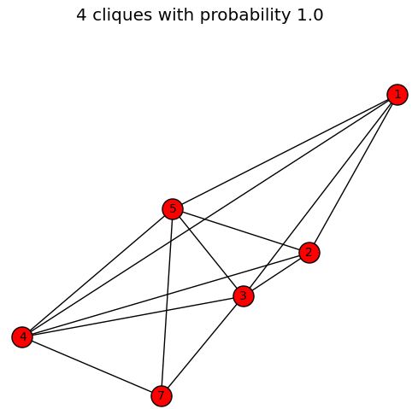
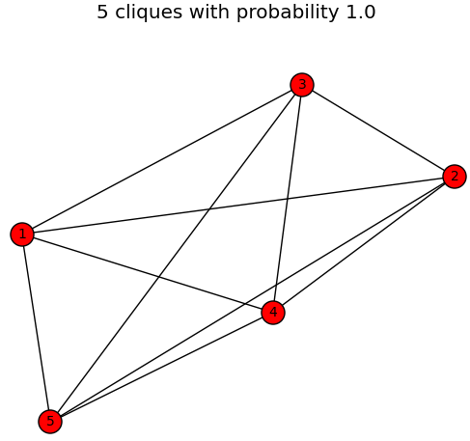
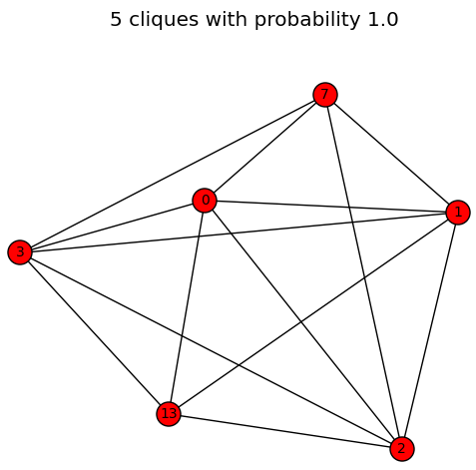
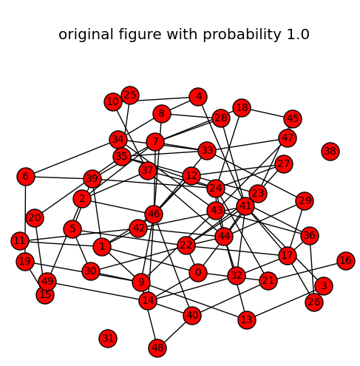
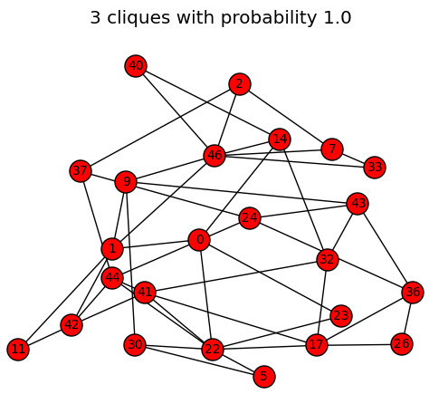
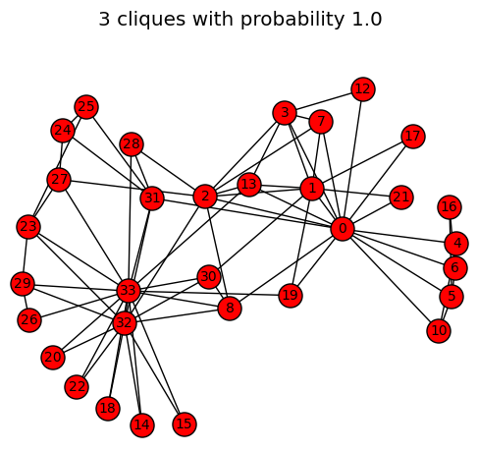
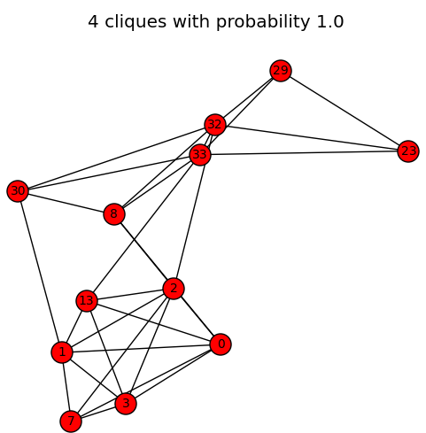
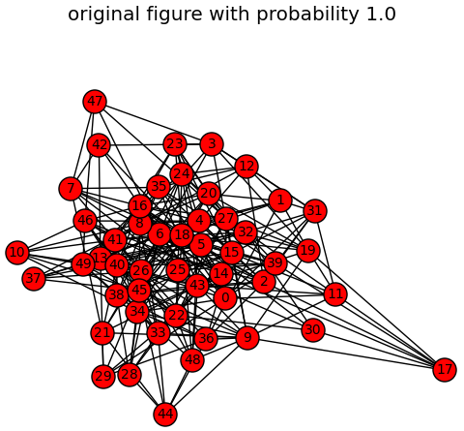
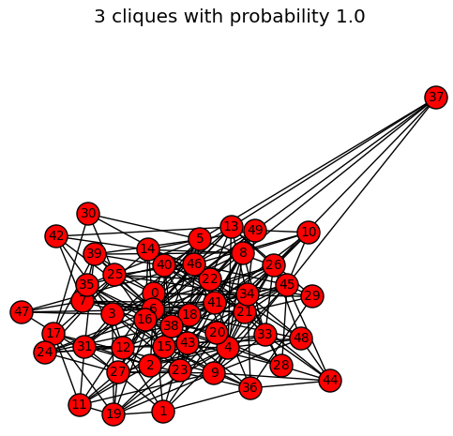
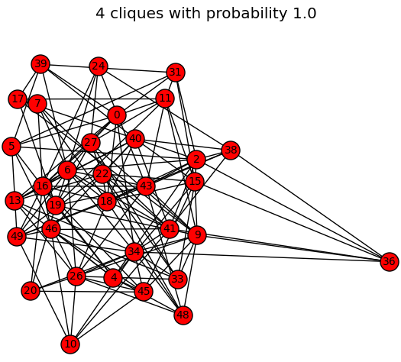
(a)
(b)
(c)
(d)

Slide 5
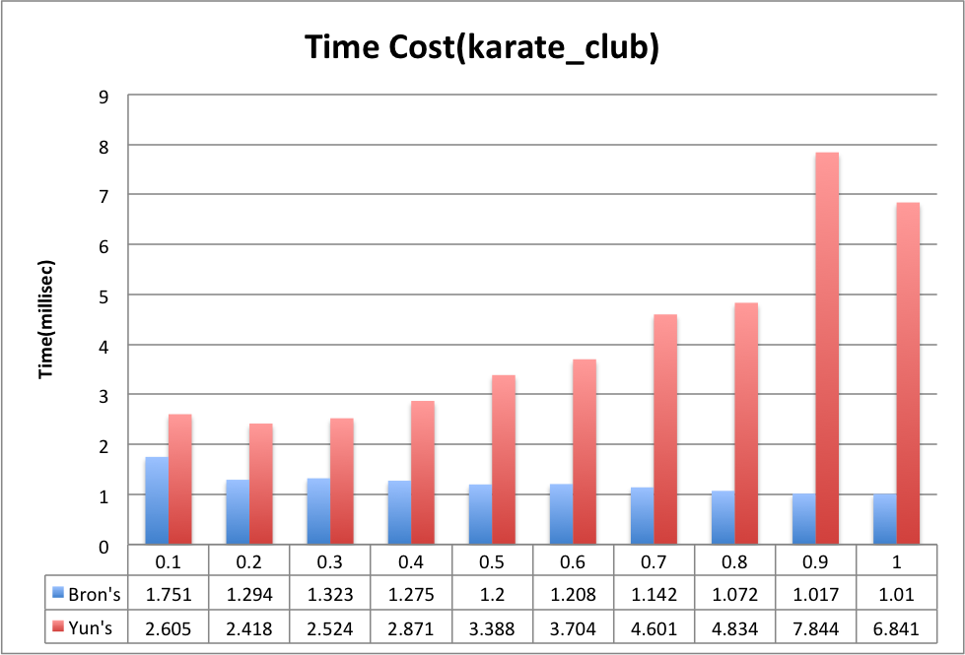
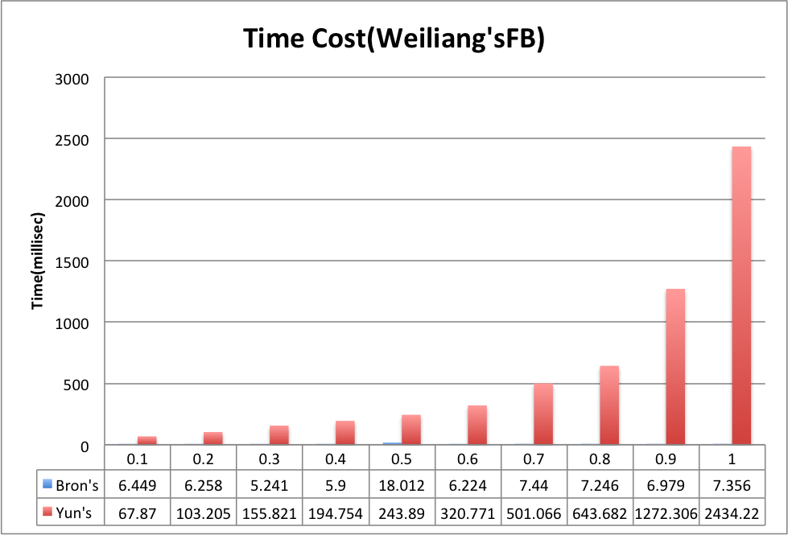
(a)
(b)

Slide 6
Bron’s karate_club:
# in prob=0.1: [0.0, 0.0, 0.0] Accuracy in prob=0.1: [0.0, 0.0, 0.0]
# in prob=0.2: [0.0, 0.0, 0.0] Accuracy in prob=0.2: [0.0, 0.0, 0.0]
# in prob=0.3: [74.0, 0.0, 0.0] Accuracy in prob=0.3: [0.356, 0.0, 0.0]
# in prob=0.4: [62.0, 0.0, 0.0] Accuracy in prob=0.4: [0.622, 0.0, 0.0]
# in prob=0.5: [72.0, 0.0, 0.0] Accuracy in prob=0.5: [0.4, 0.0, 0.0]
# in prob=0.6: [46.0, 21.0, 0.0] Accuracy in prob=0.6: [0.978, 0.091, 0.0]
# in prob=0.7: [29.0, 0.0, 0.0] Accuracy in prob=0.7: [0.644, 0.0, 0.0]
# in prob=0.8: [41.0, 11.0, 0.0] Accuracy in prob=0.8: [0.911, 1.0, 0.0]
# in prob=0.9: [38.0, 2.0, 0.0] Accuracy in prob=0.9: [0.844, 0.182, 0.0]
# in prob=1.0: [45.0, 11.0, 2.0] Accuracy in prob=1.0: [1.0, 1.0, 1.0]
Yun’s karate_club:
# in prob=0.1: [0.0, 0.0, 0.0] Accuracy in prob=0.1: [0.0, 0.0, 0.0]
# in prob=0.2: [0.0, 0.0, 0.0] Accuracy in prob=0.2: [0.0, 0.0, 0.0]
# in prob=0.3: [37.0, 0.0, 0.0] Accuracy in prob=0.3: [0.902, 0.0, 0.0]
# in prob=0.4: [62.0, 0.0, 0.0] Accuracy in prob=0.4: [0.488, 0.0, 0.0]
# in prob=0.5: [16.0, 0.0, 0.0] Accuracy in prob=0.5: [0.39, 0.0, 0.0]
# in prob=0.6: [28.0, 0.0, 0.0] Accuracy in prob=0.6: [0.683, 0.0, 0.0]
# in prob=0.7: [61.0, 8.0, 0.0] Accuracy in prob=0.7: [0.512, 0.727, 0.0]
# in prob=0.8: [41.0, 11.0, 0.0] Accuracy in prob=0.8: [1.0, 1.0, 0.0]
# in prob=0.9: [36.0, 6.0, 0.0] Accuracy in prob=0.9: [0.878, 0.545, 0.0]
# in prob=1.0: [41.0, 11.0, 2.0] Accuracy in prob=1.0: [1.0, 1.0, 1.0]
Bron’s WeiliangFB:
# in prob=0.1: [4000.0, 0.0, 0.0, 0.0, 0.0, 0.0, 0.0, 0.0] Accuracy in prob=0.1: [-0.018, 0.0, 0.0, 0.0, 0.0, 0.0, 0.0, 0.0]
# in prob=0.2: [1250.0, 0.0, 0.0, 0.0, 0.0, 0.0, 0.0, 0.0] Accuracy in prob=0.2: [0.631, 0.0, 0.0, 0.0, 0.0, 0.0, 0.0, 0.0]
# in prob=0.3: [1741.0, 1372.0, 0.0, 0.0, 0.0, 0.0, 0.0, 0.0] Accuracy in prob=0.3: [0.878, 0.596, 0.0, 0.0, 0.0, 0.0, 0.0, 0.0]
# in prob=0.4: [2672.0, 3906.0, 9537.0, 0.0, 0.0, 0.0, 0.0, 0.0] Accuracy in prob=0.4: [0.652, 0.303, -3.313, 0.0, 0.0, 0.0, 0.0, 0.0]
# in prob=0.5: [1944.0, 2048.0, 2048.0, 0.0, 0.0, 0.0, 0.0, 0.0] Accuracy in prob=0.5: [0.981, 0.89, 0.859, 0.0, 0.0, 0.0, 0.0, 0.0]
# in prob=0.6: [1917.0, 2100.0, 1158.0, 0.0, 0.0, 0.0, 0.0, 0.0] Accuracy in prob=0.6: [0.967, 0.912, 0.645, 0.0, 0.0, 0.0, 0.0, 0.0]
# in prob=0.7: [1560.0, 1343.0, 566.0, 0.0, 0.0, 0.0, 0.0, 0.0] Accuracy in prob=0.7: [0.787, 0.583, 0.315, 0.0, 0.0, 0.0, 0.0, 0.0]
# in prob=0.8: [2150.0, 2972.0, 3073.0, 2530.0, 1193.0, 0.0, 0.0, 0.0] Accuracy in prob=0.8: [0.915, 0.709, 0.288, -0.483, -0.814, 0.0, 0.0, 0.0]
# in prob=0.9: [2053.0, 1983.0, 969.0, 214.0, 9.0, 0.0, 0.0, 0.0] Accuracy in prob=0.9: [0.964, 0.861, 0.54, 0.21, 0.021, 0.0, 0.0, 0.0]
# in prob=1.0: [1982.0, 2302.0, 1795.0, 1019.0, 424.0, 125.0, 23.0, 2.0] Accuracy in prob=1.0: [1.0, 1.0, 1.0, 1.0, 1.0, 1.0, 1.0, 1.0]
Yun’s WeiliangFB:
Average Number Of Cliques Based On k From 3 To Max:
# in prob=0.1: [0.0, 0.0, 0.0, 0.0, 0.0, 0.0, 0.0, 0.0] Accuracy in prob=0.1: [0.0, 0.0, 0.0, 0.0, 0.0, 0.0, 0.0, 0.0]
# in prob=0.2: [1875.0, 31250.0, 0.0, 0.0, 0.0, 0.0, 0.0, 0.0] Accuracy in prob=0.2: [0.49, -12.134, 0.0, 0.0, 0.0, 0.0, 0.0, 0.0]
# in prob=0.3: [1259.0, 0.0, 0.0, 0.0, 0.0, 0.0, 0.0, 0.0] Accuracy in prob=0.3: [0.986, 0.0, 0.0, 0.0, 0.0, 0.0, 0.0, 0.0]
# in prob=0.4: [2250.0, 1953.0, 0.0, 0.0, 0.0, 0.0, 0.0, 0.0] Accuracy in prob=0.4: [0.188, 0.883, 0.0, 0.0, 0.0, 0.0, 0.0, 0.0]
# in prob=0.5: [1680.0, 2624.0, 1024.0, 0.0, 0.0, 0.0, 0.0, 0.0] Accuracy in prob=0.5: [0.647, 0.813, 0.656, 0.0, 0.0, 0.0, 0.0, 0.0]
# in prob=0.6: [1384.0, 1693.0, 662.0, 0.0, 0.0, 0.0, 0.0, 0.0] Accuracy in prob=0.6: [0.886, 0.766, 0.424, 0.0, 0.0, 0.0, 0.0, 0.0]
# in prob=0.7: [1569.0, 1938.0, 1345.0, 211.0, 0.0, 0.0, 0.0, 0.0] Accuracy in prob=0.7: [0.737, 0.877, 0.862, 0.208, 0.0, 0.0, 0.0, 0.0]
# in prob=0.8: [1492.0, 1701.0, 764.0, 199.0, 0.0, 0.0, 0.0, 0.0] Accuracy in prob=0.8: [0.799, 0.769, 0.489, 0.197, 0.0, 0.0, 0.0, 0.0]
# in prob=0.9: [1462.0, 2591.0, 2108.0, 1311.0, 457.0, 76.0, 0.0, 0.0] Accuracy in prob=0.9: [0.823, 0.828, 0.65, 0.705, 0.872, 0.608, 0.0, 0.0]
# in prob=1.0: [1242.0, 2211.0, 1561.0, 1012.0, 405.0, 125.0, 23.0, 2.0] Accuracy in prob=1.0: [1.0, 1.0, 1.0, 1.0, 1.0, 1.0, 1.0, 1.0]
(a)
(b)
Notes:
=====Statistical Results listed with prob: [0.1, 0.2, 0.3, 0.4, 0.5, 0.6, 0.7, 0.8, 0.9, 1.0]=====
Average Node Number: [34.0, 34.0, 34.0, 34.0, 34.0, 34.0, 34.0, 34.0, 34.0, 34.0]
Average Edge Number: [12.0, 15.0, 30.0, 32.0, 44.0, 44.0, 51.0, 61.0, 67.0, 78.0]
Average Graph Density: [0.021, 0.027, 0.053, 0.057, 0.078, 0.078, 0.091, 0.109, 0.119, 0.139]
Average Cluster Coefficient: [0.0, 0.0, 0.133, 0.0, 0.152, 0.215, 0.25, 0.148, 0.443, 0.571]
Average Transitivity: [0.0, 0.0, 0.138, 0.0, 0.138, 0.139, 0.18, 0.13, 0.207, 0.256]
Average Maximum Clique Number: [2.0, 2.0, 3.0, 2.0, 3.0, 3.0, 3.0, 4.0, 4.0, 5.0]
Average Time Cost(Milliseconds): [1.35, 1.004, 1.028, 0.996, 0.966, 0.91, 0.95, 0.975, 0.912, 0.919]
Average Speed up(times): [0.681, 0.915, 0.894, 0.923, 0.951, 1.01, 0.967, 0.943, 1.008, 1.0]
Total Time cost(Milliseconds): [1.35, 1.004, 1.028, 0.996, 0.966, 0.91, 0.95, 0.975, 0.912, 0.919]
Average Number Of Cliques Based On k From 3 To Max:
# in prob=0.1: [0.0, 0.0, 0.0] Accuracy in prob=0.1: [0.0, 0.0, 0.0]
# in prob=0.2: [0.0, 0.0, 0.0] Accuracy in prob=0.2: [0.0, 0.0, 0.0]
# in prob=0.3: [148.0, 0.0, 0.0] Accuracy in prob=0.3: [-1.289, 0.0, 0.0]
# in prob=0.4: [0.0, 0.0, 0.0] Accuracy in prob=0.4: [0.0, 0.0, 0.0]
# in prob=0.5: [56.0, 0.0, 0.0] Accuracy in prob=0.5: [0.756, 0.0, 0.0]
# in prob=0.6: [37.0, 0.0, 0.0] Accuracy in prob=0.6: [0.822, 0.0, 0.0]
# in prob=0.7: [41.0, 0.0, 0.0] Accuracy in prob=0.7: [0.911, 0.0, 0.0]
# in prob=0.8: [27.0, 8.0, 0.0] Accuracy in prob=0.8: [0.6, 0.727, 0.0]
# in prob=0.9: [38.0, 4.0, 0.0] Accuracy in prob=0.9: [0.844, 0.364, 0.0]
# in prob=1.0: [45.0, 11.0, 2.0] Accuracy in prob=1.0: [1.0, 1.0, 1.0]

Slide 7
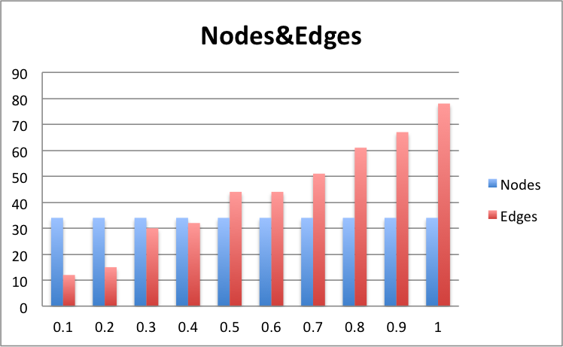
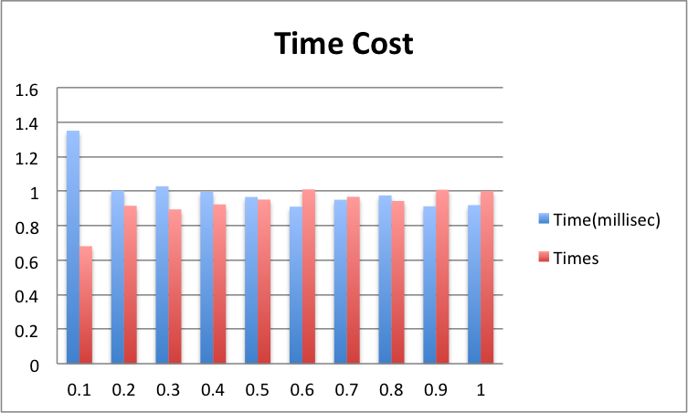
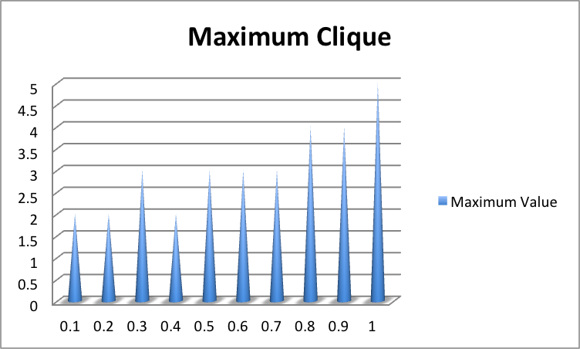
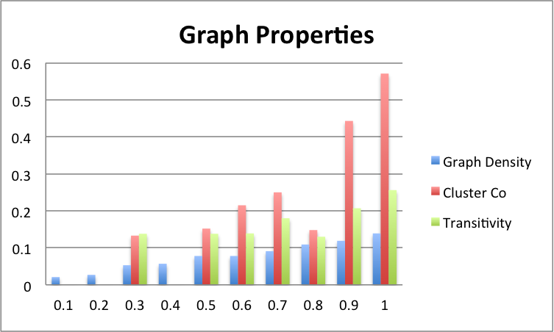

Slide 8
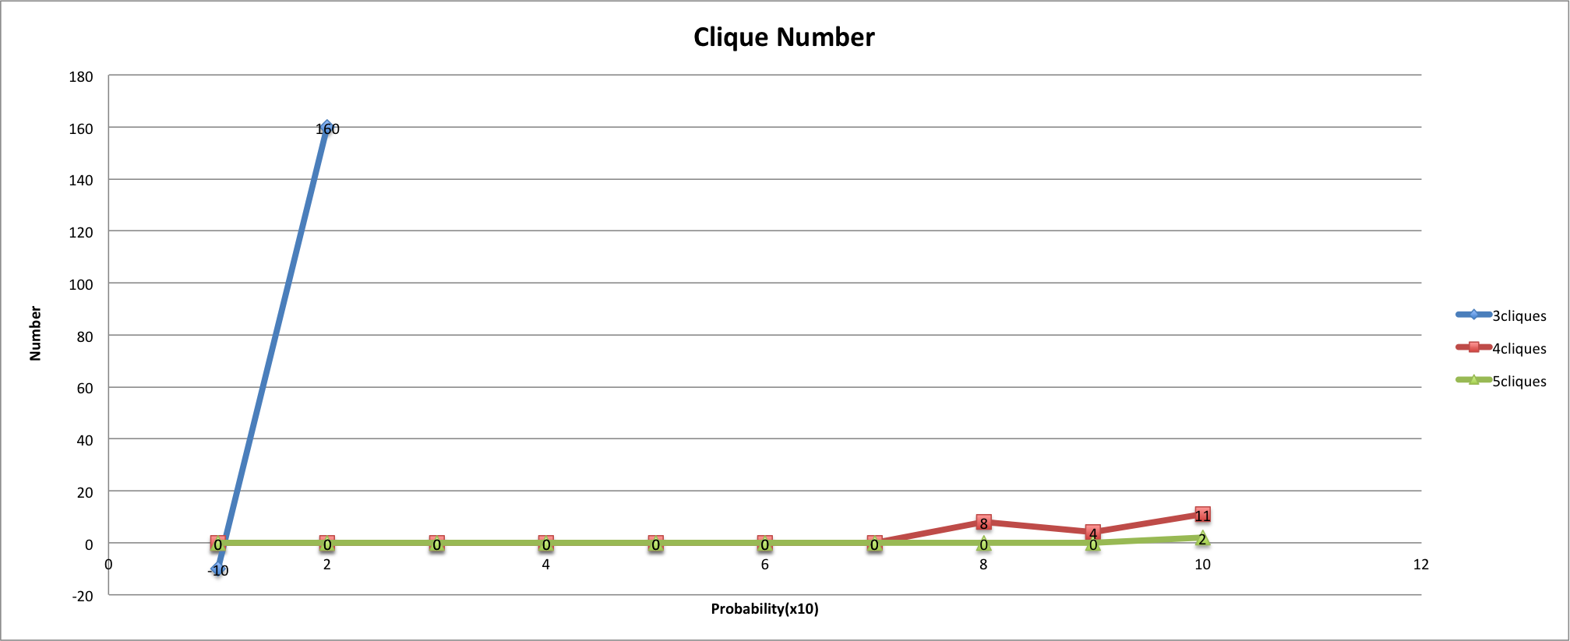
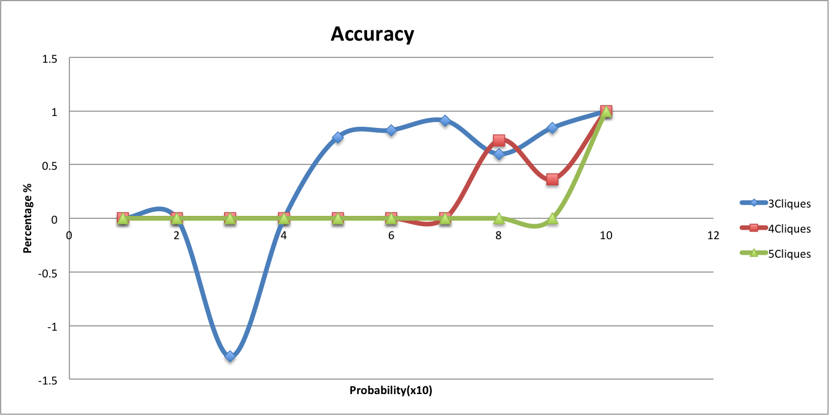
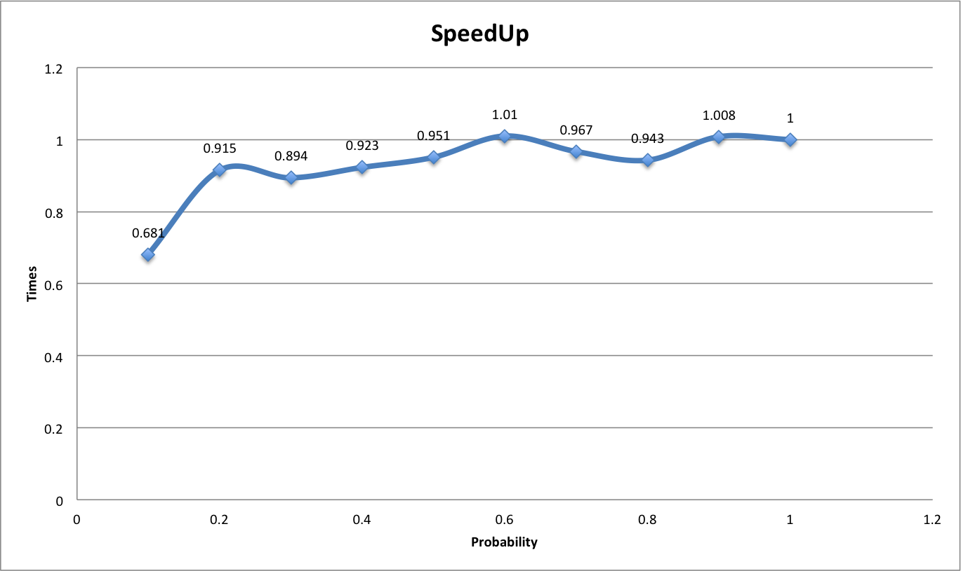

Slide 9
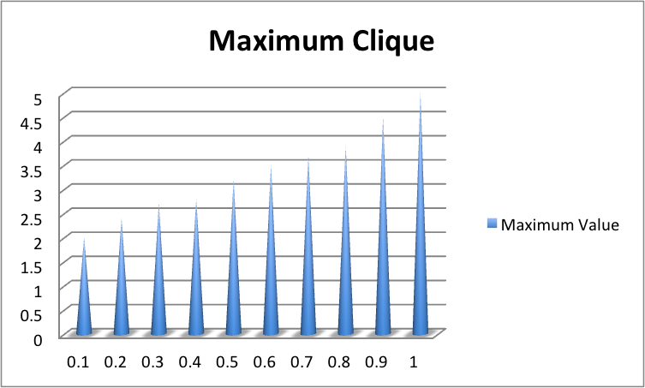
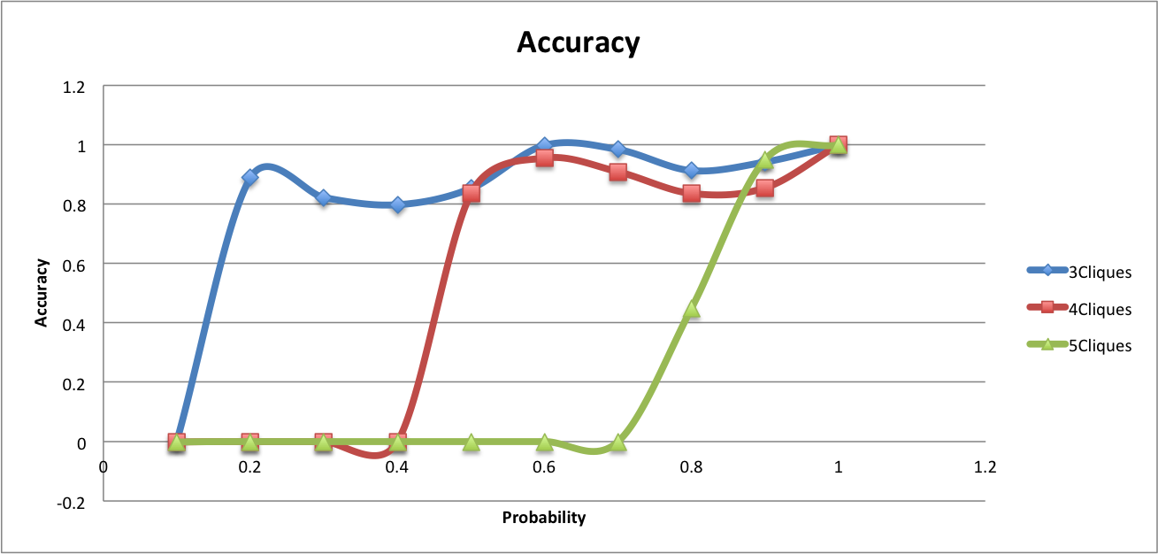
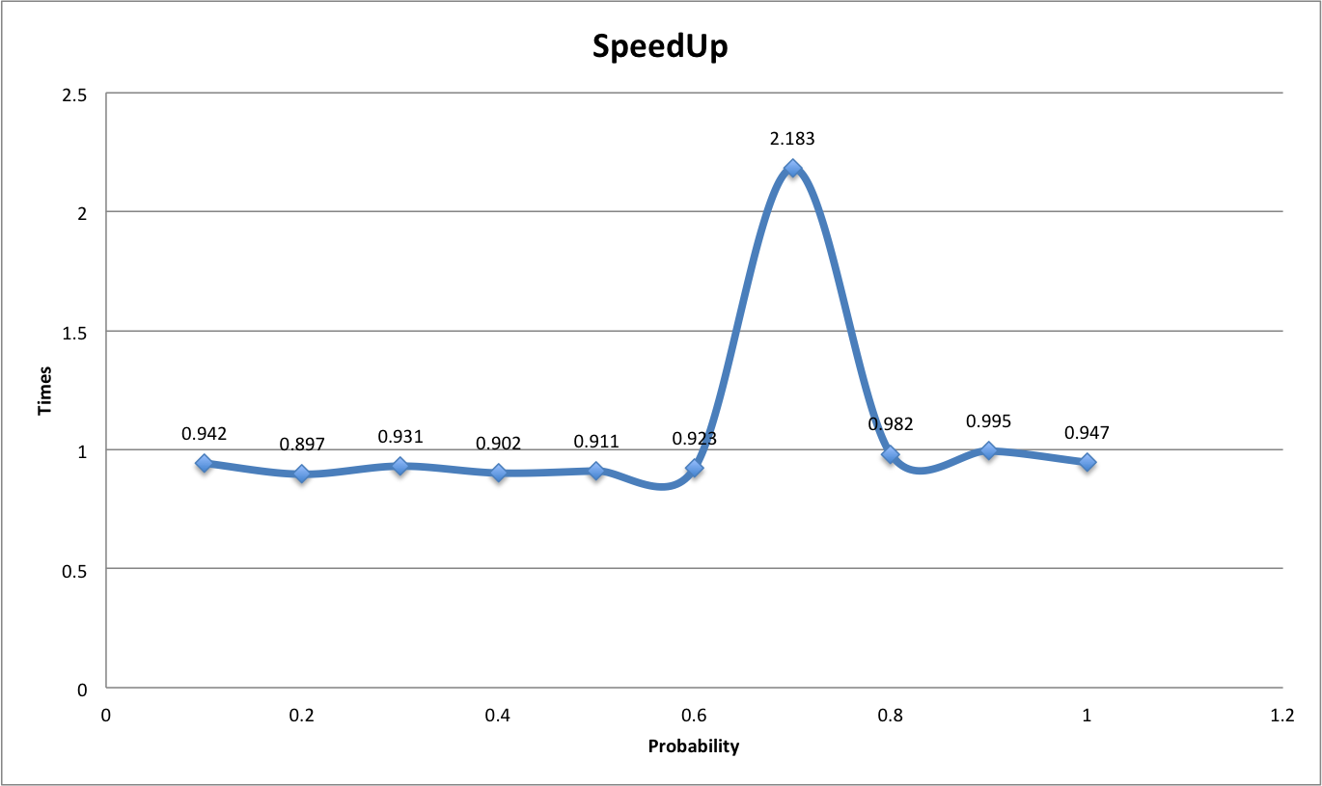

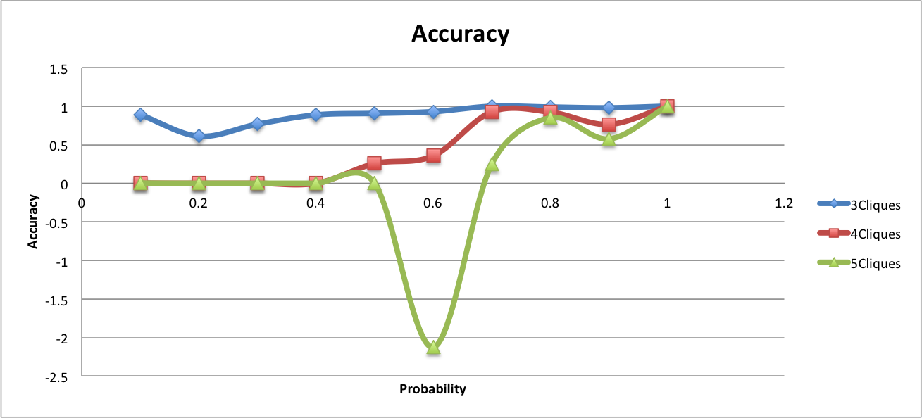
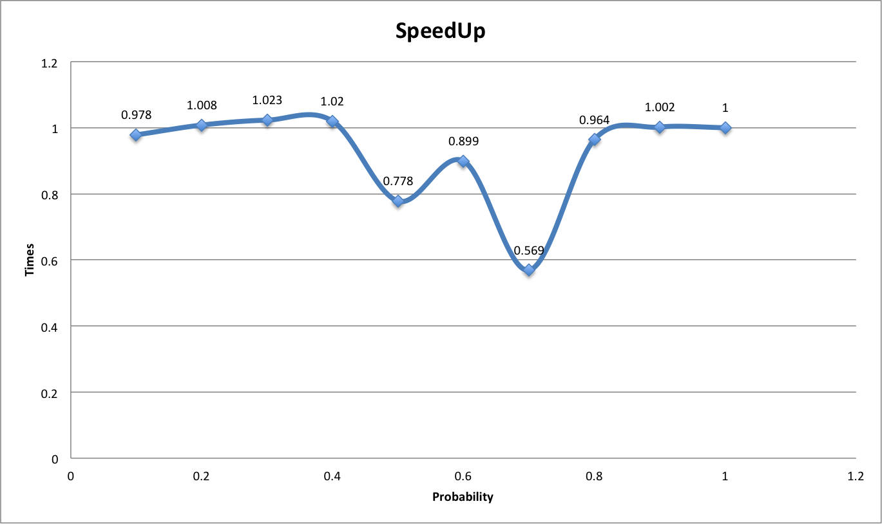

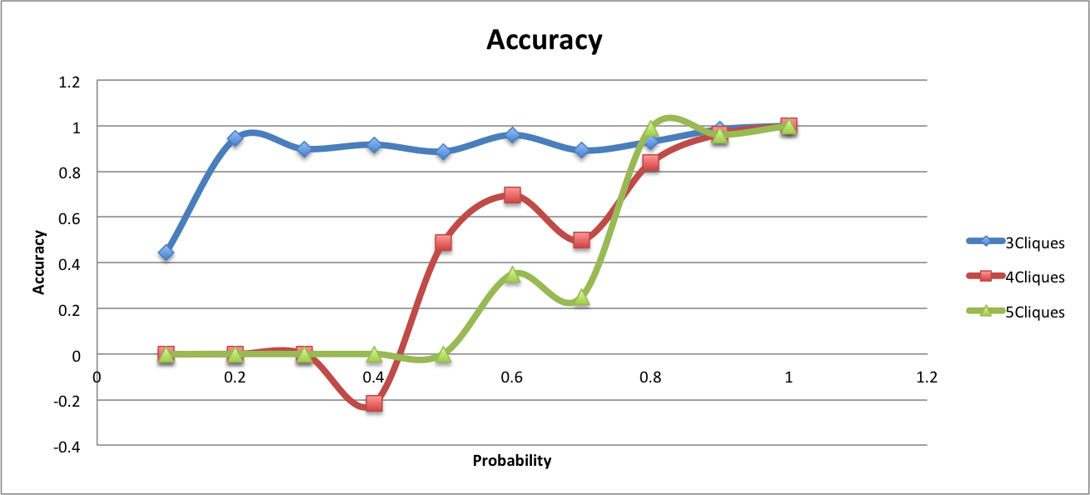
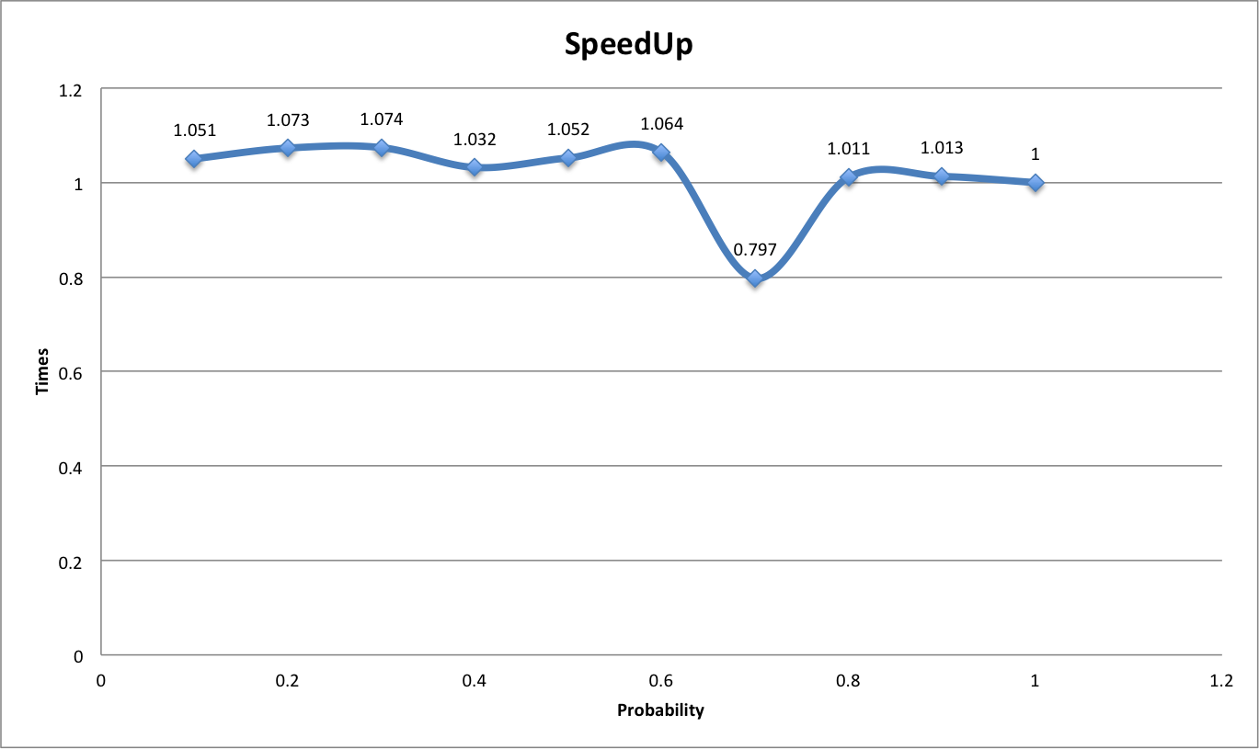

Slide 10
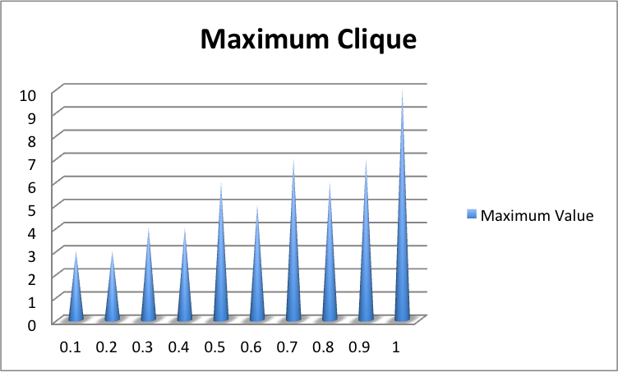
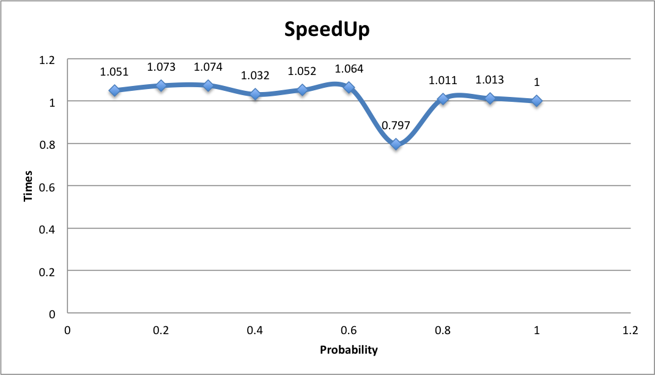
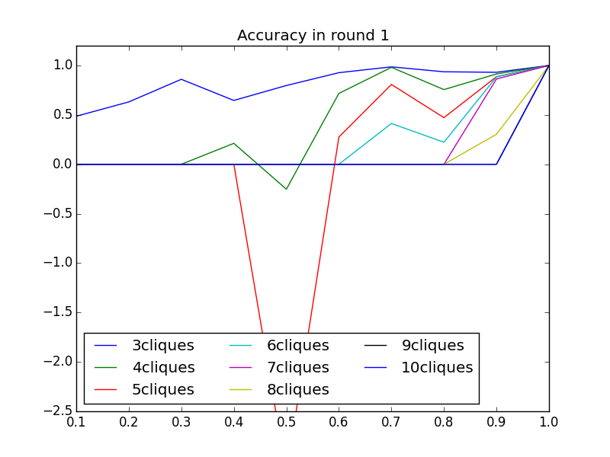
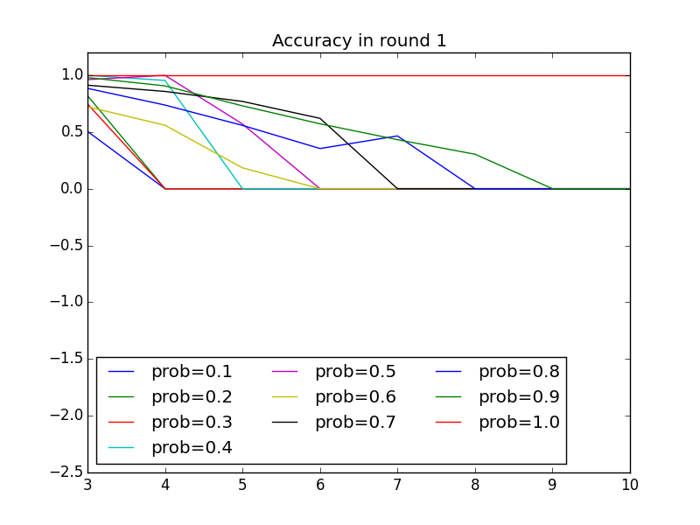
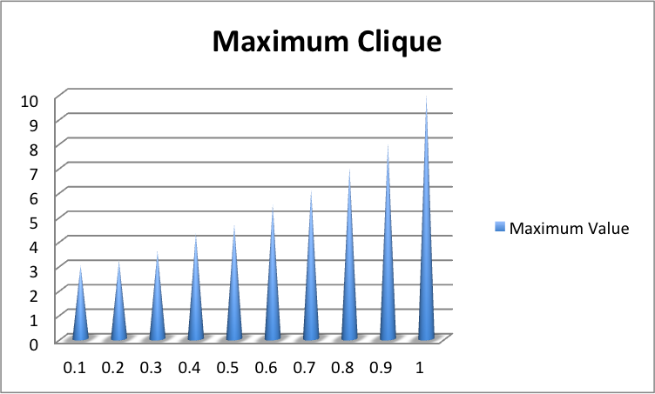
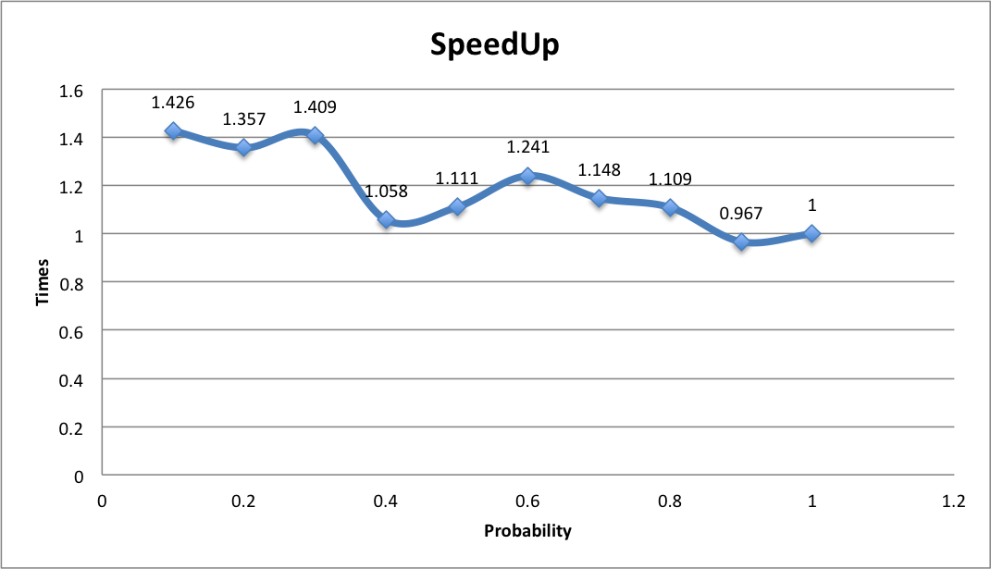
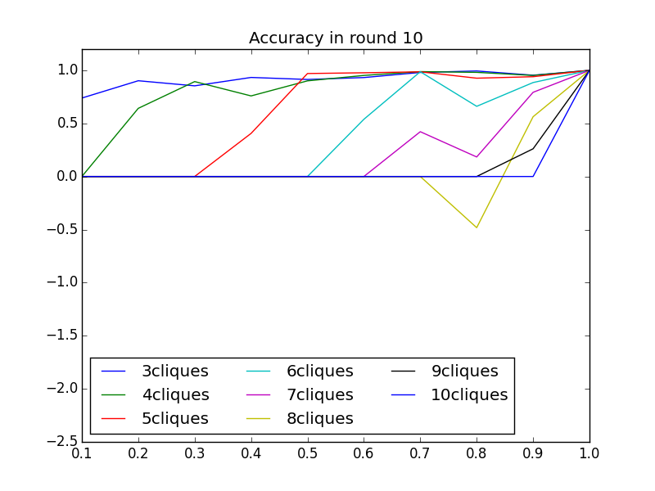
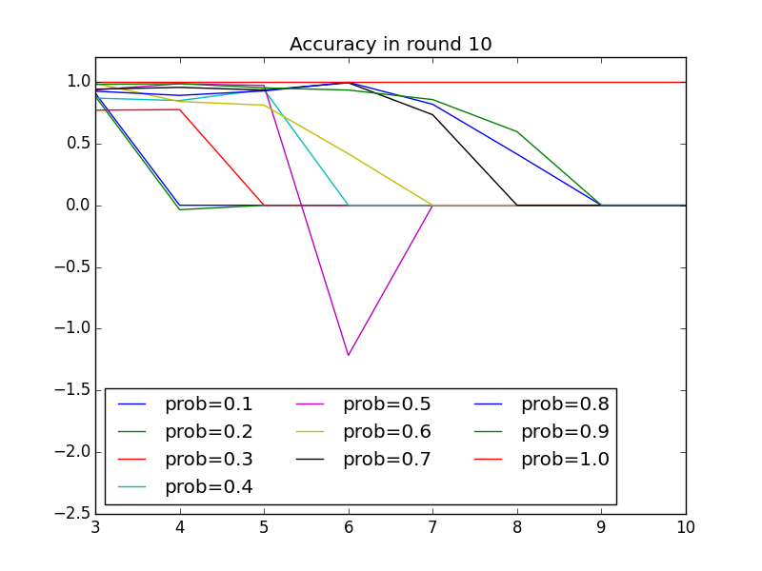
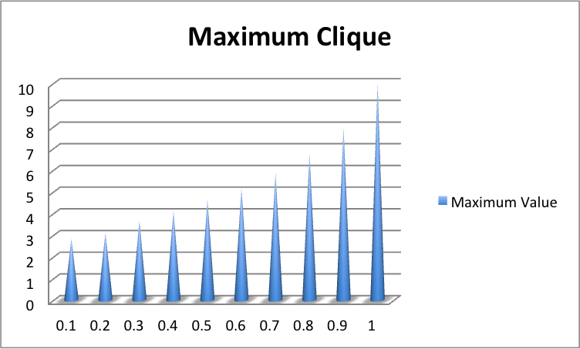
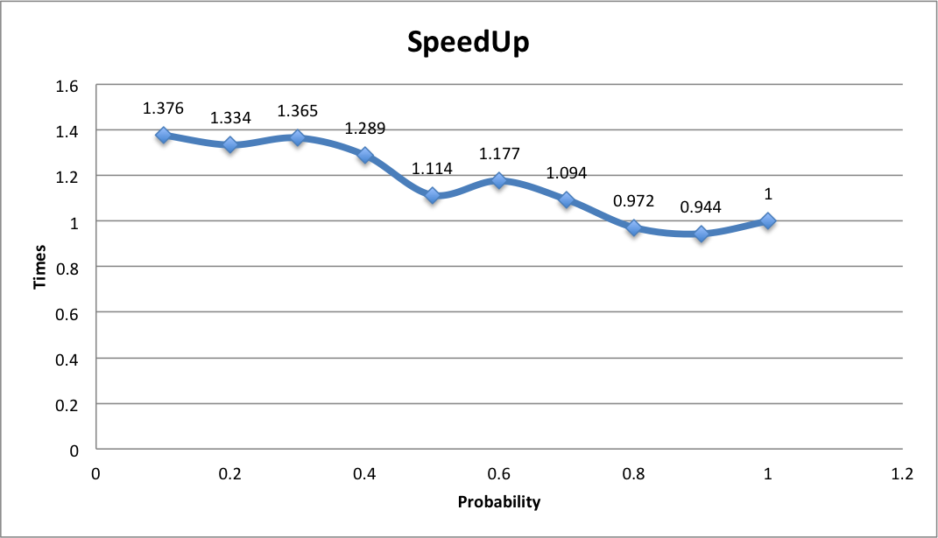
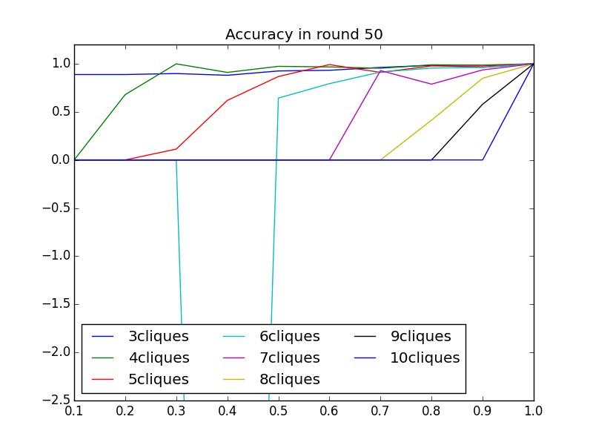
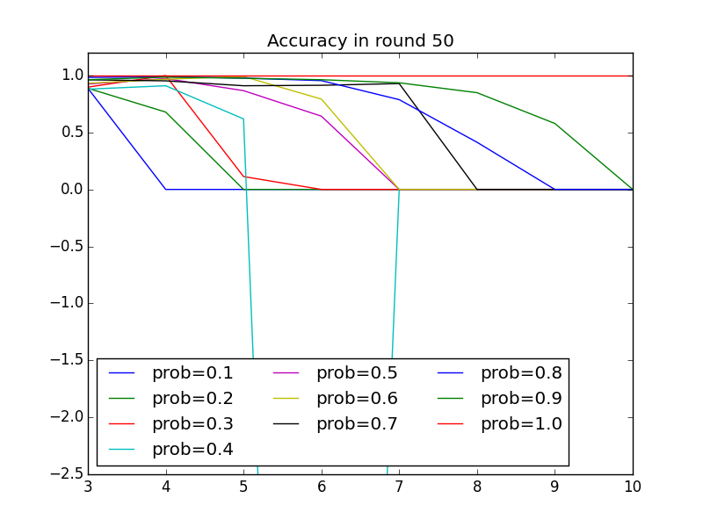

Slide 11





Slide 12
Command3: python3.4 exp.py --sample random_graph --nodes 10 --edges 3628800 --algorithm bron --times 1
Average Time Cost(Milliseconds): [0.301, 0.23, 0.255, 0.311, 0.245, 0.239, 0.299, 0.272, 0.236, 0.207]
Average Speed up(times): [0.688, 0.9, 0.812, 0.666, 0.845, 0.866, 0.692, 0.761, 0.877, 1.0]
Average Number Of Cliques Based On k From 3 To Max:
# in prob=0.1: [1000.0, 0.0, 0.0, 0.0, 0.0, 0.0, 0.0, 0.0] Accuracy in prob=0.1: [-6.333, 0.0, 0.0, 0.0, 0.0, 0.0, 0.0, 0.0]
# in prob=0.2: [0.0, 0.0, 0.0, 0.0, 0.0, 0.0, 0.0, 0.0] Accuracy in prob=0.2: [0.0, 0.0, 0.0, 0.0, 0.0, 0.0, 0.0, 0.0]
# in prob=0.3: [148.0, 0.0, 0.0, 0.0, 0.0, 0.0, 0.0, 0.0] Accuracy in prob=0.3: [0.767, 0.0, 0.0, 0.0, 0.0, 0.0, 0.0, 0.0]
# in prob=0.4: [78.0, 0.0, 0.0, 0.0, 0.0, 0.0, 0.0, 0.0] Accuracy in prob=0.4: [0.65, 0.0, 0.0, 0.0, 0.0, 0.0, 0.0, 0.0]
# in prob=0.5: [72.0, 64.0, 0.0, 0.0, 0.0, 0.0, 0.0, 0.0] Accuracy in prob=0.5: [0.6, 0.305, 0.0, 0.0, 0.0, 0.0, 0.0, 0.0]
# in prob=0.6: [116.0, 171.0, 0.0, 0.0, 0.0, 0.0, 0.0, 0.0] Accuracy in prob=0.6: [0.967, 0.814, 0.0, 0.0, 0.0, 0.0, 0.0, 0.0]
# in prob=0.7: [114.0, 161.0, 106.0, 0.0, 0.0, 0.0, 0.0, 0.0] Accuracy in prob=0.7: [0.95, 0.767, 0.421, 0.0, 0.0, 0.0, 0.0, 0.0]
# in prob=0.8: [115.0, 168.0, 112.0, 0.0, 0.0, 0.0, 0.0, 0.0] Accuracy in prob=0.8: [0.958, 0.8, 0.444, 0.0, 0.0, 0.0, 0.0, 0.0]
# in prob=0.9: [132.0, 243.0, 293.0, 214.0, 73.0, 0.0, 0.0, 0.0] Accuracy in prob=0.9: [0.9, 0.843, 0.837, 0.981, 0.608, 0.0, 0.0, 0.0]
# in prob=1.0: [120.0, 210.0, 252.0, 210.0, 120.0, 45.0, 10.0, 1.0] Accuracy in prob=1.0: [1.0, 1.0, 1.0, 1.0, 1.0, 1.0, 1.0, 1.0]
Notes:
=====Statistical Results listed with prob: [0.1, 0.2, 0.3, 0.4, 0.5, 0.6, 0.7, 0.8, 0.9, 1.0]=====
Average Node Number: [34.0, 34.0, 34.0, 34.0, 34.0, 34.0, 34.0, 34.0, 34.0, 34.0]
Average Edge Number: [12.0, 15.0, 30.0, 32.0, 44.0, 44.0, 51.0, 61.0, 67.0, 78.0]
Average Graph Density: [0.021, 0.027, 0.053, 0.057, 0.078, 0.078, 0.091, 0.109, 0.119, 0.139]
Average Cluster Coefficient: [0.0, 0.0, 0.133, 0.0, 0.152, 0.215, 0.25, 0.148, 0.443, 0.571]
Average Transitivity: [0.0, 0.0, 0.138, 0.0, 0.138, 0.139, 0.18, 0.13, 0.207, 0.256]
Average Maximum Clique Number: [2.0, 2.0, 3.0, 2.0, 3.0, 3.0, 3.0, 4.0, 4.0, 5.0]
Average Time Cost(Milliseconds): [1.35, 1.004, 1.028, 0.996, 0.966, 0.91, 0.95, 0.975, 0.912, 0.919]
Average Speed up(times): [0.681, 0.915, 0.894, 0.923, 0.951, 1.01, 0.967, 0.943, 1.008, 1.0]
Total Time cost(Milliseconds): [1.35, 1.004, 1.028, 0.996, 0.966, 0.91, 0.95, 0.975, 0.912, 0.919]
Average Number Of Cliques Based On k From 3 To Max:
# in prob=0.1: [0.0, 0.0, 0.0] Accuracy in prob=0.1: [0.0, 0.0, 0.0]
# in prob=0.2: [0.0, 0.0, 0.0] Accuracy in prob=0.2: [0.0, 0.0, 0.0]
# in prob=0.3: [148.0, 0.0, 0.0] Accuracy in prob=0.3: [-1.289, 0.0, 0.0]
# in prob=0.4: [0.0, 0.0, 0.0] Accuracy in prob=0.4: [0.0, 0.0, 0.0]
# in prob=0.5: [56.0, 0.0, 0.0] Accuracy in prob=0.5: [0.756, 0.0, 0.0]
# in prob=0.6: [37.0, 0.0, 0.0] Accuracy in prob=0.6: [0.822, 0.0, 0.0]
# in prob=0.7: [41.0, 0.0, 0.0] Accuracy in prob=0.7: [0.911, 0.0, 0.0]
# in prob=0.8: [27.0, 8.0, 0.0] Accuracy in prob=0.8: [0.6, 0.727, 0.0]
# in prob=0.9: [38.0, 4.0, 0.0] Accuracy in prob=0.9: [0.844, 0.364, 0.0]
# in prob=1.0: [45.0, 11.0, 2.0] Accuracy in prob=1.0: [1.0, 1.0, 1.0]

