Slide 1
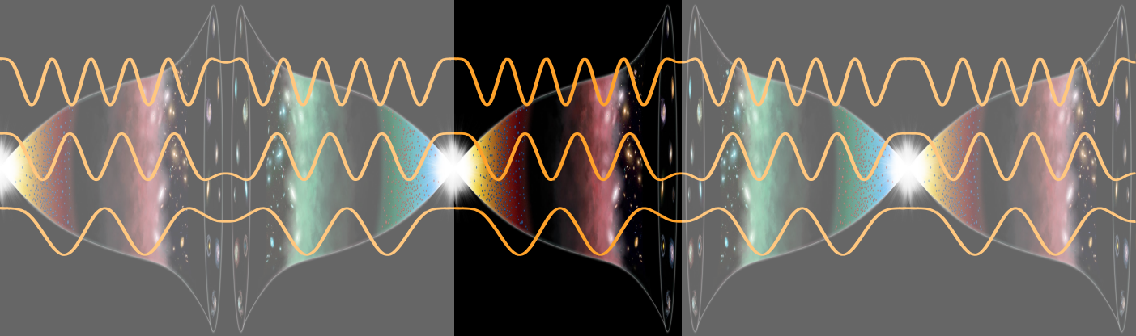
Predicting Spatial Curvature ΩK in globally CPT-symmetric universes
Wei-Ning Deng, University of Cambrige
March 19th, APS meeting
Notes:
Hello everyone, I am Wei-Ning Deng from Cambridge. Today I wan to talk about a new cosmological theory, called: CPT-symmetry universe, and some of its prediction. There will be no technical details, just big ideas. So seat back and enjoy the journey.

Slide 2
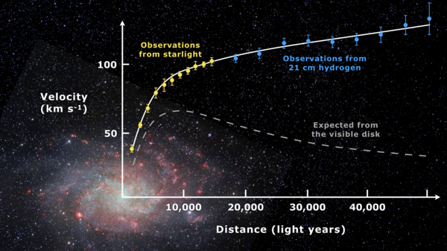
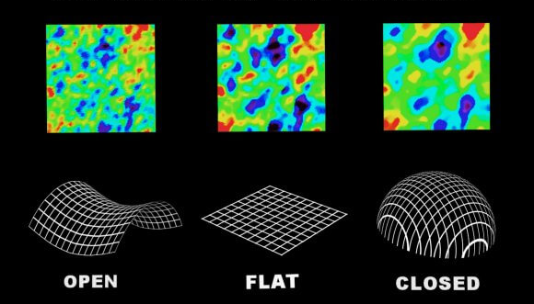
Challenges in Cosmology and SM of Physics
Flatness, homogeneity
DM
Corbelli, E.; Salucci, P. (2000-01-15)
NASA/ WMAP science group
Notes:
First, that’s start from our current understanding of the universe. Lambda CDM and standard model of particle physics, successfully explains lots of phenomenons of the universe. However, there are still lots of problems couldn’t explain.
For example, what is the composition of dark matter? Why our universe is so flat, homogeneous and isotropic?
To answer these questions, people introduced new particles, inflation era etc.

Slide 3
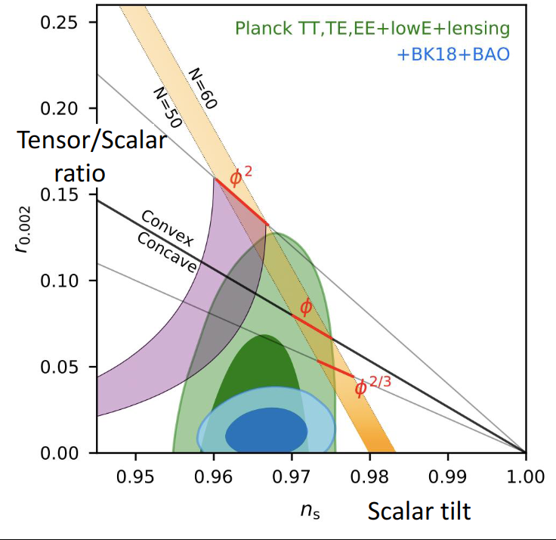
Challenges
BICEP/Keck [2203.16556]
Add complexity.
No theory can explains all problems at once.
Observational challenges.
Is there a simple theory that can explain all problems and satisfy observation?
Notes:
However, no theory can explain all problems at once.
Moreover, current observation challenges some of the most famous theory. For example, current observation shows tensor and scalar ratio should be really low, which rule out some of the most famous inflation theory.
Finally, those theory often introduce lots of new degree of freedoms and complexity. By Occam’s razor, simpler theories are preferred.
So here comes the question: is there a simple theory that can explain all problems at once?

Slide 4

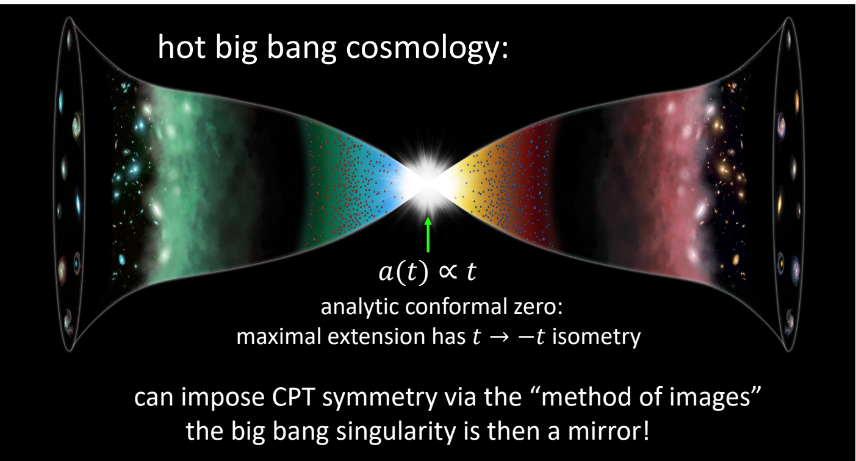
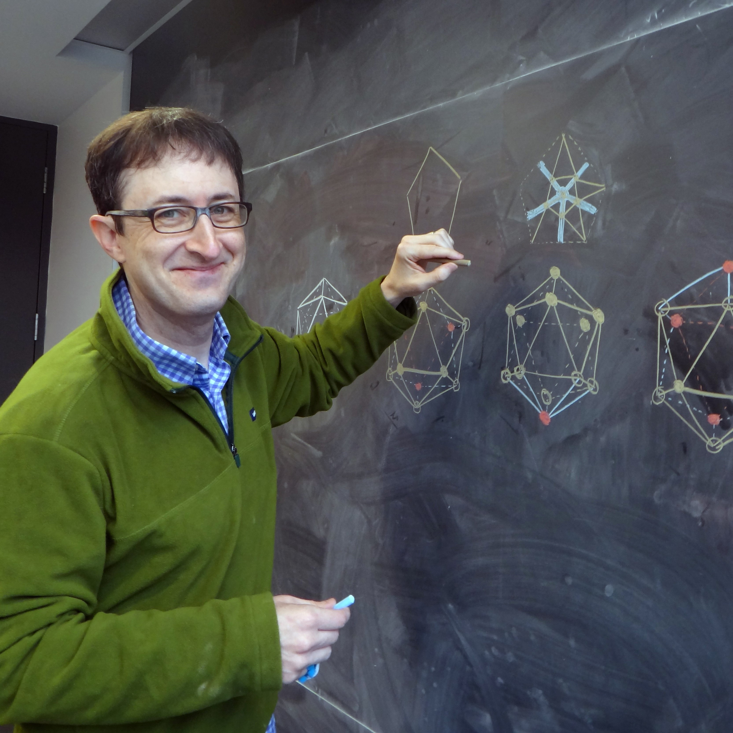
CPT-symmetry Universe – a simple explanation
The universe is CPT symmetric at the Bang
Neil Turok
The Bang acting like a mirror.
[2109.06204]
Latham Boyle
Notes:
The answer is yes, CPT-symmetry universe, proposed by Neil Turok and Latham Boyle in Eindinburgh university is one of the solution. If you solve Friedmann equation in conformal time, you will get this periodic solution. They further assume that not just scale factor, but all particles are CPT-symmetric (Charge, parity and time) symmetric at the Bang. That is, the Bang acting as a mirror. By this assumption, they can solve lots of problems in cosmology and SM without introducing any new degree of freedom.

Slide 5
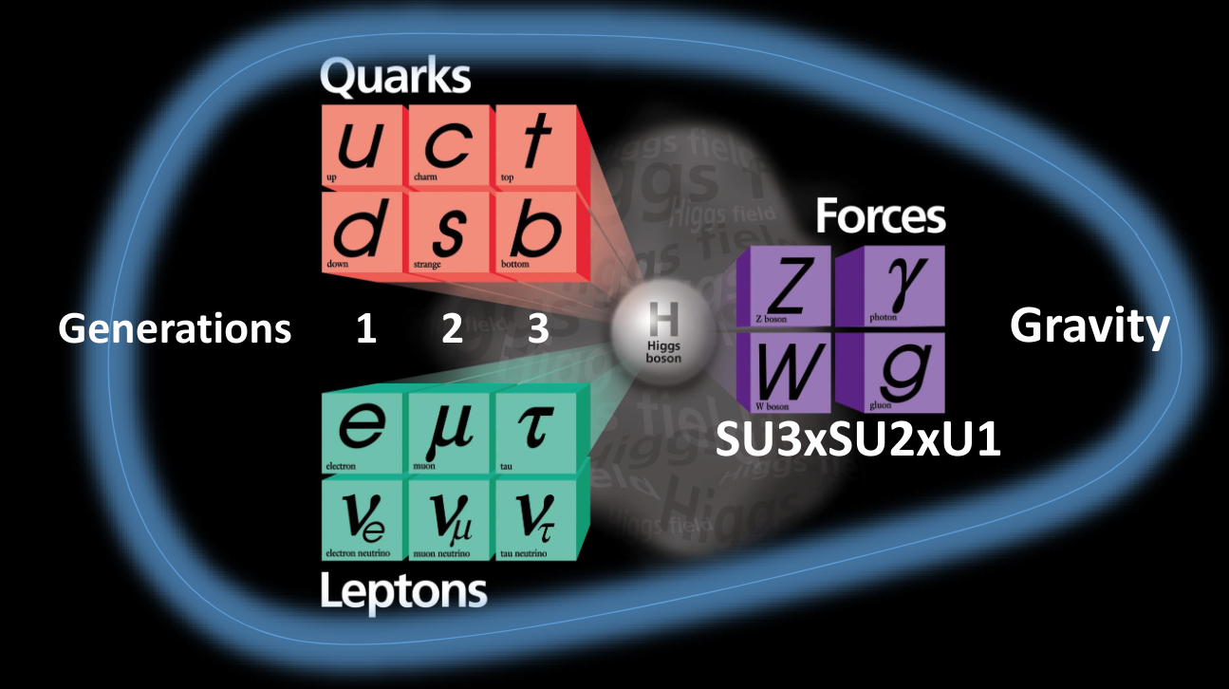
Cosmological constant Problem
Notes:
For example, people assume that cosmological constant comes from vaccum energy of particles. However, if we sum vaccum energy of all particles in SM, the values become much larger than the observed value. That is cosmological constant problem.

Slide 6
Cosmological constant Problem
L
L
L
dim-0 scalar field
R
R
R
[2110.06258]
Notes:
Neil and Latham founds that if we add three RH neutrinos, and 36 dim-0 scalar field. The problem would be solved!
It turns out that 3 RH neutrinos are quite natural to add. Because people know that LH neutrinos have tiny mass. If they are not exactly massless, there should be RH neutrinos. As for dim-0 scalar field, as they are dimensionless, they don’t add any new degree of freedoms. Keep the simplicity of the theory.

Slide 7

Dark Matter is composed of RH neutrinos
The RH neutrinos should be really massive ( ) → the LH one should be massless! [2110.06258]
Notes:
Since there are no other new particles in the universe, they assume that DM is composed of one of the RH neutrinos, which requires the RH neutrinos to be really massive. Although we cannot observe they directly, by seesaw mechanism, its corresponding LH neutrinos should be nearly massless. Which can be tested by cosmological observation.

Slide 8
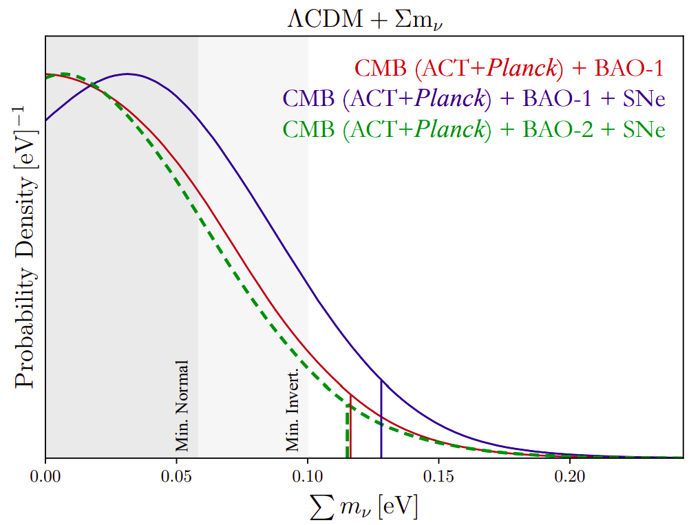
Sum of Neutrino masses Observation
Neutrino oscillation shows the minimum sum of neutrino masses should be 0.06 eV or 0.1 eV.
Since one neutrino should be massless, the sum should be minimum. Satisfy observation.
Helen Shao et al (2024)
Notes:
Neutrinos oscillation tells us that the minimum sum of neutrino mass should be 0.06 or 0.1 eV. The theory predict one neutrino should be massless, as a result, the mass sum should be the minimum, which is consistent with CMB observation.

Slide 9
L
L
L
dim-0 scalar field
?
R
R
R
Notes:
How about dim-0 scalar field?

Slide 10
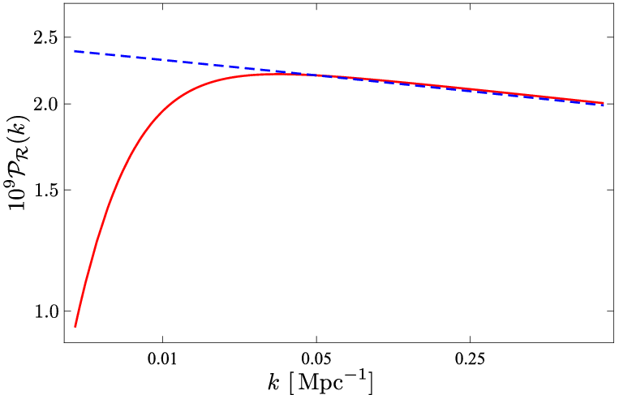
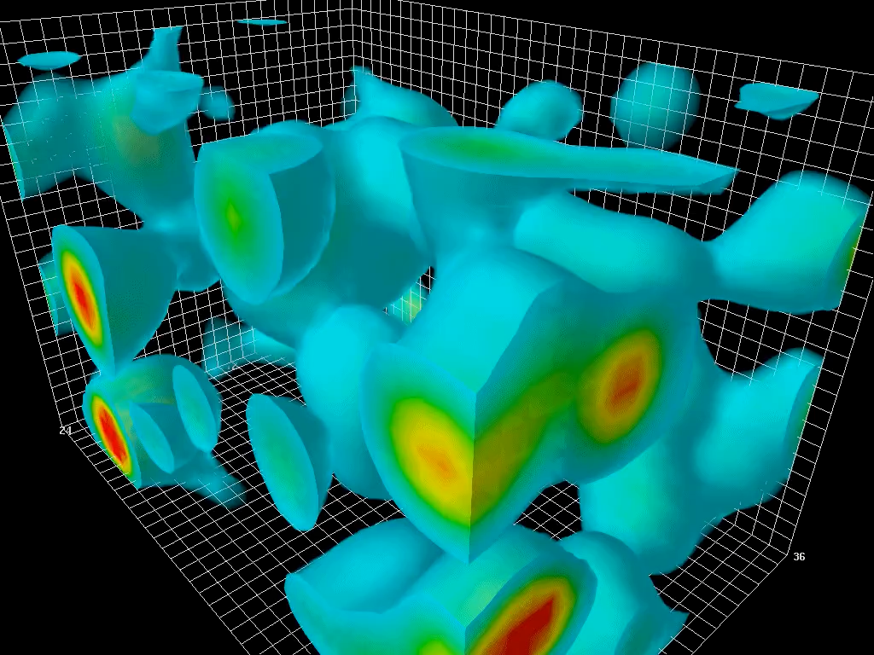
Near-scale invariant PPS
Dim-0 scalar field, as dimensionless, act as white noise → trigger near-scale invariant PPS.
No need inflation!
Dimension-0 scale field, since it is dimensionless → act as white noise
[2302.00344]
Notes:
Since dim-0 scalar field is dimensionless, it act as white noise. As a result, the primordial perturbations trigger by it should be scale invariant. The phenomenon is naturally explained without inflation!

Slide 11
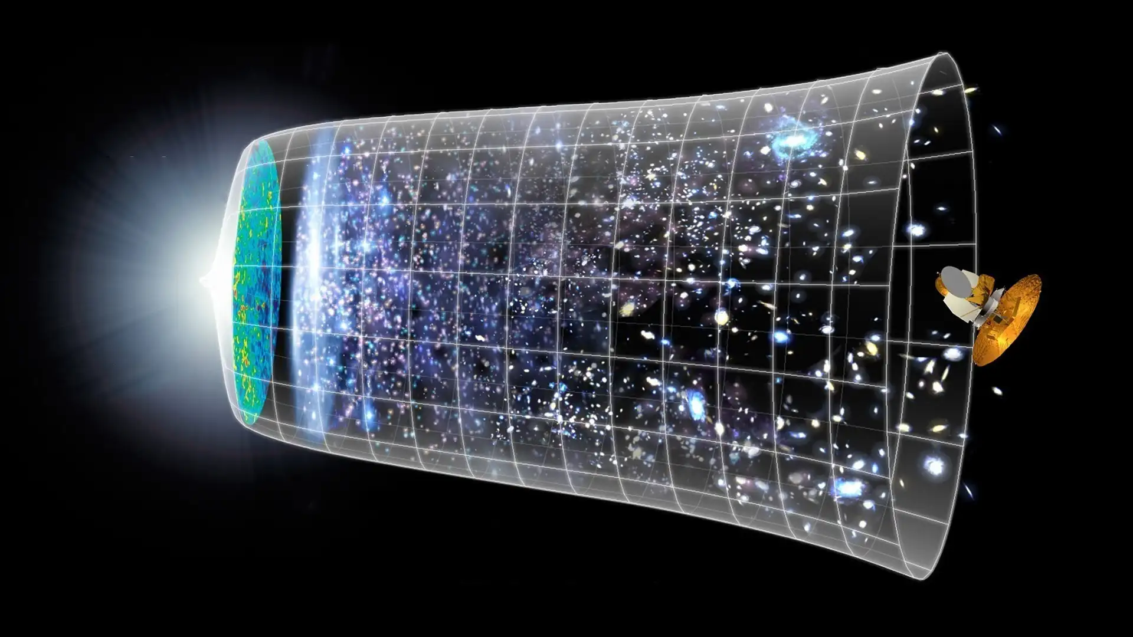
Homogenity, Flatness and Isotropy puzzle
Notes:
Finally, homonenity, flatness and isotropy puzzle. Originally people solve this problem by inflation, which happen right after Big Bang.

Slide 12
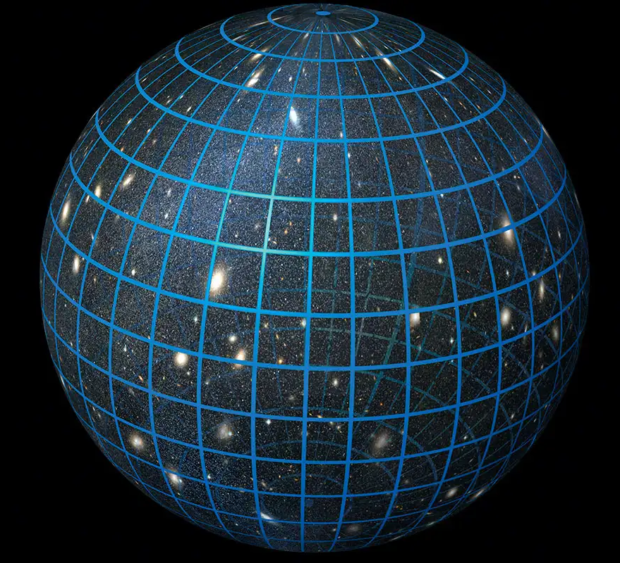
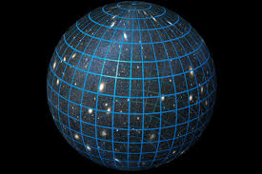
Homogenity, Flatness and Isotropy puzzle
Inflation
Observable Universe
Notes:
During inflation, the universe exponentially expand to extremely large in short amount of time. This cause observable universe become much smaller than really universe.

Slide 13
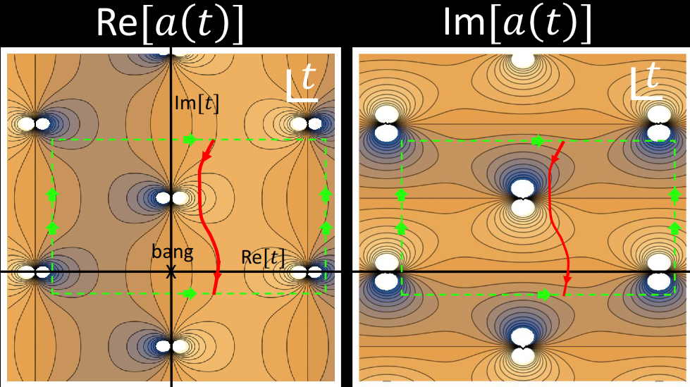
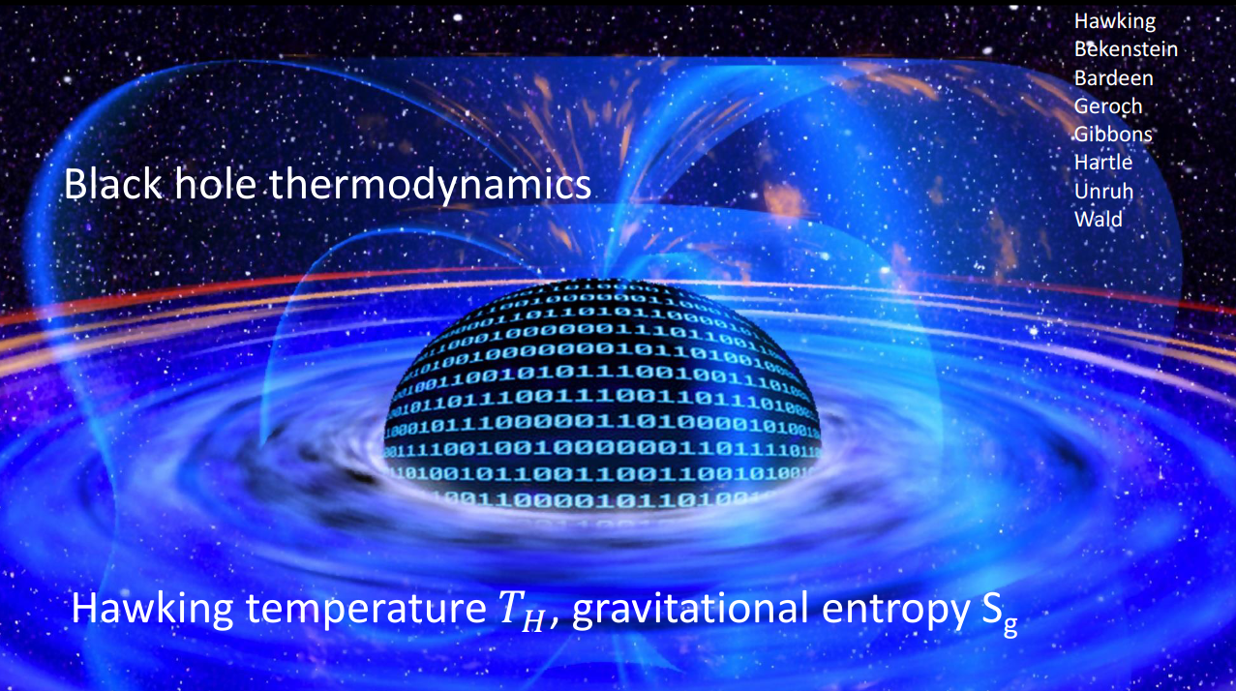
Homogenity, Flatness and Isotropy puzzle
[2210.01142]

Slide 14
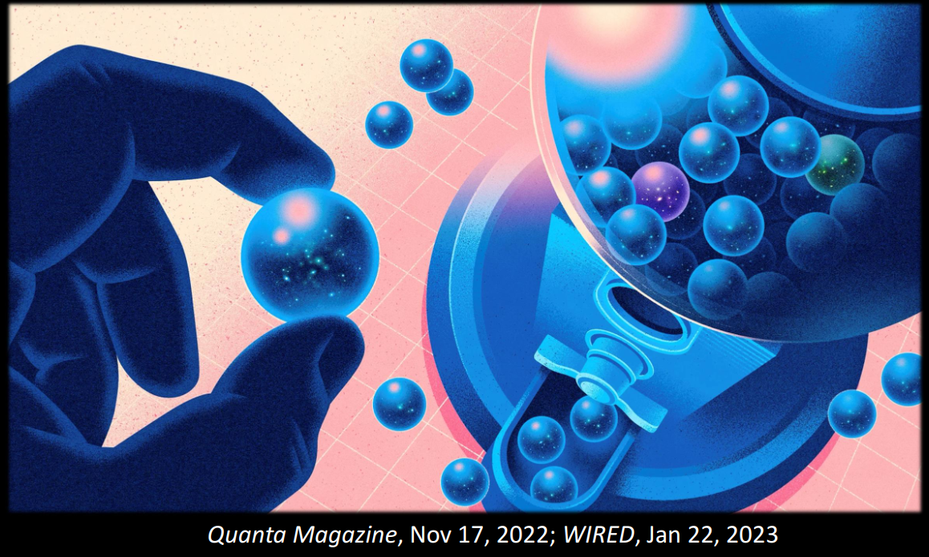
Homogenity, Flatness and Isotropy puzzle

Slide 15
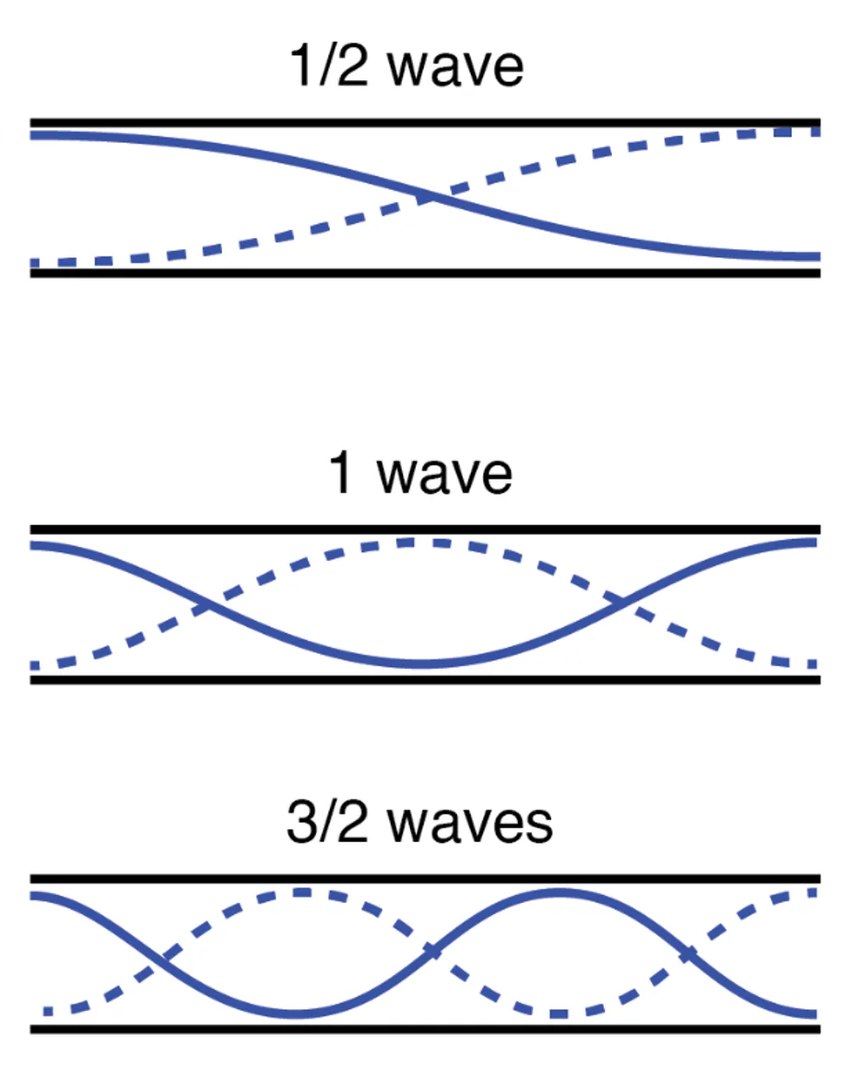
How do perturbations Evolve in the universe?
Perturbations should also be periodic. As a result, only discrete wave vectors (k) are allowed (Lasenby et. al. 2022).
Analogy: standing waves in finite tunnel.

Slide 16
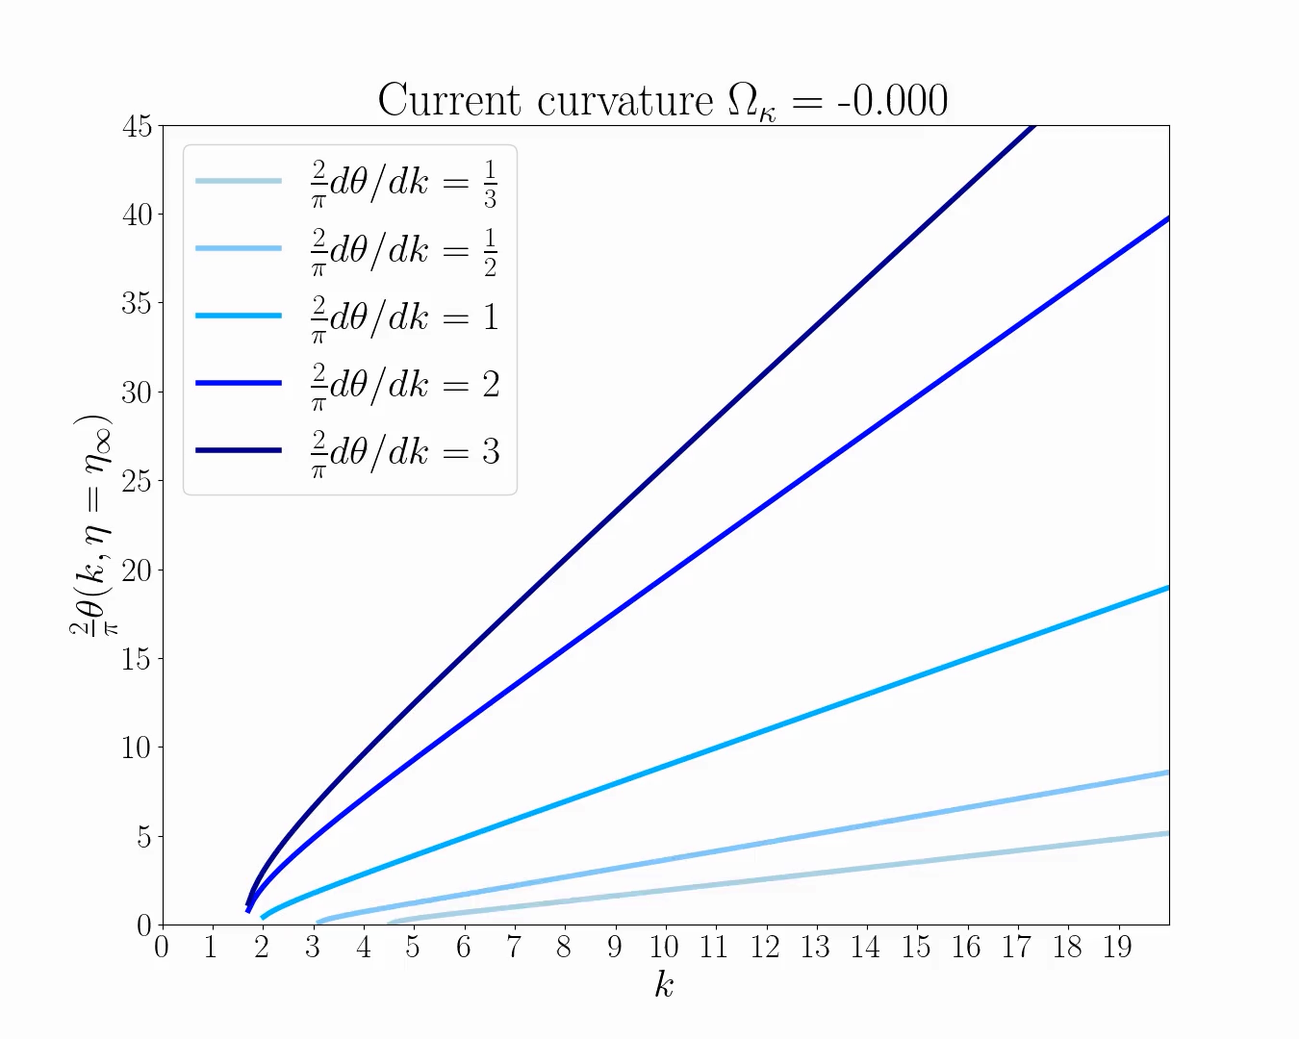
Discrete k depends on spatial curvature
1. varies with spatial curvature .
2. Finite spacetime of closed universe require .
1+2: constrains the allowed

Slide 17
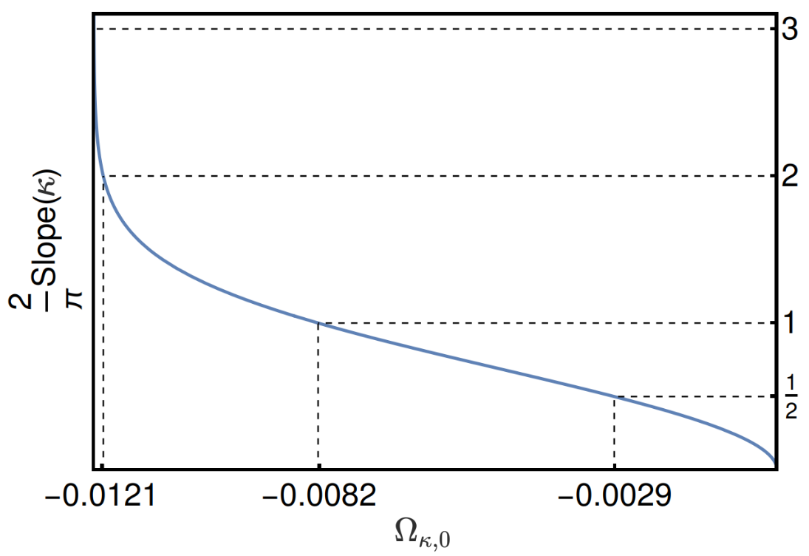
Result

Slide 18
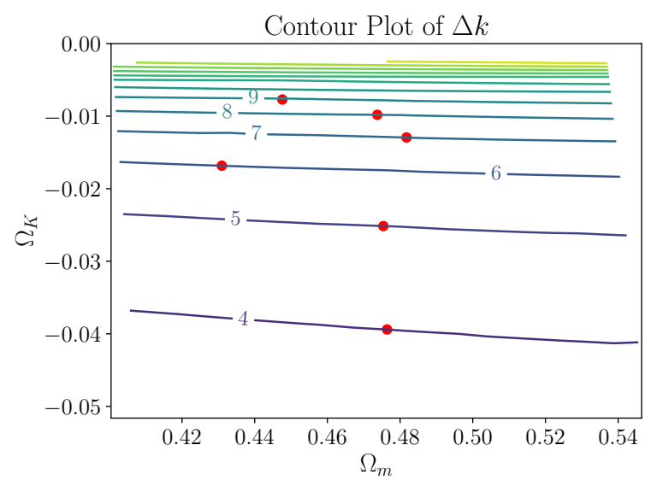
Real universe
Include matter, radiation anisotropy etc [2111.14588].
The cosmological parameters must satisfy the constraint:

Slide 19
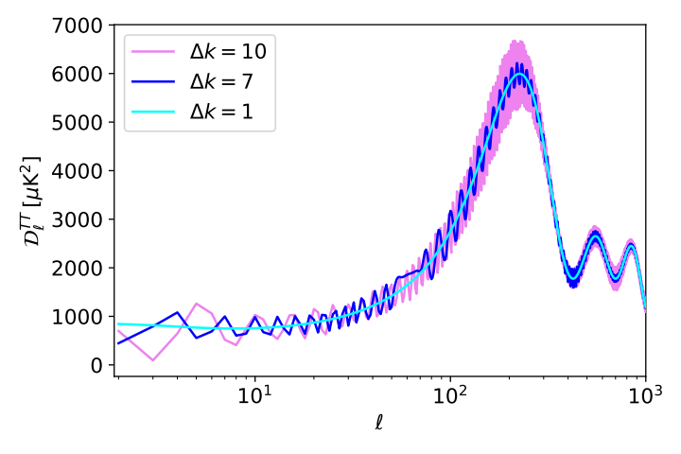
CMB with different
Modify CLASS code to allow different
The larger The more fluctuation in high-l modes.

Slide 20
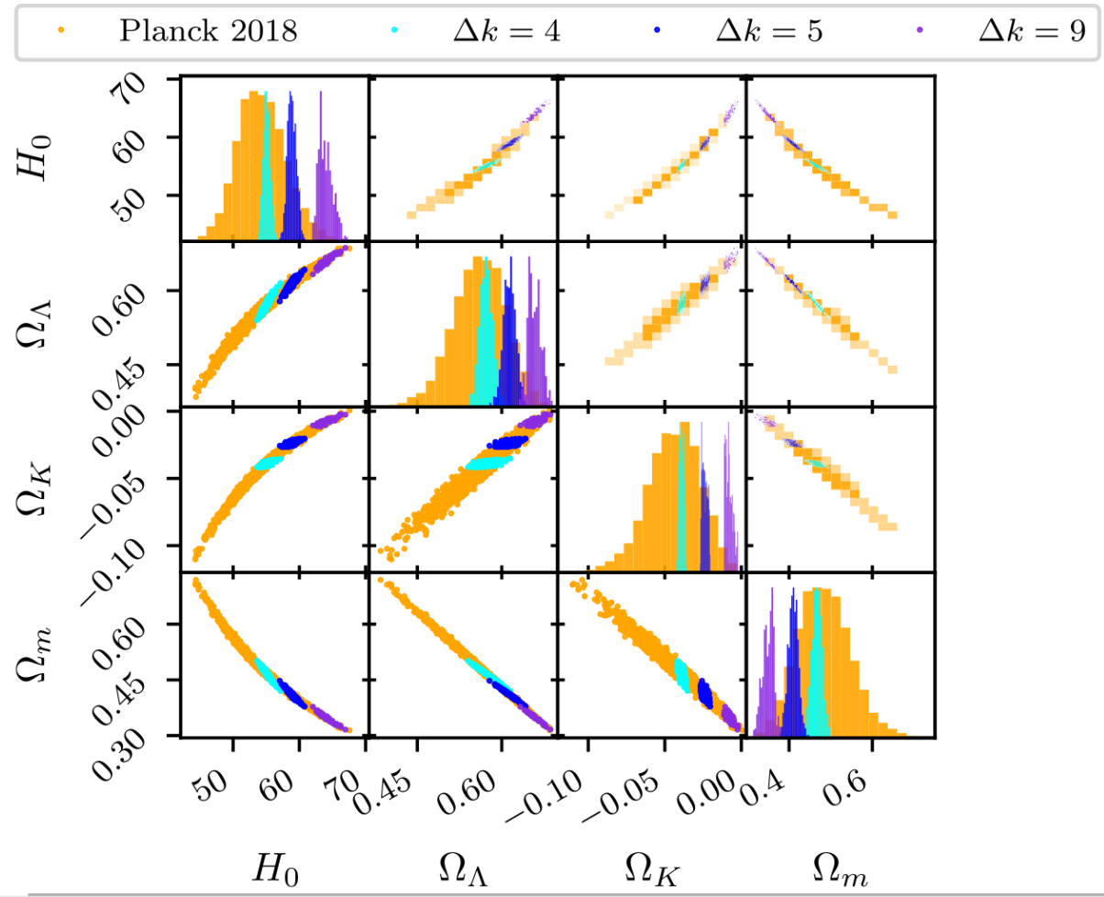
Compare with Observation
Apply the constraint
to Planck 2018 data.
Find best-fit parameters by Bayesian analysis.
Result:

Slide 21
Conclusion and future work
CPT-symmetry universe can solve lots of problems.
Perturbations should be periodic, require some discrete k.
Closed universe require integer k, which constrains curvature value to be:
Future work: incorporate combined observation (ex: CMB+BAO+SN 1a) to break the degeneracy.

Slide 22



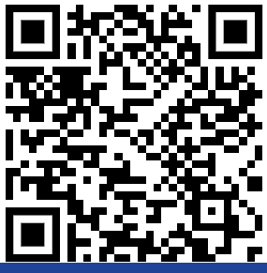
Acknowledgement
PHYSICAL REVIEW D 110, 103528 (2024)
Will Handley University of Cambridge
Latham Boyle University of Edinburgh
Wei-Ning Deng
Email: wnd22@cam.ac.uk
Thanks for listening ~

Slide 23
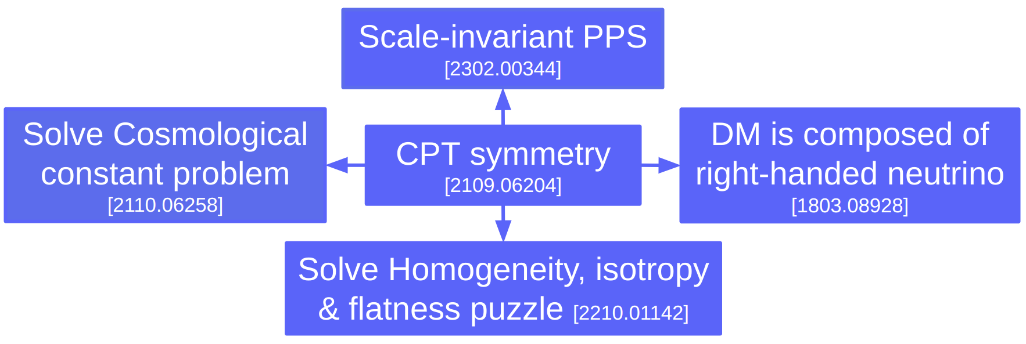
Papers for CPT-symmetry universe

Slide 24

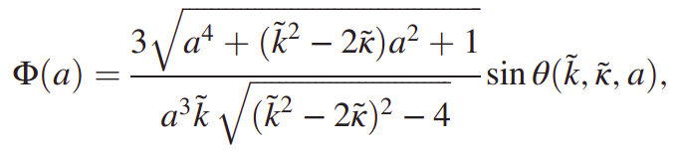
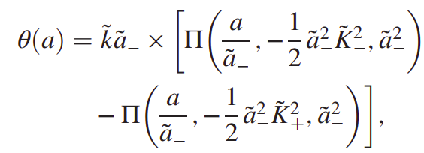
Analytic solutions of perturbations
Perturbation Equation:
Solution:

Slide 25
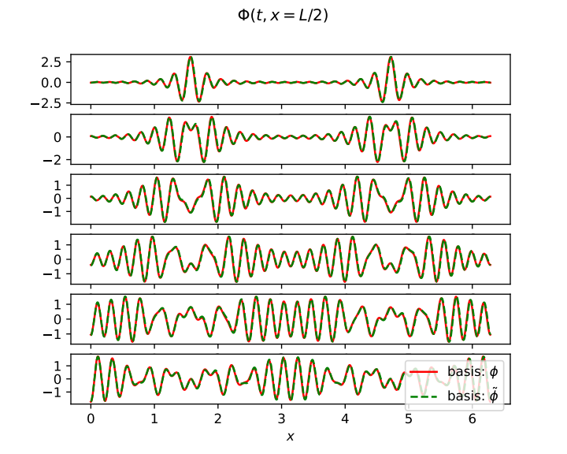
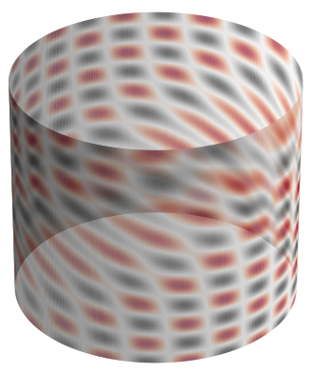
Low-k mode

