Slide 1


Employee Attrition Analysis
Adam Ercanbrack

Slide 2
Agenda
A review of the data provided – To perform exploratory data analysis on international beer bitterness(IBU) and Alcohol Volume (ABV) by State and brewery
Data Acquisition – Beer data and Brewery data were obtained in CSV format
Data Preparation –Steps taken to fill the gaps for missing values.
Data Visualization – Graphs were created using ggplot in R studio
A Discussion on Ales vs. Indian Pale Ales – A deeper analysis using knn to determine differences between Ales and IPAs.
Discussion of Recommendations – An introduction to research possibilities and market exploitables.

Slide 3

Model and Data Summary
Total number of records
Attrition Dataset: 870 records
Number of Variables: 33
Models Used:
Multiple Linear Regression
K-Nearest Neighbor
Naïve Bayes
Prediction Regression
Data Condition:
There were no missing values.
The definitions of some of the variables were not well defined.

Slide 4
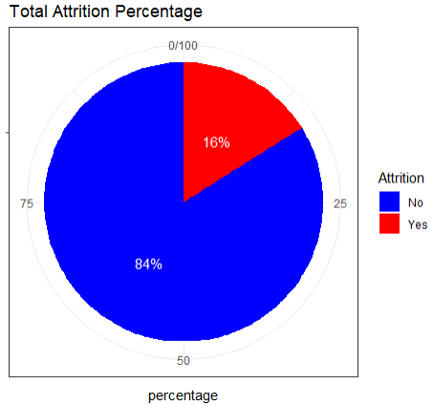

Frito Lay Annual Attrition Rate
Key Highlights
Annual Attrition Rates are quite high, representing 16 percent of the workforce

Slide 5
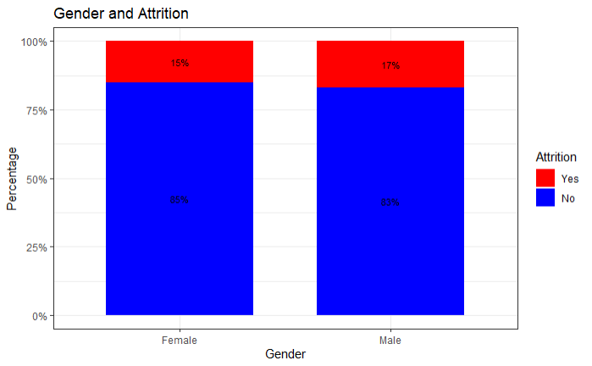
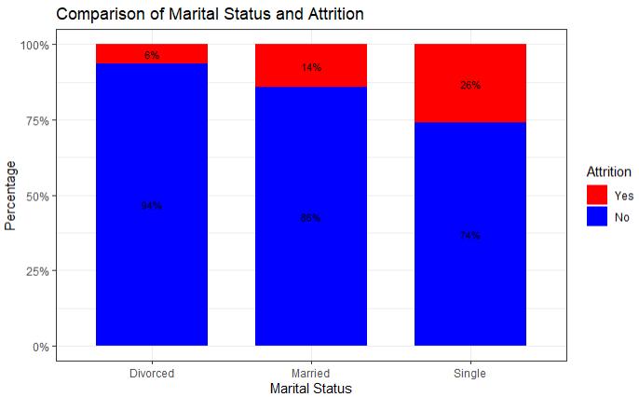
Frito Lay Demographic Breakdown
Key Highlights
Gender attrition rates are nearly equal
Single Employees are more likely to leave than previously married or married employees
No Data on race was provided

Slide 6
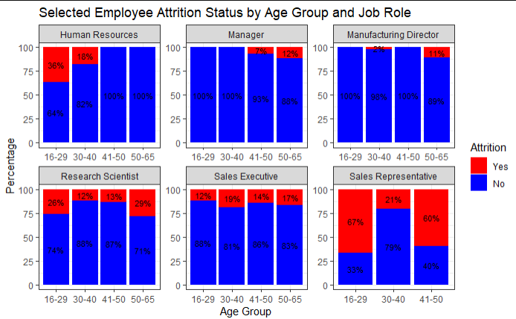

Frito Lay Demographic Breakdown
Key Highlights
The younger generation is more likely to move to a new Job
Older managers are more likely to retire or take another position than younger managers

Slide 7
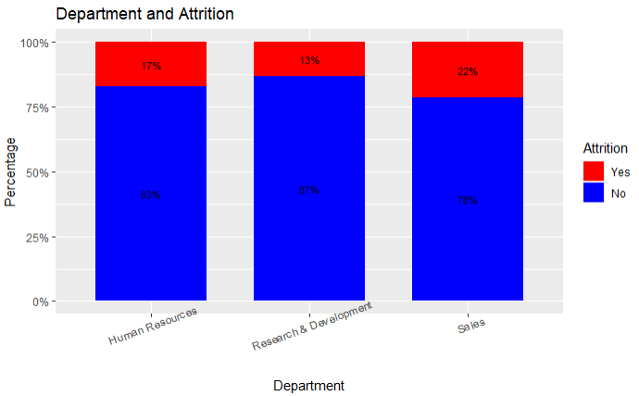

Frito Lay Departments
Key Highlights
Sales Department has the highest attrition rate.

Slide 8
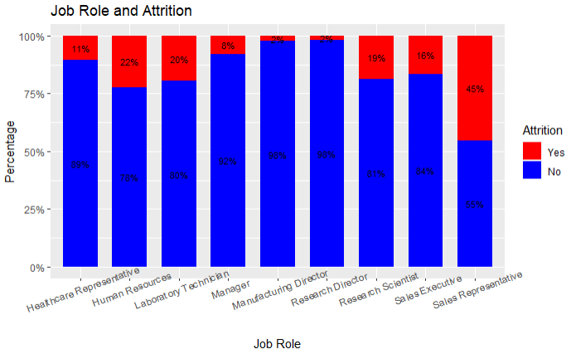
Frito Lay Employee Roles
Key Highlights
Sales Representative have the highest attrition rates.
Lab techs, Research Directors and Scientists, and HR Employees all above average

Slide 9
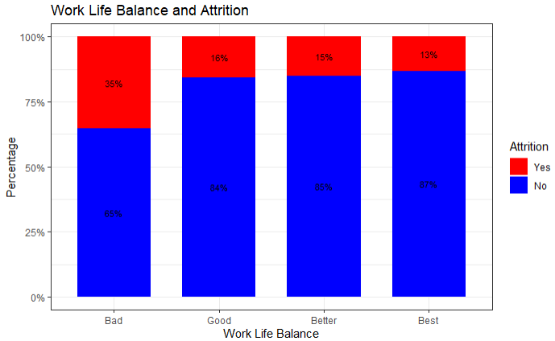

Attrition Causes: Work-Life Balance
Key Highlights
Sales Executives Seem to dislike the Work-life Balance
Views if Work-life Balance issue have less consistency with Sales Representatives
Research Scientists are flat

Slide 10
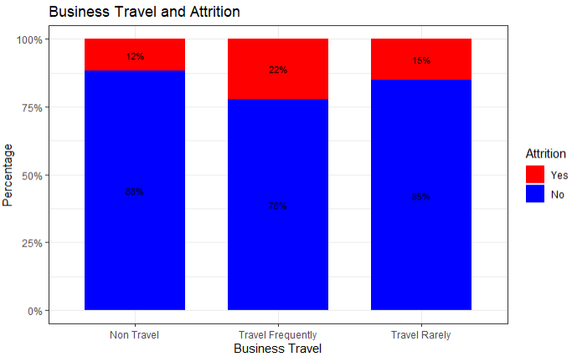
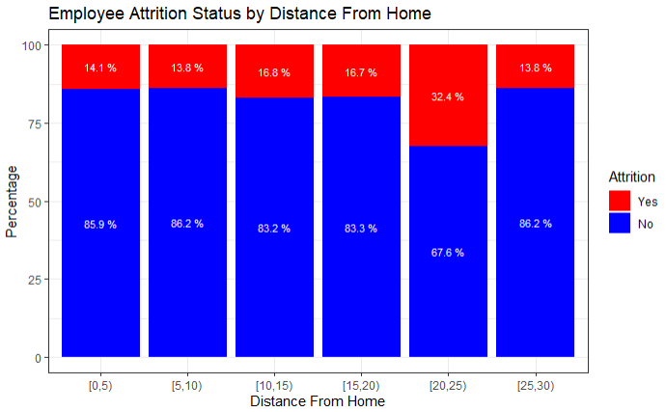
Attrition Causes: Travel
Key Highlights
Travel and Distance from work seem largely flat

Slide 11
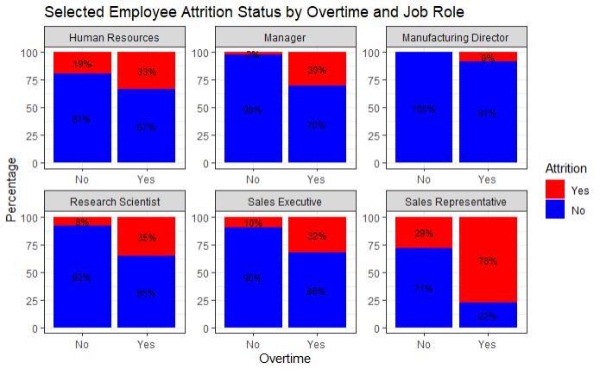
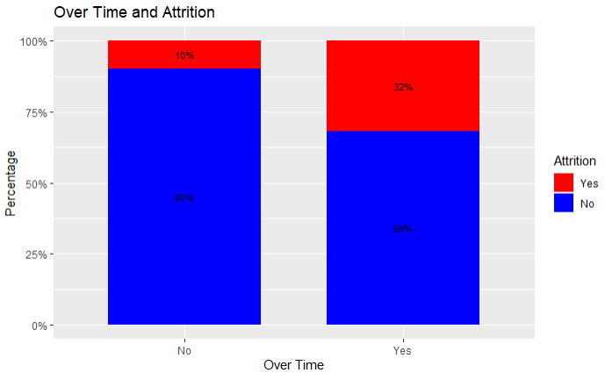
Attrition Causes: Overtime
Key Highlights
Overtime is a major trigger for Attrition
Sales Representatives have the highest rate of attrition
Research Scientists, HR, Sales Executives, and Managers also affected by overtime.

Slide 12
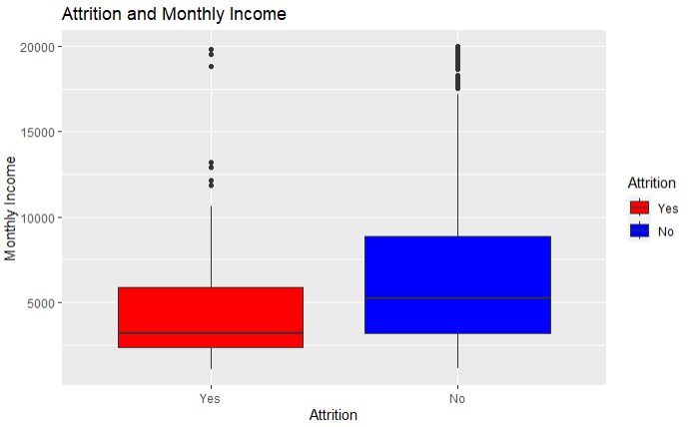
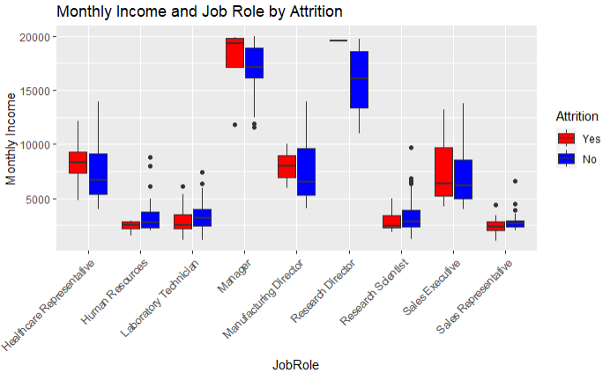
Attrition Causes : Pay
Key Highlights
Employees Leaving the workforce tend to have lower pay.
Sales Representatives, Research Scientists, Lab Techs, and HR among lowest Paid

Slide 13
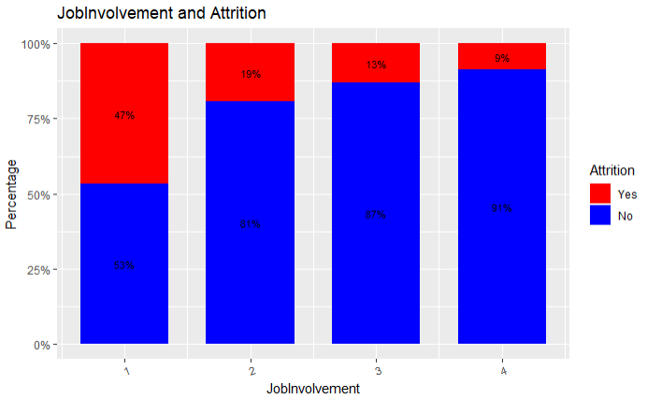
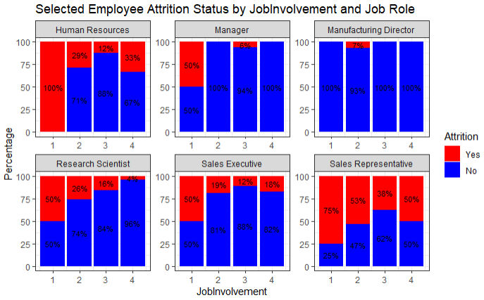
Attrition Causes: Job Involvement
Key Highlights
Job Involvement a major issue with HR and Sales Representatives
Sales Executives and Research Scientists also view Job Involvement as an issue

Slide 14
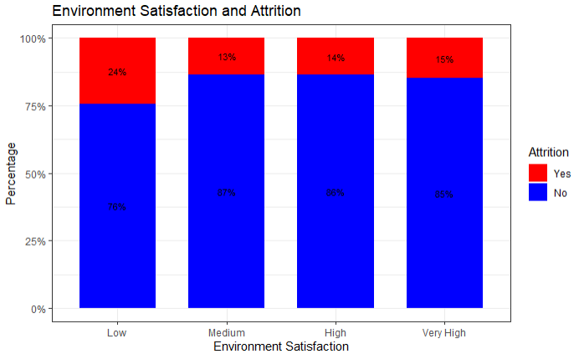
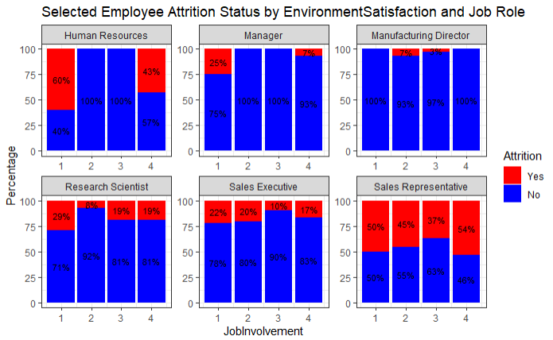
Attrition Causes: Environment Satisfaction
Key Highlights
HR, Managers, and Research Scientists Seems to have the most toxic environment.
All others appear flat

Slide 15
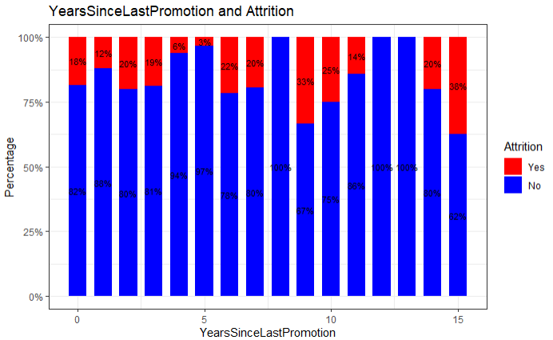
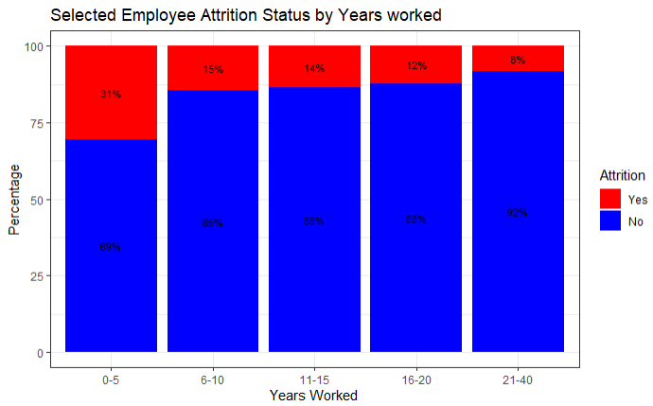
Attrition Causes: Work and Promotion Time
Key Highlights
Years since the last Promotion has a slow upward trend
Turnover among workers is highest among those on the job for the least amount of time
Research Scientists, HR, Sales Executives, and Managers also affected by overtime.

Slide 16
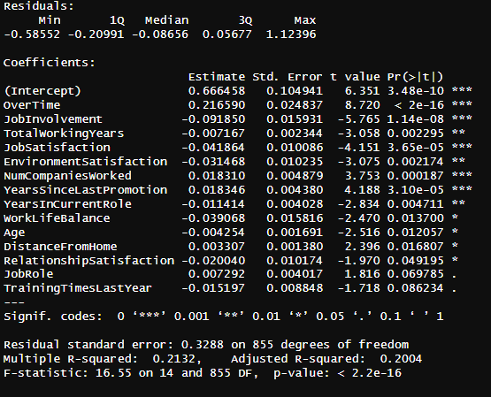
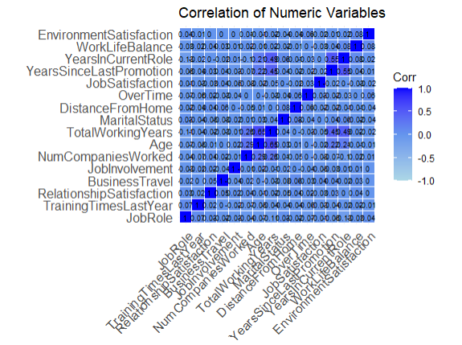
Multiple Regression Analysis
Key Highlights
A multiple linear Regression Model was used to find the most significant variables.
Significant Variables were run through stepwise analysis models
A forward and Backward analysis was selected at the best

Slide 17
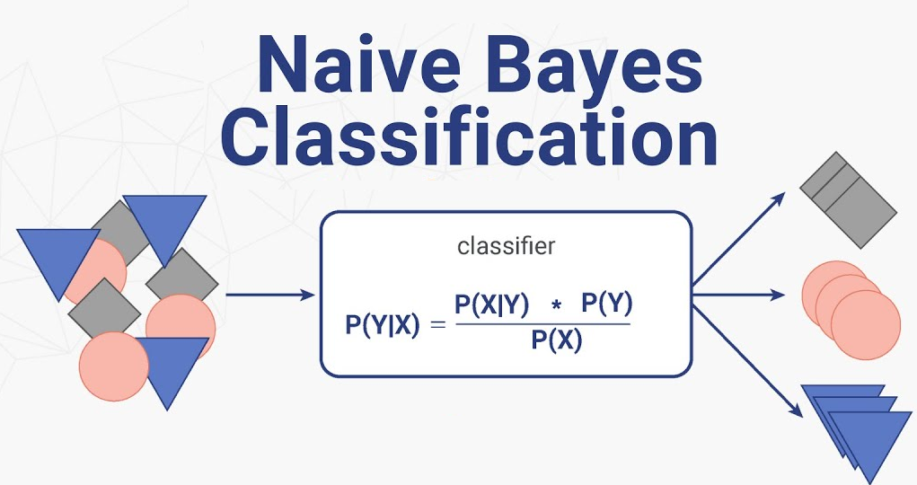
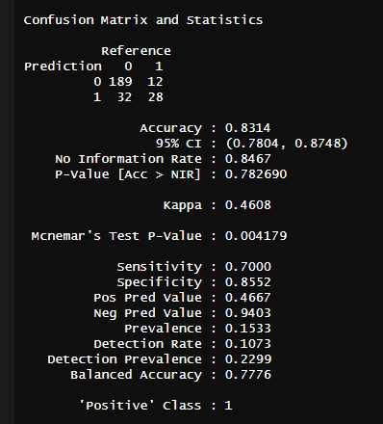
Prediction Models
Key Highlights
We tested Linear Predictive Regression Models, K-NearestNeighbor, and Naïve Bayes Predictive Models.
The Naïve Bayes Model was Selected as it had the best sensitivity, specificity, and accuracy.

Slide 18
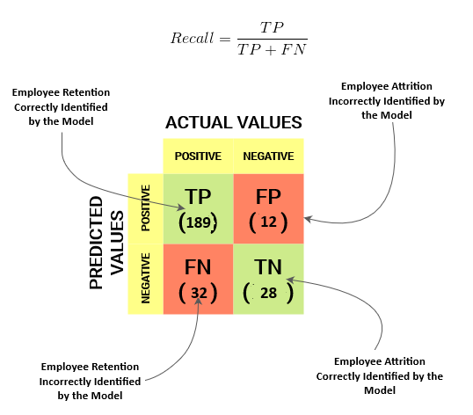
Prediction Models: Findings
Key Highlights
Sensitivity – the model’s ability to predict true positives – 70 percent
Specificity – the model’s ability to predict true negatives – 85.5 percent

Slide 19
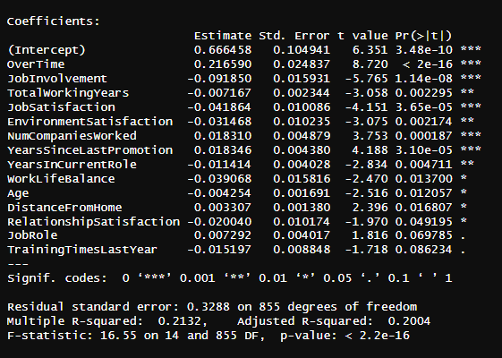
Prediction Models: Variables
Key Highlights
Overtime, Job involvement, Job Satisfaction, Number of companies worked, Last Promotion = most significant
Job role – Less significant as a whole, but highly significant with Sales Rep, Lab Tech, and HR

Slide 20

Retention Recommendations:
Conduct a Focused Analysis of the most significant variables to see what conditions are causing that outcome, for example Job Involvement.
Conduct workplace surveys that ask specifics about this outcome, for example Job Involvement.
Search for policies and workplace practices that can be changed.
Key Highlights
Overtime, Job involvement, Job Satisfaction, Number of companies worked, Last Promotion = most significant
Job role – Less significant as a whole, but highly significant with Sales Rep, Lab Tech, and HR

Slide 21
Retention Recommendations:
Conduct a more detailed Analysis based on Job Roles and Department (See how Sales Represenative compares to Research Director)
Change the culture in these job roles to help improve retention.
Remember, Retention saves money!!!
Key Highlights
Overtime, Job involvement, Job Satisfaction, Number of companies worked, Last Promotion = most significant
Job role – Less significant as a whole, but highly significant with Sales Rep, Lab Tech, and HR

Slide 22
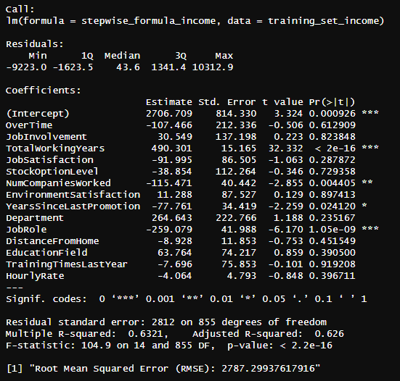
Monthly Income Analysis:
Key Highlights
We used a Regression Prediction Model to interpret monthly income
Total Working Years, Number of Companies Worked, Years Since Last Promotion, and Job role all impact income
The Root Mean Squared Error (RMSE) for this model is 2787.3 (Statistically significant)

Slide 23
Questions?
Github site:
Weiprecht/CaseStudy2DDS (github.com)
Webpage (Look In Projects): Statistical Insights (weiprecht.github.io)
Presentation Links: Statistical Insights (weiprecht.github.io)

