Slide 1

Doing Data Science
Unit 1: Live Session
First Steps on the Path of a Data Scientist
A Presentation by Adam Ercanbrack

Slide 2
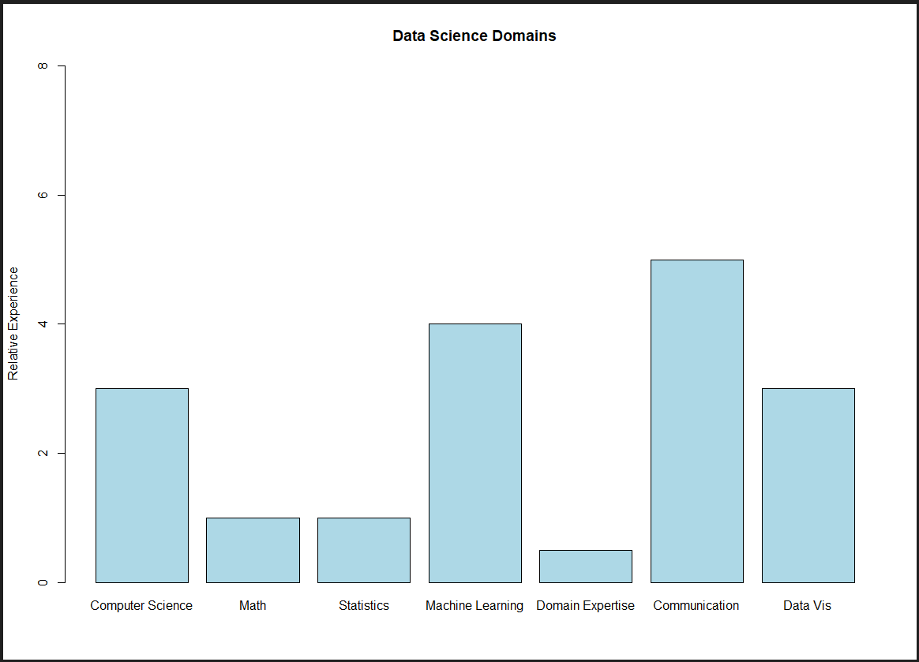

Data Science Profile
I come from a social science background, with years of experience dealing with complex problems. I have accumulated strong critical thinking and written and verbal communication skills but have limited data science experience to fit this profile. Which means:
I have many hurdles to over come.
Nonetheless, I have acquired some skills during two years in a data science position.
Computer Science: I am confident in SQL, proficient in Python, and am diving into R.
Machine Learning: I have built topic modeling, sentence extracting, and semantic searching tools.
Data Visualization: I have used Excel, Tableau, and Python to create graphics and other visuals to ease data consumption by customers.
Statistics: Although it has been 20 years since I did any serious math, I did take the SMU’s, very useful, Statistics Bridge Course.

Slide 3
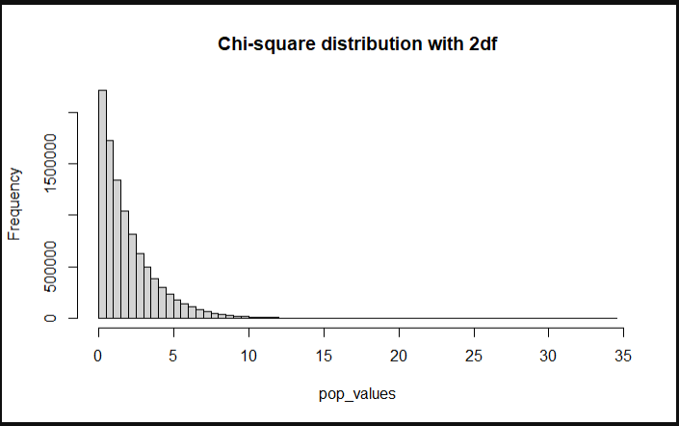
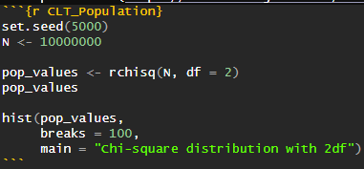
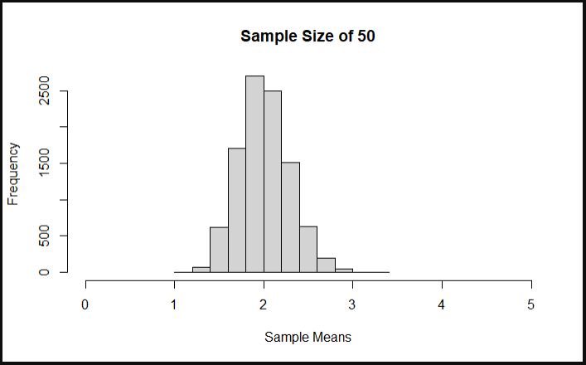
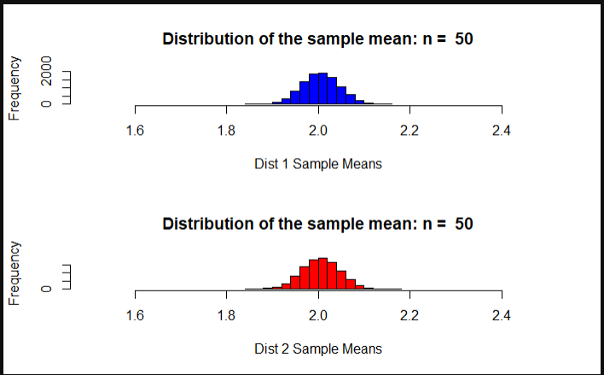
Central Limit Theorem
Adapt the code to generate a population of 10,000,000 from a chi-square distribution. (See figure 1.)
Display a histogram of this right skewed population. (See figure 2)
What is the mean and standard deviation? Mean = 1.999041 Standard Deviation = 2.000401
According to the central limit theorem a sample mean with a size ≥ 30 should have a normal distribution. (See figure 3). Since the sample was size 50 it should have a normal distribution. When tested, the sample had a mean of 2.005591, with a standard deviation of 0.2827237 reflecting this more normal distribution.
Provide the sampling distribution and histogram of these sample means. (See figure 4)
Sample mean 1 = 2.004404. Standard Deviation 1 = 0.05258683. Sample mean 2 = 2.003828. Standard Deviation 2 = 0.04011342.
Figure 1.
Figure 2.
Figure 3.
Figure 4.

Slide 4
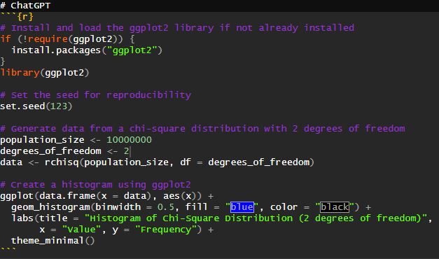
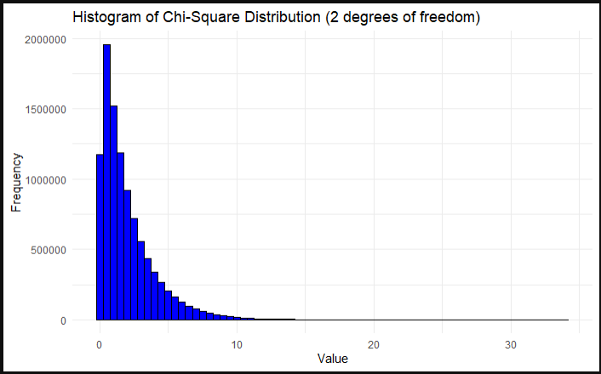
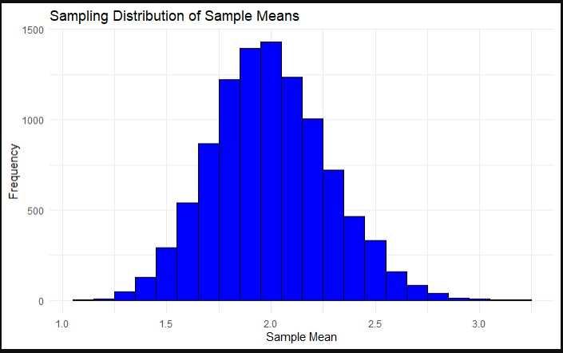
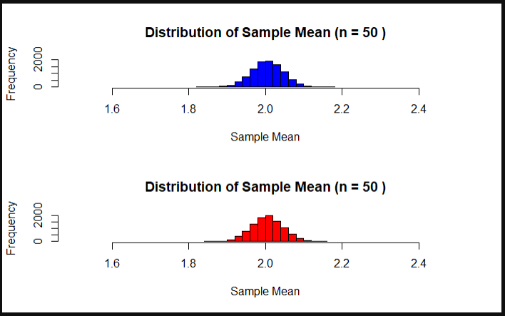
ChatGPT: Central Limit Theorem
How to make a human feel REAL Dumb!
Adapt the code to generate a population of 10,000,000 from a chi-square distribution. (See figure 1.).
Display a histogram of this right skewed population. (See figure 2).
Mean = 2.000466. Standard Deviation = 2.00042.
For a sample size of 50, the mean and standard error of the mean will be: Mean of the sample means: 2 (same as the mean of the original distribution). Standard error of the mean (SE): 2 / sqrt(50) ≈ 0.2828. Thus, the distribution of sample means of size 50 from this right-skewed population should be approximately normally distributed, with a mean of 2 and a standard error of the mean of approximately 0.2828. (See figure 3).
Provide the sampling distribution and histogram of these sample means. (See figure 4).
Mean of the sample means = 2 (same as the mean of the original distribution), and Standard deviation of the sample means ≈ 0.2828 (calculated as the original standard deviation divided by the square root of the sample size).
Figure 1.
Figure 2.
Figure 3.
Figure 4.

Slide 5
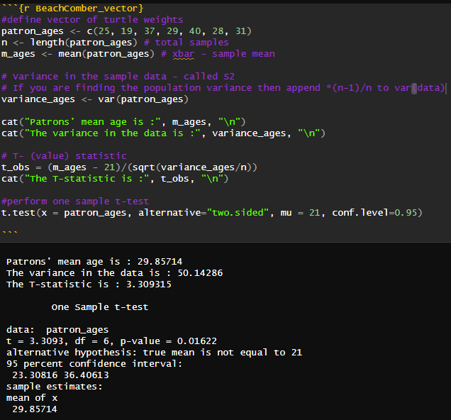
T-test and the Six Steps of a Hypothesis Test
"The following are ages of 7 randomly chosen patrons seen leaving the Beach Comber in South Mission Beach at 7pm! We assume that the data come from a normal distribution and would like to test the claim that the mean age of the distribution of Comber patrons is different than 21. Conduct a 6 step hypothesis test to test this claim. 25, 19, 37, 29, 40, 28, 31“ (See figure 1)
Step 1: Identify the null (H0) and alternative (Ha) hypotheses. H0: Beach Comber patrons' ages are, on average, equal to 21. Ha: Beach Comber patrons' ages are, on average, not equal to 21.
Step 2: Draw and shade the model - because the alternative hypothesis is not equal to 21, this is a (Two-tailed) model with 0.025 on the extreme ends.
Step 3: Test the sample against the hypothesis: The test statistic is 3.309315.
Step 4: Quantify the difference: t-score = 3.3093, p-value = 0.01622
Step 5: Decide to reject or fail to reject (FTR) H0: Since the p-value (0.01622) is < the alpha (0.025), we reject the null hypothesis.
Step 6: Conclusion: There is sufficient evidence to suggest (p-value 0.01622) that the mean age of patrons is different than 21.
Figure 1.

Slide 6
Takeaways, Questions, and Comments
Takeaways:
Data Science is a growing industry that is increasingly recognized by organizations as a powerful tool for extracting findings from data and improving business outcomes.
R is a powerful coding language for statistics and can improve a data scientist’s workflow. Git Hub can help you preserve a record of your source code for future use and sharing. I learned a lot of base R code in the last few days.
Statistics is hard and ChatGPT can answer questions much faster than I can.
Questions:
Explain how variance plays into t-tests? How does variance relate to the critical score?
In the CLT exercise, why compare the distribution of two mean samples of the same size (50) instead of different sample sizes?
Comments:
It would be nice if, at the top of the Unit 1 page, you had a walkthrough video explaining all of the elements (Assignments and Grading, 1: Git-ing Sta-R-ted!). Understanding where to find the assignment and where to post it and the expectation for the lectures would be nice. I wasted a long time just hunting through all the sections to come to a point where I could guess what the expectations were.
I did not find the Git Hub address to Doing Data Science in the Syllabus. I fortunately found your hub in the Intro to statistics class and was able to navigate to it from there.

