Slide 1

Doing Data Science
Unit 2: Live Session
Ggplot and the World of visualization
A Presentation by Adam Ercanbrack

Slide 2
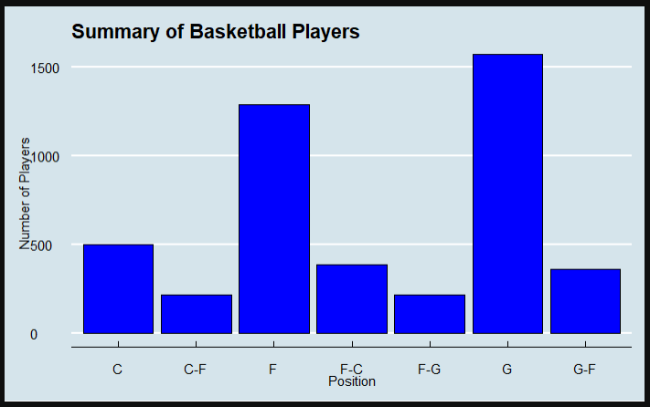
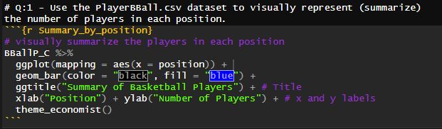
Visualization Questions: Basketball Player Data Set
Use the NBA basketball player data set to answer the question as you understand it. (3-5 hours)
Question 1: Use the PlayerBBall.csv dataset to visually represent (summarize) the number of players in each position.

Slide 3
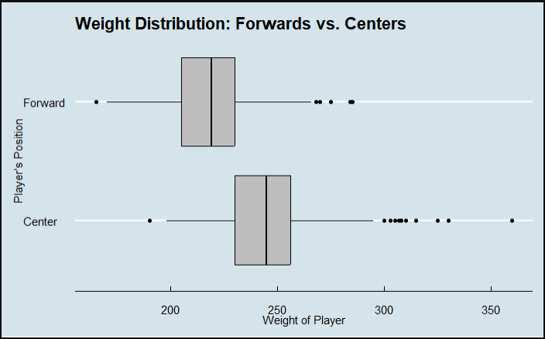
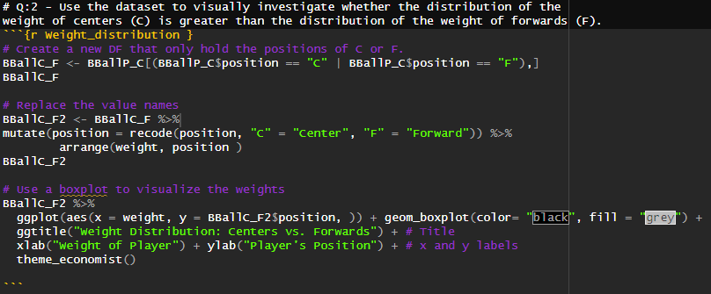
Visualization Questions: Basketball Player Data Set
Use the NBA basketball player data set to answer the question as you understand it. (3-5 hours)
Question 2: Use the dataset to visually investigate the distribution of the weight of centers (C) is greater than the distribution of the weight of forwards (F).

Slide 4
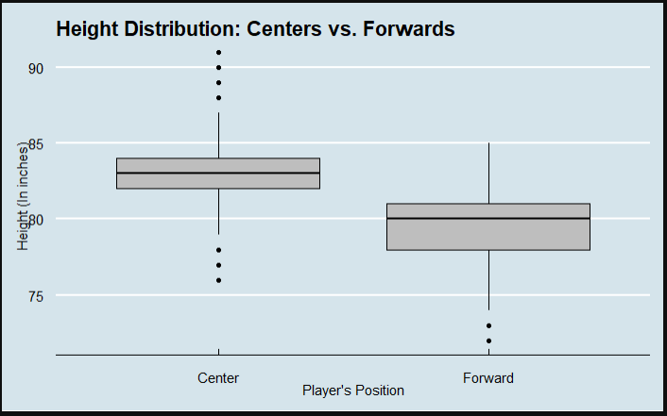
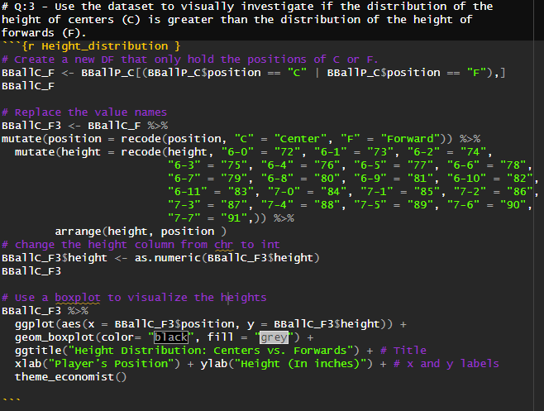
Visualization Questions: Basketball Player Data Set
Use the NBA basketball player data set to answer the question as you understand it. (3-5 hours)
Question 3: Use the dataset to visually investigate if the distribution of the height of centers (C) is greater than the distribution of the height of forwards (F).

Slide 5
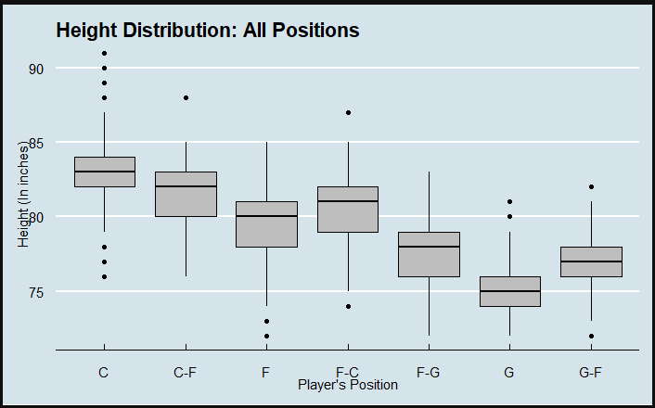
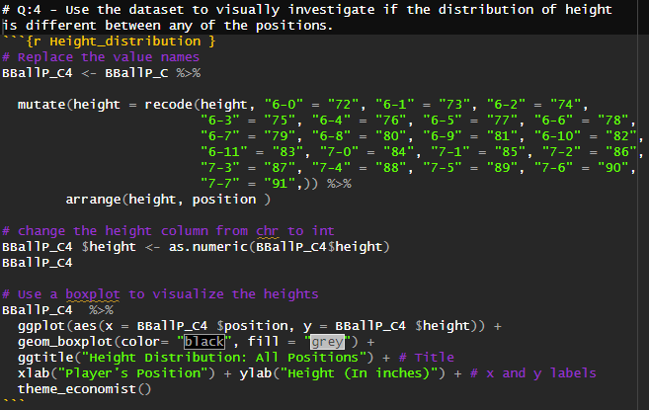
Visualization Questions: Basketball Player Data Set
Use the NBA basketball player data set to answer the question as you understand it. (3-5 hours)
Question 4: Use the dataset to visually investigate if the distribution of height is different between any of the positions.

Slide 6
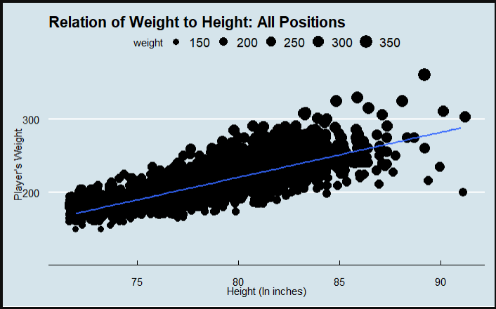
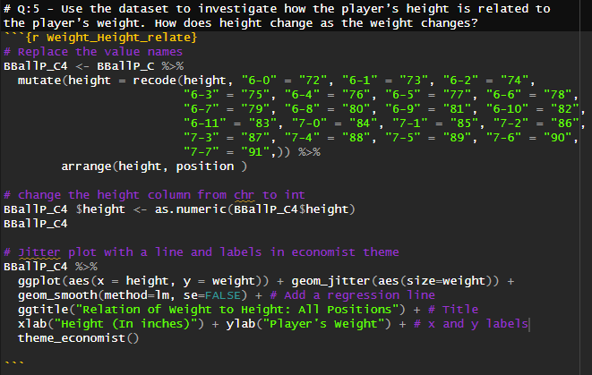
Visualization Questions: Basketball Player Data Set
Use the NBA basketball player data set to answer the question as you understand it. (3-5 hours)
Question 5: Use the dataset to investigate how the player’s height is related to the player’s weight. How does height change as the weight changes?
Answer: The greater the height the greater the weight.

Slide 7
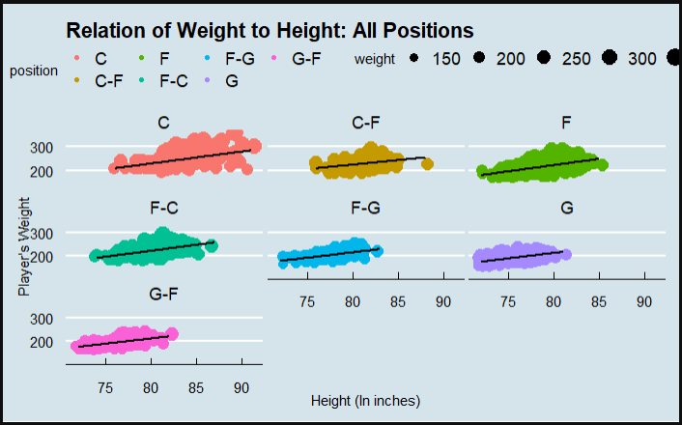
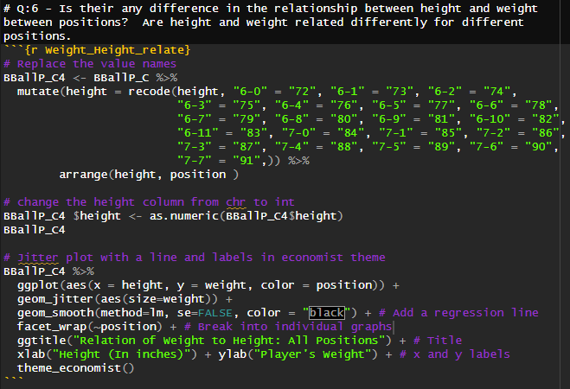
Visualization Questions: Basketball Player Data Set
Use the NBA basketball player data set to answer the question as you understand it. (3-5 hours)
Question 6: Is their any difference in the relationship between height and weight between positions? Are height and weight related differently for different positions.
Answer: Although weight and height vary based on the position, the regression line appears to be the same. The greater the height the greater the weight.

Slide 8
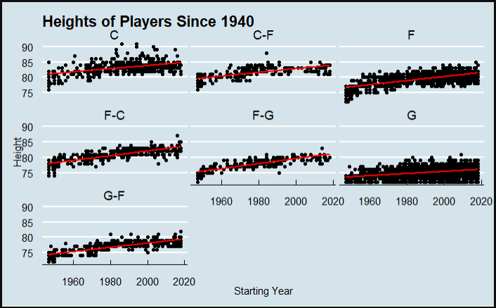
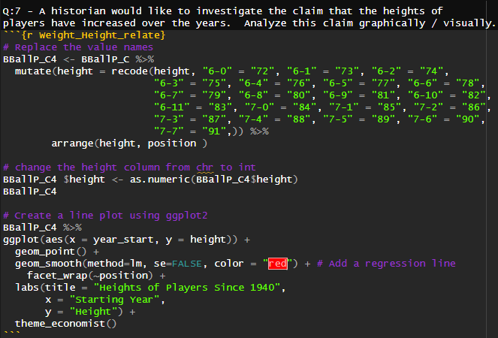
Visualization Questions: Basketball Player Data Set
Use the NBA basketball player data set to answer the question as you understand it. (3-5 hours)
Question 7: A historian would like to investigate the claim that the heights of players have increased over the years. Analyze this claim graphically / visually.
Answer: The height of NBA players has on average slightly increased between 1940 and 2020. The slope of the line varies according to position.

Slide 9
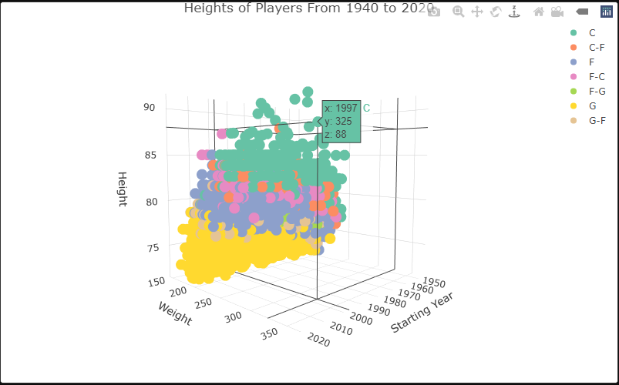
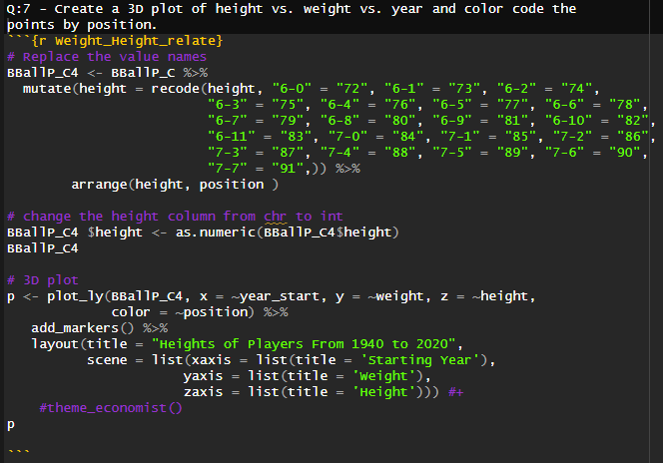
Visualization Questions: Basketball Player Data Set
Use the NBA basketball player data set to answer the question as you understand it. (3-5 hours)
Question 8: Create a 3D plot of height vs. weight vs. year and color code the points by position.

Slide 10
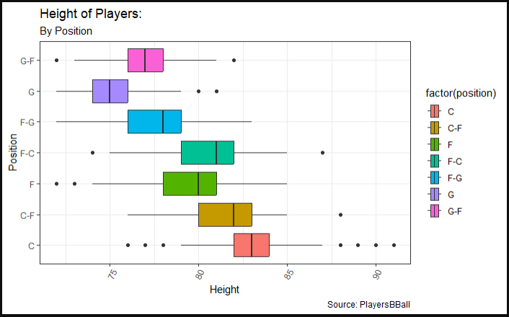
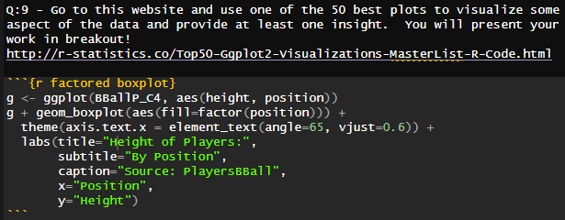
Visualization Questions: Basketball Player Data Set
Use the NBA basketball player data set to answer the question as you understand it. (3-5 hours)
Question 9: Go to this website and use one of the 50 best plots to visualize some aspect of the data and provide at least one insight. You will present your work in breakout! http://r-statistics.co/Top50-Ggplot2-Visualizations-MasterList-R-Code.html

Slide 11
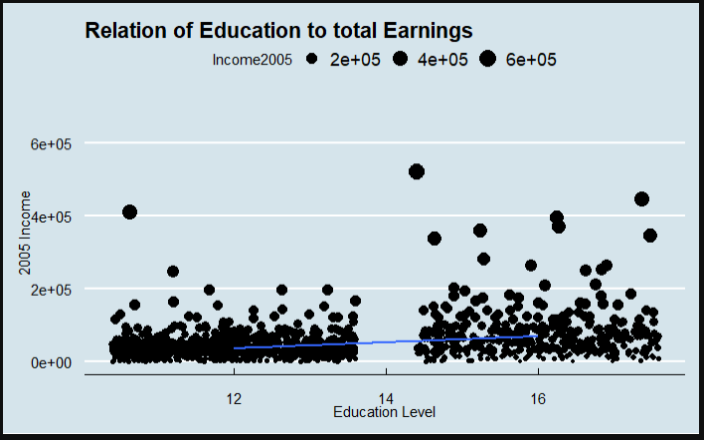
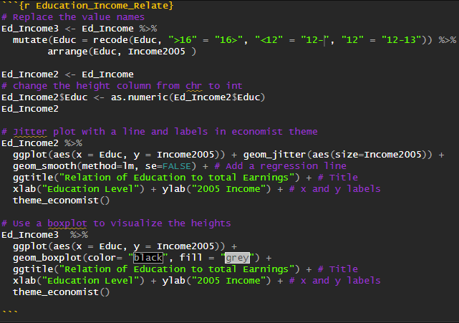
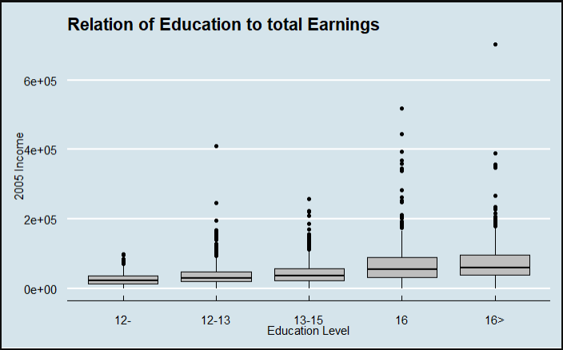
Visualization Questions: Basketball Player Data Set
The EducationIncome.csv dataset has incomes of randomly selected Americans and their level of education. (1-2 hours)
Question 10: Visually test the claim that the distribution of incomes increase (mean or median) as the education level rises.

Slide 12
Key Takeaways and Questions
Takeaways:
Scatterplots require two integers to compare values. I spent several hours trying to get various plots to work until I realized that the height column was in chr not int. Conversely, boxplot require one element to be chr if you want several boxplots across a spectrum.
GGplots has several functions that allow you to have subtitles, source attributions, and captions. GGplots themes is also great and allows you to use predefine and crafted themes and easily test them for visual quality
GGanimate has some pretty cool attributes. I tried gganimate to show a time laps over years for the basketball players height and it surprised me how many slides are stored in your file. Be ready for that.
3D graphics are cool and can be exported with the graphical interface that allows you to look at the data from multiple angles.
Questions:
How do you change the width of boxplots? How do you alter the width and height of graphics?
How do you reorder the presentation of column values? GGplots auto orders them, but they don’t often come out in the best format. It would be nice if you could define how the labels were presented.
Can you please provide your office hours? Can you also explain the final project so that I can work to be prepared for it?

