Slide 1

Statistical Foundations for Data Science
Unit 1: Live Session
FLS Q&A, plus activities
by Adam Ercanbrack

Slide 2
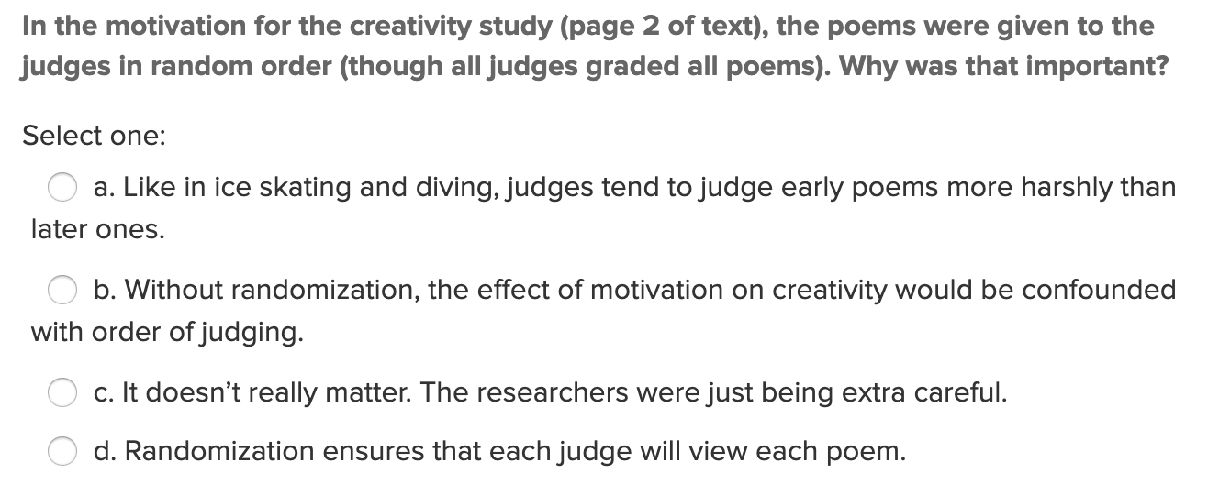
Question 1: Quick Quiz Question 1
Answer: Like in ice skating and diving, judges tend to judge early poems more harshly than later ones.

Slide 3
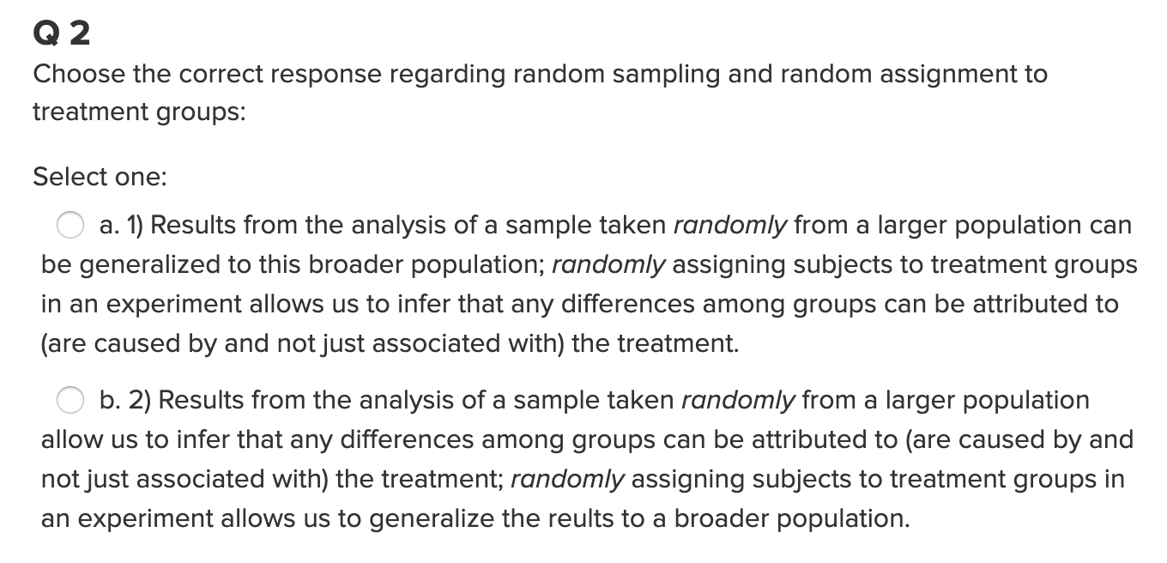
Question 1: Quick Quiz Question 2
Answer: A. Results from the analysis of a sample taken randomly from a larger population allows can be generalized to the larger population; randomly assigning subjects to treatment groups in an experiment allows us to infer that any differences among groups can be attributed to (are caused by and not just associated with) the treatment.

Slide 4
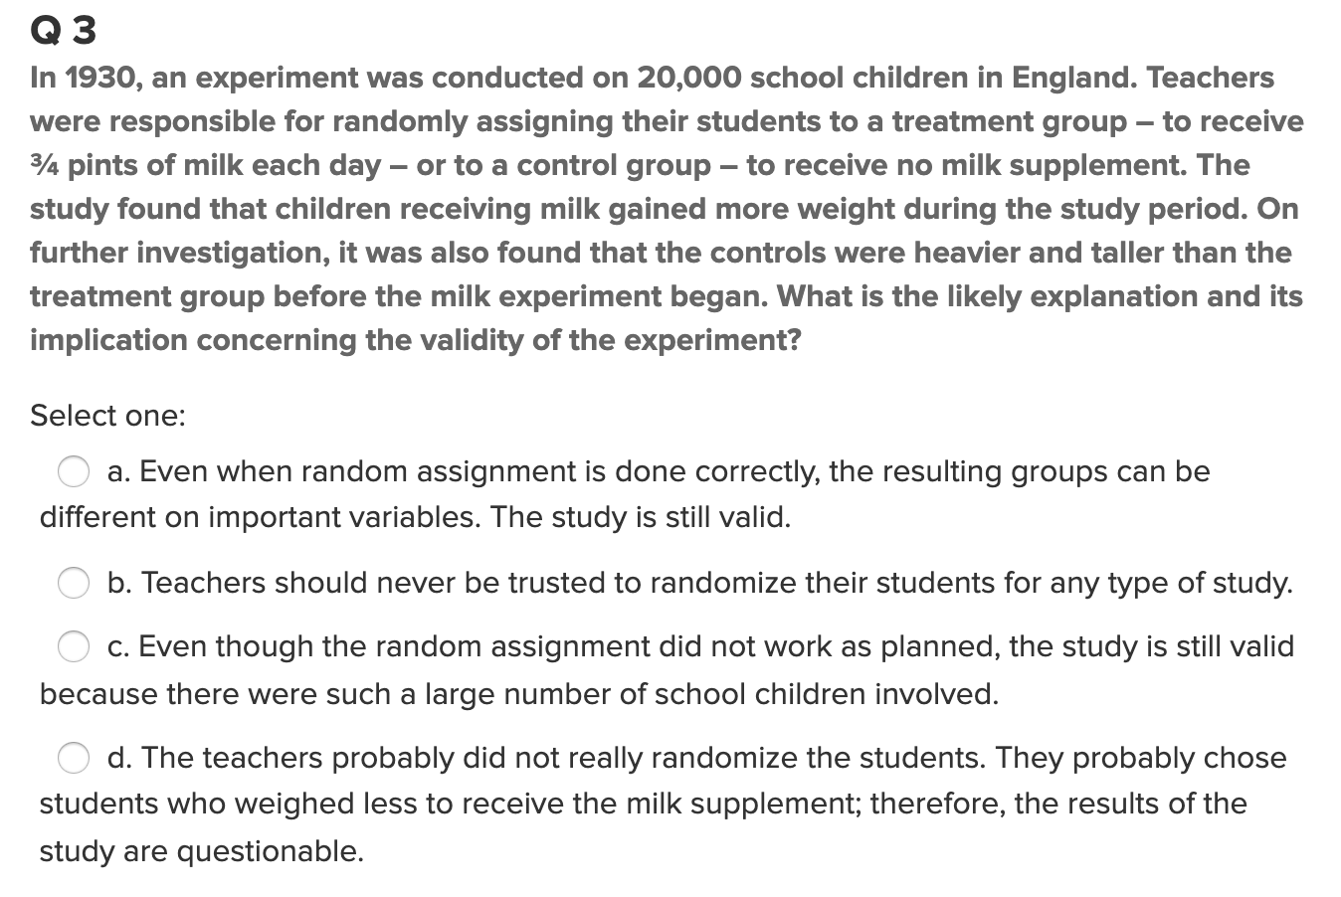
Question 1: Quick Quiz Question 3
Answer: D. The teachers probably did not really randomize the students. They probably chose students who weighed less to receive the milk supplement; therefore, the results of the study are questionable.

Slide 5
Question 2:
What is the difference between a randomized experiment and a random sample? Under what type of study/sample can a causal inference be made?
Answer: A randomized experiment seeks to establish causal relationships by introducing a treatment and studying the responses or outcomes of that treatment on the subjects. The experiment randomizes a selected sample into treatment groups to simulate chance.
Only experimental studies can establish cause-and-effect relationships because they have a controlled treatment that is applied to the study group. Observational studies can not directly establish causal relations but can show some level of association between outcomes and a subject.

Slide 6
Question 3:
Scenario: In 1936, the Literary Digest polled 1 out of every 4 Americans and concluded that Alfred Landon would win the presidential election in a landon-slide (pun intended:). Of course, history turned out dramatically different (see http://historymatters.gmu.edu/d/5168/ for further details). The magazine combined three sampling sources: subscribers to its magazine, phone number records, and automobile registration records. Comment on the desired population of interest of the survey and what population the magazine actually drew from.
Comment: In the Landon v. Roosevelt presidential race pollsters inaccurately called the election because their population sample was not representative of the population as a whole but rather a selection of wealthy Americans. Because Time magazine limited its sample to readers of its magazine, and owners of phones and cars they inadvertently introduced bias. At the time of the election the US was still recovering from the depression and many voting Americans could not afford things like phones and cars. Thus, this very important group of voters was excluded from the poll. Had pollster utilized a subset of the larger population of registered voters so that the sample mix was more reflective of the overall population, their poll may have been more accurate.

Slide 7
Question 4:
Suppose we have developed a new fertilizer that is supposed to help corn yields. This fertilizer is so potent that a small vial of it sprayed over an entire field is a sufficient dose. We find that the new fertilizer results in an average yield of 60 more bushels over the old fertilizer with a p-value of 0.0001. Write up a scope of inference under the following study designs that generated this data.
Study 1 Design: We offer the new fertilizer at a discount to customers who have purchased the old fertilizer along with a survey for them to fill out. Some farmers send in the survey after the growing season, reporting their crop yield. From our records, we know which of these farmers used the new fertilizer and which used the old one.
Study 1 Scope of Inference: This study did not use a subset of the representative population, but rather sought volunteers through discounted fertilizer, which would have limited the scope of the sample. Furthermore, because study 1 design suggests that the farmers who purchased the new fertilizer had already purchased the old fertilizer this implies that the sample population was affluent enough to purchase both. Additionally, because the sample subjects could have used either the old or the new fertilizer the control is lost and there is no way to verify which fertilizer was used. Despite the statistically significant p-value, the design was flawed and would have invalidated the results.
Study 2 Design: When a customer makes an order, we randomly send them either the old or new fertilizer. At the end of the season, some of the farmers send us a report of their yield. Again, from our records, we know which of these farmers used the new fertilizer and which used the old.
Study 2 Scope of Inference: This study used a randomized experiment to establish a causal relationship between the use of the new fertilizer and its yield as opposed to that of the old fertilizer. Because the new and old fertilizers were randomly sent to the farmers, no bias was introduced by allowing them to know which fertilizer they received, nor was there any incentive to report crop yields beyond simply providing the information. The scientist were able to establish a causal relationship as they tracked which farmer received which fertilizer and could directly link it to the yield.

Slide 8
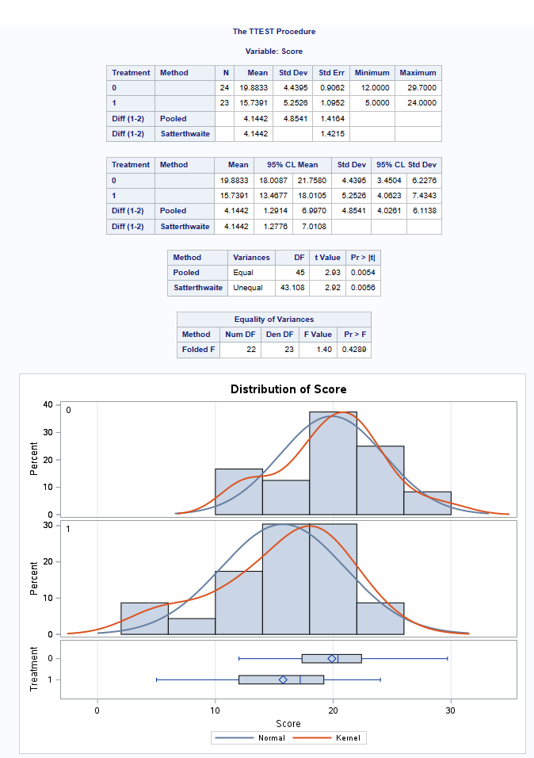
Question 5: Creativity Study (Part 1)
With respect the Creativity Study you read in the Statistical Sleuth, use the code provided to conduct a permutation test to test for a difference in mean score between those motivated intrinsically and extrinsically.
Creativity Study Description: The creativity study tested the impact of intrinsic and extrinsic suggestive thinking on creative writing. 47 experienced creative writers were randomly divided into two groups that were provided separate instructions and a survey that focused on writing for creativity and pleasure (intrinsic) verses writing for completion (extrinsic) and then asked to write a poem about laughter. The poems were then to be judged by 12 poets and graded for creativity. The judges received the poems in a random order to offset any bias that might come from the order they were reviewed. The means and standard deviation of each group were then calculated.
Hypothesis and t-test: The study claimed (the null hypothesis) that intrinsic suggestion would have no impact on the creativity of the authors’ poems. (H0 : μintrinsic = μextrinsic, Ha : μintrinsic ≠ μextrinsic). The alternative hypothesis suggest that intrinsic suggestion would impact creativity. A t-test was conducted comparing the two study groups. The intrinsic group had a mean of 19.8833, while the extrinsic group scored 15.7391. The pooled difference of the two groups calculated as 4.1442. When evaluating the null hypothesis, the study showed strong evidence (p-value = 0.0054) that the mean score of poems was different, and that intrinsic suggestion improved creative writing. (The null hypothesis is rejected at the 95% confidence level.)

Slide 9
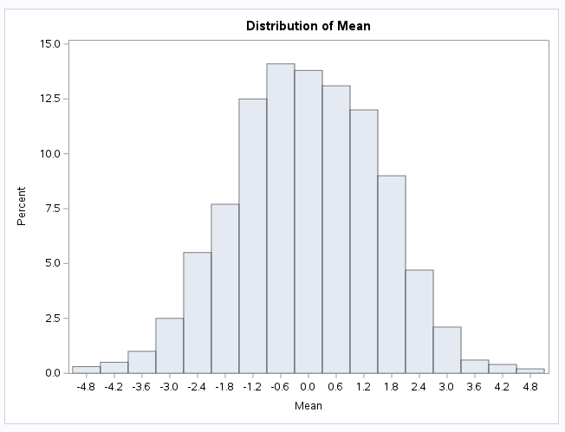
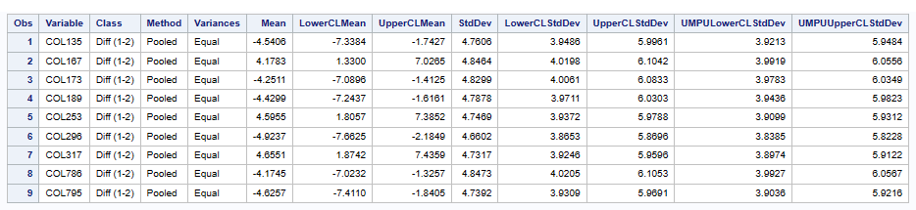
Question 5: Creativity Study (Part 2)
With respect the Creativity Study you read in the Statistical Sleuth, use the code provided to conduct a permutation test to test for a difference in mean score between those motivated intrinsically and extrinsically.
Randomization of the Study: Although the t-test showed a strong evidence that intrinsic suggestion did make a difference, it is still important to test for chance. Despite the test sample being randomly dispersed into the two groups, there is still a chance that the means could be close to equal. A permutation test of 1000 randomly shuffled results from the scores was used to test the hypothesis again. The scores were lined up into one column and randomly reassigned 1000 times to the intrinsic and extrinsic groups to test the difference between each result and then averaged to find a test mean. If there is no difference between the two groups, then randomly shuffling the groups should deliver a mean close to zero.
Permutation and final t-test: The Permutation results are then run against a new t-test to find the distribution of the mean of pooled results. As you can see on the right, the majority of the pooled mean difference fell around zero. There were only a few outliers that fell in the same region of our original pooled mean difference score of 4.1442. In order to calculate the probability of our random shuffles having a greater magnitude than the original pooled score, we simply count the them. Of the 1000 permutations, it was found that only nine out of 1000 had higher scores than our original pooled. Thus, the probability of observing a score as extreme or more extreme than the original difference is only .009 percent or a 9 percent chance of the intrinsic and extrinsic means being near zero.

Slide 10
Question 6: Key Takeaways
Takeaways:
Cause-and-effect relationships can only be inferred from randomized experiments, not from observational studies. However, confounding variables can weaken the inference that can be derived from randomized experiments with one variable.
Random sampling is used to derive inference from a sample with the same mix of subpopulations as a larger population. It avoids problems associated with a specialized self-selected population. It also allows for a greater employment of chance and thus, greater inferences of causal relations from a generalized population.
Sample designs can have a major impact on your results. Failure to build a study from the correct population can invalidate the study. The sample should be representative of the entire population being observed.
The t-score or critical value is different than the test-statistic value or t-value. Both of these scores rest on the t-distribution line which tracks the standard deviation from the mean.
A permutation test can calculate the odds that a different result could be extracted from similar scores. A p-score from these results that is similarly low can verify your initial conclusions.

Slide 11
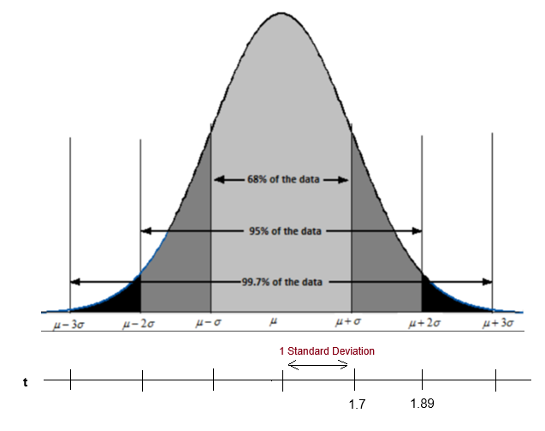
Question 7: Any Follow-up Questions?
Outstanding questions from Unit 1:
Can you explain ods on SAS? Do you have a graphic help aid that can explain each of the computations on the output graphic in SAS?
Can you please take a bit more time to explain the permutation output? For example, if you do 1000 permutations and then find the mean pooled value of each and then find the mean of all those permutations to ultimately get a new p-value, wouldn’t the p-value represent the opposite of the original p-value? I know that the new p-value is supposed to represent the probability of observing a score as extreme or more extreme than the original difference, but it is all very confusing. I really need that information relayed in layman’s terms not in statistician terms.
Can you please clarify the standard deviation. For example, if your critical value is 1.89 and your test statistic is 1.99 and your standard deviation is 1.7, does that mean that one standard deviation from the mean is equal to 1.7? If so, wouldn’t that make 2 standard deviations from the mean 3.4 instead of the 1.89 critical value at the 95 percent line? (See figure 1.) Unless, of course, each standard deviation is not equal and based on the area of that particular point on the line of the curve?
Figure 1.

