Slide 1

Statistical Foundations for Data Science
Unit 2: Live Session
FLS Q&A, plus activities
by Adam Ercanbrack

Slide 2
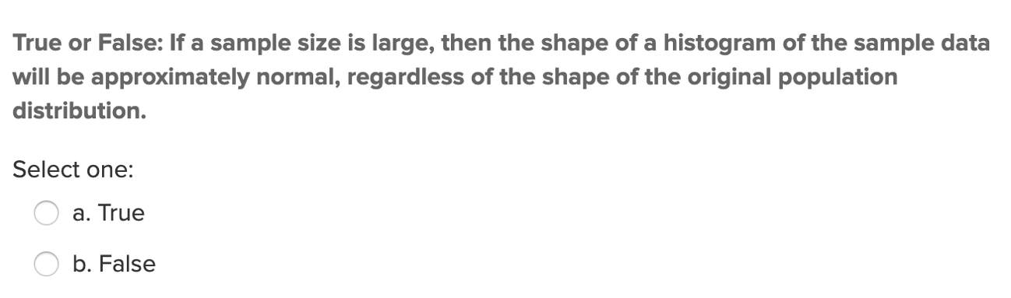
Question 1: Quick Quiz Question 1
Answer: True. The is the Central Limit Theorem.

Slide 3
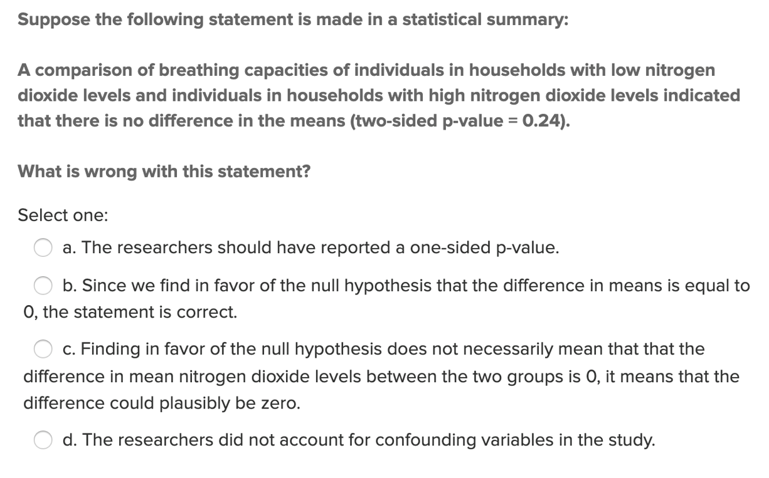
Question 1: Quick Quiz Question 2
Answer: C. Finding in favor of the null hypothesis (fail to reject, p-value=0.24) does not necessarily mean that the difference in mean nitrogen dioxide levels between the two groups is 0. Rather, it means that the difference could plausibly be zero (because there is not enough evidence) .

Slide 4
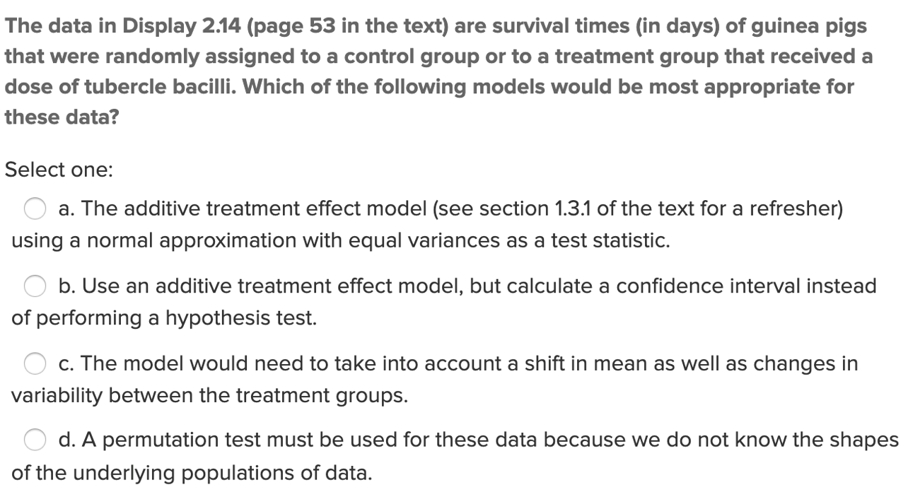
Question 1: Quick Quiz Question 3
Answer: A. The additive treatment effect model (see section 1.3.1 or the text for a refresher) using a normal approximation with equal variance as a test statistic.
(I was split on this one because I think you should do both the hypothesis test and verify it with a confidence interval…not either one or the other.)

Slide 5
Question 1: Quick Quiz Question 4
Question: What is the formal definition of the “p-value”?
Answer: The p-value is the probability value that tells you how likely it is to get the same value or something more extreme given random chance. A more extreme value than the critical value would reject the null hypothesis, while a less extreme value would indicate that the data does not show that there is a difference and thus you fail to reject the null hypothesis.

Slide 6
Question 2:
Assume you wanted to test whether a new marketing strategy is increasing the mean total sales per day. You sample days at random under the old marketing system and 10 days at random under the new marketing system and record the mean sales for each group. You find that the 95 percent confidence interval for the difference of mean sales per day (μ_new-μ_old) is ($1.23, $1.60). You note that the new marketing strategy would cost $5.00 per day to implement. Is this result statistically significant? Why? Is this study practically significant? Why?
Please respond below and add this question and your response to your FLS slide deck.
Answer: We learn from the confidence interval of ($1.23, $1.60) that the new marketing strategy is making more money than the old strategy because those numbers do not include zero, which would imply no difference. Because there is a difference the null hypothesis would have been rejected because it was not equal to zero and, as such, not statistically significant. However, since the confidence interval is not greater than the minimum fixed cost of $5.00, it is not practical to implement the new strategy as the company would lose money.

Slide 7
Question 3: Central Limit Theorem (CLT) Activity: Part 1
Consider again the Sleep 1 data from the asynch material. Using the same app:
Now, take 500 random samples, each of size 5. What is the mean of the 500 means? The mean is 8.021.
What is the range of the 500 sample means(smallest value and largest value)? The range is (6, 10.25).
What is the standard deviation of the 500 sample means? You can find this value in the upper right corner of the graph on the lower right. The standard deviation is 1.557.
Describe the distribution of 500 sample means from samples of size 5 (think shape, center, and spread). The sleep1 sampling test is approximately a normal distribution with a slight right tailed shift. It is centered on the mean of 8 and spreads from 6 to 10.25.

Slide 8
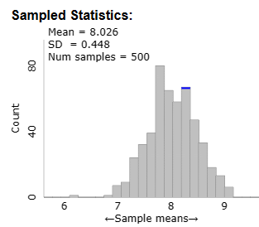
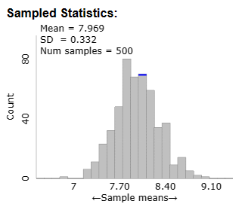
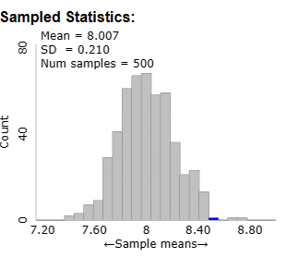
Question 3: Central Limit Theorem (CLT) Activity: Part 2
Consider again the Sleep 1 data from the asynch material. Using the same app:
Run the following simulations using the applet. Click “reset” before each simulation!! For each simulation, obtain the mean and standard deviation of the 500 sample means.
a. Number of samples = 500, sample size = 10
Answer: Mean = 8.026, SD = 0.448
b. Number of samples = 500, sample size = 20
Answer: Mean = 7.969, SD = 0.332
c. Number of samples = 500, samples size = 50
Answer: Mean =8.007, SD = 0.210

Slide 9
Question 3: Central Limit Theorem (CLT) Activity: Part 3
Consider again the Sleep 1 data from the asynch material. Using the same app:
For each of a, b, and c, above, describe the shape of the distribution of the 500 sample means relative to the original population distribution.
a. Number of samples = 500, sample size = 10
Answer: Approximately a normal distribution with a slight right tail. Smaller range (6.25, 9.25) than the original.
b. Number of samples = 500, sample size = 20
Answer: Approximately a normal distribution with a slight left tail. Smaller range (6.75, 9.1) than the original.
c. Number of samples = 500, samples size = 50
Answer: Approximately a normal distribution with a slight right tail. Smaller range (7.2, 8.8) than the original. The sample was tighter around the mean.

Slide 10
Question 3: Central Limit Theorem (CLT) Activity: Part 4
Consider again the Sleep 1 data from the asynch material. Using the same app:
For each of a, b, and c, calculate sigma divided by the square root of n and compare this to the standard deviation of the distribution of the sample means from your simulation.
a. Number of samples = 500, sample size = 10
Answer: The population SD is 1.51. 1.51 / √ 10 = 0.4775 The Sample SD (0.448) is very close to the standard error.
b. Number of samples = 500, sample size = 20
Answer: The population SD is 1.51. 1.51 / √ 20 = 0.3376 The Sample SD (0.332) is very close to the standard error.
c. Number of samples = 500, samples size = 50
Answer: The population SD is 1.51. 1.51 / √ 50 = 0.2135. The Sample SD (0.210) is very close to the standard error.

Slide 11
Question 3: Central Limit Theorem (CLT) Activity: Part 5
Consider again the Sleep 1 data from the asynch material. Using the same app:
How do the distributions of simulated samples of the same sample size compare to one another (think center, shape, and spread). These are the samples that you see in the middle histogram. Answer: The distribution of samples of the same size tend to follow the same trends, the mean, shape and spread are fairly similar, especially for larger sample sizes.
Describe the distributions of the sample means for samples of size 5, 10, 20, and 50. How do these distributions compare to one another, and to the population distribution? Answer: Smaller sample sizes seem to have a wider spread and variability (they lean more right or left). Larger samples tend to have a smaller spread with less variability and closer means.
What would you expect to happen to the distribution of the sample means if we changed the sample size again, to a larger number? Answer: the larger the sample size the closer the samples’ mean would be to the population mean. Larger samples would also be closer to a normal distribution.
What is the pattern that you see? Answer: Larger sample sizes tend to have means closer to the population mean and less variance, while smaller samples have more variance in the distribution, curve, and mean.
Fore Shadowing for the next section: Do you think the same pattern would result if we took samples and made distributions of sampling statistics for other types of populations (not sleep times)? Try it with “Pennies” and “Change”. (Note, the "Variable" needs to be set in the "Show Sampling Options" section.) What do you see? Answer: The CLT still applies; the larger the sample, regardless of the tail of the population, the closer the sample will be to the normal distribution. However, for left and right tailed populations, a normal distribution does appear to retail a slight lean to that of the population, despite a normalized distribution.
Do you think the same pattern would result if we took samples and made distributions of other sampling statistics (not the mean)? Try it by punching the radio buttons for the median and standard deviation over the plot at the bottom right. Answer: The median and SD of larger samples continue to follow a normal distribution.

Slide 12
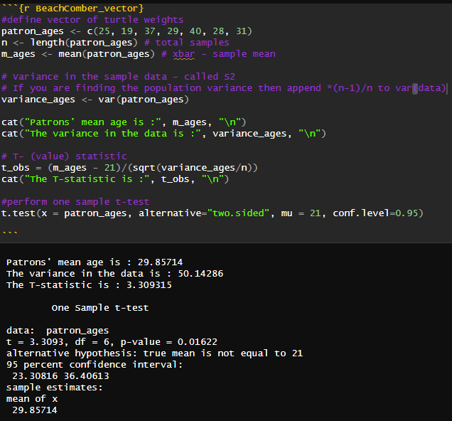
Question 4: Review Beachcomber Six Step T-test
The following are ages of 7 randomly selected patrons at the Beach Comber in South Mission Beach at 7pm! We assume that the data come from a normal distribution and would like to construct and interpret a 95% confidence interval for the actual mean age of patrons at the Comber. Assume we don’t know the population standard deviation and have estimated it to be 7.08 years. In addition, the t multiplier (t critical value) for this problem is 2.447. The other statistics needed to construct the interval will need to be derived from the data. Show and fully explain your work. (25, 19, 37, 29, 40, 28, 31) (See figure 1)
Step 1: Identify the null (H0) and alternative (Ha) hypotheses. H0: Beach Comber patrons' ages are, on average, equal to 21. Ha: Beach Comber patrons' ages are, on average, not equal to 21.
Step 2: Draw and shade the model and find the critical value - because the alternative hypothesis is not equal to 21, this is a (Two-tailed) model with 0.025 on the extreme ends.
Step 3: Test the sample against the hypothesis: The test statistic is 3.309315.
Step 4: Quantify the difference: t-score = 3.3093, p-value = 0.01622
Step 5: Decide to reject or fail to reject (FTR) H0: Since the p-value (0.01622) is < the alpha (0.05), we reject the null hypothesis.
Step 6: Conclusion: There is sufficient evidence to suggest (p-value 0.01622) that the mean age of patrons is different than 21.
Figure 1.

Slide 13
Question 5: Discrimination Study – Part 1 Introduction and data
In the United States, it is illegal to discriminate against people based on various attributes. One example is age. An active lawsuit, filed August 30, 2011, in the Los Angeles District Office is a case against the American Samoa Government for systematic age discrimination by preferentially firing older workers. Though the data and details are currently sealed, suppose that a random sample of the ages of fired and not fired people in the American Samoa Government are listed below:
Fired: 34 37 37 38 41 42 43 44 44 45 45 45 46 48 49 53 53 54 54 55 56
Not fired: 27 33 36 37 38 38 39 42 42 43 43 44 44 44 45 45 45 45 46 46 47 47 48 48 49 49 51 51 52 54
Figure 1.

Slide 14
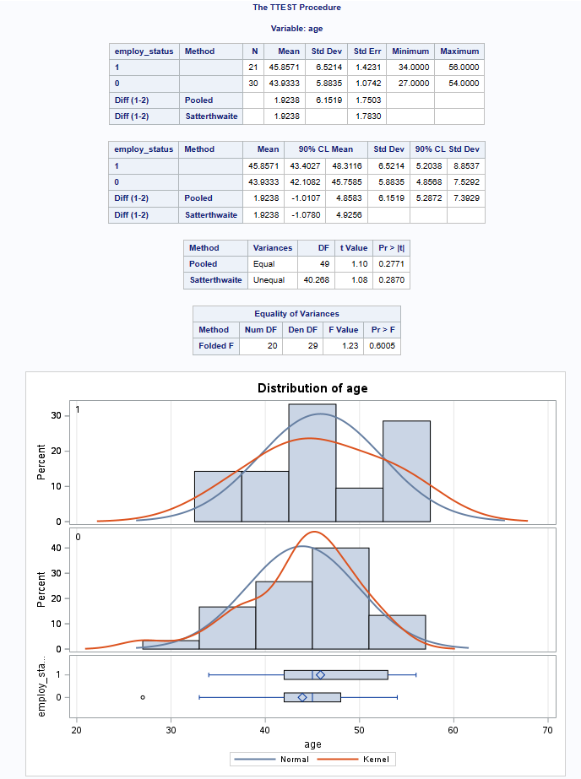
Question 5: Discrimination Study – Part 1a
Part 1: a. Perform a permutation test to test the claim that there is age discrimination. Provide the Ho and Ha, the p-value, and full statistical conclusion, including the scope (inference on population and causal inference). Note: this was similar to an example in Live Session 1. You may start from scratch or use the sample code and PowerPoints from Live Session 1.
Assumption: The claim (the null hypothesis) made in this study was that there is no difference in the age of individuals who were fired vice those that were not fired. (H0 : μFired = μNotFired). The alternative hypothesis is that there is a difference in the age of those that were fired. (Ha : μFired ≠ μNotFired) The permutation test will check if there is variation or a significant difference in the means of the age values if the ages are randomly shuffled 1000 times between the groups. The assumption being that (H0 : μFired – μNotFired = 0) and the alternative being (H0 : μFired – μNotFired ≠ 0).
Evidence: The mean age of those fired is 45.8571 minus the mean age of those not fired is 43.9333, is μFired – μNotFired = 1.9238. This suggests that those fired were on average 1.9238 years older than those that were not fired.
Figure 1.

Slide 15
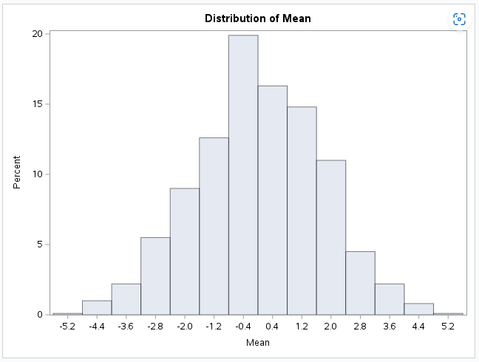
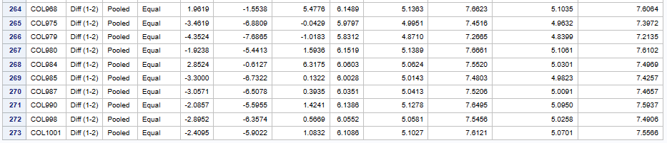
Question 5: Discrimination Study – Part 1a cont.
Part 1: a. Perform a permutation test to test the claim that there is age discrimination. Provide the Ho and Ha, the p-value, and full statistical conclusion, including the scope (inference on population and causal inference). Note: this was similar to an example in Live Session 1. You may start from scratch or use the sample code and PowerPoints from Live Session 1.
Probability: The estimated probability that a difference of 1.9238 or larger in the sample mean of the scores could happen if employees were not older is p-value = 0.273. Which includes over a quarter of the permutations. (See figure 1.)
Conclusion: There is strong evidence to suggest that the mean of those that were fired is equal to the mean of those not fired. Thus, the probability of observing a score as extreme or more extreme than the original difference is (p-value =0.273) or a 27 percent. (See figure 2.) Because this score is so extreme and this is an observational study, we cannot establish age as the cause of the firings. Additionally, several other confounding variables should be considered, including work performance, wages, and days off the job that could have also influence the decision to end employment.
Figure 1.
Figure 2. Show 273 out of 1000

Slide 16
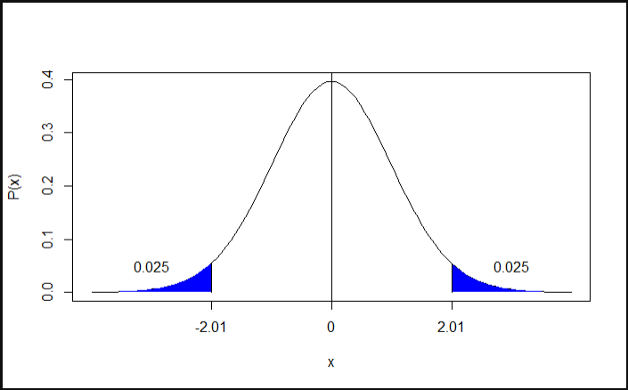
Question 5: Discrimination Study – Part 1b
Part 1: b. Now run a two sample t-test appropriate for this scientific problem. (Use SAS.) (Note: we may not have talked much about a two-sided versus a one-sided test. If you would like to read the discussion on pg. 44 (Statistical Sleuth), you can run a one-sided test if it seems appropriate. Otherwise, just run a two-sided test as in class. There are also examples in the Statistics Bridge Course.) Be sure to include all six steps, a statistical conclusion, and scope of inference.
Step 1: Identify the null (H₀) and alternative (H_{a}) hypotheses
The claim (the null hypothesis) made in this study was that there is no difference in the age of individuals who were fired vice those that were not fired (H0 : μFired = μNotFired). The alternative hypothesis is that there is a difference in the age of those that were fired (Ha : μFired ≠ μNotFired).
Step 2: Draw and shade the model and find the critical value.
The alternative hypothesis claims that the ages are not equal and, therefore, we used a two-tailed test. (See figure 1.) The alpha of 0.05 is split between the two tails. We find the critical value by first finding the degrees of freedom (21 +30 -2 = 49) and then finding the alpha on the t-distribution table. The critical value is 2.009 or 2.01 rounded.
Figure 1.

Slide 17
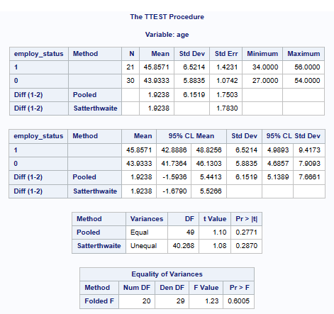
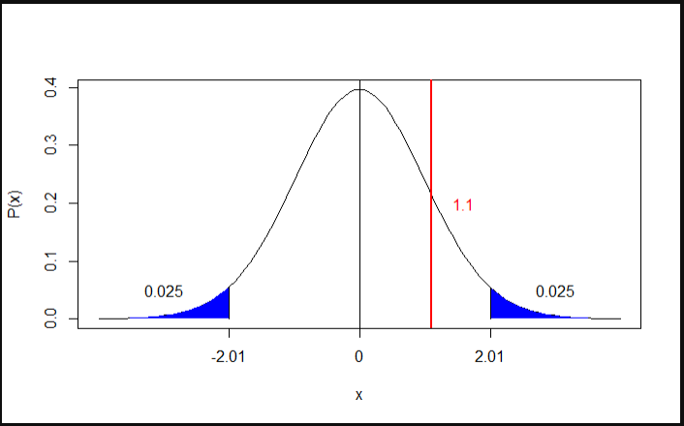
Question 5: Discrimination Study – Part 1b cont.
Part 1: b. Now run a two sample t-test appropriate for this scientific problem. (Use SAS.) (Note: we may not have talked much about a two-sided versus a one-sided test. If you would like to read the discussion on pg. 44 (Statistical Sleuth), you can run a one-sided test if it seems appropriate. Otherwise, just run a two-sided test as in class. There are also examples in the Statistics Bridge Course.) Be sure to include all six steps, a statistical conclusion, and scope of inference.
Step 3: Find the test statistic.
The test statistic, according to SAS, is 1.10. (See figure 1.)
Step 4: Quantify the difference with a p-value.
The p-value, according to SAS, is 0.2771. (See figure 1.)
Step 5: Decide to reject or fail to reject the H₀.
The p-value = 0.2771 and is greater than the 0.05 alpha. Therefore, we fail to reject the H₀.
Figure 1.
Figure 2.

Slide 18
Question 5: Discrimination Study – Part 1b cont.
Part 1: b. Now run a two sample t-test appropriate for this scientific problem. (Use SAS.) (Note: we may not have talked much about a two-sided versus a one-sided test. If you would like to read the discussion on pg. 44 (Statistical Sleuth), you can run a one-sided test if it seems appropriate. Otherwise, just run a two-sided test as in class. There are also examples in the Statistics Bridge Course.) Be sure to include all six steps, a statistical conclusion, and scope of inference.
Step 6: Conclusion.
There is not enough evidence (p-value =0.2771) to suggest that there is a difference in the age of individuals who were fired vice those that were not fired (Ha : μFired ≠ μNotFired). We failed to reject the null hypothesis.
Scope of Inference:
This study uses the ages of individuals who were fired and not fired. Since ages cannot be randomly assigned, this is an observational study. Even if the findings found that there was statistical evidence to reject the null hypothesis, discrimination could not be identified as the cause because observational studies cannot establish such a relationship. Furthermore, several other confounding variables should be considered, including work performance, wages, and days off the job that could have also influence the decision to end employment.
Figure 1.
Figure 2.

Slide 19
Question 5: Discrimination Study – Part 1c and d
Part 1: c. Compare this p-value to the randomized p-value found in the previous sub-question.
Comparison of values:
The two-sample t-test had a p-value of 0.2771 as compared to the permutation test, which had a p-value of 0.273. Since both p-values were not statistically significant, we failed to reject the null hypotheses. The fact that the two p-values were so close helped confirm that any difference in means was due more to chance than to discrimination.
Part 1: d. The jury wants to see a range of plausible values for the difference in means between the fired and not fired groups. Provide them with a confidence interval for the difference of means and an interpretation.
Confidence Interval:
The confidence interval for the pooled study is (-1.5935 to 5.4413). Since the pooled difference of 1.9238 falls within this interval, 1.9238 is a plausible value and there is no significant evidence to reject the null hypothesis.
Figure 1.

Slide 20
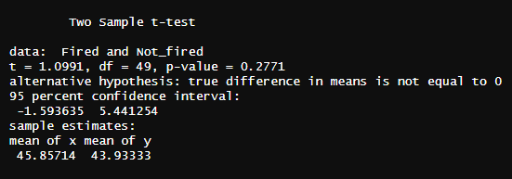
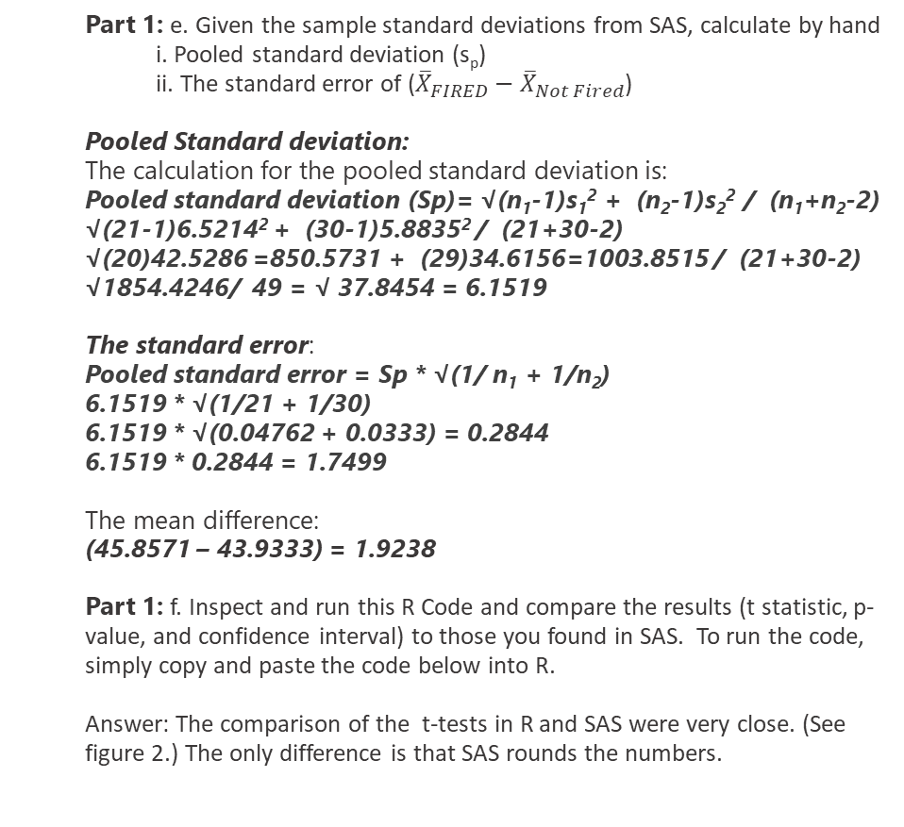
Question 5: Discrimination Study – Part 1e and f
Part 1: e. Given the sample standard deviations from SAS, calculate by hand
i. Pooled standard deviation (s_{p})
ii. The standard error of (${\overline{X}}_{FIRED}−{\overline{X}}_{Not Fired}$)
Pooled Standard deviation:
The calculation for the pooled standard deviation is:
Pooled standard deviation (Sp)= √(n₁-1)s₁² + (n₂-1)s₂² / (n₁+n₂-2)
√(21-1)6.5214² + (30-1)5.8835² / (21+30-2)
√(20)42.5286 =850.5731 + (29)34.6156=1003.8515 / (21+30-2)
√1854.4246/ 49 = √ 37.8454 = 6.1519
The standard error:
Pooled standard error = Sp * √(1/ n₁ + 1/n₂)
6.1519 * √(1/21 + 1/30)
6.1519 * √(0.04762 + 0.0333) = 0.2844
6.1519 * 0.2844 = 1.7499
The mean difference:
(45.8571 – 43.9333) = 1.9238
Part 1: f. Inspect and run this R Code and compare the results (t statistic, p-value, and confidence interval) to those you found in SAS. To run the code, simply copy and paste the code below into R.
Answer: The comparison of the t-tests in R and SAS were very close. (See figure 2.) The only difference is that SAS rounds the numbers.
Figure 1.
Figure 2.

Slide 21
Question 6: Key Takeaways
Takeaways:
You have to check any R statistical code found on the internet or with ChatGPT (which get’s its information from the same source) to see if the code has been mislabeled. For example code for the standard error and standard deviation is often mislabeled, which can lead to huge discrepancies in numbers. (Note: I broke down the t-test code into smaller parts so that I could see the calculations for each part and found a lot of discrepancies on how they were defined on the internet.)
There is a difference in code for one-sample vs. two-sampled t-tests. You have to also find the separate code when calculating a two-sample t-test to get the pooled results for standard deviation, standard error, and the test-statistic.
Pooled confidence interval provides a range of values that are likely to contain the true difference between the means of the two groups. If the difference falls within the confidence interval it means that you are 95% confident that the actual difference is within this range. (Interpreting confidence intervals is very confusing based on what I have seen on the internet.) Also interesting is the idea that if zero is within the intervals the findings have no statistical meaning.
It is impossible for me to calculate statistics accurately by hand. I need a calculator or the computer to correctly find the answers. I hope that we will not be required to do this by hand on the tests!

Slide 22
Question 7: Any Follow-up Questions?
Outstanding questions from Unit 2:
Can you explain the difference between the permutation test hypotheses and the t-test hypotheses? This is how I understand each:
T-test hypotheses: assumes the data follow a normal distribution
Permutation Test: directly assesses the probability of observing the data under the null hypothesis.
P- value > alpha (5%): failed to reject H₀ , H₀ is true and Not statistically significant,
no effect or no difference – any differences are due to chance
P-value ≤ alpha (5%): reject H₀ , H₀ is rejected and statistically significant,
evidence to suggest a difference in actual populations and that a treatment has an effect
Can you explain why it is not significant if the confidence intervals include zero? How does the confidence intervals relate to the null hypothesis? Is it correct to say that if zero is included or the difference is within the interval that there is no evidence to reject? Is it correct to say that if the difference is outside the interval, you have evidence to reject?

