Slide 1
BachBot
Symbolic Bach-style chorale generation with neural models plus music-theory decoding
371
2
usable Bach chorales
SATB token grid
from music21 corpus
soprano | alto | tenor | bass
BachBot | CSE 253 Assignment 2 | 01

Slide 2
ROADMAP
A complete pipeline, then two generation tasks
The talk follows the same path as the code and the final workbook.
1
Data
2
EDA
3
Task 1
4
Task 2
5
Metrics
6
Demo
music21 Bach chorales -> SATB token grids
sequence length, voice ranges, pitch classes
unconditioned GRU + reranking
soprano-conditioned harmonization
ML fit + music-theory metrics
final MIDI files and limits
Core thesis
For small symbolic music models, decoding and musical constraints matter as much as raw neural likelihood.
BachBot | CSE 253 Assignment 2 | 02

Slide 3
DATA
Real Bach chorales become a shared SATB grid
Both assignment tasks reuse the same representation and vocabulary.
Bach corpus
Quantize
SATB matrix
Tokenize
Split
371 usable chorales loaded from music21
eighth-note grid: 0.5 quarter length
T x 4 rows: soprano, alto, tenor, bass
88 MIDI pitch tokens + 5 special symbols
train, validation, test; augment train only
260
56 / 55
93
0.5
original train chorales
validation / test
vocabulary size
quarter-length grid
before augmentation
not augmented
pitches + special tokens
eighth-note resolution
shape: time x [soprano, alto, tenor, bass]
BachBot | CSE 253 Assignment 2 | 03

Slide 4
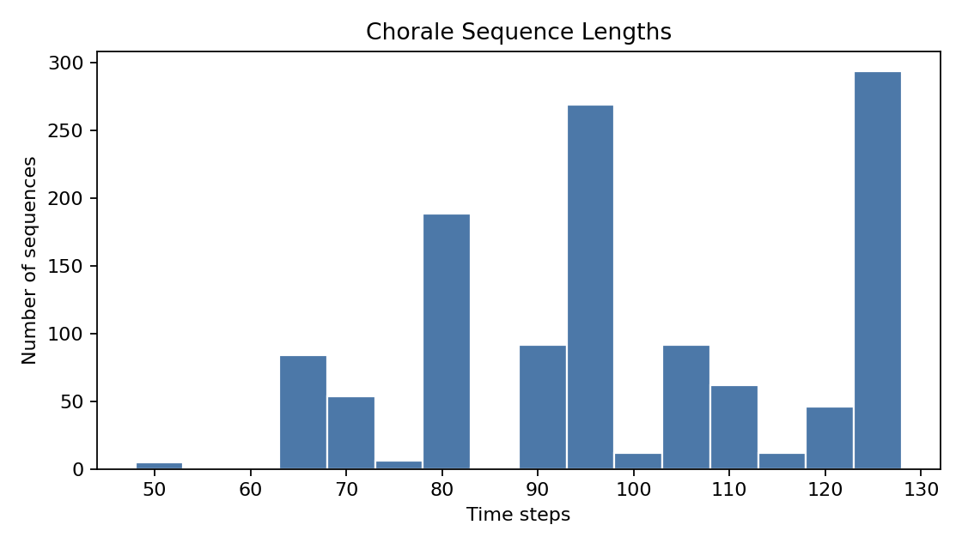
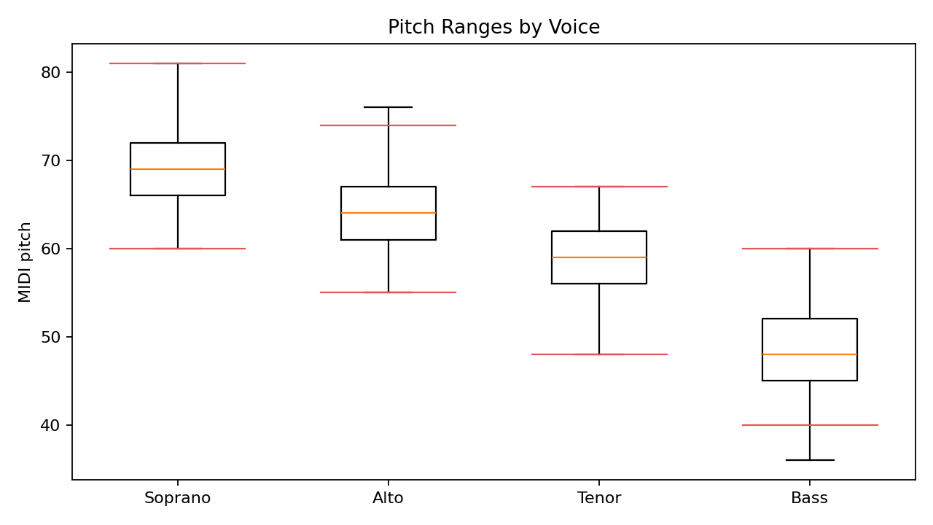
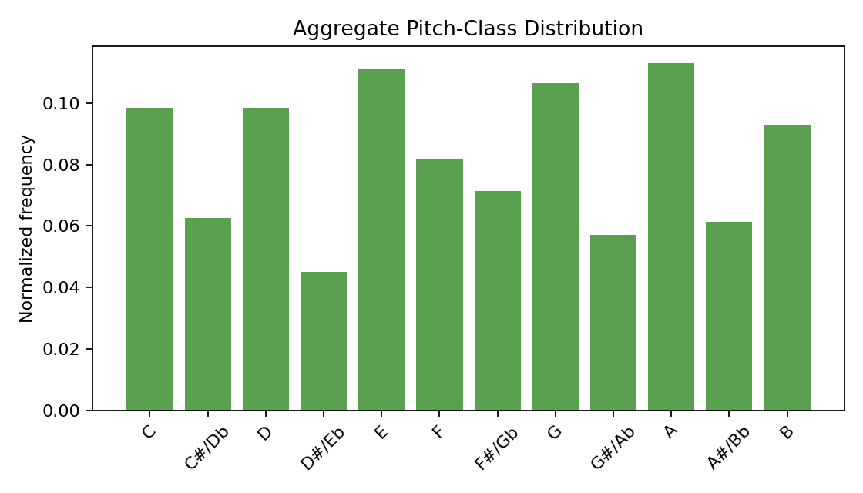
EDA
The plots check that the symbolic representation is usable
They also motivate the music-theory metrics used after generation.
Sequence lengths: compact enough for fixed-length batching
Voice ranges: soprano/alto/tenor/bass stay interpretable
Pitch-class histogram: reference style distribution
Fixed eighth-note grid keeps training simple while preserving useful rhythmic detail.
SATB range checks become direct generation-quality tests.
Pitch-class distance flags samples that drift away from the Bach corpus.
BachBot | CSE 253 Assignment 2 | 04

Slide 5
TASK 1
Generate all four voices from scratch
The upgraded path uses a neural model to propose candidates and symbolic rules to choose.
Baseline: Markov SATB tuples
Model: four-head GRU LM
state = full SATB tuple at time t
embed four voice tokens separately
counts transitions from tuple t to tuple t+1
concatenate embeddings into a sequence context
transparent, but only one-step memory
four output heads predict next SATB state
Decode upgrade
top-k temperature sampling -> postprocess -> 30 candidates -> badness-score rerank
BachBot | CSE 253 Assignment 2 | 05

Slide 6
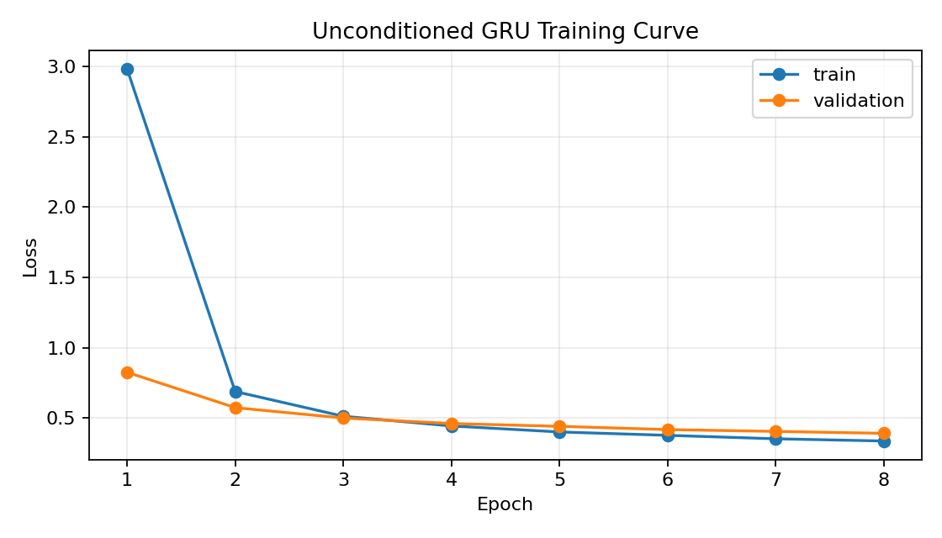
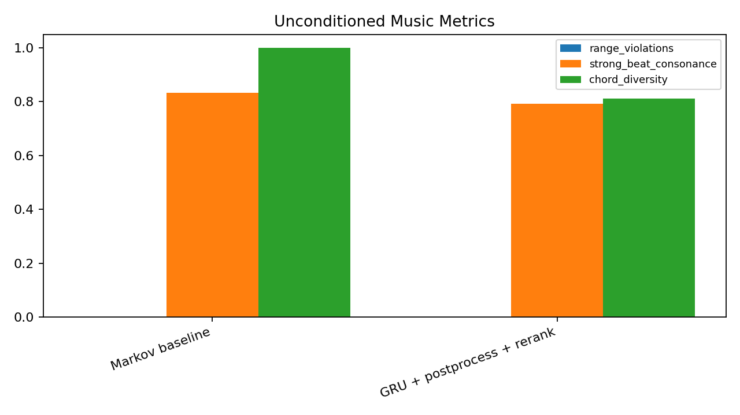
TASK 1 RESULTS
Reranking turns raw samples into cleaner chorale candidates
The GRU learns the objective; the final sample is selected by musical behavior.
Training curve: validation loss falls over 8 epochs
Music metrics: compare baseline and reranked GRU
GRU perplexity
1.09
Pitch hist distance
0.38
Voice crossings
0
Best of 30 candidates using top-k sampling, SATB repairs, and a music-quality badness score.
BachBot | CSE 253 Assignment 2 | 06

Slide 7
TASK 2
Given a soprano melody, generate alto, tenor, and bass
The whole soprano line is known, so bidirectional context is useful.
Input soprano
BiGRU harmonizer
Beam search
custom C-major melody, expanded to eighth-note grid
two-layer bidirectional GRU over soprano tokens
model probability + penalties for range, crossing, leaps, dissonance, parallels
Final MIDI
symbolic_conditioned.mid uses the Gibbs harmonization
Lookup baseline
DeepBach-style Gibbs
soprano pitch class + beat position -> common ATB tuple
local conditional sampler trained from the same Bach data
C4 D4 E4 G4 A4 G4 F4 E4 ...
BachBot | CSE 253 Assignment 2 | 07

Slide 8
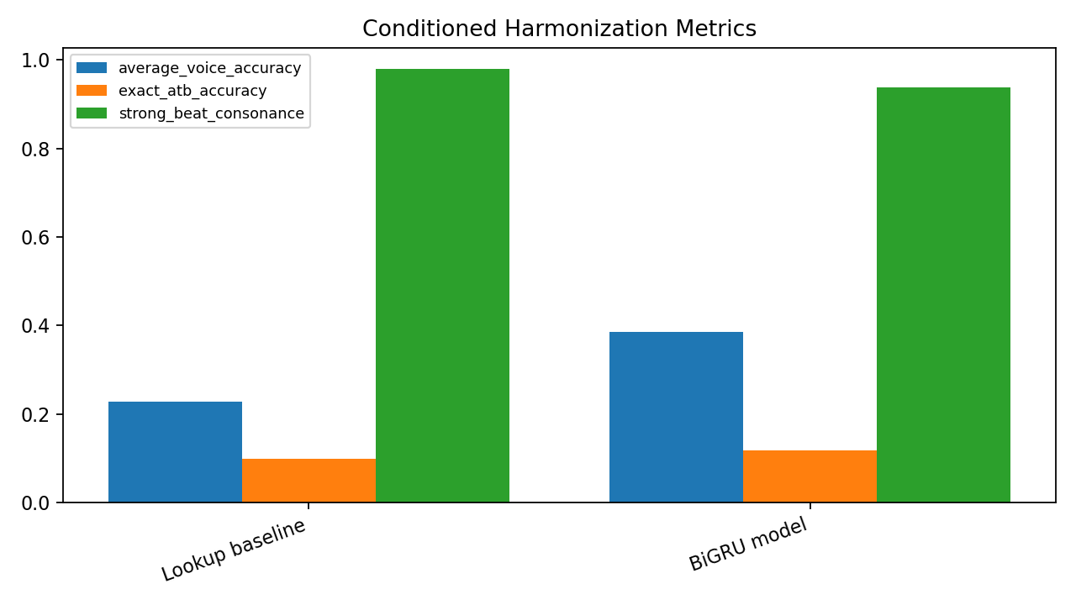
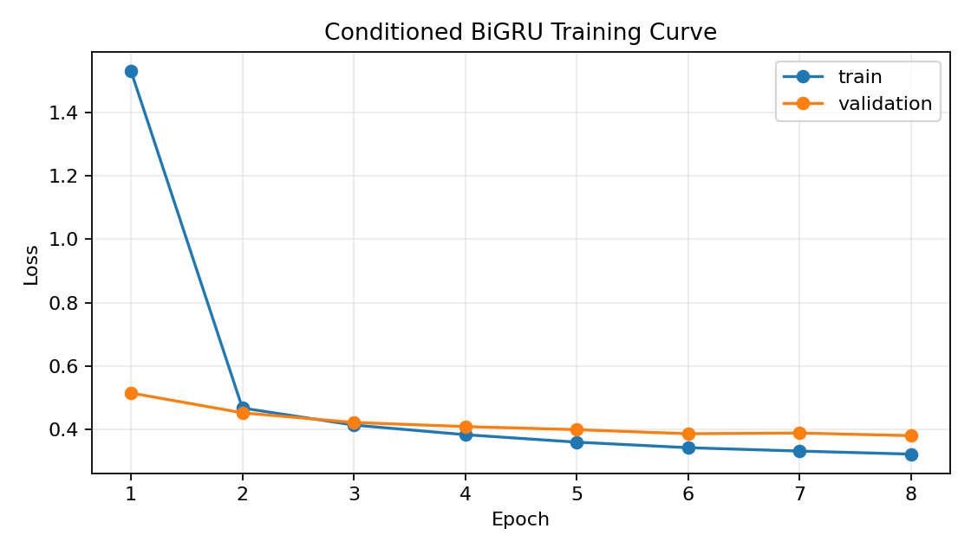
TASK 2 RESULTS
Exact-match accuracy is not the same as musical quality
There are many valid harmonizations for one soprano melody.
BiGRU training curve
Conditioned metrics
The lookup baseline matches tokens well, but the listening demo benefits from constrained beam/Gibbs decoding.
Final conditioned demo
DeepBach-inspired Gibbs reaches 100% strong-beat consonance, 0 range violations, and 0 voice crossings on the submitted conditioned MIDI.
BachBot | CSE 253 Assignment 2 | 08

Slide 9
EVALUATION
No single metric can decide whether generated music is good
We combine predictive fit, voice-leading checks, harmony checks, and distribution checks.
Predictive fit
Voice leading
Harmony
Distribution
loss, perplexity, per-voice accuracy
range violations, crossings, repeats, parallels
strong-beat consonance, chord diversity, cadence
pitch-class histogram distance
Does the model learn the token task?
Are the four lines singable and separated?
Is the sample stable without becoming static?
Does it still resemble the Bach corpus?
Listening remains part of the evaluation: these metrics catch obvious failure modes, but they do not replace musical judgment.
BachBot | CSE 253 Assignment 2 | 09

Slide 10
LISTENING DEMO
Play the final submitted MIDI files in a controlled order
The instruments are separated so the SATB lines are easier to hear.
1. symbolic_unconditioned.mid
2. symbolic_conditioned.mid
four-voice chorale generated from scratch
custom soprano melody is fixed
listen for variety, voice separation, and cadence
lower voices generated by Bach-trained sampler
selected by candidate reranking
listen for support under the soprano line
soprano
alto
tenor
bass
flute
oboe
cello
contrabass
BachBot | CSE 253 Assignment 2 | 10

Slide 11
RELATED WORK AND LIMITS
BachBot is a class-scale version of a larger symbolic music problem
The strongest future gains would come from longer-range modeling and stronger harmony constraints.
DeepBach
Bach chorale generation and harmonization with conditional resampling.
We implement a lightweight Gibbs-inspired demo trained on our processed corpus.
Music Transformer
Self-attention can model longer phrase-level symbolic structure.
Our GRUs are cheaper to train and simpler to explain for the assignment.
Bach chorales
Compact four-voice benchmark with interpretable music-theory checks.
Great for evaluation, but not a complete model of all Western harmony.
Limit: fixed eighth-note grid simplifies rhythm.
Limit: symbolic rules catch obvious failures, not full Bach harmony.
Next: train longer, add key-aware constraints, try Transformer-style context.
BachBot | CSE 253 Assignment 2 | 11

