Slide 1
CSE 153/253 ASSIGNMENT 2
BachBot
Two symbolic generation systems, one reproducible chorale pipeline.
Unconditioned SATB generation + soprano-conditioned harmonization, trained with lightweight neural models and evaluated with ML and music-theory metrics.
96
2
8
2 MIDI
20 min
chorale-style sequences in this run
assignment tasks covered
training epochs for each neural model
final generated music files
target presentation length
README.md, presentation_outline.md
01 / intro

Slide 2
TALK ROADMAP
The story follows the rubric, with shared data and evaluation up front.
1 min
3 min
4 min
4 min
5 min
3 min
Intro
Data + EDA
Task 1
Task 2
Evaluation
Limits + wrap
->
->
->
->
->
Two tasks and project goal
SATB grid, tokenization, plots
Markov baseline and GRU generator
Lookup baseline and BiGRU harmonizer
Loss, accuracy, music metrics, results
Related work, files, takeaways
Member A
Member B
Member C
Suggested ending: play both generated MIDI outputs after the formal 20 minutes.
presentation_outline.md, assignment prompt
02 / roadmap

Slide 3
DATA REPRESENTATION
Every model sees chorales as an eighth-note SATB token grid.
Used deterministic chorale-style fallback corpus because `music21` was unavailable.
This run
Score / fallback chorale
->
Quantize
0.5 quarterLength
->
T x 4 matrix
S A T B
->
Token ids
PAD REST HOLD START END + MIDI
SATB grid example
67 / 14 / 15
64.0
time
soprano
alto
tenor
bass
train / validation / test split
average time steps in each split
t
72
64
55
48
t+1
72
65
55
48
93
t+2
74
66
57
50
token vocabulary: 88 MIDI pitches + 5 special symbols
configs/mvp.yaml, outputs/tables/dataset_summary.csv, src/data.py, src/tokenization.py
03 / data

Slide 4
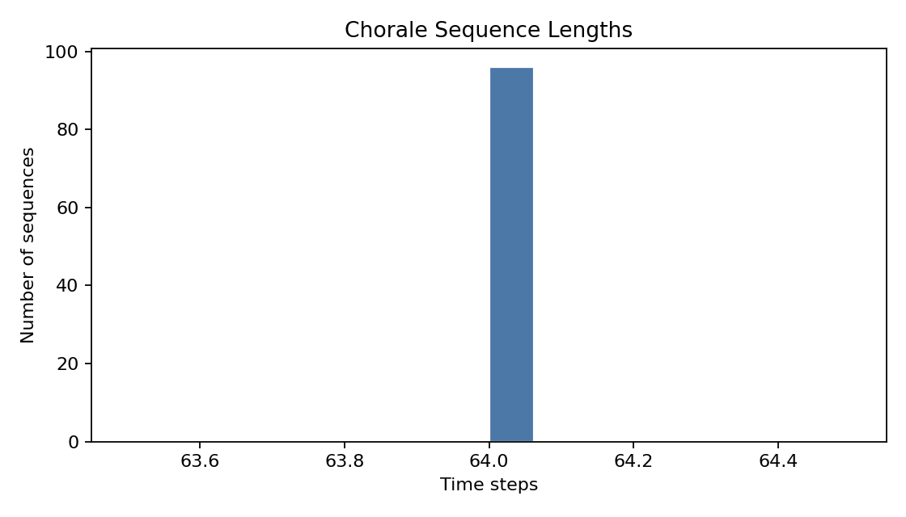
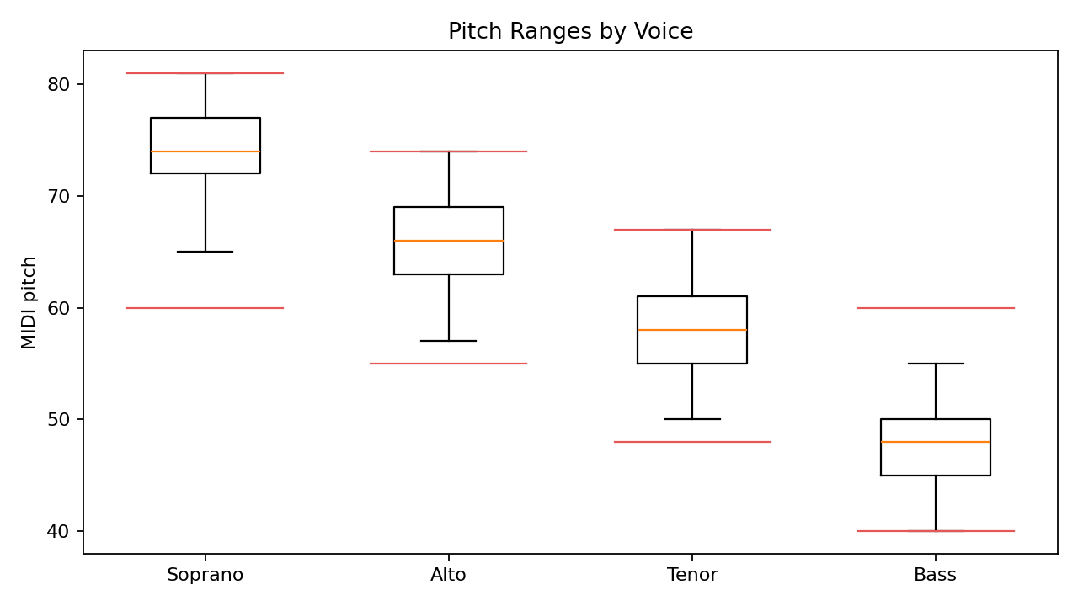
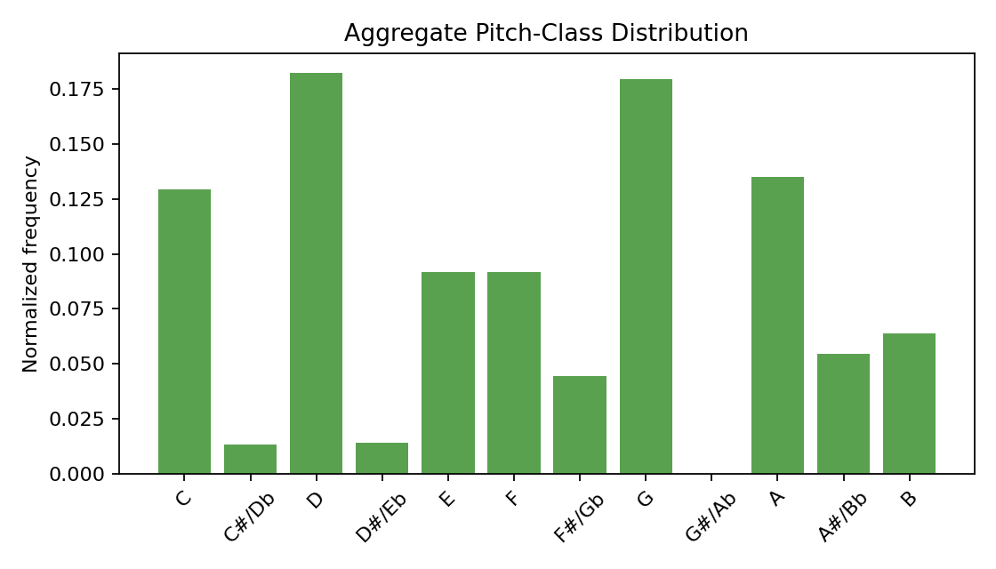
EDA
The corpus is compact, voice-ordered, and tonal enough for interpretable checks.
Why it matters
Sequence length tells us whether a fixed `max_seq_len` will cover most chorales without heavy truncation.
SATB ranges provide a sanity check for generated voices and make range violations easy to count.
Pitch-class distribution gives a compact reference for whether samples still sound tonal.
outputs/figures/sequence_lengths.png, voice_ranges.png, pitch_class_histogram.png
04 / eda

Slide 5
TASK 1 MODELING
The GRU adds sequence memory beyond a one-step Markov baseline.
Neural model: four-head GRU language model
Baseline: first-order SATB Markov chain
SATB token history
per-voice embeddings
concat
2-layer GRU
hidden=128
state t-1
(S,A,T,B)
state t
(S,A,T,B)
->
->
->
Strength: simple and transparent.
Weakness: sparse states and local-only memory.
S head
A head
T head
B head
Optimized
Cross-entropy summed over soprano, alto, tenor, and bass next-token predictions.
src/baselines.py, src/models.py, src/train_unconditioned.py
05 / task 1

Slide 6
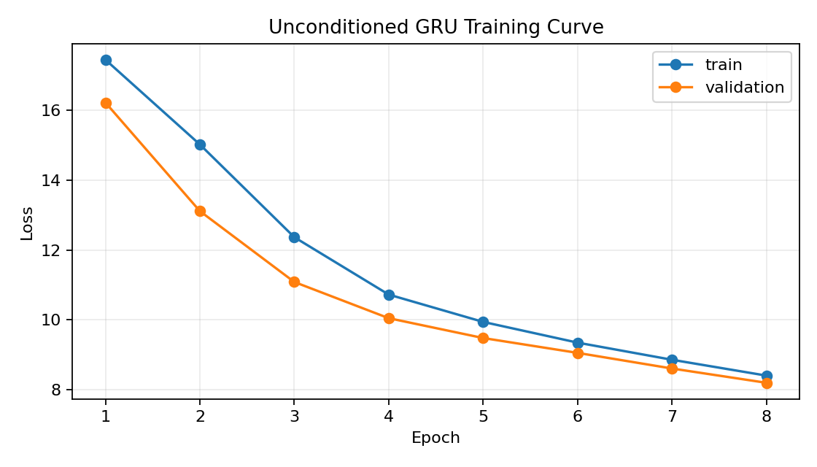
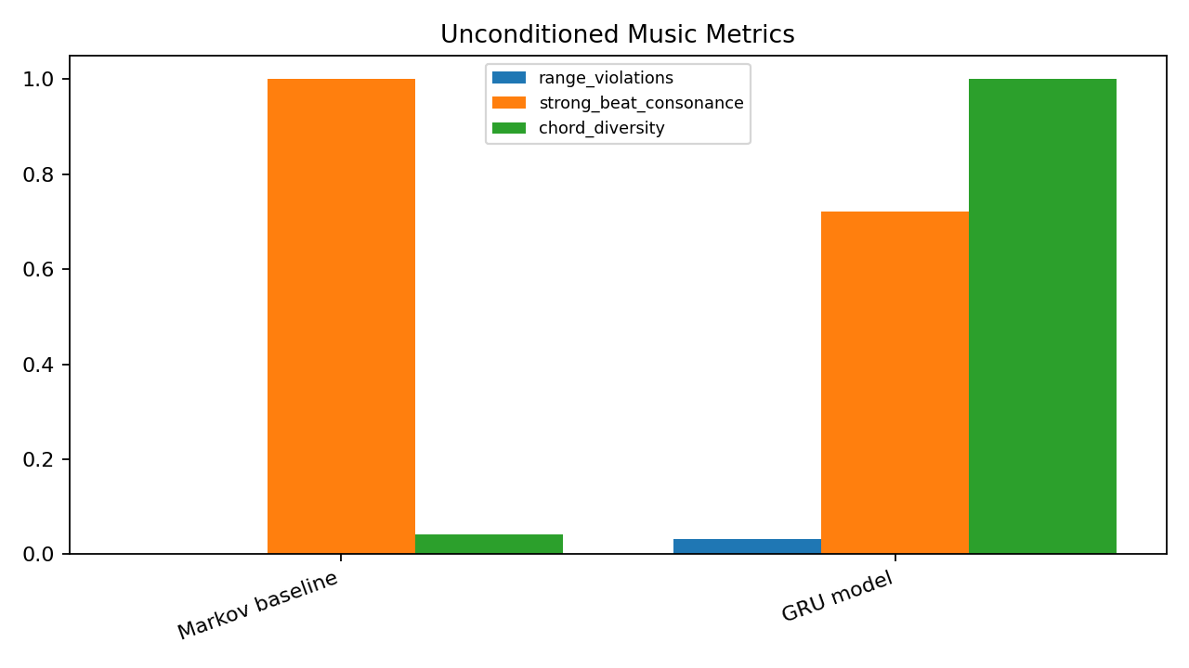
TASK 1 RESULTS
The GRU is more varied and pitch-faithful, but it pays with voice-leading errors.
7.61
GRU per-voice perplexity on the generated evaluation table
0.072
pitch-class distance vs. 1.135 for Markov
22
Model
Repeat
Diversity
Parallel
voice crossings in the GRU sample
Interpretation: the Markov sample is overly sticky, while the GRU uses many more sonorities. The tradeoff is that a small model without explicit harmony constraints can still cross voices or create parallel perfect intervals.
Markov
97.6%
4.2%
1
GRU
17.9%
100%
23
Caveat: Markov tuple NLL and four-head GRU loss are on different modeling scales, so the musical metrics carry the comparison.
outputs/logs/unconditioned_history.json, outputs/tables/unconditioned_metrics.csv
06 / task 1

Slide 7
TASK 2 MODELING
Harmonization turns the known soprano line into three lower voices.
Input
soprano_0 ... soprano_T
->
Output
[alto_t, tenor_t, bass_t] for each time step
Lookup baseline
BiGRU harmonizer
most common
ATB tuple
soprano token sequence
->
embedding
->
2-layer
bidirectional GRU
soprano pitch class
+
beat position
->
alto
tenor
bass
Why bidirectional?
The full melody is known before harmonization, so looking ahead is allowed.
src/baselines.py, src/models.py, src/train_conditioned.py
07 / task 2

Slide 8
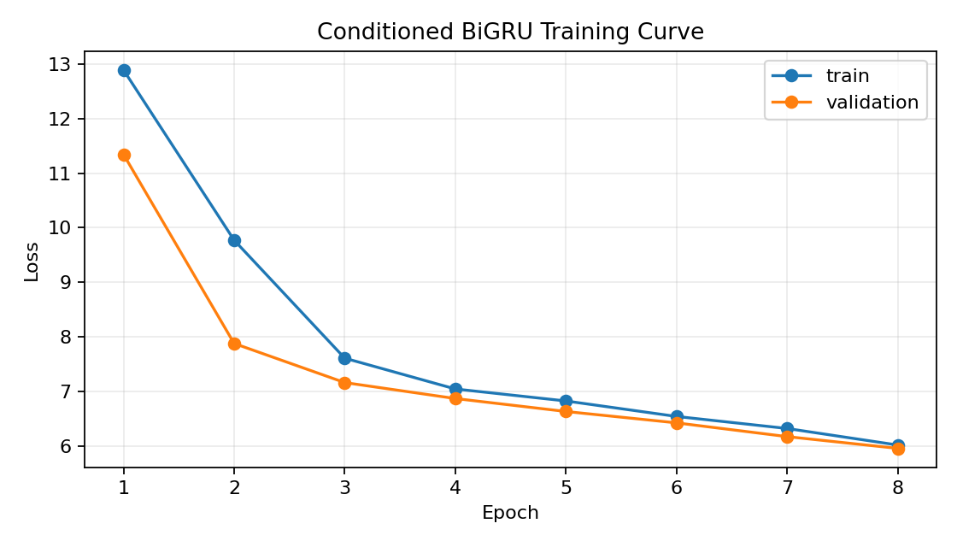
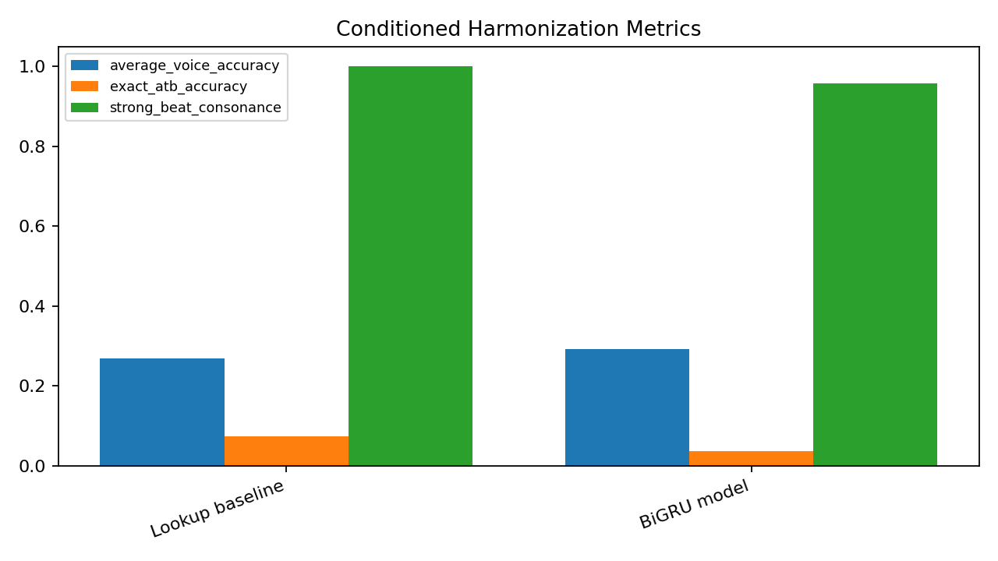
TASK 2 RESULTS
The BiGRU lifts accuracy and cuts parallels, but cadence is weaker.
29.2%
BiGRU average lower-voice accuracy vs. 27.0% lookup
12
parallel fifth/octave count vs. 42 for lookup
0.40
Model
Alto
Tenor
Bass
Exact
cadence heuristic vs. 1.00 lookup
Interpretation: exact ATB match is harsh because many harmonizations can be valid. The useful signal is the combination of per-voice accuracy, range/crossing sanity, and fewer parallel perfect intervals.
Lookup
18.4%
24.6%
37.9%
7.4%
BiGRU
26.3%
22.7%
38.5%
3.6%
Failure mode to mention during playback: the neural harmonizer is plausible locally but does not always land with a strong final cadence.
outputs/logs/conditioned_history.json, outputs/tables/conditioned_metrics.csv
08 / task 2

Slide 9
EVALUATION DESIGN
Predictive fit and musical plausibility answer different questions.
ML fit
Voice-leading
Harmony
Distribution
validation/test loss
range violations
strong-beat consonance
pitch-class histogram distance
perplexity
voice crossings
chord diversity
generated vs. training pitch footprint
per-voice accuracy
repeated-note ratio
cadence heuristic
exact ATB accuracy
parallel fifths/octaves
Core message
Good likelihood alone is not enough: a generated chorale also needs singable ranges, stable sonorities, varied chords, and a convincing ending.
src/evaluate.py, src/metrics_music.py
09 / evaluation

Slide 10
LISTENING DEMO
Use playback to connect the metric tradeoffs to what graders hear.
Playback order
What to listen for
1. symbolic_unconditioned.mid
Variety
Ordering
Cadence
Does it move beyond repeated states?
Do lower voices stay below upper voices?
Does the ending sound final?
2. symbolic_conditioned.mid
Narration cue
Frame imperfections as model behavior: this helps graders see that the evaluation and listening discussion match the code.
Optional comparison files live in `outputs/midi/`: baseline_unconditioned.mid, baseline_conditioned.mid, and reference_test_chorale.mid.
outputs/midi/symbolic_unconditioned.mid, outputs/midi/symbolic_conditioned.mid
10 / demo

Slide 11
RELATED WORK AND LIMITS
BachBot is smaller than research systems, so the tradeoffs are visible.
Reference
What it brings
How BachBot differs
DeepBach
Direct Bach chorale generation and harmonization
lighter grid representation, GRU models, class-scale training
Music Transformer
self-attention for longer-range symbolic structure
GRU is cheaper and easier to train for the MVP
Bach chorales
compact SATB benchmark with harmonic regularities
fallback corpus keeps pipeline runnable without corpus access
Limits
Small data, fixed eighth-note grid, short training, and no explicit harmony constraints explain many of the remaining musical errors.
bachbot_group_project_plan.md, notebooks/workbook.html
11 / related work

Slide 12
WRAP-UP
The project is complete enough to grade, and honest enough to improve.
Key takeaways
Submission checklist
1. A shared SATB representation supports both tasks.
2. Neural models beat simple baselines on some signals, but not every musical property.
3. The next step is adding real Bach corpus access, stronger constraints, and longer-range models.
workbook.html
video_url.txt
exported notebook
recording link placeholder
2 MIDI files
symbolic task outputs
End with audio
Play `symbolic_unconditioned.mid` and `symbolic_conditioned.mid` after Q&A or as the final minute.
README.md, submission/*
12 / wrap

