Slide 1
G-10 · B.TECH CSE · 2027 BATCH
Credit Card Fraud
Detection
An end-to-end, leakage-safe machine learning pipeline for detecting fraudulent transactions in severely imbalanced financial data
PRESENTED BY
ROLL NO.
Aarushi Sharma
2310990258
SUPERVISOR
Mr. Saubhagya Verma

Slide 2
ROADMAP
What We'll Cover
01
Problem Statement
05
Results & Explainability
Why fraud detection is a hard, high-stakes ML problem
ROC/PR curves, thresholds, SHAP reasoning
02
Dataset & EDA
06
Backend & Frontend
284,807 transactions, 0.17% fraud, distribution insights
FastAPI REST API + dual dashboards (Streamlit & built-in)
03
Pipeline Design
07
Testing & Reliability
Leak-safe split → scale → SMOTE → train → evaluate
Smoke tests, deployment fixes, two live production URLs
04
Models & Tuning
08
Benefits & Future Scope
LR, Random Forest, Optuna-tuned XGBoost, Isolation Forest
Impact, limitations, and what's next
CREDIT CARD FRAUD DETECTION
02

Slide 3
01 · THE CHALLENGE
Problem Statement
Credit card fraud costs the global economy tens of billions of dollars every year. The core difficulty isn't just detecting fraud — it's detecting a needle in a haystack where the needle appears only once in every ~580 transactions.
Extreme Imbalance
Anonymized Features
Only 492 of 284,807 transactions (0.17%) are fraud — a model predicting "legit" every time still scores 99.83% accuracy.
V1–V28 are PCA-transformed for confidentiality — the model must learn patterns without knowing what the raw features mean.
Cost Asymmetry
Real-Time Constraint
A missed fraud (false negative) costs far more than a flagged genuine transaction (false positive) — but over-flagging erodes customer trust.
Fraud must be scored in milliseconds at the point of transaction, with a decision that is explainable for compliance teams.
CREDIT CARD FRAUD DETECTION
03

Slide 4
02 · DATASET
Dataset Overview
data/creditcard.csv
284,807
31
492
0.172%
0
Total Transactions
Columns
Fraud Cases
Fraud Rate
Missing Values
SCHEMA
WHY PCA-ANONYMIZED?
Time
Seconds elapsed since first transaction in the dataset
The original dataset (European cardholders, Sept 2013) hides real transaction fields for confidentiality. V1–V28 are the outputs of a PCA transform on the true features — only Time and Amount survive untouched. This means the model must find fraud signal purely from statistical structure, not human-readable features like merchant or location.
V1 – V28
PCA-anonymized principal components (confidential source features)
Amount
Transaction amount in USD — heavily right-skewed
Class
Target label — 0 = Legitimate, 1 = Fraud
CREDIT CARD FRAUD DETECTION
04

Slide 5
03 · ARCHITECTURE
End-to-End Pipeline
01
02
03
04
05
06
Ingest
→
EDA
→
Preprocess
→
Train
→
Evaluate
→
Serve
creditcard.csv
eda.py
preprocess.py
train.py
evaluate.py
predict.py + FastAPI + Streamlit
KEY DESIGN PRINCIPLE — NO DATA LEAKAGE
❌ WRONG
✓ CORRECT (this project)
full_data → SMOTE → split → train/test
full_data → split → SMOTE(train only) → train → evaluate on raw test
Synthetic fraud samples bleed into the test set — metrics look great but are meaningless in production.
SMOTE lives inside an ImbPipeline, refit fresh on every CV fold's training portion — the test set (and validation folds) never see synthetic data.
CREDIT CARD FRAUD DETECTION
05

Slide 6
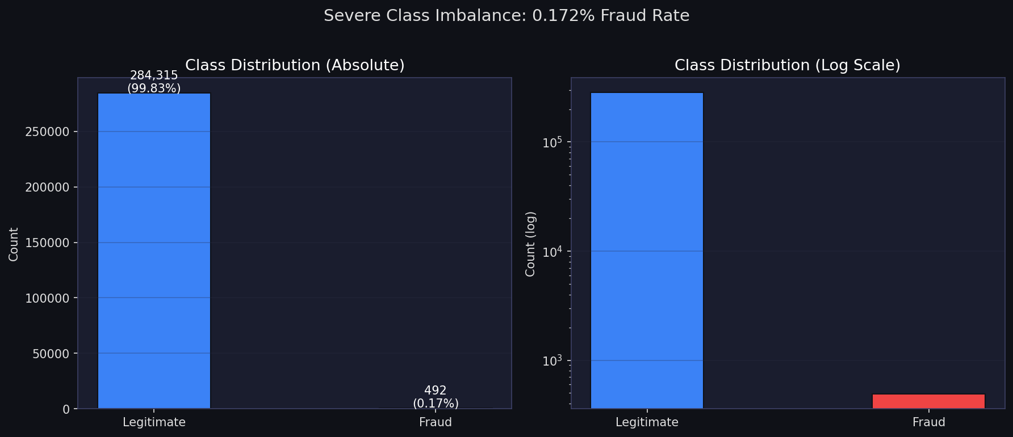
04 · EXPLORATORY DATA ANALYSIS
Severe Class Imbalance
284,315
Legitimate transactions (99.83%)
492
Fraud transactions (0.17%)
WHY THIS MATTERS
A model predicting "legitimate" for every transaction is 99.83% "accurate" yet catches zero fraud. This is exactly why the team rejected accuracy and optimized for PR-AUC and F1 instead.
Ratio: roughly 1 fraudulent transaction for every 578 legitimate ones — the log-scale chart on the right makes the 492 fraud cases visible at all.
CREDIT CARD FRAUD DETECTION
06

Slide 7
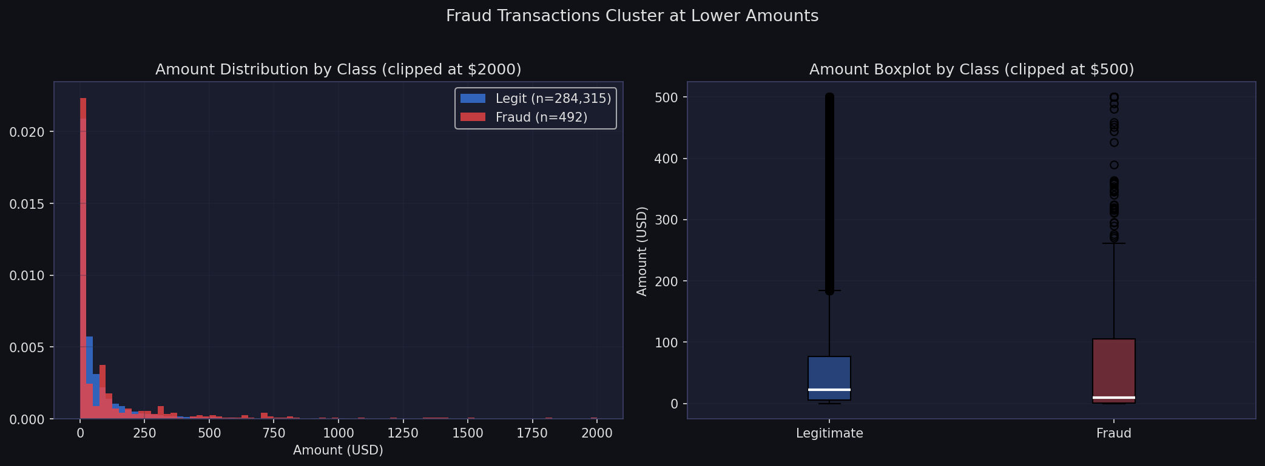
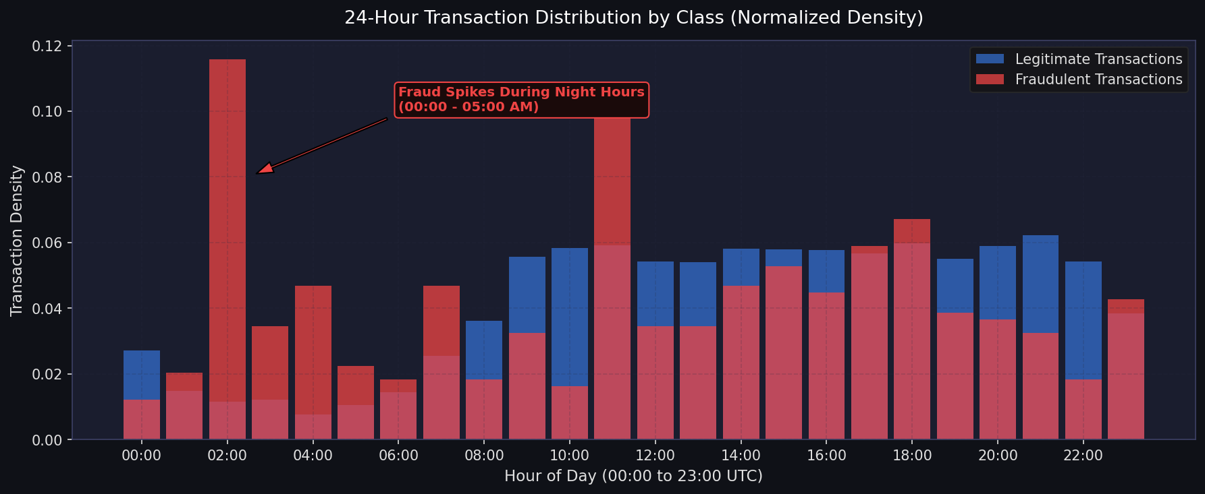
04 · EXPLORATORY DATA ANALYSIS
Transaction Amount & Time Patterns
Fraudulent transactions cluster at lower amounts and show a flatter, less periodic distribution across time compared to the strong day/night cycle seen in legitimate transactions — both signals the model can exploit.
CREDIT CARD FRAUD DETECTION
07

Slide 8
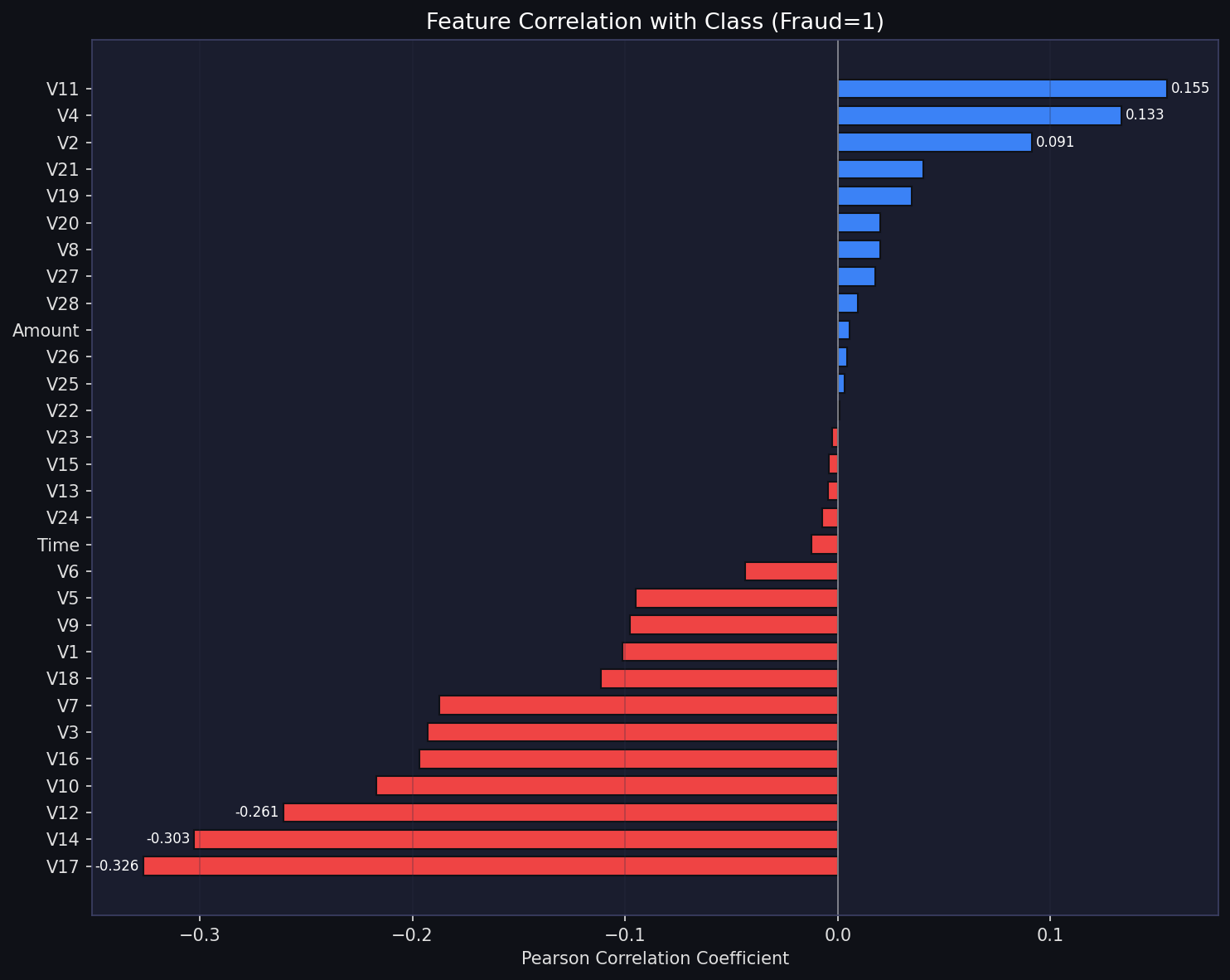
04 · EXPLORATORY DATA ANALYSIS
Feature Correlation with Fraud
V14, V4, V12
Strongest correlated PCA components with the fraud label — V14 and V12 are later confirmed as top predictors by Random Forest's feature importance too.
Amount & Time
Weak linear correlation individually — but still useful in combination, which is why they're retained and scaled rather than dropped.
CREDIT CARD FRAUD DETECTION
08

Slide 9
05 · PREPROCESSING
Preprocessing & Feature Engineering
Stratified Split
80 / 20 train-test split, stratified on Class so both sets preserve the 0.17% fraud rate — done BEFORE any scaling or resampling.
1
Robust Scaling
RobustScaler fit on X_train only, applied to Amount & Time (median/IQR-based — resistant to the extreme outliers common in transaction amounts). V1–V28 are already PCA-scaled.
2
SMOTE Inside Pipeline
Minority class oversampled to 15% of majority (sampling_strategy=0.15) via imblearn's ImbPipeline — refit fresh on every CV fold's training portion only.
3
Threshold Engineering
Rather than the default 0.5 cut-off, the optimal decision threshold is computed by scanning the full precision-recall curve for the F1-maximizing point.
4
CREDIT CARD FRAUD DETECTION
09

Slide 10
06 · MODELING
Four Models, Four Perspectives
Logistic Regression
Random Forest
SUPERVISED · BASELINE
SUPERVISED · ENSEMBLE (DEPLOYED MODEL)
class_weight='balanced', solver='saga', max_iter=1000 — a fast, interpretable linear benchmark.
200 trees, max_depth=12, min_samples_leaf=2, balanced weights — captures non-linear feature interactions.
XGBoost
Isolation Forest
SUPERVISED · BOOSTING
UNSUPERVISED · ANOMALY DETECTION
Optuna-tuned over 50 trials (n_estimators, max_depth, learning_rate, scale_pos_weight, etc.) — highest PR-AUC (0.8766).
200 estimators, contamination = live fraud rate — flags outliers without ever seeing labels during training.
WHY RANDOM FOREST OVER XGBOOST?
Random Forest posts the highest ROC-AUC of all four models (0.9808) and nearly matches XGBoost's F1 (0.8542 vs 0.8743) — but at a far safer decision threshold (0.655 vs XGBoost's extreme 0.993) and without an extra heavyweight dependency to keep stable in production.
CREDIT CARD FRAUD DETECTION
10

Slide 11
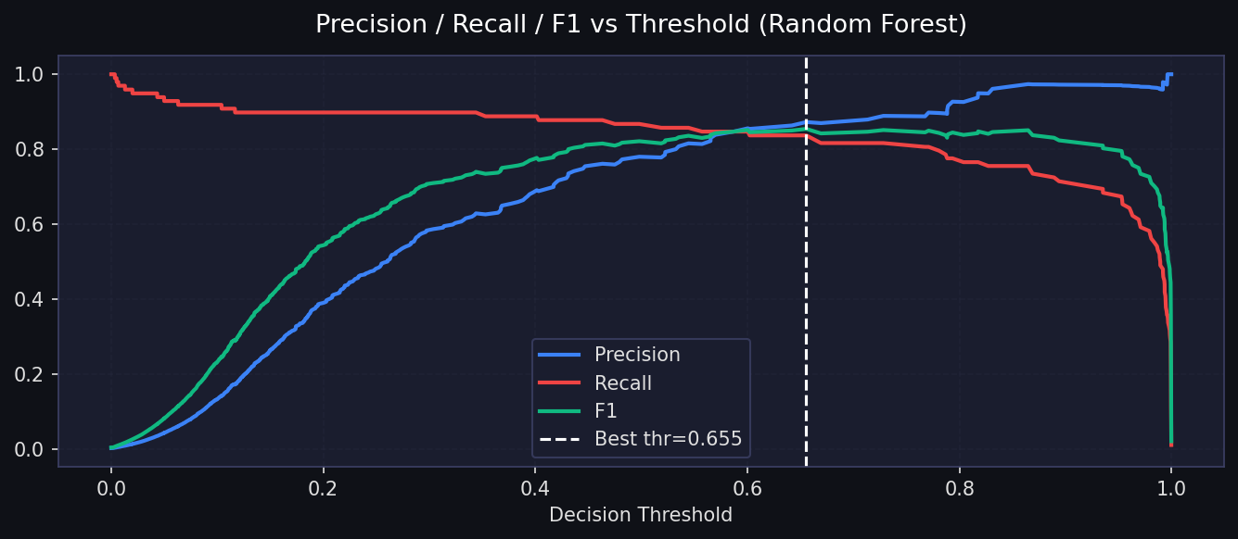
06 · MODELING
Hyperparameter & Threshold Tuning
train.py — best_threshold_f1() (applied per-model)
F1 IMPROVEMENT FROM THRESHOLD TUNING — RANDOM FOREST
precisions, recalls, thresholds = \
precision_recall_curve(y_true, y_prob)
# [:-1] aligns arrays: f1s[i] <-> thresholds[i]
f1s = 2 * precisions[:-1] * recalls[:-1] / \
(precisions[:-1] + recalls[:-1] + 1e-9)
best_idx = np.argmax(f1s)
thr = float(thresholds[best_idx])
# prob >= 1.0 is always False at inference
thr = min(thr, 0.9999)
return thr, float(f1s[best_idx])
0.816 → 0.854
Random Forest F1-score at default 0.5 threshold vs. the tuned optimal threshold (0.6554) — a smaller, safer jump than XGBoost's, since RF was already well-calibrated near 0.5.
Optuna search (train_xgboost)
50 trials tuning n_estimators, max_depth, learning_rate, subsample, colsample_bytree, min_child_weight, gamma & scale_pos_weight — each trial wraps XGBoost inside the SMOTE pipeline so CV stays leakage-free. Random Forest and Logistic Regression use fixed, sensible configs instead of a full search.
CREDIT CARD FRAUD DETECTION
11

Slide 12
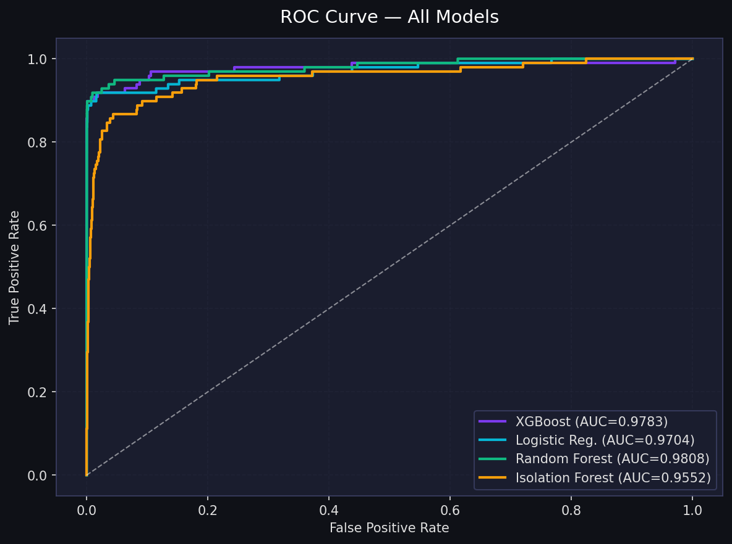
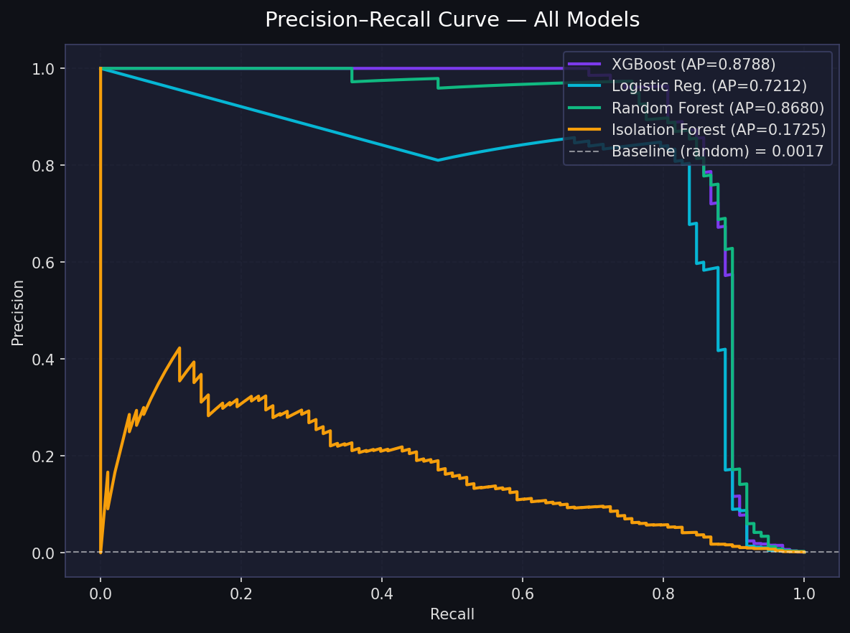
07 · EVALUATION
Model Comparison — ROC & PR Curves
Random Forest posts the best ROC-AUC of all four (0.9808); XGBoost edges ahead on PR-AUC (0.877 vs 0.868) — both far ahead of Isolation Forest (0.173), confirming unsupervised anomaly detection alone isn't enough for this problem.
CREDIT CARD FRAUD DETECTION
12

Slide 13
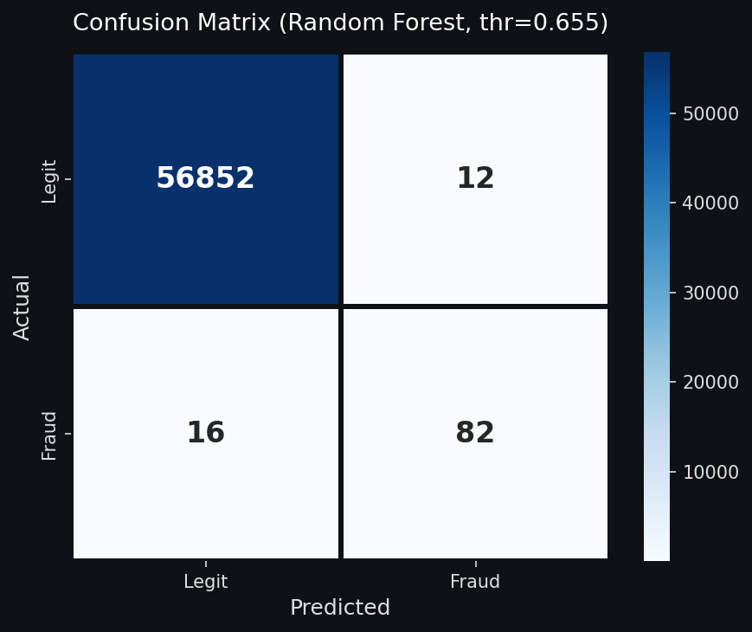
07 · EVALUATION
Confusion Matrix — Final Model (Random Forest)
READING THE MATRIX AT thr = 0.6554
True Negatives — 56,852
Legitimate transactions correctly cleared
False Positives — 12
Genuine transactions incorrectly flagged — the customer-friction cost
False Negatives — 16
Fraud that slipped through — the direct financial-loss cost, minimized by threshold tuning
True Positives — 82
Fraud correctly caught and stopped
Chosen decision threshold: 0.6554 — picked to maximize F1 for Random Forest, not the naive 0.5 default.
CREDIT CARD FRAUD DETECTION
13

Slide 14
07 · EVALUATION
Final Metrics — All Models
Model | ROC-AUC | PR-AUC | F1 @ 0.5 | F1 @ Best Thr | Best Thr
Logistic Regression | 0.9704 | 0.7212 | 0.1119 | 0.7558 | 0.9999
Random Forest ★ | 0.9808 | 0.8680 | 0.8155 | 0.8542 | 0.6554
XGBoost (Optuna) | 0.9777 | 0.8766 | 0.7644 | 0.8743 | 0.9928
Isolation Forest | 0.9552 | 0.1725 | 0.1304 | 0.2944 | 0.7666
★ Random Forest selected as the production model — best overall ROC-AUC, near-identical F1 to XGBoost at a much safer threshold, and it powers both the FastAPI backend and the Streamlit dashboard (model.pkl).
Accuracy is deliberately excluded — with 99.83% legitimate transactions, a model that predicts "not fraud" every single time would score 99.83% accuracy while catching zero fraud. PR-AUC and F1 are the metrics that matter here.
CREDIT CARD FRAUD DETECTION
14

Slide 15
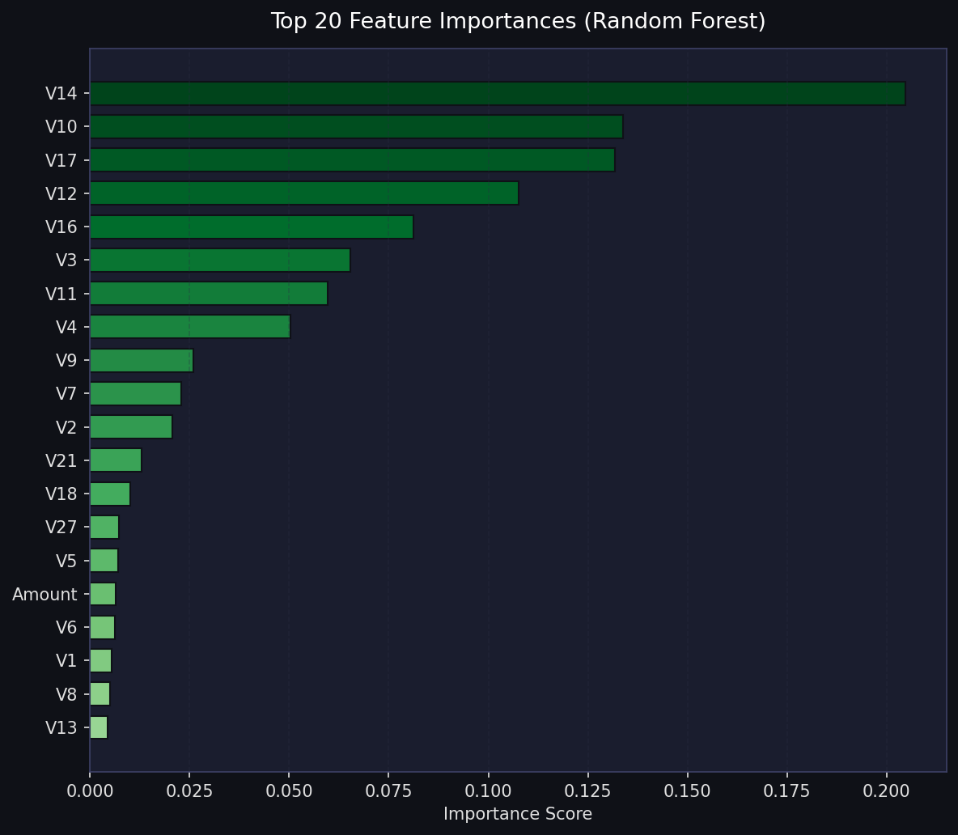
08 · EXPLAINABILITY
Feature Importance & SHAP Reasoning
predict.py — FraudPredictor
Every prediction runs through a shap.TreeExplainer on the deployed Random Forest classifier. The top-3 features by |SHAP value| are returned with their raw value and direction (↑ fraud / ↓ fraud) — giving analysts a reason, not just a score. The same predictor class backs both the FastAPI endpoint and the Streamlit app.
Sample response
{
"probability": 0.923,
"verdict": "FRAUD",
"threshold": 0.6554,
"shap_top3": [
{"feature": "V14", "shap_value": -0.812,
"direction": "↑ fraud"},
{"feature": "V10", "shap_value": 0.531,
"direction": "↓ fraud"},
{"feature": "V17", "shap_value": -0.487,
"direction": "↑ fraud"}
]
}
CREDIT CARD FRAUD DETECTION
15

Slide 16
09 · BACKEND
Backend — FastAPI REST API
app/api.py
CONTAINERIZED DEPLOYMENT
GET
/health
Model-loaded check + live threshold + feature count
Dockerfile
python:3.11-slim base → pip install -r requirements.txt → uvicorn app.api:app --host 0.0.0.0 --port 8000
GET
/metrics
Full config.json — all 4 models' metrics, params, threshold
render.yaml
POST
/predict
Score one transaction — probability, verdict, confidence, SHAP top-3
Render web service · PYTHON_VERSION pinned to 3.11.9 · startCommand runs uvicorn directly on Render's $PORT
GET
/random
Pull a real fraud or legit row from test_sample.csv for demos
GET
/
Built-in HTML/JS dashboard — same UI, zero separate frontend needed
LIVE DEPLOYMENT
creditcard-qro9.onrender.com
GET
/docs
Auto-generated Swagger UI — try every endpoint from the browser
A real, working REST API — not a mock. Hit /docs to try /predict live with a Swagger form, or /random to pull an actual test-set transaction and see the model score it in real time.
CORS enabled (allow_origins="*") · Pydantic-validated request body (TransactionInput) · same FraudPredictor singleton as the Streamlit app — one source of truth, zero logic drift between frontend and backend.
CREDIT CARD FRAUD DETECTION
16

Slide 17
10 · FRONTEND
Frontend — Two Dashboards, One Design Language
STREAMLIT APP
FASTAPI'S BUILT-IN DASHBOARD
app/streamlit_app.py
app/api.py — served at GET /
🔍 Transaction Check tab — pick a random real/fraud/legit row or type your own, get verdict + SHAP reasoning instantly.
Same two-tab layout, same colors, same SHAP cards — rebuilt from scratch in vanilla HTML/CSS/JS + Plotly.js, no React or Streamlit runtime needed.
📊 Model Dashboard tab — ROC/PR curves, confusion matrix and per-model KPIs, all rendered with Plotly.
🎲 Random transaction / 🚨 Random fraud / ✅ Random legit buttons call /random and /predict live via fetch() — a full working demo from one static page.
Hand-built CSS: black background, red = fraud, green = legit, blue = accent — cached model loading via @st.cache_resource.
Proves the model works even for someone who only has the raw API URL — no separate frontend deploy required.
Live: credit-card-fraudd-detection.streamlit.app
Live: creditcard-qro9.onrender.com
CREDIT CARD FRAUD DETECTION
17

Slide 18
11 · RELIABILITY
Testing & Deployment Reliability
src/smoke_test.py — end-to-end check
src/export_sample.py
Threshold sanity — asserts 0 < config threshold < 1 (a threshold ≥ 1.0 would silently classify nothing as fraud, ever).
Regenerates models/test_sample.csv — 196 balanced rows (98 fraud + 98 legit from the real test split) — in under a second, without re-running the full training pipeline. This is what powers every "random transaction" button in both dashboards.
Reproduces the exact train/test split (same random_state) to pull real, known fraud and legit rows.
Scores 5 known-fraud + 3 known-legit rows through the full predictor and checks at least one fraud is actually flagged.
DEPLOYMENT FIX — PYTHON VERSION PINNING
Validates every SHAP top-3 entry has a real feature name and a valid ↑/↓ direction.
Streamlit Cloud's first deploy failed — it defaulted to Python 3.14, and Pillow's old pinned version had no prebuilt wheel for it, so pip tried (and failed) to compile it from source. Fixed by explicitly pinning the runtime (render.yaml's PYTHON_VERSION and Dockerfile's python:3.11-slim base) so every dependency installs from a prebuilt wheel — no compilation, no surprises.
Confirms predictor.threshold exactly matches config.json — catches the kind of silent mismatch a dashboard-vs-inference threshold bug could cause.
CREDIT CARD FRAUD DETECTION
18

Slide 19
12 · IMPACT
Benefits
Loss Prevention
Statistically Honest Metrics
Explainable Decisions
F1-optimal Random Forest model (0.854) catches far more real fraud than a naive rule-based or accuracy-driven baseline ever could.
Leak-free split → scale → SMOTE design means reported performance will hold up in production, not just on paper.
SHAP-backed reasoning lets fraud analysts and auditors see why a transaction was flagged, supporting compliance.
Tunable Risk Appetite
Ready to Deploy
Reduced Manual Review
The F1-optimal threshold can be shifted toward recall or precision depending on business risk tolerance.
A working dashboard and inference engine already exist — this isn't just a notebook, it's a usable product.
Automated, confidence-scored triage means human analysts focus only on genuinely ambiguous cases.
CREDIT CARD FRAUD DETECTION
19

Slide 20
13 · WHAT'S NEXT
Future Scope
Real-Time Streaming
Graph & Network Features
Move from batch scoring to a Kafka/Flink pipeline for millisecond-level, at-the-swipe decisions.
Model relationships between cards, merchants, and devices to catch coordinated fraud rings, not just single transactions.
Deep Sequential Models
Active Learning Loop
Explore LSTMs / Transformers or autoencoders over a cardholder's transaction history for behavioral drift detection.
Feed analyst-confirmed verdicts back into periodic retraining so the model adapts to evolving fraud patterns.
Cloud-Native Deployment
Privacy-Preserving Collaboration
Scale the existing FastAPI backend with Kubernetes and autoscaling, plus a proper CI/CD pipeline beyond the current Render setup.
Federated learning across banks to learn from broader fraud patterns without ever sharing raw customer data.
CREDIT CARD FRAUD DETECTION
20

Slide 21
THANK YOU
Questions & Discussion
Aarushi Sharma · 2310990258 · G-10
Supervisor: Mr. Saubhagya Verma

