Slide 1

GIT

Slide 3

What is Version Control System (VCS)?
VCS is a software that helps software developers to work together and maintain a complete history of their work.
It is the practice of tracking and managing changes to software code.
They are software tools that help software teams manage changes to source code over time.
Keeps track of every modification to the code in a special kind of database.
There are two types of VCS –
Centralized Version Control System (CVCS)
Distributed Version Control System (DVCS)

Slide 4
Centralized VCS
In Subversion, CVS, Perforce, etc. A central server repository holds the “official copy” of the code.
- The server maintains the sole version history of the repo
You make “checkouts” of it to your local copy.
- You make local modifications
- Your changes are not versioned
When you’re done, you “check in” back to the server.
- Your checkin increments the repo’s version
Computer A
Central VCS Server
Checkout
file
Version Database
Version 3
Version 2
Computer B
Version 1
Checkout
file

Slide 5


Advantages & Disadvantages of CVCS
Relatively easy setup
Provides transparency
Enable admins control the workflow
If the main server goes down, developers can’t save versioned changes
Remote commits are slow
Unsolicited changes might ruin development
If the central database is corrupted, the entire history could be lost (security issues)

Slide 6
Distributed VCS
Server Computer
In git, mercurial, etc., you don’t “checkout” from a central repo.
You “clone” it and “pull” changes from it
Your local repo is a complete copy of everything on the remote server.
- Yours is “just as good” as theirs
Many operations are local:
- Check in/out from local repo
- Commit changes to local repo
- Local repo keeps version history
When you’re ready, you can “push” changes back to server.
Version Database
Version 3
Version 2
Version 1
Computer A
Computer B
file
file
Version Database
Version Database
Version 3
Version 3
Version 2
Version 2
Version 1
Version 1

Slide 7

Advantages of DVCS
Allows developers to work simultaneously
Does not allow overwriting each other’s changes
Maintains a history of every version
Being able to trace each change made to the software and connect it to project management and bug tracking software
Managing and Protecting the Source Code
Supports the developers’ workflow and not any rigid way of working
Backup
CI/CD
Integration in development tools

Slide 8




Git?
Git is a distributed revision control and source code management system with an emphasis on speed.
Created by Linus Torvalds, creator of Linux, in 2005
- Came out of Linux development community
- Designed to do version control on Linux kernel
Goals of Git:
Speed
Support for non-linear development
Fully distributed
Able to handle large projects efficiently
- (A “git” is a cranky old man. Linus meant himself.)
https://git-scm.com/
git --version

Slide 9

Git – Life Cycle
General workflow of Git is as follows –
You clone the Git repository as a working copy
You modify the working copy by adding/editing files
If necessary, you also update the working copy by taking other developer’s changes
You review the changes before commit
You commit changes. If everything is fine, then you push the changes to the repository
After committing, if you realize something is wrong, then you correct the last commit and push the changes to the repository

Slide 10
Initialization
Repository
Working Copy
Clone operation
Edit, Add, Move files
Update operation
Modify working copy
Status & Diff
Review changes
Commit & Push
Push operation
Commit changes
Amend & Push
Push operation
Fix mistakes

Slide 11

Git snapshots
Subversion
Centralized VCS like Subversion track version data on each individual file.
Git keeps “snapshots” of the entire state of the project.
Each checkin version of the overall code has a copy of each file in it.
Some files change on a given checkin, some do not.
More redundancy, but faster.
Checkins over time
Version 1
Version 2
Version 3
Version 4
File A
Δ1
Δ2
File B
Δ1
Δ2
File C
Δ1
Δ2
Δ3
Git
Checkins over time
Version 1
Version 2
Version 3
Version 4
File A
A1
A1
A2
File B
B
B
B1
File C
C1
C2
C2

Slide 12
Local git areas
Local Operations
In your local copy on git, files can be:
In your local repo
(committed)
Checked out and modified but not yet committed
(working copy)
Or, in-between, in a “staging” area
Staged files are ready to be committed.
A commit saves a snapshot of all staged state.
Working
directory
Staging
area
Git directory
(repository)
Checkout the project
Stage files
Commit
Unmodified/modified
Files
Staged
Files
Committed
Files

Slide 13
Basic Git workflow
Modify files in your working directory.
Stage files, adding snapshots of them to your staging area.
Commit, which takes the files in the staging area and stores that snapshot permanently to your Git directory.
Untracked
Unmodified
modified
Staged
Edit the file
Add the file
Stage the file
Remove the file
Commit

Slide 14




Internet hosting for Git repos
GitHub
https://www.devopsschool.com/blog/top-5-git-hosting-solutions/
Bitbucket
GitLab

Slide 15

.git directory structure
.git
HEAD/ (A pointer to your current branch)
config/ (contains all configuration preferences)
description/ (description of your project)
Index/ (is used as staging area between working directory and repo)
logs/ (keeps records to changes that are made in ref)
objects/ (all data are stored here: commits, trees and tags)
hooks/ (shell scripts that are invoked after executing a command)
refs/ (holds your local branch, remote branch and tags)

Slide 16
Customize Git Environment
Git stores all global configurations in .gitconfig file, which is located in your home directory.
To set these configuration values as global, add the --global option.
If you omit --global option, then your configurations are specific for the current Git repository.
You can also setup system wide configuration use --system option with root/administrative right.
Git stores these values in the /etc/gitconfig file, which contains the configuration for every user and repository on the system.

Slide 17
… Cont
Setting username:
Setting email id:
Avoid merge commits for pulling:
Setting default editor:
Color highlighting:
Setting default merge tool:
git config --global user.name “weirdocourses”
git config --global user.email “weirdo.courses@gmail.com”
git config --global branch.autosetuprebase always
git config --global core.editor vim
git config --global color.ui true
git config --global color.status auto
git config --global color.branch auto
git config --global mege.tool vimdiff

Slide 18
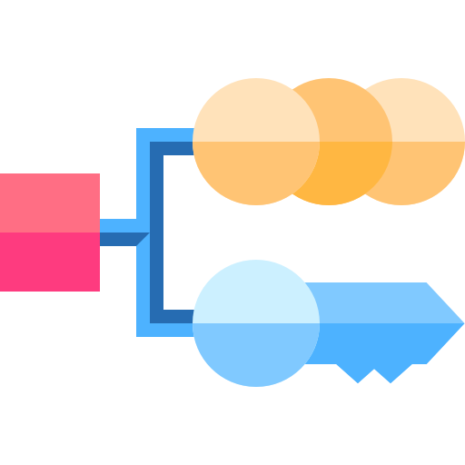
… Cont
Listing Git settings:
The above command will produce the following result:
git config --list
user.name=weirdocourses
user.email=weirdo.courses@gmail.com
push.default=nothing
branch.autosetuprebase=always
color.ui=true
color.status=auto
color.branch=auto
core.editor=vim
merge.tool=vimdiff

Slide 19
Git Commands
Command | Description
git clone url [dir] | Copy a Git repository so you can add to it
git add file | Adds file contents to the staging area
git commit | Records a snapshot of the staging area
git status | View the status of your files in the working directory and staging area
git diff | Shows diff of what is staged and what is modified but unstaged
git help [command] | Get help info about a particular command
git pull | Fetch from a remote repo and try to merge into the current branch
git push | Push you new branches and data to a remote repository
others: init, reset, branch, checkout, merge, log, tag

Slide 20
https://www.tutorialspoint.com/git/git_basic_concepts.htm
https://courses.cs.washington.edu/courses/cse403/13au/lectures/git.ppt.pdf
https://www.atlassian.com/git/tutorials/what-is-version-control

