Slide 1
CS 2275 – Module 2 Functions, Parameters, Pass-by Value, Pass-by Reference, Pass-by const ref, test plans
David V. Beard

Slide 2
Readings for Module 2
Lippman: 1.4,2.1-2.5,4.1-4.7, 4.9, 4.11, 4.12, 5.1-5.5, 6.1-6.3

Slide 3
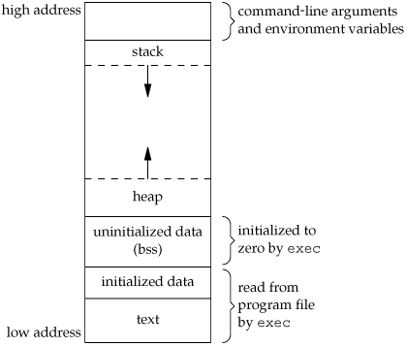
C++ Memory Organization (more or less)
From http://www.geeksforgeeks.org/memory-layout-of-c-program/
Text segment
Initialized data segment
Uninitialized data segment
Heap
Stack

Slide 4
C++ Functions: Pass by Value – note 2.6
pass by value: value of argument expression in call is copied into parameter variable in function’s stack frame. Arguments do not have to match type.
With pass by value: arguments cannot be changed.
long sumIntegerRange(int n1, int n2) {
long sum = 0;
if (n1<n2) {int foo = n1;n2=n2; n2=foo;}
for(int i=n1;i<=n2;i=i+1) sum = sum +i;
return sum;
}
Int main() {cout << sumIntegerRange(42+3, 51.4); return 0; }

Slide 5
Pass-by Reference - note 2.6
Arguments for n1 and n2, mainly r1, r2 need to be altered by swap. Pointer to r1 and r2 passed into swap. n2=foo actually alters r2.
void swap( int&n1, int &n2) {
int foo = n1;
n1 = n2;
n2 = foo;
}
int main () { int r1=3; int r2=4; swap(r1,r2); return 0; }

Slide 6
Const string &s -unchanging pass by reference
Pass by value protects arguments from being altered, but requires copying data – problem for very large data items such as strings, arrays, class instances.
Int foo(const & string s)
Reference to a large argument is passed into function, but data item cannot be changed.

Slide 7
Static and Global Variables – note 2.7
int foo=9; //global variables – BAD IDEA – almost never needed
int globalCountCalls() { foo++; }
int countCalls() {
static int goo = 1; //static saves information between calls
goo ++;
return goo;
}
int main() {
GlobalCountCalls(); GlobalCountCalls(); GlobalCountCalls();
cout << foo << endl;
for(int i=1;i<5;i++) cout << countCalls() << endl;
}

Slide 8
Test Plans
What tests are needed for the following to be confident of its correctness?
“Write a C++ function that accepts a 1D array and an integer indicating its length, and reverses it.”
a={1,2,3,4,5} reverse(a,5) IS NOT ENOUGH!
reverse (a,-1), reverse (a,8)
What about array length 0?. What about array length 2^34?
Sketch out the test plan BEFORE you write the function.
Might consider adding it to the block comment
Anything that can go wrong probably will and in the worse possible way at the worse possible time (be sufficiently paranoid)

