Slide 1
与知识图谱的交互学习下的推荐系统
—— 豆瓣电影数据集
47
刘威 王笛合 肖儒峰

Slide 2
Preparation

Slide 3
Dataset Preprocessing
User Rates Table
Knowledge Graph Table
user_id | movie_id | rates
18 | 6989755 | 1
18 | 4049665 | 4
18 | 6521838 | 4
18 | 4049667 | 4
18 | 3231622 | 5
movie_id | relation | tail
3542816 | directors | Archie Mayo
3542816 | writers | 凯西·罗宾逊
3542816 | actors | Leslie Howard
3542816 | type | 喜剧
3542816 | tags | 美国
Notes:
用于模型的输入和知识图谱的构建

Slide 4
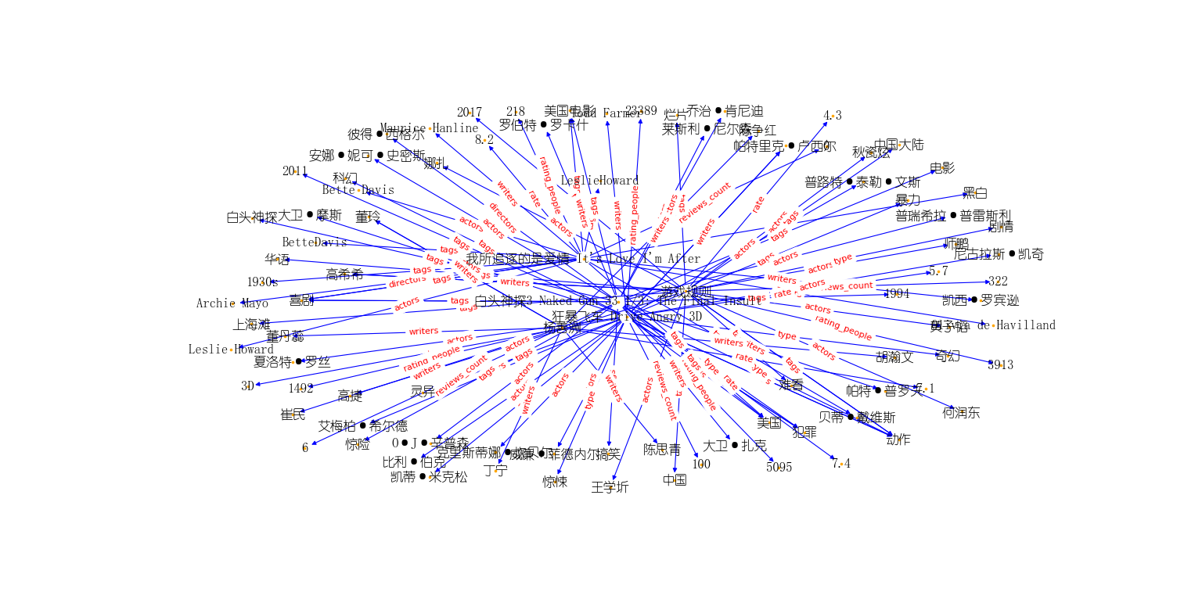
Knowledge Graph Visualization

Slide 5
Model Introduction

Slide 6
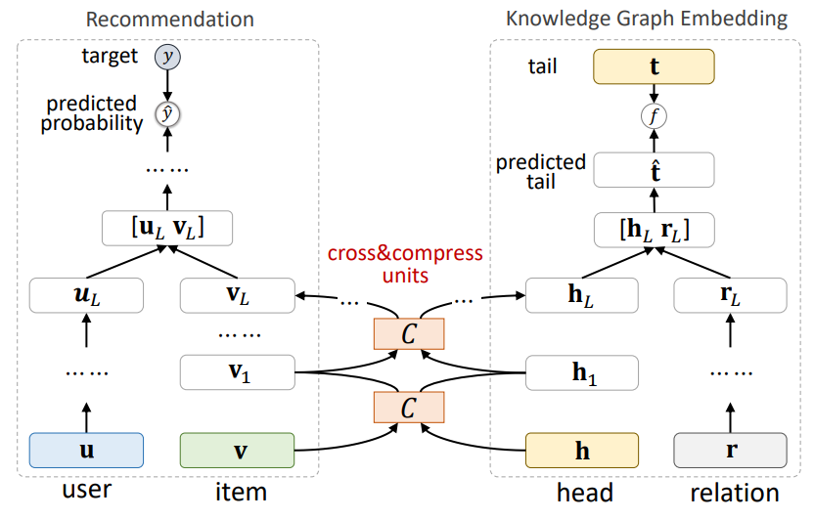
Base Model (MKR)
左：推荐系统模块，中：交叉压缩单元，右：知识图谱模块
1. Hongwei Wang et al. 2019. Multi-Task Feature Learning for Knowledge Graph Enhanced Recommendation.

Slide 7
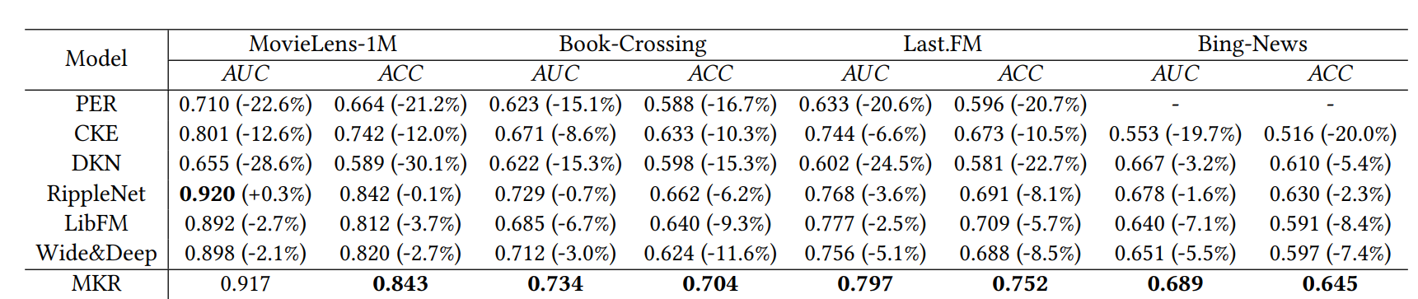
AUC and Accuracy in CTR prediction

Slide 8
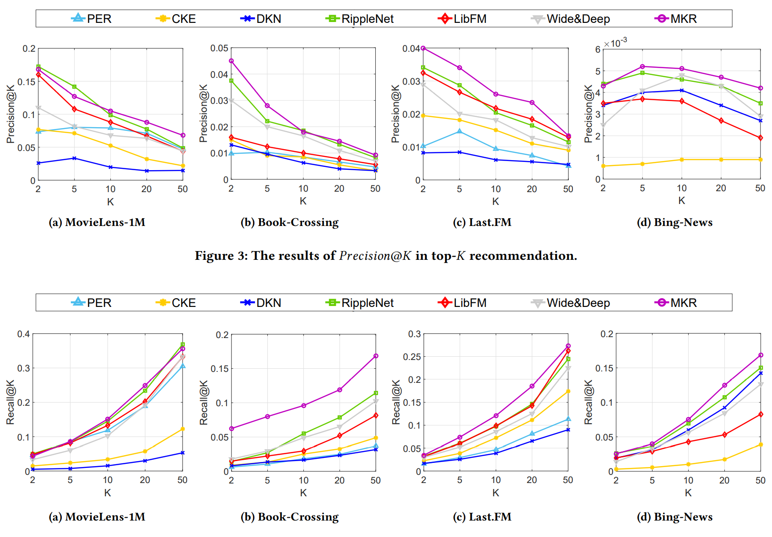
Precision@K and Recall@K

Slide 9
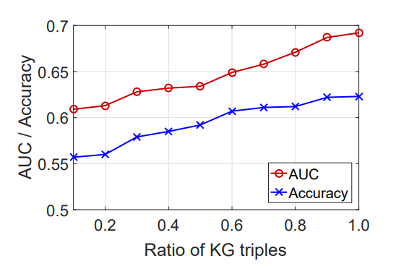
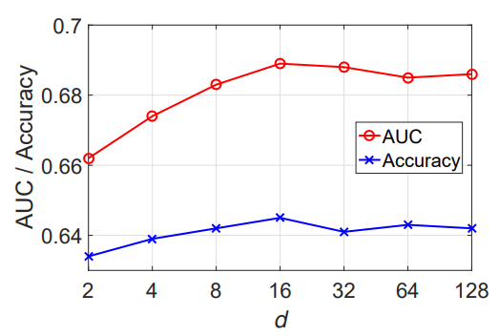
AUC/Acc & num KG or d

Slide 10
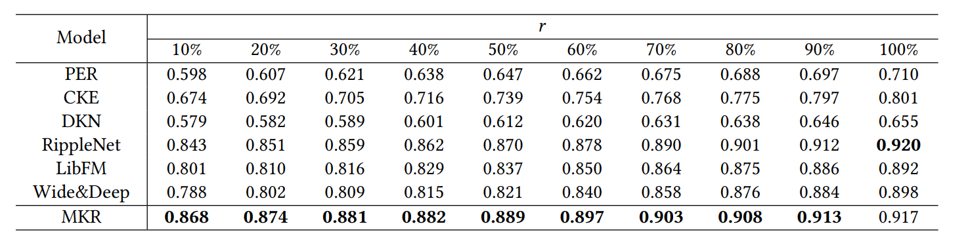
AUC in CTR prediction with different ratios of training set r

Slide 11
Idea

Slide 12
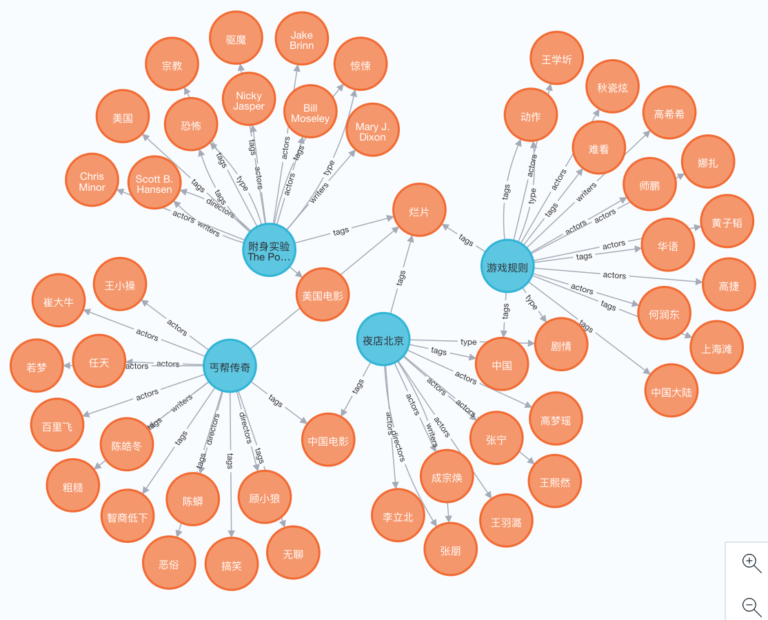
Rename ALL Entity

Slide 13
Attempt ( not Improve :<
原模型：entity one-hot编码，没有到实体语意。
设想：对entity进行语义嵌入(bert)，再输入模型。

Slide 14
Result

Slide 15
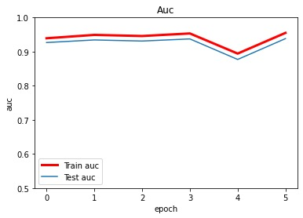
Result of base model

Slide 16
base model in the whole Douban dataset
train auc | train acc | eval auc | eval acc | test auc | test acc
0.9566 | 0.8831 | 0.9385 | 0.8739 | 0.9380 | 0.8738
 | @1 | @2 | @5 | @10 | @20 | @50 | @100
precision | 0.0600 | 0.0600 | 0.0700 | 0.0680 | 0.0510 | 0.0426 | 0.0363
recall | 0.0018 | 0.0049 | 0.0147 | 0.0294 | 0.0456 | 0.1013 | 0.1704
f1 | 0.0034 | 0.0091 | 0.0243 | 0.0411 | 0.0481 | 0.0600 | 0.0599

Slide 17
Result of the small dataset^{[1]}: base model VS new model(based on bert dim32)
1. Entity通过bert作embedding后，训练时间长；
2. 高维下情形下，模型本身性能下降；
3. 非结构化数据（相对）；
 | train auc | eval auc | test auc
base model | 0.9977 | 0.9826 | 0.9815
new model | 0.7852 | 0.7806 | 0.7895
1. Knowledge graphy entries = 22876, and deleting the relevant user rates entries

Slide 18
Reference
1. Hongwei Wang, Fuzheng Zhang, Miao Zhao, Wenjie Li, Xing Xie, Minyi Guo. 2019. Multi-Task Feature Learning for Knowledge Graph Enhanced Recommendation. In Proceedings of the 2019 World Wide Web Conference (WWW ’19), May 13–17, 2019, San Francisco, CA, USA. ACM, New York, NY, USA, 11 pages.
2. Vaswani A, Shazeer N, Parmar N, et al. Attention is all you need[C]//Advances in neural information processing systems. 2017: 5998-6008.

Slide 19
Thanks!

