Slide 1

Changes in cardiovascular disease risk over time among people living with HIV (PLHIV)
Weisi Chen | Supervisor: Dr David Boettiger | Master of health data science

Slide 2
Outline
Background
Literature gap
Study objectives
Study methods and results
Discussion of the main findings
Notes:
Firstly, I will quickly go through the agenda for today’s talk. I will talk about the background of our study first followed by literature reviews and literature gaps. Then I will go through our study objectives, study methods and results in details. For each study objective, I will also discuss some of the study’s key findings.

Slide 3
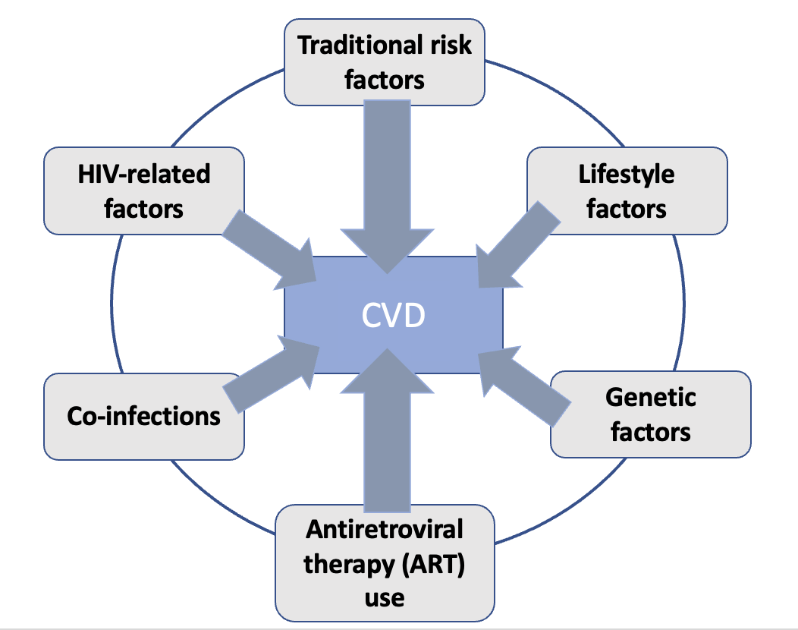
HIV & cardiovascular disease (CVD)
People with HIV have a higher risk of CVD
Why?
Notes:
People with HIV have a higher risk of cardiovascular disease. The reason why they have a higher risk is quite complicated and not fully understood. I made a graph here, this will display the information better. We can see from the graph that, there are multiple factors at play among people living with HIV.

Slide 4
HIV & cardiovascular disease (CVD)
People with HIV have a higher risk of CVD
Why?
Age
Gender
Family history
Traditional CVD risk factors
CVD
Notes:
It can be due to traditional cardiovascular risk factors.

Slide 5
HIV & cardiovascular disease (CVD)
People with HIV have a higher risk of CVD
Why?
HIV related factors
Chronic immune activation/
inflammation
CVD
Notes:
Or, HIV-related factors like chronic immune activation and inflammation

Slide 6
HIV & cardiovascular disease (CVD)
People with HIV have a higher risk of CVD
Why?
CVD
Co-infections
Notes:
Or, co-infections such as hepatitis B and hepatitis C infections

Slide 7
HIV & cardiovascular disease (CVD)
People with HIV have a higher risk of CVD
Why?
CVD
Metabolic abnormalities
Antiretroviral therapy (ART)-related factors
Notes:
Or, the anti-HIV medications, the antiretroviral therapy use.

Slide 8
HIV & cardiovascular disease (CVD)
People with HIV have a higher risk of CVD
Why?
Genetic factors
CVD
Lifestyle factors
Smoking
Alcohol use
Stress
Notes:
As well as genetic factors and lifestyle factors such as smoking, alcohol use and stress

Slide 9
HIV & cardiovascular disease (CVD)
High-risk sub-groups: injecting drug users, gay and bisexual men & people with low socioeconomic status
Notes:
Certain HIV sub-populations such as injecting drug users, gay and bisexual men, and people with low socioeconomic status may have a particularly higher risk for atherosclerotic cardiovascular disease.

Slide 10
Traditional vs HIV-specific CVD risk assessment equation
Traditional CVD equations - Framingham equation | Data Collection on Adverse Effects of Anti-HIV drugs (D:A:D) equation
Age, gender, diabetes, family history of CVD, smoking status, total & HDL cholesterol, systolic blood pressure & anti-hypertensive treatment | Age, gender, diabetes, family history of CVD, smoking status, total & HDL cholesterol, systolic blood pressure & HIV-specific factors [CD4 counts, anti-HIV medication use].
Notes:
Therefore, it’s important to calculate the ASCVD risk score among people living with HIV, so it can guide prevention and treatment for cardiovascular disease. Basically, we have two kinds of equations to calculate the ASCVD score. The traditional equations were derived from the general population. The most famous one is the probably the Framingham equation. As you can see it here, It doesn’t use HIV related factors. Because of that, the accuracy of using it among people with HIV was being questioned. So, this study, the D:A:D study, they came up with a HIV-specific equation, which also used HIV-specific factors, such as CD4 cell counts, and the anti-HIV medication use. CD4 basically is the target immune cells for HIV infections.

Slide 11
Literature gap
Most studies: prevalence of CVD risk factors
Gap: how the CVD risk evolves over time among PLHIV (lack of longitudinal studies)
Notes:
Now, I am gonna talk about the literature reviews and literature gap. Although many studies have investigated the prevalence of cardiovascular risk factors, there is currently a lack of understanding in how the ASCVD risk evolves over time.

Slide 12
Study objectives
Primary objective: Model changes in CVD risk over time among PLHIV
Secondary objective: Model changes in CVD risk over time among HIV high-risk groups
Notes:
That’s the primary objective of our study, we wanna see how CVD risk changes over time. The secondary objective is to model changes in cardiovascular risk over time among HIV sub-populations.

Slide 13
Study design – overview
Data used | Therapeutic Research, Education, and AIDS training in Asia HIV Observational Database (TAHOD) Australian HIV Observational Database (AHOD)
Inclusion criteria | HIV infected adults (≥ 18 years) Used ≥ 1 anti-HIV medication Had no history of CVD events
Primary endpoint | CVD risk scores calculated by the D:A:D equation
Baseline | Anti-HIV medication initiation
Follow up | First five years after baseline
Notes:
Now, I am gonna talk about the study design. We used two databases, TAHOD and AHOD. TAHOD recruits HIV positive patients from Asian countries, and AHOD recruits HIV positive patients from Australia and New Zealand. The study population we included were HIV positive adults aged, who used at least one anti-HIV medication, and who had no history of cardiovascular events like coronary heart disease and heart attack. The outcome of interest is the cardiovascular risk scores, which were calculated from the D:A:D equation. The baseline is when they started on the anti-HIV medication. The follow-up time period is the first five years after they started on the anti-HIV medication.

Slide 14
Study population
Final study population: n = 3368 (TAHOD: 3221, AHOD: 147)
7912 people were excluded because:
Transgender
Age < 18
Had prior CVD events
Didn’t have all CVD risk factors defined in the D:A:D equation within the first five years after baseline
Notes:
Now I am gonna talk about the study population. Because we need data for all CVD risk factors defined in the D:A:D equation within the first five years, in the end, we had 3,3&68 people who had all data needed to calculate their CVD risk scores.

Slide 15
Study methods & results — Objective 1: Changes in CVD risk over time
Beta-distributed generalized linear mixed model (GLMM)
Why?
Notes:
Now, I am gonna talk about the study methods and study results. The objective 1 is to model changes in cardiovascular risk over time. Here we have cardiovascular risk scores from the D:A:D equation, and we wanna model it against time. The method I used was called beta-distributed generalized linear mixed model or beta-distributed GLMM. Why did I wanna use it?

Slide 16
Study methods & results — Objective 1: Changes in CVD risk over time
Beta-distributed generalized linear mixed model (GLMM)
Beta regression vs linear regression?
Notes:
I will break it down, and explain why I wanna use beta regression over linear regression first.

Slide 17
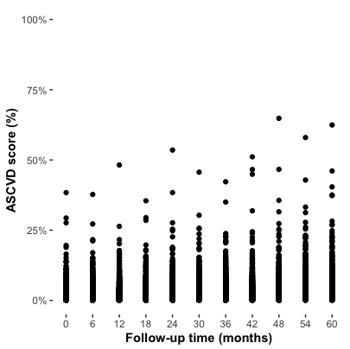
How the beta distributed GLMM works?
100
75
CVD score
(%)
50
25
0
0 6 12 18 24 30 36 42 48 54 60
Time post ART (anti-HIV medication) initiation (months)
Figure: Observed CVD risk scores over time
Notes:
That’s a scatterplot of the observed ASCVD risk scores against time.

Slide 18
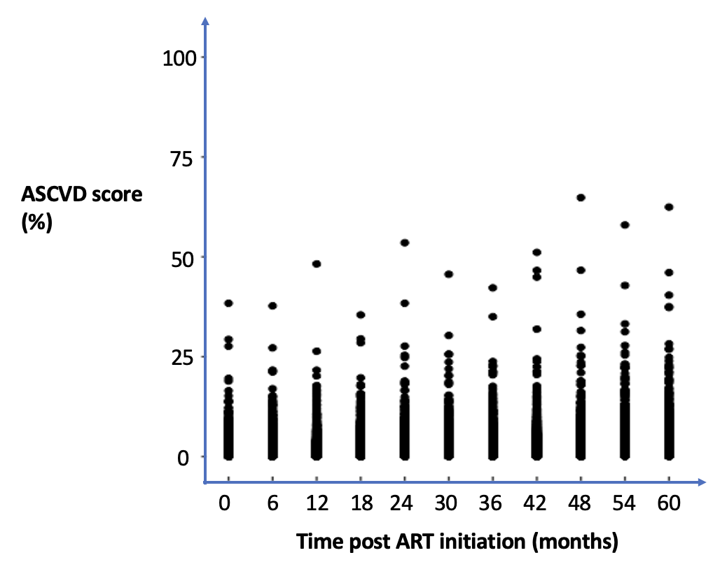
How the beta distributed GLMM works?
CVD
(%)
Figure: Observed CVD risk scores over time
1) Bounded to (0, 1)
Notes:
If you look at the y-axis, because it is the percentage data, therefore, it is bounded to 0 to 100%, or, 0 to 1. That’s one issue when dealing with percentage data.

Slide 19
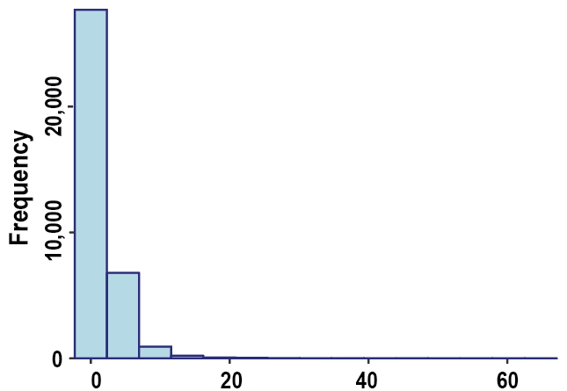
How the beta distributed GLMM works?
CVD
(%)
Total CVD risk score (%)
Figure: Observed CVD risk scores over time
Figure: The histogram of total CVD risk scores
1) Bounded to (0, 1)
2) Often highly skewed
Beta regression – model percentage data
Notes:
The other issue is more problematic, it is that the percentage data are often highly skewed because they are not natural additives. Here I included a histogram of the total cardiovascular risk scores in my data, as you can see, it’s highly skewed to the left. Most of the data are very small. That’s the main reason why I wanna use the beta regression over the linear regression, is that the beta regression is designed to model the percentage data, and look after these two issues quite well.

Slide 20
Study methods & results — Objective 1: Changes in CVD risk over time
Beta-distributed generalized linear mixed model (GLMM)
Notes:
Now, I am gonna explain why I wanna use mixed model, or mixed-effects model, or multi-levelling model as we learned from our course.

Slide 21
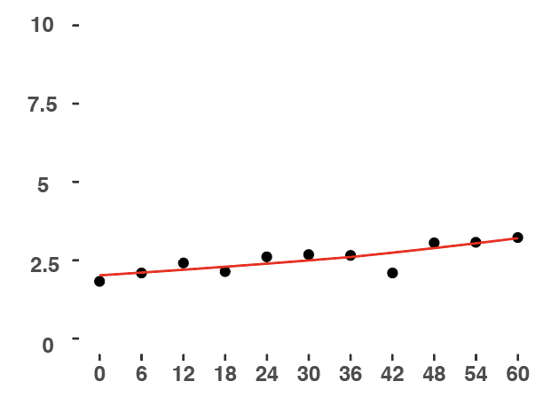
How the beta distributed GLMM works?
Patient # 1
CVD score
(%)
Time post ART (anti-HIV medication) initiation (months)
Notes:
Here, we have one patient, let’s call it patient number 1, the dot points are the observed cardiovascular risk scores, and the solid linear is the prediction from my model. As you can see here, the model fits the patient number 1’s data quite well.

Slide 22
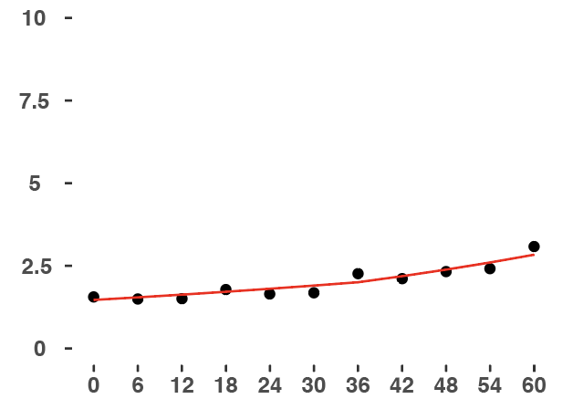
How the beta distributed GLMM works?
Patient # 1
Patient # 2
CVD score
(%)
Time post ART (anti-HIV medication) initiation (months)
Notes:
Let’s move onto the patient number 2, again, as you can see, the model fits the patient number 2’s data quite well.

Slide 23
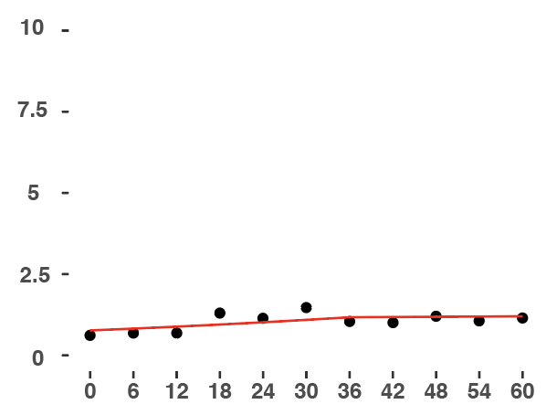
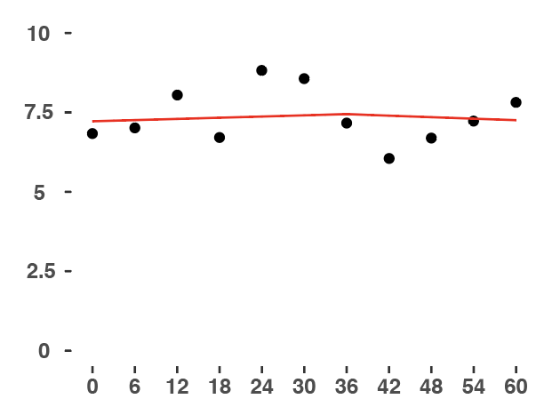
How the beta distributed GLMM works?
Patient # 1
Patient # 2
CVD score
(%)
Patient # 3
Patient # 4
Time post ART (anti-HIV medication) initiation (months)
Notes:
Here, we have one patient, let’s call it patient number 1, the dot points are the observed cardiovascular risk scores, and the solid linear is the prediction from my model. As you can see here, the model fits the patient number 1’s data quite well.

Slide 24
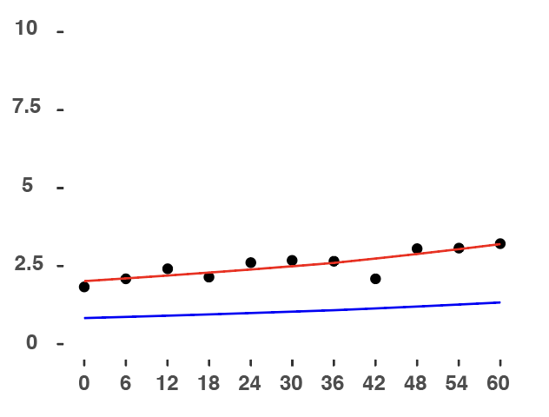
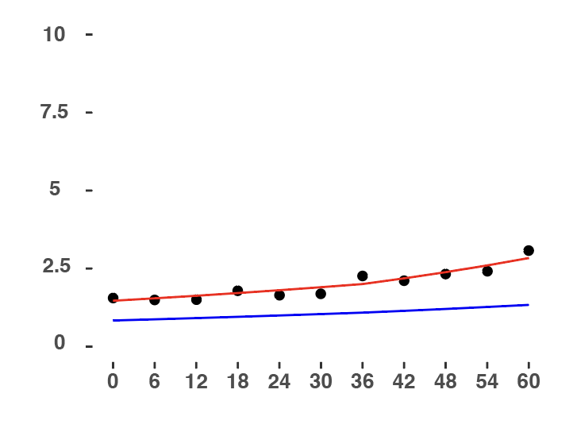
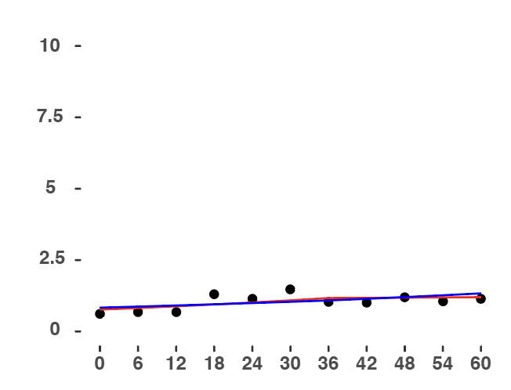
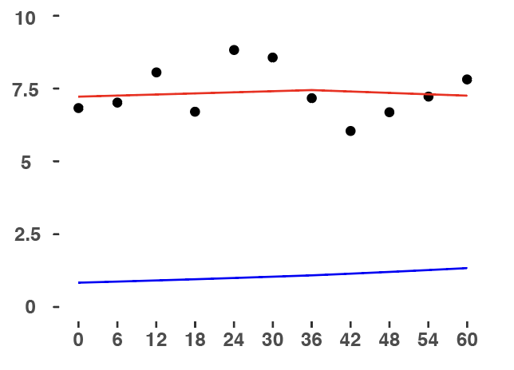
How the beta distributed GLMM works?
Patient # 1
Patient # 2
CVD score
(%)
Individual
predictions
Patient # 3
Patient # 4
Population level
estimates
Time post ART (anti-HIV medication) initiation (months)
Notes:
That’s one of the main reasons why we want to use the mixed model. Because we wanted to consider the individual variation, but we also wanted to get the population level estimates.

Slide 25
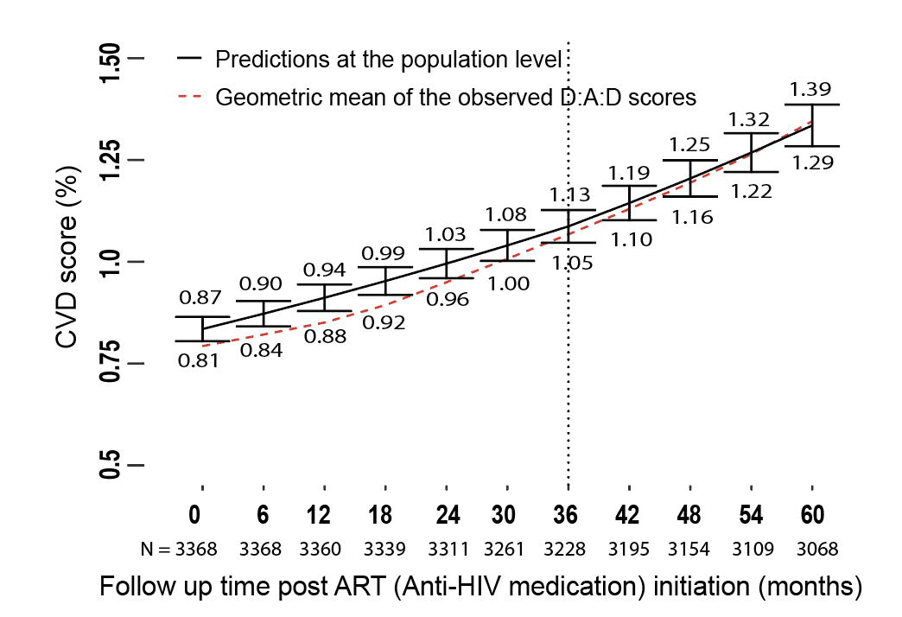
Study results — Objective 1: Changes in CVD risk over time
Notes:
Now, I am gonna show you the results. For objective 1, we wanna see how CVD risk changes over time, and this is the model I built for the objective 1.
The solid linear is the predictions from the model on the population level. It’s actually not a linear line, the best model is a segmented model. By that I means two linear lines with a breakpoint at 3 years.

Slide 26
Study results — Objective 1: Changes in CVD risk over time
Notes:
If I draw up a linear line here, it will make the information more clear. it’s actually a linear line up to 36 months.

Slide 27
Study results — Objective 1: Changes in CVD risk over time
Notes:
If I draw up a linear line here, it will make the information more clear. it’s actually a linear line up to 36 months.

Slide 28
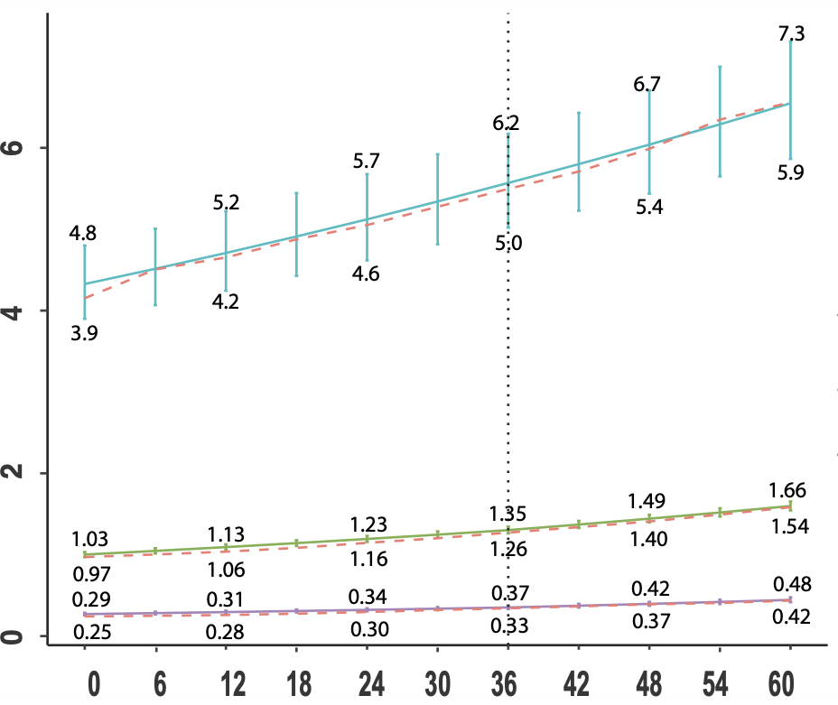
Study results — Objective 1: Changes in CVD risk over time by age groups
Geometric mean of the observed D:A:D scores
Baseline age > 55 years
CVD risk score (%)
Baseline age 30-55 years
Baseline age < 30 years
Follow up time post ART (anti-HIV medication) initiation (months)
Notes:
An easy way to do it is to stratify people INTO different age groups. The model shows the increases in cardiovascular risk in the general population was mainly due to people who are older, like people who are older than 55 years.

Slide 29
Study methods — Objective 2: Changes in CVD risk over time among HIV sub-groups
Added new variables [to stratify people into sub-groups of interest] in the model
Variable selection – backward selection (p ≤ 0.05)
Notes:
Now moving onto the second objective, we wanna know how the CVD risk changes among HIV high-risk groups. The method I used was to make some new variables to stratify people into sub-groups of interest, then I added all these variables in the model. Then, I used backward selection of variables, by that, I meant, I excluded non-significant variables one by one from the model, until all variables in the model were significant.

Slide 30
Study results — Objective 2: Changes in CVD risk over time among HIV sub-groups
Mode of HIV acquisition: Injecting Drug User, Gay and Bisexual Man, Heterosexual, Other
Ethnicity: Caucasian, Asian, Other
Lowest CD4 counts at baseline : < 200 & ≥ 200 cells/mm³
AIDS diagnosis prior to baseline: Yes & No
Family history of CVD: Yes & No
Gender: Male & Female
Hepatitis B diagnosis: Yes & No
Hepatitis C diagnosis: Yes & No
Data source: TAHOD vs AHOD
Baseline age groups: <30, 30-55 & >55 years
Baseline smoking status: Never, Former & Current
Baseline BMI: Underweight (< 18.5), Normal healthy (18.5-24.9) & Overweight (≥ 25)
Notes:
So that’s all variables I made to stratify people into sub-groups of interest, ranging from the mode of HIV acquisition to baseline BMI categories.

Slide 31
Study results — Objective 2: Changes in CVD over time among HIV sub-groups
Variables | Who has a higher risk? | Is p ≤ 0.05 at baseline?
The mode of HIV acquisition | Heterosexual | Yes
Baseline lowest CD4 counts | CD4 < 200 cells/mm³ | Yes
Family history of CVD | With family history | Yes
Gender | Male | Yes
Baseline age groups | >55 years | Yes
Baseline smoking status | Current | Yes
Baseline BMI categories | Overweight (BMI ≥ 25) | Yes
Notes:
The significant variables were HIV exposure, baseline lowest CD4 cell counts, family history of cardiovascular disease, gender, baseline age groups, baseline smoking status, and baseline BMI categories. My study shows heterosexual people, people with CD4 less than 200, people with a family history of CVD, males, people older than 55, current smokers, and overweight people have a higher risk than their counterparts.

Slide 32
Study results — Objective 2: Changes in CVD over time among HIV sub-groups
Interaction vs Time ≥ 3 years | Explanation - CVD risk increased more rapidly after 3 years in….. | P-value
Gender | In males than females | 0.001
Age groups | In people age >55 years than those < 30 years (a trend towards significance) | 0.08
BMI categories | In people with BMI ≥ 25 than those with BMI < 18.5 (a trend towards significance) | 0.08
Notes:
In terms of interaction. The interaction between female and time >=3 years is significant, so we can say the CVD risk increased more rapidly after 3 years in males than females. The interaction between age groups and time >= 3 years, and the interaction between BMI and time >= 3 years are significant, so we can also say there are trends towards significance that CVD risk increased more rapidly among people older than 55 and higher BMI of more than 25.

Slide 33
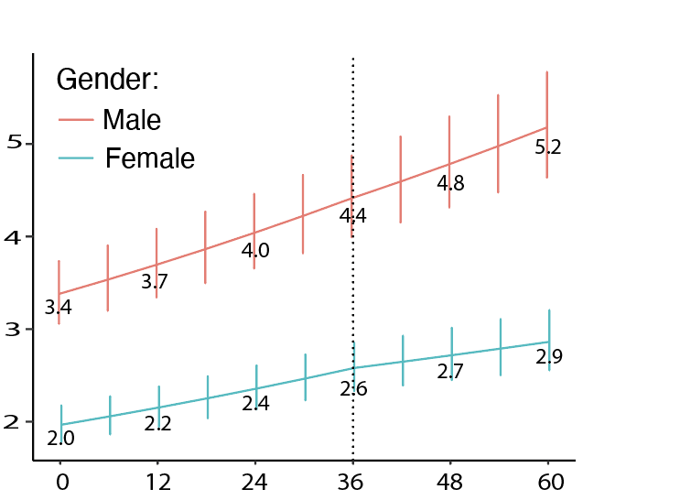

Study results — Objective 2: Changes in CVD over time by gender
(P= 0.001 after 3 years vs male)
Follow-up time post ART (anti-HIV medication) initiation (months)
Figure: Adjusted mean CVD risk scores (%) by gender among Asian heterosexual PLHIV aged > 55 years, with baseline lowest CD4 counts ≥ 200 cells/mm³, normal BMI, never smoked, and had no family history of CVD.
Notes:
I picked the group gender. It’s not surprising that males have a higher risk of CVD over females as being a male is one of the cardiovascular risk factors. But more interestingly, because the interaction between gender and time > 3 years is significant, so we can also say the increase was more rapid after 3 years in males than females

Slide 34
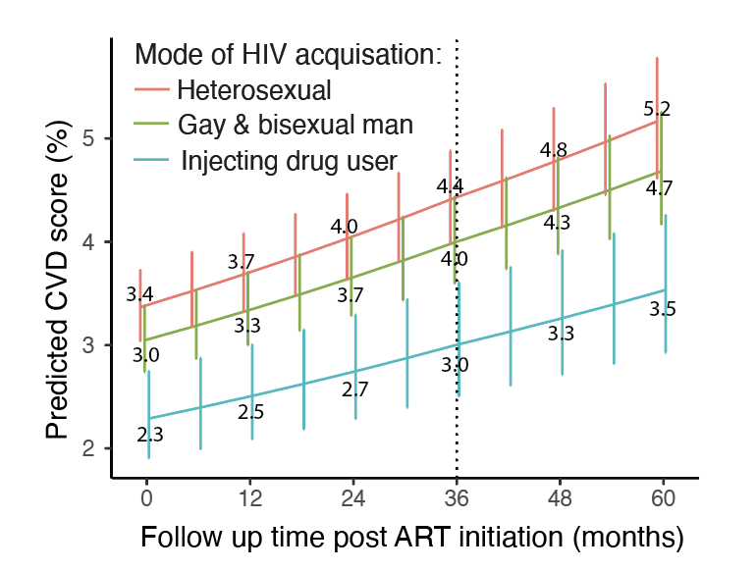
Study results — Objective 2: Changes in CVD over time by mode of HIV acquisition
Follow-up time post ART (anti-HIV medication) initiation (months)
Figure: Adjusted mean CVD risk scores (%) by the mode of HIV acquisition among male Asian PLHIV aged > 55 years, with baseline lowest CD4 counts ≥ 200 cells/mm³, normal BMI, never smoked, and had no family history of CVD.
Notes:
The second group I picked is the mode of HIV acquisition. Our model shows heterosexual people had a higher risk than gay as well injecting drug users, although the difference between each group was not signficaint. But we actually hypothesized that gay and bisexual men and injecting drug users would have a higher risk than heterosexual people.

Slide 35
Study results — Objective 2: Changes in CVD over time by mode of HIV acquisition
Table: TAHOD and AHOD participants’ characteristics
Characteristics |  | TAHOD (n = 3221) | AHOD (n = 147)
Mode of exposure | Heterosexual Gay and Bisexual Man Injecting Drug User Other Unknown | 2039 (63.3%) 953 (29.6%) 100 (3.1%) 129 (4%) | 19 (12.9%) 114 (77.6%) 8 (5.5%) 3 (2%) 3 (2%)
Notes:
We suspected that the reason could be due to under-reporting of sexual orientation and injection drug users due to shame and stigma. Here is the table of TAHOD and AHOD participants’ characteristics. We can see the percentage of gay and bisexual men reported in TAHOD is much lower than AHOD. And the percentage of injecting drug users reported in both TAHOD and AHOD are quite small.

Slide 36
Study’s main findings
CVD risk increased consistently over time among PLHIV
The increase was mainly due to people aged > 55 years
After adjusting other confounders, CVD risk increased more rapidly among males
There are trends towards significance that CVD risk increased more rapidly among people aged >55 years and those with bigger BMI
Notes:
Lastly, I will quickly summarize the study’s main finding. In my study, we found CVD risk increased consistently over time among PLHIV, and the increase was mainly due to people who are older than 55 years. Also, the CVD risk increased more rapidly among males. Lastly, there are trends towards significance that CVD risk increased more rapidly among people who are older than 55 and those with bigger BMI.

Slide 37
Acknowledgement
I would like to acknowledge my main supervisor, Dr. David Boettiger, for all his patience, guidance, advice and support throughout this project.

Slide 38
Supplementary

Slide 39
Model comparisons
 | Model 1 (Null model) | Model 2 (Random intercept) |  | Model 3 (Random intercept & random slope) |  | Model 4 (Quadratic function of time) | Model 5 (Piecewise model)
Predictors | Estimates [95% CI] | Estimates [95% CI]
Intercept | 1.57 % [1.54 – 1.59%] | 0.86% [0.83 – 0.89%] | 0.86% [0.83 – 0.89%] | 0.85% [0.82 – 0.88%] | 0.85% [0.82 – 0.88%] | 0.84% [0.81 – 0.87%] | 0.84% [0.81 – 0.87%]
Time | 1.0056 [1.0052 – 1.0061] | 1.0084 [1.0083 – 1.0086] | 1.0084 [1.0083 – 1.0086] | 1.0079 [1.0076 – 1.0081] | 1.0079 [1.0076 – 1.0081] | 1.007 [1.0064, 1.0081] | -
Time - squared | - |  | - |  | - | 1.00002 [1.00001, 1.00003]
Time < 3 years | - | - | - | - | - | - | 1.0074 [1.0071, 1.0078]
Time ≥ 3 years | - | - | - | - | - | - | 1.0087 [1.0082, 1.0092]
ICC | - | 0.91 | 0.91 | 0.94 | 0.94 | 0.94 | 0.95
AIC | -215501 | -292110 | -292110 | -303071 | -303071 | -306577 | -306672
Notes:
The best model was determined on the AIC.
The exploratory data analysis suggested a potential association between ASCVD risk scores and time.
Piecewise model has the best AIC than other models and also has better interpretation.

Slide 40
Model diagnostics – DHARMa package in R
Notes:
It’s quite difficult to interpret the residuals of beta-distributed GLMM and they are not expected to be normal.
This package called DHARMa in R helps to create readily interpretable residuals. Basically they used simulation approach to standardize residuals to values between 0 and 1 and plot against the expected distribution. Basically, the standardized residuals of our model fall in the diagonal line, which shows the residuals of the model are good. There are no significant deviations from the expected distribution. The figure B shows homogeneity in variance.

Slide 41
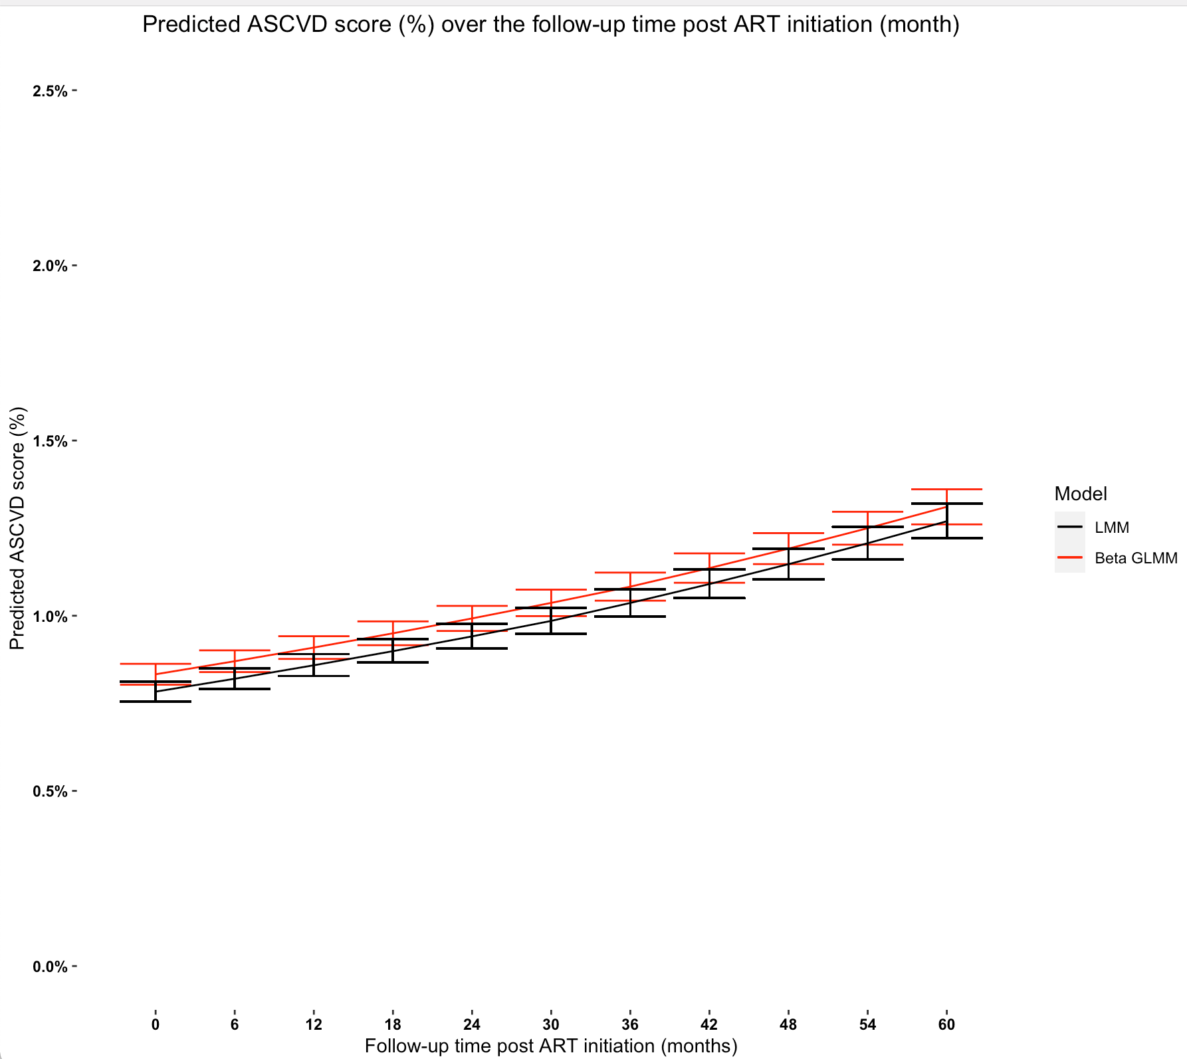

Predictions from the beta-distribution GLMM vs Linear mixed model
2.5
2.0
1.5
Beta-distributed GLMM
LMM (log-transformed CVD risk scores) – residuals are not normal
1.0
0.5
0
0 6 12 18 24 30 36 42 48 54 60
Follow-up time post ART initiation
Notes:
That’s the graph comparing the predictions from the beta-distributed GLMM with the linear mixed model. In linear mixed model, I log-transformed the outcome variable. The residuals are not normal.
The predictions from two models are quite close, and the confident intervals are overlapping.
The main difference is toward the boundary, in this case, 0, which also makes sense, because the data is highly skewed to the left.

Slide 42
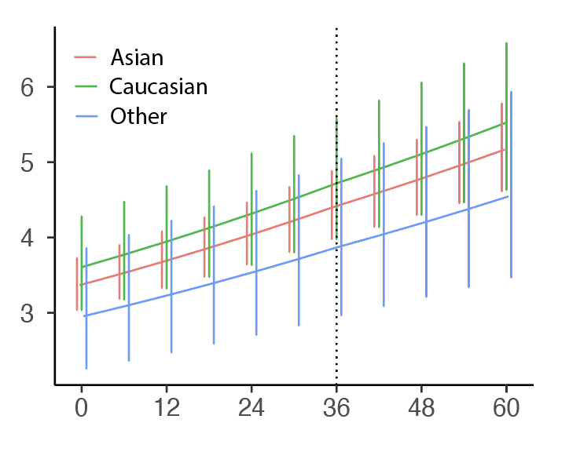
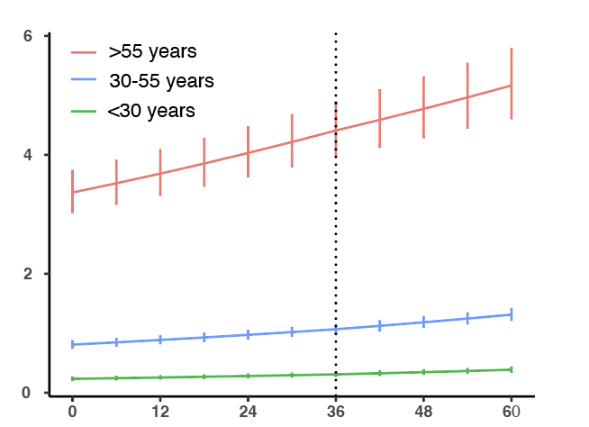
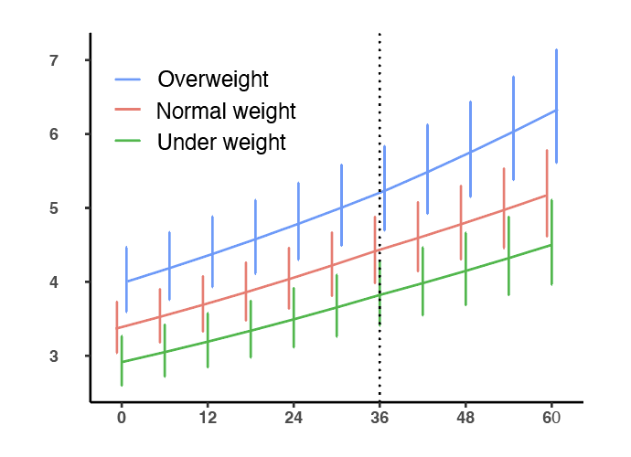
Predicted CVD scores in other sub-groups The core reference categories were male, Asian, heterosexual, aged > 55 years, baseline nadir CD4 counts of ≥ 200 cells/mm³, normal BMI (18.5-24.9), never smoked, and no family history of ASCVD.
Follow-up time post ART initiation (months)
Follow-up time post ART initiation (months)
Follow-up time post ART initiation (months)
Notes:
Asian people in our cohort have a higher risk of CVD than Caucasian, although the difference at baseline and over time were not significant. Asians had a lower risk because they are overall lighter, younger, have a relative lower prevalence of CVD risk factors.

