Slide 1


EE308
Githelper搜索聚合
皮套人！把我逮住没你好果子吃小组
MADE IN HEAVEN

Slide 2

Ⅰ. Division Of Labor And Expectation
目录
Ⅱ. Actual Progress And Burnout Diagram
contents
Ⅲ. Difficulties Encountered In Production
Ⅳ. Actual Structure Of The Project
Ⅴ. Project Testing
Ⅵ. Members Experience

Slide 3
Ⅰ
Division Of Labor And Expectation

Slide 4
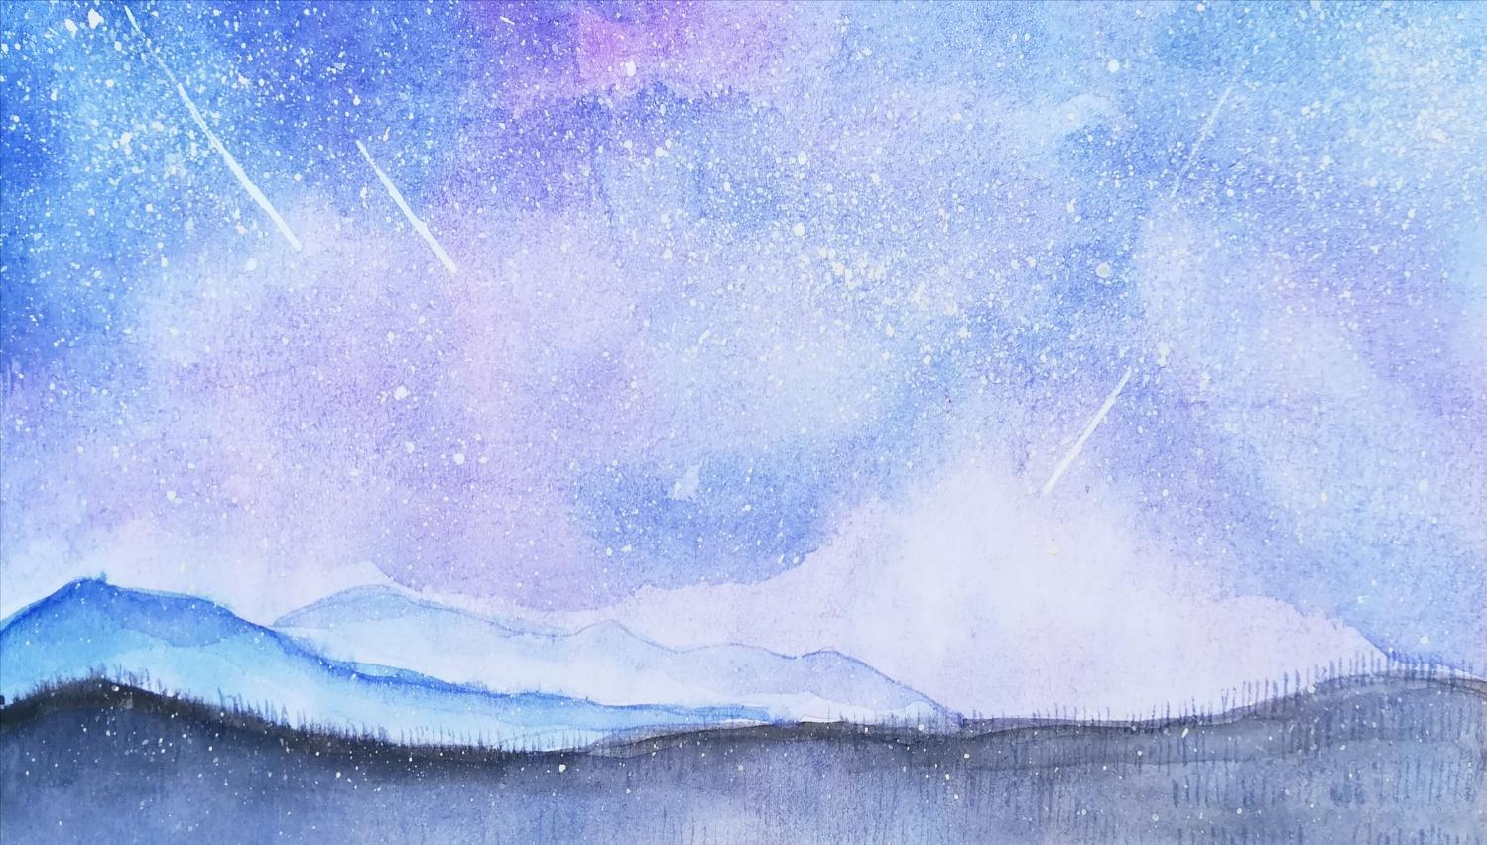
Responsible for UI design and implementation
韦知辰
Responsible for the overall framework of the applet and the data analysis of the front and back ends
王彦翔
Responsible for the experience Optimization of applet and the improvement of architecture
李宗潭
潘弘泽
Be responsible for helping the preparation of documents, and the content module is responsible for
罗天
Responsible for UI design and implementation

Slide 5
Expected plan
The expected plan of this project is that two people write the front-end display, and the remaining three people are responsible for obtaining data through API and analyzing JSON. After that, integrate the acquired data into the front-end interface. The disadvantages of this are also obvious. The code of some components is difficult to integrate or cannot be integrated and needs to be rewritten. Therefore, we later adopted the module method. Each person is responsible for a module, popular content, search, help, etc. after that, we can simply add some methods of module direct switching.

Slide 6
Ⅱ
Actual Progress And Burnout Diagram

Slide 7
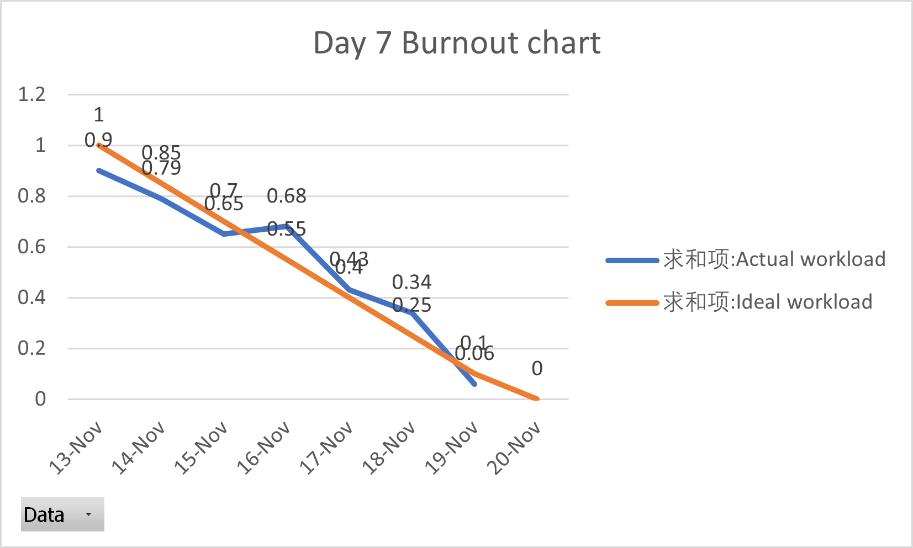
Actual Progress And Burnout Diagram

Slide 8
Ⅲ
Difficulties Encountered In Production

Slide 9
Difficulties Encountered In Production
Gitee's API is hard to find, and even some are not open source.
The decoding of Web text and pictures does not adapt to the mobile phone layout, and it is cumbersome to change the text size and color in the later stage.
Difficulty1
Difficulty4
The team members do not have a system classification when updating, and sometimes upload the old version to the; Some team members do not write comments when writing code, so the code readability is low; Duplicate variable name; These problems have caused many difficulty for integration.
Difficulty2
The framework was not used in the production, and the software development encountered great resistance.
Difficulty3

Slide 10
Ⅳ
Actual Structure Of The Project

Slide 11

We don't use frameworks to develop applets. Although we were sad to know this, the development was coming to the end when we realized it.
The technologies we use: rich text analysis and markdown analysis. Of course, it also includes various development languages of wechat applet.

Slide 12
Ⅴ
Project Testing

Slide 13
Project Testing
Compare whether the search sorting results on the applet are consistent with those on GitHub and gitee
Search
Testing
Can the article be consulted normally
result
After testing, there is no problem
Content
Help
Can help documents be viewed normally

Slide 14
Ⅵ
Members Experience

Slide 15
韦知辰
As the group leader, through the cooperation these days, I learned how difficult the arrangement and division of labor are. Many times, the instructions issued can not be well communicated, and some do not come as required, but I can't bear to continue when I see everyone's tired appearance. However, the final content effect is still very satisfactory to me.
王彦翔
Through the 7-day team cooperation of this project, I realized that individuals are inseparable from the team, and the team is more efficient. I hope this project can contribute to the open source community.

Slide 16
李宗潭
As a whole, there are still many details that are not in place. The integration takes a lot of time and the learning cycle is short.
罗天
潘弘泽
I learned a lot of useful things in this team programming project. Obviously, my applet programming ability has been further improved, but on top of this, I have experienced team development and learned how to efficiently complete my tasks and cooperate with other teammates in a team.
After the seven-day Alfa Sprint, I have a more tacit cooperation with my classmates and gained more experience in similar team work. Through this experiment, I have mastered more skills about wechat small program making, understood the importance of team division of labor, and had a deeper understanding of software engineering development.

Slide 17
THANKS FOR WATCHING

