Slide 1
Analysis of spot statistics

Slide 2
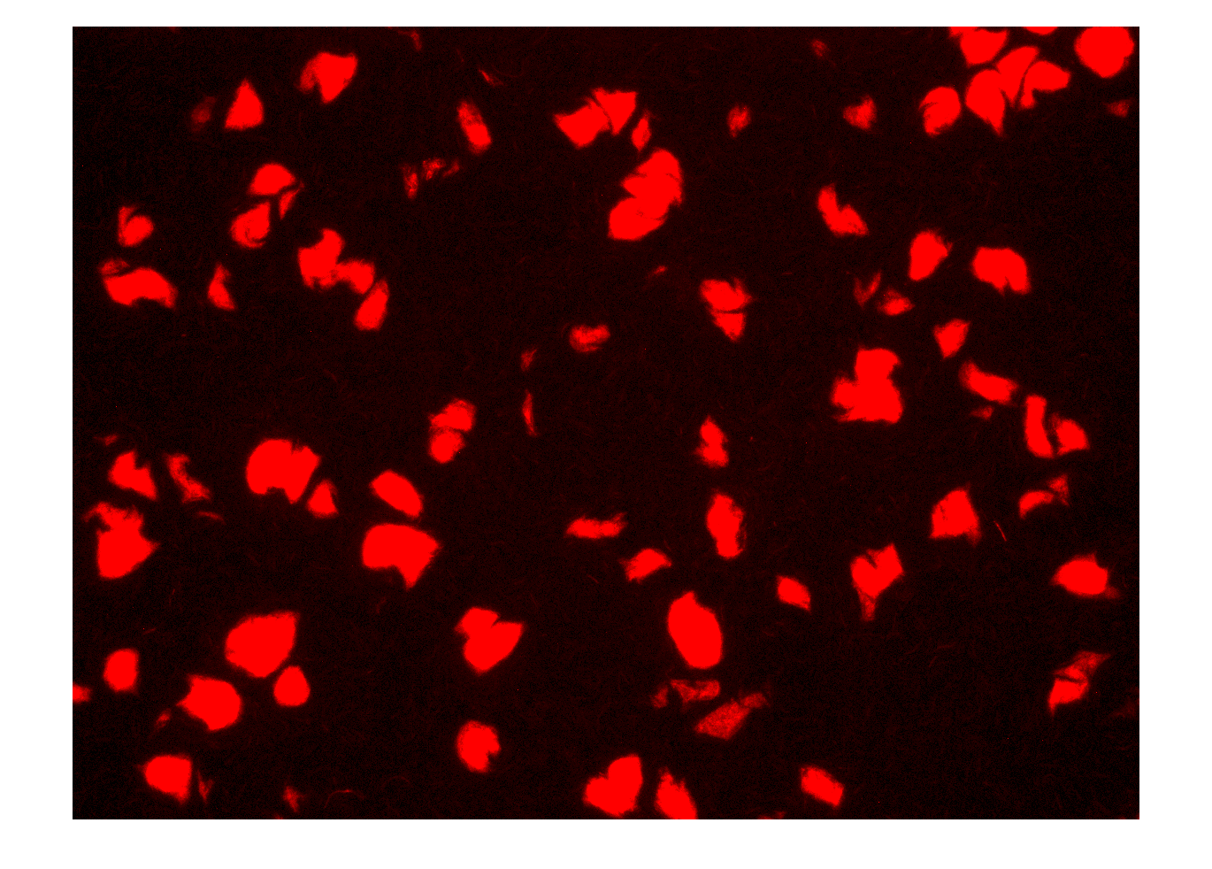
Original image in Figure 2A

Slide 3
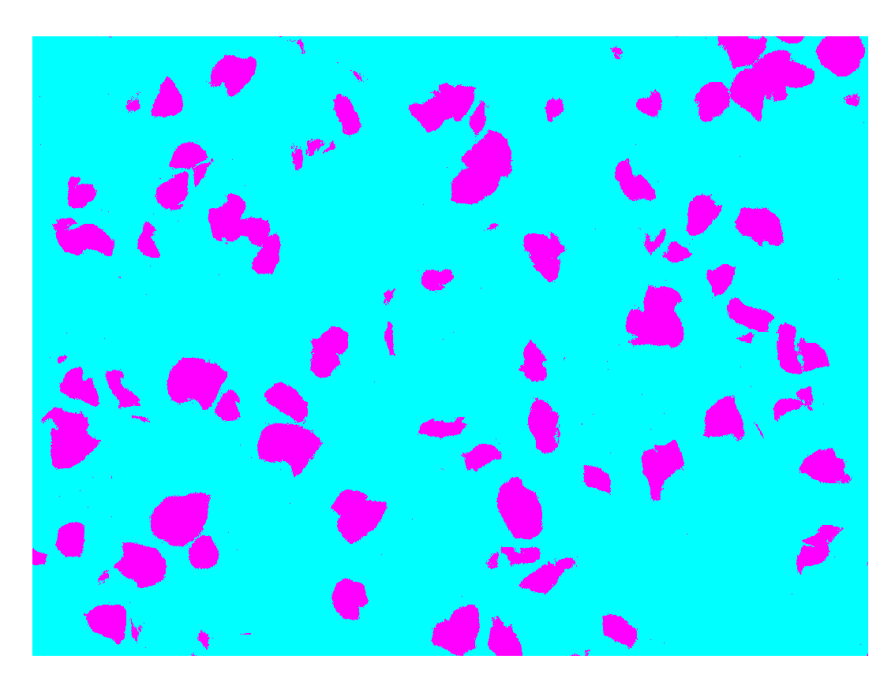
Image is psedo-colored

Slide 4
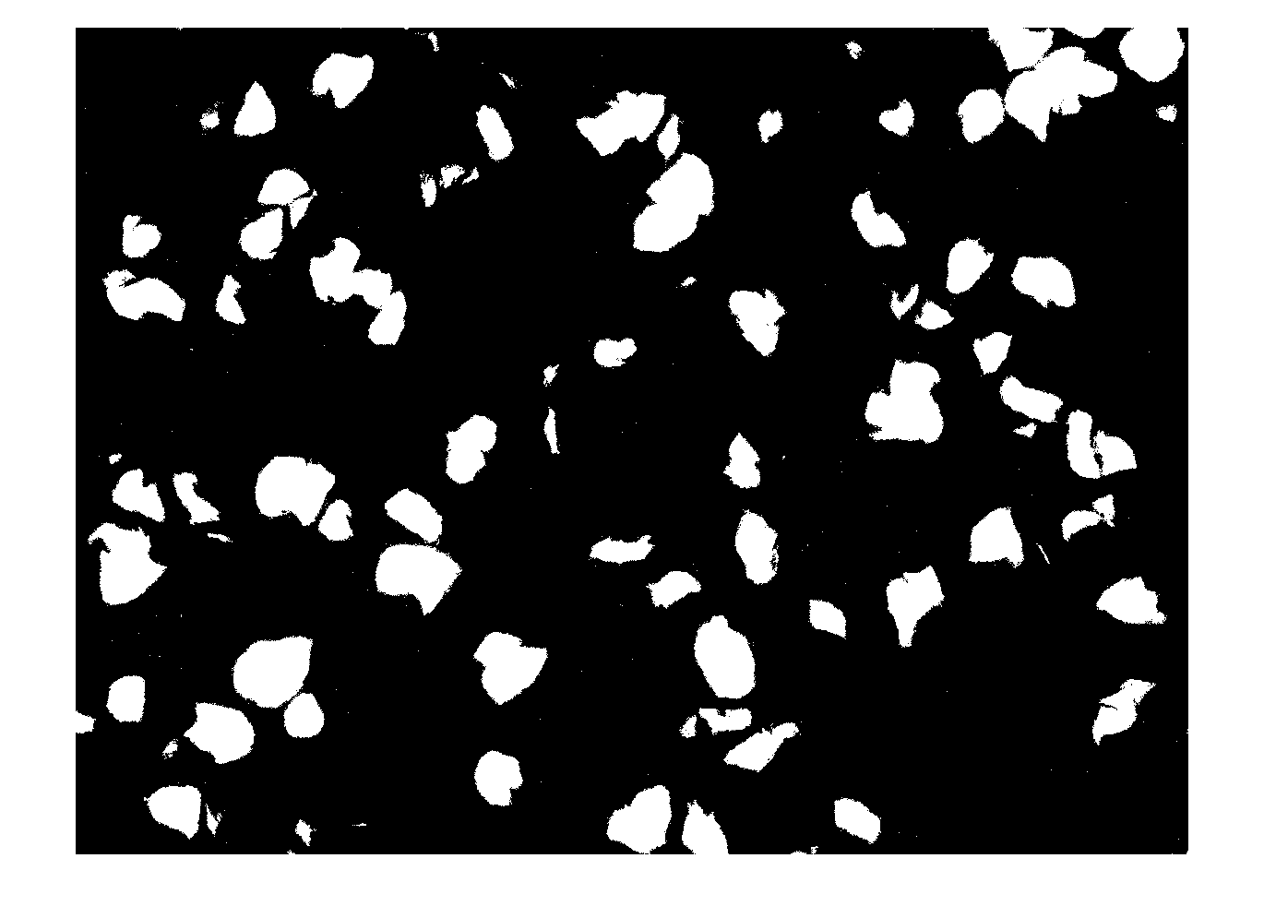
Image converted to black-and-white

Slide 5
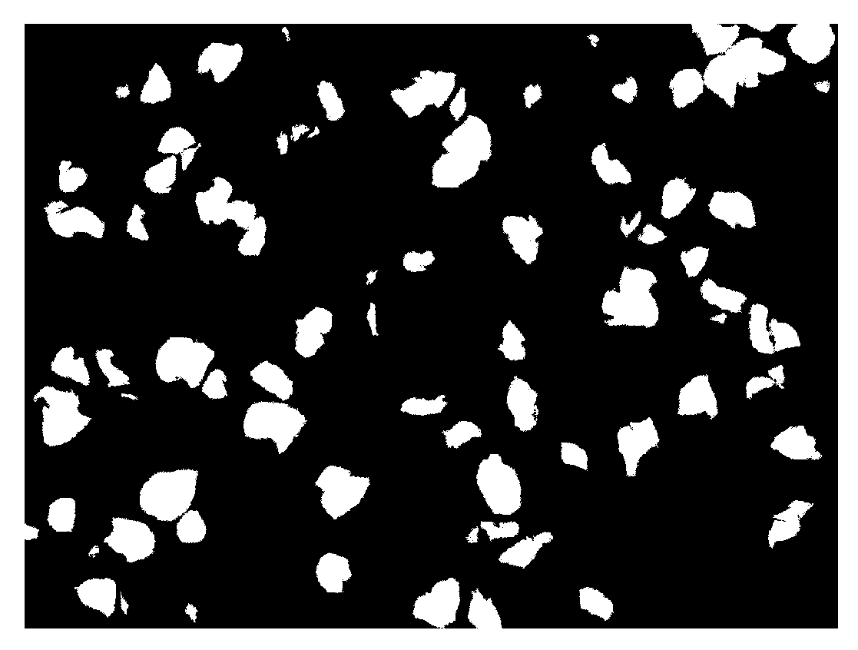
Image is processed by filtering out tiny spots (assumed to be random variations)

Slide 6
Statistics of the processed image (Fig 2A)
Spot number = 75
Mean spot area = 1804.9 pixels
Maximal spot area = 6009 pixels
Minimal spot area = 112 pixels
Statistics of spots in the unit of pixels:

Slide 7
Statistics of the processed image (Fig 2A)
Spot number = 75
Mean spot area = 690.6 um²
Maximal spot area = 2299.2 um²
Minimal spot area = 42.9 um²
Median spot area = 618.8 um²
Standard deviation of spot area = 544.8 um²
Statistics of spots in the unit of um:

Slide 8
Few arguments for the statement that “Spots emerge with sizes much larger than that of a single cell”:
The averaged spot size in Fig 2A is ~690 um², which is much larger than that of a single cell growing in a rich nutrient environment and displayed in a perfect 2D plane (~ 3um² in a 2D plane) (about 230 cells)
In the real experimental setting where cells are highly packed on an agar plate, the average size of a cell shall be smaller than 3um²,due to the following reasons
because of the limited nutrient access in the highly compacted environment, the actual size of the cells is smaller than the cells growing in a rich environment
Cells actually grew into a 3D structure, with different rotations and displacements. Thus, cells size were only partially projected to the 2D image.
Another very important fact is that cells on the agar were grown into a multi-layer, 3D structure. There are, for each spot, there are multiple layers of cells. The spot size estimation above (690 um²) only reflect the possible numbers of cells that are packed horizontally.

