Slide 1
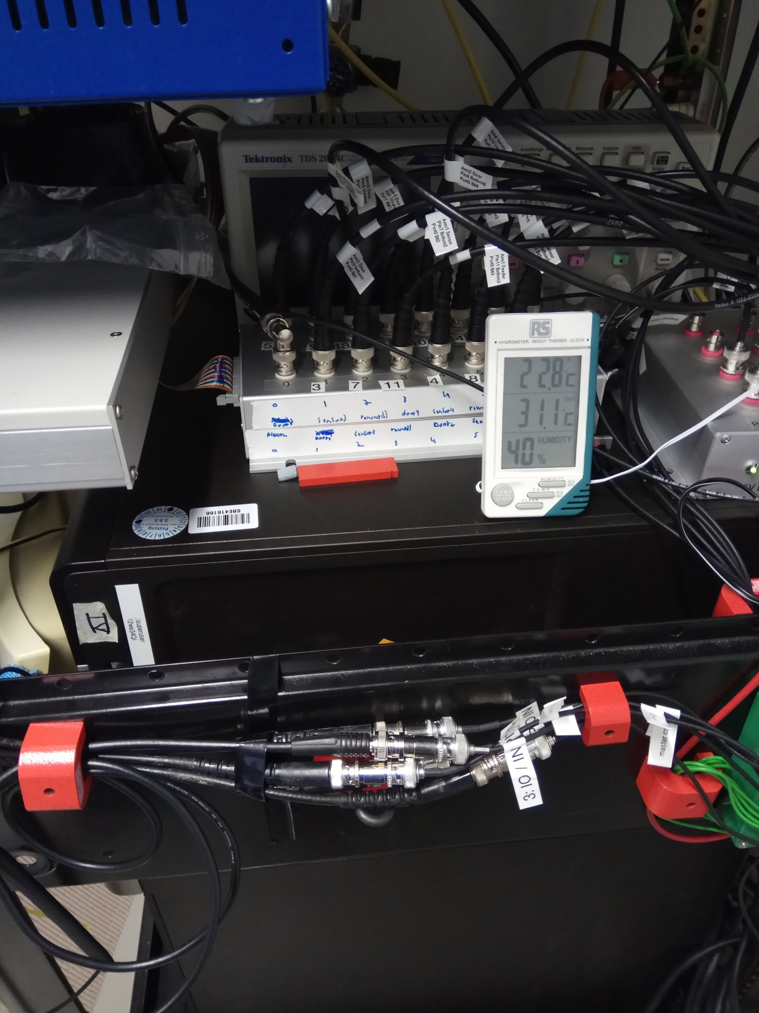
Basler and behavioral TTLs going to Neuralynx
Plexon signal going into Basler cameras

Slide 2
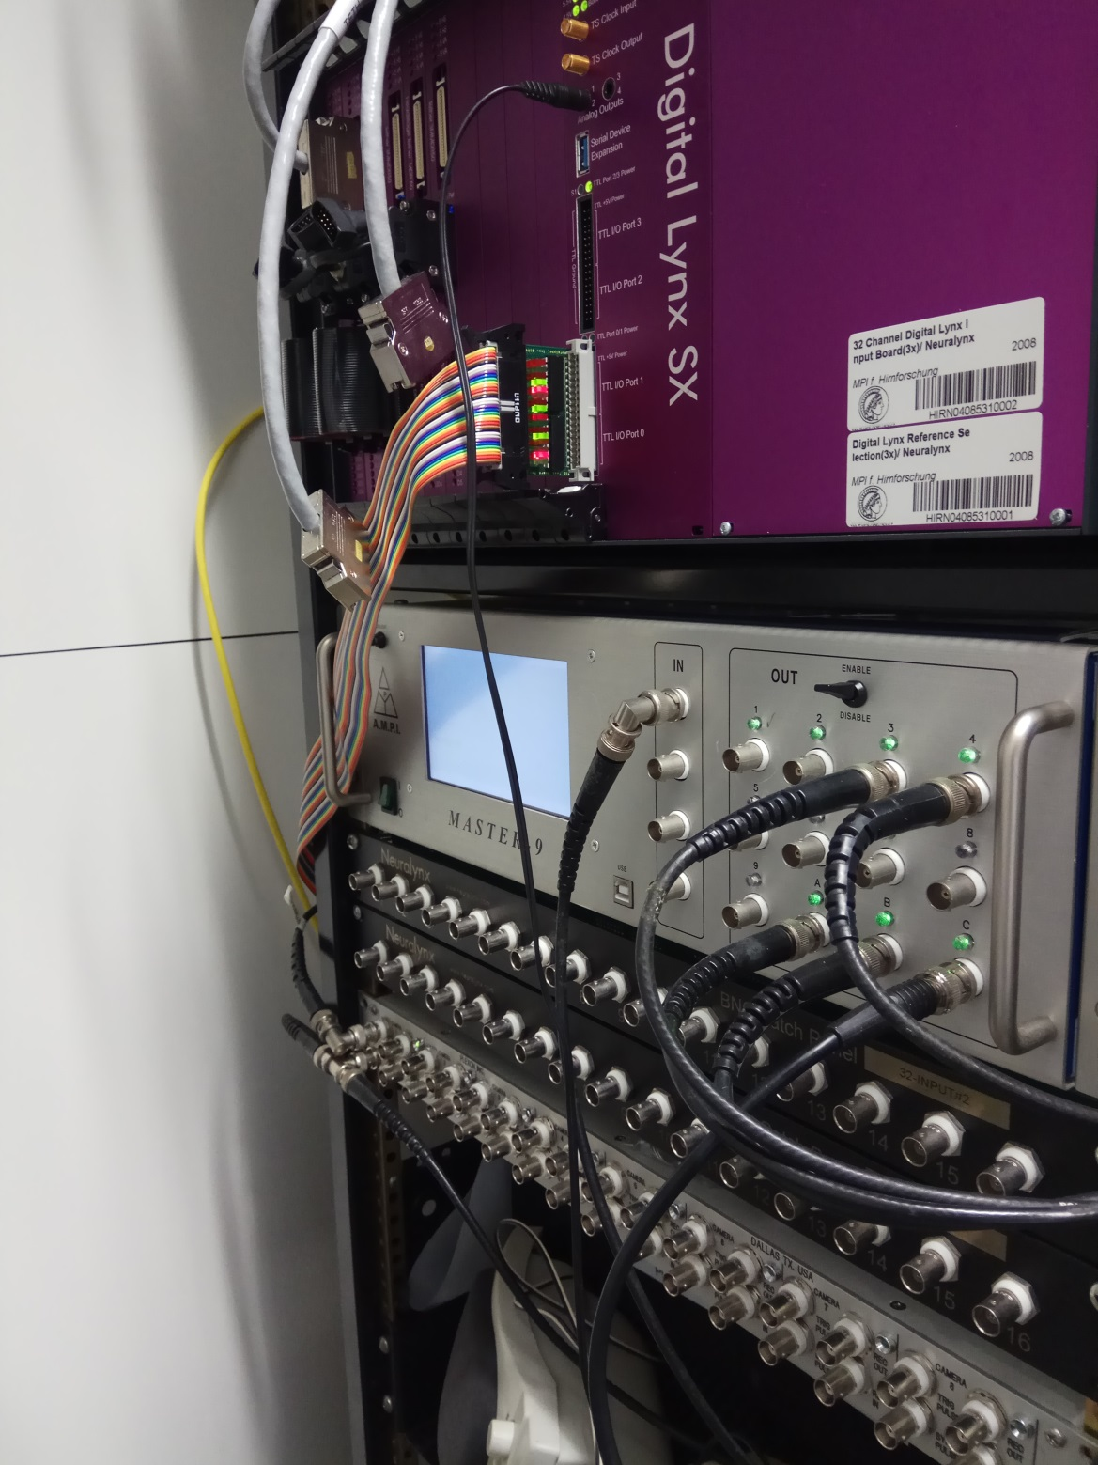
Signal split to activate Basler cameras
PLEXON frame TTL IN
PLEXON OUT
To Basler cameras
PLEXON OUT TTL
to Neuralynx

