Slide 1
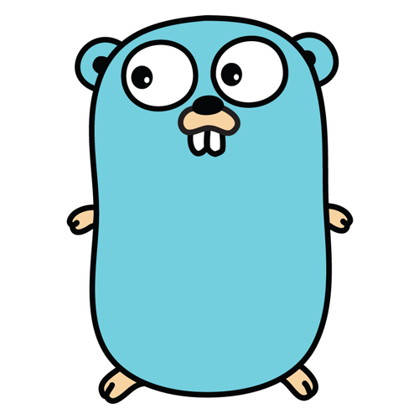
Golang
Charles Shook, Christopher Bare, Mark Weiss, Trevor Bormann

Slide 2
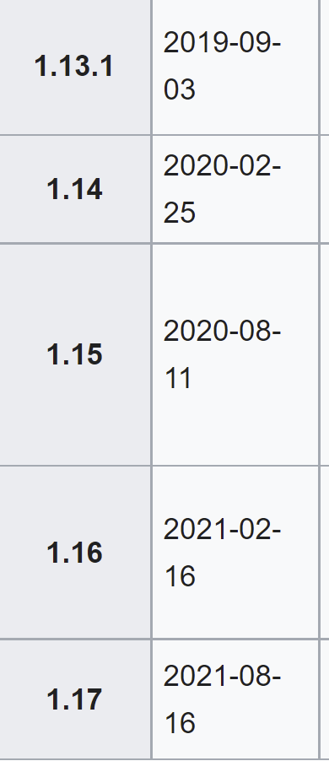
Language Version
1.17.5
With updates commonly every 6 months

Slide 3
philosophy
One Problem, One Solution
1:1
Concurrency

Slide 4
Why should it be used
Go was created with the idea of simplicity, and increasing productivity
Speeeeeed
Easy to compile, easy to grasp
Concurrency

Slide 5
Common uses
Micro service Architecture
Back-end development on high load server
Media platforms like Twitch and YouTube use Go to handle heavy load
Cloud services like Drobox use Go to manage its network efficiently
Basically any service connected to the internet

Slide 6
Basic language usage
Demo

Slide 7
The problem
Discord Bot!

Slide 8
Why it should be used to solve the problem
Discord is an online service that has a heavy load of thousands of users, and thousands of messages. A bot is the perfect companion to help with certain external capabilities wanted of a discord server such as:
Tracking stats!
Calculatoring!
Changing role color!
Telling time!
Displaying its own commands!
Chicken!
Go is perfect for this idea because it has concurrency and can handle multiple messages at once, it's fast so the bot will respond to your message immediately, and Go has amazing infrastructure for any network based API, allowing us to simple import the discord API package and Go!

Slide 9
(cut to code running here)

Slide 10
Fin
FIN ACK

