Slide 1
SONiC support for 400ZR – Microsoft work summary
Chuan Qin, Yawei Yin
Jan 17, 2023

Slide 2
Content
SONiC support on 400ZR is mainly based on OIF CMIS and C-CMIS
Reference HLD: [Link]
“show” and “configure” CLIs
state_DB and its schemas
config_DB and its schemas
Driver APIs
Repo | PR Title | State
sonic-utilities | fix for non-coherent cmis modules | Merged
sonic-utilities | [sfputil] Firmware download/upgrade CLI support for QSFP-DD | Merged
sonic-utilities | Add transceiver-info items advertised for cmis-supported moddules | Merged
sonic-platform-daemons | Include changes from xcvr_api in transceiver_info table | Merged
sonic-platform-common | Skip CDB and VDM for flat memory modules | Merged
sonic-platform-common | [CMIS]Fix low-power to high power mode transition | Merged
sonic-platform-common | Firmware upgrade CLI support for QSFP-DD transceivers | Merged
sonic-platform-common | fix for firmware functions | Merged
sonic-platform-common | Gracefully handle CMIS APIs for passive modules | Merged
sonic-platform-common | code fix for copper cable modules with flat memory | Merged
sonic-platform-common | 400zr initial support | Merged
sonic-platform-daemons | Xcvrd changes to support 400G ZR configuration | Merged
sonic-utilities | portconfig option to configure Tx power and laser frequency of ZR transceiver module | Merged
sonic-buildimage | Yang model for xcvr tx power and frequency configuration | Merged
Related PR

Slide 3
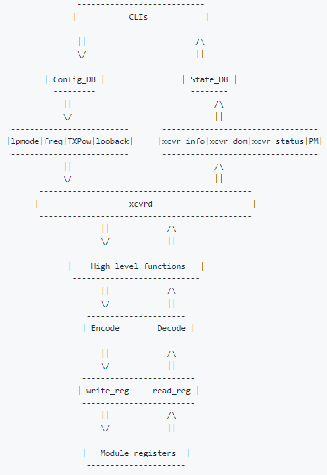
Working principle diagram
CLI interfaces with the module registers through config_DB and state_DB and xcvrd platform. [Link]

Slide 4
Command line interface (CLI) – “show”, “configure”, and firmware related
CLIs defined in sonic-utilities repo
Show commands:
show interfaces transceiver (eeprom [-d|--dom] | presence | error-status | status | pm | loopback) [<interface_name>]
For more details, please refer to [Link]
Configure commands:
config interface transceiver (lpmode | frequency | tx_power | loopback) [<interface_name>]
For more details, please refer to [Link]
Firmware commands:
show interfaces transceiver (firmware version) [<interface_name>]
configure interfaces transceiver (firmware download <bin_file> | firmware commit | firmware run | firmware upgrade <bin_file> | firmware switch) [<interface_name>]
For more details, please refer to [Link]

Slide 5
state_DB and config_DB
DBs defined in sonic-platform-daemons repo
state_DB [Link]
Transceiver info Table: module info, module form-factor, SN, PN, firmware, etc.
Transceiver DOM sensor Table: dom info, TX/RX power, temperature, BER, optical and DSP metrics
Transceiver DOM Threshold Table: module threshold info
Transceiver Status Table: module status info, module state, data path state, flags, etc.
Transceiver PM Table: module PMs, corresponding to C-CMIS page 0x34 and 0x35
Transceiver Loopback Table: module loopback info
config_DB [Link]
Port configuration including port low power mode, frequency, TX power, loopback mode.

Slide 6
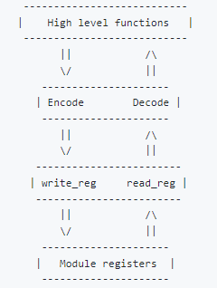
Driver APIs
Driver APIs defined in sonic-platform-common repo
Supported APIs: [Link]
CMIS
C-CMIS
VDM
CDB
Encoding and decoding: [Link]
Write and read: [Link]
Memory maps: [Link]
CMIS
C-CMIS

Slide 7
Next Steps
Enrich HLD and CLI/REST/gRPC library of utilities
Standardize state_DB and config_DB for more sets of parameters
Community support on implementing platform-common
Leverage existing standard definition
CMIS, C-CMIS
OIF 400G-ZR IA
OpenConfig data models
…

