Slide 1
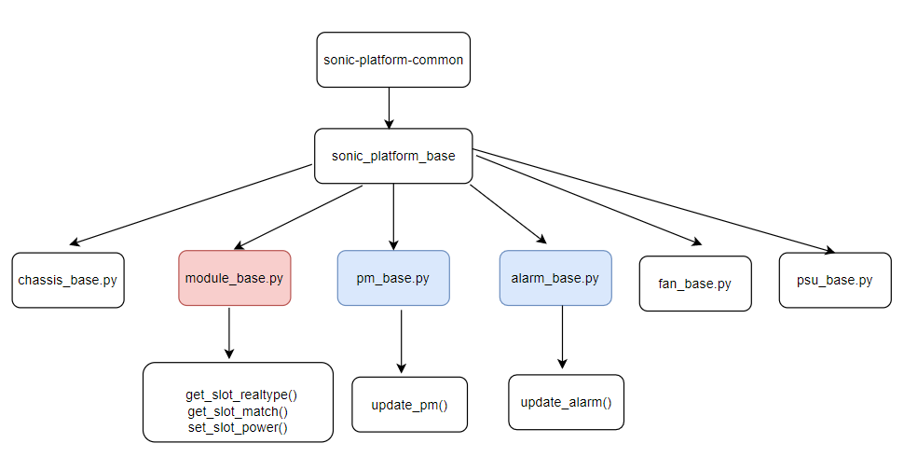
OTN -PMON
<1> Expansion of the original part: including performance and alarm parts
1. sonic-platform-common add pm_base.py and alarm_base.py, extend module_base.py

Slide 2
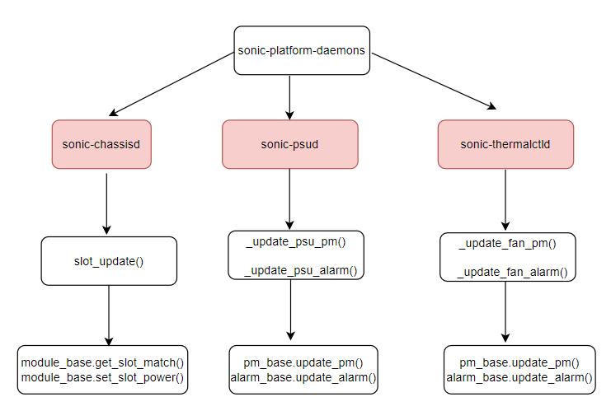
2. sonic-platform-daemons extend sonic-chassisd, sonic-psud and sonic-thermalctld
3. vendor implement the subclass of the new class and extended functions
sonic-buildimage/platform/ot-<vendor>/platform-modules-<device-vendor>/<device>/ module.py
...................................................................................................................................................

Slide 3
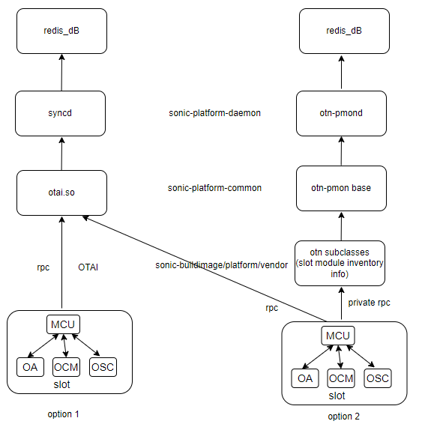
<2> Hardware Information Reporting Scheme of linccard Optical Module
Option 1: The slot reports optical module hardware information to syncd through the OTAI interface, and then the syncd is directly written to the redis database.
Option 2: The vendor driver reports slot optical module through private RPC, and pmon write to the Redis database.
We prefer option 1.
1. The PMON(platform Monitor) is mainly for peripheral modules of equipment. For the optical module on the OTN lincard, we think it is equivalent to the switching chip and belongs to the core device of traffic processing. All informations should be defined in OTAI, similar to the switch chip In SWITCH, and its information should also be defined in SAI, such as SAI_SWITCH_ATTR_FIRMWARE_MAJOR_VERSION and SAI_SWITCH_ATTR_FIRMWARE_MINOR_VERSION, the PMON doesn’t process those items.
2. If the optical module is divided into PMON and Syncd for processing separately, it requires the vendor to implement OTAI lib and platform/vendor/driver. But most vendors report the optical module information of the linecard through a unified interface , whether it is manufacture information or traffic information. If the informations are divided into two modules, it will increase the difficulty of vendor implementation.

