Slide 1


ARM CoreLink 400 & 500 Series System IP
PD Product Marketing December 2012
1

Slide 2
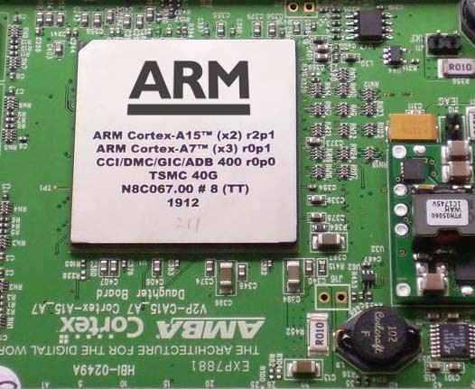
ARM CoreLink™ and CoreSight™
System IP for the best ARM Cortex™ and Mali™ processor performance
Power efficient system
Maximum cache & DDR utilization
Shortest path to memory
System performance
End-to-end QoS provides b/w & latency per master
Optimized system
CoreSight debug and performance profiling
big.LITTLE™ test chip 2
System assured
Designed together, verified together
CONFIDENTIAL

Slide 3




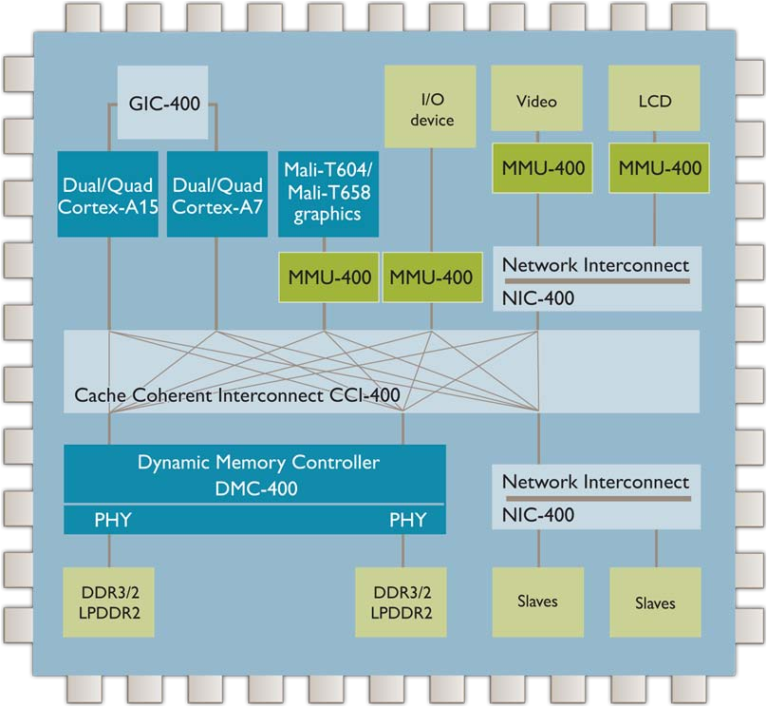
CoreLink 400 System IP Available Now
400 Series
Coherency
CoreLink CCI-400
▪
▪
Full cache coherency I/O coherency
▪
CoreLink ADB-400
For DVFS
Virtualization
▪
▪
CoreLink MMU-400
OS level virtualization
cache
cache
cache
CoreLink GIC-400
MMU
MMU
▪
▪
Virtual interrupts
Multi-processor support
ADB-400
ADB-400
snoop
control
External Memory Sub-system
DVM mesaging
▪
CoreLink DMC-400
TZC-400
TZC-400
▪
▪
High DDR utilisation Integrated with DDR3 PHY
▪
CoreLink TZC-400*
Secure regions
Rest of SoC Interconnect
CoreLink NIC-400
▪
▪
Low latency Routing efficiency
* TZC-400 available 1Q13
CONFIDENTIAL

Slide 4
Wide Adoption of ARM System IP
50,000 downloads of AMBA specs in last 3 years
80+ licensees of NIC-301, 12+ licensees of NIC-400
15+ licensees of CCI-400
10+ licensees of DMC-400
30 licensees of CoreSight SoC-400
Adopted across all market segments
CONFIDENTIAL

Slide 5
Updates to Existing CoreLink 400 Products
CoreLink NIC-400 smaller, faster, lower power
▪
▪
Hierarchical clock gating reduces idle power by 80% TLX-400 Thin Links to reduce routing
End-to-end QoS Virtual Networks across:
CoreLink NIC-400 + QoS-400 + QVN-400
Prevents blocking for higher multi master performance
CoreLink CCI-400r1
With enhanced throughput up to 25 GB/s @ 533MHz
CoreLink DMC-400r1
With integrated controller + PHY DDR3 28HPM
CoreLink TZC-400 secures regions in DRAM
5

Slide 6
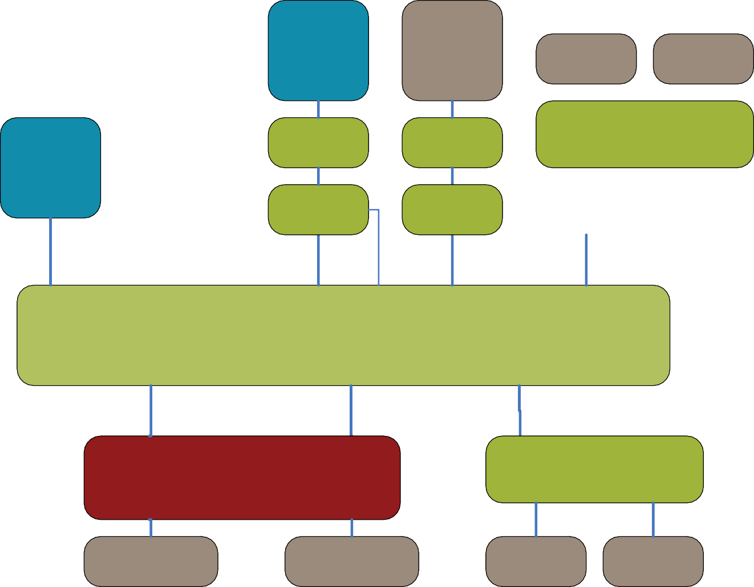
CoreLink CCI-400 Cache Coherent Interconnect
First ARM interconnect to support AMBA 4 AXI Coherency Extensions (ACE)
Mali-T604 graphics
Coherent I/O device
GIC-400
Video
LCD
ACE-Lite
Extends coherency to the system, multiple processors
Supports big.LITTLE™
Supports barriers, virtualisation, cache maintenance
Configurable: AXI4/AXI3/AHB
ADB-400
ADB-400
NIC-400
Quad Cortex-A15
Quad Cortex-A7
AXI4
▪
▪
ACE
ACE
MMU-400
MMU-400
MMU-400
ACE
ACE ACE-Lite + DVM ACE-Lite + DVM
CCI-400 Cache Coherent Interconnect 128-bit @ 0.5x CPU frequency
ACE-Lite ACE-Lite ACE-Lite
ACE-Lite + DVM
▪
Fixed 5x3 topology, configurable for performance/area from 100k to 500k gates
2x full ACE (CPU)
3x ACE-Lite + DVM I/O coherent slaves
3x master interfaces (2x DRAM + system)
End-to-end QoS with NIC-400 and DMC-400
ACE-Lite
ACE-Lite
AXI4
NIC-400
Configurable: AXI4/AXI3/AHB/APB
DMC-400
PHY
PHY
DDR2/3 / LPDDR2
DDR2/3 / LPDDR2
Other Slaves
Other Slaves
▪
6
CONFIDENTIAL

Slide 7
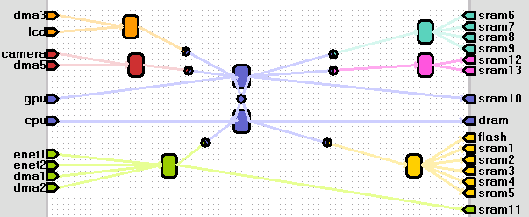

CoreLink NIC-400 Network Interconnect
New in NIC-400:
▪
▪
20% faster, 20% smaller than NIC-301
Addition of AMBA 4 AXI4 interfaces and interconnect switches
Long burst support, QoS signalling
▪ + everything NIC-301 does, including support for AMBA 3 AXI, AHB, APB
Hierarchical clock gating
90% reduction in idle and near idle power on LP
▪
▪
▪
Configurable Network Interconnect Structure
Quality of Service Virtual Networks (QVN-400)
▪
▪
▪
Separation of critical real-time traffic from high bandwidth low priority traffic Removes head of line and cross stream blocking
End-to-end QoS with CCI-400 and DMC-400
▪
Advanced QoS Regulators (QoS-400)
New bandwidth sensitive dynamic regulator
Thin Links (TLX-400)
Packetized links between NIC-400s, masters & slaves, reduces routing, example 65% less wires at 2x freq, same bandwidth
▪

Slide 8
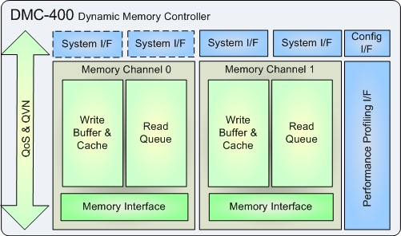
CoreLink DMC-400 Dynamic Memory Controller
AMBA 4 Dynamic Memory Controller
▪
▪
▪
▪
▪
Highly efficient interface from ARM systems to off chip LPDDR2 and DDR2 / DDR3 Delivers high bandwidth and low latency for high performance multimedia systems Effective management of power in memory sub-system
End-to-end QoS with NIC-400 and CCI-400
Improves performance for Cortex-A5, Cortex-A9, Cortex-R and Mali processor- based designs
Features and functionality
▪
▪
▪
Configurable and programmable
Full support for advanced QoS-400 features
>90% max theoretical utilization of memory bus traffic
▪
▪
1, 2 or 4 system ports and memory channels Tight integration with ARM DDR3 PHY solutions

Slide 9
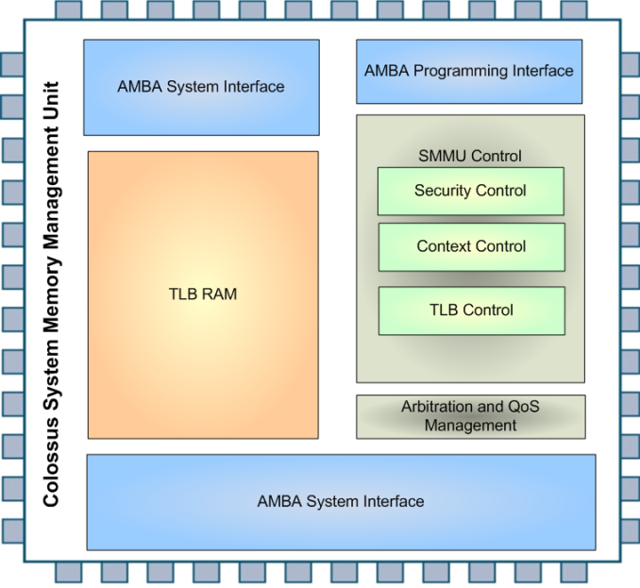
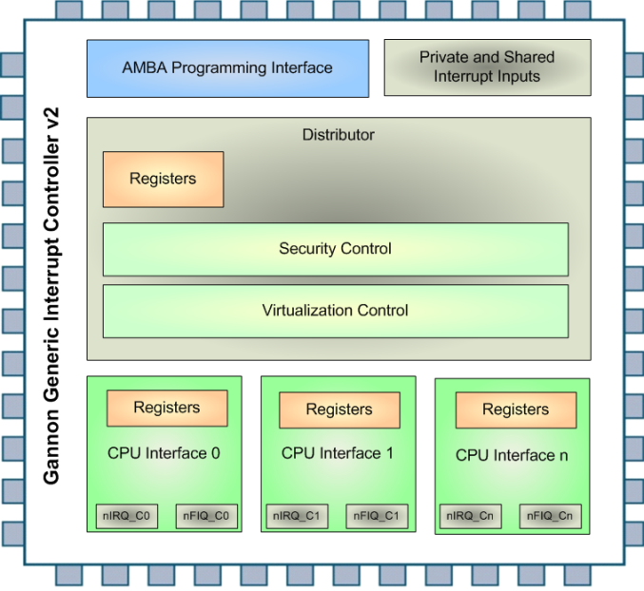
CoreLink MMU-400 and GIC-400
MMU-400
GIC-400
I/O virtualization with distributed TLB maintenance messaging
Stage 2 address translation for hypervisor support
ARMv7 virtualization extension architecture compliant
Generic Interrupt Controller for multiple Cortex-A15, Cortex-A7 clusters
IRQs and FIQs securely managed by hypervisor for each OS
ARMv7 virtualization extension architecture compliant

Slide 10
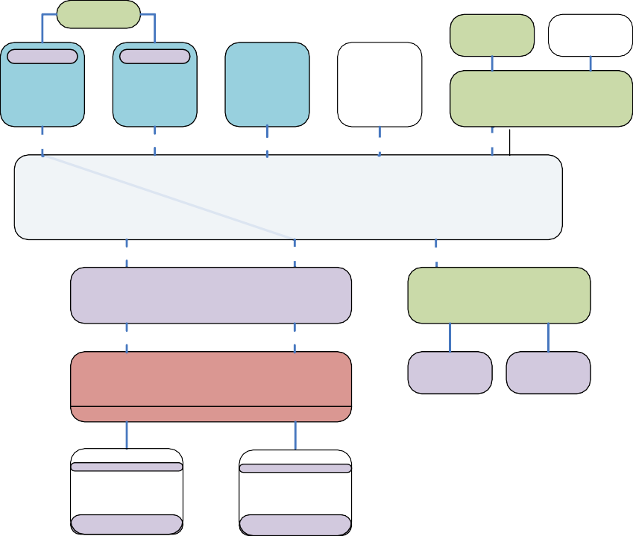


TZC-400 TrustZone Address Space Controller
Extends secure memory with low cost external DRAM
Prevents illegal access to protected memory regions
Protection from software attacks
Part of TrustZone® system
Between CCI/NIC and DMC
Applications: secure transactions with sensitive data, DRM
GIC-400
TrustZone
Cortex- A15
ACE
DMA-330 LCD
TrustZone
Mali-T604
Graphics
ACE-Lite
Coherent I/O device
Cortex-A7
AXI3
AXI3/AHB
NIC-400
ACE
128b
ACE
128b
ACE-Lite
128b
ACE-Lite
AXI3
128b
ACE
128b
ACE-Lite
CoreLink™ CCI-400 Cache Coherent Interconnect
ACE-Lite
128b
ACE-Lite ACE-Lite
128b
128b
AXI3
TZC-400
NIC-400
Configurable: AXI3/AHB-Lite/APB
ACE-Lite
128b
ACE-Lite
ACE-Lite
128b
ACE-Lite
DMC-400
Secure ROM
Secure RAM
PHY
PHY
Address Map
DDR3/2 LPDDR2
DDR3/2 LPDDR2
Master A
Region 0
Region 1
Region 2
Write
Supports multiple interfaces (1, 2 or 4)
Secures 8 memory regions
Enables a secure data pipe
Master B
Read
Write
Master C
Read
Setup read / write for specific masters
Write
Fast Path for low latency masters
256 outstanding transactions
Master D
Read
10
CONFIDENTIAL

Slide 11
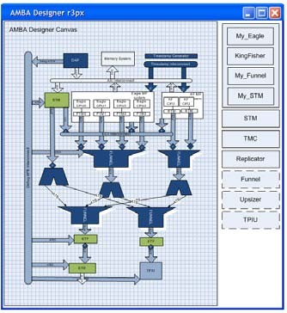


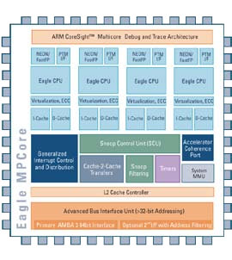
CoreSight SoC-400
A debug and trace framework for ARM based SoCs
Build the most effective on-chip visibility with CoreSight SoC IP
Configurable debug & trace infrastructure to address all markets and latest processors
SoC level time-stamping infrastructure
Improve productivity with CoreSight SoC flow
Describe, check for compliance your CoreSight systems in minutes.
Automated validation of your CoreSight systems
Unified flow for OEMs and silicon providers
Based on IP-XACT 1.4 & AMBA Designer
A generic solution for all markets & processors
▪
▪
Integrate homogeneous & heterogeneous systems Trace Macrocells become add-ons

Slide 12
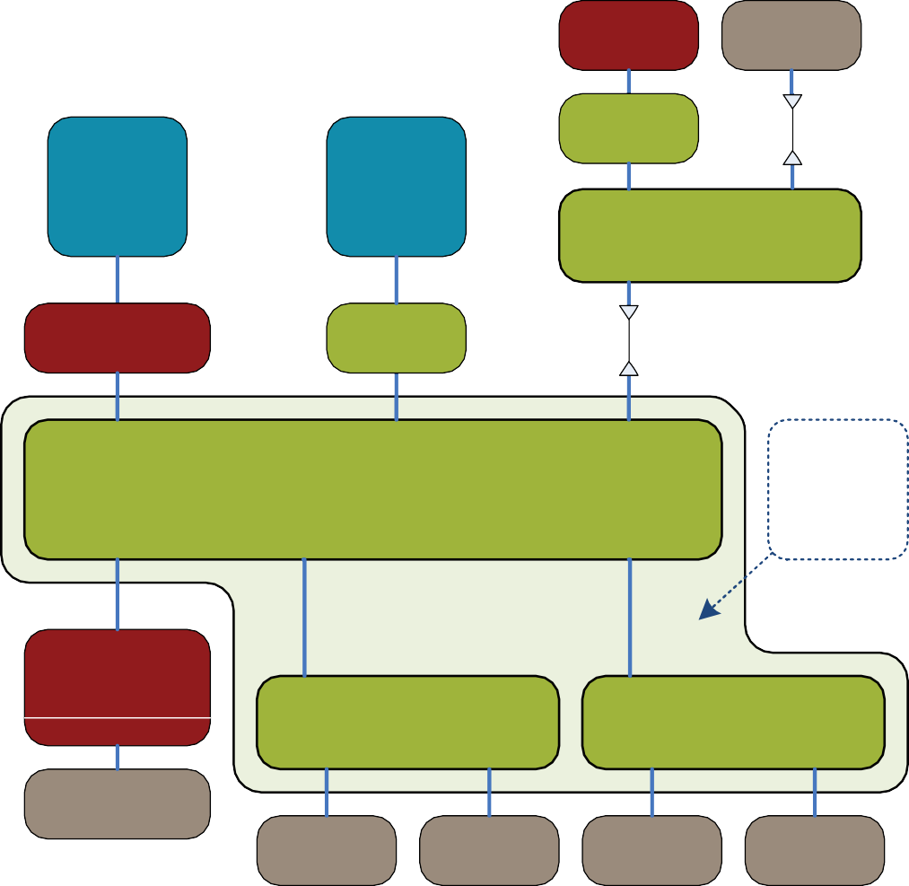
CoreLink 400 Series for AMBA 3
NIC-400 configurable interconnect
▪
▪
High performance and rest of SoC interconnect AXI4, AXI3, AHB and APB4
DMA-330
LCD
MMU-400
Thin Link
Thin Links to reduce routing
Between switches
End-to-end Quality of Service with virtual networks and regulation
Separates low latency, real-time and high bandwidth masters
Prevents head-of-line and cross-stream blocking
DMC-400 high efficiency, multi- channel memory controller
Dual Cortex-A
AXI3
MALI GPU
AXI4
Configurable: AXI4/AXI3/AHB
NIC-400 switch
AXI4
L2C-310
MMU-400
Thin Link
AXI3
AXI4
AXI4
NIC-400 top level includes hierarchy of switches
X-bar switch
AXI4
AXI4
AXI3
CoreLink NIC-400
ACE-Lite
Network Interconnect
DMC-400
AXI4
AXI3
X-bar switch
Configurable: AXI4/AXI3/AHB/APB
X-bar switch
Configurable: AXI4/AXI3/AHB/APB
▪
▪
AXI3 and AXI4 supported Unified QoS mechanisms
PHY
DDR3/2 LPDDR2
MMU-400 assists hypervisor for I/O
Stage 2 address translation
Other Slaves
Other Slaves
Other Slaves
Other Slaves

Slide 13
CoreLink 500 System IP for 2013
Support for ARMv8-A Cortex-A57 and Cortex-A53 SoCs
CoreLink CCN-504 Cache Coherent Network
Up to 4 clusters of Cortex-A57, Cortex-A53 and Cortex-A15
~1 terabit/sec useable system bandwidth
CoreLink DMC-520 Dynamic Memory Controller
72-bit DDR4-3200 and interfaces directly with CCN-504
CoreLink GIC-500 Generic Interrupt Controller
GICv3 Architecture for interrupt scaling with affinity routing
Message based interrupts and direct GIC⬄CPU interface
CoreLink MMU-500 System Memory Management Unit
2 stages of address translation
System MMU Architecture v2 with new 64k page tables
Up to 48-bit addressing for IO device virtualization

Slide 14
Example High End Mobile Solution
System Control Processor
Cortex- M3
GIC-500
IPU
DSP
Cortex
-R7
Cortex
-R7
Thin Link
DMA-330
Dual Cortex- A57
ACE
AXI3
AXI3
NIC-400
AXI3
Quad
Cortex-A53
ACE
Mali GPU
AXI4
AXI3
NIC-400
AHB
AXI3
ACE-Lite
ACE-Lite
AXI4
Video Ctrl
LCD
Ctrl
ADB-400
ADB-400
ADB-400
ADB-400
MMU-500
ACE
ACE
ACE-Lite
ACE-Lite
ACE-Lite + DVM
AXI3
AXI3
NIC-400
AXI3
Thin Link
CCI-400
ACE-Lite
ACE-Lite
ACE-Lite
TZC-400
TZC-400
TZC-400
TZC-400
AXI4
AXI3
AXI3
ACE-Lite
ACE-Lite
NIC-400
Configurable: AXI4/AXI3/AHB/APB
DMC-400
PHY
PHY
Other Slaves
Other Slaves
DDR3/2 LPDDR2
DDR3/2 LPDDR2

Slide 15
Growing Importance of Virtualization
Virtualization hardware supported in ARMv7-A, ARMv8-A “Virtualization is execution of software in an environment separated from the underlying hardware resources”
Virtualization use cases
IP obfuscation; IP protection; environment duplication; multiple guest-OS support under hypervisor control
System without virtualization System with virtualization
Virtual Machine 1
Virtual Machine 2
App 1
App 2
App 1
App 2
App 1
App 2
Guest OS 1
Guest OS 2
Operating System
Virtual Machine Monitor (VMM, or Hypervisor)
Hardware
Hardware

Slide 16
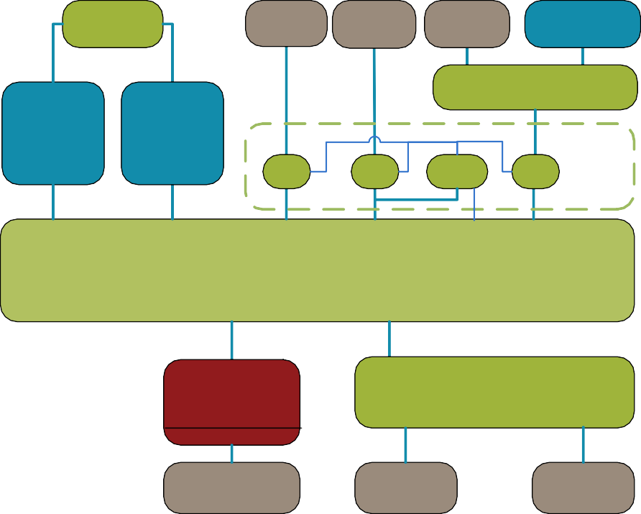


Virtualization with MMU-500
Nested translation
Stage 1 and Stage 2
Supports virtual address (VA) programming of devices
Scatter/gather function
Adds ARMv8 support
To enable interoperability with Cortex-A57 & Cortex-A53
Also supports Cortex-A15 and Cortex-A7 page table formats
GIC-400
GPU
Audio
DSP
Cortex-M3
AXI3
AHB
NIC-400
AXI4
Cortex-A15
Cortex-A7
MMU-500
TBU
ACE
ACE
TBU
TBUMMUT-C5U 00
ACE
ACE
ACE-Lite
ACE-Lite
DVM ACE-Lite
CCI-400
ACE-Lite
ACE-Lite
ACE-Lite
DMC-400
AXI4
NIC-400
PHY
Configurable: AXI4/AXI3/AHB/APB
LPDDR2
Flash
GPIO

Slide 17
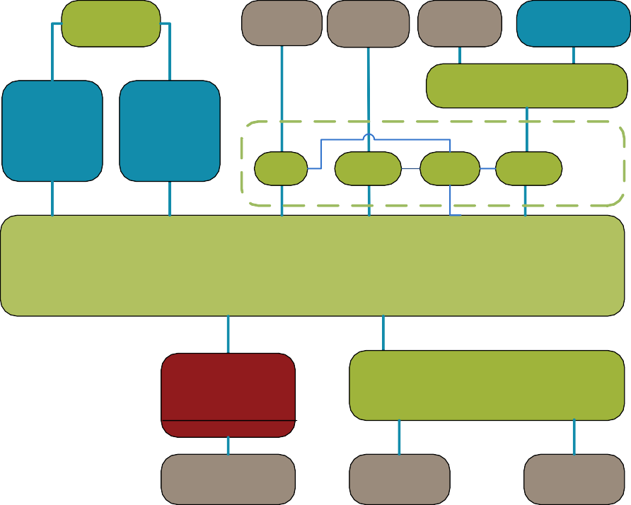
Virtualization with MMU-500
Nested translation
Stage 1 and Stage 2
Supports virtual address (VA) programming of devices
Scatter/gather function
Adds ARMv8 support
To enable interoperability with Cortex-A57 & Cortex-A53
Also supports Cortex-A15 and Cortex-A7 page table formats
Distributed TLBs
To increase TLB efficiency and to save power and area
Point-to-point connection
n x 1:1 TLB⬄TCU interfaces
GIC-400
GPU
Audio
DSP
Cortex-M3
AXI3
AHB
NIC-400
AXI4
Cortex-A15
Cortex-A7
MMU-500
TBU
ACE
ACE
TBU
TBU
TCU
ACE
ACE
ACE-Lite
ACE-Lite
DVM
ACE-Lite
CCI-400
ACE-Lite
ACE-Lite
ACE-Lite
DMC-400
AXI4
NIC-400
PHY
Configurable: AXI4/AXI3/AHB/APB
LPDDR2
Flash
GPIO
ARM System MMU Terminology:
TBU =
TCU =
Translation Buffer Unit (containing the TLB)
Translation Control Unit (containing the page table walker)

Slide 18
Generic Interrupt Controller for ARMv8
GIC-500 supports 48 CPUs
CPU *
Cortex-A57 and Cortex-A53
GICv3 architecture
CPU 0.0.1.2
CPU 0.0.1.2
LPIs
SPIs
Shared Peripheral Interrupts
CoreLink GIC-500
Up to 960 SPIs
Direct to AL0 or all
Interrupt Re-distribution –
Logical View
Message based interrupts
Affinity 3
0
Lower cost per interrupt
Direct to AL0
MSI(-X) support
VMs can directly program peripherals to reduce hypervisor overhead
Affinity 2
0
Affinity 1 0
1
2
n
Affinity level routing
CPU I/F
CPU I/F
CPU I/F CPU I/F
CPU I/F
CPU I/F
CPU I/F CPU I/F
CPU I/F
CPU I/F
CPU I/F CPU I/F
CPU I/F
CPU I/F
CPU I/F CPU I/F
Affinity 0
0
1
2
3
0
1
2 3
0
1
2 3
0
1
2
3
Allows for scalability
Consolidated as one monolithic block for GIC-500
SPI = Shared Peripheral Interrupt (wired interrupt)
LPI = Local Peripheral Interrupt (message based interrupt)

Slide 19
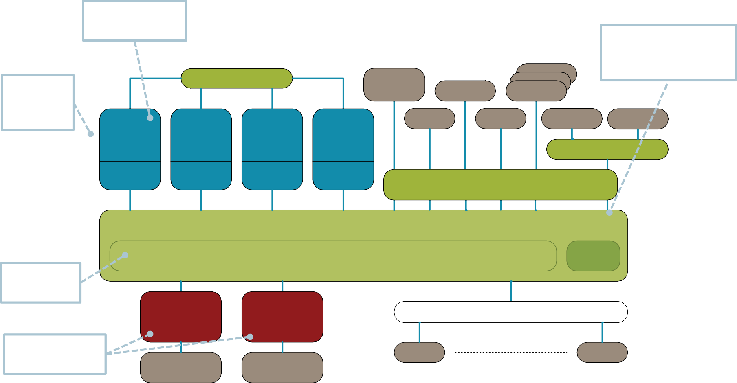
High Performance, Efficient, Cache Coherent
Up to 4 cores per cluster
Heterogeneous processors – CPU, GPU, DSP and accelerators
18 AMBA ACE-Lite
interfaces for I/O coherency
GIC-500
10-40
GbE
DSP
4 fully coherent clusters
PCIe
DSP
DSP
DPI
Crypto
USB
SATA
Quad Cortex-A57
Quad Cortex-A57
Quad Cortex-A57
Quad Cortex-A57
NIC-400
128-bit bus @ CPU
frequency
L2 cache
L2 cache
L2 cache
L2 cache
MMU-500
CoreLink™ CCN-504 Cache Coherent Network
8/16MB L3 cache
To minimize snoop traffic
Snoop Filter
Integrated L3 cache
CoreLink™ DMC-520
CoreLink™ DMC-520
NIC-400 Network Interconnect
Dual channel DDR3/4 x72
Flash GPIO
x72 DDR4-3200
x72 DDR4-3200
Peripheral address space
Usable system bandwidth: ~ 1 Terabit/second

Slide 20


Scalable System Features
CoreLink CCN-504
CPU | 4 ports up to 16 cores Cortex-A57, Cortex- A53 and Cortex-A15
IO | 18 ports: AMBA® 4 AXI4/ACE-Lite interfaces
DDR | 2 channels supported with CoreLink DMC- 520
RAS | ECC on RAMs and parity on transport
QoS | QoS regulation and priority management
Security | TrustZone aware
Low Power Support | Extensive clock gating, leakage mitigation hooks, Granular DVFS and CPU shutdown support, Partial or full L3 cache shutdown, Retention modes

Slide 21


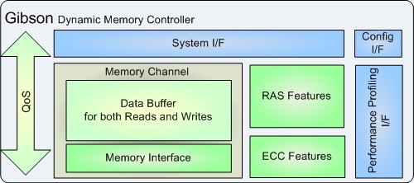


Security, Reliability, Quality of Service
CoreLink DMC-520
Artisan® DDR4, 3 & 3L PHY 3200 Mbps
5th Generation ARM DMC targeting >95% DRAM efficiency
ECC and RAS features
Performance Profiling
TrustZone Address Space Control
High efficiency through close integration with CCN-504
System wide QoS, designed and verified with ARM CPUs
RAS = Reliability, Availability, Serviceability

Slide 22

High Performance Memory Access
CoreLink DMC-520
Performance | Max bandwidth: 25.6 GB/s per channel Buffering to optimize read/write turnaround
Interfaces | Optimal direct connection to CCN-504 Industry standard DFI-3.0 to connect to PHY
PHY | Low-latency PHY from ARM
Memory | Support for x72 DRAM DDR3, DDR3L and DDR4 up to DDR4-3200
Low Power Support | Programmable DRAM power modes

Slide 23

CoreLink End-to-End QoS Architecture
Enterprise Requirements
“Bursty” datapath
CoreLink End-to-End QoS
QoS field for every transaction Fixed, programmable or regulated End-to-End propagation
Programmable QoS mechanisms Regulation of all traffic on ingress Bandwidth management
Latency management
QoS re-ordering and arbitration
Interconnect ingress Non-blocking transport L3 cache
DMC
▪
▪
High peak bandwidth Multiple interfaces
▪
▪
CPU
Accel
IO
L3
DDR
“Compute intensive” Control Path
Lowest latency requirements
“Latency Sensitive” Air interface
Predictable Latency
▪
▪
▪
▪
▪
▪
▪

Slide 24
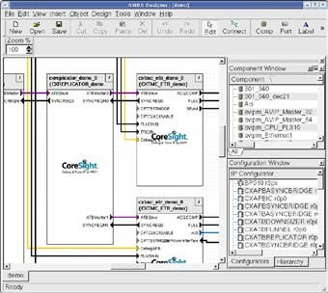
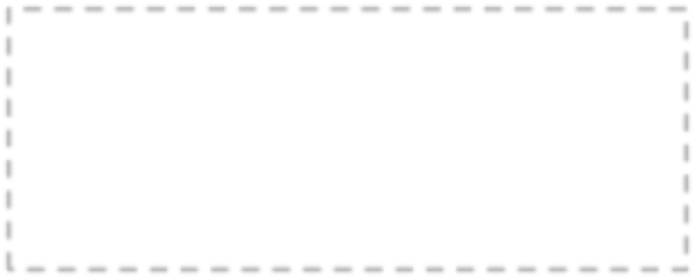

CoreSight SoC-400 for ARMv8
STM
Trace bus
TPIU
ETM
ETM
Debug bus
DAP
SWD/ JTAG
C
ortex-
M3
IPU
System Control Processor
DSP
Cortex
Cortex
-R7
E_{E}T_{T}M_{M}
GIC-500
-R7
E_{E}T_{T}M_{M}
Thin Link
DMA-330
Dual
AXI3
AXI3
AXI3
Cortex-
Quad
Mali
AXI4
AXI3
NIC-400
AHB
NIC-400
A57
ACE
Cortex-A53
ACE
GPU
AXI3
ACE-Lite
ACE-Lite
AXI4
Video Ctrl
LCD
Ctrl
▪ADB_{B}-40_{o}0 _{th}A_{A}DB-_{R}400 _{Mv}AD₇B-4&00 _{ARM}MMU_{v}-50₈0
processors
ADB-400
aArCEe sAuCEp-LiteportAeCE-dLite bAyCE-LiCte + DoVMreSight SoC-400
ACE
AXI3
AXI3
NIC-400
AXI3
Thin Link
Support fo^{CC}r^{I-4}C⁰⁰ortex-A53 & Cortex-A57
ACE-L_{a}ite _{vailable fr}AC_{o}E-L_{m}ite
core’s^{AC}L^{E-L}A^{ite} C release
TZC-400
TZC-400
TZC-400
▪
TZC-400
Embedded Trace Macrocells (ETM)
AXI3
AXI3
ACE-Lite
ACE-Lite
AXI4
NIC-400
DMC-400
provided with processCoonfigrurasble: AXI4/AXI3/AHB/APB
PHY
PHY
Other Slaves
Other Slaves
DDR3/2 LPDDR2
DDR3/2 LPDDR2

Slide 25
Summary
CoreLink 400 series is available now
Coherency support for Cortex-A15, Cortex-A7 and the latest Cortex-A50 series
NIC-400 Network Interconnect for Cortex-A and Cortex-R series processors
CoreLink 500 series offers new system scaling
16 core support in CCN-504 Cache Coherent Network for enterprise applications
Enterprise DDR3/4 memory support with DMC-520
ARMv8 page stable support with MMU-500
ARM CoreLink System IP offers the best ARM Cortex and Mali™ processor performance
Designed together, validated together

