Slide 1
ARMV8和ARMV9架构学习
异常/中断/gic专题
gicv3的介绍
讲师：代码改变世界ctw

Slide 2
目录
gic model
GIC version
Interrupt INTID
GIC interconnect
GIC states
Target interrupts
Security model
example
gic architecture
Distributor
Redistributors
CPU interfaces
Register Configuring
Routing a pending interrupt to a PE
Taking an interrupt
Running priority and preemption
End of interrupt
State of individual INTIDs
Generating SGIs
Controlling the Security state and grouping
Comparison of GICv3 and GICv2

Slide 3
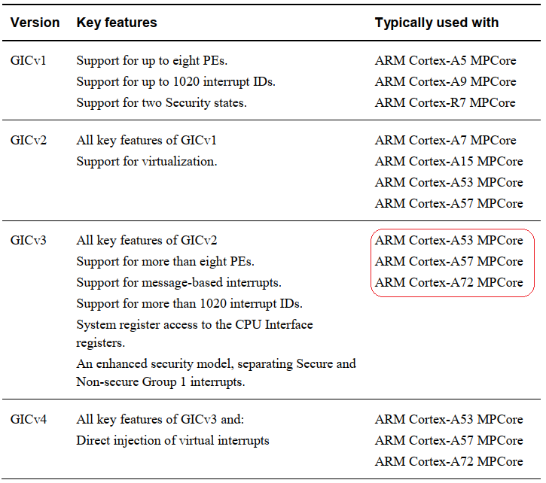
GIC version
◾gic400，支持gicv2架构版本。 ◾gic500，支持gicv3架构版本。 ◾gic600，支持gicv3架构版本
◾gic700, 支持gicv4.1架构版本

Slide 4
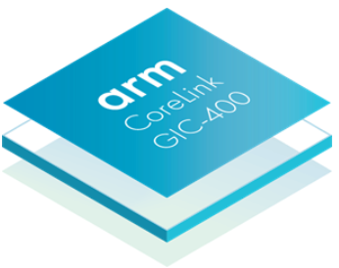
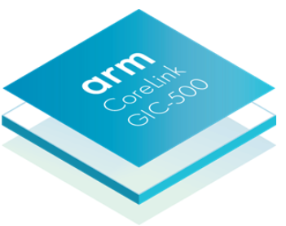
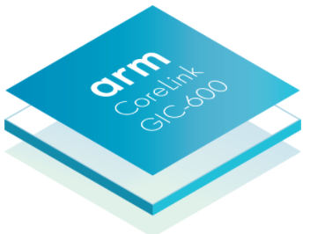

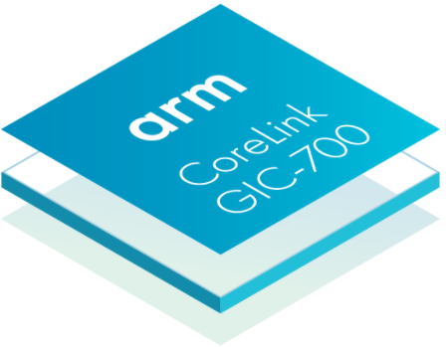
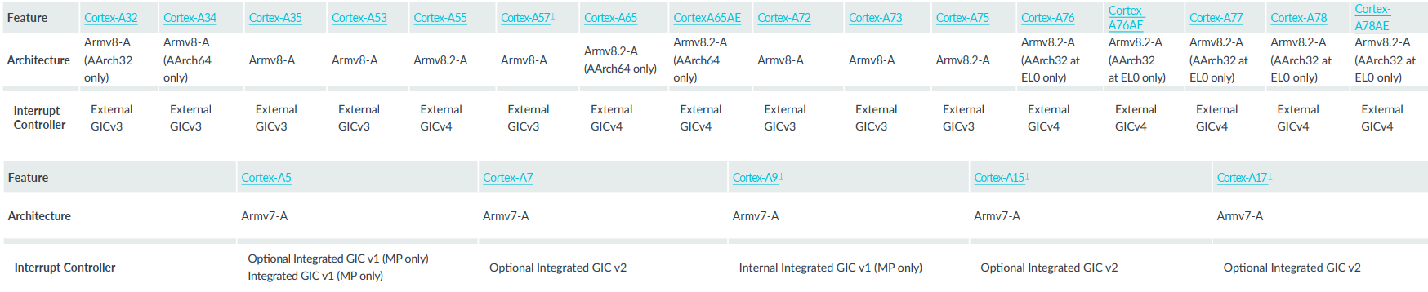
gic model
Cortex-A73, Cortex-A72, Cortex-A57, Cortex-A53
Cortex-A76, Cortex-A55
Cortex-A78AE, Cortex-A76AE, Cortex-A76, Cortex-A55
Cortex-A15, Cortex-A7
enhancing virtualization capabilities

Slide 5
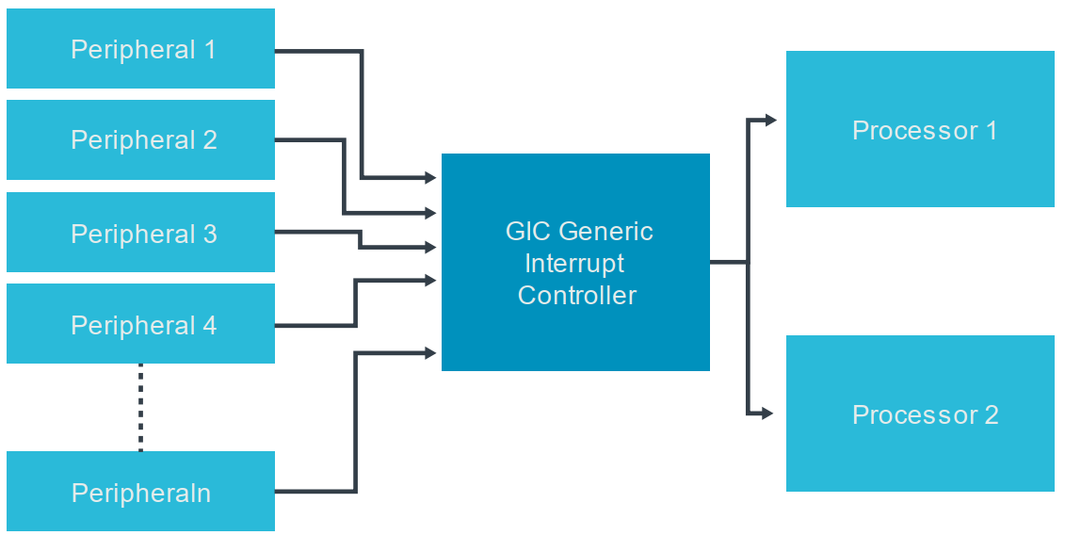
gic model
GIC是一个为Cortex-A和Arm Cortex-R设计的标准的中断控制器

Slide 6
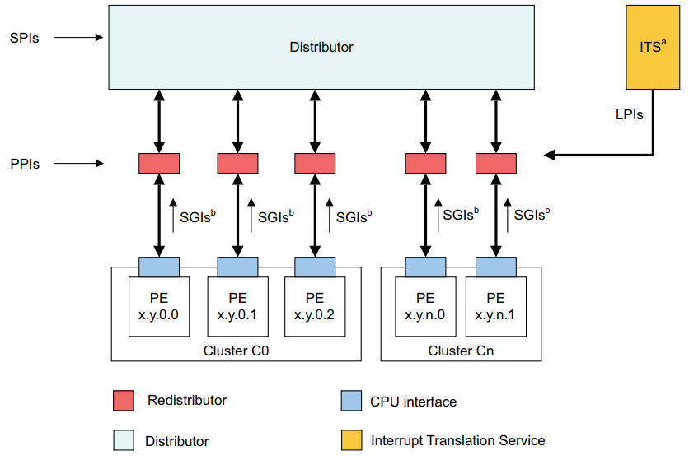
gic model
gicv3/gicv4的四大组件
Distributor
Redistributor
CPU insterface
Interrupt Translation Service
4种类型中断:
SGI 软件产生中断
PPI 私有中断
SPI 共享中断
LPI 区域特定中断
— Locality-specific Peripheral Interrupts (LPIs).
— Private Peripheral Interrupts (PPIs).
— Software Generated Interrupts (SGIs).
— Shared Peripheral Interrupts (SPIs).

Slide 7
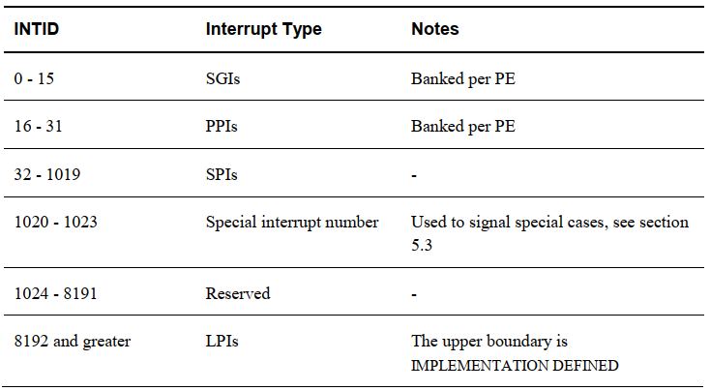
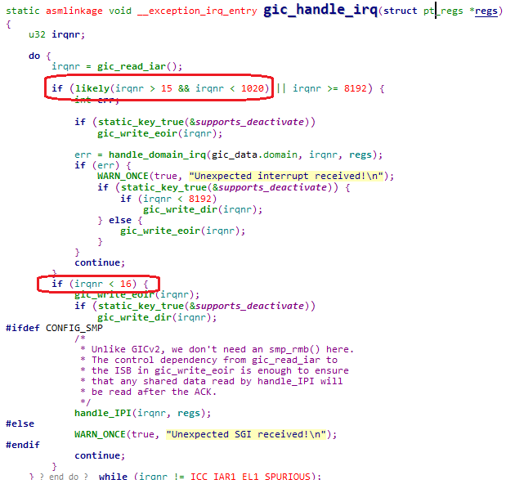
Interrupt INTID
Shared Peripheral Interrupt (SPI)
Private Peripheral Interrupt (PPI)
Software Generated Interrupt (SGI)
Locality-specific Peripheral Interrupt (LPI)

Slide 8
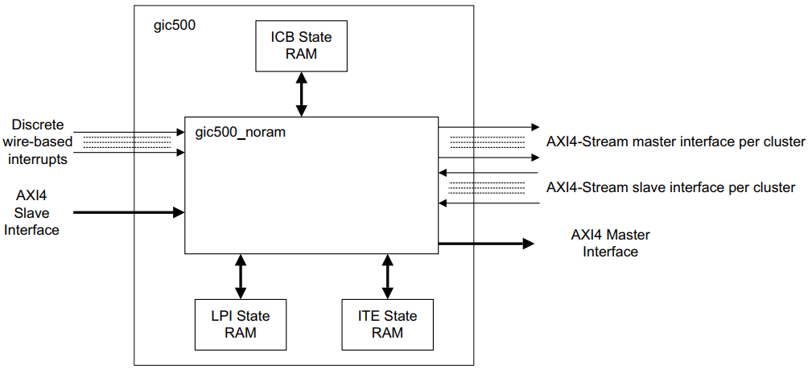
GIC interconnect

Slide 9
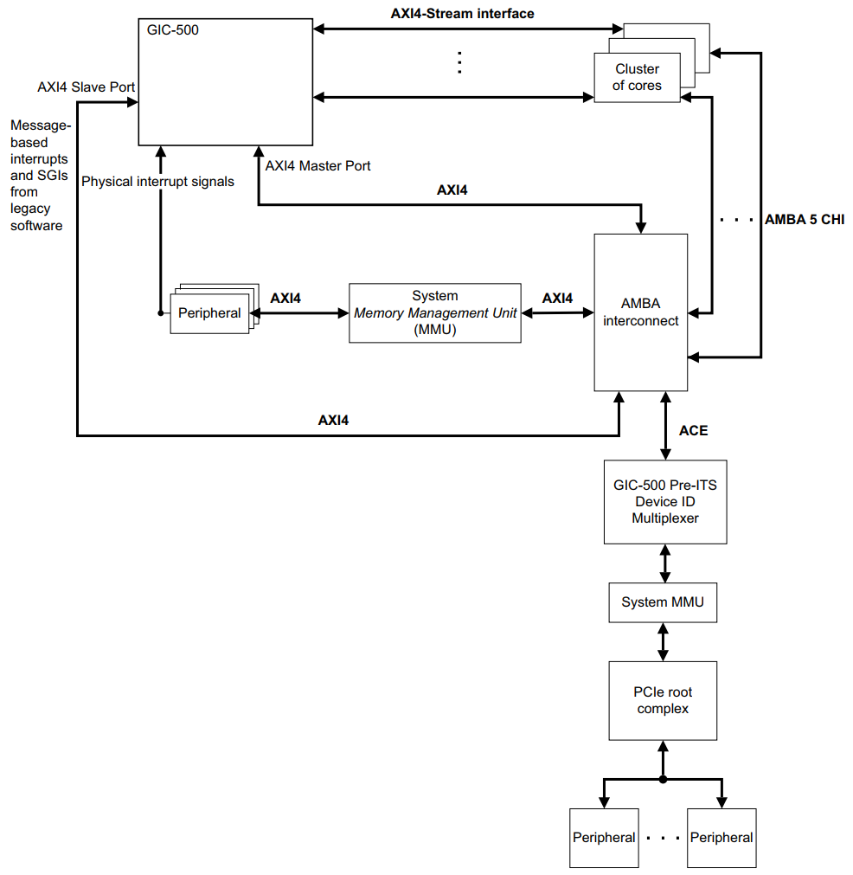

GIC interconnect

Slide 10
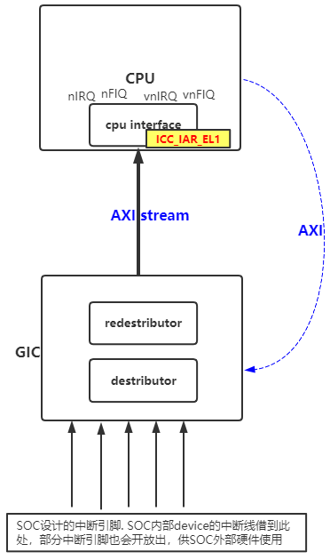
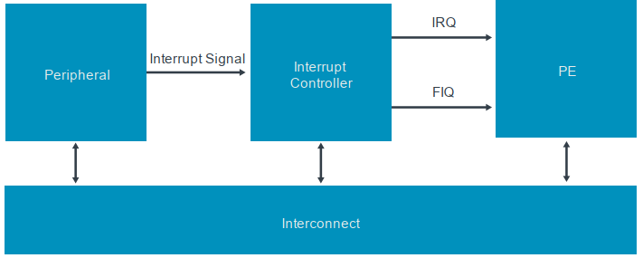
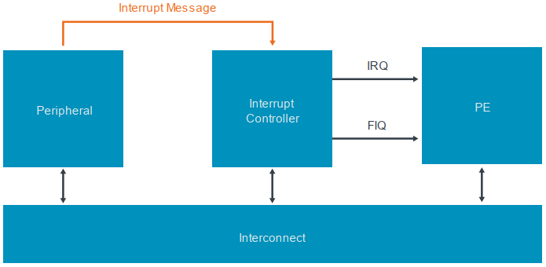
GIC interconnect
for message-signaled interrupts

Slide 11
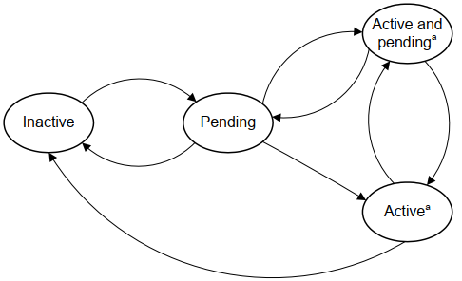
GIC states
中断的生命周期:
对于电平触发的中断(level-sensitive interrupts)，一个上升沿输入，将中断变成pending，中断信号线保持高电平直到PE断言该中断信号.
对于边沿触发的中断(edge-sensitive interrupts)，一个上升沿输入，将中断变成pending，中断信号线不会保持高电平.

Slide 12
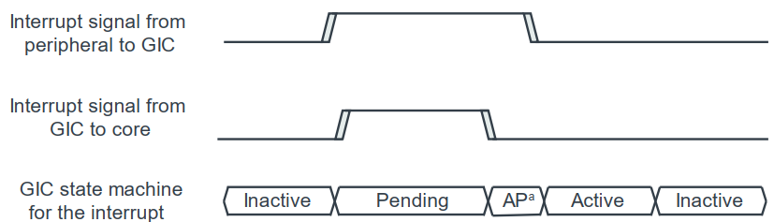
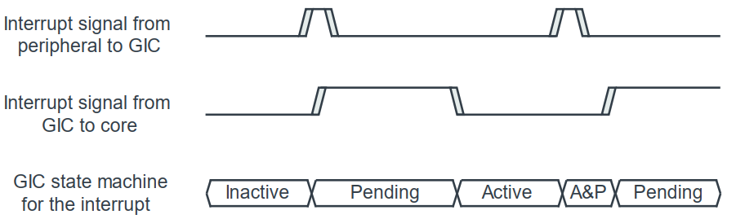
GIC states
Level sensitive interrupts
Edge-triggered interrupts

Slide 13
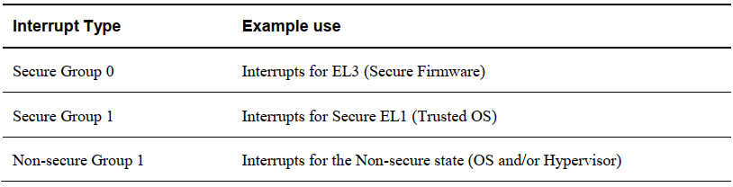
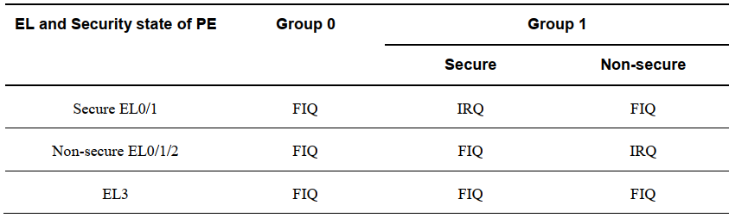
Security model

Slide 14
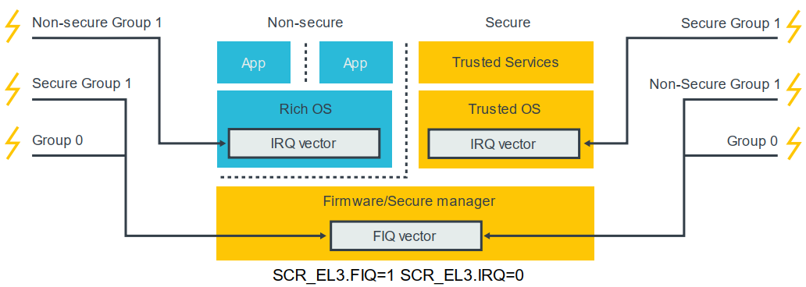
Use with Security model

Slide 15
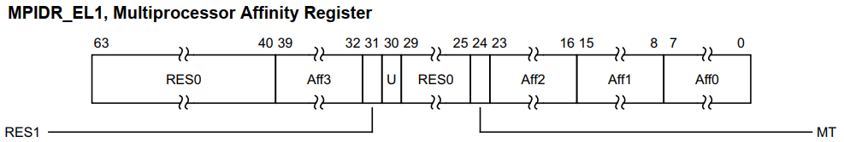
Target interrupts
中断发送给哪个CPU，是由affinity值定的，对于SPIs中断，在Distributer中就仲裁了发送给哪个CPU，而对于PPI/SGI中断,由Redestributter寄存器决定;
对应的，ARM Core端，也有一个寄存器标志着CPU的编号
An affinity is a 32-bit value that is split into four fields:
<affinity level 3>.<affinity level 2>.<affinity level 1>.<affinity level 0>
0.0.0.[0:3] Cores 0 to 3 of a Cortex-A53 processor
0.0.1.[0:1] Cores 0 to 1 of a Cortex-A57 processor

Slide 16
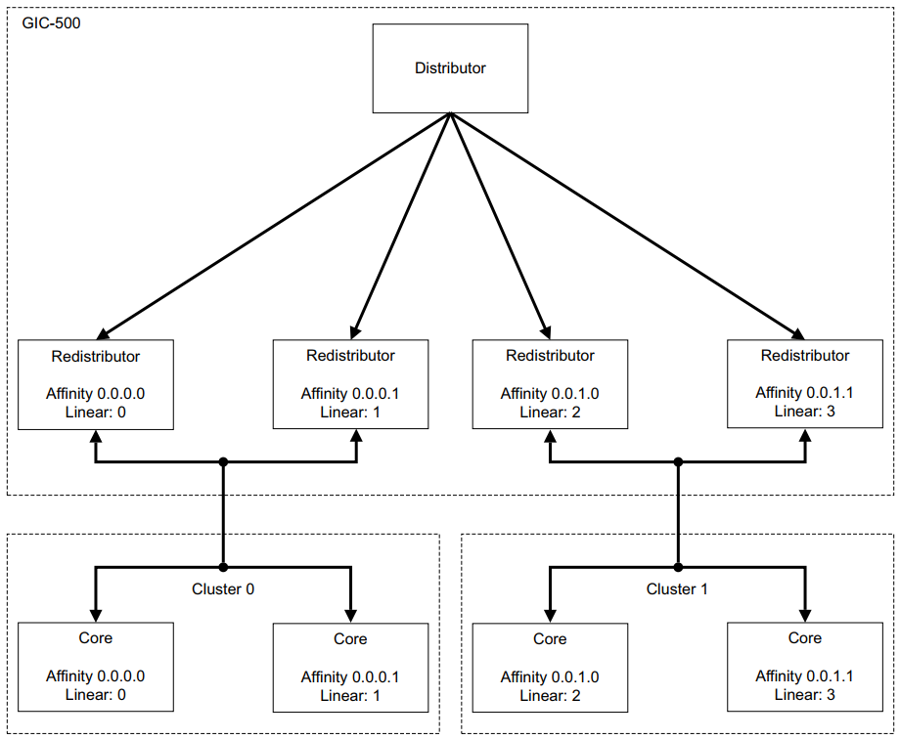

Slide 17
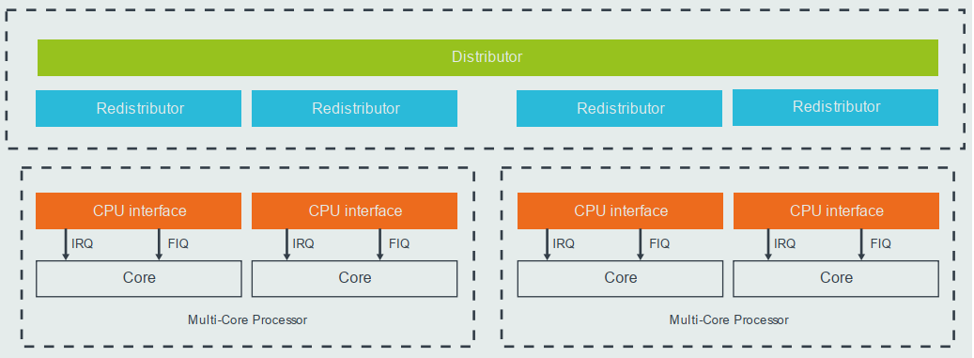
gic architecture
• Distributor interface
• Redistributor interface
• CPU interface

Slide 18
Distributor
Distributor (GICD_*) for SPIs
• SPIs 启用和禁用
• 设置每个 SPI 的优先级
• 每个 SPI 的路由信息(发给哪个cpu)
• 每个 SPI 设置为电平敏感或边沿触发
• 产生message-signaled SPI中断
• 控制每个SPI 的状态(active、pending)
• 在每一个Security state 下，配置路由模型 (affinity routing or legacy)
• 配置每一个SPIs的中断分组

Slide 19
Redistributors
Redistributors (GICR_*)
• 启用和禁用 SGI 和 PPI
• 设置每个 SGI 和 PPI 的优先级
• 设置每个 PPI 为电平敏感或边沿触发
• 将每个 SGI 和 PPI 分配给一个中断组
• 控制 SGI 和 PPI 的状态
• 控制内存中支持 LPI 相关中断属性和挂起状态的数据结构的基地址
• 为连接的 PE 提供电源管理支持

Slide 20
CPU interfaces
CPU interfaces (ICC_*_ELn)
• 提供通用控制和配置以启用中断处理
• Acknowledge an interrupt
• 执行优先级下降和中断停用(de-active)
• 为 PE 设置中断优先级掩码(即设置最低优先级)
• 定义 PE 的抢占策略
• 确定 PE 的最高的 priority pending interrupt
In Arm CoreLink GICv3, the CPU Interface registers are accessed as System registers: ICC_*_ELn.

Slide 21
Configuring - Global settings
GICD_CTLR.ARE: Enable Affinity routing (ARE bits), 1-使用gicv3 mode，0-使用legacy mode(gicv2 mode). 默认为1
GICD_CTLR.EnableGrp1S
GICD_CTLR.EnableGrp1NS
GICD_CTLR.EnableGrp0
注意在GIC-600 does not support legacy operation

Slide 22
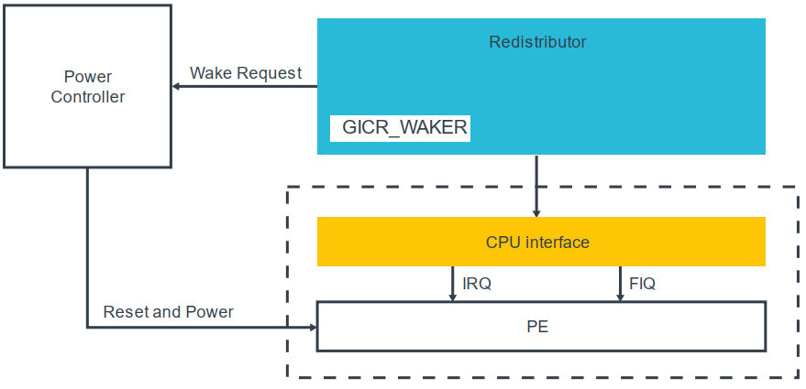
Configuring - (Redistributor)Settings for each PE
Redistributor中包含了一个GICR_WAKER寄存器，用于记录connected PE的状态是onLine还是offline. 如果让PE变成online，软件则必需这样做：
• Clear GICR_WAKER.ProcessorSleep to 0.
• Poll GICR_WAKER.ChildrenAsleep until it reads 0
如果PE is offline (GICR_WAKER.ProcessorSleep==1)时，来了一个中断target到该PE上，将产一个wake request信号，这个信号连接PE的power controller，该controller将会打开PE。然后PE clear the ProcessorSleep bit

Slide 23
configuration - CPU interface
CPU interfaces (ICC_*_ELn)
SRE bit--- enable cpu interface
注：有些处理器可能不支持legacy operation，SRE比特位也是固定为1，那么软件就不需要处理该比特了
Set Priority Mask and Binary Point registers
ICC_PMR_EL1、ICC_BPRn_EL1
Set EOI mode （EOI:End of interrupt）
ICC_CTLR_EL1 and ICC_CTLR_EL3
Enable signaling of each interrupt group
ICC_IGRPEN1_EL1 (banked by Security state)
ICC_IGRPEN0_EL1

Slide 24
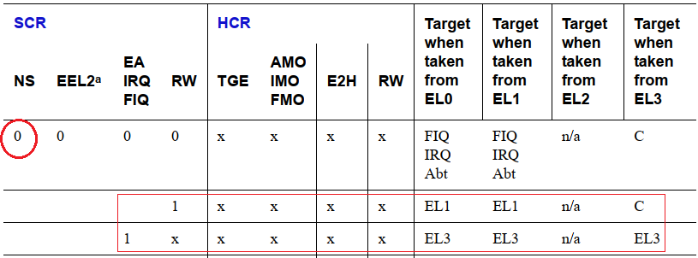

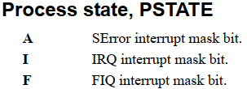
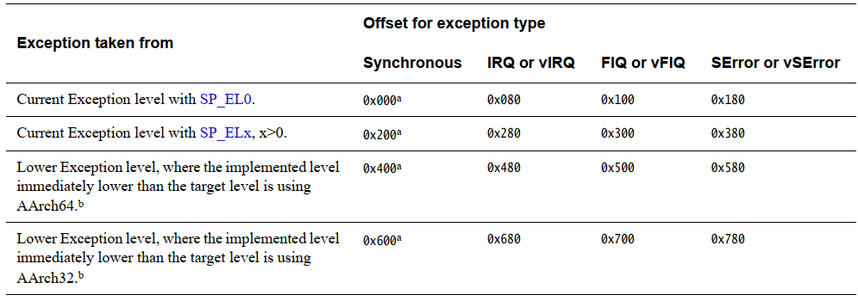
PE configuration
Routing controls - SCR_EL3 、 HCR_EL2
Interrupt masks - PSTATE
Vector table - VBAR_ELn

Slide 25
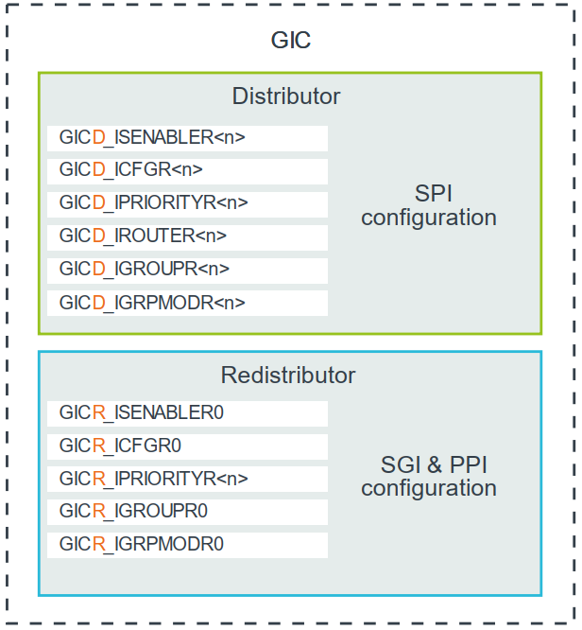
interrupt sources configuration
• SPIs are configured through the Distributor, using the GICD_* registers.
• PPIs and SGIs are configured through the individual Redistributors, using the GICR_* registers
对于每一个中断，软件必需配置的：
-Priority: GICD_IPRIORITYn, GICR_IPRIORITYn
Group: GICD_IGROUPn, GICD_IGRPMODn, GICR_IGROUPn, GICR_IGRPMODn
Edge-triggered or level-sensitive: GICD_ICFGRn, GICR_ICFGRn
Enable: GICD_ISENABLERn, GICD_ICENABLER, GICR_ISENABLERn, GICR_ICENABLERn

Slide 26
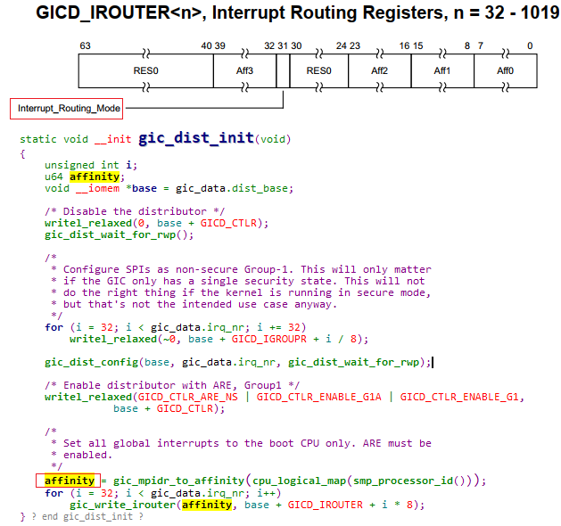
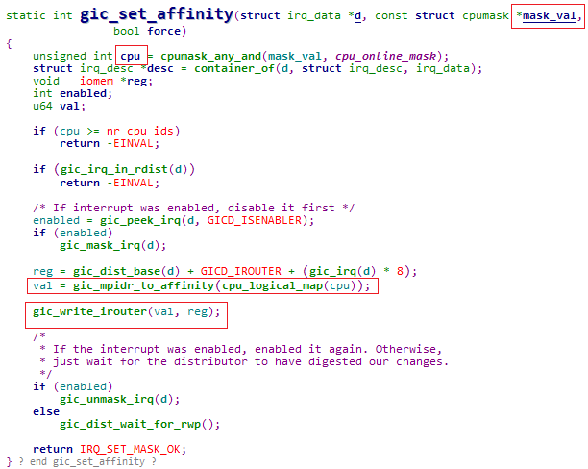
Setting the target PE for SPIs
GICD_IROUTERn.Interrupt_Routing_Mode == 0 rounting到制定的PE
GICD_IROUTERn.Interrupt_Routing_Mode == 1 Distributor硬件会自动选择一个PE，可以是0-n
A PE can opt out of receiving 1-of-N interrupts. This is controlled by the DPG1S, DPG1NS and DPG0 bits in GICR_CTLR.

Slide 27
Routing a pending interrupt to a PE
Check that the group associated with the interrupt is enabled
Check that the interrupt is enabled
Check the routing controls to decide which PEs can receive the interrupt.
routing is controlled by GICD_IROUTERn，An SPI can target one specific PE, or any one of the connected PEs
Check the interrupt priority and priority mask to decide which PEs are suitable to handle the interrupt
Each PE has a Priority Mask register, ICC_PMR_EL1, in its CPU interface
Check the running priority to decide which PEs are available to handle the interrup
Only an interrupt with a higher priority than the running priority can preempt the current interrupt

Slide 28
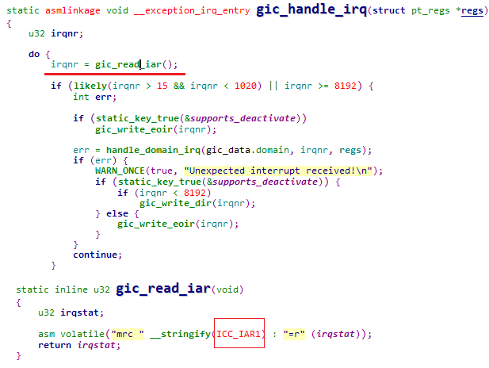
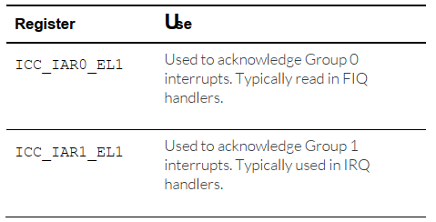
Taking an interrupt

Slide 29
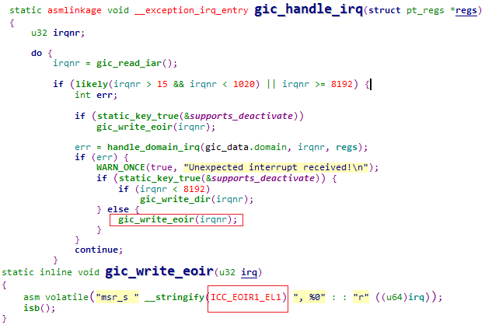
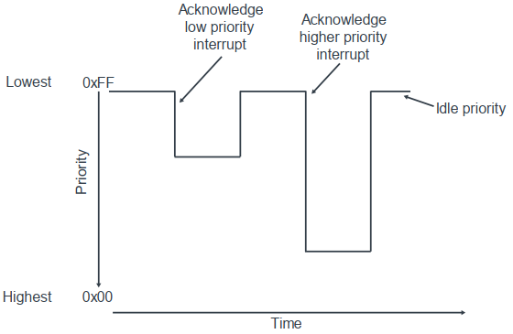
Running priority and preemption

Slide 30
End of interrupt
• Priority drop - 将中断优先级降到中断产生之前的值
• Deactivation - 将中断从active变成inactive
在gicv3中，drop和deactivation通常是一起打开的。
ICC_CTLR_ELn.EOImode = 1: 通过写ICC_EOIR0_EL1、ICC_EOIR1_EL1让drop and deactivation同时生效
ICC_CTLR_ELn.EOImode = 0: 通过写ICC_EOIR0_EL1、ICC_EOIR1_EL1让drop生效，写ICC_DIR_EL1让deactivation生效，这在虚拟化中会用到.
大多数的软件系统中 EOIMode==0，而下hypervisor的系统中 EOIMode==1

Slide 31
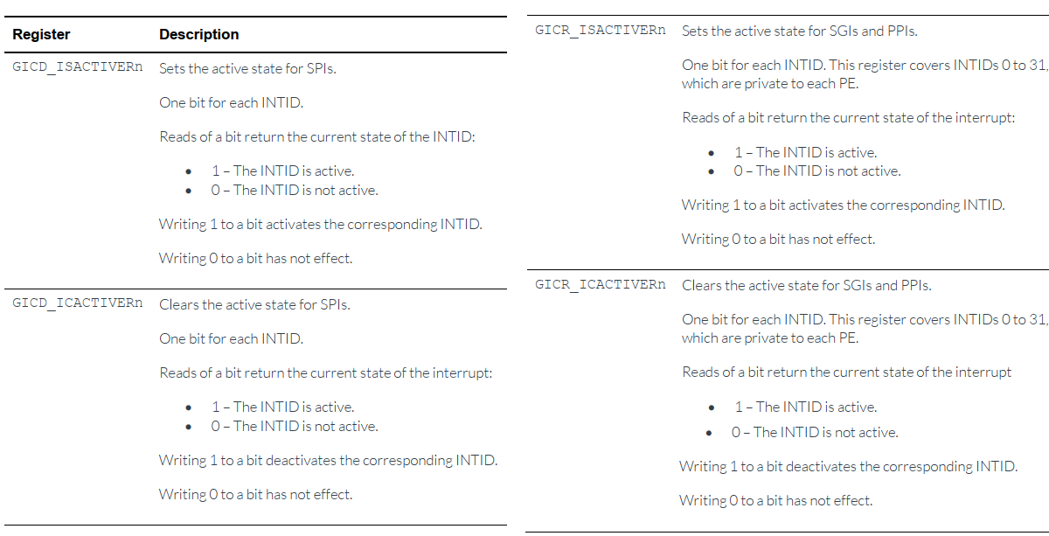
State of individual INTIDs

Slide 32
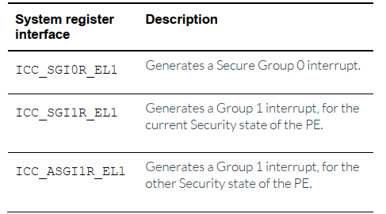
Generating SGIs
IRM (Interrupt Routing Mode)
IRM = 0 rounting到Affinity指定的PE;
IRM = 1 routing到所有PE(除当前PE之外)

Slide 33
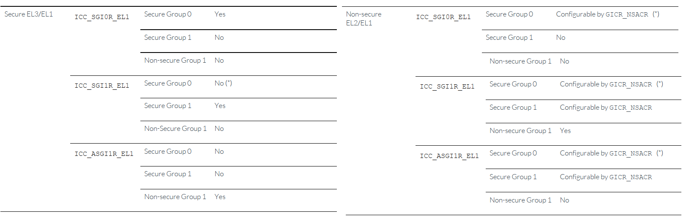
Controlling the Security state and grouping
PE在secure执行时，可以产生secure和non-secure的SGI;
PE在non-secure执行时，也是可以产生secure的SGI，但是取决于GICR_NSACR寄存器的配置，该寄存器只能在secure中读写

Slide 34
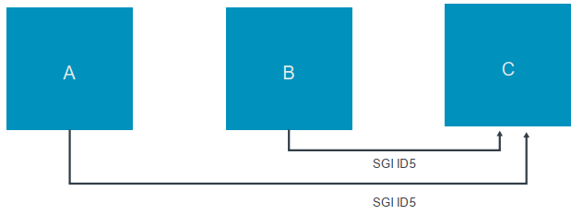
Comparison of GICv3 and GICv2
Comparison of GICv3 and GICv2
在gicv2中，SGI INTIDs对于originating PE和the target PE是banked
在gicv3中，SGI仅仅对target PE是banked
在gicv2中同时收到两个SGI=5中断，两个中断都会被PE处理。
而在gicv3上，由于originating不是banked，所有前一个SGI=5中断将会丢失。PE只能收到一个

Slide 35
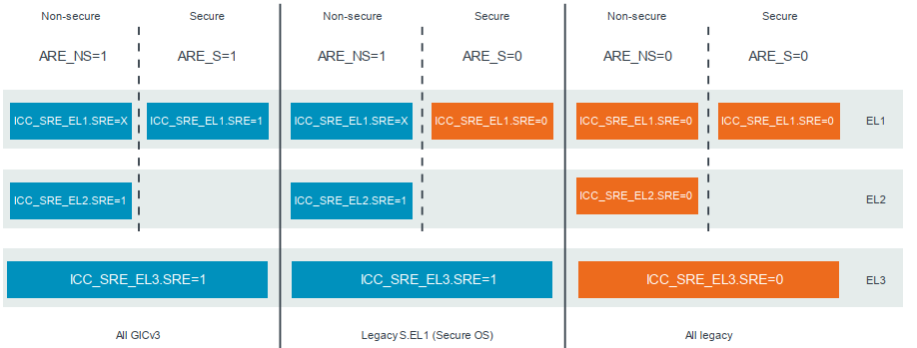
Legacy operation
• When ARE==0, affinity routing is disabled (legacy operation)
• When ARE==1, affinity routing is enabled (GICv3 operation)

Slide 36
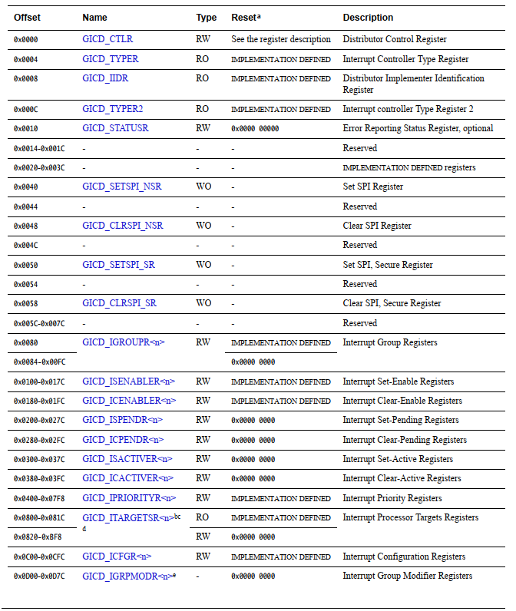
GICD register

Slide 37
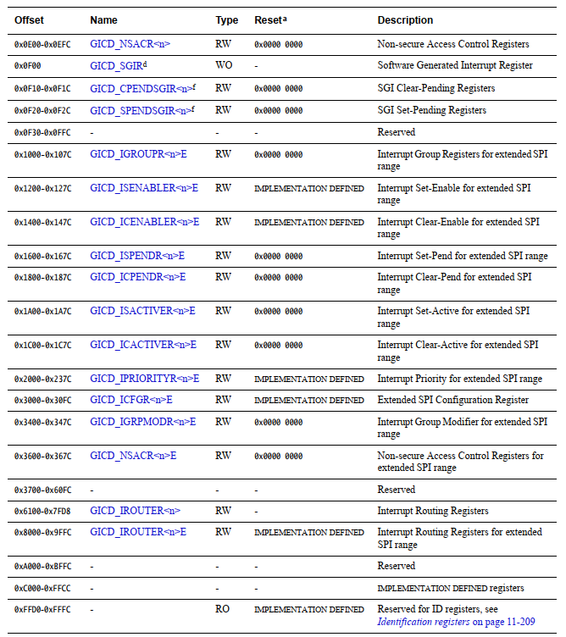
GICD register

Slide 38
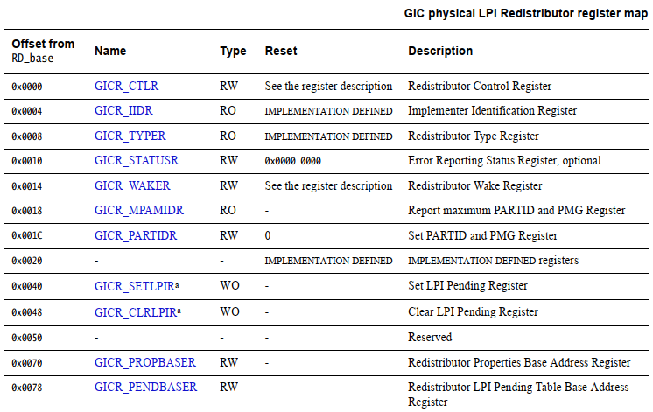
GICR register

Slide 39
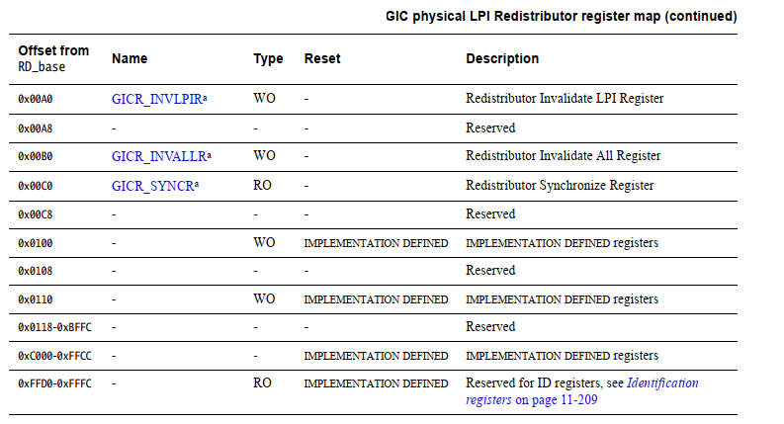
GICR register

Slide 40
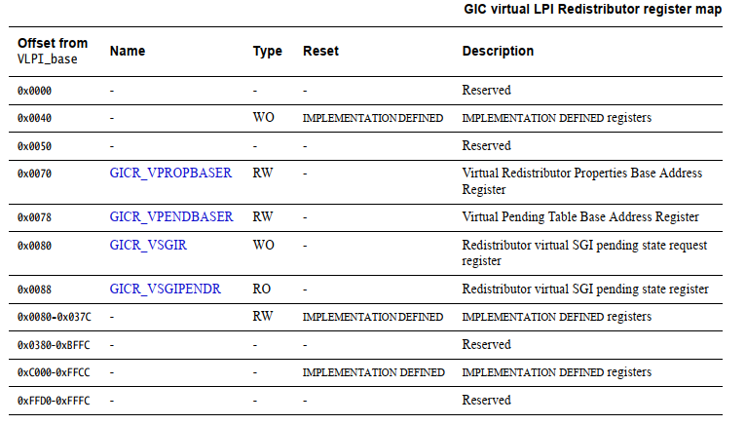
GICR register

Slide 41
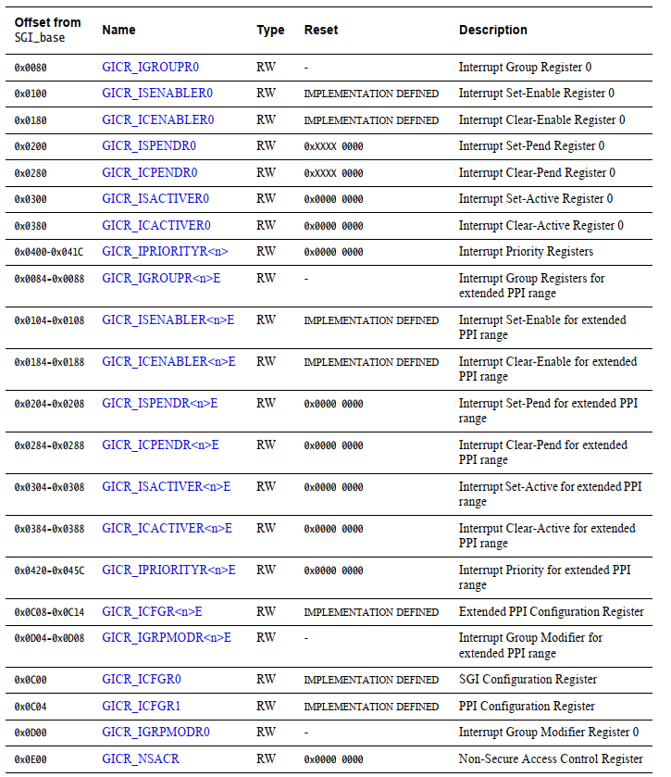
GICR register – SGI/PPI

Slide 42
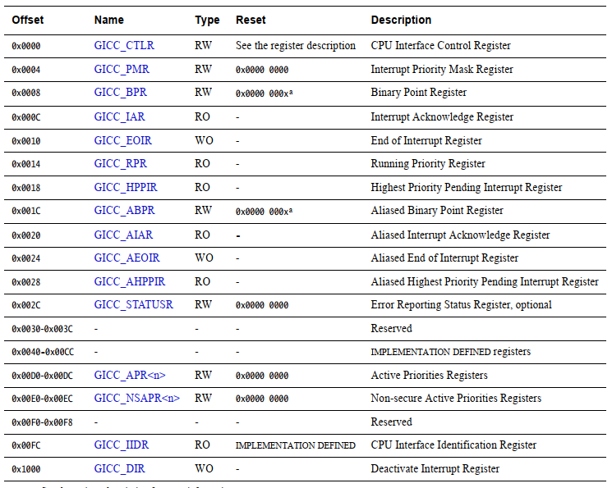
CPU interface

