Slide 1

CS 61C: Great Ideas in Computer Architecture Lecture 2: Introduction to C, Part I
Instructors:
Vladimir Stojanovic & John Wawrzynek
http://inst.eecs.berkeley.edu/~cs61c/

Slide 2
Agenda
Compile vs. Interpret
C vs. Java vs. Python
Administrivia
Quick Start Introduction to C
News/Technology Break
Pointers
And in Conclusion, …

Slide 3
Agenda
Compile vs. Interpret
C vs. Java vs. Python
Administrivia
Quick Start Introduction to C
News/Technology Break
Pointers
And in Conclusion, …

Slide 4
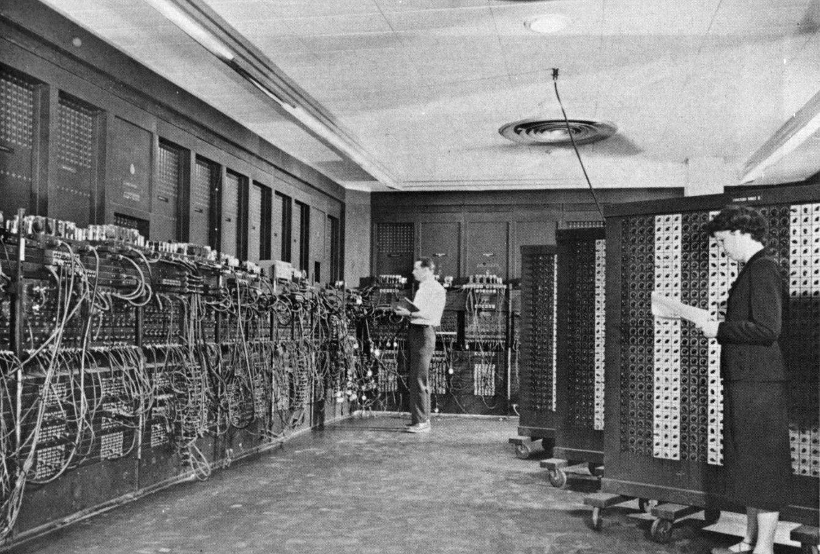
ENIAC (U.Penn., 1946) First Electronic General-Purpose Computer
Blazingly fast (multiply in 2.8ms!)
10 decimal digits x 10 decimal digits
But needed 2-3 days to setup new program, as programmed with patch cords and switches
Notes:
-Electronic Numerical Integrator and Computer
-Digital (electronic), capable of being reprogrammed to solve a variety of mathematical problems
-Dev began at the end of WWII, was designed and primarily used to calculate artillery firing tables for the US Army’s
-Very slow to program
-Story about 2 architects who designed it and Von Neumann, how it led to EDSAC
-Slow program entry, I/O

Slide 5
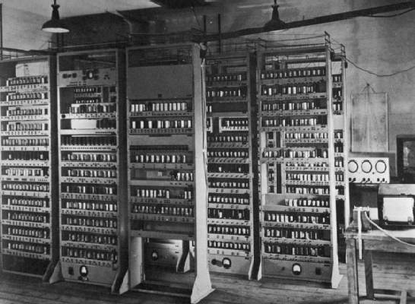
EDSAC (Cambridge, 1949) First General Stored-Program Computer
Programs held as numbers in memory
35-bit binary 2’s complement words
Notes:
Programming EDSAC

Slide 6
Components of a Computer
Memory
Processor
Input
Enable?
Read/Write
Control
Program
Datapath
Address
Bytes
PC
Registers
Write Data
Data
Arithmetic & Logic Unit
(ALU)
ReadData
Output
Processor-Memory Interface
I/O-Memory Interfaces
Notes:
7:00

Slide 7
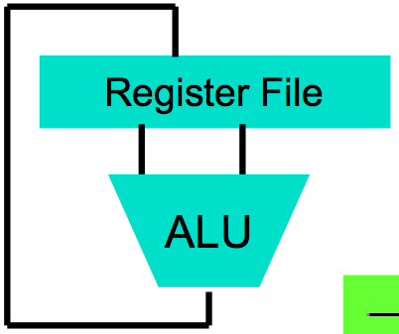
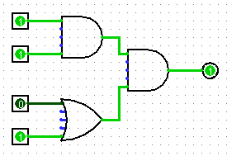
Great Idea: Levels of Representation/Interpretation
High Level Language Program (e.g., C)
temp = v[k];
v[k] = v[k+1];
v[k+1] = temp;
We are here!
Compiler
Anything can be represented as a number, i.e., data or instructions
lw $t0, 0($2)
lw $t1, 4($2)
sw $t1, 0($2)
sw $t0, 4($2)
Assembly Language Program (e.g., MIPS)
Assembler
0000 1001 1100 0110 1010 1111 0101 1000
1010 1111 0101 1000 0000 1001 1100 0110
1100 0110 1010 1111 0101 1000 0000 1001
0101 1000 0000 1001 1100 0110 1010 1111
Machine Language Program (MIPS)
Machine Interpretation
Hardware Architecture Description (e.g., block diagrams)
Architecture Implementation
Logic Circuit Description (Circuit Schematic Diagrams)
Notes:
9:00
-Programming EDSAC in binary

Slide 8
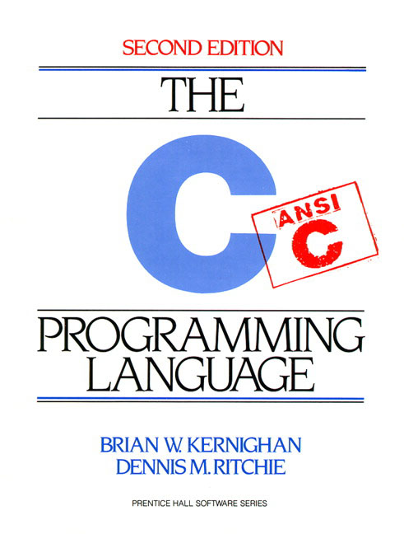
Introduction to C “The Universal Assembly Language”
“Some” experience is required before CS61C
C++ or Java OK
Class pre-req included classes teaching Java
Python used in two labs
C used for everything else

Slide 9
Language Poll!
Please raise hand for first one of following you can say yes to
☐
I have programmed in C, C++, C#, or Objective-C
☐
I have programmed in Java
I have programmed in FORTRAN, Cobol, Algol-68, Ada, Pascal, or Basic
☐
☐
None of the above

Slide 10
Intro to C
C is not a “very high-level” language, nor a “big” one, and is not specialized to any particular area of application. But its absence of restrictions and its generality make it more convenient and effective for many tasks than supposedly more powerful languages.
Kernighan and Ritchie
Enabled first operating system not written in assembly language: UNIX - A portable OS!

Slide 11
Intro to C
Why C?: we can write programs that allow us to exploit underlying features of the architecture – memory management, special instructions, parallelism
C and derivatives (C++/Obj-C/C#) still one of the most popular application programming languages after >40 years!

Slide 12
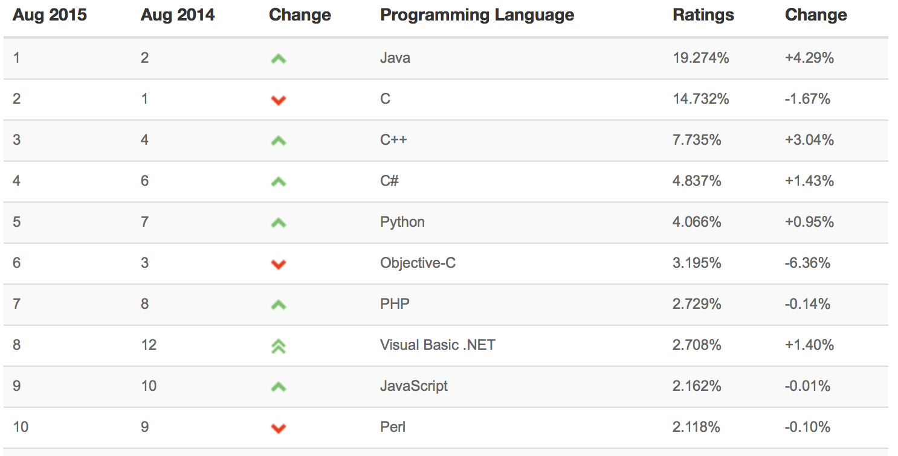
TIOBE Index of Language Popularity
The ratings are based on the number of skilled engineers world-wide, courses and third party vendors.
http://www.tiobe.com
Notes:
http://www.tiobe.com/index.php/content/paperinfo/tpci/index.html

Slide 13
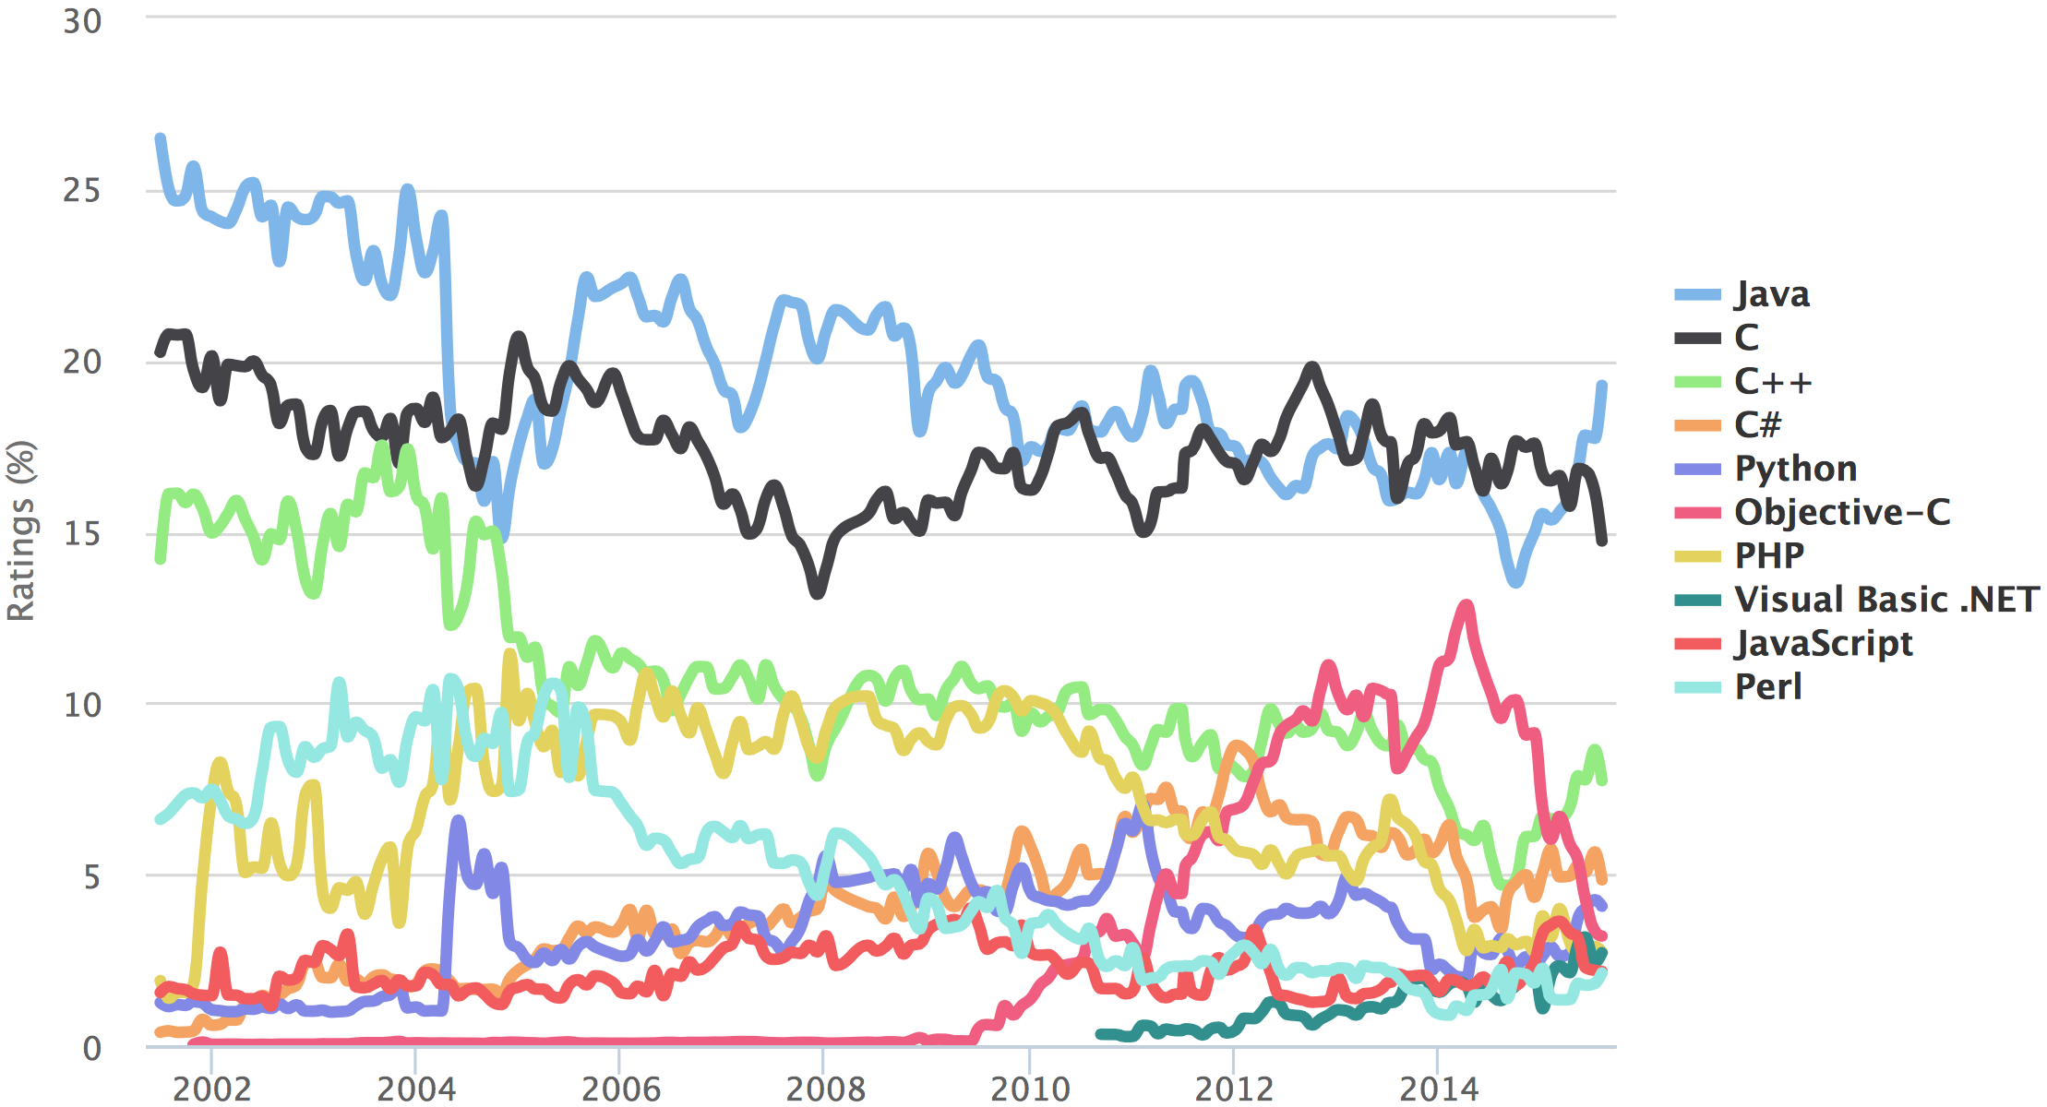
TIOBE Programming Community Index

Slide 14
Disclaimer
You will not learn how to fully code in C in these lectures! You’ll still need your C reference for this course
K&R is a must-have
Check online for more sources
“JAVA in a Nutshell,” O’Reilly
Chapter 2, “How Java Differs from C”
http://oreilly.com/catalog/javanut/excerpt/index.html
Brian Harvey’s helpful transition notes
On CS61C class website: pages 3-19
http://inst.eecs.berkeley.edu/~cs61c/resources/HarveyNotesC1-3.pdf
Key C concepts: Pointers, Arrays, Implications for Memory management

Slide 15
Compilation: Overview
C compilers map C programs into architecture-specific machine code (string of 1s and 0s)
Unlike Java, which converts to architecture-independent bytecode
Unlike Python environments, which interpret the code
These differ mainly in exactly when your program is converted to low-level machine instructions (“levels of interpretation”)
For C, generally a two part process of compiling .c files to .o files, then linking the .o files into executables;
Assembling is also done (but is hidden, i.e., done automatically, by default); we’ll talk about that later

Slide 16
C Compilation Simplified Overview (more later in course)
foo.c
bar.c
C source files (text)
Compiler
Compiler
Compiler/assembler combined here
foo.o
bar.o
Machine code object files
Linker
lib.o
Pre-built object file libraries
a.out
Machine code executable file

Slide 17
Compilation: Advantages
Excellent run-time performance: generally much faster than Scheme or Java for comparable code (because it optimizes for a given architecture)
Reasonable compilation time: enhancements in compilation procedure (Makefiles) allow only modified files to be recompiled

Slide 18
Compilation: Disadvantages
Compiled files, including the executable, are architecture-specific, depending on processor type (e.g., MIPS vs. RISC-V) and the operating system (e.g., Windows vs. Linux)
Executable must be rebuilt on each new system
I.e., “porting your code” to a new architecture
“Change → Compile → Run [repeat]” iteration cycle can be slow during development
but Make tool only rebuilds changed pieces, and can do compiles in parallel (linker is sequential though -> Amdahl’s Law)
Notes:
28:07

Slide 19
C Pre-Processor (CPP)
foo.c
foo.i
Compiler
CPP
C source files first pass through macro processor, CPP, before compiler sees code
CPP replaces comments with a single space
CPP commands begin with “#”
#include “file.h” /* Inserts file.h into output */
#include <stdio.h> /* Looks for file in standard location */
#define M_PI (3.14159) /* Define constant */
#if/#endif /* Conditional inclusion of text */
Use –save-temps option to gcc to see result of preprocessing
Full documentation at: http://gcc.gnu.org/onlinedocs/cpp/
Notes:
show this on term

Slide 20
Agenda
Compile vs. Interpret
C vs. Java vs. Python
Administrivia
Quick Start Introduction to C
News/Technology Break
Pointers
And in Conclusion, …

Slide 21
C vs. Java
 | C | Java
Type of Language | Function Oriented | Object Oriented
Program-ming Unit | Function | Class = Abstract Data Type
Compilation | gcc hello.c creates machine language code | javac Hello.java creates Java virtual machine language bytecode
Execution | a.out loads and executes program | java Hello interprets bytecodes
hello, world | #include<stdio.h> int main(void) { printf("Hello\n"); return 0; } | public class HelloWorld { public static void main(String[] args) { System.out.println("Hello"); } }
Storage | Manual (malloc, free) | Automatic (garbage collection)
From http://www.cs.princeton.edu/introcs/faq/c2java.html

Slide 22
C vs. Java
 | C | Java
Comments | /* … */ | /* … */ or // … end of line
Constants | #define, const | final
Preprocessor | Yes | No
Variable declaration | At beginning of a block | Before you use it
Variable naming conventions | sum_of_squares | sumOfSquares
Accessing a library | #include <stdio.h> | import java.io.File;
From http://www.cs.princeton.edu/introcs/faq/c2java.html

Slide 23
Typed Variables in C
int variable1 = 2;
float variable2 = 1.618;
char variable3 = 'A';
Must declare the type of data a variable will hold
Types can't change
Type Description Examples
int integer numbers, including negatives 0, 78, -1400
unsigned int integer numbers (no negatives) 0, 46, 900
float floating point decimal numbers 0.0, 1.618, -1.4
char single text character or symbol 'a', 'D', '?’
double greater precision/big FP number 10E100 long larger signed integer 6,000,000,000

Slide 24
Integers: Python vs. Java vs. C
Language | sizeof(int)
Python | >=32 bits (plain ints), infinite (long ints)
Java | 32 bits
C | Depends on computer; 16 or 32 or 64
C: int should be integer type that target processor works with most efficiently
Only guarantee: sizeof(long long) ≥ sizeof(long) ≥ sizeof(int) ≥ sizeof(short)
Also, short >= 16 bits, long >= 32 bits
All could be 64 bits
Notes:
C: The actual size of integer types varies by implementation. The only guarantee is that the long long is not smaller than long, which is not smaller than int, which is not smaller than short. Also, int should be the integer type that the target processor is most efficient working with. This allows great flexibility: for example, all types can be 64-bit.

Slide 25
Consts and Enums in C
Constant is assigned a typed value once in the declaration; value can't change during entire execution of program
const float golden_ratio = 1.618;
const int days_in_week = 7;
You can have a constant version of any of the standard C variable types
Enums: a group of related integer constants. Ex:
enum cardsuit {CLUBS,DIAMONDS,HEARTS,SPADES};
enum color {RED, GREEN, BLUE};

Slide 26
Clicker Test
Clicker participation starting on Thursday
No web-based clickers or phone apps
Participation only is recorded, not correctness of answers
Register on bCourses

Slide 27
Clicker Test
A: I have an iClicker
B: I don’t have an iClicker
C: I don’t have an iClicker
D: I don’t have an iClicker
E: I don’t have an iClicker

Slide 28
Compare “#define PI 3.14” and
“const float pi=3.14” – which is true?
A: Constants “PI” and “pi” have same type
B: Can assign to “PI” but not “pi”
C: Code runs at same speed using “PI” or “pi”
D: “pi” takes more memory space than “PI”
E: Both behave the same in all situations

Slide 29
Agenda
Compile vs. Interpret
C vs. Java vs. Python
Administrivia
Quick Start Introduction to C
News/Technology Break
Pointers
And in Conclusion, …

Slide 30
Administrivia
Enrollment: We plan to admit from the waitlist and concurrent enrollment. Details TBD.
Class website is up:
http://www-inst.eecs.berkeley.edu/~cs61c/fa15/
Labs start this week
Meet people in your lab, think about proj1 teams
HW0 out, Please sign up for EDX
Due: Sunday 9/06 @ 11:59:59pm
HW0-mini-bio posted on course website
Give paper copy to your TA in lab section this week
If you have lab on Monday, give it to your TA in section next week
Monday is Labor Day – if you have a Monday lab, attend any lab this week (Thur, Fri)
Get iClickers and register on bCourses! Participation points start Thursday.
Let us know about exam conflicts by the end of this week
Notes:
Maybe Break here
TAs will post mini-bios too

Slide 31
Agenda
Compile vs. Interpret
C vs. Java vs. Python
Administrivia
Quick Start Introduction to C
News/Technology Break
Pointers
And in Conclusion, …
Notes:
52:00

Slide 32
Typed Functions in C
int number_of_people ()
{
return 3;
}
float dollars_and_cents ()
{
return 10.33;
}
int sum ( int x, int y)
{
return x + y;
}
You have to declare the type of data you plan to return from a function
Return type can be any C variable type, and is placed to the left of the function name
You can also specify the return type as void
Just think of this as saying that no value will be returned
Also necessary to declare types for values passed into a function
Variables and functions MUST be declared before they are used

Slide 33
Structs in C
Structs are structured groups of variables, e.g.,
typedef struct {
int length_in_seconds;
int year_recorded;
} Song;
Song song1;
song1.length_in_seconds = 213;
song1.year_recorded = 1994;
Song song2;
song2.length_in_seconds = 248;
song2.year_recorded = 1988;
Dot notation: x.y = value

Slide 34
A First C Program: Hello World
Original C:
main()
{
printf("\nHello World\n");
}
ANSI Standard C:
#include <stdio.h>
int main(void)
{
printf("\nHello World\n");
return 0;
}

Slide 35
C Syntax: main
When C program starts
C executable a.out is loaded into memory by operating system (OS)
OS sets up stack, then calls into C runtime library,
Runtime 1st initializes memory and other libraries,
then calls your procedure named main ()
We’ll see how to retrieve command-line arguments in main() later…

Slide 36
A Second C Program: Compute Table of Sines
#include <stdio.h>
#include <math.h>
int main(void)
{
int angle_degree;
double angle_radian, pi, value;
/* Print a header */
printf("\nCompute a table of the sine function\n\n");
/* obtain pi once for all */
/* or just use pi = M_PI, where */
/* M_PI is defined in math.h */
pi = 4.0*atan(1.0);
printf("Value of PI = %f \n\n", pi);
printf("angle Sine \n");
angle_degree = 0;
/* initial angle value */
/* scan over angle */
while (angle_degree <= 360)
/* loop until angle_degree > 360 */
{
angle_radian = pi*angle_degree/180.0;
value = sin(angle_radian);
printf (" %3d %f \n ", angle_degree, value);
angle_degree = angle_degree + 10;
/* increment the loop index */
}
return 0;
}

Slide 37
Second C Program Sample Output
Compute a table of the sine function
Value of PI = 3.141593
angle Sine
0 0.000000
10 0.173648
20 0.342020
30 0.500000
40 0.642788
50 0.766044
60 0.866025
70 0.939693
80 0.984808
90 1.000000
100 0.984808
110 0.939693
120 0.866025
130 0.766044
140 0.642788
150 0.500000
160 0.342020
170 0.173648
180 0.000000
190 -0.173648
200 -0.342020
210 -0.500000
220 -0.642788
230 -0.766044
240 -0.866025
250 -0.939693
260 -0.984808
270 -1.000000
280 -0.984808
290 -0.939693
300 -0.866025
310 -0.766044
320 -0.642788
330 -0.500000
340 -0.342020
350 -0.173648
360 -0.000000

Slide 38
C Syntax: Variable Declarations
Similar to Java, but with a few minor but important differences
All variable declarations must appear before they are used (e.g., at the beginning of the block)
A variable may be initialized in its declaration; if not, it holds garbage!
Examples of declarations:
Correct: {
int a = 0, b = 10;
...
Incorrect: for (int i = 0; i < 10; i++)
}
Newer C standards are more flexible about this, more later

Slide 39
C Syntax : Control Flow (1/2)
Within a function, remarkably close to Java constructs (shows Java’s legacy) in terms of control flow
if-else
if (expression) statement
if (expression) statement1
else statement2
while
while (expression)
statement
do
statement
while (expression);

Slide 40
C Syntax : Control Flow (2/2)
for
for (initialize; check; update) statement
switch
switch (expression){
case const1: statements
case const2: statements
default: statements
}
break

Slide 41
C Syntax: True or False
What evaluates to FALSE in C?
0 (integer)
NULL (a special kind of pointer: more on this later)
No explicit Boolean type
What evaluates to TRUE in C?
Anything that isn’t false is true
Same idea as in Python: only 0s or empty sequences are false, anything else is true!

Slide 42
C and Java operators nearly identical
arithmetic: +, -, *, /, %
assignment: =
augmented assignment: +=, -=, *=, /=, %=, &=, |=, ^=, <<=, >>=
bitwise logic: ~, &, |, ^
bitwise shifts: <<, >>
boolean logic: !, &&, ||
equality testing: ==, !=
subexpression grouping: ( )
order relations: <, <=, >, >=
increment and decrement: ++ and --
member selection: ., ->
conditional evaluation: ? :

Slide 43
Agenda
Compile vs. Interpret
C vs. Java vs. Python
Administrivia
Quick Start Introduction to C
News/Technology Break
Pointers
And in Conclusion, …

Slide 44
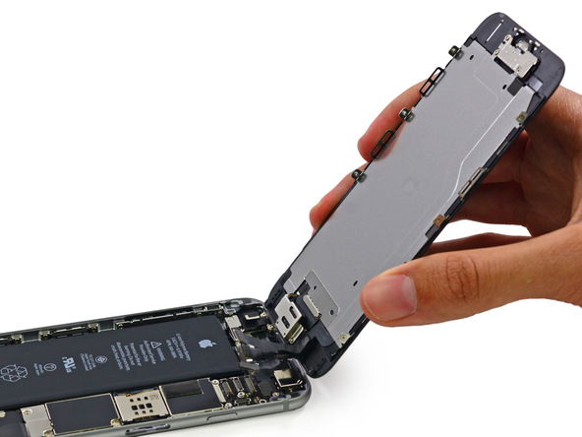
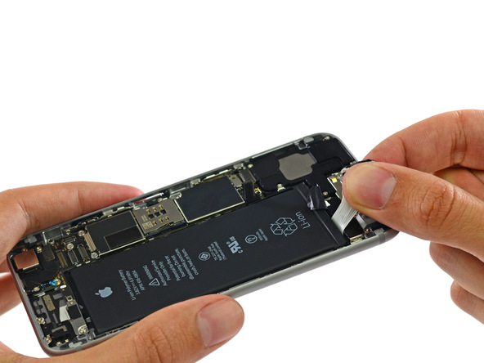
iPhone6 Teardown fixit.com

Slide 45
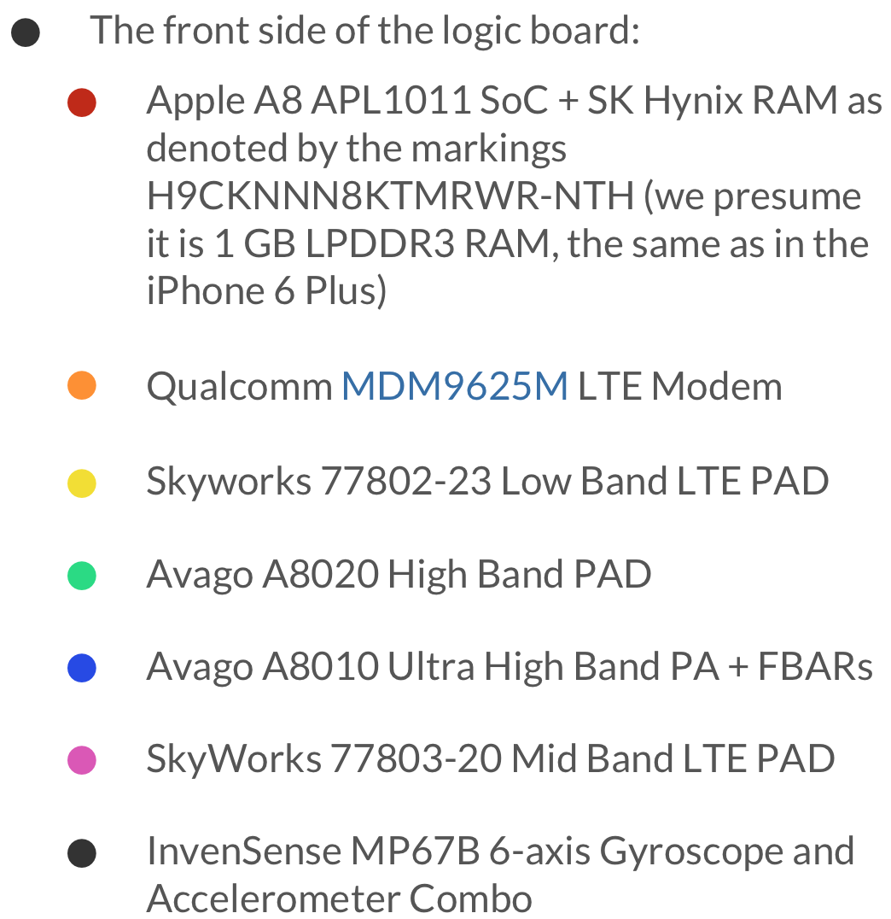
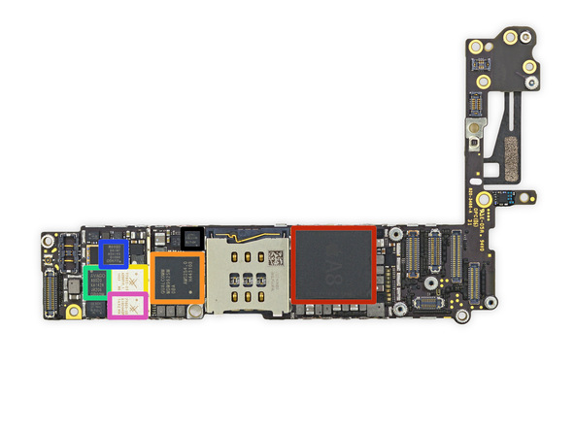
The A8 is manufactured on a 20 nm process by TSMC. It contains 2 billion transistors. Its physical size is 89 mm^2. ] It has 1 GB of LPDDR3 RAM included in the package. It is dual core, and has a frequency of 1.38 GHz.

Slide 46
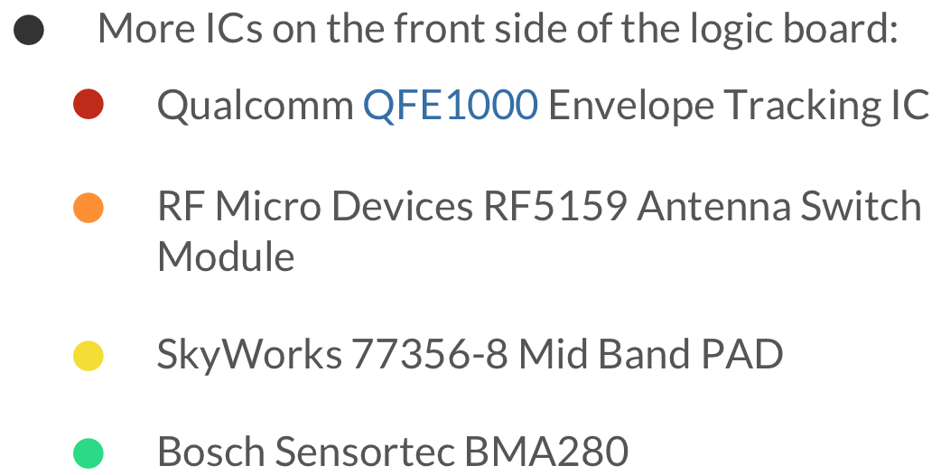
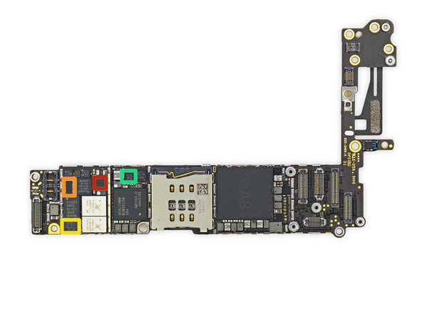

Slide 47
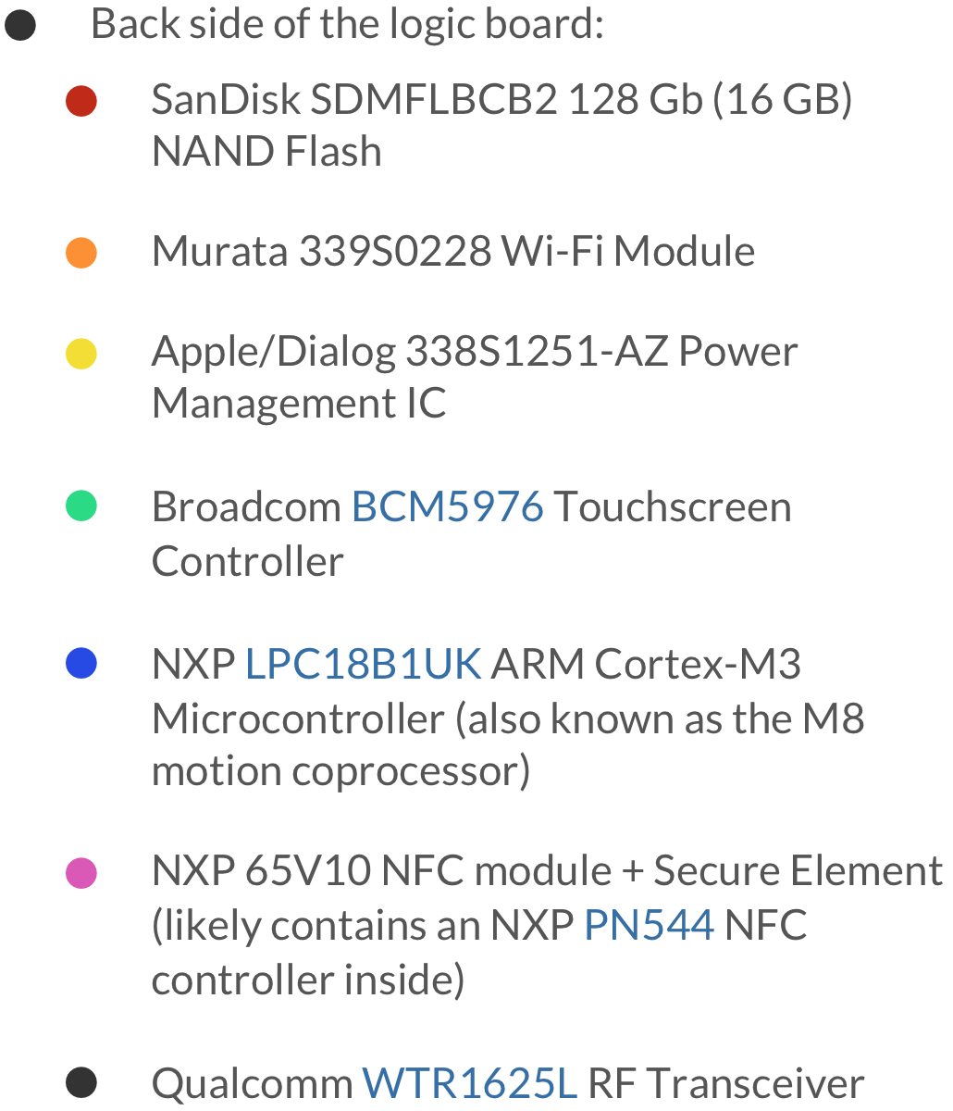
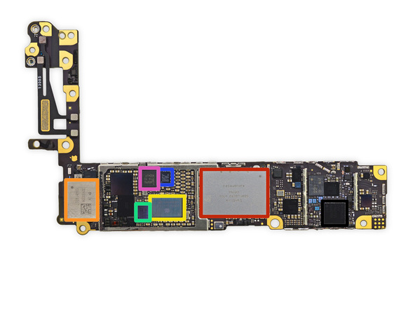

Slide 48
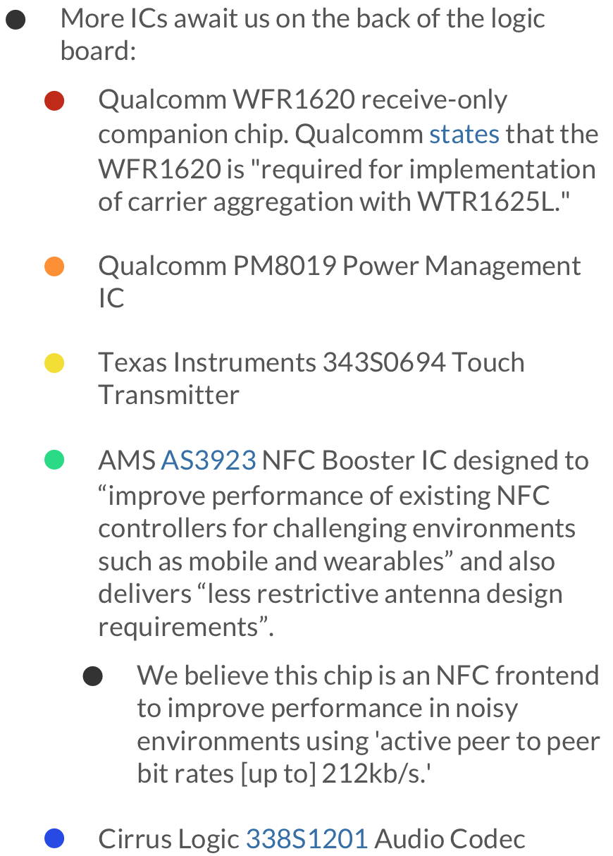
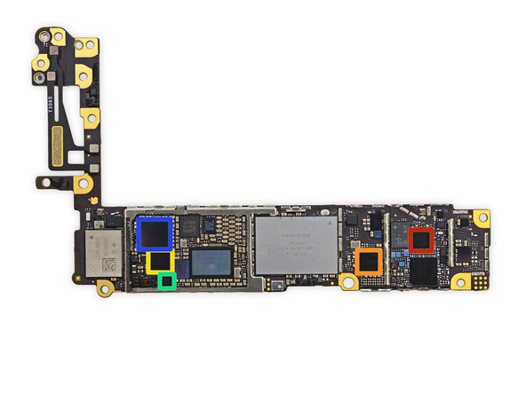

Slide 49
Break

Slide 50
Agenda
Compile vs. Interpret
C vs. Java vs. Python
Administrivia
Quick Start Introduction to C
News/Technology Break
Pointers
And in Conclusion, …

Slide 51
Address vs. Value
Consider memory to be a single huge array
Each cell of the array has an address associated with it
Each cell also stores some value
For addresses do we use signed or unsigned numbers? Negative address?!
Don’t confuse the address referring to a memory location with the value stored there
...
101 102 103 104 105 ...
...
23
42

Slide 52
Pointers
An address refers to a particular memory location; e.g., it points to a memory location
Pointer: A variable that contains the address of a variable
Location (address)
...
101 102 103 104 105 ...
...
23
42
104
x
y
p
name

Slide 53
Pointer Syntax
int *x;
Tells compiler that variable x is address of an int
x = &y;
Tells compiler to assign address of y to x
& called the “address operator” in this context
z = *x;
Tells compiler to assign value at address in x to z
* called the “dereference operator” in this context

Slide 54
Creating and Using Pointers
How to create a pointer:
& operator: get address of a variable
int *p, x;
Note the “*” gets used 2 different ways in this example. In the declaration to indicate that p is going to be a pointer, and in the printf to get the value pointed to by p.
p
?
x
?
x = 3;
p
?
x
3
p = &x;
p
x
3
How get a value pointed to?
“*” (dereference operator): get the value that the pointer points to
printf(“p points to %d\n”,*p);

Slide 55
Using Pointer for Writes
How to change a variable pointed to?
Use the dereference operator * on left of assignment operator =
p
x
3
*p = 5;
p
x
5

Slide 56
Pointers and Parameter Passing
Java and C pass parameters “by value”
Procedure/function/method gets a copy of the parameter, so changing the copy cannot change the original
void add_one (int x) { x = x + 1; }
int y = 3;
add_one(y);
y remains equal to 3

Slide 57
Pointers and Parameter Passing
How can we get a function to change the value held in a variable?
void add_one (int *p) { *p = *p + 1; }
int y = 3;
add_one(&y);
y is now equal to 4

Slide 58
Types of Pointers
Pointers are used to point to any kind of data (int, char, a struct, etc.)
Normally a pointer only points to one type (int, char, a struct, etc.).
void * is a type that can point to anything (generic pointer)
Use void * sparingly to help avoid program bugs, and security issues, and other bad things!

Slide 59
More C Pointer Dangers
Declaring a pointer just allocates space to hold the pointer – it does not allocate the thing being pointed to!
Local variables in C are not initialized, they may contain anything (aka “garbage”)
What does the following code do?
void f()
{
int *ptr;
*ptr = 5;
}

Slide 60
Pointers and Structures
typedef struct {
int x;
int y;
} Point;
Point p1;
Point p2;
Point *paddr;
/* dot notation */
int h = p1.x;
p2.y = p1.y;
/* arrow notation */
int h = paddr->x;
int h = (*paddr).x;
/* This works too */
p1 = p2;

Slide 61
Pointers in C
Why use pointers?
If we want to pass a large struct or array, it’s easier / faster / etc. to pass a pointer than the whole thing
In general, pointers allow cleaner, more compact code
So what are the drawbacks?
Pointers are probably the single largest source of bugs in C, so be careful anytime you deal with them
Most problematic with dynamic memory management—coming up next week
Dangling references and memory leaks

Slide 62
Why Pointers in C?
At time C was invented (early 1970s), compilers often didn’t produce efficient code
Computers 25,000 times faster today, compilers better
C designed to let programmer say what they want code to do without compiler getting in way
Even give compilers hints which registers to use!
Today’s compilers produce much better code, so may not need to use pointers in application code
Low-level system code still needs low-level access via pointers

Slide 63
Video: Fun with Pointers
https://www.youtube.com/watch?v=6pmWojisM_E

Slide 64
Agenda
Compile vs. Interpret
C vs. Java vs. Python
Administrivia
Quick Start Introduction to C
News/Technology Break
Pointers
And in Conclusion, …

Slide 65
And In Conclusion, …
All data is in memory
Each memory location has an address to use to refer to it and a value stored in it
Pointer is a C version (abstraction) of a data address
* “follows” a pointer to its value
& gets the address of a value
Arrays and strings are implemented as variations on pointers
C is an efficient language, but leaves safety to the programmer
Variables not automatically initialized
Use pointers with care: they are a common source of bugs in programs

