Slide 1
CS 61C: Great Ideas in Computer Architecture Intro to Assembly Language, MIPS Intro
Instructors:
John Wawrzynek & Vladimir Stojanovic
http://inst.eecs.Berkeley.edu/~cs61c/fa15

Slide 2
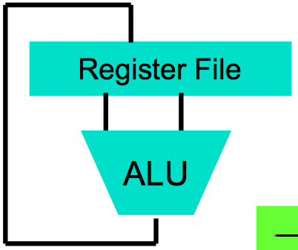
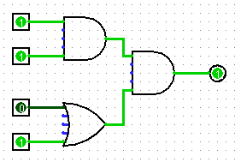
Levels of Representation/Interpretation
High Level Language Program (e.g., C)
temp = v[k];
v[k] = v[k+1];
v[k+1] = temp;
Compiler
Anything can be represented as a number, i.e., data or instructions
lw $t0, 0($2)
lw $t1, 4($2)
sw $t1, 0($2)
sw $t0, 4($2)
Assembly Language Program (e.g., MIPS)
Assembler
0000 1001 1100 0110 1010 1111 0101 1000
1010 1111 0101 1000 0000 1001 1100 0110
1100 0110 1010 1111 0101 1000 0000 1001
0101 1000 0000 1001 1100 0110 1010 1111
Machine Language Program (MIPS)
Machine Interpretation
Hardware Architecture Description (e.g., block diagrams)
Architecture Implementation
Logic Circuit Description (Circuit Schematic Diagrams)

Slide 3
Assembly Language
Basic job of a CPU: execute lots of instructions.
Instructions are the primitive operations that the CPU may execute.
Different CPUs implement different sets of instructions. The set of instructions a particular CPU implements is an Instruction Set Architecture (ISA).
Examples: ARM, Intel x86, MIPS, RISC-V, IBM/Motorola PowerPC (old Mac), Intel IA64, ...

Slide 4
Instruction Set Architectures
Early trend was to add more and more instructions to new CPUs to do elaborate operations
VAX architecture had an instruction to multiply polynomials!
RISC philosophy (Cocke IBM, Patterson, Hennessy, 1980s) – Reduced Instruction Set Computing
Keep the instruction set small and simple, makes it easier to build fast hardware.
Let software do complicated operations by composing simpler ones.

Slide 5
MIPS Architecture
MIPS – semiconductor company that built one of the first commercial RISC architectures
We will study the MIPS architecture in some detail in this class (also used in upper division courses CS 151, 152, 162, 164)
Why MIPS instead of Intel x86?
MIPS is simple, elegant. Don’t want to get bogged down in gritty details.
MIPS widely used in embedded apps, x86 little used in embedded, and more embedded computers than PCs

Slide 6
Assembly Variables: Registers
Unlike HLL like C or Java, assembly cannot use variables
Why not? Keep Hardware Simple
Assembly Operands are registers
Limited number of special locations built directly into the hardware
Operations can only be performed on these!
Benefit: Since registers are directly in hardware, they are very fast (faster than 1 ns - light travels 30cm in 1 ns!!! )

Slide 7
Number of MIPS Registers
Drawback: Since registers are in hardware, there are a predetermined number of them
Solution: MIPS code must be very carefully put together to efficiently use registers
32 registers in MIPS
Why 32? Smaller is faster, but too small is bad. Goldilocks problem.
Each MIPS register is 32 bits wide
Groups of 32 bits called a word in MIPS

Slide 8
Names of MIPS Registers
Registers are numbered from 0 to 31
Each register can be referred to by number or name
Number references:
$0, $1, $2, … $30, $31
For now:
$16 - $23➔ $s0 - $s7 (correspond to C variables)
$8 - $15 ➔ $t0 - $t7 (correspond to temporary variables)
Later will explain other 16 register names
In general, use names to make your code more readable

Slide 9
C, Java variables vs. registers
In C (and most High Level Languages) variables declared first and given a type
Example: int fahr, celsius; char a, b, c, d, e;
Each variable can ONLY represent a value of the type it was declared as (cannot mix and match int and char variables).
In Assembly Language, registers have no type; operation determines how register contents are treated

Slide 10
Addition and Subtraction of Integers
Addition in Assembly
Example: add $s0,$s1,$s2 (in MIPS)
Equivalent to: a = b + c (in C)
where C variables ⇔ MIPS registers are:
a ⇔ $s0, b ⇔ $s1, c ⇔ $s2
Subtraction in Assembly
Example: sub $s3,$s4,$s5 (in MIPS)
Equivalent to: d = e - f (in C)
where C variables ⇔ MIPS registers are: d ⇔ $s3, e ⇔ $s4, f ⇔ $s5

Slide 11
Addition and Subtraction of Integers Example 1
How to do the following C statement?
a = b + c + d - e;
Break into multiple instructions
add $t0, $s1, $s2 # temp = b + c
add $t0, $t0, $s3 # temp = temp + d
sub $s0, $t0, $s4 # a = temp - e
A single line of C may break up into several lines of MIPS.
Notice the use of temporary registers – don’t want to modify the variable registers $s
Everything after the hash mark on each line is ignored (comments)

Slide 12
Immediates
Immediates are numerical constants
They appear often in code, so there are special instructions for them
Add Immediate:
addi $s0,$s1,-10 (in MIPS)
f = g - 10 (in C)
where MIPS registers $s0,$s1 are associated with C variables f, g
Syntax similar to add instruction, except that last argument is a number instead of a register
add $s0,$s1,$zero (in MIPS)
f = g (in C)

Slide 13
Overflow in Arithmetic
Reminder: Overflow occurs when there is a “mistake” in arithmetic due to the limited precision in computers.
Example (4-bit unsigned numbers):
15 1111
+ 3 + 0011
18 10010
But we don’t have room for 5-bit solution, so the solution would be 0010, which is +2, and “wrong”.

Slide 14
Overflow handling in MIPS
Some languages detect overflow (Ada), some don’t (most C implementations)
MIPS solution is 2 kinds of arithmetic instructions:
These cause overflow to be detected
add (add)
add immediate (addi)
subtract (sub)
These do not cause overflow detection
add unsigned (addu)
add immediate unsigned (addiu)
subtract unsigned (subu)
Compiler selects appropriate arithmetic
MIPS C compilers produce addu, addiu, subu

Slide 15
Data Transfer: Load from and Store to memory
Memory
Processor
Input
Enable?
Read/Write
Control
Program
Datapath
Address
Bytes
PC
Write Data = Store to memory
Registers
Data
Arithmetic & Logic Unit
(ALU)
Read Data = Load from
memory
Output
Processor-Memory Interface
I/O-Memory Interfaces

Slide 16
Memory Addresses are in Bytes
Lots of data is smaller than 32 bits, but rarely smaller than 8 bits – works fine if everything is a multiple of 8 bits
8 bit chunk is called a byte
(1 word = 4 bytes)
Memory addresses are really in bytes, not words
Word addresses are 4 bytes apart
Word address is same as address of
leftmost byte – most significant byte (i.e. Big-endian convention)
Most significant byte in a word
…
…
…
…
…
12
13
14
15
3
8
9
10
11
2
4
5
6
7
1
0
1
2
3
0

Slide 17
Transfer from Memory to Register
C code
int A[100];
g = h + A[3];
Using Load Word (lw) in MIPS:
lw $t0,12($s3) # Temp reg $t0 gets A[3]
add $s1,$s2,$t0 # g = h + A[3]
Note: $s3 – base register (pointer)
12 – offset in bytes
Offset must be a constant known at assembly time
Notes:
80 – 5 (Clicker) – 3 (News/Administrativia) = 72 (36 slides max)
Clicker at 20 (half+)

Slide 18
Transfer from Register to Memory
C code
int A[100];
A[10] = h + A[3];
Using Store Word (sw) in MIPS:
lw $t0,12($s3) # Temp reg $t0 gets A[3]
add $t0,$s2,$t0 # Temp reg $t0 gets h + A[3]
sw $t0, 40($s3) # A[10] = h + A[3]
Note: $s3 – base register (pointer)
12,40 – offsets in bytes
$s3+12 and $s3+40 must be multiples of 4
Notes:
80 – 5 (Clicker) – 3 (News/Administrativia) = 72 (36 slides max)
Clicker at 20 (half+)

Slide 19
Loading and Storing bytes
In addition to word data transfers (lw, sw), MIPS has byte data transfers:
load byte: lb
store byte: sb
Same format as lw, sw
E.g., lb $s0, 3($s1)
contents of memory location with address = sum of “3” + contents of register $s1 is copied to the low byte position of register $s0.
zzz zzzz
$s0:
xxxx xxxx xxxx xxxx xxxx xxxx
x
byte loaded
…is copied to “sign-extend”
This bit

Slide 20
Speed of Registers vs. Memory
Given that
Registers: 32 words (128 Bytes)
Memory: Billions of bytes (2 GB to 8 GB on laptop)
and the RISC principle is…
Smaller is faster
How much faster are registers than memory??
About 100-500 times faster!
in terms of latency of one access

Slide 21
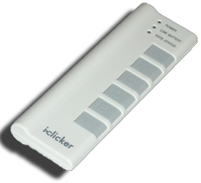
How many hours h on Homework 0?
A: 0 ≤ h < 5
B: 5 ≤ h < 10
C: 10 ≤ h < 15
D: 15 ≤ h < 20
E: 20 ≤ h

Slide 22
Clickers/Peer Instruction
We want to translate *x = *y +1 into MIPS
(x, y pointers stored in: $s0 $s1)
A: addi $s0,$s1,1
B: lw $s0,1($s1)
sw $s1,0($s0)
C: lw $t0,0($s1)
addi $t0,$t0,1
sw $t0,0($s0)
D: sw $t0,0($s1)
addi $t0,$t0,1
lw $t0,0($s0)
E: lw $s0,1($t0)
sw $s1,0($t0)
Notes:
Answer: [correct=c]
We must first load the contents of y’s pointee into a temp variable [$t0], then add 1, and then we have to store $t0 back into x’s pointee

Slide 23
MIPS Logical Instructions
Useful to operate on fields of bits within a word
e.g., characters within a word (8 bits)
Operations to pack /unpack bits into words
Called logical operations
Logical operations | C operators | Java operators | MIPS instructions
Bit-by-bit AND | & | & | and
Bit-by-bit OR | | | | | or
Bit-by-bit NOT | ~ | ~ | not
Shift left | << | << | sll
Shift right | >> | >>> | srl

Slide 24
Logic Shifting
Shift Left: sll $s1,$s2,2 #s1=s2<<2
Store in $s1 the value from $s2 shifted 2 bits to the left (they fall off end), inserting 0’s on right; << in C.
Before: 0000 0002_{hex} 0000 0000 0000 0000 0000 0000 0000 0010_{two}
After: 0000 0008_{hex} 0000 0000 0000 0000 0000 0000 0000 1000_{two}
What arithmetic effect does shift left have?
Shift Right: srl is opposite shift; >>

Slide 25
Arithmetic Shifting
Shift right arithmetic moves n bits to the right (insert high order sign bit into empty bits)
For example, if register $s0 contained
1111 1111 1111 1111 1111 1111 1110 0111_{two}= -25_{ten}
If executed sra $s0, $s0, 4, result is:
1111 1111 1111 1111 1111 1111 1111 1110_{two}= -2_{ten}
Unfortunately, this is NOT same as dividing by 2^{n}
Fails for odd negative numbers
C arithmetic semantics is that division should round towards 0
Notes:
\

Slide 26
Computer Decision Making
Based on computation, do something different
In programming languages: if-statement
MIPS: if-statement instruction is
beq register1,register2,L1
means: go to statement labeled L1 if (value in register1) == (value in register2)
….otherwise, go to next statement
beq stands for branch if equal
Other instruction: bne for branch if not equal

Slide 27
Types of Branches
Branch – change of control flow
Conditional Branch – change control flow depending on outcome of comparison
branch if equal (beq) or branch if not equal (bne)
Unconditional Branch – always branch
a MIPS instruction for this: jump (j)

Slide 28
Example if Statement
Assuming translations below, compile if block
f → $s0 g → $s1 h → $s2
i → $s3 j → $s4
if (i == j) bne $s3,$s4,Exit
f = g + h; add $s0,$s1,$s2
Exit:
May need to negate branch condition

Slide 29
Example if-else Statement
Assuming translations below, compile
f → $s0 g → $s1 h → $s2
i → $s3 j → $s4
if (i == j) bne $s3,$s4,Else
f = g + h; add $s0,$s1,$s2
else j Exit
f = g – h; Else: sub $s0,$s1,$s2
Exit:

Slide 30
Administrivia
Hopefully everyone turned-in HW0
Project 1 out
Make sure you test your code on hive machines, that’s where we’ll grade them
Guerrilla sections starting this Saturday
Saturdays and Tuesdays, every other week
Schedule on the course website

Slide 31
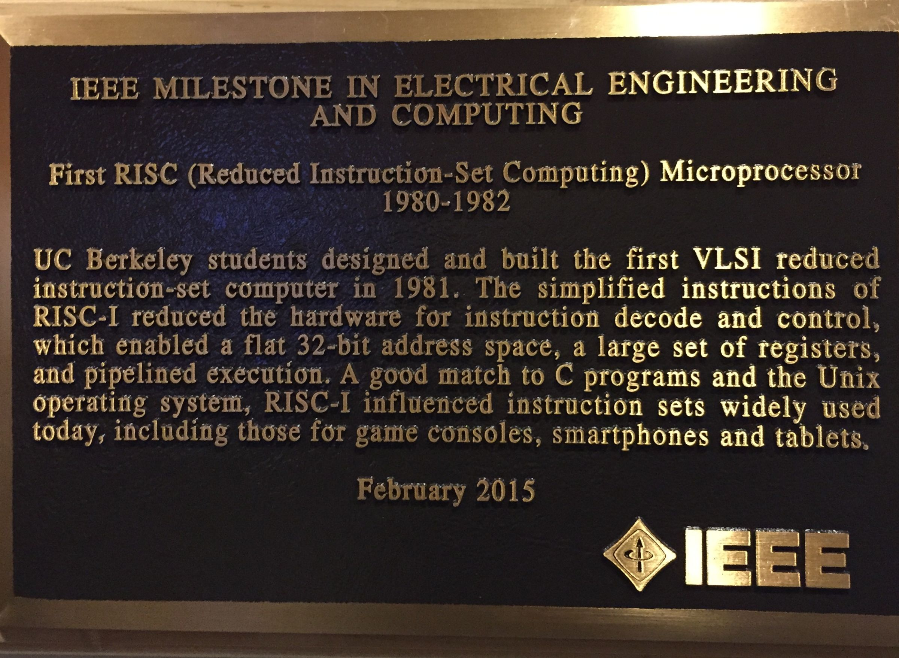
CS61C in the News pt. 1

Slide 32
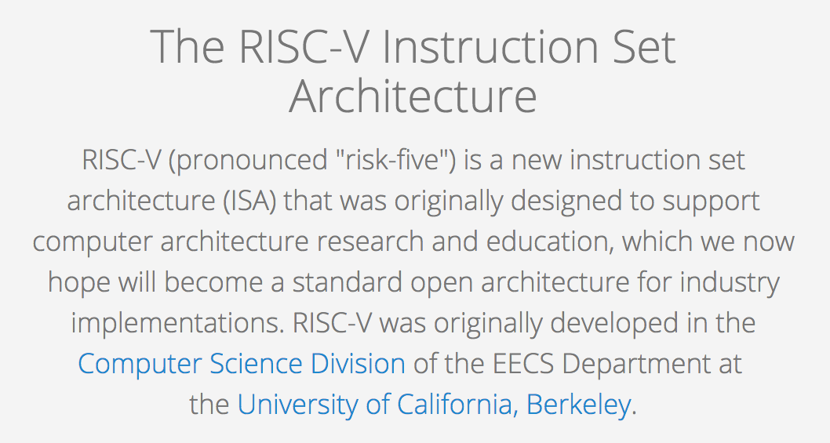
CS61C in the News pt. 2
EECS151/251A, CS152, CS250, CS252 use RISC-V
Notes:
ARM license fees

Slide 33
Inequalities in MIPS
Until now, we’ve only tested equalities (== and != in C). General programs need to test < and > as well.
Introduce MIPS Inequality Instruction:
“Set on Less Than”
Syntax: slt reg1,reg2,reg3
Meaning: if (reg2 < reg3) reg1 = 1; else reg1 = 0;
“set” means “change to 1”, “reset” means “change to 0”.

Slide 34
Inequalities in MIPS Cont.
How do we use this? Compile by hand: if (g < h) goto Less; #g:$s0, h:$s1
Answer: compiled MIPS code…
slt $t0,$s0,$s1 # $t0 = 1 if g<h bne $t0,$zero,Less # if $t0!=0 goto Less
Register $zero always contains the value 0, so bne and beq often use it for comparison after an slt instruction
sltu treats registers as unsigned

Slide 35
Immediates in Inequalities
slti an immediate version of slt to test against constants
Loop: . . . slti $t0,$s0,1 # $t0 = 1 if # $s0<1 beq $t0,$zero,Loop # goto Loop # if $t0==0 # (if ($s0>=1))

Slide 36
Loops in C/Assembly
Simple loop in C; A[] is an array of ints
do { g = g + A[i]; i = i + j; } while (i != h);
Use this mapping: g, h, i, j, &A[0] $s1, $s2, $s3, $s4, $s5
Loop: sll $t1,$s3,2 # $t1= 4*i addu $t1,$t1,$s5 # $t1=addr A+4i lw $t1,0($t1) # $t1=A[i] add $s1,$s1,$t1 # g=g+A[i] addu $s3,$s3,$s4 # i=i+j bne $s3,$s2,Loop # goto Loop # if i!=h

Slide 37
And In Conclusion …
Computer words and vocabulary are called instructions and instruction set respectively
MIPS is example RISC instruction set in this class
Rigid format: 1 operation, 2 source operands, 1 destination
add,sub,mul,div,and,or,sll,srl,sra
lw,sw,lb,sb to move data to/from registers from/to memory
beq, bne, j, slt, slti for decision/flow control
Simple mappings from arithmetic expressions, array access, if-then-else in C to MIPS instructions

