Slide 1
CS 61C: Great Ideas in Computer Architecture MIPS Instruction Formats
Instructors:
John Wawrzynek & Vladimir Stojanovic
http://inst.eecs.Berkeley.edu/~cs61c/fa15

Slide 2
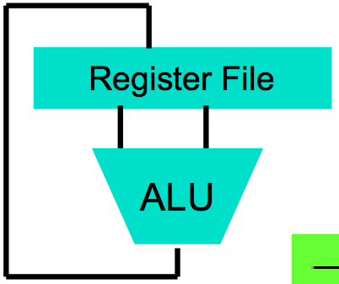
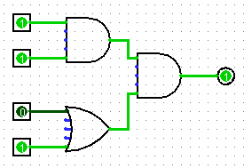
Levels of Representation/Interpretation
High Level Language Program (e.g., C)
temp = v[k];
v[k] = v[k+1];
v[k+1] = temp;
Compiler
Anything can be represented as a number, i.e., data or instructions
lw $t0, 0($2)
lw $t1, 4($2)
sw $t1, 0($2)
sw $t0, 4($2)
Assembly Language Program (e.g., MIPS)
Assembler
0000 1001 1100 0110 1010 1111 0101 1000
1010 1111 0101 1000 0000 1001 1100 0110
1100 0110 1010 1111 0101 1000 0000 1001
0101 1000 0000 1001 1100 0110 1010 1111
Machine Language Program (MIPS)
Machine Interpretation
Hardware Architecture Description (e.g., block diagrams)
Architecture Implementation
Logic Circuit Description (Circuit Schematic Diagrams)

Slide 3
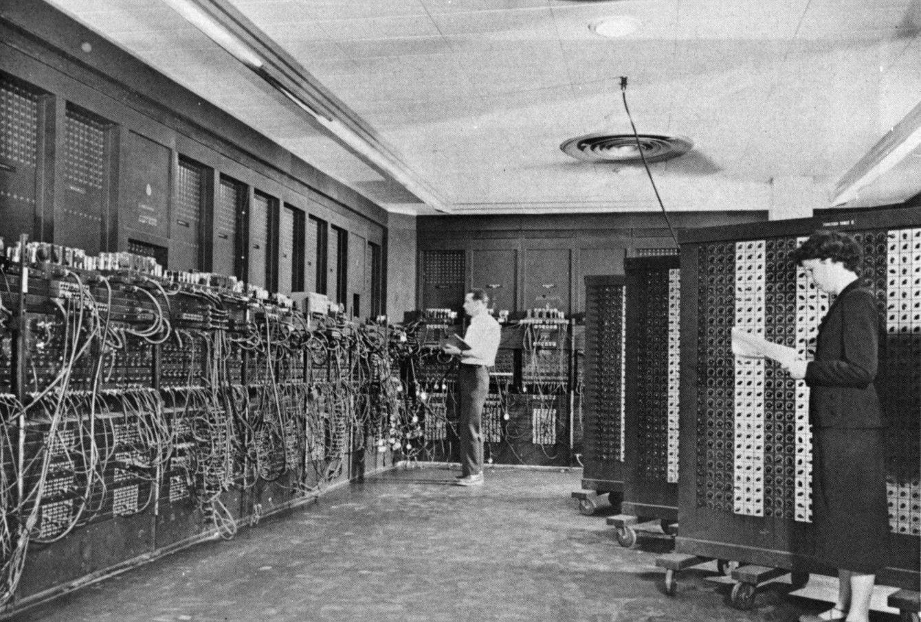
ENIAC (U.Penn., 1946) First Electronic General-Purpose Computer
Blazingly fast (multiply in 2.8ms!)
10 decimal digits x 10 decimal digits
But needed 2-3 days to setup new program, as programmed with patch cords and switches
Notes:
-Electronic Numerical Integrator and Computer
-Digital (electronic), capable of being reprogrammed to solve a variety of mathematical problems
-Dev began at the end of WWII, was designed and primarily used to calculate artillery firing tables for the US Army’s
-Very slow to program
-Story about 2 architects who designed it and Von Neumann, how it led to EDSAC
-Slow program entry, I/O

Slide 4
Big Idea: Stored-Program Computer
First Draft of a Report on the EDVAC
^{by}
^{John von Neumann}
^{Contract No. W–670–ORD–4926}
^{Between the}
United States Army Ordnance Department and the
^{University of Pennsylvania}
Moore School of Electrical Engineering
^{University of Pennsylvania}
^{June 30, 1945}
Instructions are represented as bit patterns - can think of these as numbers
Therefore, entire programs can be stored in memory to be read or written just like data
Can reprogram quickly (seconds), don’t have to rewire computer (days)
Known as the “von Neumann” computers after widely distributed tech report on EDVAC project
Wrote-up discussions of Eckert and Mauchly
Anticipated earlier by Turing and Zuse

Slide 5
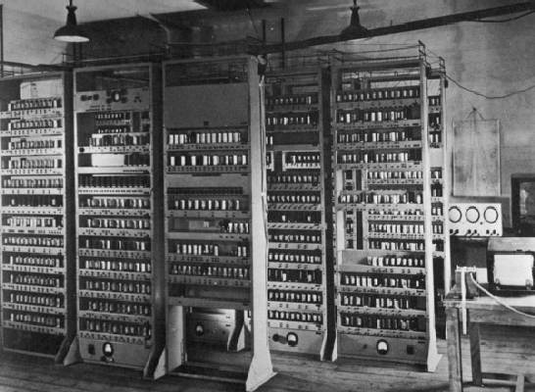
EDSAC (Cambridge, 1949) First General Stored-Program Computer
Programs held as numbers in memory
35-bit binary 2’s complement words
Notes:
Programming EDSAC

Slide 6
Consequence #1: Everything Addressed
Since all instructions and data are stored in memory, everything has a memory address: instructions, data words
both branches and jumps use these
C pointers are just memory addresses: they can point to anything in memory
Unconstrained use of addresses can lead to nasty bugs; up to you in C; limited in Java by language design
One register keeps address of instruction being executed: “Program Counter” (PC)
Basically a pointer to memory: Intel calls it Instruction Pointer (a better name)

Slide 7
Consequence #2: Binary Compatibility
Programs are distributed in binary form
Programs bound to specific instruction set
Different version for Macintoshes and PCs
New machines want to run old programs (“binaries”) as well as programs compiled to new instructions
Leads to “backward-compatible” instruction set evolving over time
Selection of Intel 8086 in 1981 for 1st IBM PC is major reason latest PCs still use 80x86 instruction set; could still run program from 1981 PC today

Slide 8
Instructions as Numbers (1/2)
Currently all data we work with is in words (32-bit chunks):
Each register is a word.
lw and sw both access memory one word at a time.
So how do we represent instructions?
Remember: Computer only understands 1s and 0s, so “add $t0,$0,$0” is meaningless.
MIPS/RISC seeks simplicity: since data is in words, make instructions be fixed-size 32-bit words also

Slide 9
Instructions as Numbers (2/2)
One word is 32 bits, so divide instruction word into “fields”.
Each field tells processor something about instruction.
We could define different fields for each instruction, but MIPS seeks simplicity, so define 3 basic types of instruction formats:
R-format
I-format
J-format

Slide 10
Instruction Formats
I-format: used for instructions with immediates, lw and sw (since offset counts as an immediate), and branches (beq and bne)
(but not the shift instructions; later)
J-format: used for j and jal
R-format: used for all other instructions
It will soon become clear why the instructions have been partitioned in this way

Slide 11
R-Format Instructions (1/5)
Define “fields” of the following number of bits each: 6 + 5 + 5 + 5 + 5 + 6 = 32
For simplicity, each field has a name:
Important: On these slides and in book, each field is viewed as a 5- or 6-bit unsigned integer, not as part of a 32-bit integer
Consequence: 5-bit fields can represent any number 0-31, while 6-bit fields can represent any number 0-63
6
5
5
5
5
6
opcode
rs
rt
rd
shamt
funct

Slide 12
R-Format Instructions (2/5)
What do these field integer values tell us?
opcode: partially specifies what instruction it is
Note: This number is equal to 0 for all R-Format instructions
funct: combined with opcode, this number exactly specifies the instruction
Question: Why aren’t opcode and funct a single 12-bit field?
We’ll answer this later

Slide 13
R-Format Instructions (3/5)
More fields:
rs (Source Register): usually used to specify register containing first operand
rt (Target Register): usually used to specify register containing second operand (note that name is misleading)
rd (Destination Register): usually used to specify register which will receive result of computation

Slide 14
R-Format Instructions (4/5)
Notes about register fields:
Each register field is exactly 5 bits, which means that it can specify any unsigned integer in the range 0-31. Each of these fields specifies one of the 32 registers by number.
The word “usually” was used because there are exceptions that we’ll see later

Slide 15
R-Format Instructions (5/5)
Final field:
shamt: This field contains the amount a shift instruction will shift by. Shifting a 32-bit word by more than 31 is useless, so this field is only 5 bits (so it can represent the numbers 0-31)
This field is set to 0 in all but the shift instructions
For a detailed description of field usage for each instruction, see green insert in COD (You can bring with you to all exams)

Slide 16
R-Format Example (1/2)
MIPS Instruction:
add $8,$9,$10
opcode = 0 (look up in table in book)
funct = 32 (look up in table in book)
rd = 8 (destination)
rs = 9 (first operand)
rt = 10 (second operand)
shamt = 0 (not a shift)

Slide 17
R-Format Example (2/2)
MIPS Instruction:
add $8,$9,$10
Decimal number per field representation:
Binary number per field representation:
hex representation: 012A 4020_{hex}
Called a Machine Language Instruction
0
9
10
8
0
32
000000
01001
01010
01000
00000
100000
_{hex}
opcode
rs
rt
rd
shamt
funct

Slide 18
I-Format Instructions (1/4)
What about instructions with immediates?
5-bit field only represents numbers up to the value 31: immediates may be much larger than this
Ideally, MIPS would have only one instruction format (for simplicity): unfortunately, we need to compromise
Define new instruction format that is partially consistent with R-format:
First notice that, if instruction has immediate, then it uses at most 2 registers.

Slide 19
I-Format Instructions (2/4)
Define “fields” of the following number of bits each: 6 + 5 + 5 + 16 = 32 bits
Again, each field has a name:
Key Concept: Only one field is inconsistent with R-format. Most importantly, opcode is still in same location.
6
5
5
16
opcode
rs
rt
immediate

Slide 20
I-Format Instructions (3/4)
What do these fields mean?
opcode: same as before except that, since there’s no funct field, opcode uniquely specifies an instruction in I-format
This also answers question of why R-format has two 6-bit fields to identify instruction instead of a single 12-bit field: in order to be consistent as possible with other formats while leaving as much space as possible for immediate field.
rs: specifies a register operand (if there is one)
rt: specifies register which will receive result of computation (this is why it’s called the target register “rt”) or other operand for some instructions.

Slide 21
I-Format Instructions (4/4)
The Immediate Field:
addi, slti, sltiu, the immediate is sign-extended to 32 bits. Thus, it’s treated as a signed integer.
16 bits ➔ can be used to represent immediate up to 2¹⁶ different values
This is large enough to handle the offset in a typical lw or sw, plus a vast majority of values that will be used in the slti instruction.
Later, we’ll see what to do when a value is too big for 16 bits

Slide 22
I-Format Example (1/2)
MIPS Instruction:
addi $21,$22,-50
opcode = 8 (look up in table in book)
rs = 22 (register containing operand)
rt = 21 (target register)
immediate = -50 (by default, this is decimal in assembly code)

Slide 23
I-Format Example (2/2)
MIPS Instruction:
addi $21,$22,-50
Decimal/field representation:
8
22
21
-50
Binary/field representation:
001000
10110
10101
1111111111001110
hexadecimal representation: 22D5 FFCE_{hex}

Slide 24
Clicker/Peer Instruction
Which instruction has same representation as integer 35_{ten}?
a) add $0, $0, $0
b) subu $s0,$s0,$s0
c) lw $0, 0($0)
d) addi $0, $0, 35
e) subu $0, $0, $0
Registers numbers and names: 0: $0, .. 8: $t0, 9:$t1, ..15: $t7, 16: $s0, 17: $s1, .. 23: $s7
Opcodes and function fields:
add: opcode = 0, funct = 32
subu: opcode = 0, funct = 35
addi: opcode = 8
lw: opcode = 35
opcode
rs
rt
rd
shamt
funct
opcode
rs
rt
rd
shamt
funct
opcode
rs
rt
offset
opcode
rs
rt
immediate
opcode
rs
rt
rd
shamt
funct

Slide 25
Administrivia
Project 1 due next Tuesday 9/22 @ 23:59:59
Piazza – Top 1% of contributors will get full EPA points!
Piazza Etiquette
Please don’t post code. We do not debug over piazza. Come to OH instead!
Search through other posts, FAQs before posting a question

Slide 26
Branching Instructions
beq and bne
Need to specify a target address if branch taken
Also specify two registers to compare
Use I-Format:
opcode specifies beq (4) vs. bne (5)
rs and rt specify registers
How to best use immediate to specify addresses?
31
0
opcode
rs
rt
immediate

Slide 27
Branching Instruction Usage
Branches typically used for loops (if-else, while, for)
Loops are generally small (< 50 instructions)
Function calls and unconditional jumps handled with jump instructions (J-Format)
Recall: Instructions stored in a localized area of memory (Code/Text)
Largest branch distance limited by size of code
Address of current instruction stored in the program counter (PC)

Slide 28
PC-Relative Addressing
PC-Relative Addressing: Use the immediate field as a two’s complement offset to PC
Branches generally change the PC by a small amount
Can specify ± 2¹⁵ addresses from the PC

Slide 29
Branch Calculation
If we don’t take the branch:
PC = PC + 4 = next instruction
If we do take the branch:
PC = (PC+4) + (immediate*4)
Observations:
immediate is number of instructions to jump (remember, specifies words) either forward (+) or backwards (–)
Branch from PC+4 for hardware reasons; will be clear why later in the course

Slide 30
Branch Example (1/2)
Start counting from instruction AFTER the branch
MIPS Code:
Loop: beq $9,$0,End addu $8,$8,$10 addiu $9,$9,-1 j Loop End:
I-Format fields:
opcode = 4 (look up on Green Sheet)
rs = 9 (first operand)
rt = 0 (second operand)
immediate = ???
1
2
3
3

Slide 31
Branch Example (2/2)
MIPS Code:
Loop: beq $9,$0,End addu $8,$8,$10 addiu $9,$9,-1 j Loop End:
Field representation (decimal):
Field representation (binary):
31
0
4
9
0
3
31
0
000100
01001
00000
0000000000000011

Slide 32
Questions on PC-addressing
Does the value in branch immediate field change if we move the code?
If moving individual lines of code, then yes
If moving all of code, then no
What do we do if destination is > 2¹⁵ instructions away from branch?
Other instructions save us
beq $s0,$0,far bne $s0,$0,next # next instr → j far next: # next instr
Notes:
As we will see, jumping instructions can reach farther than branching

Slide 33
J-Format Instructions (1/4)
For branches, we assumed that we won’t want to branch too far, so we can specify a change in the PC
For general jumps (j and jal), we may jump to anywhere in memory
Ideally, we would specify a 32-bit memory address to jump to
Unfortunately, we can’t fit both a 6-bit opcode and a 32-bit address into a single 32-bit word

Slide 34
J-Format Instructions (2/4)
Define two “fields” of these bit widths:
As usual, each field has a name:
Key Concepts:
Keep opcode field identical to R-Format and I-Format for consistency
Collapse all other fields to make room for large target address
31
0
6
26
31
0
opcode
target address

Slide 35
J-Format Instructions (3/4)
We can specify 2²⁶ addresses
Still going to word-aligned instructions, so add 0b00 as last two bits (multiply by 4)
This brings us to 28 bits of a 32-bit address
Take the 4 highest order bits from the PC
Cannot reach everywhere, but adequate almost all of the time, since programs aren’t that long
Only problematic if code straddles a 256MB boundary
If necessary, use 2 jumps or jr (R-Format) instead

Slide 36
J-Format Instructions (4/4)
Jump instruction:
New PC = { (PC+4)[31..28], target address, 00 }
Notes:
{ , , } means concatenation { 4 bits , 26 bits , 2 bits } = 32 bit address
Book uses || instead
Array indexing: [31..28] means highest 4 bits
For hardware reasons, use PC+4 instead of PC

Slide 37
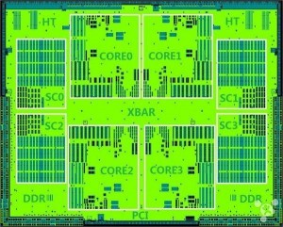
In the News: MIPS CPU that executes x86 and ARM
China-based Loongson
MIPS64 Release 3 instructions
The binary translation to run x86 and ARM code – called ‘LoongBT’
LoongVM instructions for custom virtual machines
LoongSIMD instructions for 128- and 256-bit vector arithmetic operations
See more at: http://www.electronicsweekly.com/news/components/microprocessors-and-dsps/quad-core-64bit-mips-processors-execute-arm-x86-instructions-2015-09/#sthash.bq66vrRQ.dpuf

Slide 38
Assembler Pseudo-Instructions
Certain C statements are implemented unintuitively in MIPS
e.g. assignment (a=b) via add $zero
MIPS has a set of “pseudo-instructions” to make programming easier
More intuitive to read, but get translated into actual instructions later
Example:
move dst,src
translated into addi dst,src,0

Slide 39
Assembler Pseudo-Instructions
List of pseudo-instructions: http://en.wikipedia.org/wiki/MIPS_architecture#Pseudo_instructions
List also includes instruction translation
Load Address (la)
la dst,label
Loads address of specified label into dst
Load Immediate (li)
li dst,imm
Loads 32-bit immediate into dst
MARS has additional pseudo-instructions
See Help (F1) for full list

Slide 40
Assembler Register
Problem:
When breaking up a pseudo-instruction, the assembler may need to use an extra register
If it uses a regular register, it’ll overwrite whatever the program has put into it
Solution:
Reserve a register ($1 or $at for “assembler temporary”) that assembler will use to break up pseudo-instructions
Since the assembler may use this at any time, it’s not safe to code with it

Slide 41
Dealing With Large Immediates
How do we deal with 32-bit immediates?
Sometimes want to use immediates > ± 2¹⁵ with addi, lw, sw and slti
Bitwise logic operations with 32-bit immediates
Solution: Don’t mess with instruction formats, just add a new instruction
Load Upper Immediate (lui)
lui reg,imm
Moves 16-bit imm into upper half (bits 16-31) of reg and zeros the lower half (bits 0-15)

Slide 42
lui Example
Want: addiu $t0,$t0,0xABABCDCD
This is a pseudo-instruction!
Translates into:
lui $at,0xABAB # upper 16 ori $at,$at,0xCDCD # lower 16 addu $t0,$t0,$at # move
Now we can handle everything with a 16-bit immediate!
Only the assembler gets to use $at ($1)

Slide 43
Multiply and Divide
Example pseudo-instruction:
mul $rd,$rs,$rt
Consists of mult which stores the output in special hi and lo registers, and a move from these registers to $rd
mult $rs,$rt
mflo $rd
mult and div have nothing important in the rd field since the destination registers are hi and lo
mfhi and mflo have nothing important in the rs and rt fields since the source is determined by the instruction (see COD)

Slide 44
MAL vs. TAL
True Assembly Language (TAL)
The instructions a computer understands and executes
MIPS Assembly Language (MAL)
Instructions the assembly programmer can use (includes pseudo-instructions)
Each MAL instruction becomes 1 or more TAL instruction

Slide 45
Clicker Question
Which of the following place the address of LOOP in $v0?
la $t1, LOOP
lw $v0, 0($t1)
2) jal LOOP
LOOP: addu $v0, $ra, $zero
3) la $v0, LOOP
1 2 3
T, T, T
T, T, F
F, T, T
F, T, F
F, F, T

Slide 46
Summary
I-Format: instructions with immediates, lw/sw (offset is immediate), and beq/bne
But not the shift instructions
Branches use PC-relative addressing
J-Format: j and jal (but not jr)
Jumps use absolute addressing
R-Format: all other instructions
I:
opcode
rs
rt
immediate
J:
opcode
target address
R:
opcode
rs
rt
rd
shamt
funct

