Slide 1
CS 61C: Great Ideas in Computer Architecture Pipelining & Hazards
Instructors:
John Wawrzynek & Vladimir Stojanovic
http://inst.eecs.Berkeley.edu/~cs61c/fa15

Slide 2
Review: Single-Cycle Processor
Five steps to design a processor:
1. Analyze instruction set → datapath requirements
2. Select set of datapath components & establish clock methodology
3. Assemble datapath meeting the requirements
4. Analyze implementation of each instruction to determine setting of control points that effects the register transfer.
5. Assemble the control logic
Formulate Logic Equations
Design Circuits
Processor
Input
Control
Memory
Datapath
Output

Slide 3
Review: A Single-Cycle Datapath
Inst
Memory
Instruction<31:0>
<21:25>
<16:20>
<0:15>
<11:15>
Adr
Rs
Rt
Rd
Imm16
nPC_sel & Equal
RegDst
Rd
Rt
Equal
ALUctr
MemtoReg
1
0
MemWr
4
RegWr
Rs
Rt
5
5
5
Adder
Rw
Ra
Rb
busA
32
00
busW
=
32
32
RegFile
busB
ALU
0
Mux
PC
0
clk
32
Adder
32
WrEn
Adr
PC Ext
clk
imm16
1
Data In
1
16
Extender
Data
Memory
32
clk
imm16
ExtOp
ALUSrc
Notes:
So here is the single cycle datapath we just built.
If you push into the Instruction Fetch Unit, you will see the last slide showing the PC, the next address logic, and the Instruction Memory.
Here I have shown how we can get the Rt, Rs, Rd, and Imm16 fields out of the 32-bit instruction word.
The Rt, Rs, and Rd fields will go to the register file as register specifiers while the Imm16 field will go to the Extender where it is either Zero and Sign extended to 32 bits.
The signals ExtOp, ALUSrc, ALUctr, MemWr, MemtoReg, RegDst, RegWr, Branch, and Jump are control signals.
And I will show you how to generate them on Friday.
+2 = 80 min. (Z:00)

Slide 4
Review: Controller Implementation
opcode
func
add
RegDst
ALUSrc
sub
MemtoReg
ori
RegWrite
“AND” logic
lw
“OR” logic
MemWrite
sw
nPCsel
Jump
beq
ExtOp
jump
ALUctr[0]
ALUctr[1]

Slide 5
Single Cycle Performance
Assume time for actions are
100ps for register read or write; 200ps for other events
Clock period is?
Instr | Instr fetch | Register read | ALU op | Memory access | Register write | Total time
lw | 200ps | 100 ps | 200ps | 200ps | 100 ps | 800ps
sw | 200ps | 100 ps | 200ps | 200ps |  | 700ps
R-format | 200ps | 100 ps | 200ps |  | 100 ps | 600ps
beq | 200ps | 100 ps | 200ps |  |  | 500ps
Clock rate (cycles/second = Hz) = 1/Period (seconds/cycle)
Notes:
1.25 GHz

Slide 6
Single Cycle Performance
Assume time for actions are
100ps for register read or write; 200ps for other events
Clock period is?
Instr | Instr fetch | Register read | ALU op | Memory access | Register write | Total time
lw | 200ps | 100 ps | 200ps | 200ps | 100 ps | 800ps
sw | 200ps | 100 ps | 200ps | 200ps |  | 700ps
R-format | 200ps | 100 ps | 200ps |  | 100 ps | 600ps
beq | 200ps | 100 ps | 200ps |  |  | 500ps
What can we do to improve clock rate?
Will this improve performance as well?
Want increased clock rate to mean faster programs
Notes:
1.25 GHz

Slide 7
Gotta Do Laundry
Ann, Brian, Cathy, Dave each have one load of clothes to wash, dry, fold, and put away
Washer takes 30 minutes
Dryer takes 30 minutes
“Folder” takes 30 minutes
“Stasher” takes 30 minutes to put clothes into drawers
A
B
C
D

Slide 8
Sequential Laundry
Sequential laundry takes 8 hours for 4 loads
6 PM
7
8
9
10
11
12
1
2 AM
T
a
s
k
O
r
d
e
r
30
30
30
30
30
30
30
30
30
30
30
30
30
30
30
30
Time
A
B
C
D

Slide 9
Pipelined Laundry
Pipelined laundry takes 3.5 hours for 4 loads!
6 PM
7
8
9
10
11
12
1
2 AM
30
30
30
30
30
Time
T
a
s
k
O
r
d
e
r
30
30
A
B
C
D

Slide 10
Pipelining Lessons (1/2)
6 PM
7
8
9
Pipelining doesn’t help latency of single task, it helps throughput of entire workload
Multiple tasks operating simultaneously using different resources
Potential speedup = Number pipe stages
Time to “fill” pipeline and time to “drain” it reduces speedup: 2.3x (8/3.5) v. 4x (8/2) in this example
T
a
s
k
O
r
d
e
r
Time
30
30
30
30
30
30
30
A
B
C
D

Slide 11
Pipelining Lessons (2/2)
6 PM
7
8
9
Suppose new Washer takes 20 minutes, new Stasher takes 20 minutes. How much faster is pipeline?
Pipeline rate limited by slowest pipeline stage
Unbalanced lengths of pipe stages reduces speedup
T
a
s
k
O
r
d
e
r
Time
30
30
30
30
30
30
30
A
B
C
D

Slide 12
Execution Steps in MIPS Datapath
1) IFtch: Instruction Fetch, Increment PC
2) Dcd: Instruction Decode, Read Registers
3) Exec: Mem-ref: Calculate Address Arith-log: Perform Operation
4) Mem: Load: Read Data from Memory Store: Write Data to Memory
5) WB: Write Data Back to Register

Slide 13
Single Cycle Datapath
rd
PC
instruction
memory
registers
rs
Data
memory
rt
ALU
+4
imm
2. Decode/
Register Read
1. Instruction
Fetch
5. Write Back
3. Execute
4. Memory

Slide 14
Pipeline registers
rd
PC
instruction
memory
registers
rs
Data
memory
rt
ALU
+4
imm
2. Decode/
Register Read
1. Instruction
Fetch
5. Write Back
3. Execute
4. Memory
Need registers between stages
To hold information produced in previous cycle

Slide 15
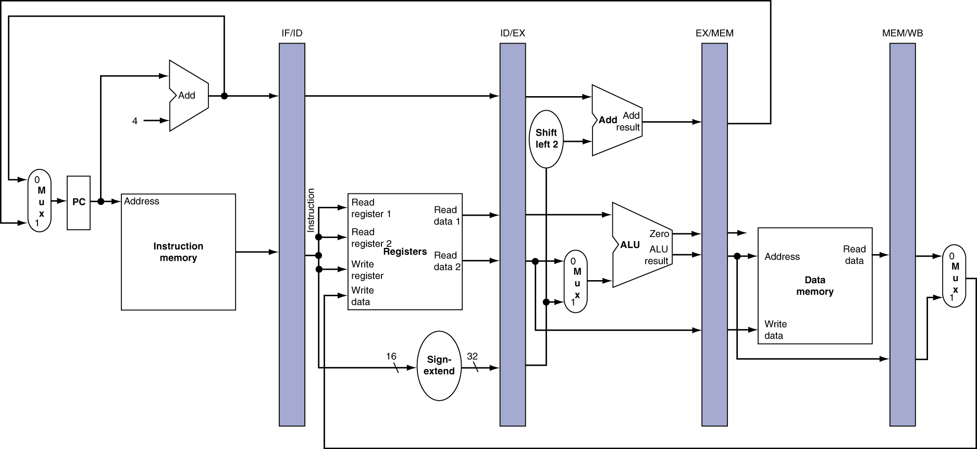
More Detailed Pipeline

Slide 16
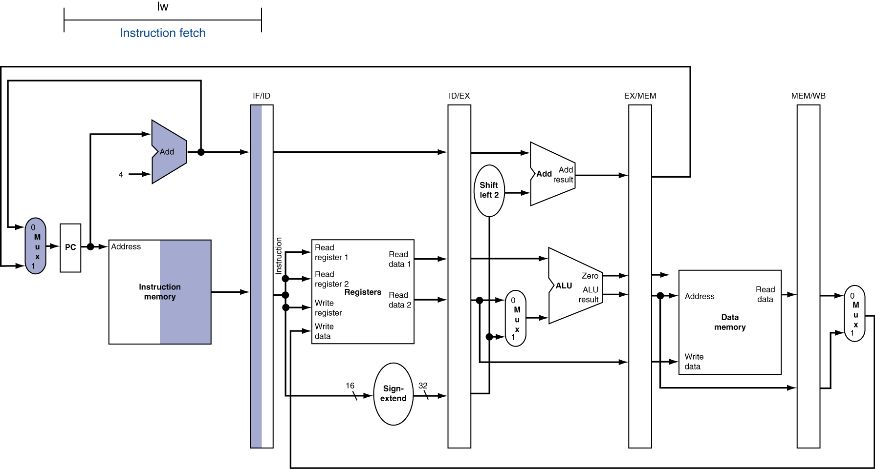
IF for Load, Store, …

Slide 17
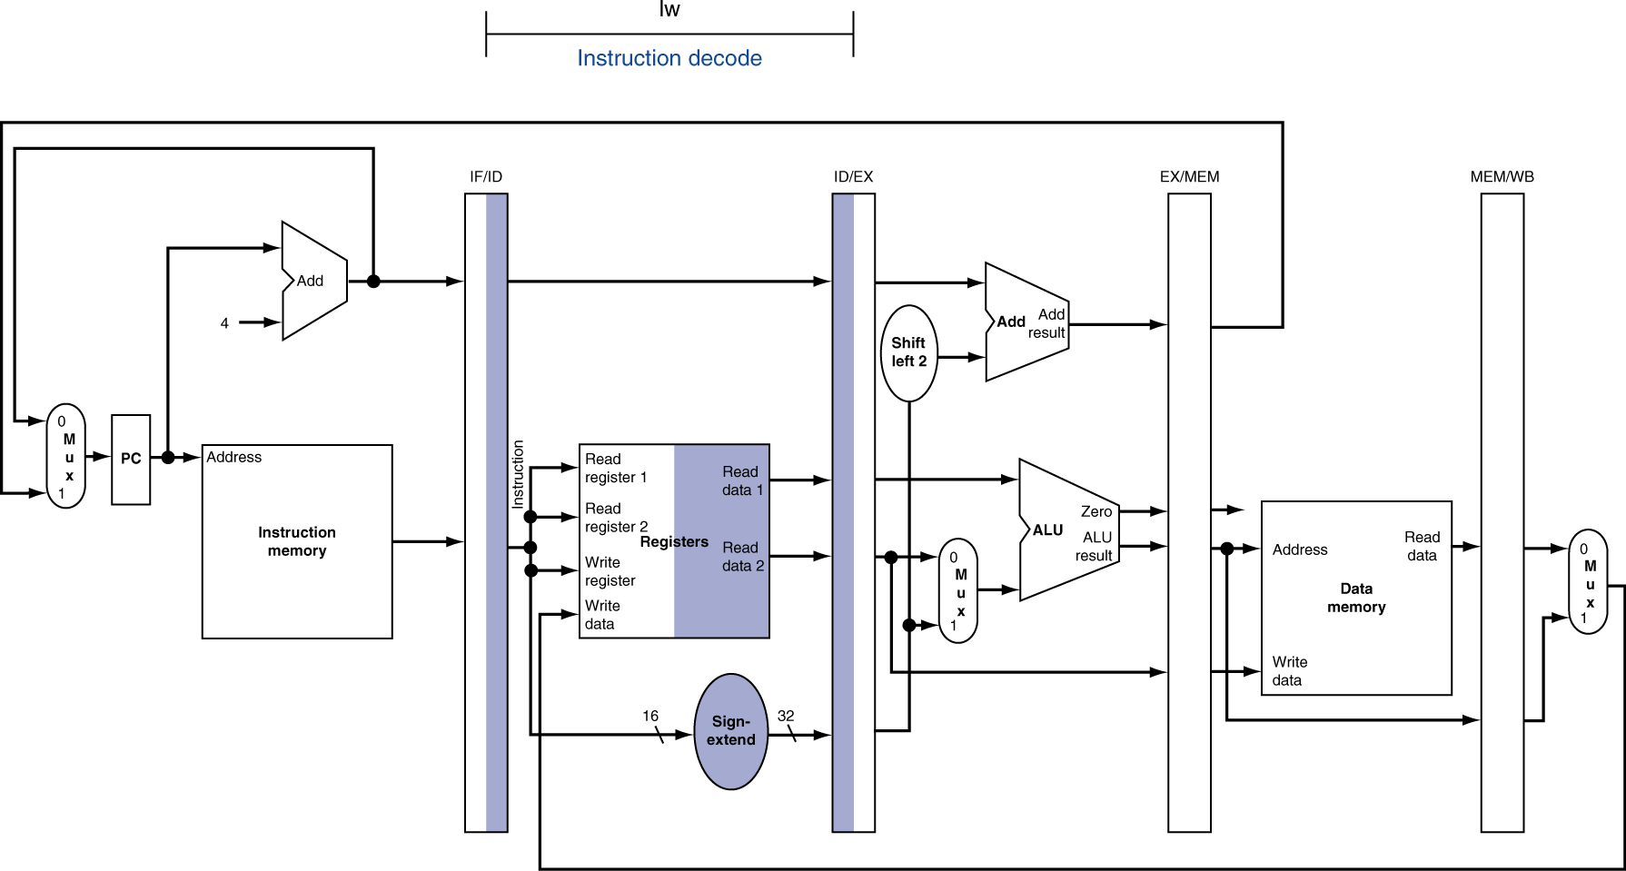
ID for Load, Store, …

Slide 18
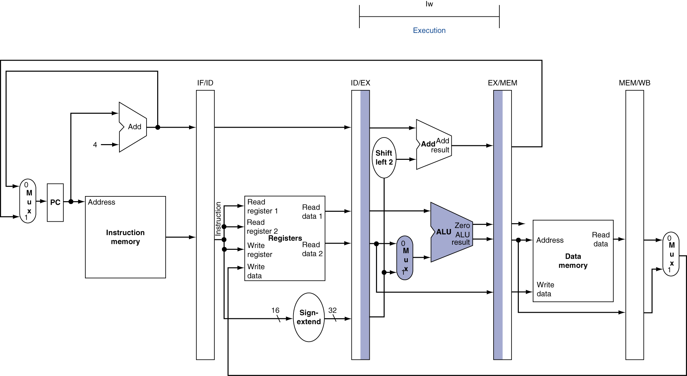
EX for Load

Slide 19
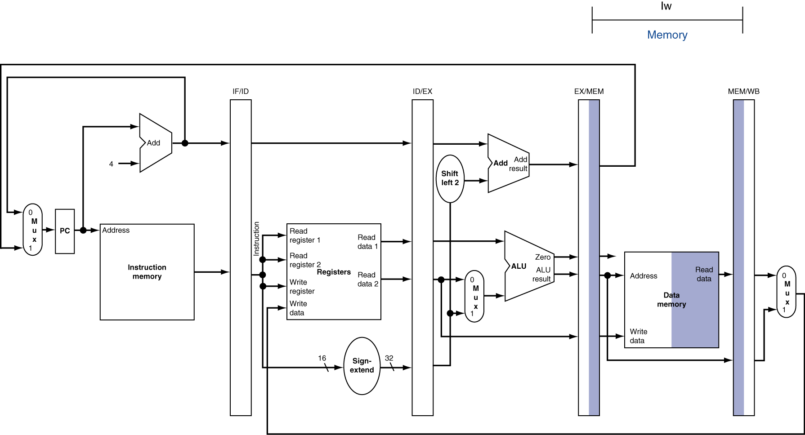
MEM for Load

Slide 20
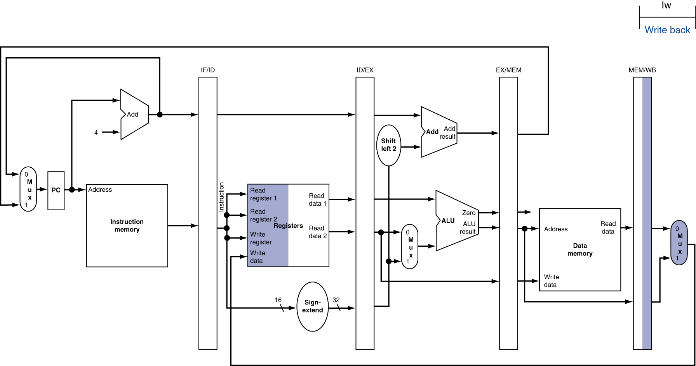
WB for Load – Oops!
Wrong register number!

Slide 21
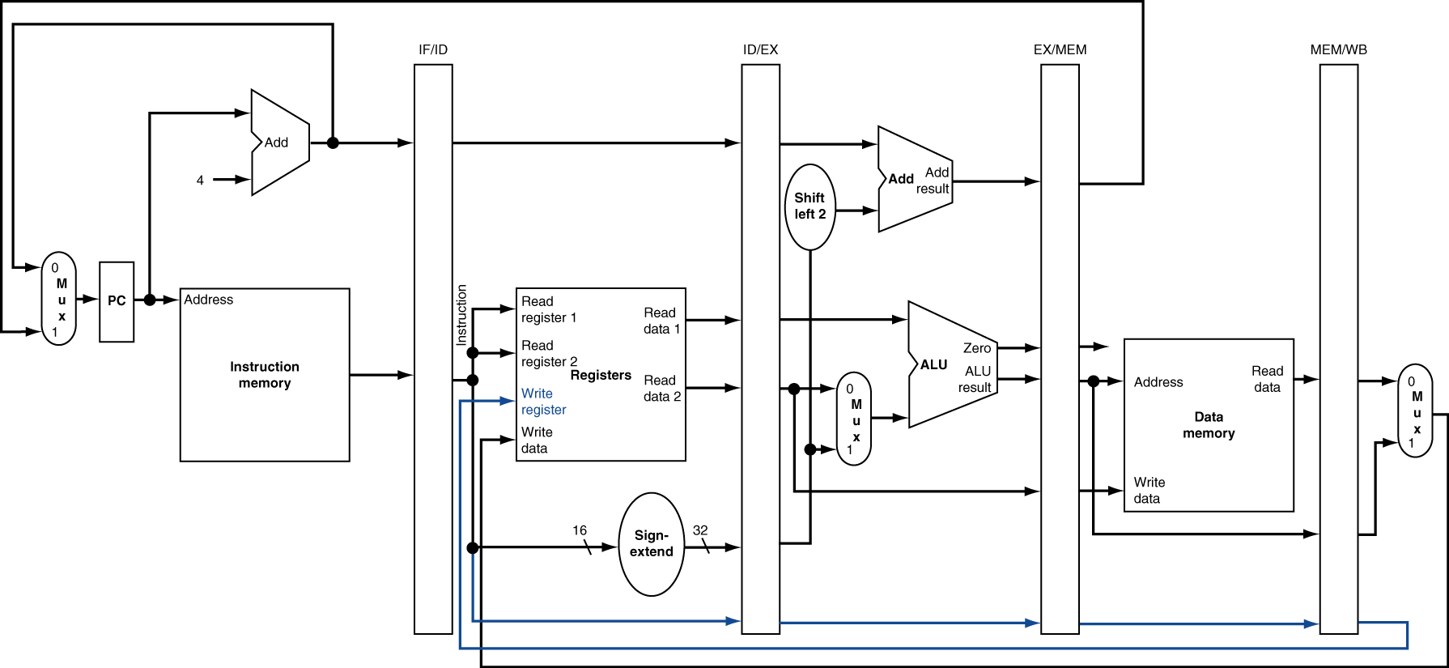
Corrected Datapath for Load

Slide 22
Pipelined Execution Representation
Time
IF
ID
EX
MEM
WB
IF
ID
EX
MEM
WB
IF
ID
EX
MEM
WB
IF
ID
EX
MEM
WB
IF
ID
EX
MEM
WB
IF
ID
EX
MEM
WB
Every instruction must take same number of steps, so some stages will idle
e.g. MEM stage for any arithmetic instruction
Notes:
Each instruction has identical latency!

Slide 23
Graphical Pipeline Diagrams
rd
Register
File
ALU
PC
instruction
memory
rs
Data
memory
rt
+4
imm
MUX
1. Instruction
Fetch
2. Decode/
Register Read
3. Execute
4. Memory
5. Write
Back
Use datapath figure below to represent pipeline:
IF
ID
EX
Mem
WB
I$
Reg
ALU
D$
Reg

Slide 24
Graphical Pipeline Representation
RegFile: left half is write, right half is read
Time (clock cycles)
I
n
s
t
r
O
r
d
e
r
Load
I$
Reg
ALU
D$
Reg
Add
I$
Reg
ALU
D$
Reg
Store
I$
Reg
ALU
D$
Reg
Sub
I$
Reg
ALU
D$
Reg
Or
I$
Reg
ALU
D$
Reg

Slide 25
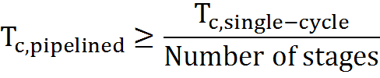
Pipelining Performance (1/3)
Use T_{c} (“time between completion of instructions”) to measure speedup
Equality only achieved if stages are balanced (i.e. take the same amount of time)
If not balanced, speedup is reduced
Speedup due to increased throughput
Latency for each instruction does not decrease

Slide 26
Pipelining Performance (2/3)
Assume time for stages is
100ps for register read or write
200ps for other stages
What is pipelined clock rate?
Compare pipelined datapath with single-cycle datapath
Instr | Instr fetch | Register read | ALU op | Memory access | Register write | Total time
lw | 200ps | 100 ps | 200ps | 200ps | 100 ps | 800ps
sw | 200ps | 100 ps | 200ps | 200ps |  | 700ps
R-format | 200ps | 100 ps | 200ps |  | 100 ps | 600ps
beq | 200ps | 100 ps | 200ps |  |  | 500ps

Slide 27
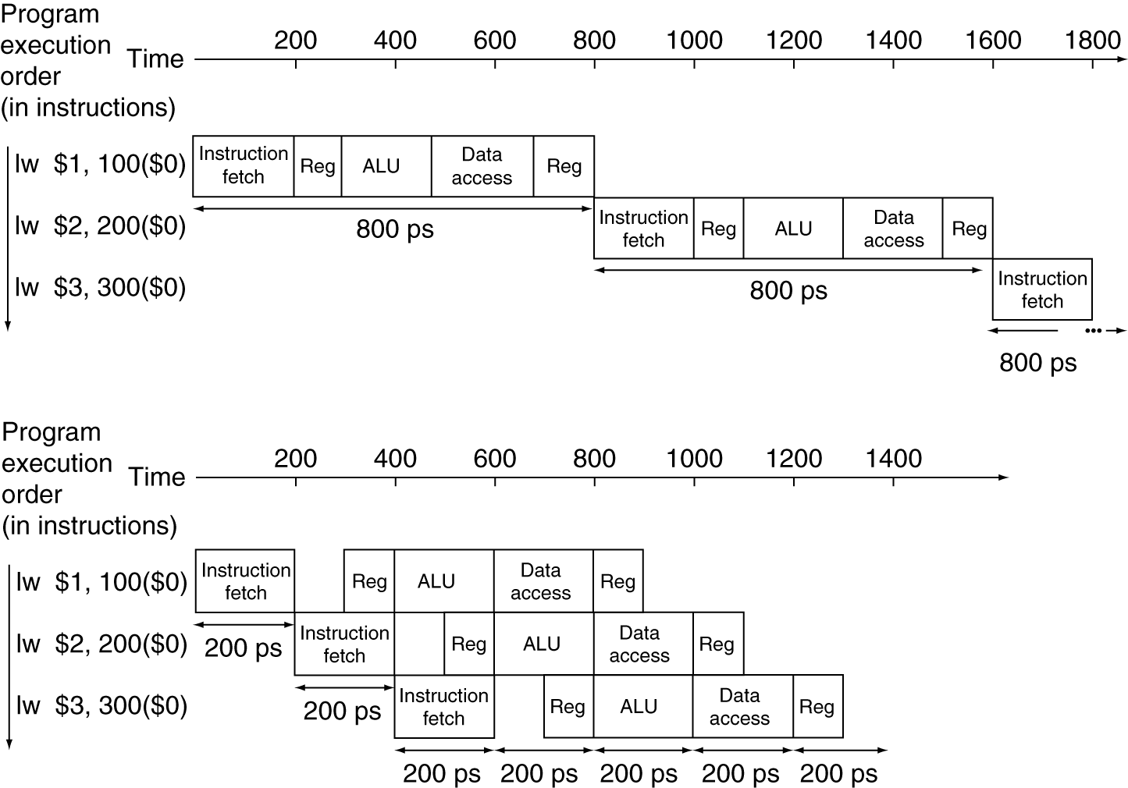
Pipelining Performance (3/3)
Single-cycle
T_{c} = 800 ps
f = 1.25GHz
Pipelined
T_{c} = 200 ps
f = 5GHz
Notes:
Here using T_{c} as “time between completion of instructions.”

Slide 28
Clicker/Peer Instruction
Logic in some stages takes 200ps and in some 100ps. Clk-Q delay is 30ps and setup-time is 20ps. What is the maximum clock frequency at which a pipelined design can operate?
A: 10GHz
B: 5GHz
C: 6.7GHz
D: 4.35GHz
E: 4GHz

Slide 29
Administrivia
HW2 due 10/16 @ 23:59:59
Project 3-1 due date now 10/21 (release 10/14)
Project 3-2 due date now 10/28 (release 10/18)

Slide 30
Pipelining Hazards
A hazard is a situation that prevents starting the next instruction in the next clock cycle
Structural hazard
A required resource is busy (e.g. needed in multiple stages)
Data hazard
Data dependency between instructions
Need to wait for previous instruction to complete its data read/write
Control hazard
Flow of execution depends on previous instruction

Slide 31
Structural Hazard #1: Single Memory
Time (clock cycles)
I
n
s
t
r
O
r
d
e
r
Trying to read same memory twice in same clock cycle
Load
I$
Reg
ALU
D$
Reg
Instr 1
I$
Reg
ALU
D$
Reg
Instr 2
I$
Reg
ALU
D$
Reg
Instr 3
I$
Reg
ALU
D$
Reg
Instr 4
I$
Reg
ALU
D$
Reg

Slide 32
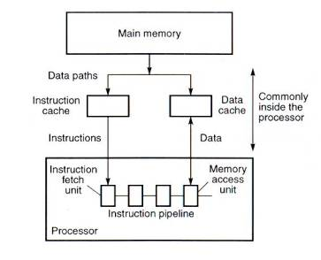
Solving Structural Hazard #1 with Caches

Slide 33
Structural Hazard #2: Registers (1/2)
Time (clock cycles)
I
n
s
t
r
O
r
d
e
r
Load
I$
Reg
ALU
D$
Reg
Can we read and write to registers simultaneously?
Instr 1
I$
Reg
ALU
D$
Reg
Instr 2
I$
Reg
ALU
D$
Reg
Instr 3
I$
Reg
ALU
D$
Reg
Instr 4
I$
Reg
ALU
D$
Reg

Slide 34
Structural Hazard #2: Registers (2/2)
Two different solutions have been used:
Split RegFile access in two: Write during 1st half and Read during 2nd half of each clock cycle
Possible because RegFile access is VERY fast (takes less than half the time of ALU stage)
Build RegFile with independent read and write ports
Conclusion: Read and Write to registers during same clock cycle is okay
Structural hazards can always be removed by adding hardware resources

Slide 35
Data Hazards (1/2)
Consider the following sequence of instructions:
add $t0, $t1, $t2
sub $t4, $t0, $t3
and $t5, $t0, $t6
or $t7, $t0, $t8
xor $t9, $t0, $t10

Slide 36
2. Data Hazards (2/2)
Data-flow backwards in time are hazards
Time (clock cycles)
I
n
s
t
r
O
r
d
e
r
IF
ID/RF
EX
MEM
WB
add $t0,$t1,$t2
I$
Reg
ALU
D$
Reg
sub $t4,$t0,$t3
I$
Reg
ALU
D$
Reg
and $t5,$t0,$t6
I$
Reg
ALU
D$
Reg
or $t7,$t0,$t8
I$
Reg
ALU
D$
Reg
xor $t9,$t0,$t10
I$
Reg
ALU
D$
Reg

Slide 37
Data Hazard Solution: Forwarding
Forward result as soon as it is available
OK that it’s not stored in RegFile yet
IF
ID/RF
EX
MEM
WB
add $t0,$t1,$t2
I$
Reg
ALU
D$
Reg
sub $t4,$t0,$t3
I$
Reg
ALU
D$
Reg
and $t5,$t0,$t6
I$
Reg
ALU
D$
Reg
or $t7,$t0,$t8
I$
Reg
ALU
D$
Reg
xor $t9,$t0,$t10
I$
Reg
ALU
D$
Reg

Slide 38
Datapath for Forwarding (1/2)
What changes need to be made here?

Slide 39
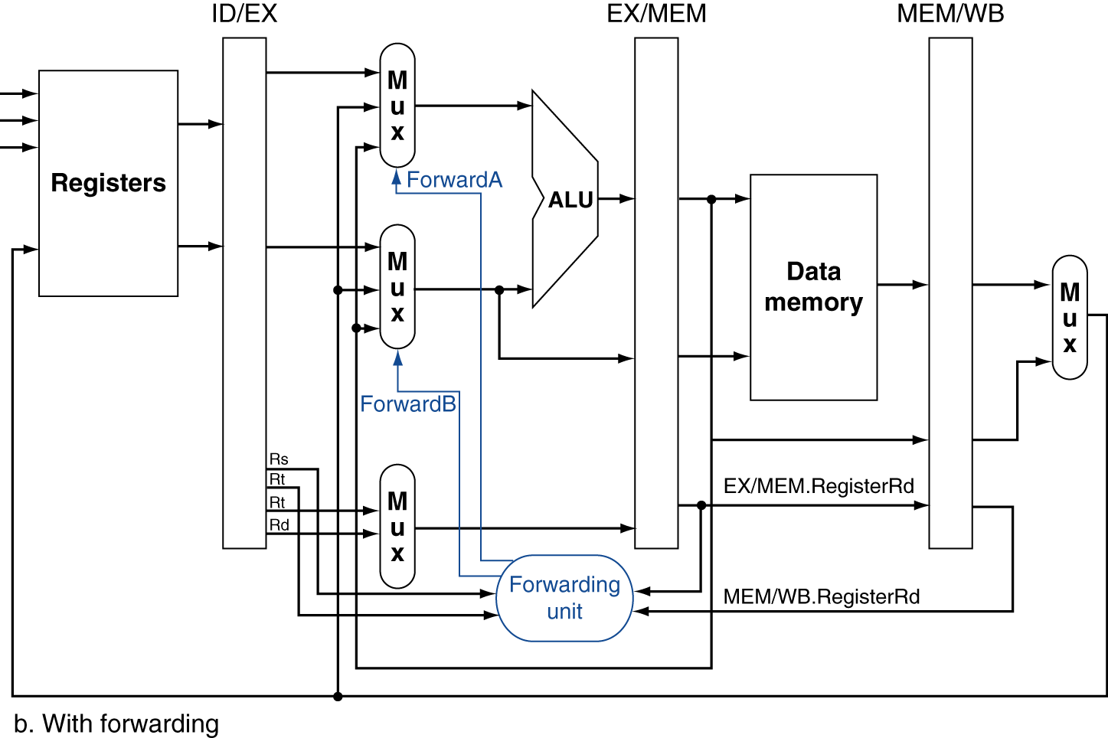
Datapath for Forwarding (2/2)
Handled by forwarding unit
Notes:
Scan figure 4.54 on p. 368.

Slide 40
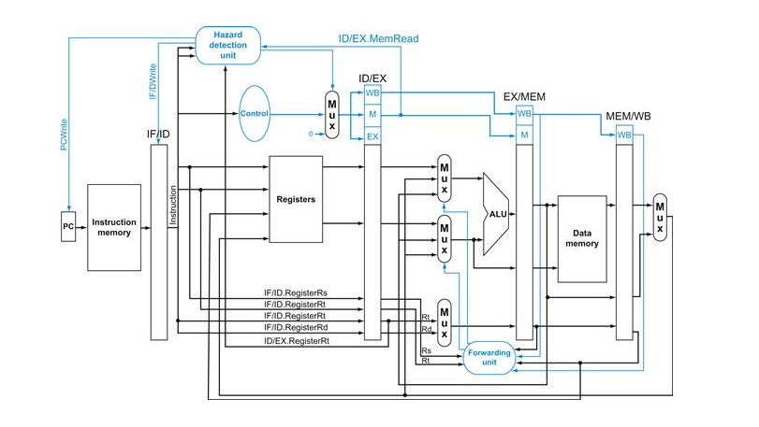
Datapath and Control
The control signals are pipelined, too

Slide 41
Data Hazard: Loads (1/3)
Recall: Dataflow backwards in time are hazards
Can’t solve all cases with forwarding
Must stall instruction dependent on load, then forward (more hardware)
IF
ID/RF
EX
MEM
WB
lw $t0,0($t1)
I$
Reg
ALU
D$
Reg
sub $t3,$t0,$t2
I$
Reg
ALU
D$
Reg

Slide 42
Data Hazard: Loads (2/3)
Stalled instruction converted to “bubble”, acts like nop
lw $t0, 0($t1)
I$
Reg
ALU
D$
Reg
sub $t3,$t0,$t2
bubble
bubble
bubble
I$
Reg
sub $t3,$t0,$t2
I$
Reg
ALU
D$
Reg
and $t5,$t0,$t4
I$
Reg
ALU
Reg
D$
First two pipe stages stall by repeating stage one cycle later
or $t7,$t0,$t6
I$
Reg
ALU
D$

Slide 43
Data Hazard: Loads (4/4)
Slot after a load is called a load delay slot
If that instruction uses the result of the load, then the hardware interlock will stall it for one cycle
Letting the hardware stall the instruction in the delay slot is equivalent to putting an explicit nop in the slot (except the latter uses more code space)
Idea: Let the compiler put an unrelated instruction in that slot → no stall!

Slide 44
Clicker Question
How many cycles (pipeline fill+process+drain) does it take to execute the following code?
lw $t1, 0($t0)
lw $t2, 4($t0)
add $t3, $t1, $t2
sw $t3, 12($t0)
lw $t4, 8($t0)
add $t5, $t1, $t4
sw $t5, 16($t0)
7
9
11
13
14

Slide 45
Code Scheduling to Avoid Stalls
Reorder code to avoid use of load result in the next instruction!
MIPS code for D=A+B; E=A+C;
# Method 1:
lw $t1, 0($t0)
lw $t2, 4($t0)
add $t3, $t1, $t2
sw $t3, 12($t0)
lw $t4, 8($t0)
add $t5, $t1, $t4
sw $t5, 16($t0)
# Method 2:
lw $t1, 0($t0)
lw $t2, 4($t0)
lw $t4, 8($t0)
add $t3, $t1, $t2
sw $t3, 12($t0)
add $t5, $t1, $t4
sw $t5, 16($t0)
Stall!
Stall!
13 cycles
11 cycles

Slide 46
Break
(Maybe)

Slide 47
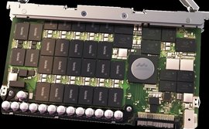
In The News: SanDisk announces ½ PetaByte flash drive
512TB of flash memory in 3U of rack space
That’s 2^49 bytes
780,000 I/O/second
7 GB/s sustained bandwidth

Slide 48
3. Control Hazards
Branch determines flow of control
Fetching next instruction depends on branch outcome
Pipeline can’t always fetch correct instruction
Still working on ID stage of branch
BEQ, BNE in MIPS pipeline
Simple solution Option 1: Stall on every branch until branch condition resolved
Would add 2 bubbles/clock cycles for every Branch! (~ 20% of instructions executed)

Slide 49
Stall => 2 Bubbles/Clocks
Time (clock cycles)
I
n
s
t
r.
O
r
d
e
r
beq
I$
Reg
ALU
D$
Reg
Instr 1
I$
Reg
ALU
D$
Reg
Instr 2
I$
Reg
ALU
D$
Reg
Instr 3
I$
Reg
ALU
D$
Reg
Instr 4
I$
Reg
ALU
D$
Reg
Where do we do the compare for the branch?

Slide 50
Control Hazard: Branching
Optimization #1:
Insert special branch comparator in Stage 2
As soon as instruction is decoded (Opcode identifies it as a branch), immediately make a decision and set the new value of the PC
Benefit: since branch is complete in Stage 2, only one unnecessary instruction is fetched, so only one no-op is needed
Side Note: means that branches are idle in Stages 3, 4 and 5
Question: What’s an efficient way to implement the equality comparison?

Slide 51
One Clock Cycle Stall
Time (clock cycles)
I
n
s
t
r.
O
r
d
e
r
beq
I$
Reg
ALU
D$
Reg
Instr 1
I$
Reg
ALU
D$
Reg
Instr 2
I$
Reg
ALU
D$
Reg
Instr 3
I$
Reg
ALU
D$
Reg
Instr 4
I$
Reg
ALU
D$
Reg
Branch comparator moved to Decode stage.

Slide 52
Control Hazards: Branching
Option 2: Predict outcome of a branch, fix up if guess wrong
Must cancel all instructions in pipeline that depended on guess that was wrong
This is called “flushing” the pipeline
Simplest hardware if we predict that all branches are NOT taken
Why?

Slide 53
Control Hazards: Branching
Option #3: Redefine branches
Old definition: if we take the branch, none of the instructions after the branch get executed by accident
New definition: whether or not we take the branch, the single instruction immediately following the branch gets executed (the branch-delay slot)
Delayed Branch means we always execute inst after branch
This optimization is used with MIPS

Slide 54
Example: Nondelayed vs. Delayed Branch
Nondelayed Branch
Delayed Branch
or $8, $9, $10
add $1, $2,$3
add $1, $2, $3
sub $4, $5, $6
sub $4, $5, $6
beq $1, $4, Exit
beq $1, $4, Exit
or $8, $9, $10
xor $10, $1, $11
xor $10, $1, $11
Exit:
Exit:

Slide 55
Control Hazards: Branching
Notes on Branch-Delay Slot
Worst-Case Scenario: put a nop in the branch-delay slot
Better Case: place some instruction preceding the branch in the branch-delay slot—as long as the changed doesn’t affect the logic of program
Re-ordering instructions is common way to speed up programs
Compiler usually finds such an instruction 50% of time
Jumps also have a delay slot …

Slide 56
Greater Instruction-Level Parallelism (ILP)
Deeper pipeline (5 => 10 => 15 stages)
Less work per stage ⇒ shorter clock cycle
Multiple issue “superscalar”
Replicate pipeline stages ⇒ multiple pipelines
Start multiple instructions per clock cycle
CPI < 1, so use Instructions Per Cycle (IPC)
E.g., 4GHz 4-way multiple-issue
16 BIPS, peak CPI = 0.25, peak IPC = 4
But dependencies reduce this in practice
“Out-of-Order” execution
Reorder instructions dynamically in hardware to reduce impact of hazards
Take CS152 next to learn about these techniques!

Slide 57
In Conclusion
Pipelining increases throughput by overlapping execution of multiple instructions in different pipestages
Pipestages should be balanced for highest clock rate
Three types of pipeline hazard limit performance
Structural (always fixable with more hardware)
Data (use interlocks or bypassing to resolve)
Control (reduce impact with branch prediction or branch delay slots)

