Slide 1
CS 61C: Great Ideas in Computer Architecture (Machine Structures) Caches Part 1
Instructors:
John Wawrzynek & Vladimir Stojanovic
http://inst.eecs.berkeley.edu/~cs61c/

Slide 2


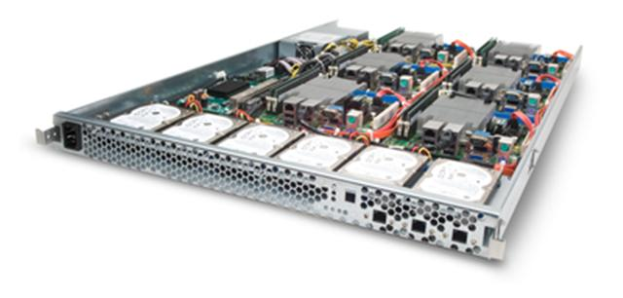
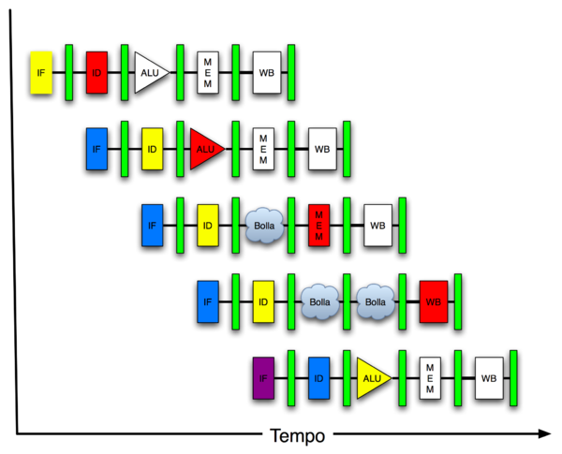
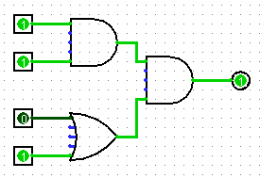
New-School Machine Structures (It’s a bit more complicated!)
Software Hardware
Parallel Requests
Assigned to computer
e.g., Search “Katz”
Parallel Threads
Assigned to core
e.g., Lookup, Ads
Parallel Instructions
>1 instruction @ one time
e.g., 5 pipelined instructions
Parallel Data
>1 data item @ one time
e.g., Add of 4 pairs of words
Hardware descriptions
All gates @ one time
Programming Languages
Warehouse Scale Computer
Smart Phone
Harness Parallelism &
Achieve High Performance
How do we know?
Computer
Core
…
Core
Memory (Cache)
Input/Output
Core
Instruction Unit(s)
Functional
Unit(s)
A₀+B₀
A₁+B₁
A₂+B₂
A₃+B₃
Cache Memory
Logic Gates

Slide 3
Components of a Computer
Memory
Processor
Input
Enable?
Read/Write
Control
Program
Datapath
Address
Bytes
PC
Registers
Write Data
Data
Arithmetic & Logic Unit
(ALU)
ReadData
Output
Processor-Memory Interface
I/O-Memory Interfaces

Slide 4
Problem: Large memories slow? Library Analogy
Finding a book in a large library takes time
Takes time to search a large card catalog – (mapping title/author to index number)
Round-trip time to walk to the stacks and retrieve the desired book.
Larger libraries makes both delays worse
Electronic memories have the same issue, plus the technologies that we use to store an individual bit get slower as we increase density (SRAM versus DRAM versus Magnetic Disk)
However what we want is a large yet fast memory!

Slide 5
Processor-DRAM Gap (latency)
µProc 60%/year
1000
CPU
Processor-Memory
Performance Gap: (growing 50%/yr)
100
Performance
10
DRAM
7%/year
DRAM
1
1986
1988
1987
1989
1990
1991
1992
1993
1994
1995
1980
1996
1981
1982
1983
1984
1985
1997
1998
1999
2000
Time
1980 microprocessor executes ~one instruction in same time as DRAM access
2015 microprocessor executes ~1000 instructions in same time as DRAM access
Slow DRAM access could have disastrous impact on CPU performance!
Notes:
Why doesn’t DRAM get faster?

Slide 6
What to do: Library Analogy
Want to write a report using library books
E.g., works of J.D. Salinger
Go to Doe library, look up relevant books, fetch from stacks, and place on desk in library
If need more, check them out and keep on desk
But don’t return earlier books since might need them
You hope this collection of ~10 books on desk enough to write report, despite 10 being only 0.00001% of books in UC Berkeley libraries

Slide 7
Big Idea: Memory Hierarchy
Processor
Inner
Increasing distance from processor, decreasing speed
Levels in memory hierarchy
Level 1
Level 2
Level 3
Outer
. . .
Level n
Size of memory at each level
As we move to outer levels the latency goes up and price per bit goes down. Why?

Slide 8
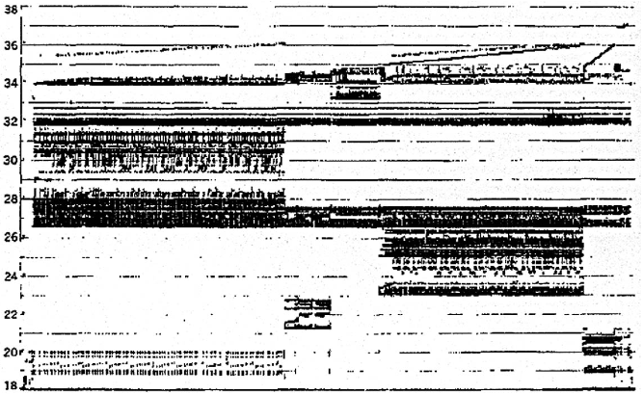
Real Memory Reference Patterns
Memory Address (one dot per access)
Donald J. Hatfield, Jeanette Gerald: Program Restructuring for Virtual Memory. IBM Systems Journal 10(3): 168-192 (1971)
Time

Slide 9
Big Idea: Locality
Temporal Locality (locality in time)
Go back to same book on desktop multiple times
If a memory location is referenced, then it will tend to be referenced again soon
Spatial Locality (locality in space)
When go to book shelf, pick up multiple books on J.D. Salinger since library stores related books together
If a memory location is referenced, the locations with nearby addresses will tend to be referenced soon
Notes:
How does the memory hierarchy work? Well it is rather simple, at least in principle.
In order to take advantage of the temporal locality, that is the locality in time, the memory hierarchy will keep those more recently accessed data items closer to the processor because chances are (points to the principle), the processor will access them again soon.
In order to take advantage of the spatial locality, not ONLY do we move the item that has just been accessed to the upper level, but we ALSO move the data items that are adjacent to it.
+1 = 15 min. (X:55)

Slide 10
Memory Reference Patterns
Temporal
Locality
Memory Address (one dot per access)
Spatial
Locality
Time
Donald J. Hatfield, Jeanette Gerald: Program Restructuring for Virtual Memory. IBM Systems Journal 10(3): 168-192 (1971)

Slide 11
Principle of Locality
Principle of Locality: Programs access small portion of address space at any instant of time (spatial locality) and repeatedly access that portion (temporal locality)
What program structures lead to temporal and spatial locality in instruction accesses?
In data accesses?

Slide 12
Memory Reference Patterns
Address
n loop iterations
Instruction
fetches
subroutine call
subroutine return
Stack
accesses
argument access
vector access
Data
accesses
scalar accesses
Time

Slide 13
Cache Philosophy
Programmer-invisible hardware mechanism to give illusion of speed of fastest memory with size of largest memory
Works fine even if programmer has no idea what a cache is
However, performance-oriented programmers today sometimes “reverse engineer” cache design to design data structures to match cache
We’ll do that in Project 3

Slide 14
Memory Access without Cache
Load word instruction: lw $t0,0($t1)
$t1 contains 1022_{ten,} Memory[1022] = 99
Processor issues address 1022_{ten} to Memory
Memory reads word at address 1022_{ten} (99)
Memory sends 99 to Processor
Processor loads 99 into register $t0

Slide 15
Adding Cache to Computer
Processor
Memory
Enable?
Read/Write
Input
Control
Program
Cache
Datapath
Address
Bytes
PC
Write Data
Registers
Data
Arithmetic & Logic Unit
(ALU)
ReadData
Output
Processor-Memory Interface
I/O-Memory Interfaces

Slide 16
Memory Access with Cache
Load word instruction: lw $t0,0($t1)
$t1 contains 1022_{ten,} Memory[1022] = 99
With cache: Processor issues address 1022_{ten} to Cache
Cache checks to see if has copy of data at address 1022_{ten}
2a. If finds a match (Hit): cache reads 99, sends to processor
2b. No match (Miss): cache sends address 1022 to Memory
Memory reads 99 at address 1022_{ten}
Memory sends 99 to Cache
Cache replaces word with new 99
Cache sends 99 to processor
Processor loads 99 into register $t0

Slide 17
Administrivia
HW2 due 10/16 @ 23:59:59
Project 3-1 due date now 10/21 – already released, start early
Project 3-2 due date now 10/28 (release 10/18)
Midterm 1:
grades posted today
Stats, next slide

Slide 18
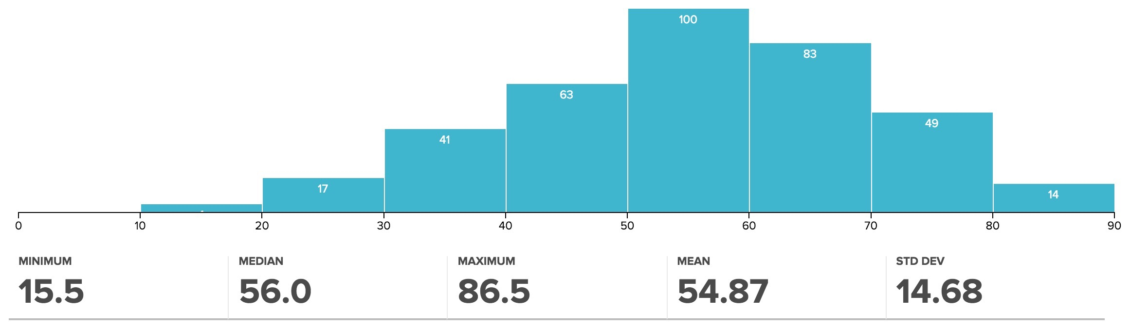
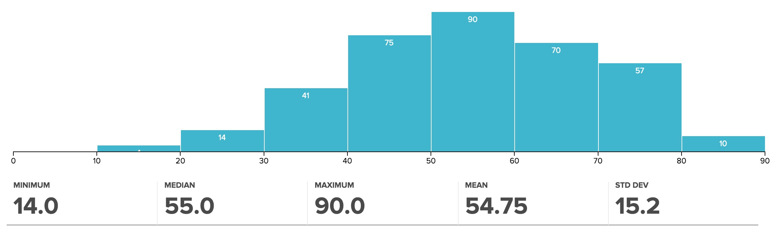
Version A
Version B

Slide 19
Cache “Tags”
Need way to tell if have copy of location in memory so that can decide on hit or miss
On cache miss, put memory address of block in “tag address” of cache block
1022 placed in tag next to data from memory (99)
Tag | Data
252 | 12
1022 | 99
131 | 7
2041 | 20
From earlier
instructions

Slide 20
Anatomy of a 16 Byte Cache, 4 Byte Block
Processor
Operations:
Cache Hit
Cache Miss
Refill cache from memory
Cache needs Address Tags to decide if Processor Address is a Cache Hit or Cache Miss
Compares all 4 tags
32-bit
Address
32-bit
Data
252
12
1022
99
131
7
2041
20
Cache
32-bit
Address
32-bit
Data
Memory

Slide 21
Cache Replacement
Suppose processor now requests location 511, which contains 11?
Doesn’t match any cache block, so must “evict” one resident block to make room
Which block to evict?
Replace “victim” with new memory block at address 511
Tag | Data
252 | 12
1022 | 99
511 | 11
2041 | 20
Tag | Data
252 | 12
1022 | 99
131 | 7
2041 | 20

Slide 22
Block Must be Aligned in Memory
Word blocks are aligned, so binary address of all words in cache always ends in 00_{two}
How to take advantage of this to save hardware and energy?
Don’t need to compare last 2 bits of 32-bit byte address (comparator can be narrower)
=> Don’t need to store last 2 bits of 32-bit byte address in Cache Tag (Tag can be narrower)

Slide 23
Anatomy of a 32B Cache, 8B Block
Processor
Blocks must be aligned in pairs, otherwise could get same word twice in cache
Tags only have even-numbered words
Last 3 bits of address always 000_{two}
Tags, comparators can be narrower
Can get hit for either word in block
32-bit
Address
32-bit
Data
252
12
-10
1022
99
1000
130
42
7
2040
1947
20
Cache
32-bit
Address
32-bit
Data
Memory

Slide 24
Hardware Cost of Cache
Processor
Need to compare every tag to the Processor address
Comparators are expensive
Optimization: use 2 “sets” of data with a total of only 2 comparators
1 Address bit selects which set
Compare only tags from selected set
Generalize to more sets
32-bit
Address
32-bit
Data
Set 0
Tag
Data
Tag
Data
Set 1
Tag
Data
Tag
Data
Cache
32-bit
Address
32-bit
Data
Memory
24

Slide 25
Processor Address Fields used by Cache Controller
Block Offset: Byte address within block
Set Index: Selects which set
Tag: Remaining portion of processor address
Size of Index = log2 (number of sets)
Size of Tag = Address size – Size of Index – log2 (number of bytes/block)
Processor Address (32-bits total)
Tag
Set Index
Block offset
Notes:
For class handout

Slide 26
What is limit to number of sets?
For a given total number of blocks, we can save more comparators if have more than 2 sets
Limit: As Many Sets as Cache Blocks => only one block per set – only needs one comparator!
Called “Direct-Mapped” Design
Tag
Index
Block offset

Slide 27
Direct Mapped Cache Ex: Mapping a 6-bit Memory Address
5
4
3
2
1
0
Tag
Index
Byte Offset
Mem Block Within $ Block
Block Within $
Byte Within Block
In example, block size is 4 bytes/1 word
Memory and cache blocks always the same size, unit of transfer between memory and cache
# Memory blocks >> # Cache blocks
16 Memory blocks = 16 words = 64 bytes => 6 bits to address all bytes
4 Cache blocks, 4 bytes (1 word) per block
4 Memory blocks map to each cache block
Memory block to cache block, aka index: middle two bits
Which memory block is in a given cache block, aka tag: top two bits

Slide 28
One More Detail: Valid Bit
When start a new program, cache does not have valid information for this program
Need an indicator whether this tag entry is valid for this program
Add a “valid bit” to the cache tag entry
0 => cache miss, even if by chance, address = tag
1 => cache hit, if processor address = tag

Slide 29
Caching: A Simple First Example
Main Memory
0000xx
0001xx
0010xx
0011xx
0100xx
0101xx
0110xx
0111xx
1000xx
1001xx
1010xx
1011xx
1100xx
1101xx
1110xx
1111xx
One word blocks
Two low order bits (xx) define the byte in the block (32b words)
Cache
Index
Valid
Tag
Data
00
01
10
11
Q: Where in the cache is the mem block?
Use next 2 low-order memory address bits – the index – to determine which cache block (i.e., modulo the number of blocks in the cache)
Q: Is the memory block in cache?
Compare the cache tag to the high-order 2 memory address bits to tell if the memory block is in the cache (provided valid bit is set)
Notes:
For lecture
Valid bit indicates whether an entry contains valid information – if the bit is not set, there cannot be a match for this block

Slide 30
Direct-Mapped Cache Example
One word blocks, cache size = 1K words (or 4KB)
Byte offset
31 30 . . . 13 12 11 . . . 2 1 0
Hit
Tag
20
10
Data
Valid bit ensures something useful in cache for this index
Index
Read data from cache instead of memory if a Hit
Index
Valid
Tag
Data
0
1
2
.
.
.
1021
1022
1023
Compare Tag with upper part of Address to see if a Hit
20
32
Comparator
What kind of locality are we taking advantage of?
Notes:
Let’s use a specific example with realistic numbers: assume we have a 1 K word (4Kbyte) direct mapped cache with block size equals to 4 bytes (1 word).
In other words, each block associated with the cache tag will have 4 bytes in it (Row 1).
With Block Size equals to 4 bytes, the 2 least significant bits of the address will be used as byte select within the cache block.
Since the cache size is 1K word, the upper 32 minus 10+2 bits, or 20 bits of the address will be stored as cache tag.
The rest of the (10) address bits in the middle, that is bit 2 through 11, will be used as Cache Index to select the proper cache entry
Temporal!

Slide 31
Multiword-Block Direct-Mapped Cache
Four words/block, cache size = 1K words
Byte offset
Hit
31 30 . . . 13 12 11 . . . 4 3 2 1 0
Data
Tag
20
8
2
Word offset
Index
Index
Valid
Tag
Data
0
1
2
.
.
.
253
254
255
20
32
What kind of locality are we taking advantage of?
Notes:
to take advantage for spatial locality want a cache block that is larger than word word in size.

Slide 32
Cache Names for Each Organization
“Fully Associative”: Block can go anywhere
First design in lecture
Note: No Index field, but 1 comparator/block
“Direct Mapped”: Block goes one place
Note: Only 1 comparator
Number of sets = number blocks
“N-way Set Associative”: N places for a block
Number of sets = number of blocks / N
N comparators
Fully Associative: N = number of blocks
Direct Mapped: N = 1

Slide 33
Range of Set-Associative Caches
For a fixed-size cache, and a given block size, each increase by a factor of 2 in associativity doubles the number of blocks per set (i.e., the number of “ways”) and halves the number of sets –
decreases the size of the index by 1 bit and increases the size of the tag by 1 bit
More Associativity (more ways)
Tag
Index
Block offset
What if we can also change the block size?
Notes:
For class handout

Slide 34
Clickers/Peer Instruction
For a cache with constant total capacity, if we increase the number of ways by a factor of 2, which statement is false:
A: The number of sets could be doubled
B: The tag width could decrease
C: The block size could stay the same
D: The block size could be halved
E: Tag width must increase

Slide 35
Total Cash Capacity =
Associativity * # of sets * block_size
Bytes = blocks/set * sets * Bytes/block
C = N * S * B
Tag
Index
Byte Offset
address_size = tag_size + index_size + offset_size
= tag_size + log2(S) + log2(B)
Clicker Question: C remains constant, S and/or B can change such that
C = 2N * (SB)’ => (SB)’ = SB/2
Tag_size = address_size – (log2(S) + log2(B)) = address_size – log2(SB)
= address_size – (log2(SB) – 1)

Slide 36
Typical Memory Hierarchy
On-Chip Components
Control
Third-Level
Cache
(SRAM)
Instr
Cache
Second-Level
Cache
(SRAM)
Main
Memory
(DRAM)
Secondary
Memory
(Disk
Or Flash)
Datapath
RegFile
Data
Cache
Speed (cycles): ½’s 1’s 10’s 100’s 1,000,000’s
Size (bytes): 100’s 10K’s M’s G’s T’s
Cost/bit: highest lowest
Principle of locality + memory hierarchy presents programmer with ≈ as much memory as is available in the cheapest technology at the ≈ speed offered by the fastest technology
Notes:
Instead, the memory system of a modern computer consists of a series of black boxes ranging from the fastest to the slowest.
Besides variation in speed, these boxes also varies in size (smallest to biggest) and cost.
What makes this kind of arrangement work is one of the most important principle in computer design. The principle of locality. The principle of locality states that programs access a relatively small portion of the address space at any instant of time.
The design goal is to present the user with as much memory as is available in the cheapest technology (points to the disk).
While by taking advantage of the principle of locality, we like to provide the user an average access speed that is very close to the speed that is offered by the fastest technology.
(We will go over this slide in detail in the next lectures on caches).

Slide 37
Handling Stores with Write-Through
Store instructions write to memory, changing values
Need to make sure cache and memory have same values on writes: 2 policies
1) Write-Through Policy: write cache and write through the cache to memory
Every write eventually gets to memory
Too slow, so include Write Buffer to allow processor to continue once data in Buffer
Buffer updates memory in parallel to processor

Slide 38
Write-Through Cache
Processor
Write both values in cache and in memory
Write buffer stops CPU from stalling if memory cannot keep up
Write buffer may have multiple entries to absorb bursts of writes
What if store misses in cache?
32-bit
Address
32-bit
Data
Cache
252
12
1022
99
Write Buffer
7
131
2041
20
Addr
Data
32-bit
Address
32-bit
Data
Memory

Slide 39
Handling Stores with Write-Back
2) Write-Back Policy: write only to cache and then write cache block back to memory when evict block from cache
Writes collected in cache, only single write to memory per block
Include bit to see if wrote to block or not, and then only write back if bit is set
Called “Dirty” bit (writing makes it “dirty”)

Slide 40
Write-Back Cache
Processor
Store/cache hit, write data in cache only & set dirty bit
Memory has stale value
Store/cache miss, read data from memory, then update and set dirty bit
“Write-allocate” policy
Load/cache hit, use value from cache
On any miss, write back evicted block, only if dirty. Update cache with new block and clear dirty bit.
32-bit
Address
32-bit
Data
Cache
252
D
12
1022
Dirty Bits
D
99
131
D
7
2041
D
20
32-bit
Address
32-bit
Data
Memory

Slide 41
Write-Through vs. Write-Back
Write-Through:
Simpler control logic
More predictable timing simplifies processor control logic
Easier to make reliable, since memory always has copy of data (big idea: Redundancy!)
Write-Back
More complex control logic
More variable timing (0,1,2 memory accesses per cache access)
Usually reduces write traffic
Harder to make reliable, sometimes cache has only copy of data

Slide 42
And In Conclusion, …
Principle of Locality for Libraries /Computer Memory
Hierarchy of Memories (speed/size/cost per bit) to Exploit Locality
Cache – copy of data lower level in memory hierarchy
Direct Mapped to find block in cache using Tag field and Valid bit for Hit
Cache design choice:
Write-Through vs. Write-Back

