Slide 1
CS 61C: Great Ideas in Computer Architecture (Machine Structures) Caches Part 2
Instructors:
John Wawrzynek & Vladimir Stojanovic
http://inst.eecs.berkeley.edu/~cs61c/

Slide 2
Typical Memory Hierarchy
On-Chip Components
Control
Third-Level
Cache
(SRAM)
Instr
Cache
Second-Level
Cache
(SRAM)
Main
Memory
(DRAM)
Secondary
Memory
(Disk
Or Flash)
Datapath
RegFile
Data
Cache
Speed (cycles): ½’s 1’s 10’s 100’s 1,000,000’s
Size (bytes): 100’s 10K’s M’s G’s T’s
Cost/bit: highest lowest
Principle of locality + memory hierarchy presents programmer with ≈ as much memory as is available in the cheapest technology at the ≈ speed offered by the fastest technology
Notes:
Instead, the memory system of a modern computer consists of a series of black boxes ranging from the fastest to the slowest.
Besides variation in speed, these boxes also varies in size (smallest to biggest) and cost.
What makes this kind of arrangement work is one of the most important principle in computer design. The principle of locality. The principle of locality states that programs access a relatively small portion of the address space at any instant of time.
The design goal is to present the user with as much memory as is available in the cheapest technology (points to the disk).
While by taking advantage of the principle of locality, we like to provide the user an average access speed that is very close to the speed that is offered by the fastest technology.
(We will go over this slide in detail in the next lectures on caches).

Slide 3
Review: Adding Cache to Computer
Processor
Memory
Enable?
Read/Write
Input
Control
Program
Cache
Datapath
Address
Bytes
PC
Write Data
Registers
Data
Arithmetic & Logic Unit
(ALU)
ReadData
Output
Processor-Memory Interface
I/O-Memory Interfaces

Slide 4
Memory Block-addressing example

Slide 5
Block number aliasing example
12-bit memory addresses, 16 Byte blocks
Block #
Block # mod 8
Block # mod 2

Slide 6
Caches Review
Principle of Locality
Temporal Locality and Spatial Locality
Hierarchy of Memories (speed/size/cost per bit) to Exploit Locality
Cache – copy of data in lower level of memory hierarchy
Direct Mapped to find block in cache using Tag field and Valid bit for Hit
Cache design organization choices:
Fully Associative, Set-Associative, Direct-Mapped

Slide 7
Cache Organizations
“Fully Associative”: Block can go anywhere
First design in lecture
Note: No Index field, but 1 comparator/block
“Direct Mapped”: Block goes one place
Note: Only 1 comparator
Number of sets = number blocks
“N-way Set Associative”: N places for a block
Number of sets = number of blocks / N
N comparators
Fully Associative: N = number of blocks
Direct Mapped: N = 1

Slide 8
Processor Address Fields used by Cache Controller
Block Offset: Byte address within block
Set Index: Selects which set
Tag: Remaining portion of processor address
Size of Index = log2 (number of sets)
Size of Tag = Address size – Size of Index – log2 (number of bytes/block)
Processor Address (32-bits total)
Tag
Set Index
Block offset
Notes:
For class handout

Slide 9
Direct-Mapped Cache Review
One word blocks, cache size = 1K words (or 4KB)
Byte offset
31 30 . . . 13 12 11 . . . 2 1 0
Hit
Tag
20
10
Data
Valid bit ensures something useful in cache for this index
Index
Read data from cache instead of memory if a Hit
Index
Valid
Tag
Data
0
1
2
.
.
.
1021
1022
1023
Compare Tag with upper part of Address to see if a Hit
20
32
Comparator
Notes:
Let’s use a specific example with realistic numbers: assume we have a 1 K word (4Kbyte) direct mapped cache with block size equals to 4 bytes (1 word).
In other words, each block associated with the cache tag will have 4 bytes in it (Row 1).
With Block Size equals to 4 bytes, the 2 least significant bits of the address will be used as byte select within the cache block.
Since the cache size is 1K word, the upper 32 minus 10+2 bits, or 20 bits of the address will be stored as cache tag.
The rest of the (10) address bits in the middle, that is bit 2 through 11, will be used as Cache Index to select the proper cache entry
Temporal!

Slide 10
Four-Way Set-Associative Cache
2⁸ = 256 sets each with four ways (each with one block)
31 30 . . . 13 12 11 . . . 2 1 0
Byte offset
Set Index
Tag
22
8
Index
V
Tag
Data
V
Tag
Data
V
Tag
Data
V
Tag
Data
0
1
2
.
.
.
253
254
255
0
1
2
.
.
.
253
254
255
0
1
2
.
.
.
253
254
255
0
1
2
.
.
.
253
254
255
Way 0
Way 1
Way 2
Way 3
32
4x1 select
Hit
Data
Notes:
This is called a 4-way set associative cache because there are four cache entries for each cache index. Essentially, you have four direct mapped cache working in parallel.
This is how it works: the cache index selects a set from the cache. The four tags in the set are compared in parallel with the upper bits of the memory address.
If no tags match the incoming address tag, we have a cache miss.
Otherwise, we have a cache hit and we will select the data from the way where the tag matches occur.
This is simple enough. What is its disadvantages?
+1 = 36 min. (Y:16)

Slide 11
Handling Stores with Write-Through
Store instructions write to memory, changing values
Need to make sure cache and memory have same values on writes: 2 policies
1) Write-Through Policy: write cache and write through the cache to memory
Every write eventually gets to memory
Too slow, so include Write Buffer to allow processor to continue once data in Buffer
Buffer updates memory in parallel to processor

Slide 12
Write-Through Cache
Processor
Write both values in cache and in memory
Write buffer stops CPU from stalling if memory cannot keep up
Write buffer may have multiple entries to absorb bursts of writes
What if store misses in cache?
32-bit
Address
32-bit
Data
Cache
252
12
1022
99
Write Buffer
7
131
2041
20
Addr
Data
32-bit
Address
32-bit
Data
Memory

Slide 13
Handling Stores with Write-Back
2) Write-Back Policy: write only to cache and then write cache block back to memory when evict block from cache
Writes collected in cache, only single write to memory per block
Include bit to see if wrote to block or not, and then only write back if bit is set
Called “Dirty” bit (writing makes it “dirty”)

Slide 14
Write-Back Cache
Processor
Store/cache hit, write data in cache only & set dirty bit
Memory has stale value
Store/cache miss, read data from memory, then update and set dirty bit
“Write-allocate” policy
Load/cache hit, use value from cache
On any miss, write back evicted block, only if dirty. Update cache with new block and clear dirty bit.
32-bit
Address
32-bit
Data
Cache
252
D
12
1022
Dirty Bits
D
99
131
D
7
2041
D
20
32-bit
Address
32-bit
Data
Memory

Slide 15
Write-Through vs. Write-Back
Write-Through:
Simpler control logic
More predictable timing simplifies processor control logic
Easier to make reliable, since memory always has copy of data (big idea: Redundancy!)
Write-Back
More complex control logic
More variable timing (0,1,2 memory accesses per cache access)
Usually reduces write traffic
Harder to make reliable, sometimes cache has only copy of data

Slide 16
Administrivia
Project 3-1 due date Wednesday 10/21.
Project 3-2 due date now 10/28 (release 10/21)
Midterm 1:
grades posted

Slide 17
Cache (Performance) Terms
Hit rate: fraction of accesses that hit in the cache
Miss rate: 1 – Hit rate
Miss penalty: time to replace a block from lower level in memory hierarchy to cache
Hit time: time to access cache memory (including tag comparison)
Abbreviation: “$” = cache (A Berkeley innovation!)

Slide 18
Average Memory Access Time (AMAT)
Average Memory Access Time (AMAT) is the average time to access memory considering both hits and misses in the cache
AMAT = Time for a hit + Miss rate × Miss penalty
Notes:
AMAT = 1 + 0.02x50 = 2

Slide 19
Clickers/Peer instruction
AMAT = Time for a hit + Miss rate x Miss penalty
Given a 200 psec clock, a miss penalty of 50 clock cycles, a miss rate of 0.02 misses per instruction and a cache hit time of 1 clock cycle, what is AMAT?
☐
A: ≤200 psec
☐
B: 400 psec
☐
C: 600 psec
☐
D: ≥ 800 psec
Notes:
VertLeftWhiteCheck1
B: Print It saves PC+4 …because ints in this system are 4-bytes long and the actual address increments by 4 even though it appears to only incrememt 1.

Slide 20
Example: Direct-Mapped Cache with 4 Single-Word Blocks, Worst-Case Reference String
Consider the main memory address reference string of word numbers: 0 4 0 4 0 4 0 4
Start with an empty cache - all blocks initially marked as not valid
0
4
0
4
0
4
0
4
Notes:
For class handout

Slide 21
Example: Direct-Mapped Cache with 4 Single-Word Blocks, Worst-Case Reference String
Consider the main memory address reference string of word numbers: 0 4 0 4 0 4 0 4
Start with an empty cache - all blocks initially marked as not valid
0
miss
01
4
miss
00
0
miss
01
4
miss
4
4
0
00 Mem(0)
00 Mem(0)
01 Mem(4)
00 Mem(0)
00
0
miss
0
01
4
miss
4
00
0
miss
0
01
4
miss
4
01 Mem(4)
00 Mem(0)
01 Mem(4)
00 Mem(0)
8 requests, 8 misses
Ping-pong effect due to conflict misses - two memory locations that map into the same cache block
Notes:
For class handout

Slide 22
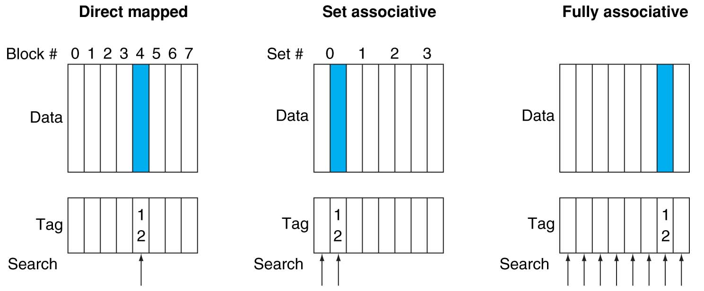
Alternative Block Placement Schemes
DM placement: mem block 12 in 8 block cache: only one cache block where mem block 12 can be found—(12 modulo 8) = 4
SA placement: four sets x 2-ways (8 cache blocks), memory block 12 in set (12 mod 4) = 0; either element of the set
FA placement: mem block 12 can appear in any cache blocks

Slide 23
Example: 2-Way Set Associative $ (4 words = 2 sets x 2 ways per set)
Main Memory
0000xx
0001xx
0010xx
0011xx
0100xx
0101xx
0110xx
0111xx
1000xx
1001xx
1010xx
1011xx
1100xx
1101xx
1110xx
1111xx
One word blocks
Two low order bits define the byte in the word (32b words)
Cache
Way
Set
V
Tag
Data
0
0
1
0
1
1
Q: How do we find it?
Use next 1 low order memory address bit to determine which cache set (i.e., modulo the number of sets in the cache)
Q: Is it there?
Compare all the cache tags in the set to the high order 3 memory address bits to tell if the memory block is in the cache
Notes:
For lecture
This picture is as opposed to
Way 0
both red Set 0
Way 1
------------------------------------
Way 0
both green Set 1
Way 1

Slide 24
Example: 4 Word 2-Way SA $ Same Reference String
Consider the main memory word reference string
0 4 0 4 0 4 0 4
Start with an empty cache - all blocks initially marked as not valid
0
4
0
4
Notes:
For class handout

Slide 25
Example: 4-Word 2-Way SA $ Same Reference String
Consider the main memory address reference string
0 4 0 4 0 4 0 4
Start with an empty cache - all blocks initially marked as not valid
0
miss
4
miss
0
hit
4
hit
000 Mem(0)
000 Mem(0)
000 Mem(0)
000 Mem(0)
010 Mem(4)
010 Mem(4)
010 Mem(4)
8 requests, 2 misses
Solves the ping-pong effect in a direct-mapped cache due to conflict misses since now two memory locations that map into the same cache set can co-exist!
Notes:
For lecture
Another sample string to try 0 1 2 3 0 8 11 0 3

Slide 26
Four-Way Set-Associative Cache
2⁸ = 256 sets each with four ways (each with one block)
31 30 . . . 13 12 11 . . . 2 1 0
Byte offset
Tag
22
8
Index
Index
V
Tag
Data
V
Tag
Data
V
Tag
Data
V
Tag
Data
0
1
2
.
.
.
253
254
255
0
1
2
.
.
.
253
254
255
0
1
2
.
.
.
253
254
255
0
1
2
.
.
.
253
254
255
Way 0
Way 1
Way 2
Way 3
32
4x1 select
Hit
Data
Notes:
This is called a 4-way set associative cache because there are four cache entries for each cache index. Essentially, you have four direct mapped cache working in parallel.
This is how it works: the cache index selects a set from the cache. The four tags in the set are compared in parallel with the upper bits of the memory address.
If no tags match the incoming address tag, we have a cache miss.
Otherwise, we have a cache hit and we will select the data from the way where the tag matches occur.
This is simple enough. What is its disadvantages?
+1 = 36 min. (Y:16)

Slide 27
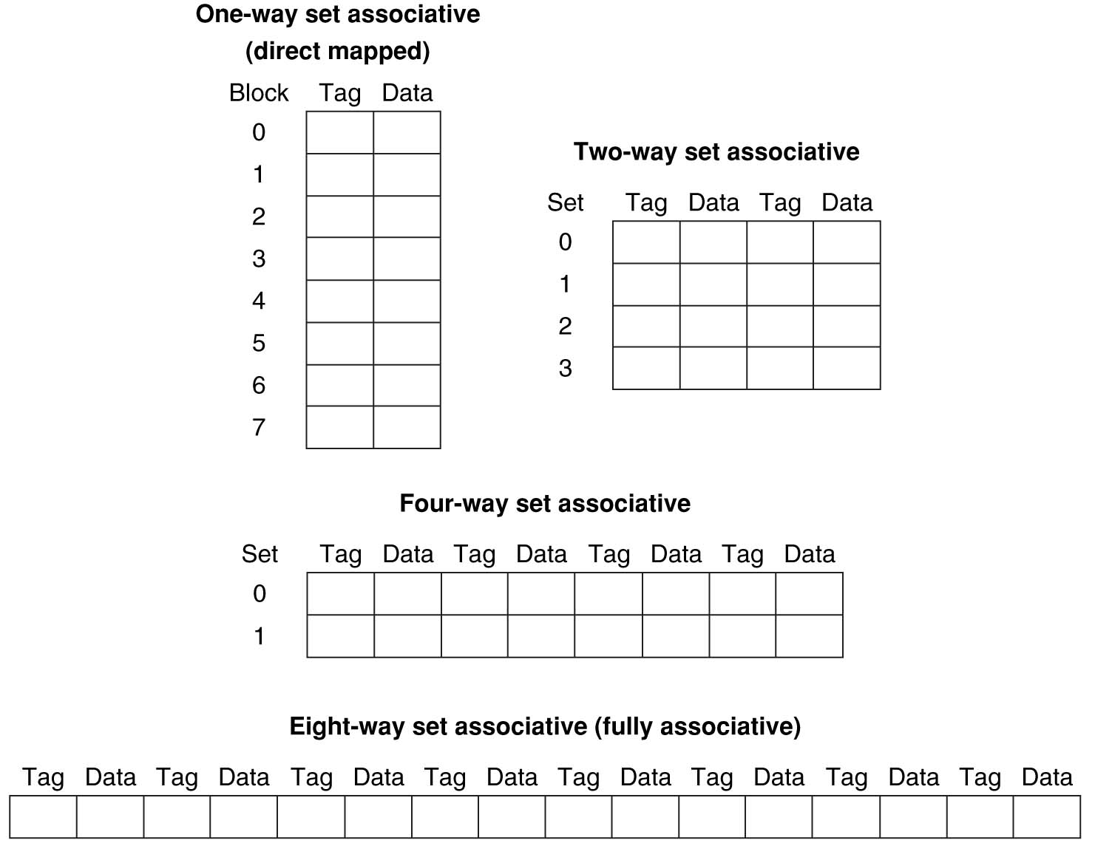
Different Organizations of an Eight-Block Cache
Total size of $ in blocks is equal to number of sets × associativity. For fixed $ size and fixed block size, increasing associativity decreases number of sets while increasing number of elements per set. With eight blocks, an 8-way set-associative $ is same as a fully associative $.

Slide 28
Range of Set-Associative Caches
For a fixed-size cache and fixed block size, each increase by a factor of two in associativity doubles the number of blocks per set (i.e., the number or ways) and halves the number of sets – decreases the size of the index by 1 bit and increases the size of the tag by 1 bit
Tag
Index
Word offset
Byte offset
Notes:
For class handout

Slide 29
Range of Set-Associative Caches
For a fixed-size cache and fixed block size, each increase by a factor of two in associativity doubles the number of blocks per set (i.e., the number or ways) and halves the number of sets – decreases the size of the index by 1 bit and increases the size of the tag by 1 bit
Used for tag compare
Selects the set
Selects the word in the block
Tag
Index
Word offset
Byte offset
Increasing associativity
Decreasing associativity
Fully associative
(only one set)
Tag is all the bits except
block and byte offset
Direct mapped
(only one way)
Smaller tags, only a single comparator
Notes:
For lecture
In 2008, the greater size and power consumption of CAMs generally leads to 2-way and 4-way set associativity being built from standard SRAMs with comparators with 8-way and above being built using CAMs

Slide 30
Total Cache Capacity =
Associativity × # of sets × block_size
Bytes = blocks/set × sets × Bytes/block
C = N × S × B
Tag
Index
Byte Offset
address_size = tag_size + index_size + offset_size
= tag_size + log₂(S) + log₂(B)

Slide 31
Clickers/Peer Instruction
For a cache with constant total capacity, if we increase the number of ways by a factor of 2, which statement is false:
A: The number of sets could be doubled
B: The tag width could decrease
C: The block size could stay the same
D: The block size could be halved
E: Tag width must increase

Slide 32
Total Cache Capacity =
Associativity × # of sets × block_size
Bytes = blocks/set × sets × Bytes/block
C = N × S × B
Tag
Index
Byte Offset
address_size = tag_size + index_size + offset_size
= tag_size + log₂(S) + log₂(B)
Clicker Question: C remains constant, S and/or B can change such that
C = 2N * (SB)’ => (SB)’ = SB/2
Tag_size = address_size – (log₂(S) + log₂(B)) = address_size – log₂(SB)
= address_size – log₂(SB/2)
= address_size – (log₂(SB) – 1)

Slide 33
Costs of Set-Associative Caches
N-way set-associative cache costs
N comparators (delay and area)
MUX delay (set selection) before data is available
Data available after set selection (and Hit/Miss decision). DM $: block is available before the Hit/Miss decision
In Set-Associative, not possible to just assume a hit and continue and recover later if it was a miss
When miss occurs, which way’s block selected for replacement?
Least Recently Used (LRU): one that has been unused the longest (principle of temporal locality)
Must track when each way’s block was used relative to other blocks in the set
For 2-way SA $, one bit per set → set to 1 when a block is referenced; reset the other way’s bit (i.e., “last used”)
Notes:
First of all, a N-way set associative cache will need N comparators instead of just one comparator (use the right side of the diagram for direct mapped cache).
A N-way set associative cache will also be slower than a direct mapped cache because of this extra multiplexer delay.
Finally, for a N-way set associative cache, the data will be available AFTER the hit/miss signal becomes valid because the hit/mis is needed to control the data MUX.
For a direct mapped cache, that is everything before the MUX on the right or left side, the cache block will be available BEFORE the hit/miss signal (AND gate output) because the data does not have to go through the comparator.
This can be an important consideration because the processor can now go ahead and use the data without knowing if it is a Hit or Miss. Just assume it is a hit.
Since cache hit rate is in the upper 90% range, you will be ahead of the game 90% of the time and for those 10% of the time that you are wrong, just make sure you can recover.
You cannot play this speculation game with a N-way set-associative cache because as I said earlier, the data will not be available to you until the hit/miss signal is valid.
+2 = 38 min. (Y:18)

Slide 34
Cache Replacement Policies
Random Replacement
Hardware randomly selects a cache evict
Least-Recently Used
Hardware keeps track of access history
Replace the entry that has not been used for the longest time
For 2-way set-associative cache, need one bit for LRU replacement
Example of a Simple “Pseudo” LRU Implementation
Assume 64 Fully Associative entries
Hardware replacement pointer points to one cache entry
Whenever access is made to the entry the pointer points to:
Move the pointer to the next entry
Otherwise: do not move the pointer
(example of “not-most-recently used” replacement policy)
Entry 0
Entry 1
Replacement
:
Pointer
Entry 63

Slide 35
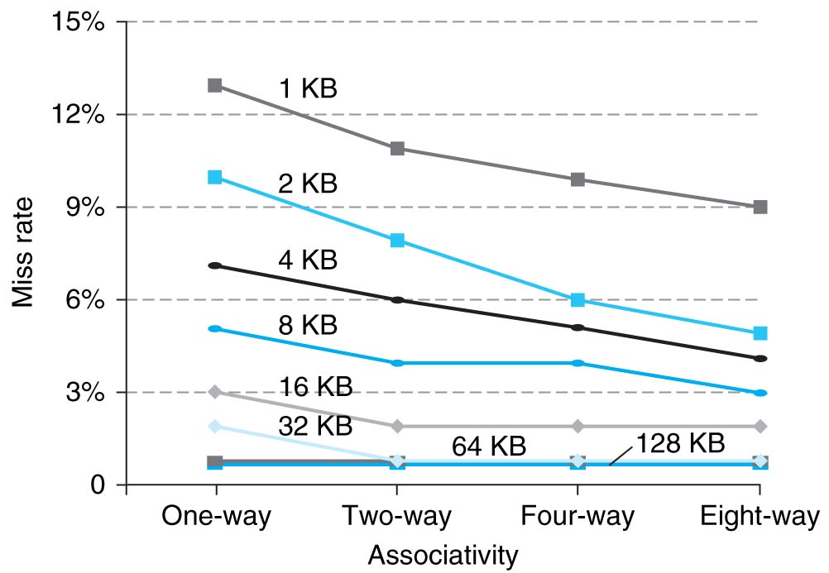
Benefits of Set-Associative Caches
Choice of DM $ versus SA $ depends on the cost of a miss versus the cost of implementation
Largest gains are in going from direct mapped to 2-way (20%+ reduction in miss rate)
Notes:
As cache sizes grow, the relative improvement from associativity increases only slightly; since the overall miss rate of a larger cache is lower, the opportunity for improving the miss rate decreases and the absolute improvement in miss rate from associativity shrinks significantly.

Slide 36
Understanding Cache Misses: The 3Cs
Compulsory (cold start or process migration, 1st reference):
First access to block impossible to avoid; small effect for long running programs
Solution: increase block size (increases miss penalty; very large blocks could increase miss rate)
Capacity:
Cache cannot contain all blocks accessed by the program
Solution: increase cache size (may increase access time)
Conflict (collision):
Multiple memory locations mapped to the same cache location
Solution 1: increase cache size
Solution 2: increase associativity (may increase access time)
Notes:
(Capacity miss) That is the cache misses are due to the fact that the cache is simply not large enough to contain all the blocks that are accessed by the program.
The solution to reduce the Capacity miss rate is simple: increase the cache size.
Here is a summary of other types of cache miss we talked about.
First is the Compulsory misses. These are the misses that we cannot avoid. They are caused when we first start the program.
Then we talked about the conflict misses. They are the misses that caused by multiple memory locations being mapped to the same cache location.
There are two solutions to reduce conflict misses. The first one is, once again, increase the cache size. The second one is to increase the associativity.
For example, say using a 2-way set associative cache instead of directed mapped cache.
But keep in mind that cache miss rate is only one part of the equation. You also have to worry about cache access time and miss penalty. Do NOT optimize miss rate alone.
Finally, there is another source of cache miss we will not cover today. Those are referred to as invalidation misses caused by another process, such as IO , update the main memory so you have to flush the cache to avoid inconsistency between memory and cache.
+2 = 43 min. (Y:23)

Slide 37
How to Calculate 3C’s using Cache Simulator
Compulsory: set cache size to infinity and fully associative, and count number of misses
Capacity: Change cache size from infinity, usually in powers of 2, and count misses for each reduction in size
16 MB, 8 MB, 4 MB, … 128 KB, 64 KB, 16 KB
Conflict: Change from fully associative to n-way set associative while counting misses
Fully associative, 16-way, 8-way, 4-way, 2-way, 1-way

Slide 38
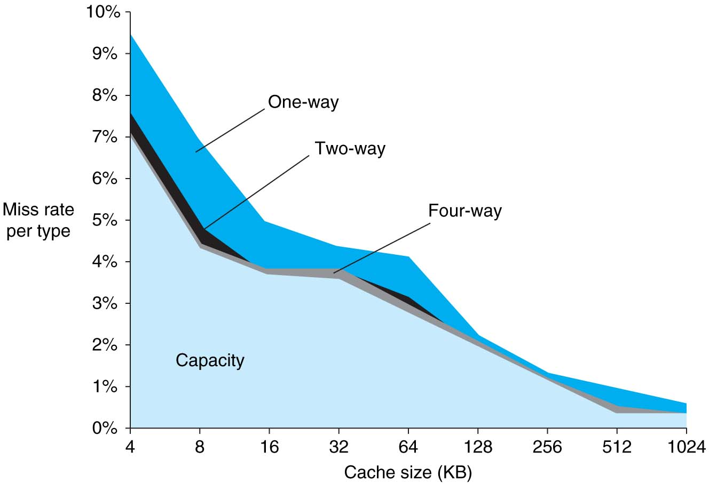
3Cs Analysis
Three sources of misses (SPEC2000 integer and floating-point benchmarks)
Compulsory misses 0.006%; not visible
Capacity misses, function of cache size
Conflict portion depends on associativity and cache size

Slide 39
Improving Cache Performance
AMAT = Time for a hit + Miss rate x Miss penalty
Reduce the time to hit in the cache
E.g., Smaller cache
Reduce the miss rate
E.g., Bigger cache
Reduce the miss penalty
E.g., Use multiple cache levels

Slide 40
Impact of Larger Cache on AMAT?
1) Reduces misses (what kind(s)?)
2) Longer Access time (Hit time): smaller is faster
Increase in hit time will likely add another stage to the pipeline
At some point, increase in hit time for a larger cache may overcome the improvement in hit rate, yielding a decrease in performance
Computer architects expend considerable effort optimizing organization of cache hierarchy – big impact on performance and power!
Notes:
AMAT = 1 + 0.02x50 = 2

Slide 41
Clickers: Impact of longer cache blocks on misses?
For fixed total cache capacity and associativity, what is effect of longer blocks on each type of miss:
A: Decrease, B: Unchanged, C: Increase
Compulsory?
Capacity?
Conflict?

Slide 42
Clickers: Impact of longer blocks on AMAT
For fixed total cache capacity and associativity, what is effect of longer blocks on each component of AMAT:
A: Decrease, B: Unchanged, C: Increase
Hit Time?
Miss Rate?
Miss Penalty?

Slide 43
Clickers/Peer Instruction: For fixed capacity and fixed block size, how does increasing associativity effect AMAT?
A: Increases hit time, decreases miss rate
B: Decreases hit time, decreases miss rate
C: Increases hit time, increases miss rate
D: Decreases hit time, increases miss rate

Slide 44
Cache Design Space
Several interacting dimensions
Cache size
Block size
Associativity
Replacement policy
Write-through vs. write-back
Write allocation
Optimal choice is a compromise
Depends on access characteristics
Workload
Use (I-cache, D-cache)
Depends on technology / cost
Simplicity often wins
Cache Size
Associativity
Block Size
Bad
Good
Factor A
Factor B
Less
More
Notes:
No fancy replacement policy is needed for the direct mapped cache.
As a matter of fact, that is what cause direct mapped trouble to begin with: only one place to go in the cache--causes conflict misses.
No fancy replacement policy is needed for the direct mapped cache.
As a matter of fact, that is what cause direct mapped trouble to begin with: only one place to go in the cache--causes conflict misses.
Besides working at Sun, I also teach people how to fly whenever I have time.
Statistic have shown that if a pilot crashed after an engine failure, he or she is more likely to get killed in a multi-engine light airplane than a single engine airplane.
The joke among us flight instructors is that: sure, when the engine quit in a single engine stops, you have one option: sooner or later, you land. Probably sooner.
But in a multi-engine airplane with one engine stops, you have a lot of options. It is the need to make a decision that kills those people.

Slide 45
And, In Conclusion …
Name of the Game: Reduce AMAT
Reduce Hit Time
Reduce Miss Rate
Reduce Miss Penalty
Balance cache parameters (Capacity, associativity, block size)

